Slide 1
Integrating Health Information Technology into your Quality Improvement Program
Presenters:
Girma Alemu, MD, MPH
Miryam Gerdine, MPH
Natassja Manzanero, MS
Moderator:
Amber Berrian, MPH
Department of Health and Human Services
Health Resources and Services Administration
Office of Special Health Affairs
Office of Health Information Technology and Quality

Slide 2
Disclosures
This continuing education activity is managed and accredited by Professional
Education Service Group (PESG). The Information presented in this activity
represents the opinion of the author(s) or faculty. Neither PESG, nor any
accrediting organization endorses any commercial products displayed or
mentioned in conjunction with this activity.
Commercial support was not received for this activity.
Girma Alemu, MD, MPH has no financial interest or relationships to disclose.
Miryam Gerdine, MPH has no financial interest or relationships to disclose.
Natassja Manzanero, MS has no financial interest or relationships to disclose.
Amber Berrian, MPH has no financial interest or relationships to disclose.

Slide 3
Learning Objectives
At the conclusion of this workshop, participants
will be able to:
Describe the National Quality Strategy and HRSA’s quality measurement and alignment strategy
Understand HRSA’s Health IT workforce development efforts
Locate HRSA web-based training curricula and quality improvement resources

Slide 4



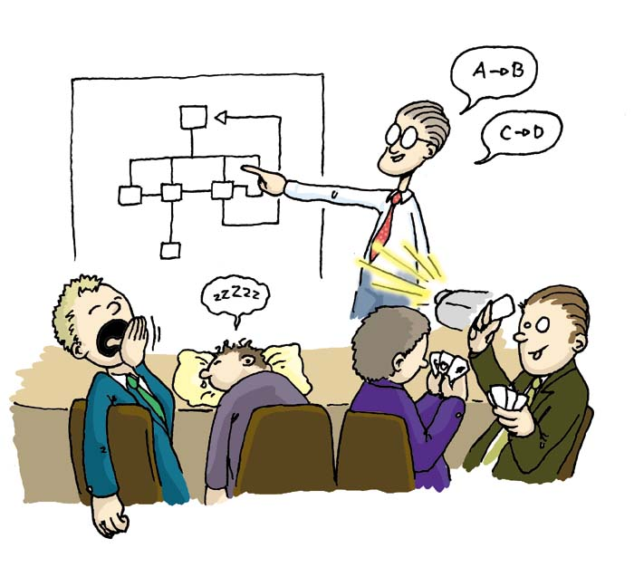


OHITQ
Notes:
Brief introduction to OHITQ

Slide 5
Environmental Trends in
Quality Measurement

Slide 6
Quality Healthcare
Quality healthcare is the provision of appropriate services to
individuals and populations, that are consistent with current
professional knowledge, in a technically competent manner, with good
communication, shared decision-making and cultural sensitivity.
Quality healthcare is evidence-based; increases the likelihood of
desired health outcomes; and addresses six aims: safe, effective,
patient-centered, timely, efficient, and equitable – using a systems
approach to continuously improve clinical, operational, and financial
domains.
Based on definitions of quality from:
Institute of Medicine (IOM). Medicare: A Strategy for Quality Assurance: Washington, DC; National Academy Press, 1990.
IOM. Crossing the Quality Chasm: A New Health System for the 21st Century; Washington, DC; National Academy Press, 2001.

Slide 7
What Do We Know About
Healthcare Quality?
Quality can be measured
Health care systems must be accountable for quality
Measurement AND accountability drive improvement
Consumers want and use information about health care quality

Slide 8
“The only way to know whether the quality of care is improving is to measure performance.”
Institute of Medicine

Slide 9

“If you cannot measure it,
you cannot improve it.”
Lord Kelvin (1824-1907)

Slide 10


2011 National Healthcare Quality and Disparities Reports
Key findings:
  Quality of care improving slowly overall
  Access not improving for most minority groups
www.ahrq.gov/qual/qrdr11.htm

Slide 11
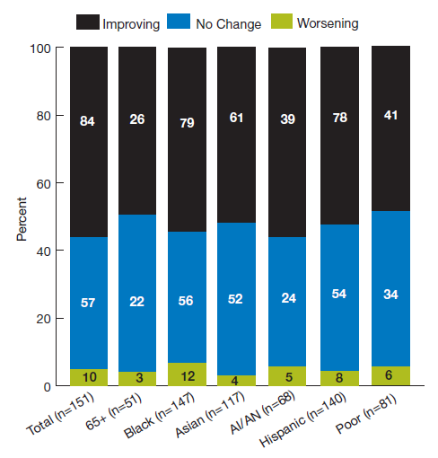
Quality is Improving Slowly
Nearly 60 percent of health care quality measures tracked showed improvement
However, the median rate of change was 2.5 percent per year
AHRQ 2011 National Healthcare Quality and Disparities Reports
Notes:
Quality measures that are improving, not changing or worsening, overall and for select populations.

Slide 12
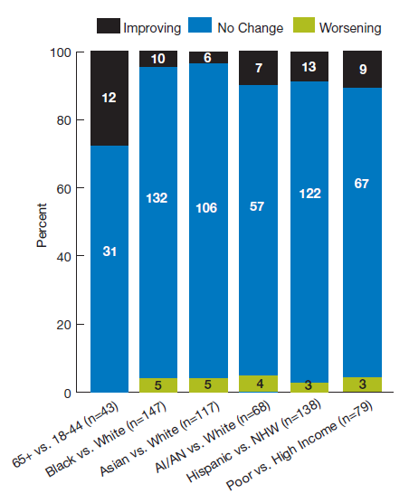
Limited Improvement in
Healthcare Disparities
In some areas there were improvements in reducing disparities
AHRQ 2011 National Healthcare Quality and Disparities Reports
Notes:
Quality measures for which disparities related to age, race, ethnicity and income are improving, not changing or worsening.
Most clinical conditions showed little to no improvement in the rate of health disparities; however, in some areas there were improvements in reducing disparities.
Internet Citation:
National Advisory Council: Meeting Summary, July 13, 2012. Agency for Healthcare Research and Quality, Rockville, MD. http://www.ahrq.gov/about/nac2012/nac0712/index.html

Slide 13
Rapidly Evolving Landscape
Health Information Technology for Economic and Clinical Health Act
Affordable Care Act
  Meaningful Use - EHR Incentive Program
  National Quality Strategy
  HHS contract with the National Quality Forum
4
Notes:
HITECH act –mention specifically issues regarding quality measurement and quality improvement in federal legislation
13
12/2/2012

Slide 14
National Quality Strategy
Section 3011 of the Affordable Care Act (ACA) requires the establishment of a National Quality Strategy (NQS)
Additional Directions:
Agency-specific strategic plans to achieve national priorities
Minimize duplication of efforts and [promote the] utilization of common quality measures
Inter-agency collaboration
Measures alignment
Notes:
12/2/2012
14

Slide 15
National Quality Strategy
NQS Aims
1) Improve overall quality by making health care more patient-centered, reliable, accessible and safe 2) Improve population health by supporting proven interventions to address behavioral, social and environmental determinants of health, in addition to delivering higher-quality care. 3) Reduce the cost of quality health care for individuals, families, employers and government.
NQS Priorities
1) Making care safer by reducing harm caused in the delivery of care 2) Ensuring that each person and family are engaged as partners in their care 3) Promoting effective communication and coordination of care 4) Promoting the most effective prevention and treatment practices for the leading causes of mortality, starting with cardiovascular disease 5) Working with communities to promote wide use of best practices to enable healthy living 6) Making quality care more affordable for individuals, families, employers, and governments by developing and spreading new health care delivery models

Slide 16
Next Steps for NQS
Continue stakeholder engagement
Identify a national strategy for data collection, measurement, and reporting
Develop organizational infrastructure at the community level that assumes responsibility for improvement efforts
Reform payment and delivery systems
Continue alignment and streamlining of measurement across HHS programs
Continue alignment of HHS programmatic goals with NQS priorities
Notes:
Continue stakeholder engagement, particularly around the strategic opportunities for improvement identified by the National Quality Forum:

Slide 17
How does Health IT Fit?

Slide 18
What is Meaningful Use?
Meaningful Use is using certified EHR
technology to:
Improve quality, safety, efficiency, and reduce health disparities
Engage patients and families in their health care
Improve care coordination
Improve population and public health
All the while maintaining privacy and security
Source: http://www.cms.gov/EHRIncentivePrograms/
Notes:
Meaningful Use mandated in law to receive incentives

Slide 19
What are the Three Main Components of Meaningful Use?
Use of certified EHR in a meaningful manner (e.g., e-prescribing)
Use of certified EHR technology for electronic exchange of health information to improve quality of health care
Use of certified EHR technology to submit clinical quality measures(CQM) and other such measures selected by the Secretary
Source: http://www.cms.gov/EHRIncentivePrograms/
Notes:
The Recovery Act specifies the following three
components of Meaningful Use:

Slide 20
EHR Incentive Program
Stage 1 – Structured data collection
Stage 2 – Health information exchange
Stage 3 – Improved health outcomes
Notes:
The requirements in Stage 1 are focused on providers capturing patient data and sharing that data either with the patient or with other healthcare professionals.
Stage 1: Focuses on electronically capturing health information in a structured format
Stage 2: Expand exchange of information in the most structured format possible-Health Information Exchange

Slide 21
Who is Eligible?
MEDICARE:
  Physicians
  Podiatrists
  Optometrist
  Chiropractor
  Hospitals / CAHs
MEDICAID:
  Physicians
  Dentists
  Nurse Practitioners
  Certified Nurse Midwives
  Physician Assistants who lead an FQHC or RHC
  Acute Care and Children’s Hospitals

Slide 22
Basic Overview of Stage 1
2011 and 2012
Meaningful Use Stage I
  To meet certain objectives/measures, 80% of all patients must have records in the certified EHR technology
  EPs have to report on 20 of 25 MU objectives
  Eligible hospitals have to report on 19 of 24 MU objectives
  Reporting Period – 90 days for first year; one year subsequently
Notes:
Eps:
15 core and 5 from 10 menu set
6 clinical quality measures
Eligible Hospitals
14 core and 5 from 10 menu set
15 clinical quality measures
Medicaid: Adopt, implement, upgrade (AIU)
First participation year only
No EHR reporting period
Medicare:
EPs must report on 6 total Clinical Quality Measures (3 core or alternate core, and 3 out of 38 from additional set)
Hospitals must report on 15 Clinical Quality Measures
Define core set /alternative/ and menu set
Stage 1 MU didn’t include any HIV specific measures, but stage 2 does

Slide 23
Meaningful Use Stage I
EP – 15 Core Objectives
1. Computerized provider order entry (CPOE)
2. E-Prescribing (eRx)
3. Report ambulatory clinical quality measures to CMS/States
4. Implement one clinical decision support rule
Provide patients with an electronic copy of their health
information, upon request
6. Provide clinical summaries for patients for each office visit
7. Drug-drug and drug-allergy interaction checks
8. Record demographics
Maintain an up-to-date problem list of current and active
diagnoses
10. Maintain active medication list
11. Maintain active medication allergy list
12. Record and chart changes in vital signs
13. Record smoking status for patients 13 years or older
Capability to exchange key clinical information among providers
of care and patient-authorized entities electronically
15. Protect electronic health information
Notes:
EH’s have 14 objectives that they can report on as well however, for the purposes of this presentation we are provided objectives for EPs.
Eps:
15 core and 5 from 10 menu set
6 clinical quality measures
Eligible Hospitals
14 core and 5 from 10 menu set
15 clinical quality measures
Medicaid: Adopt, implement, upgrade (AIU)
First participation year only
No EHR reporting period
Medicare:
EPs must report on 6 total Clinical Quality Measures (3 core or alternate core, and 3 out of 38 from additional set)
Hospitals must report on 15 Clinical Quality Measures
Define core set /alternative/ and menu set
Stage 1 MU didn’t include any HIV specific measures, but stage 2 does

Slide 24
Meaningful Use Stage 2
Final Rule for Stage 2 of Meaningful Use published August 2012
The rule is set to become effective for participants in the program no earlier than 2014

Slide 25
Meaningful Use Stage 2
What’s New?
Higher thresholds for MU objectives
Increased focus on patient engagement
Increased emphasis on health information exchange
Improved data security and privacy
Notes:
Unlike the first stage of the meaningful use incentive program, for which practices mostly had to demonstrate they were capable of performing certain tasks with their electronic health record systems, stage 2 will require practices to actually perform those tasks
Stage 2 essentially makes the optional menu items from Stage 1 mandatory, adds a requirement for patient engagement, allows medical groups to attest to Meaningful Use for multiple providers at once, and raises some of the thresholds in meeting mandatory items. For example, Stage 2 requires providers to enter medication orders electronically for at least 60% of their patients, up from 30% in Stage 1.
A big focus of stage 2, Loughlin said, is care coordination that is made possible through data exchange.

Slide 26
New Stage 2 Core Objectives
Use secure electronic messaging to communicate with patients on relevant health information (for EPs only)
Automatically track medications from order to administration using assistive technologies in conjunction with an electronic medication administration record (eMAR) (for Eligible Hospitals/CAHs only)
Stage 2 Patient Access Objectives:
Provide patients the ability to view online, download and transmit their health information within four business days of the information being available to the EP (for EPs only)
Provide patients the ability to view online, download and transmit their health information within 36 hours after discharge from the hospital (for Eligible Hospitals/CAHs only)
Notes:
AS EXPECTED, THE NEXT STAGE OF MEANINGFUL USE BUILDS ON THE CRITERIA OF THE FIRST STAGE, INCLUDING INCREASING THE THRESHOLD FOR PERFORMANCE OF EXISTING MEASURES AND PUSHING PROVIDERS TO ACTUALLY EXCHANGE INFORMATION IN VARIOUS TRANSACTIONS TO DRIVE CONTINUOUS QUALITY IMPROVEMENT.
Stage 2 also replaces the previous Stage 1 objectives to provide electronic copies of health information or discharge instructions and provide timely access to health information with objectives that allow patients to access their health information online.

Slide 27

EHRs Do Not Solve All Problems
Notes:
Key principle is: just plugging in a computer isn’t going to result in quality…EHRs are necessary but not sufficient. Requires redesign with end goal on patient focused quality improvement but need EHRs and data to drive that quality

Slide 28
Ryan White Clinics
900 clinics providing HIV services
More than 75% use an EHR
Over 50% report directly from EHR
Almost 2/3 of grantees plan to apply for MU this year
Notes:
Survey administered summer 2011
Response rate 65% (n =222)
78% indicated using some form of EHR
Top features: pat history & demographics (97%), clinical notes (94%), view lab results (84%). Less likely: erx (73%), lab ordering (72%), clinical reminders (54%)
Top products: ECW (11%), NextGen (10%), Centricity (10%), Epic (9%), Allscripts (5%)
51% report directly from EHR- primary reason is that some lack client level data report generation functions or lack certain required elements of RSR or doesn’t allow movement of data fro one software app to another
64% plan to apply for MU this year. Additional 10% plan to apply by 2014
Biggest challenges:
Help using capabilities tht have been turned off
Help getting vendors to capture the Ryan White elements in the EHR system
TA to meet MU requirements
Encourage vendores to generat XML files
28

Slide 29
HIV/AIDS Clinical Quality Measures
MU STAGE 2
NQF 0403- HIV/AIDS: Medical Visit
Description: Percentage of patients, regardless of age, with a diagnosis of HIV/AIDS with at least two medical visits during the measurement year with a minimum of 60 days between each visit
NQF 0405- HIV/AIDS: Pneumocystis jiroveci pneumonia (PCP) Prophylaxis
Description: Percentage of patients aged 6 weeks and older with a diagnosis of HIV/AIDS who were prescribed Pneumocystis jiroveci pneumonia (PCP) prophylaxis
TBD (proposed as NQF 0407): HIV/AIDS: RNA control for Patients with HIV
Description: Percentage of patients aged 13 years and older with a diagnosis of HIV/AIDS, with at least two visits during the measurement year, with at least 60 days between each visit, whose most recent HIV RNA level is <200
copies/mL.
Finalized for Medicare and Medicaid Eligible Professionals beginning with CY 2014
Notes:
HIV/AIDS CQMs FINALIZED FOR MEDICARE AND MEDICAID EPs BEGINNING WITH CY 2014
Stage 1 MU didn’t include any HIV specific measures, but stage 2 does
(TO GET INCENTIVES- Must report subset of quality measures directly to CMS)

Slide 30
HRSA Quality Activities
The national movement towards alignment of measures for quality
Need for HRSA to actively participate in this effort
Ensure inclusion of measures that reflect the safety net population
Notes:
Providers need limited number and types of measures- BURDEN
HIT requires that we use the same metrics

Slide 31
HRSA Quality Activities
Established a Measures Management Review Board (MMRB) to:
  Align with the NQS
  Harmonize HRSA measures with those across the Department
  Attain measure parsimony
  Promote use of nationally recognized measures- National Quality Forum (NQF) endorsed measures

Slide 32
HAB Measures Submitted for
NQF Endorsement
Medical visit frequency
Description: Percentage of patients, regardless of age, with a diagnosis of HIV who
had at least one medical visit in each 6-month period of the 24-month
measurement period with a minimum of 60 days between medical visits.
Gap in medical visits
Description: Percentage of patients, regardless of age, with a diagnosis of HIV who
did not have a medical visit in the last 6 months of the measurement year.
HIV viral load suppression
Description: Percentage of patients, regardless of age, with a diagnosis of HIV with
a HIV viral load less than 200 copies/mL at last HIV viral load test during the
measurement year.
Prescription of HIV antiretroviral therapy
Description: Percentage of patients, regardless of age, with a diagnosis of HIV
prescribed antiretroviral therapy for the treatment of HIV infection during the
measurement year.

Slide 33
Questions for Discussion
Please discuss with your neighbor for 5 Minutes
What insights did you get from this presentation?
What excites you about this work to improve the quality of care?
How might you put this information to use in your current work?

Slide 34



HRSA Health IT Workforce Initiatives

Slide 35
Shortage of HIT Professionals across the U.S.
There is a great need for health IT professionals.
Shortage even more apparent in safety net settings.
Health IT can play a critical role in improving care coordination; to assist those living with HIV with the coordination of a wide variety of medical and behavioral health services.
Notes:
Shortage of Health IT Professionals across the U.S.

Slide 36
Office of the National Coordinator
Community College Consortia to Educate Health Information Technology Professionals Program
Curriculum Development Centers Program
Program of Assistance for University-Based Training
Competency Examination Program
Notes:
Addresses Yael’s comment regarding…Discuss all 4 ONC programs together

Slide 37
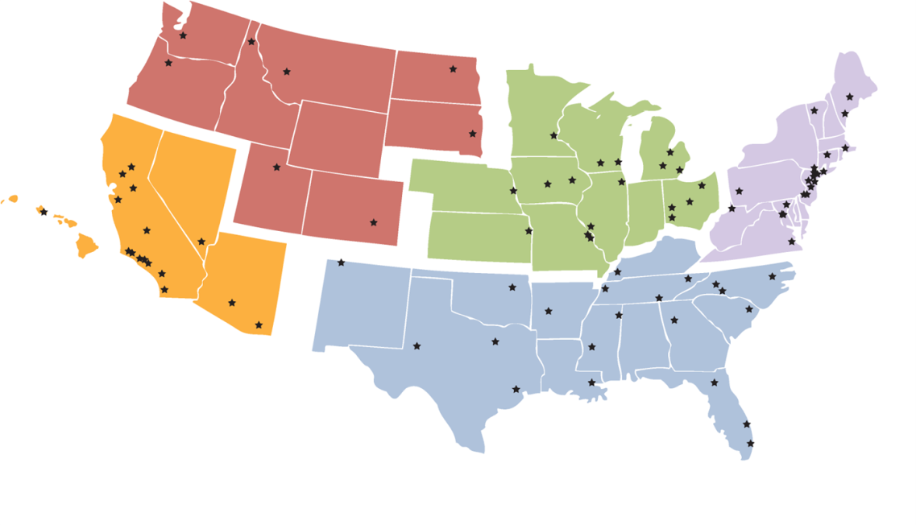
Community College Consortia
Training the HIT Workforce
Listing of the 82 Community Colleges http://healthit.hhs.gov/portal/server.pt?open=512&mode=2&objID=3603

Slide 38
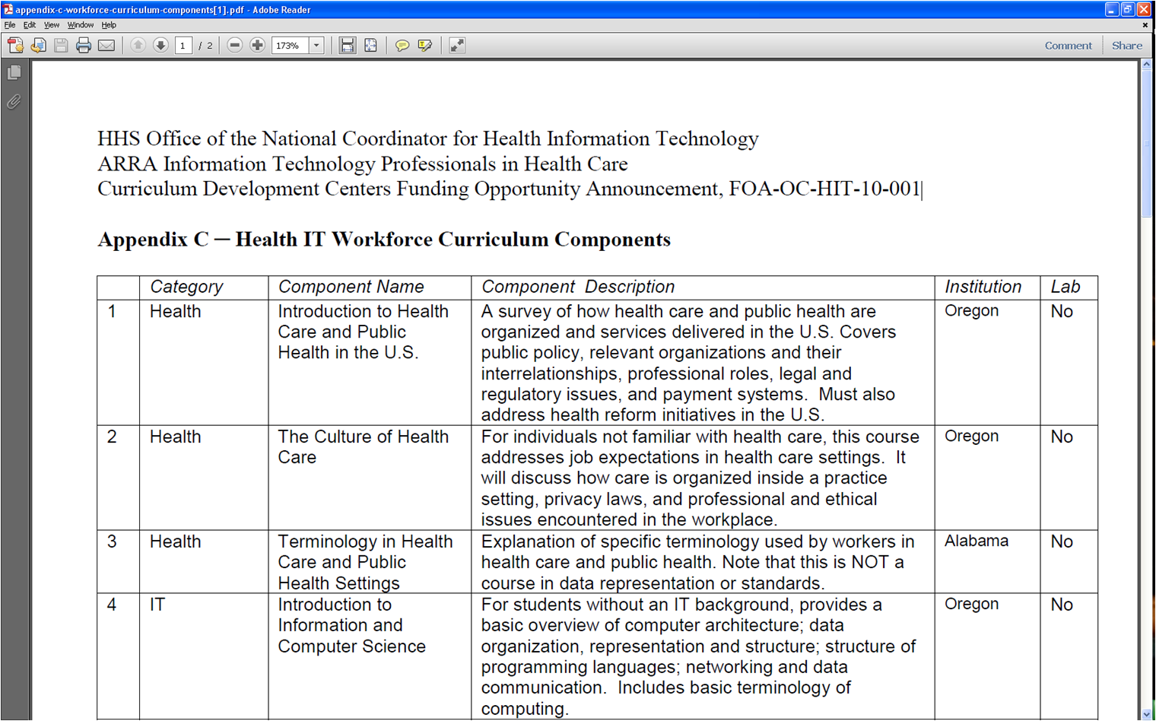
http://www.onc-ntdc.org
HIT Training Curriculum

Slide 39
Competency
Examination Program
$6 Million Program
Cooperative Agreement Awarded to Northern Virginia Community College
Competency exams for the six roles that Community College and Curriculum Development Centers are addressing
Tests for Individuals Completing Non-Degree Training
NOT A CERTIFICATION PROGRAM
First ~ 25,000 examinees take exam free of charge
Notes:
The competency exam is now in the field and available for students and HIT professionals to take the exam and validate their knowledge and skills.

Slide 40
On-site Health IT Staff
  53% health centers reported having a full-time staff person dedicated to IT/MIS
  33% health centers reported having full-time Director
  22% health centers reported having IT services available through HCCN, contract service, or regional arrangement
  10% health centers reported having a Part-time staff person
  10% health centers reported having NO Staffing
  5% health centers reported having Part-time Director
Source: Geiger Gibson / RCHN Community Health Foundation Research Collaborative . Policy Research Brief #27 “Results from the 2010-11 Readiness for Meaningful Use of HIT and Patient Centered Medical Home Recognition Survey.”
Notes:
Define HCCN to audience

Slide 41
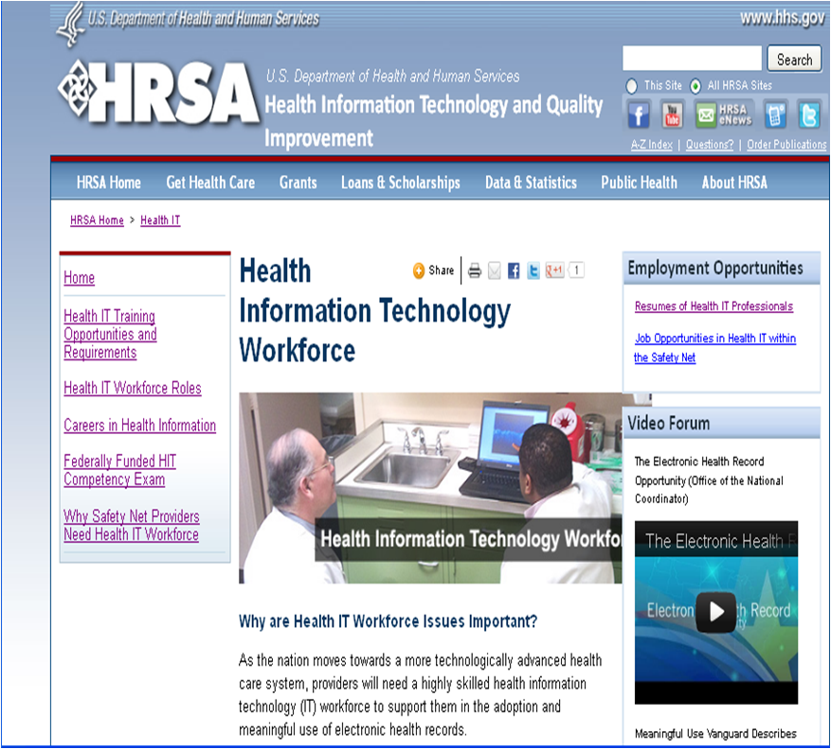

http://www.hrsa.gov/healthit/workforce/index.html
Health IT Workforce Webpage

Slide 42
Development of HIT Workforce
Training Modules
Learning Module 1: What is Health Information and Meaningful Use?
Learning Module 2: Key Roles in Implementing a Certified EHRs
Learning Module 3: Key Roles in Maintaining and Optimizing a Certified EHRs
The training modules will be publicly available Winter, 2013.

Slide 43
http://www.nachc.com/HealthITJobMine.cfm
HIMSS JobMine
The new HIMSS JobMine® is open to all NACHC members and HRSA grantees to post job openings, search resumes, and take advantage of career development services. This new initiative complements an existing one in which ONC HIT Workforce Development Program participants post resumes, search for job openings, and use HIMSS’ career development services.
This new partnership will SAVE health centers $330 per job posting and $38 per resume search by offering these services FREE of charge, exclusively for Federally Qualified Community Health Centers. All you need to do is use the special coupons codes during checkout.

Slide 44
HRSA HIT Workforce Activities
Tools and resources to educate public
Working with the Public Health Training Centers
MOU with the DOL Employment and Training Administration (ETA)
NHSC training on MU and HIT

Slide 45
Questions for Discussion
Please discuss with your neighbor for 5 Minutes
What insights did you get from this presentation?
What excites you about this work to improve workforce development?
How might you put this information to use in your current work?
Notes:
HRSA Scholar Presentation
12/2/2012
HRSA Center for Quality
45

Slide 46
HRSA Web-Based Training Curricula & Quality Improvement Resources
www.hrsa.gov/quality
www.hrsa.gov/healthit

Slide 47
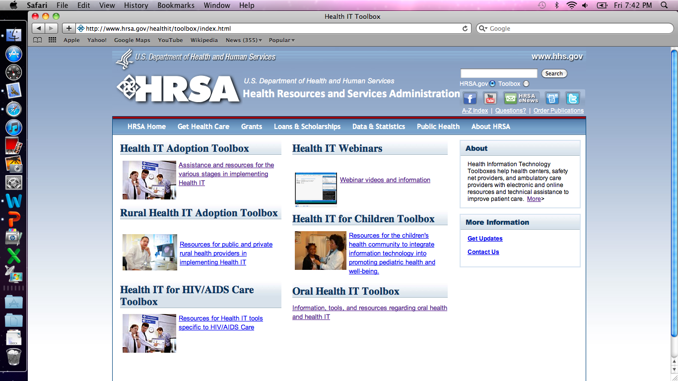
Health IT Toolkits
Notes:
HRSA’s IT Adoption toolkit- compilation of planning, implementation, evaluation resources to help safety net and all ambulatory care providers
Focus is for staff at all levels include clinicians, financial planners, administrative staff, and system integrators
Includes info on Staffing, financing, system assessment, implementation, change management, opportunities for collaboration, ongoing eval, sustainability
NEW FEATURES: Meaningful use, quality improvement, E-prescribing, privacy an security, PHRs
New Modules to meet specific needs:
Oral Health IT
Pediatric Health IT
HIV/AIDS
Rural Health Toolkit- new features providing one stop shop on hit for rural providers

Slide 48
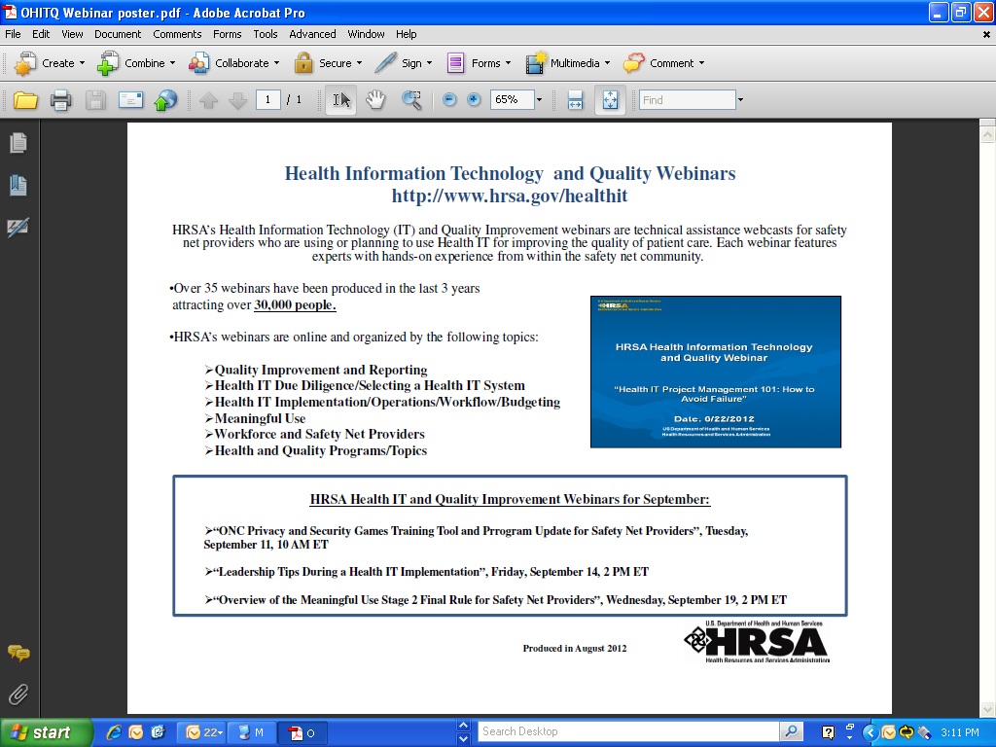
Educational Webinars
Notes:
Every month
Feature topics of relevance to past viewers
Over 8000 viewers in past 6 months
All webinars available for download on website as transcript, full audio, or just 508 compliant slide deck
Features Qs and As asked during call

Slide 49

Network Guide
The Network Guide is a directory of Health Center Networks and offers helpful tips to engage directly with potential network partners. It is a user-friendly resource for grantees of the Health Resources and Services Administration (HRSA), safety net providers, and all health care organizations seeking information and technical assistance with their quality improvement and operational efforts. The Guide is a collaborative project between HRSA and the National Association of Community Health Centers.
The Guide is available at http://www.hrsa.gov/healthit/networkguide and will be routinely updated to include health center and other networks.
Please email healthit@hrsa.gov with any questions and for more information on submitting new or updated information for future releases
Notes:
Brand new tool
Describes what health center networks are, their history, the different types (HCCN, multi site, PCAs, other)
Includes 25 tables helping to provide information about available networks
A resource to help identify TA resources
Includes features such as EHR experience: vendor selection, implementation, needs assessment, ongoing maintenance, meeting MU, data reporting, clinical repository, data warehouse, eRX, PHRs,
Includes other features like PCMH, ACO, personnel, HR, finance, quality measureemnt and reporting
Provides examples of how to use guide
Plans for quarterly updates
Inclusion of other networks including new rural health IT networks
Intended as resource guide, not endorsement of any particular model
Long term goal is to make this online tool for updating by networks themselves

Slide 50
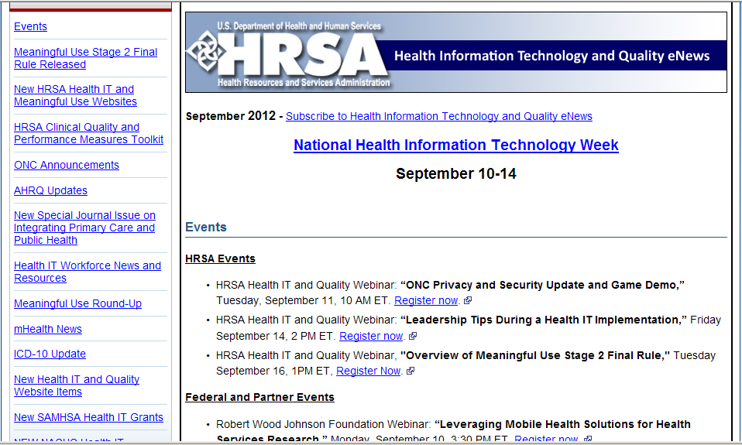
Monthly Newsletter
Notes:
Monthly newsletter on quality and health IT
Distributed to all grantees and project officers
Includes grantee of month
Highlights important new announcements,
Features important stories like ICD-10, health IT workforce programs, updated info on meaningful use
Provides links to all upcoming training and public education sessions related to health IT
These are just a few of the highlights from the December issue
Also includes a “Meaningful Use Roundup”, Latest mhealth news,

Slide 51
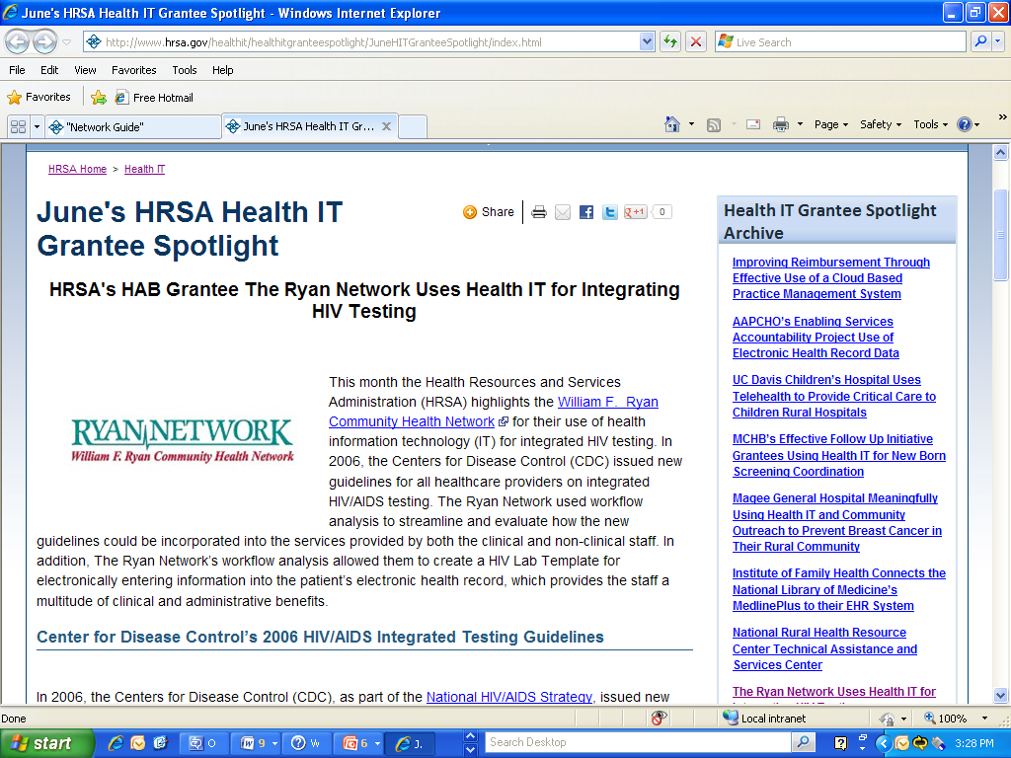
Grantee Spotlights
Notes:
Highlights specific examples of providers who have successfully implemented health IT to advance quality efforts in safety net settings
Information helps highlight details of challenges and how they were overcome
Opportunities to use health IT in innovative ways such as consumer engagement and patient outreach
RECs have been using this as a resource to share best practices

Slide 52

HRSA Quality Toolkit
Notes:
The HRSA Quality Toolkit provides educational tools and resources useful for implementing Health Care Quality Improvement.
Examples target a core set of clinical quality performance measures currently in use by many HRSA grantees.
The quality improvement and systems redesign principles shared throughout this toolkit are applicable to other health conditions and measures and can often be implemented in conjunction with an organization’s existing QI program.
The HRSA Quality Toolkit creates one convenient location to access materials and concepts developed through a variety of HRSA sponsored quality activities.

Slide 53
How is the HRSA
Quality Toolkit Organized?
Seven Clinical Quality Measure Modules
  Critical Pathway
  Care Model
Eight Quality Improvement Modules
Embedded Case Studies

Slide 54
HRSA Quality Toolkit
Diabetes HbA1c | Developing and Implementing a QI Plan
Breast Cancer Screening | Improvement Teams
HIV Testing for Pregnant Women | Readiness Assessment and Developing Project Aims
Prenatal First Trimester Access | Quality Improvement
Cervical Cancer Screening | Performance Measurement and Management
Hypertension Screening | Testing for Improvement
Colorectal Cancer Screening | Managing Data for Performance Improvement
 | Redesigning a System of Care to Promote QI

Slide 55
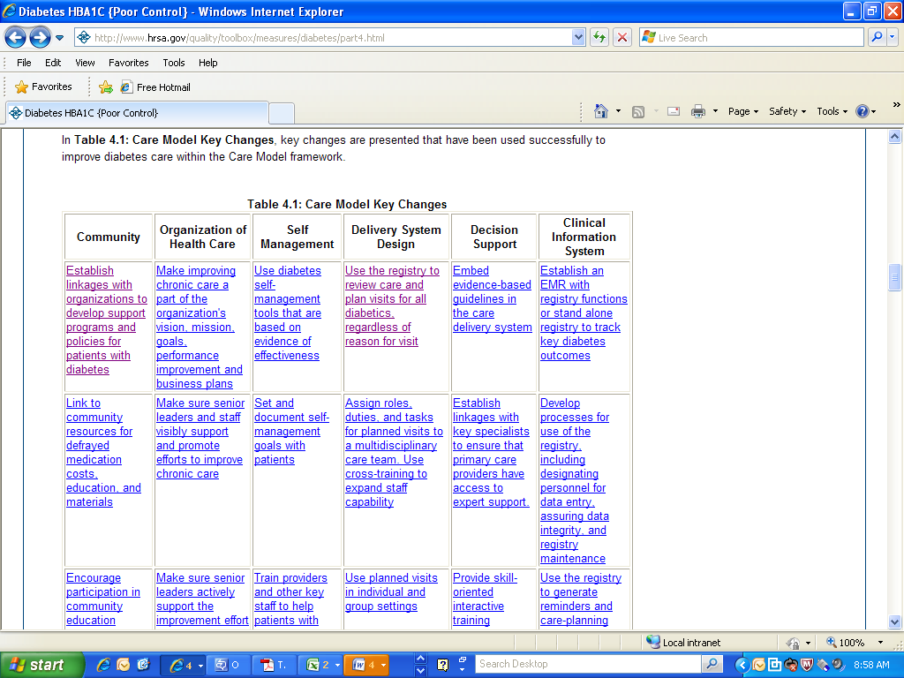

Slide 56

Notes:
Screenshot of a tool available for download

Slide 57

Opportunities
Notes:
AB CONCLUSION SLIDE
We envision that by enhancing existing technical assistance
vehicles and strategically developing new ones,
HRSA has the opportunity to help its grantees:
Develop, support and sustain QI infrastructure
Align QI efforts locally and nationally
Adopt and integrate HIT

Slide 58
Questions

Slide 59
Contact Information
Amber Berrian
aberrian@hrsa.gov
301-443-0845
http://www.hrsa.gov/healthit/

Slide 60
Obtaining CME / CE Credit
If you would like to receive continuing
education credit for this activity, please
visit:
http://www.pesgce.com/RyanWhite2012

