Slide 1


An Introduction to Performance Measurement for Quality Improvement
Introduction to Quality
Session 201
Performance Measurement for Quality Improvement – How to Get Started
Lori DeLorenzo and Marlene Matosky
Wednesday, November 28, 3:30-5:00 pm
Virginia C
RWA-0239

Slide 2
Learning Objectives
Understand the balance of performance measurement and quality improvement activities
Identify and implement key performance measurement steps
Understand the purpose, definitions, and expectations of the quality measures released by HAB
Learn how to access existing resources on performance measurement
Notes:
In this session, we will learn about the basics of performance measurement, including a brief discussion on how to define indicators. We are going to learn about how you can effectively and efficiently collect quality data. We are going to show you how to sample records for performance reviews by establishing review eligibility criteria, identifying minimal sample sizes and selecting a random sample. Next you will learn how to design a data collection plan that takes into account selecting key indicators, designing an effective collection tool, assigning abstractors, and conducting a pilot test before you begin. We will discuss appropriate ways to go about actually collecting your data and validating your results. We’d like to make this session as interactive as possible and we welcome your participation, questions, ideas, and thoughts.

Slide 3

Key Question
Why is measurement so important to quality, and how does measurement support quality improvement?

Slide 4
Pop Quiz
How many people were estimated to be living with HIV in the United States in the year 2007?
18,000
43,000
929,000
1,200,000
Notes:
Let’s begin our exploration of this question with another question.
Do you know how many people were estimated to be living with HIV in the United States in the year 2007?

Slide 5
Answer: About 1,200,000
This is a measure
What can we do with this measure?
  Estimate resources
  Make predictions
  Epidemic getting better?
Notes:
In 2007, roughly1.3 million people in the United States were living with HIV.
Let’s think a bit about this number and what it means. 1.3 million is a measure.
With this measure we can:
Estimate resources that will be needed to care for these people
Predict the number of cases of AIDS we can expect
Evaluate, when we repeat the measure in 2008, whether the epidemic is getting worse or better
Having this measure gives us a lot more power in our work in HIV care than we would have if we just had the “gut instinct” that – hey, there’s a lot of HIV in the United States.

Slide 6

Why Measure?
It’s very simple:
“You can’t improve what you can’t measure!”
Notes:
“You can’t improve what you can’t measure.” Measurement gives us power. And, it enables us to see if we are improving.

Slide 7
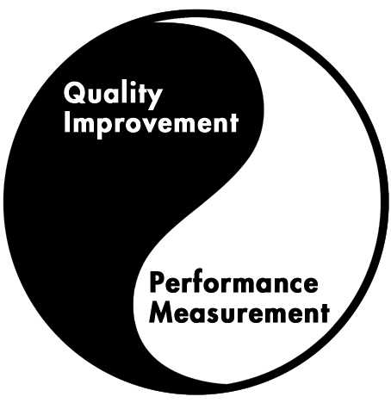
Measurement and Quality Improvement are Interlinked
Notes:
You can actually think of measurement and quality improvement as ying and yang. Performance measurement enables quality improvement, and the desire to improve quality informs performance measurement. The two are dependent on each other.

Slide 8
What is a Quality Measure?
A quality measure is a tool to assess specific aspects of care and services that are linked to better health outcomes while being consistent with current professional knowledge and meeting client needs.
Notes:
Quality is defined as “the degree to which health services for individuals and populations increase the likelihood of desired health outcomes and are consistent with current professional knowledge.”
An indicator is a way of measuring whether care and services you provide, as well as the activities you perform, are linked to improved health outcomes for clients.
An indicator takes one aspect of HIV care, and provides a way of assessing how often this specific aspect of care is properly provided.
By defining what “properly provided” means (this is where the “current professional knowledge” comes in), indicators enable you to learn about the level of quality in the care your HIV program provides.

Slide 9
Measures Can Be Both…
Outcomes
  The end result
  The effect on the individual or the population
Processes
  The actions taken to produce the outcome
  The procedures for achieving the best outcomes
Notes:
In some cases, indicators look at outcomes - the results of care. An outcome indicator could look at, for example, the CD4 levels of patients on antiretroviral therapy. The patients viral load is a result or outcome of the therapy.
In other cases, indicators look at processes: the actions that are taken. A process indicator for antiretroviral therapy could look at, for example, whether patients were assessed for their adherence to antiretroviral treatment. This process of treatment adherence assessment is a critical piece to optimizing antiretroviral therapy.

Slide 10
Examples of Outcomes Include:
Patient Health Status
    Intermediate outcomes like immune & virological status
    Disability
    The patient’s own sense of his/her quality of life
    Hospital and ER visits
Patient Satisfaction
Public Health Outcomes
    Retention in Care
    Access to Care
Notes:
Here are some examples of outcomes.
The most important – and most commonly used – outcomes relate to a patient’s health status. What is their viral load? How long have they lived with HIV? How do they describe their own quality of life? How often are they hospitalized?
Patient satisfaction is also an outcome. What is their experience with care?
Because we are concerned with care for both individuals and populations, we are also interested in public health outcomes: are people staying in care? Do they have access to the care and services they need?

Slide 11
What Makes a Good Measure?
Relevance
  Does the measure affect a lot of people or programs?
  Does the measure have a great impact on the programs or patients/clients in your EMA, State, network or clinic?
Measurability
  Can it realistically and efficiently be measured given finite resources?
Notes:
Clearly, the universe of things that can be measured is vast. How do we begin to select a manageable number of areas to track?
There are four main criteria to use in selecting sound indicators. The first two are:
Relevance. Are you looking at something that matters to your program?
Measurability. Can you actually measure this aspect of care, given the resources you have?

Slide 12
What Makes a Good Measure?
Accuracy
  Is the measure based on accepted guidelines or developed through formal group-decision making methods?
Improvability
  Can the performance rate associated with the measure realistically be improved given the limitations of your services and population?
Notes:
The next two criteria are:
Accuracy. How valid is this indicator? Does it really reflect current professional knowledge? Does it build on accepted guidelines for HIV care? If it deals with an aspect of care not yet covered by a guideline, has there been consensus by professionals and peers? And lastly,
Improvability: the ultimate goal is to improve the quality of care. As you select indicators, focus first on those that will help you improve.
If you answer "no" to any of these questions, the indicator—while still relevant to patient care—is probably either too difficult to measure or less than critical to patient care. On the other hand, if you answer "yes" to all of the questions, you have most likely found a viable indicator that will give you the most benefit for your measurement resources.

Slide 13
Range of Performance Measures Available
HRSA HIV/AIDS Bureau (HAB)
HHS HIV Measures
National Quality Forum (NQF)
National Quality Center (NQC)
In+care Campaign
HIVQUAL

Slide 14
HAB Performance Measures www.hab.hrsa.gov/deliverhivaidscare/habperformmeasures.html
Clinical (Groups 1-3)
Medical Case Management
Pediatrics
Oral Health
ADAP
Systems-level

Slide 15
HAB Clinical Performance Measures
Address 3 Aspects of Care
Clinical Care
Medical Care and Treatment
Laboratory Screening
Counseling, mental health and substance use assessment
Notes:
Based on review of the literature, of a number of quality improvement programs, and on comments from HIV care providers across the country, the Bureau has identified three aspects of clinical care for persons with HIV and AIDS, and has developed measures for each of these. The key aspects of care are:
Medical care and treatment
Laboratory screening
Counseling, mental health and substance use assessment
Refer to handout that shows list of all HAB PMs

Slide 16
HAB Does Not Require Grantees to Use These Measures
But it strongly urges you to use the measures to:
Track and trend performance
Identify areas for improvement
Strengthen quality management plans
Notes:
Data is a valuable tool for anyone managing a program. The HIV/AIDS Bureau has identified the core clinical performance measures and expects Ryan White Program-funded sites to use the measures as just such a tool. YOU DO NOT NEED TO REPORT YOUR PROGRAM’S DATA TO THE BUREAU. Instead, make use of the measures for your own quality improvement work.
You might use the data to, for example:
Track and trend data on performance to monitor quality of care provided. What is your program doing well? Is your performance getting better, worse, or staying the same?
Identify areas for improvement. Do the data show clinical performance levels that are too low? Or a downward trend?
Strengthen your program’s quality management plan.
HAB released the PMM in 2012 to collect data for applying for national endorsement for a subset of HAB measures. Reports are generated that allow the user to compare performance regionally (PHS regions) and nationally
Example of report is on next slide

Slide 17
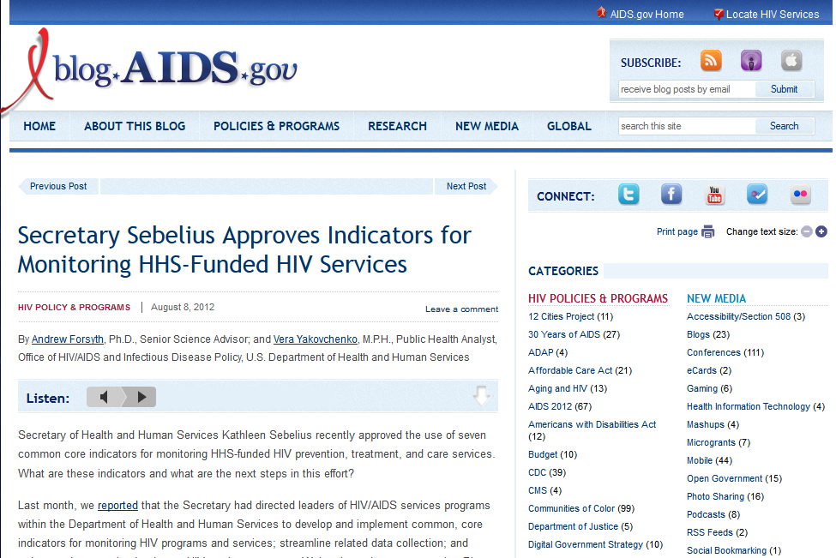
http://blog.aids.gov/2012/08/secretary-sebelius-approves-indicators-for-monitoring-hhs-funded-hiv-services.html

Slide 18
Measure | Numerator | Denominator
HIV Positivity | Number of HIV positive tests in the 12-month measurement period | Number of HIV tests conducted in the 12-month measurement period
Late HIV Diagnosis | Number of persons with a diagnosis of Stage 3 HIV infection (AIDS) within 3 months of diagnosis of HIV infection in the 12-month measurement period | Number of persons with an HIV diagnosis in the 12-month measurement period
Linkage to HIV Medical Care | Number of persons who attended a routine HIV medical care visit within 3 months of HIV diagnosis | Number of persons with an HIV diagnosis in 12-month measurement period
Retention in HIV Medical Care | Number of persons with an HIV diagnosis who had at least one HIV medical care visit in each 6 month period of the 24 month measurement period, with a minimum of 60 days between the first medical visit in the prior 6 month period and the last medical visit in the subsequent 6 month period | Number of persons with an HIV diagnosis with at least one HIV medical care visit in the first 6 months of the 24‐month measurement period

Slide 19
Measure | Numerator | Denominator
Antiretroviral Therapy (ART) Among Persons in HIV Medical Care | Number of persons with an HIV diagnosis who are prescribed ART in the 12-month measurement period | Number of persons with an HIV diagnosis and who had at least one HIV medical care visit in the 12-month measurement period
Viral Load Suppression Among Persons in HIV Medical Care | Number of persons with an HIV diagnosis with a viral load <200 copies/mL at last test in the 12–month measurement period | Number of persons with an HIV diagnosis and who had at least one HIV medical care visit in the 12-month measurement period
Housing Status | Number of persons with an HIV diagnosis who were homeless or unstably housed in the 12-month measurement period | Number of persons with an HIV diagnosis receiving HIV services in the last 12 months

Slide 20
HRSA/CDC Measures
Found Suitable for NQF Endorsement
Medical visit frequency
Gap in medical care
Prescribed HIV antiretroviral therapy
Viral load suppression

Slide 21
These Measures Are Useful at
Many Levels of HIV Care
To align the work on the different Ryan White Program Parts
At the system level
At the provider level
Within a program’s quality management plan
Notes:
And the measures make sense at and across levels of care. In fact, the Bureau hopes that these measures will help to align the work of the different Ryan White Program Parts, so that – whatever the funding entity or type of program – the importance of key components of HIV care is emphasized.
The measures also can be used either at the provider or system level:
The measures can be rolled up to look at issues from a system perspective, such as with Part A and B Programs.
Programs can also work with their subcontractors, vendors or sub-grantees to implement the performance measures at the provider level.
And, at the discrete program level, as we’ve discussed, the core clinical performance measures can play a role in a program’s quality management plan.

Slide 22

Key Question
What should we be measuring to assess and improve the quality of our HIV care and services?

Slide 23
The Measures Provide a Menu of Choices
Care
ARV?
CD4?
Screening
Pap?
Hep C?
Counseling
Adherence?
Substance Use?
Visits?
PCP?
Oral?
Vaccines?
Lipids?
TB?
Syphilis?
Hep B?
Risk?
Alcohol?
Tobacco?
Notes:
We’ve discussed how different types of organizations can use the measures in different ways. Now we’re going to talk about how an organization might choose exactly which measures to use.
The Core Clinical Measures provide a menu of choices. We all know that HIV/AIDS care is multi-factorial. In the best care, lots of things should happen, lots of elements of care should be looked at. Here are some of the elements of care covered by the measures. But if we used them all, would we be overwhelmed with measurement work? Swimming in data? How do we make best use of the measures?
Added “?” after tobacco

Slide 24
Selecting & Prioritizing Measures
Consider the following:
  Epidemic
    Primary modes of transmission
    Change in trends
    Subpopulations affected
  Population served
    Race/ethnicity
    Gender
    Age
    Risk factors
    Culture
  Influencing Factors
Notes:
Examples of Influencing factors include funding priorities, NHAS, state priorities, etc.
24

Slide 25
Balanced Measures
1 or 2 measures are not sufficient
Consider the purpose of the measures
  Primary focus of your program will impact the set of measures selected
    Process vs. outcome
    State or region-focus vs. stand alone clinic
    Support services program vs. clinical program
Notes:
INSERT BENJAMIN’S INFO HERE TO DISCUSS HOW THEY SELECTED THE MEASURES AND WHICH ONES THEY USED
25

Slide 26
Key Question
Once you have identified the measures you will use, how do you go about collecting effectively valid and useful performance data?
Notes:
It has been our experience that data collection within most organizations is not optimal. We will help you improve and refine your data collection efforts.
This key question focuses on how to collect data that are valid and useful, in a way that doesn’t over-stretch your HIV program’s resources.

Slide 27
Develop Criteria to Define
Your Measurement Population
Location: all sites, or only some?
Gender: men, women, or both?
Age: any limits?
Client conditions: all HIV-infected clients, or only those with a specific diagnosis?
Treatment status?
Exclusions?
Notes:
To start, you need to define your eligibility criteria for the measurement population.
The measurement population consists of those patients who are eligible for measurement based on pre-established criteria. Defining a population requires identifying both which records should be reviewed and which should not. The key point here is to select the focus of your data collection efforts.
Consider the following criteria to define your measurement population:
- Location: What facilities within the care system will be included?
- Gender: Does the indicator apply exclusively to men or women, or to both?
- Age: Are there particular age limits?
- Patient condition: Is a confirmed diagnosis required, or simply symptoms or signs? Do certain conditions make the patient ineligible?
- Active treatment status: How many visits are required for eligibility? Must the patient currently be in treatment? Must the treatment have occurred within a certain time frame?
When you are finished addressing these questions, you will have a list of eligibility criteria.

Slide 28

Example: Eligibility Definition by HIVQUAL US
HIV+ patients who have had at least 2 HIV primary care visits in the last 12 months; at least 1 visit in the period January through June, and at least 1 visit in the period July through December
Notes:
HIV ambulatory care sites that participate in the National HIVQUAL Project, a national capacity building initiative by the New York State Department of Health, define the eligibility for records to be included in the measurement population as follows.
HIV+ patients, who have had at least 2 primary care visits in last 12 months; with at least 1 primary care visit in the period January through June and at least 1 primary care visit in the period July through December.

Slide 29
“Just Enough” Data: Not 100% and Not Maximal Power
The goal is to improve care, not prove a new theorem
In most cases, a straightforward sample will do just fine
Notes:
The data you need for quality improvement are not the same as the data that drive a peer-reviewed study of a randomized clinical trial. You don’t need to count every chart. In fact, the sample size is one of the biggest differences between collecting data for quality improvement versus conducting research. For the purpose of quality improvement, simple sampling techniques work quite well.
Keep in mind that in most cases, a straightforward sample will do just fine.

Slide 30
The HIVQUAL Sample Size Table
The HIVQUAL Sample Size Table indicates:
  The minimum number of records to be reviewed
Notes:
The Table here shows the HIVQUAL Sample Size Table to help you decide what sample size you need. The table indicates the minimum total number of records to review based on eligible cases. The maximum number of records to be reviewed is 107 though it depends on the facility’s case load. The Table also includes an additional column that indicates the number of charts to be pulled in preparation for a review, allowing for over sampling.
For example, for a clinic with 212 eligible patients, you should review at minimum 75 records and pull 23 more records (a total of 98) based on the HIVQUAL Sample Size Table.
This chart is based on a 90% confidence interval with an error width of 16% when using the minimum number of records.
If you were to apply this table to a network, consortia, regional or state level, you can apply the sample size table to each clinic/agency

Slide 31
Construct Your Sample Size
Identify eligible patients
Review all records for eligibility. Eligibility for review is defined as all HIV+ patients who meet the following visit criteria:
  At least two medical visits during the study period; one in each half of the year (i.e., study period = 1/1/2011 through 12/31/2011)
  Patients who died prior to the end of the review period are still eligible if the above conditions are met
Notes:
What are the steps to construct your sample size? We suggest that you take the following steps:
First, identify your eligible patients, your measurement population, by reviewing all records for eligibility.
The example provided here is based on the HIVQUAL Sample Instructions and was already mentioned in an earlier slide.
Please be aware, that HIVQUAL suggests that patients who died prior to the end of the review period are still eligible if the above conditions are met.
At the end of this step you should have a list of all records that are eligible based on your criteria.

Slide 32
Construct Your Sample Size
Identify the number of eligible records
Count the number of eligible records
Sequentially order the list, either alphabetically, by medical record, or client number
Notes:
The next step determines the number of male and female records that are eligible.
First, the eligible patient caseload should be divided into one list only for males and one list for females.
Then, count and document the number of eligible male and female records. The total eligible population is the sum of the two lists.
Lastly, each list should be sorted sequentially, either alphabetically, by medical record or client number. Use of an Excel spreadsheet may facilitate this activity.

Slide 33
Construct Your Sample Size
3. Select charts randomly for review
Apply the random number sets to the lists of eligible patients using the sequence you created when numbering your lists
Notes:
In the next step you select which records are to be reviewed. Charts must be selected randomly. You can’t just pick out the records that you know are ”good.” “Random selection” means that each record has an equal chance of being included in the sample. The easiest way to select records randomly is to find a random number table and pull each record in the random sequence.
If you use random number tables, you should
1. Obtain a random number set equal to the number of females needed and a random number set equal to the number of males needed.
3. Apply the random number sets to the lists of eligible males and females using the sequence you created when numbering your lists.

Slide 34


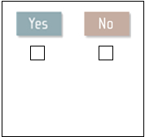
Develop Simple Data Collection Forms
For example:
List all indicator questions on one page with “yes” or “no” boxes to be checked
Copy one page for each record you are reviewing
Computer systems can be useful, but remember, they are a tool, not a goal
Notes:
One thing to keep in mind is to keep your data collection forms simple.
You do, however, need to be able to go back and double-check your results, so having one data collection form for each record you review is useful.
Use computers if they help but don’t feel like you must. Use simple tools that help you accomplish the job easily.

Slide 35
Example of Data Collection Forms
Visit the eHIVQUAL website for chart abstraction tools
https://www.ehivqual.org
Notes:
Here is an example of a Data Collection Form, developed by the HIVQUAL Project.
You can visit the National HIVQUAL Project at www.hivqual.org for adult care, pediatric care and case management data collection forms.

Slide 36



Establish Accountability for Data Collection
Notes:
The quality committee might decide who will routinely and accurately measure the selected indicators. A staff person or a team can be assigned with this task. At minimum, the designated person or team should receive a brief training to review the measurement process and to fully understand each indicator on which data are collected.
Keep in mind, you should establish clear timeframes for data collection and assign a representative to report the data (and potential data collection barriers) at the next quality management committee meeting.

Slide 37
Train Your Abstractors
Run a brief training session in person
Talk about how data will be used
Have lots of time for Q&A
Notes:
Help the people who will be collecting the data understand what they are supposed to do, and why. You’ll get better results, and more people will trust that the data you collect are valid.
Run a brief training session in person with each of the people charged with helping to collect the data.
Talk about how data will be used so that everyone understands the end goal.
Also, remember to set aside plenty of time for Q & A. It is important for everyone to have a clear understanding.

Slide 38
Run a Pilot
Select 2-3 records in the sample
Ask abstractors to collect the requested information
Check for accuracy
Routinely meet with abstractors to discuss
Revise collection tools and plans accordingly
Notes:
Don’t forget to test your system first with a small pilot. It is better to discover that your collection form was unclear after 2 charts than after 50.
First, do a pilot test, just 2-3 records, and talk to the abstractors to see what they are finding.
Next, check for accuracy along the performance measurement process and then routinely meet with abstractors to discuss the results and their observations on the collection process.
Finally, revise your collection tools and plans accordingly to adjust for any corrections to your methodology.

Slide 39
Key Points
Successful data collection involves:
  A representative sample of records
  A comprehensive plan, including
    Clear questions to be answered
    Simple forms to be used
    Well-trained and engaged staff
  Action!
  Validation of data
Notes:
In summary,
To get valid and useful data, without stressing out your entire HIV care program, be sure to follow these steps.
First, select a representative sample as outlined by the HIVQUAL chart. You will want to be clear on what information you want and then design simple data collection forms in order to collect your information. It is imperative that you train your staff and listen to their feedback. Remember to have one person as a dedicated contact in case anyone on the team has questions. Most importantly, do it! Nothing will get done if you do not take action. Finally, validate, again, using a sample of what you’ve collected.

Slide 40
Develop Your Own Work Plan for
Data Collection
Do you have measures identified and defined?
Have you determined your sample size?
Do you have a random number list of records?
  www.randomizer.org
Where will you get your data from?
Who will be responsible for overseeing the process?
Who will be assigned to collect the different elements of data?

Slide 41
Data Collection Plan
Do you have a data collection tool?
Do you have computer capability to collect data?
When will you train the data collectors?
When will you start data collection?
Who’s going to validate the data?
Resource: Free: Gantt-chart_L.xls at http://www.vertex42.com/ExcelTemplates/excel-gantt-chart.html
Notes:
The Gantt chart is a tool you can use to develop a time-line for any sort of work plan. This resource takes you to a site that allows you to download a free Excel Gantt chart. It can be edited for any purpose.

Slide 42
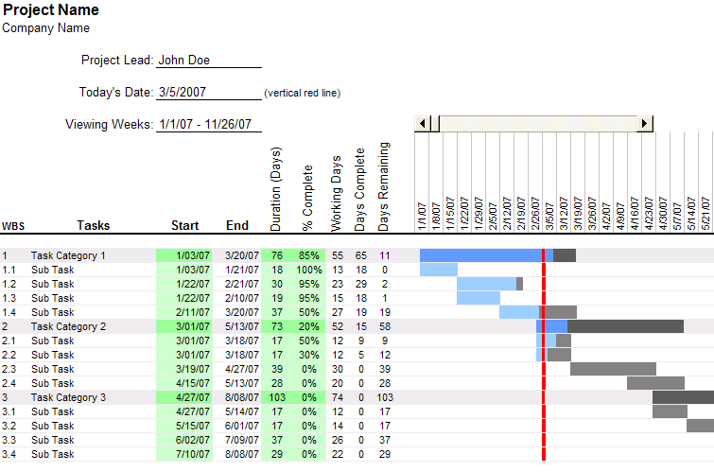
Notes:
INSERT INFO FROM BENJAMIN ABOUT HOW THEY APPROACHED DATA COLLECTION, WHO DID THE DATA COLLECTION, HOW THEY VALIDATED DATA, ETC.

Slide 43
How would you rate each of the following on a scale of 1 ("It makes me shudder even to think about it") to 5 ("It all worked really well")?
1
2
3
4
5
The time it took
The money it cost
How my colleagues and I felt about it
The accuracy of the results
The usefulness of the information the data gave us
Notes:
Think about your most recent experience in data collection. How would you rate each of the following on a scale of 1 ("It makes me shudder even to think about it") to 5 ("It all worked really well")? Turn to the person next to you and share your experience
What worked or didn’t
What did you learn from the experience---what would you do differently or the same

Slide 44
Key Practical Strategies for Data Collection:
What has worked for you?
Notes:
Let’s take about 10 minutes to talk about what’s worked for data collection in different organizations. Listen to people when they describe their strategies. They may have practical ideas that are adaptable to your organization.

Slide 45
Reviewing Data—Answer these ?
  What screening measure had the lowest score? Highest score?
  What screening measure may not meet the improvability criteria?
  What screening measure as the most relevance for your program?
  What trend is appearing when looking at data over time?
  What area would you select for a QI project?
Notes:
Ask everyone to review the dashboard and answer the questions
If time allows, use small groups to discuss which QI project they would select and why. Allow time for a few people to report out.

Slide 46
Use the Data to Guide your Improvement Work
Look at the data
Doing well, or not?
Performance stable, or a trend?
Compared to other grantees?
Decide how to act on the data
Which areas need improvement?
Begin improvement work
Identify project team
What are our priorities for improvement?
Define improvement goal
Notes:
ASK BENJAMIN TO TALK ABOUT WHAT THEIR DATA SHOWED AND HOW THEY USED IT TO SELECT QI PROJECTS
46

Slide 47
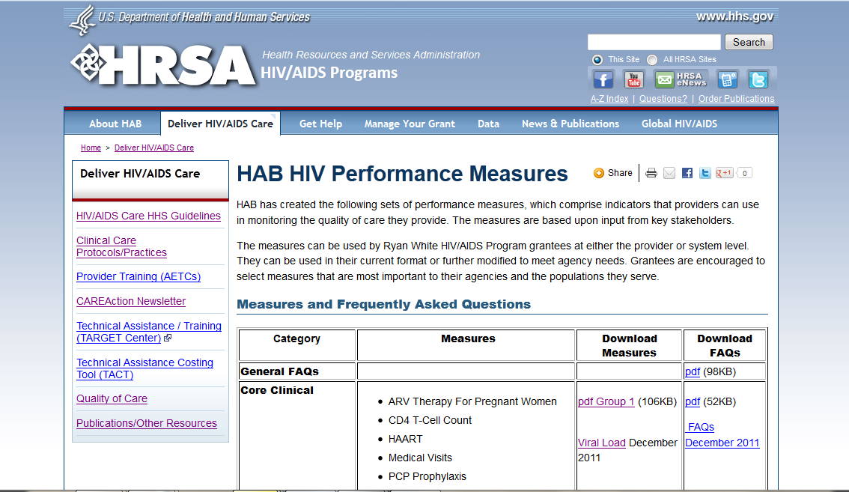
http://hab.hrsa.gov/deliverhivaidscare/habperformmeasures.html

Slide 48
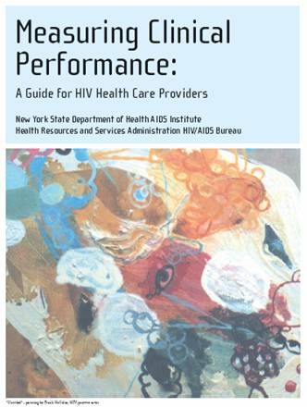

Performance Measurement Resources
Notes:
There are many publications available to help your organization in its quality improvement work.
“Measuring Clinical Performance: A Guide for HIV Health Care Providers” is a publication we will mention often during The Quality Academy. The New York State Department of Health AIDS Institute developed this guide that includes a step-by-step process for measuring clinical performance with the goal of improving quality of care. This guide, and other quality improvement resources can be downloaded when clicking on the documents on your screen.
On the right is a set of guideline-based quality indicators that were created by the NQC

Slide 49


Performance Measurement Resources
Notes:
On your left you see the HIVQUAL Workbook, a comprehensive guide to quality improvement in HIV care developed in the 8 years of the HIVQUAL Project’s work. The guide covers both organizational infrastructure and specific quality activities, with many practical examples, tips, and tools for success. If you want to learn more about quality improvement in HIV care, study this detailed book and its chapters.
On the right is a screenshot of the HIVQUAL data collection software, called HIVQUAL3. This software gives HIV programs and services an easy way to collect data on performance on the HIVQUAL quality-of-care indicators and to submit reports to the HIVQUAL staff to be aggregated into national program reports. It also includes adult, pediatric and case management indicators. While it is quite useful, please be reminded that it is not an electronic medical record.
A second, valuable New York State Department of Health AIDS Institute publication is “Patient Satisfaction Survey for HIV Ambulatory Care.” Patient satisfaction is an important element of the quality of care, but good surveys are difficult to develop. This is believed to be the first HIV-specific validated satisfaction survey with 5 modules, including case management, women’s health, substance use, etc. This tool is also available in Spanish.

Slide 50
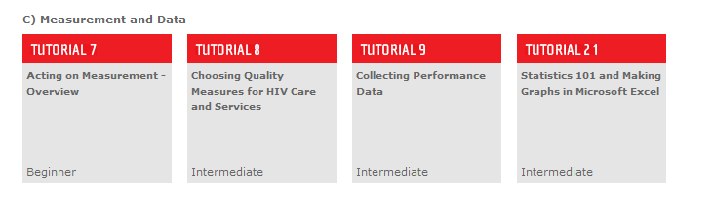
Quality Academy
Notes:
The Quality Academy provides a series of tutorials focused on performance measurement
ASK BENJAMIN TO IDENTIFY SPECIFIC RESOURCES THAT HE FOUND PARTICULARLY HELPFUL

Slide 51
Aha Moment and Action Planning
What have you learned from this workshop?
What will you do differently in response to this workshop?
Complete the Action Planning Form on your chair

Slide 52
Marlene Matosky, MPH, RN
Nurse Consultant/Quality Advisor
HRSA HIV/AIDS Bureau mmatosky@hrsa.gov
301-443-0798
Lori DeLorenzo, RN, MSN
NQC Consultant
National Quality Center (NQC)

Slide 53
National Quality Center
212-417-4730
NationalQualityCenter.org
Info@NationalQualityCenter.org

