Slide 1
The Grantee Toolbox: RSR Data Quality - 101
Notes:
Welcome to today’s presentation: RSR Data: Are they complete?, Are they right?, Do they reflect your program?
Grantees and providers are continuing to improve their RSR submissions! In 2010, all grantees and providers submitted their required reports. During this presentation, we’d like to show you how these data look. We’ll go over the importance of data quality and how we can work together to improve data quality.
My name is Ellie Coombs, and I am part of the DART team. Along with SAIC and WRMA/CSR, we provide TA for the RSR.

Slide 2
Outline of Today’s Presentation
The Importance of Data Quality
Data Quality Improvements and Remaining Issues
Tools to Help You Assess Data Quality
Right Now!
At Upload (Starting January 7, 2013)
Notes:
First, I’ll present why data quality is so important. Then, we’d like to congratulate you because data quality improved between the 2009 and 2010 reporting years. However, there are still some remaining data quality issues, such as missing data, inconsistencies between the RSR and the RDR, and internal inconsistencies within the RSR. During this presentation, we’ll go over reasons why they may occur and how we can work together to improve data quality as we move to reporting 2011 data and capturing 2012 data.
Finally, we’ll end the session with tools to help you assess your data quality. Some of these tools can only be used after you have submitted your data. Often, at this point, it’s too late for you to go back and fix your data before the submission deadline. Therefore, the primary purpose of these tools is to help you improve your data quality before the next submission period. Other tools allow you to “take your temperature” throughout the reporting period. The goal is for you to periodically check your data, identify issues, and fix problems well before the submission deadline. This will not only improve the quality of your data, but also make the submission period much more relaxing.

Slide 3
Learning Objectives
Why are we concerned about data quality?
What aspects of data quality deserve the most attention?
How can we improve data quality in the future?
Notes:
We want you to walk away from this presentation knowing why data quality is so important. We also want you to learn about strategies for improving data quality without making you feel overwhelmed. We’ll focus on those aspects of data worth tackling and the tools we offer for checking and improving data quality.

Slide 4
Quality of Data Versus Quality of Care
Quality of Data
=
Accuracy of your
data
Quality of Care
=
What your program is doing compared to what it should be doing
Notes:
What is the difference between quality of data and quality of care?
High quality data are data that accurately reflect the services you deliver.
Quality of care compares the services that were actually delivered to an external measure of quality.
Let’s look at some examples: The HAB performance measure on CD4 tests requires at least 2 tests spread out during the year.
If you only capture data on CD4 tests that are done at your agency’s onsite lab, and half of the CD4 tests are sent to an outside lab, you will not count, nor report on, the tests that went to the outside lab. If you have 100 patients and half of the patients’ tests are not in your report, it will look like you did not do CD4 tests half of the time. Your best possible score would be 50%. You wouldn’t know if it was the quality of care or the quality of data.
If you capture data on all of the CD4 tests done by your agency, your very best possible score could be 100%. If it falls below that, you have an opportunity for improvement in the quality of your care.
If you don’t know if you have quality data, you don’t know where to focus your improvement.
Good quality data can help you improve quality of care, poor quality data cannot.
Check out the Seven Essential Steps in Data Flow, posted on TARGET, for the process on identifying, collecting and validating your data and then using data to assess and inform program activities.

Slide 5
RSR Data Count!
RSR data will be used to publically report information about the Ryan White Program
Congress
HIV/AIDS community
The public
RSR data should accurately reflect your program activities
Notes:
As you know, the RSR is only in its third year. During 2009 and 2010, we kept the training wheels on by maintaining the RDR while you were figuring out how to submit the RSR and then how to submit quality RSR data. During this time, HAB used the RDR data to report information about the program to the public. In 2011, the RDR is no more. This means two things. First, you only have to submit one report. Second, that report is all the more important. In 2011, RSR data will be used to report information about the program to Congress, the HIV community, and the public at large. It is essential that these RSR data accurately reflect your program activities.

Slide 6
Notes:
To illustrate the importance of data quality, here is a representation of your program – a masterpiece!

Slide 7
Notes:
Here’s your program through the lens of the RSR. It only covers the funded patients, so it may lack some color.

Slide 8
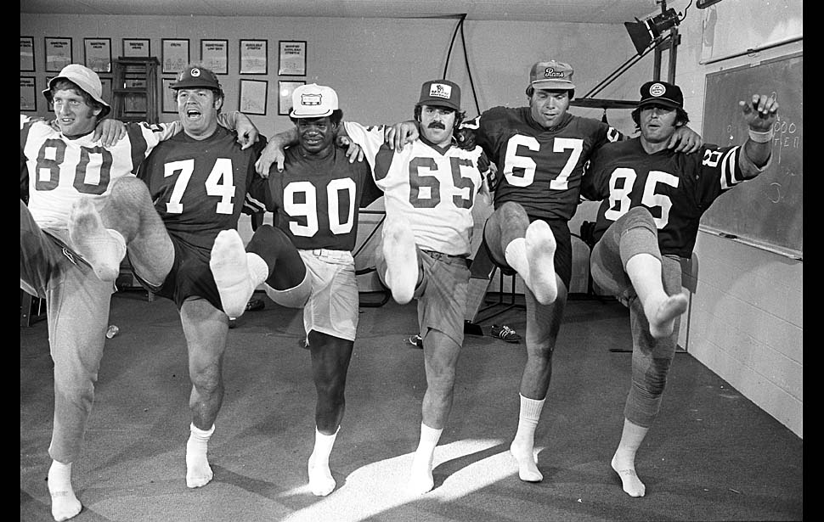
Notes:
And finally, here’s your program through the lens of the RSR with poor data quality. The data do not reflect its true quality.

Slide 9
Outline of Today’s Presentation
The Importance of Data Quality
Data Quality Improvements and Remaining Issues
Tools to Help You Assess Data Quality
Right Now!
At Upload (Starting January 7, 2013)

Slide 10
How we define data quality
Are data complete?
Do data pass the giggle test? (not so funny when issues prevent submission)
Do data meet reporting requirements?

Slide 11
Evaluating Completeness
What does it mean to have complete data?
No missing values
Reasonable amount of “unknown” values
Measures of completeness – percentage of clients with:
A known value reported
An “unknown” value reported
Nothing reported (missing)
A known or “unknown” value reported (complete)
Notes:
What does complete data mean exactly? For one, complete data means that a value is reported for each required client. Also, there should be a reasonable level of “unknown” data. For example, you may have a large Hispanic population that does not self-report race. Some level of Unknown is unavoidable for this reason – and therefore, acceptable. However, look at your Unknown data carefully. What if you have a large share of “uknowns” for pregnancy status? Knowing this information is essential for providing quality care – therefore, you’ll want to work out a strategy for capturing these data.
For each data element, HAB uses four indicators of data completeness:
The percentage of required clients that have a known value reported,
The percentage of required clients that have an “unknown” value reported,
And, the percentage of required clients that have nothing reported at all. We call these missing data.
In addition, we also look at the percentage of clients with either a known value or an “unknown” value reported. Although, as we mentioned before, “unknown” values are not ideal, but they are valid responses in the RSR. We call these complete data.
Therefore, for each data element, a provider has a Known Rate, an “Unknown” Rate, a Missing Rate, and a Completeness Rate.

Slide 12
Data completeness is improving!
Missing Rates Unknown Rates
Notes:
Data completeness is a key aspect of data quality – so, let’s look at some related indicators. In 2009, about 6 percent of required data in the RSR was missing. This dropped to less than 3 percent in 2011. Some of this decrease may have resulted from our fine tuning of requirement conditions – just like you, we are learning as we go and working to improve things.
We see the same trend with “unknown” data – which dropped from about 8 percent to 5 percent.
This is good news!

Slide 13
Clinical data remain difficult to capture
Notes:
Here we see the 2011 completeness rates for demographic data, client services, and clinical data.
Overall, clinical data remain the most difficult to capture, with the lowest Completeness Rates. In 2011, close to 100 percent of required demographic data were complete, whereas about 94 percent of clinical data were complete. That said, clinical completeness is improving, about a percentage point a year.

Slide 14
Some providers continue to struggle
Notes:
Here we see the 2011 completeness rates for demographic data, client services, and clinical data.
Overall, clinical data remain the most difficult to capture, with the lowest Completeness Rates. In 2011, close to 100 percent of required demographic data were complete, whereas about 94 percent of clinical data were complete. That said, clinical completeness is improving, about a percentage point a year.

Slide 15
Data that don’t pass the giggle test
Services before birth year
Services after death date
AIDS diagnosis year without CDC-defined AIDS
Transgender subgroup without transgender
Service dates come before the “first” service date

Slide 16
Data that don’t meet reporting requirements
Unfunded services or clients reported
Services outside of the reporting period
Is it a program issue or data quality issue?
Services reported without a funded contract
Core medical services provided to HIV-negative clients

Slide 17
Outline of Today’s Presentation
The Importance of Data Quality
Data Quality Improvements and Remaining Issues
Tools to Help You Assess 2012 Data Quality
Right Now!
At Upload (Starting January 7, 2013)

Slide 18
Start reviewing your 2012 data now!
X-ERT
Reports within your data management system
Canned reports
Customized reports
Performance measures

Slide 19
Why X-ERT?
Many providers perceive the XML file as a black box
T-REX already includes the ability to convert the client-level data file from XML to Access
X-ERT builds on this ability, converting from Access to a flat Excel file
19
Notes:
From the beginning of the RSR reporting, some grantees and providers have expressed concern that they can’t check the XML file that they are submitting, that it seems like a black box to them.
We are actively encouraging RSR-Ready Systems to add ways for providers to check their data, and in fact, adding such checks will become a requirement to keep the label of RSR-Ready.
And, not everyone knows, but T-REX has long included an ability to essentially “reverse” the XML. T-REX’s basic function is to convert from an Access database into XML, but it also allows you to go the other way. In other words, if you have an XML file from another system, you can use T-REX to convert that file into Access.
X-ERT builds on this aspect of T-REX, converting from Access to a flat file that can be moved into Excel. By “flat file”, I mean a single table that has one row per client.
Before I go on, an important note about software requirements: For both the conversion from XML to Access and the use of the X-ERT in Access and Excel, Access and Excel 2007 or more recent is required. We had some early tester try it in Access 2003 and they had trouble importing the XML into T-REX.

Slide 20
X-ERT matches reports in the RSR Web System
Upload Confirmation Report, split into three pieces:
Client demographics
Services
Clinical data
Validation checks
Completeness Report
20
Notes:
The key aspect of X-ERT is an Excel template that uses this flat file to automatically generate reports that are comparable to those in the RSR system. These include counts that should match the Upload Confirmation Report; validation checks that map to the errors, warnings and alerts in the RSR system; and completeness rates similar to the completeness reports. In a few cases, we’ve added on information, but matching these elements of the RSR system is really the central purpose of X-ERT.

Slide 21
How to use X-ERT
Create your client-level XML file
Upload the file into T-REX
Use the “X-ERT Form” in T-REX to create a flat file in Excel
Copy the flat file into an Excel template to check your data
21

Slide 22
Counts tab mimics Confirmation Report
22

Slide 23
Validation Checks tab mimics Validation Report
23

Slide 24
Missing Validations tab mimics Validation Report
24

Slide 25
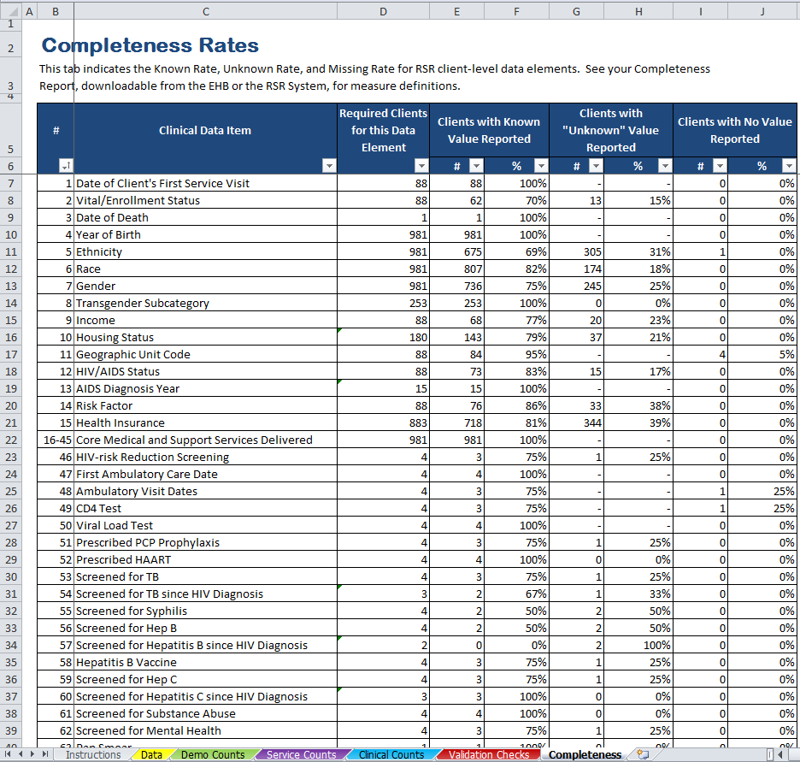
Completeness tab mimics Completeness Report
25

Slide 26
Reports within your data management system
Canned reports
Customized reports
Performance measures (canned or customized)

Slide 27
Canned reports
CAREWare Summary Report and Client Viewer
More examples from RSR-Ready Systems

Slide 28
Customized reports
Are you worried about a particular data item for a particular population?
Clients with OAC without viral load
Age of indeterminate babies
Clients with “unknown” medical insurance status
Contact your internal IT staff person and vendor representative
Customized reports can help you deal with quality of care issues too!

Slide 29
Group 1 Performance Measures
Measure | Description
ARV therapy for pregnant women | % of pregnant women with HIV infection who are prescribed antiretroviral therapy
CD4 T-cell count | % of clients with HIV infection who had 2 or more CD4 T-cell counts performed in the measurement year
HAART | % of clients with AIDS who are prescribed HAART
Medical visits | % of clients with HIV infection who had two or more medical visits in an HIV care setting in the measurement year
PCP prophylaxis | % of clients with HIV infection and a CD4 T-cell count below 200 cells/mm³ who were prescribed PCP prophylaxis
Notes:
One way to answer this question is to calculate the Group 1 performance measures using your client-level data. These measures are presented on the slide (describe measures).

Slide 30
RSR data items used to calculate measures
Measure | Denominator | Numerator
ARV therapy for pregnant women | HIV/AIDS status (#12) Current gender (#7) Pregnant (#64) | Prescribed ARV (#66)
CD4 T-cell count | HIV/AIDS status (#12) | Value and test date of CD4 cell counts (#49)
HAART | HIV/AIDS status (#12) | Prescribed HAART (#52)
Medical visits | HIV/AIDS status (#12) | Outpatient/ambulatory care visit dates (#48)
PCP prophylaxis | HIV/AIDS status (#12) Value and test date of CD4 cell counts (#49) | PCP prophylaxis (#51)
Notes:
This slide contains the client-level data elements necessary to calculate the measures.

Slide 31
RSR data items used to calculate measures
Measure | Denominator | Numerator
ARV therapy for pregnant women | HIV/AIDS status (#12) Current gender (#7) Pregnant (#64) | Prescribed ARV (#66)
CD4 T-cell count | HIV/AIDS status (#12) | Value and test date of CD4 cell counts (#49)
HAART | HIV/AIDS status (#12) | Prescribed HAART (#52)
Medical visits | HIV/AIDS status (#12) | Outpatient/ambulatory care visit dates (#48)
PCP prophylaxis | HIV/AIDS status (#12) Value and test date of CD4 cell counts (#49) | PCP prophylaxis (#51)
Notes:
For example, to calculate the ARV measure, you use the total number of HIV positive pregnant women as the denominator, based on items #12, #7, and #64. As the numerator, you’d use the # of clients that were prescribed ARV (item #66).

Slide 32
Example: ARV Therapy for Pregnant Women
100 reported clients
47 female (#7) with HIV (#12)
Denominator: 13 pregnant (#64)
Numerator: 11 pregnant (#64) and on ARV (#66)
Percentage: 11/13 = 85%
Notes:
Now, let’s look at an example. Say you report 100 clients. 50 of those are female, as indicated by item #7, and 47 of those females are HIV positive, as indicated by item #12. Of those 47 women, 13 are pregnant – item #64. Therefore, 13 is the denominator in the calculation. Of those 13 clients, 11 are on ARV (#66). Your percentage is 11 over 13 or 85%.
You can see by this example that Unknown values can seriously limit the meaningfulness of the performance measures. If you have a high share of women with an Unknown pregnancy status, these women are not captured in the denominator of the performance measure calculation. Therefore, your final calculation is favorably biased.
Calculating the performance measures with RSR data does have some limitations. For example, you cannot capture some of the exclusions – such as whether the client was in her first trimester and newly enrolled in care during the last three months of the measurement year.
Also, every item is not required for all clients – the items you must report depend on the services that client receives. It is possible you want to calculate measures for all you clients – not the ones with the related services.

Slide 33
Answer the Following Questions
Which percentages are lower or higher than expected?
Why?
Is my data system not capturing the data necessary to properly reflect my program?
Is my data system not reporting the data necessary to properly reflect my program?
How can I improve my system to better capture and report data?
Notes:
Once you have calculated your performance measures, you can ask yourself if any of these numbers seems strange to you – too high or too low. If so, you might be seeing a data quality issue. Check to see if your data system is capturing all the necessary data. Or maybe the problem lies with reporting; you have the data in your system, but you are not extracting it correctly. Finally, you can work with us to fix those problems for better data quality in the future.

Slide 34
Outline of Today’s Presentation
The Importance of Data Quality
Data Quality Improvements and Remaining Issues
Tools to Help You Assess 2012 Data Quality
Right Now!
At Upload (Starting January 7, 2013)

Slide 35
Upload early!
Tools within the RSR Web System
Confirmation Report (within minutes)
Validation Report (within minutes)
Completeness Report (within days)
Use these tools to review your data
Fix issues and re-upload before the submission deadline
It’s that easy!

Slide 36
Confirmation Reports
Presents number and share of clients with each response option
Summarizes all data reported (not just required clients)
Aggregates all files submitted for the provider
What it doesn’t tell you: missing data for required clients

Slide 37
Validation Report
Three types of data issues:
Error: can’t submit
Warning: add a comment
Alert: flag, go back and check your data
Many new validations in 2012, including missing and unknown data

Slide 38
Completeness Report
New for 2012! Completeness Report will be available several days after upload
Create a report for one or multiple providers
For each data item, it presents the percent of required clients with
An “unknown” response
A known response
No response (missing)

Slide 39
A Provider Reports…
1,000 eUCIs
Item #7 (Gender): 22 transgender clients
Item #8 (Transgender subgroup):
-Male to Female: | 5
-Female to Male: | 10
-Unknown: | 3
Notes:
Now, let’s look at an example.
Say you reported 1,000 unduplicated clients. 22 of these clients are transgender. Therefore, the number of required clients for data element #8 (transgender subgroup) is 22.

Slide 40
Rates for Transgender Subgroup
Item #7 (Gender): 22 transgender clients
Known Rate | 15/22= | 68%
Unknown Rate | 3/22= | 14%
Missing Rate | 4/22= | 18%
Total |  | 100%
Known Rate | 15/22= | 68%
Unknown Rate | 3/22= | 14%
Completeness Rate |  | 82%
Notes:
Therefore, your Known Rate is 15/22 = 68%; your Unknown Rate is 3/22 = 14%; your Missing Rate is 4/22 = 18%. Notice that these three rates add up to 100%.
A Completeness Rate is the sum of the Known Rate and Unknown Rate – in this case, 82%.

Slide 41
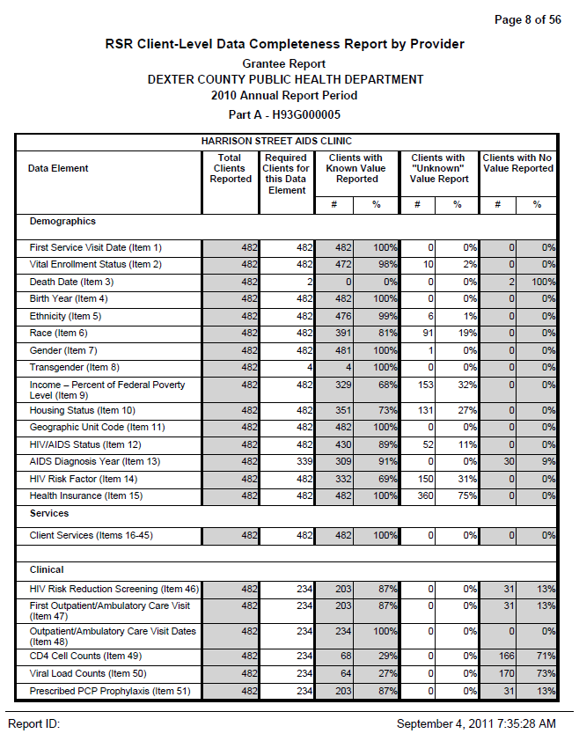
Report Columns
Notes:
The first column contains the names of the elements. (1) The second column shows the number of records submitted with a service and a unique eUCI. (2) And the third column contains the number of clients required to have a value reported for each data element. The numbers are different for each element b/c reporting on some elements depends on the services a client has received and other client characteristics. For example, you need to report a gender, ethnicity and birth year for all clients. But you only need to report AIDS diagnosis year for clients with a certain service and diagnosed with AIDS.
The number reported in this third column is the denominator in the completeness calculations corresponding to the data element in the same row.
The following columns are the (3) number and percentage of required clients that have a known value reported,(4) the number and percentage of required clients that have an “unknown” value reported, and (5) the number and percentage of required clients that have nothing reported at all.

Slide 42
What happens after submission if I have data quality issues?
We may contact you
We are streamlining our outreach
We may involve your Project Officer
Outreach is not punitive; we want to help you
Identify the source of the problem
Develop and implement a fix

Slide 43
Summary of Ways to Improve Your Data Quality
Notes:
I’d like to wrap up the presentation with some final slides.

Slide 44
Identify Problems
Use T-REX and the X-ERT form
Run canned and customized reports in your data management system
Calculate your Group 1 performance measures
Upload early to check out your Confirmation Report, Validation Report and Completeness Report

Slide 45
Investigate and Fix Problems
Contact your providers and IT staff
Contact the DART Team: Data.TA@caiglobal.org
Notes:
If you identify a problem, you’ll need to contact the relevant provider. And depending on the problem, you may want to work with us, your provider, IT staff and vendor to fix issues such as incorrect filters on data extraction or problems with data merging. Finally, stay informed on upcoming system upgrades that incorporate logic checks.

Slide 46
Learn More
Other RSR-related sessions at the AGM
Visit us at the Federal Village
Webcasts until the reporting deadline
TARGET Center Website

Slide 47
Disclosures
This continuing education activity is managed and accredited by Professional Education Service Group. The information presented in this activity represents the opinion of the author(s) or faculty. Neither PESG, nor any accrediting organization endorses any commercial products displayed or mentioned in conjunction with this activity.
Commercial Support was not received for this activity.

Slide 48
Obtaining CME/CE Credit
If you would like to receive continuing education credit for this activity, please visit:
http://www.pesgce.com/RyanWhite2012

