Slide 1



Guidance to Integrating Affordable Care Act, National HIV/AIDS Strategy, and Ryan White
Presented by:
Randy Russell, LASW - CEO
Seattle, Washington

Slide 2
Section I – Setting the Stage
Ryan White
  Assume the audience is very familiar
National HIV/AIDS Strategy
  Specific elements of the strategy will be key focus
Affordable Care Act
  Big Picture, some state-specific examples/outcomes
  Options to notice as your state prepares

Slide 3
Section I – Setting the Stage
National HIV/AIDS Strategy – 15 Federal Departments (July 2010)
Affordable Care Act (Election Results?)
Ryan White (September 2013?)

Slide 4
Setting the Stage
Who is Here & What is knowledge level?

Slide 5
Your Presenter…
Randy Russell, LASW - CEO, Lifelong AIDS Alliance

Slide 6

This Slide Deck is Your Toolkit
Please provide your email address and a copy of this presentation will be sent to you following the conference.
You may also request a copy by emailing kimc@llaa.org.

Slide 7




Slide Deck Legend
Case studies or references that can be used for your own
state-specific toolkit
Case studies or references that are Washington State-specific

Slide 8
The Lifelong & Health Care Authority Partnership
On March 8, 2012, Lifelong AIDS Alliance convened its first monthly “Medicaid Expansion for Chronic Diseases Workshop” meeting for community advocates, providers, and consumers
Washington State Health Care Authority (HCA) and Lifelong connected as a result of this meeting, began collaborative work
In WA State, the Department of Health (DOH), Department of Social and Health Services (DSHS) and the Office of the Insurance Commissioner (OIC), and county public health departments also play prominent roles in coverage of those diagnosed with HIV
The same agencies + newly formed Health Benefit Exchange will play equally significant roles in the implementation of Healthcare Reform in WA
Lifelong actively seeks out opportunities to work collaboratively with these agencies, participating in workgroups, committees, planning councils, and focus groups

Slide 9
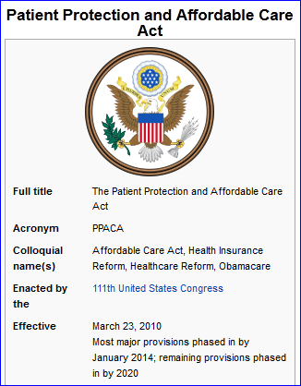

Section II – National HIV/AIDS Strategy

Slide 10
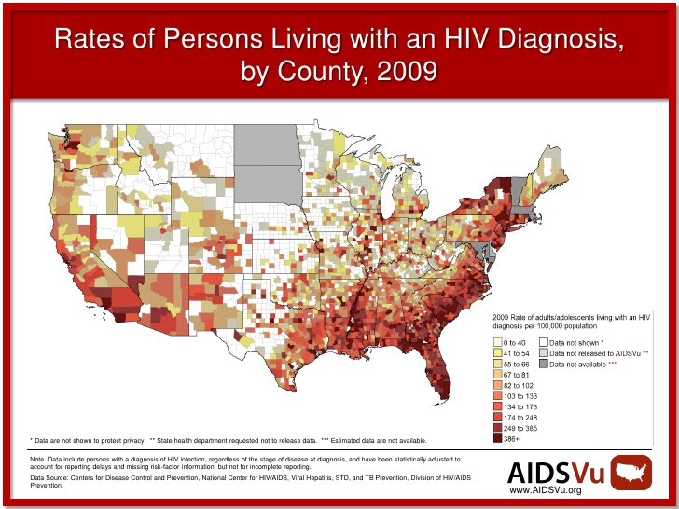

Slide 11
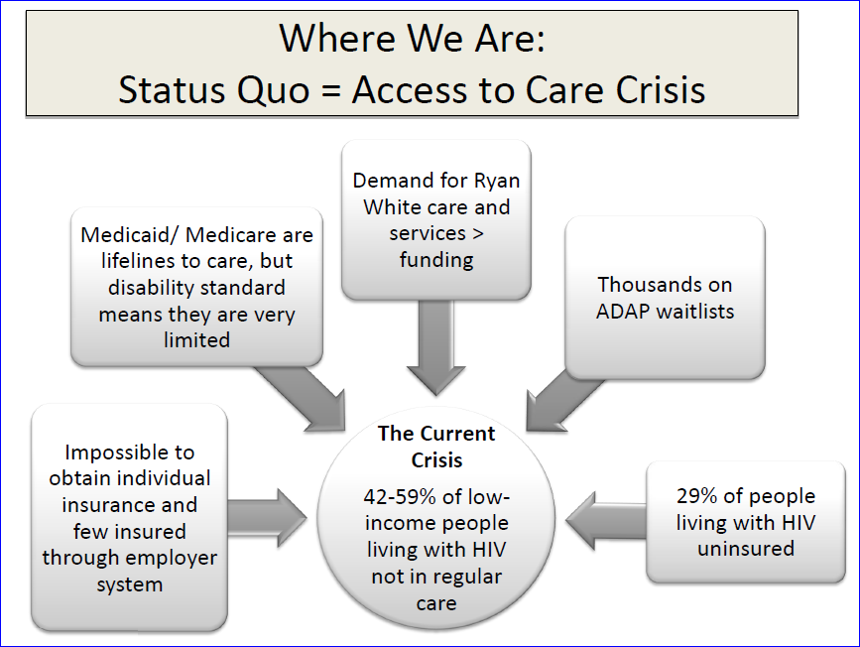

Slide 12
National HIV/AIDS Strategy
Next seven slides outline the Goals and Action Steps at a high level of the strategy.
What is happening in your state?
Are you at the table?
How do I find out if there is a table?

Slide 13
Goals of the National HIV/AIDS Strategy
I. Reducing New HIV infections
By 2015, lower the annual number of new infections by 25% (from 56,300 to 42,225).
Reduce the HIV transmission rate, which is a measure of annual transmissions in relation to the number of people living with HIV, by 30% (from 5 persons infected per 100 people with HIV to 3.5 persons infected per 100 people with HIV).
By 2015, increase from 79% to 90% the percentage of people living with HIV who know their serostatus (from 948,000 to 1,080,000 people).

Slide 14
Goals of the National HIV/AIDS Strategy
II. Increasing Access to Care and Improving Health Outcomes for People
Living with HIV
By 2015, increase the proportion of newly diagnosed patients linked to clinical care within three months of their HIV diagnosis from 65% to 85% (from 26,824 to 35,078 people).
By 2015, increase the proportion of Ryan White HIV/AIDS Program clients who are in continuous care (at least 2 visits for routine HIV medical care in 12 months at least 3 months apart) from 73% to 80% (or 237,924 people in continuous care to 260,739 people in continuous care).
By 2015, increase the number of Ryan White clients with permanent housing from 82% to 86% (from 434,000 to 455,800 people). (This serves as a measurable proxy of our efforts to expand access to HUD and other housing supports to all needy people living with HIV.)

Slide 15
Goals of the National HIV/AIDS Strategy
III. Reducing HIV-Related Health Disparities
Improve access to prevention and care services for all Americans.
By 2015, increase the proportion of HIV diagnosed gay and bisexual men with undetectable viral load by 20%.
By 2015, increase the proportion of HIV diagnosed Blacks with undetectable viral load by 20%.
By 2015, increase the proportion of HIV diagnosed Latinos with undetectable viral load by 20%.

Slide 16
Action Steps of the National HIV/AIDS Strategy
Reduce New infections
Intensify HIV prevention efforts in the communities where HIV is most heavily concentrated
Expand targeted efforts to prevent HIV infection using a combination of effective, evidence-based approaches
Educate all Americans about the threat of HIV and how to prevent it

Slide 17
Action Steps of the National HIV/AIDS Strategy
Increase Access to Care and Improve Health Outcomes for People Living with HIV
Establish a seamless system to immediately link people to continuous and coordinated quality care when they learn they are infected with HIV
Take deliberate steps to increase the number and diversity of available providers of clinical care and related services for people living with HIV
Support people living with HIV with co-occurring health conditions and those who have challenges meeting their basic needs, such as housing

Slide 18
Action Steps of the National HIV/AIDS Strategy
Reduce HIV-Related Disparities and Health Inequities
Reduce HIV-related mortality in communities at high risk for HIV infection
Adopt community-level approaches to reduce HIV infection in high-risk communities
Reduce stigma and discrimination against people living with HIV

Slide 19
Action Steps of the National HIV/AIDS Strategy
Achieve a More Coordinated National Response to the HIV Epidemic
Increase the coordination of HIV programs across the Federal government and between Federal agencies and state, territorial, tribal, and local governments
Develop improved mechanisms to monitor and report on progress toward achieving national goals

Slide 20
What do we do now?
Is your state forming a state-level response to the National HIV/AIDS Strategy?
Are you involved in Ryan White groups where everyone waited for the election? Or you live in a state that has said flat no to Medicaid Expansion?
What alternatives are there?
Where an how do we get the metrics?

Slide 21
HIV TREATMENT AS PREVENTION – WHERE ARE WE NOW?
United States
~19% of PLWH are virally suppressed
(Gardner, et.al., CID, 2011)
Notes:
21

Slide 22

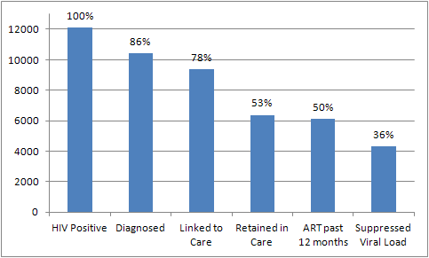



Modified Care Cascade - Estimate of Viral Load Suppression in WA (10/10)
HIV TREATMENT AS PREVENTION – WHERE ARE WE NOW?
Washington State
Notes:
Sources:
Number of HIV-positive persons from surveillance program prevalence estimate; mid point of range with a low of 11,500 and high of 12,700
Number of diagnoses from eHARS; October 2010 Quarterly, people living with HIV as of December 31, 2009
Linked to care is from Washington surveillance data, including case reports and lab reports. This figure is from work done for Category C grant; 90% of people linked to care within 3 months after diagnosis. Linked to Care based on 2009 Washington diagnoses. It is not possible for us to know about linkage to care for all persons living with HIV in Washington, as some were initially diagnosed out of state, and we do not have initial linkage to care information on them.
Retained in Care is from the Medical Monitoring Project (MMP) medical record abstraction. It means the presence of an HIV-related lab test (any HIV viral load or CD4) during the previous 12 months.
On ART past 12 months is based on data from the MMP medical record abstraction.
Suppressed Viral Load is from MMP medical record abstraction, and is based on the most recent viral load during the previous 12 months.

Slide 23
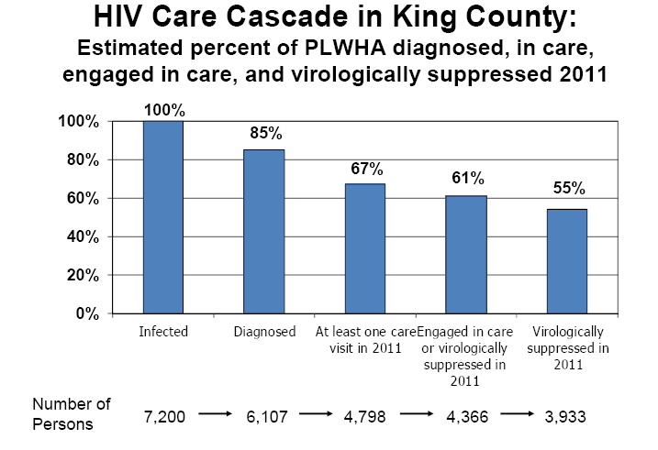
HIV TREATMENT AS PREVENTION – WHERE ARE WE NOW?
(Seattle Metro)
King County Public Health, (2011). Washington State/Seattle-King County HIV/AIDS Epidemiology Report. Retrieved from website: http://www.kingcounty.gov/healthservices/health/communicable/hiv/epi/~/media/health/publichealth/documents/hiv/2ndHalf2011EpiReport.ashx

Slide 24
Awareness of Serostatus Among People with HIV: Estimates of Transmission
Accounting for:
~46% of New Infections
~75% Aware of Infection
~54% of
New Infections
~25% Unaware of Infection
People Living with HIV/AIDS: 1,039,000-1,185,000
New Sexual Infections Each Year: ~32,000
Marks, G., Crepaz, N., Janssen, R.S., Estimating sexual transmission of HIV from persons aware and unaware that they are infected with the virus in the USA, AIDS 2006, 20:1447-50.
Notes:
It is estimated that sexual transmission accounts for 32,000 of the 40,000 new infections each year.
25% of people who are unaware that they are infected account for at least 54%, and potentially as much as 70%, of the new sexually transmitted infections each year. The transmission rate among those who don’t know they are infected is 3.5 times higher than for people who know about their HIV infection.
The importance of getting these individuals tested and into care that includes both treatment and prevention interventions is critical.

Slide 25

HIV TREATMENT AS PREVENTION
HIV Prevention Trials Network 052 Study (HPTN 052)
  Released NEJM in August 2011
  “Breakthrough of the Year” (Science, 2011)
  First randomized clinical trial to demonstrate the prevention benefits of ART
    “Providing early ART to an HIV infected person can reduce the risk of sexual transmission of HIV to an uninfected person by 96%.”
  Also demonstrated positive impact on clinical outcomes for HIV infected partners
    41% lower risk of adverse outcomes compared to participants for whom treatment was delayed
Essential strategy, BUT not a silver bullet: drug resistance and acute HIV infection are real concerns
(HPTN Press Release, 2011)
Notes:
25

Slide 26
HIV TREATMENT AS PREVENTION – HOW DO WE GET THERE?
Engagement in Care
Re-engagement in Care
THIS IS WHAT WE WANT!
Retention in Care
HIV Diagnosis
Linkage to Care
ART Receipt
ART Adherence
Outcomes
Diagnose HIV-positive persons who do not know their status.
(Prevention)
Ensure newly diagnosed HIV-positive persons are linked to care.
(Prevention and Client Services)
Ensure HIV-positive persons receive ART.
(Client Services)
Ensure HIV-positive persons are ART adherent.
(Client Services)
INDIVIDUAL AND POPULATION LEVEL VIRAL SUPPRESSION
POSITIVE INDIVIDUAL LEVEL CLINICAL OUTCOMES
REDUCED HIV TRANSMISSION
(CID, 2001: 52 (Suppl 2))
Notes:
26

Slide 27
What is Combination Prevention?
  Combination prevention includes: treatment with antiretroviral drugs, condom distribution, knowledge transfer, use of PREP or nPEP, school-based education, screening, testing, and diagnosing
  Medicaid covers some of the above elements and if positioned correctly, can prevention HIV transmission
PrEP
HIV Testing
Stigma
Treatment
Sexual Health Curriculum
Screening
Policy – Opt-out Testing in ERs and TX Centers
Linkage to Care

Slide 28
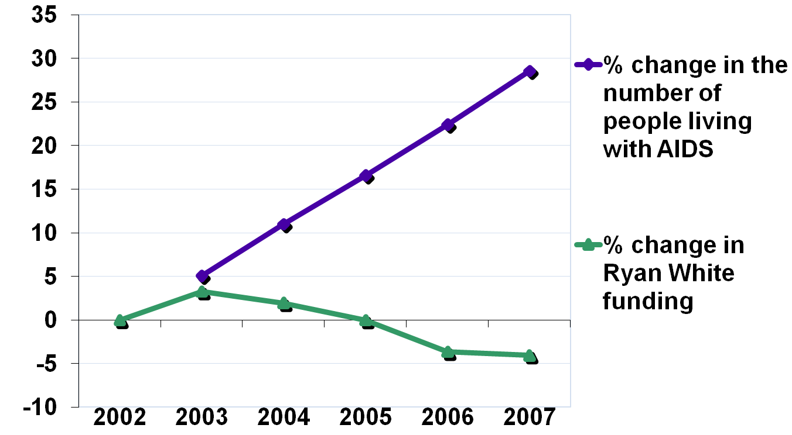
Ryan White Funding is Not Enough to
Meet Increased Need
Number of People Living with AIDS in the US
vs. Ryan White Funding (adjusted for inflation)

Slide 29

What Does Health Care Reform Mean for Ryan White Clients?
2008
2014
Ryan White Program
Medicaid
Expands to most
people up to 133% FPL
Eliminates disability
requirement
30% were uninsured
68% had incomes at
or below 100% FPL
22% had incomes
between 101% and
200% FPL
34% were insured
through Medicaid
12% had private
insurance
Health Care Reform
Private Insurance
Subsidies to purchase
insurance for people
with income up to
400% FPL
Elimination of pre-
existing condition
exclusions

Slide 30

What Does Health Care Reform Mean for Ryan White Providers?
Starting in 2014, the Role for Ryan White Will Change Because Most People Will Have Insurance Coverage
Greatest challenges
  Medicaid’s provider reimbursement rates
  New reimbursement systems
Greatest opportunities
  Relief to an increasingly underfunded Ryan White Program
  New investments in community-based care
  Potential for new reimbursement systems and funding
  streams for Ryan White providers (RWPs)

Slide 31

Don’t be afraid to ask
lots of questions in ACA forums, both at USCA and back home…
The path is often unclear to everyone involved in implementation,
including federal, state, and local agencies and their employees
We are all learning together!

Slide 32
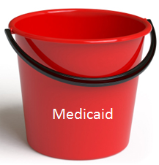
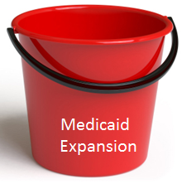


Four Buckets of the New Coverage Continuum
Existing Medicaid – Currently Covered
Medicaid Expansion – childless adults and parents up to 138% FPL
Duals (Medicaid & Medicare Eligible) – Poor, sick, disabled, aging
Health Benefit Exchange – 138% - 400% FPL
Eligible for Health Home Services under Section 2703 of ACA
Notes:
People with Medicare will not be eligible for Medicaid Expansion.
(Add a bar across first 3 buckets “Section 2703 of the ACA: Health Homes”

Slide 33
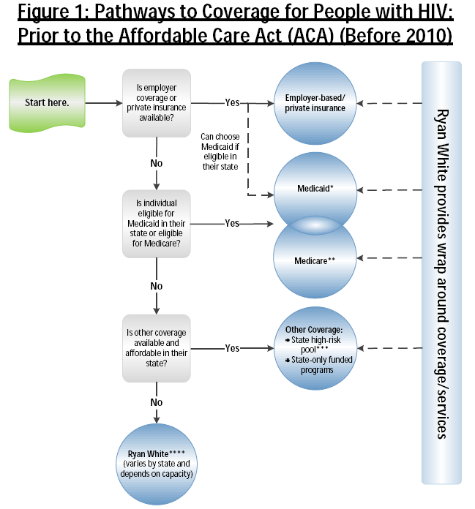
The Henry J. Kaiser Family Foundation, (2012). How the ACA changes pathways to insurance coverage for people with HIV. Retrieved from website: http://healthreform.kff.org/notes-on-health-insurance-and-reform/2012/september/how-the-aca-changes-pathways-to-insurance-coverage-for-people-with-hiv.aspx?CFID=567585223&CFTOKEN=74185225&jsessionid=6030aa207ae092ba6d8019601b655963616b

Slide 34
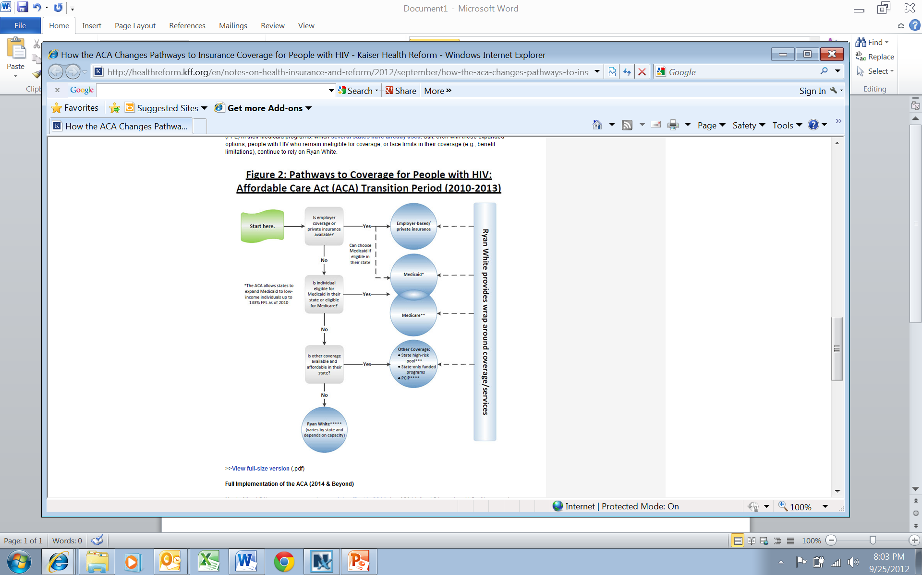
The Henry J. Kaiser Family Foundation, (2012). How the ACA changes pathways to insurance coverage for people with HIV. Retrieved from website: http://healthreform.kff.org/notes-on-health-insurance-and-reform/2012/september/how-the-aca-changes-pathways-to-insurance-coverage-for-people-with-hiv.aspx?CFID=567585223&CFTOKEN=74185225&jsessionid=6030aa207ae092ba6d8019601b655963616b

Slide 35
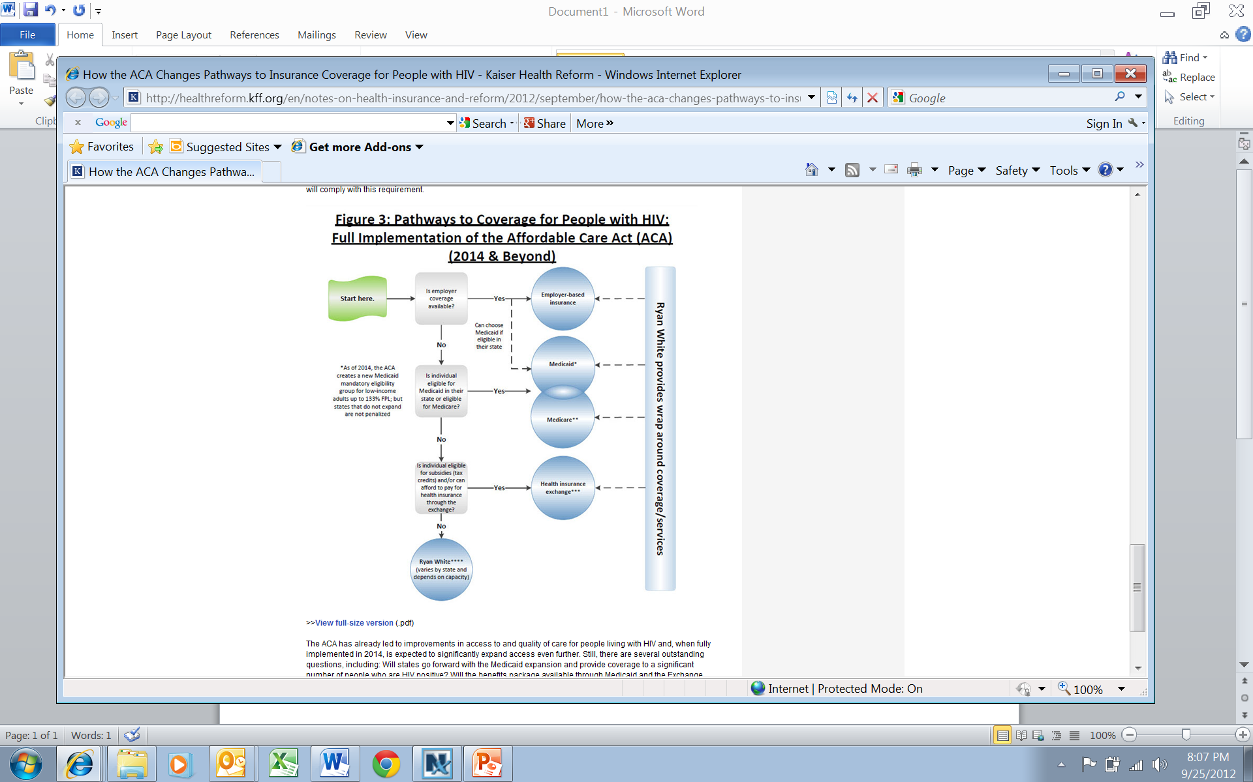
The Henry J. Kaiser Family Foundation, (2012). How the ACA changes pathways to insurance coverage for people with HIV. Retrieved from website: http://healthreform.kff.org/notes-on-health-insurance-and-reform/2012/september/how-the-aca-changes-pathways-to-insurance-coverage-for-people-with-hiv.aspx?CFID=567585223&CFTOKEN=74185225&jsessionid=6030aa207ae092ba6d8019601b655963616b

Slide 36
Medicaid vs. Subsidized Exchange Coverage: Differences in Eligibility and Benefits
 | Medicaid (Adults) | Exchange
Income | ≤138% FPL | 139-250% FPL | 251-400% FPL
Premiums | None | Limited to 3.00-8.05% of Income | Limited to 8.05-9.50% of Income
Cost Sharing | Limited to nominal amounts for most services | Credits based on sliding scale | None
Source: “Determining Income for Adults Applying for Medicaid and Exchange Coverage Subsidies: How Income Measured With a Prior Tax Return Compares to Current Income at Enrollment”, Focus on Health Reform, the Kaiser Family Foundation, March 2011.

Slide 37
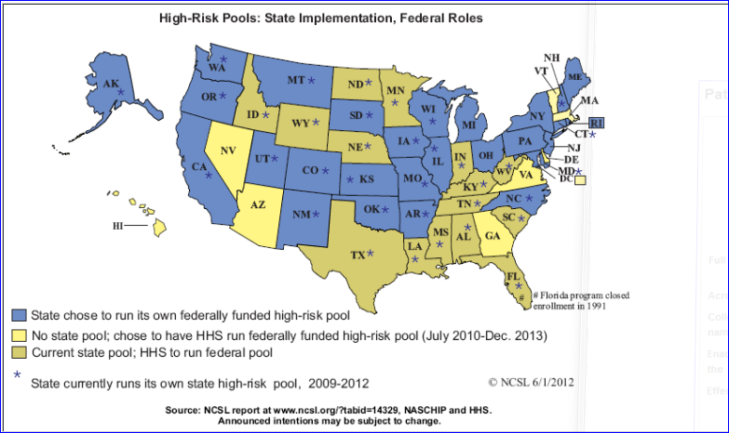
High Risk Insurance Pools
http://www.ncsl.org/issues-research/health/high-risk-pools-for-health-coverage.aspx

Slide 38
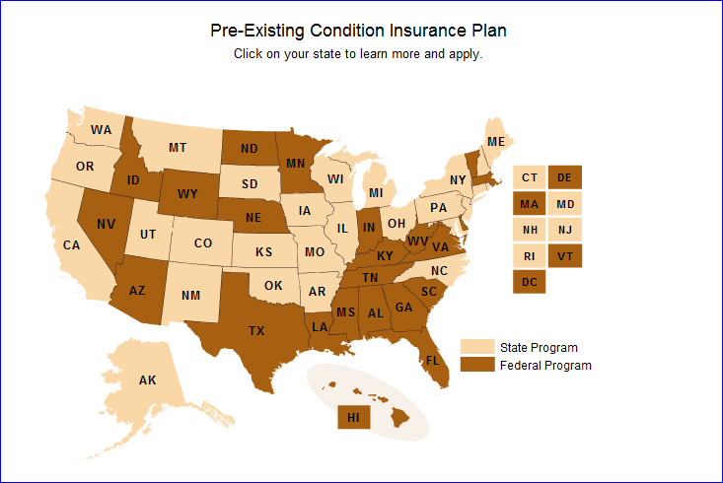
Pre-Existing Condition Insurance Plans
http://www.healthcare.gov/law/features/choices/pre-existing-condition-insurance-plan/index.html

Slide 39
Washington State’s Starting Place (HIV/AIDS)
What % are below 138%?
Moving from this model to January 1, 2014 means what?
Who is in charge of planning the shift?
Medicare – 1,500
Insurance Continuation – 2,300
Medicaid – 3,800
Employer/Private Coverage - Unknown
Unknown
ADAP – 1,200
High Risk Pool,
Pre-existing Condition Insurance,
COBRA, Private plans

Slide 40
Four Buckets of the New Coverage Continuum
Existing Medicaid – Currently Covered
Medicaid Expansion – up to 138% FPL
Duals (Medicaid & Medicare Eligible) – Poor, sick, disabled, aging
Health Benefit Exchange – 138% - 400% FPL
Eligible for Health Home Services under Section 2703 of ACA
Notes:
People with Medicare will not be eligible for Medicaid Expansion.
(Add a bar across first 3 buckets “Section 2703 of the ACA: Health Homes”

Slide 41

Transitions for Your State
  Plan to avoid disruptions
    map how people are currently covered
    imagine how they will be covered in the future
    plan for the transition to new coverage options
  Some clients will not face the same transitions
    Medicare
    Employer-Sponsored or “Group” Insurance
    Goal is to have seamless, continuous coverage

Slide 42
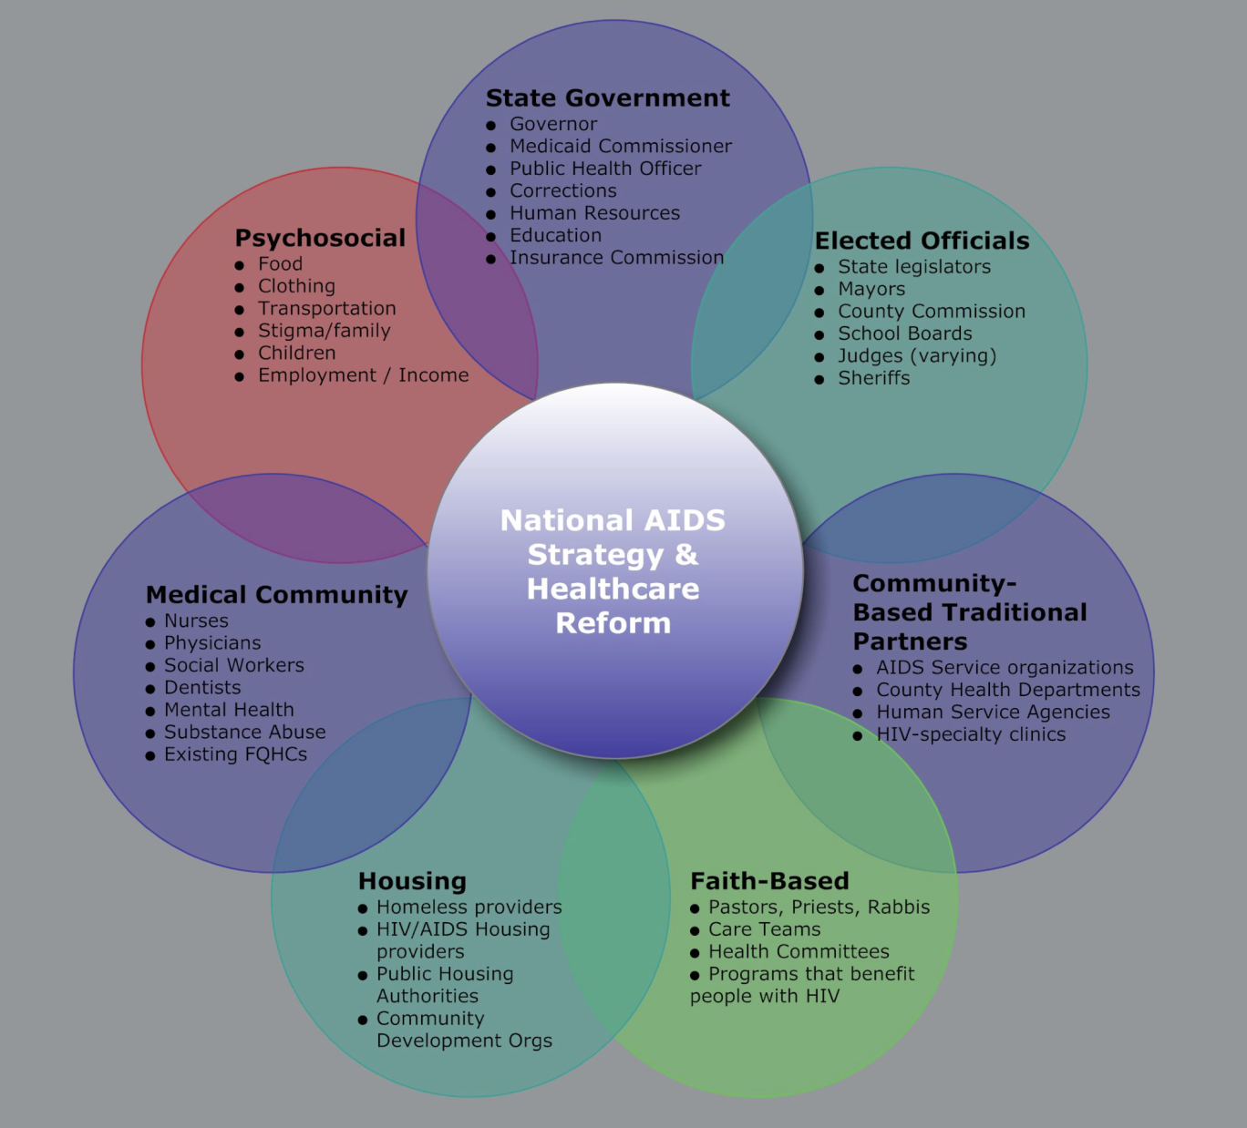
State-Level Control
Who is in charge of reform readiness and overall National HIV/AIDS Strategy at the state level?
State-level connections required for Medicaid, public health, corrections, education, housing, etc. – State AIDS Director’s do not have authority over Medicaid or other critical areas – how are partnerships going to be formed?
A new way of doing business – those states already underway with reform have not yet prioritized chronic, communicable disease.

Slide 43


Slide 44

Section III - Medicaid

Slide 45
Section III: Standard Medicaid
  Original intent
  Current federal guidance – www.medicaid.gov
  SPA – State Plan Amendment, what’s that?
  State Plan – what’s that?
  How do we find our state’s plan and/or amendments (SPA)?
  How do we find out where our state is with Standard Medicaid Pharmacy benefits, formulary status, and % share of our state’s expenses?
    www.statehealthfacts.org
    www.kff.org/hivaids/index.cfm
  How do we find the various eligibility levels of the different standard Medicaid population?
  What is FMAP and how do we find it?
    US map of FMAPs
  What is Medicaid Managed Care?

Slide 46
Medicaid Managed Care
Medicaid Managed Care provides for the delivery of Medicaid health benefits and additional services in the United Stated through an arrangement between a state Medicaid agency and Managed Care Organizations that accept a set payment – “capitation” – for these services.

Slide 47
Managed Care Organizations (MCOs)
An MCO (Managed Care Organization) health plan is a group of doctors and other health care providers who work together to provide health care for their members. The doctors and other health care providers agree to follow certain rules about how they provide services. When you enroll in an MCO, you select a primary care doctor who is part of that MCO to do your checkups, provide basic care, and make referrals. If you need to see a specialist, you see a specialist who is part of your MCO.

Slide 48


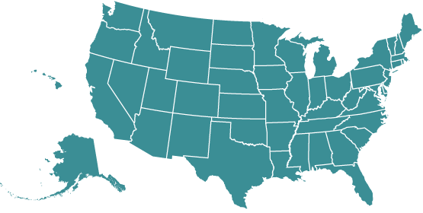
What Is Medicaid?
State-administered and funded by both federal and state governments
Means-tested entitlement program
  Means tested: strict income requirements
  Entitlement: funding and enrollment are uncapped
Largest funder of health services for the nation’s poorest residents
Medicaid
State and
federally
funded
$$$
Administered
by states
Centers for Medicare and Medicaid Services. Medicaid Overview. www.cms.gov/MedicaidGenInfo.
Notes:
Medicaid is a state-administered health insurance program funded by both the federal and state governments. It is a means-tested program, meaning that strict income eligibility limits—and in many states, asset limits as well—apply. It is also an entitlement program (as opposed to a discretionary program), which means that federal financing for Medicaid is not capped. Individuals who are eligible for coverage cannot be turned away.
Medicaid has provided an important safety net in the current economic crisis, as many people lose health insurance when they lose their jobs. In June 2009, the program covered nearly 47 million Americans.

Slide 49
Statutory Federal Medical Assistance Percentages (FMAP), FY 2012
ME
WA
VT
MT
ND
MN
NH
OR
MA
SD
WI
NY
ID
MI
RI
WY
PA
CT
NE
IA
OH
NJ
NV
IL
IN
DE
UT
CO
WV
MD
CA
KS
VA
DC
MO
KY
NC
AZ
TN
NM
OK
AR
SC
MS
AL
GA
TX
LA
AK
FL
HI
50 percent (15 states)
51 – 59 percent (11 states)
60 – 66 percent (13 states)
67 – 74 percent (12 states including DC)
NOTE: Rates are rounded to nearest percent. These rates will be in effect Oct. 1, 2011 – Sept. 30, 2012.
SOURCE: Federal Register,, Nov, 10, 2010 (Vol. 75, No. 217), pp. 69082-69083.
http://edocket.access.gpo.gov/2010/pdf/2010-28319.pdf

Slide 50
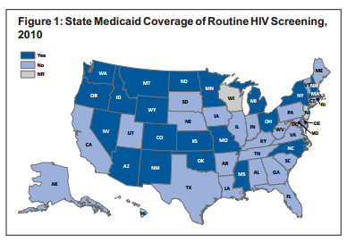
This map represents state and finds that currently, about half of states cover routine screening under their Medicaid programs. The CDC recommends routine HIV screening for all patients between the ages of 13 and 64, but routine screening is currently an optional Medicaid benefit, which states may choose to cover.
Medicaid Coverage of Routine HIV Screening
The Henry J. Kaiser Family Foundation, (2012). HIV/AIDS Policy Fact Sheet: State Medicaid Coverage of Routine HIV Screening. Retrieved from website: http://www.kff.org/hivaids/upload/8286.pdf

Slide 51





Who Pays for Medicaid?
Already eligible
Federal government and states share costs based on Federal Medical Assistance Percentage (FMAP), which varies by state
No change
No change
No change
Newly eligible
Current FMAP rates if states chose to expand
100% FMAP (fed gov’t)
Gradual reduction in FMAP to 90%*
90% (fed gov’t)*
GOVERNMENT
Present - 2013
2014 - 2016
BENEFICIARIES
2017 - 2018
2019 +
Beneficiaries in both groups have some cost sharing under Medicaid
*Under the healthcare reform law, states will be eligible for an increased FMAP rate if they provide prevention services (eg, immunizations and smoking cessation programs) with no cost sharing (free to beneficiary)
Kaiser Family Foundation. 2010. Focus on Health Reform: Medicaid and Children’s Health Insurance Program. Provisions in the New Health Reform Law.
Notes:
51
The federal government and states share costs of the Medicaid program. The Federal Medical Assistance Percentage (FMAP) is the share of a state’s Medicaid expenditures for services paid by the federal government. It varies from state to state and is determined by a formula that compares the state’s average per capita income to the national average. By law, the FMAP cannot be lower than 50% (a dollar-for-dollar match) or higher than 83%.
The healthcare reform law sets the federal matching rate at 100% for all newly eligible beneficiaries for 2014-2016. The rate is gradually reduced for this group until 2019 and thereafter, when the matching rate will be 90% for newly eligible beneficiaries. The new healthcare reform law does not change the matching rate for already eligible beneficiaries. Importantly, states that choose to expand early will be subject to the regular FMAP rate and not the rates put in place by ARRA. The healthcare reform law also provides some additional federal support to “expansion” states (those covering parents and childless adults at least up to 100 percent of the FPL on the date of enactment of the law) for the cost of covering childless adults who are already eligible for Medicaid as of December 1, 2009. States meeting these criteria can receive a phased-in increase in their federal matching rate for childless adults that by 2019 will equal the enhanced matching rate available for newly eligible adults.
Under both pre- and post-reform law, beneficiaries also carry some of the cost of Medicaid through cost sharing, premiums, and enrollment fees, though federal law limits the cost-sharing provisions states can impose. For instance, most cost sharing must be nominal, and federal law imposes caps on copayments for care. Some beneficiaries and services cannot be subject to cost sharing without a waiver, including: pregnant women, most children under 18, and hospital or nursing home patients expected to contribute most of their income to their care, emergency services, family planning services, and hospice care. Premiums are generally prohibited, except for certain groups including infants and pregnant women with income over 150% FPL, families receiving extended transitional medical assistance, certain people who are disabled and working, and individuals who qualify for Medicaid due to high out-of-pocket medical expenses.
Under the healthcare reform law, states will be eligible for an increased FMAP rate if they cover prevention services (eg, immunizations and smoking cessation programs) with no cost sharing.
51

Slide 52
Section IV – Medicaid Expansion

Slide 53
Part I: How Does Medicaid Expansion
Prevent the Transmission of HIV?
Treatment is Prevention
  Supportive services
  Clinical Trial HIV/Prevention Trials Network 052 (known as HPTN 052) demonstrated that if a person was virally suppressed to undetectable levels of HIV in the bloodstream, they are 96% less able to transmit the disease to their partner. That news means clearly treatment is prevention. So “getting to zero” or “no new infections” are part of the plan. So tracking throughout the presentation how the elements of prevention (see below) can also be highlighted.
Outcomes of Expanding Medicaid to Prevent HIV

Slide 54
Overview of the Supreme Court Decision
A divided Supreme Court ruled that:
The Affordable Care Act (ACA) requirement for individuals to have insurance or pay a tax penalty is constitutional.
States can choose not to expand Medicaid to cover all state residents under 133% FPL, without risking federal funding for their entire Medicaid program.
“The Affordable Care Act’s requirement that certain individuals pay a financial penalty for not obtaining health insurance may reasonably be characterized as a tax. Because the Constitution permits such a tax, it is not our role to forbid it, or to pass upon its wisdom or fairness.”
– Chief Justice Roberts in Majority Opinion
“In this case, the financial ‘inducement’ Congress has chosen is much more than ‘relatively mild encouragement’—it is a gun to the head.”
– Chief Justice Roberts in Majority Opinion

Slide 55
The Decision’s Implications for Medicaid
States May Opt Out of Medicaid Expansion
Simplification and Streamlining Children’s Expansion Maintenance of Effort Drug Rebates in Medicaid Managed Care DSH Payment Reductions Delivery System Reform
The Balance of ACA Medicaid Provisions Stand

Slide 56
Medicaid Modernization*: Making Coverage Accessible
New Income Counting Rules
Change from a complicated net income test to modified adjusted gross income (MAGI)
Alignment across all subsidy programs: Medicaid, CHIP and premium tax credits/cost sharing reductions
One Health Insurance Application Process
Simple process for everyone, regardless of individuals’ income or whether they are eligible for Medicaid, CHIP, or premium tax credits/cost sharing reductions
Simplified and Web-Based Enrollment Pathway
Eliminates paper-driven process
Verification of applicants’ attestation of eligibility using electronic data sources
Real or near real time eligibility decisions
Administrative Renewal to Keep Individuals Covered and Reduce Churning
Exchange/Medicaid agency verifies eligibility up-front and sends notice
Coverage is automatically renewed for another 12 months if all information is correct
*Required regardless of expansion decision

Slide 57
New Adults Receive Medicaid Benchmark
The Medicaid Benchmark must:
  Cover all 10 essential health benefits (EHBs)
  Meet mental health parity
  Cover non-emergency medical transportation
  Cover Early Periodic Screening, Diagnosis and Treatment (EPSDT)
The Medicaid Benchmark may:
  Align with existing Medicaid benefit package
  Differ for different eligibility groups
  Be different for: (1) healthy adults, and (2) medically frail adults

Slide 58
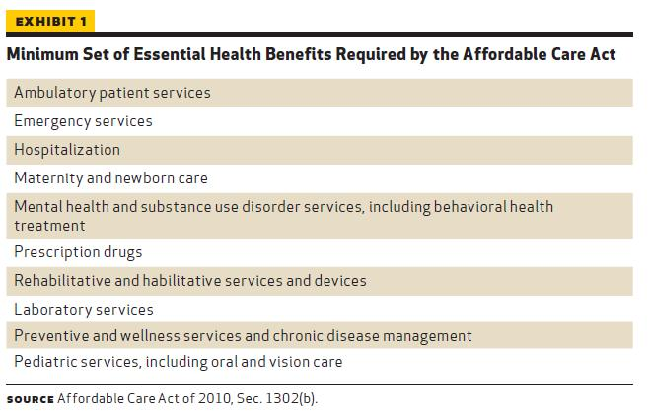
10 Categorical Essential Health Benefits
“Health Policy Brief: Essential Health Benefits," Health Affairs, April 25, 2012.
http://www.healthaffairs.org/healthpolicybriefs/

Slide 59
Fiscal Implications of Expanding Medicaid
The cost of covering newly eligible adults with the benchmark package of benefits, considering:
  Number of newly eligible who enroll -- no means-tested program ever achieves 100% take-up
  Per member per year costs of newly eligible -- newly eligible persons tend to be lower-risk
  Fully federally funded from 2014-2016, with federal funding decreasing to 90% of costs in 2020 and remains at 90% thereafter
The potential State savings from current Medicaid and state/locally-funded services, and additional State revenues, including:
  Current Medicaid populations move to new adult group with enhanced federal match
  Costs of State-funded programs for the uninsured (e.g. mental health/substance abuse programs) will go down as population gains Medicaid coverage
  State revenue increases from provider/insurer assessments & general business taxes on new Medicaid revenue
Notes:
** Language for #1
Newly eligible adults – or – adults in new expansion group??

Slide 60
Fiscal Implications of Expanding Medicaid
The broader economic value of additional health care dollars to the health care system and the State economy, including:
  Reduced number of uninsured (increased access to care, fewer medical bankruptcies)
  Increased revenue for providers
  Increased employment in the health care sector
Notes:
** Language for #1
Newly eligible adults – or – adults in new expansion group??

Slide 61
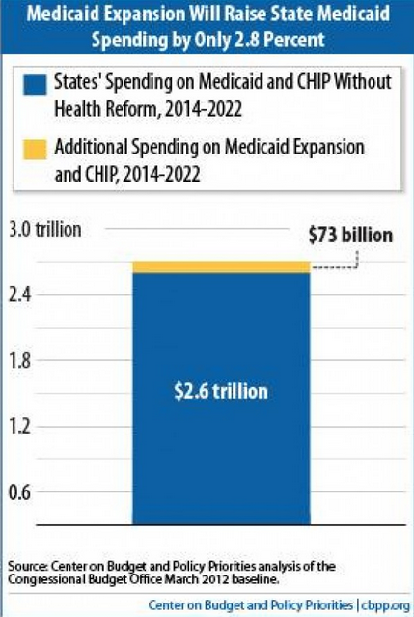

Slide 62





Costs of Not Expanding Medicaid
Consumers
Providers
Individuals whose incomes are too high for Medicaid but too low for Premium Tax Credits (less than 100% of the FPL) will have no coverage options and no tax subsidies for purchasing health insurance
Hospitals will face not only the continued costs of providing uncompensated care, but also a reduction in federal disproportionate share hospital (DSH) funding
Employers
Exchange
Employers will face new coverage obligations for individuals with incomes between 100% and 138% of the FPL; additionally, large employers will face a penalty if full-time employees in this income bracket obtain a premium tax credit through the Exchange
Interfacing between State Medicaid programs and the Exchange will become very complex administratively, with many “hand-offs” and eligibility determinations conducted against a patchwork of existing state Medicaid categories with variable income levels

Slide 63
Section IV: Medicaid Expansion (cont.)
  Section 2703 – Health Homes – why they fit?
    Basic outline
    90/10 Federal match
    How it fits in the Standard Medicaid and Medicaid Expansion buckets
      Dual Eligibles
    What Options are there?
      States can design their own programs (NY, CA, WA programs)

Slide 64
Four Buckets of the New Coverage Continuum
Existing Medicaid – Currently Covered
Medicaid Expansion – up to 138% FPL
Duals (Medicaid & Medicare Eligible) – Poor, sick, disabled, aging
Health Benefit Exchange – 138% - 400% FPL
Eligible for Health Home Services under Section 2703 of ACA
Notes:
People with Medicare will not be eligible for Medicaid Expansion.
(Add a bar across first 3 buckets “Section 2703 of the ACA: Health Homes”

Slide 65

Part I: Four Buckets - WA State
Existing Medicaid
1.2M lives
“Woodwork” effect
Patchwork of eligibility
Medicaid Expansion
500K to become eligible
250K/500K anticipated to enroll
Health Benefits Exchange
Officially formed 3/2012
Board appointed and exchange formation underway
Duals
Medicare & Medicaid eligible
115K
CMMI demonstration state
Notes:
People with Medicare will not be eligible for Medicaid Expansion.
(Add a bar across first 3 buckets “Section 2703 of the ACA: Health Homes”

Slide 66
Post Implementation of the Affordable Care Act (ACA):
Subsidized Coverage Landscape in Washington
1.16 million
current enrollees
545,000
currently eligible but not enrolled**
494,000
newly eligible
532,000
eligible for subsidies
Individuals (in thousands)
344
2012
2014
Note: Analysis forecast assumes full take up rate and the ACA was in effect in 2011. **Includes individuals who have access to other coverage (e.g., employer sponsored insurance). Sources: The ACA Medicaid Expansion in Washington, Health Policy Center, Urban Institute (May 2012); The ACA Basic Health Program in Washington State, Health Policy Center, Urban Institute (May 2012) ; Milliman Market Analysis; ‘and Washington Health Care Authority for Medicaid/CHIP enrollment.

Slide 68
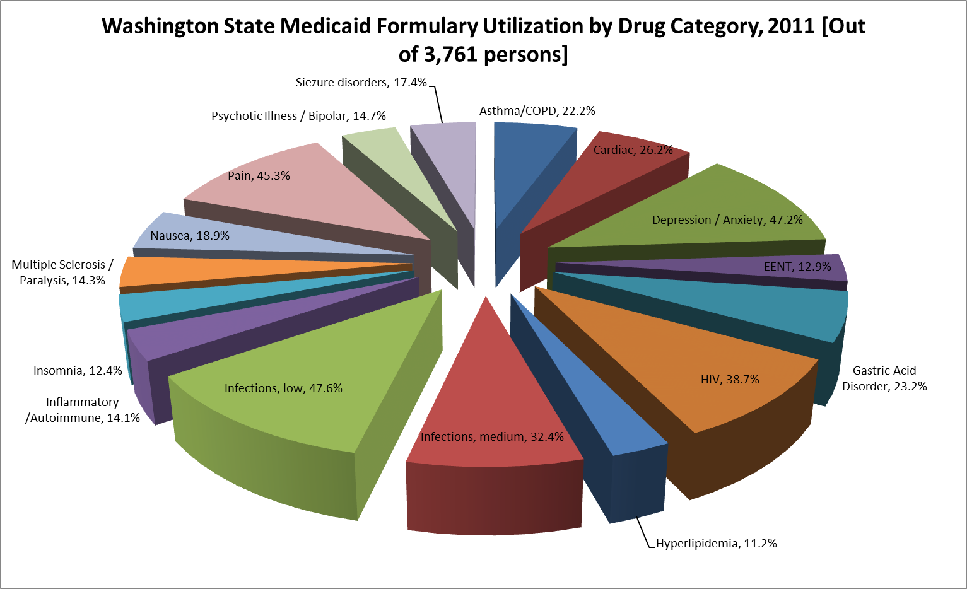

Slide 69
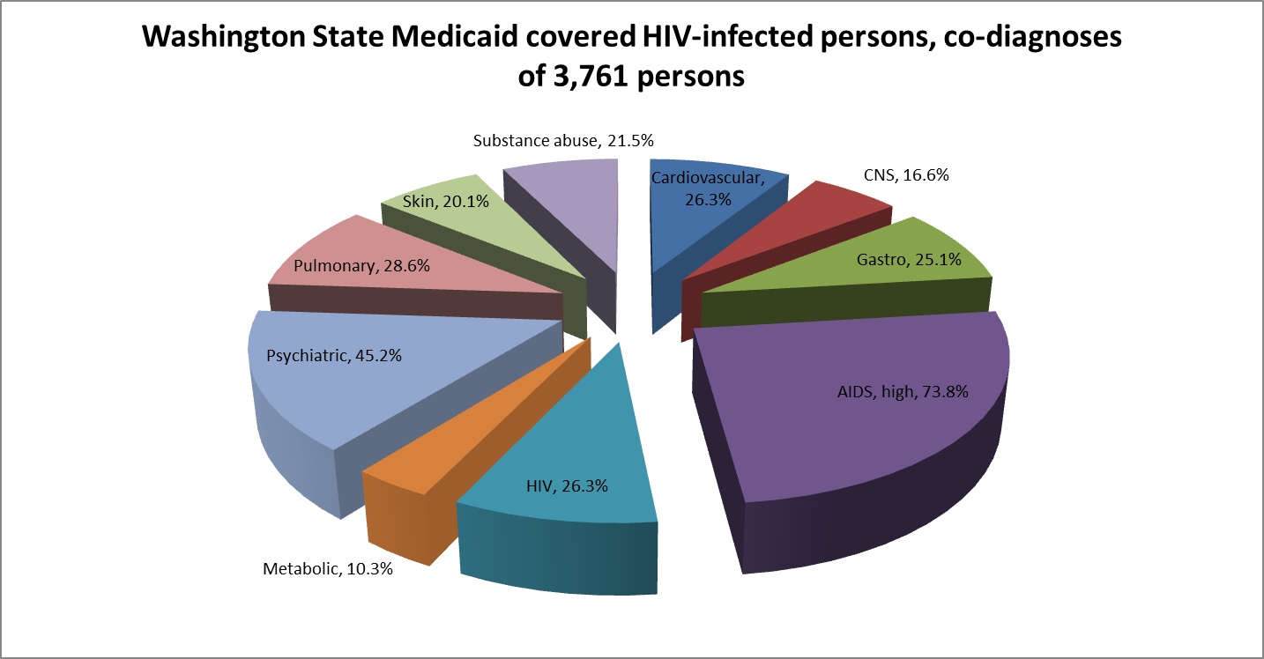

Slide 70
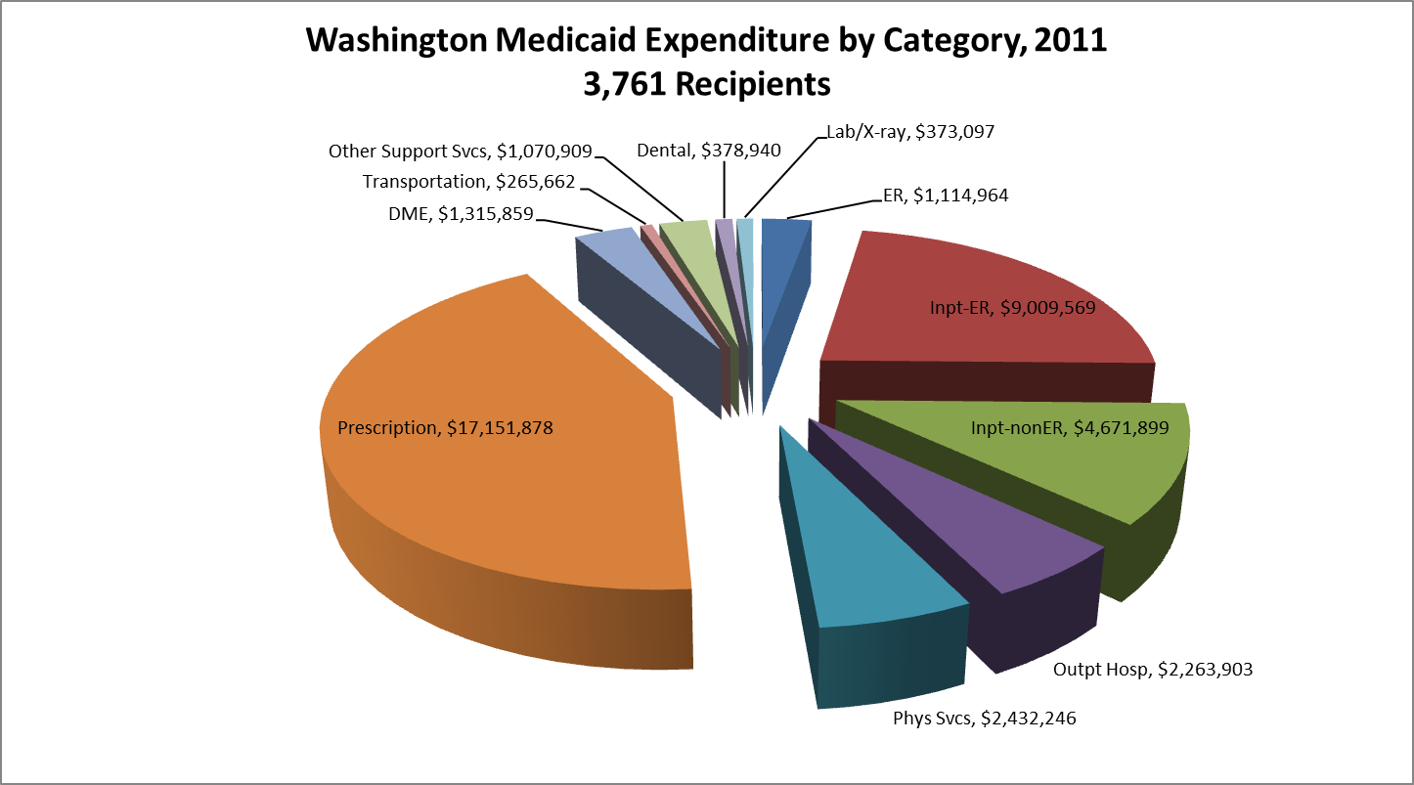

Slide 71
Section V – Health Homes

Slide 72
Health Homes: What is a Health Home?
“The goal in building ‘health homes’ will be to expand the traditional medical home models to build linkages to other community and social supports, and to enhance coordination of medical and behavioral health care, in keeping with the needs of persons with multiple chronic illnesses.”
- CMS Medicaid Director Letter

Slide 73
Health Homes Definition
Network of organizations that provide health home services
Each network has an identified “lead entity” that is responsible for administrative functions
Bridges all service domains including medical, mental health, chemical dependency and long term services and supports
May include health plans, community based organizations, clinics, etc.

Slide 74
Health Homes Under MCO Contracts
Language requiring care coordination and care management services
Definitions for health home, care management and care coordination
Provide or contract with health homes
Plans looking to state for guidance on health homes
Notes:
Coordination of care federal contract language that “assures the enrollee and providers have access to and take into consideration, all required information on the enrollee’s conditions and treatments to ensure that the enrollee receives appropriate health care services” (42 CFR 438.208)
Health home defined:
Development and use of interdisciplinary team
Full breadth of clinical and social service expertise
Includes providers from local communities that authorize services, mental health, long-term services and supports, CD and medical services

Slide 75
Service Needs Overlap for High Risk/High Cost Beneficiaries
Eligible for Medicare & Medicaid
95% served by ADSA
Notes:
This venn diagram shows that the needs and services for individuals who are dually eligible for both Medicare and Medicaid and meet high cost/high risk medical indicators have a significant overlap with services provided through the department of social and health services. Approximately 40% of this population meets the high cost/high risk medical criteria.
The yellow circle represents long term services and supports (80%)
The green represents services under the division of developmental disabilities (less than 10%)
The orange are individuals who have an indicator of a serious mental illness (30%)
The purple are individuals who have an indicator of chemical or substance abuse (less than 10%)

Slide 76
Service Needs for High Risk/High Cost Medicaid-Only Beneficiaries Overlap
29% served by ADSA
AOD only
SMI only
LTC only
DD only
Notes:
This is a similar venn diagram for individuals who receive services only from Medicaid. A smaller proportion of this population (20%) meets the high cost/high risk criteria and just about 70% only receive medical services through the state, not other social services. But for 30% of the population they do have overlapping needs and services.

Slide 77
Eligibility Calculation for Health Homes
Definition of “chronic condition”
  Utilization
  Disability
  Disease states

Slide 78
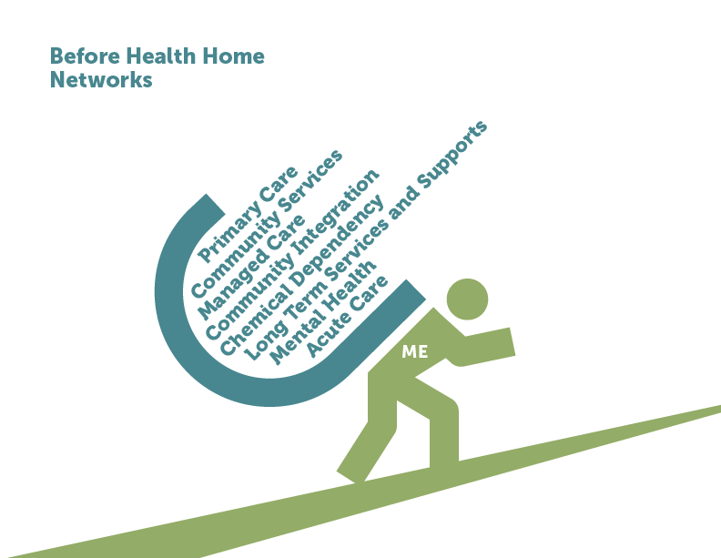
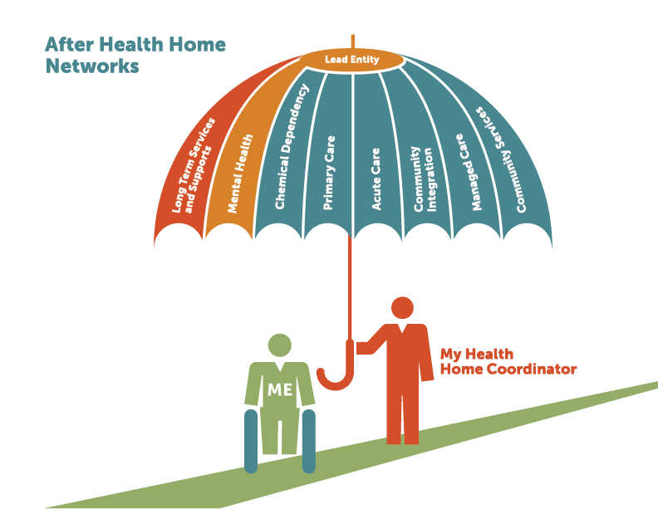
Washington State Health Home Model

Slide 79
Section VI – Health Benefit Exchange

Slide 80
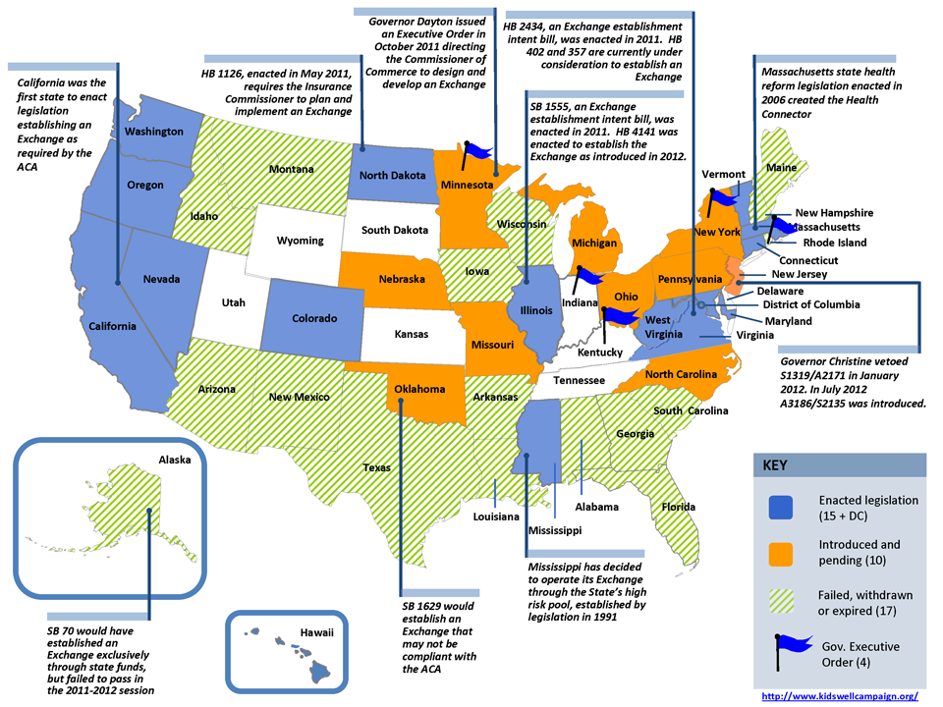
Washington is a Leader State: Establishing Exchange

Slide 81
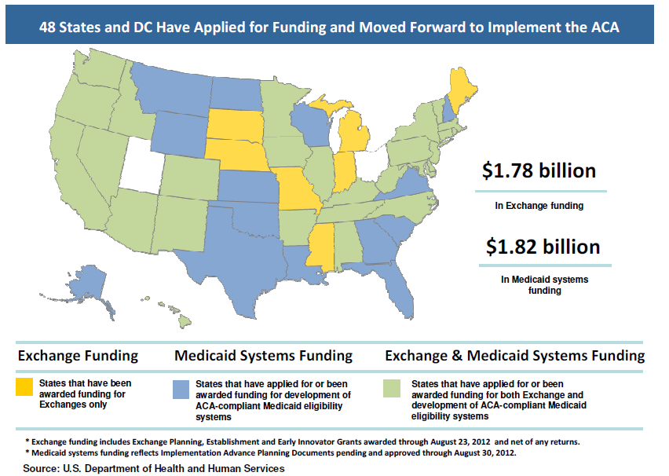
Washington is a Leading State in the Process of Securing
$178M for Exchange Establishment & Medicaid Eligibility Systems

Slide 82



Building the Exchange
2013
2012
  Exchange must be certified by HHS
    Additional legislative action taken as needed
      Open Enrollment begins (October 1)
  Board begins governing authority
  ESSHB 2319 passed
    Deloitte Consulting, LLP, signs on as system integrator
      Exchange names first CEO and moves into new building
        Washington becomes second Level 2 establishment grant recipient, $128 million
    Exchange moves onto own payroll and accounting systems
    WA HBE applies for certification to operate state based exchange with HHS/CCIIO
    Sustainability plan submitted to Legislature
2011
2014
  HCA receives one-year $22.9 million grant to design and develop Exchange
  SSB 5445 passed creating Exchange as “public private partnership”
  Governor names Exchange Board members
  Coverage purchased in the Exchange begins
    Open enrollment ends (February)
Notes:
82

Slide 83
Opportunities in Your State
Identify the key players in your city, county, and state
Consider planning a meeting for community advocates, providers, and consumers that brings all players together
Seek out state and local agencies to begin collaborative work
Identify opportunities to work collaboratively with these agencies to participate in workgroups, committees, planning councils, and focus groups
  Leverage the benefits of acting as an “information hub” and collaborator

Slide 84

AIDS-Service Organizations May Consider Broadening of Mission
HIV care and support services can continue to be a core competency but mission expansion to include other chronic conditions better positions an organization to secure care coordination and navigation contracts for consumers outside of the traditional scope of ASOs.

Slide 86
Section VII – CASE STUDIES

Slide 87
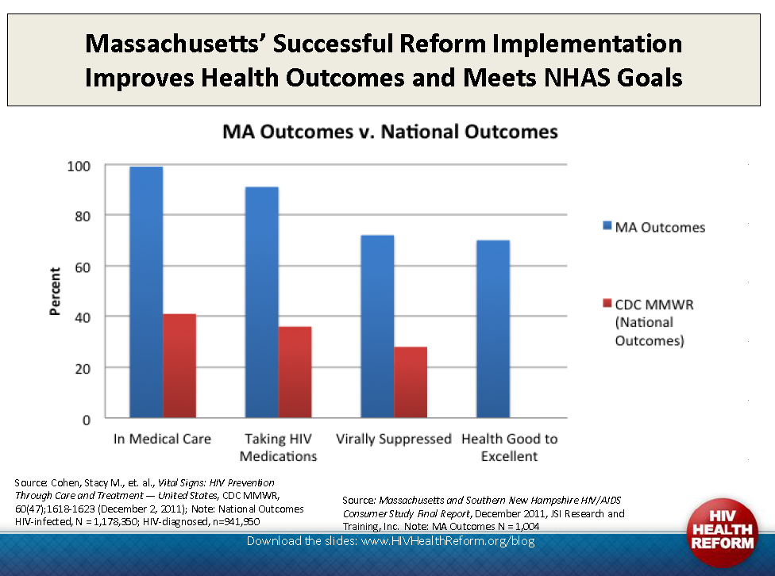
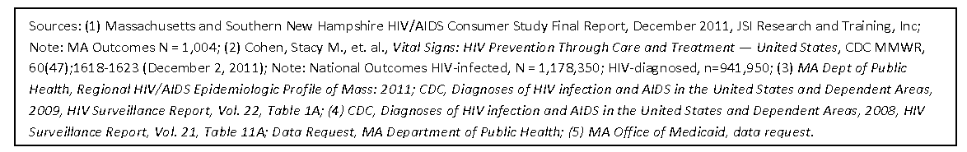

Slide 88
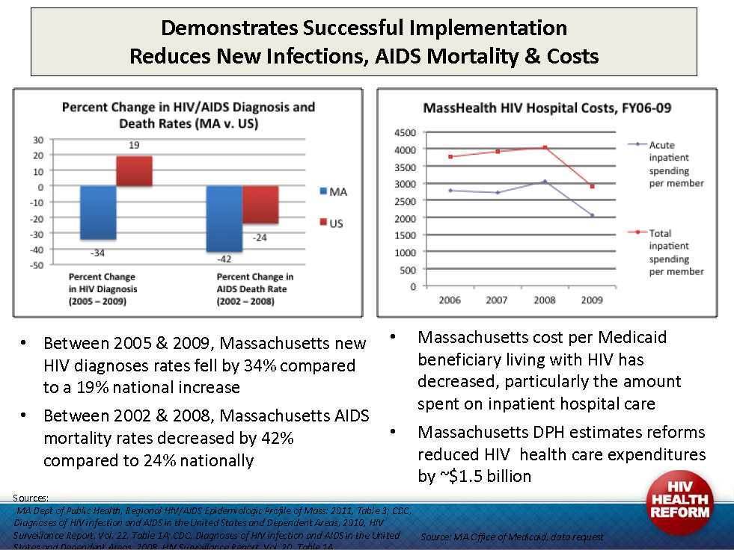

Slide 89

Case Study: Sylvia (hypothetical)
PROFILE
Age 41 Single, no children Unemployed/uninsured HIV+ symptomatic
Pre-Reform Eligibility
Denied SSI disability claim Income– $240 per month state emergency assistance (26% FPL) Healthcare through Ryan White Program public health clinic and ADAP
Post-Reform Eligibility
Eligible for Medicaid Eligibility based on income alone – 133% FPL Will still need Ryan White Program support for care and support services not covered under Medicaid
Notes:
89
Sylvia is a 41-year-old single woman with no children. Sylvia, who is unemployed and uninsured, was denied when she applied for SSI disability, because she is HIV symptomatic, but does not qualify as disabled. She currently receives healthcare from a Ryan White public health clinic and ADAP.
After healthcare reform implementation, Sylvia would automatically be eligible for Medicaid, since her income is less than 133% of the federal poverty level, and there will no longer be a requirement to be disabled before receiving benefits. She will still need help from the Ryan White program, though, since Medicaid will not cover all of the care and support services she needs.

Slide 90
Case Study: Sylvia (hypothetical)
WA State
PROFILE
Age 41 Single, no children Unemployed/uninsured HIV+ symptomatic
Pre-Reform Eligibility
Denied SSI disability claim Income– $240 per month state emergency assistance (26% FPL) Healthcare through Washington State High-Risk Pool (ADAP)
Post-Reform Eligibility
Eligible for Medicaid Eligibility based on income alone – 133% FPL Will still need Ryan White Program support for care and support services not covered under Medicaid
90
Notes:
90
Sylvia is a 41-year-old single woman with no children. Sylvia, who is unemployed and uninsured, was denied when she applied for SSI disability, because she is HIV symptomatic, but does not qualify as disabled. She currently receives healthcare from a Ryan White public health clinic and ADAP.
After healthcare reform implementation, Sylvia would automatically be eligible for Medicaid, since her income is less than 133% of the federal poverty level, and there will no longer be a requirement to be disabled before receiving benefits. She will still need help from the Ryan White program, though, since Medicaid will not cover all of the care and support services she needs.
90

Slide 91

Case Study: Glen (hypothetical)
PROFILE
Age: 29 Nondisabled Seasonally employed HIV+
Pre-Reform Eligibility
Earning approximately $12,000/year (107% FPL) Uninsured Untreated panic attacks and depression
Post-Reform Eligibility
Eligible for Medicaid starting in 2014 As newly eligible beneficiary, will receive benchmark benefit package, which must include mental health services
Notes:
91
Glen is 29 and nondisabled. His income is less than 133% of FPL. As a nondisabled, childless adult, he is not eligible under current Medicaid law, but will be eligible under the healthcare reform law starting in 2014 or earlier if his state chooses early expansion. As a newly eligible beneficiary, Glen will receive the benchmark benefit package, the details of which have not yet been finalized, but which will include mental health benefits. Coverage for Glen will be paid for entirely by the federal government for 2014-2016.

Slide 92

Case Study: Marie and Sam (hypothetical)
PROFILE
Ages: Marie 51 and Sam (son) 12 Undocumented immigration status Marie is AIDS-Disabled
Pre-Reform Eligibility
Uninsured Employed part-time, $1250/month (99% FPL) Undocumented immigration status means ineligible for Medicaid/CHIP Healthcare through Ryan White Program public health clinic and ADAP
Post-Reform Eligibility
Ineligible for Medicaid/CHIP Ineligible for private insurance coverage subsidies and protections Will still need Ryan White Program support for care and support services New Federal reimbursement under Alien Emergency Medical (AEM)
Notes:
92
Marie is a 51-year-old divorced mother with a 12-year-old child named Sam. Marie and Sam are undocumented immigrants. Marie works part time, earning $15,000 dollars a year, but is uninsured. Even though she has AIDS and is demonstrably disabled, because of her immigration status, she is currently ineligible for Medicaid, and receives healthcare from a Ryan White Program public health clinic and an ADAP.
After healthcare reform is implemented, Marie and Sam will still be ineligible for Medicaid/CHIP, as well as for private insurance coverage subsidies and protections, because healthcare reform does not include provisions for undocumented immigrants. Therefore, Marie will still need to rely on the Ryan White Program for care and support services.

Slide 93

Case Study: Joe (hypothetical)
PROFILE
Age: 53 Disabled and unemployed Receiving Medicare & Medicaid (Dual) HIV+
Pre-Reform Eligibility
Income totals $690/month (74% FPL) Family history of heart disease and prostate cancer
Post-Reform Eligibility
Already eligible beneficiary (as opposed to newly eligible) Nothing changes for benefits and coverage Eligible for Health Homes
Notes:
93
Joe was eligible for Medicaid in his state at the time the healthcare reform law went into effect, but was not enrolled in the program. Outreach efforts to enroll newly eligible beneficiaries succeeded in getting Joe enrolled, but Joe will not receive the benchmark benefits package that the new law mandates for newly eligible beneficiaries. He is entitled to the benefits in place in his state at the time the healthcare reform law was enacted. His state does not currently cover diagnostic, screening, and preventative services. As an already eligible beneficiary, Joe will remain ineligible for these diagnostic services that are available to newly eligible beneficiaries. In addition, the new FMAP matching rate does not apply to Joe.

Slide 94
Post Implementation of the ACA: Remaining Uninsured
Undocumented immigrants
Individuals exempt from the mandate who choose to not be insured (e.g., because coverage not affordable)
Individuals subject to the mandate who do not enroll (and are therefore subject to the penalty)
Individuals who are eligible for Medicaid but do not enroll

Slide 96
Additional Resources:
  Treatment Access Expansion Project: taepusa.org
  Kaiser Family Foundation state health data: statehealthfacts.org
  Kaiser Family Foundation Health Reform Source: healthreform.kff.org
  Urban Institute Health Policy Center: www.urban.org/health_policy
  HRSA Resources, www.hrsa.gov
  Treatment Access Expansion Project, www.taepusa.org

Slide 97
Additional Resources (cont.):
  AIDS United, www.aidsunited.org
  Dose of Change, www.doseofchange.org
  HIV Medicine Association, www.hivma.org
  Kaiser Family Foundation, www.kff.org
  FamiliesUSA, www.familiesusa.org
  Community Catalyst, www.communitycatalyst.org
  Healthcare.gov, www.healthcare.gov

