Slide 1
Sustainable Partnering Strategies for RWHAP-funded AIDS Service Organizations (ASOs) and Community-Based Organizations (CBOs)
Notes:
Welcome to the Sustainable Partnering Strategies for RWHAP-funded AIDS Service Organizations (ASOs) and Community-Based Organizations (CBOs). My name is Kristin Potterbusch…..

Slide 2
Disclaimer
This webinar is supported by the Health Resources and Services Administration (HRSA) of the U.S. Department of Health and Human Services (HHS) under Grant U69HA30790 (National Training and Technical Assistance, total award $875,000). This information or content and conclusions are those of the author and should not be construed as the official position or policy of, nor should any endorsements be inferred by HRSA, HHS, or the U.S. Government.
Notes:
Please read slide verbatim.

Slide 3
Primary Care Development Corporation (PCDC) is a national nonprofit organization and a community development financial institution catalyzing excellence in primary care through strategic community investment, capacity building, and policy initiatives to achieve health equity.
Notes:
Please read slide

Slide 4
Sustainable Strategies for Ryan White HIV and AIDS (RWHAP) Community Organizations
PCDC’s HIV care and treatment capacity building assistance program provides free training and technical assistance to AIDS Service Organization (ASOs) and Community Based Organizations (CBOs) with the goal of revising and/or developing service models to increase engagement and retention in care of People Living with HIV (PLWH).
Notes:
Please do not read slide – speaker notes only: Through PCDC’s Sustainable Strategies for Ryan White HIV Program Community Organizations, we provide free training and technical assistance to RWHAP-funded ASOs and CBOs to increase their capacity to improve engagement and retention of PLWH in care by enhancing service models or partnering with service providers in the health care system.
This is a 3 year, HRSA-HAB funded, cooperative agreement under the Division of Policy and Data (DPD), Evaluation Analysis and Dissemination Branch. Our Program Officer is Michael Evanson.

Slide 5
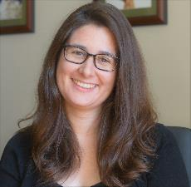
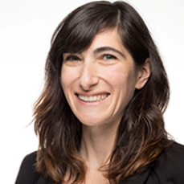
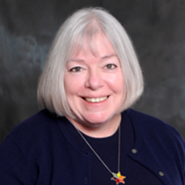
Presenters
Kristin Potterbusch
Juliet Fink Yates
Dr. Ann Robison
kpotterbusch@pcdc.org
jjfink@fight.org
arobison@montrosecenter.org
Notes:
Joining me today is Juliet Fink Yates from Philadelphia FIGHT Community Health Centers and Dr. Ann Robison from the Montrose Center.

Slide 6
Objectives
Understand foundations of partnership best practices
Analyze opportunities for organizational partnership
Evaluate risk and benefit of partnering
Advise your CBO/ASO on innovative and sustainable partnership options

Slide 7
Momentum for Sustainability
Building on improvements
Responsive to client and staff needs
Continued assessment
Sustaining funding
Partnering for success
Notes:
Reviewing how partnership is a key component of the sustainability continuum. Partnering can serve many purposes from increasing resources, to connecting with local champions. Strategic decision making and staff time goes into other aspects of organizational input, but many organizations struggle to prioritize partnering even though smart partnerships can be central to long term success

Slide 8
Building Blocks
Interorganizational Knowledge
Preparation
Value
Maintenance
Innovation
Notes:
Determining how, when, why and what to partner for can be daunting. This slide will review how to break down the aspects to consider into smaller meaningful areas. The key to all of the aspects is interorganizational knowledge, even if innovation can be the most fun, or if value outlines the areas of highest need. When thinking about decision making consider how information those at the table are about all these varying aspects. Be aware if one becomes top heavy, such as preparation or maintenance, that can indicate a cycle of barriers to success.

Slide 9
Poll
Where are you on the partnership spectrum?
Not started
Planning phase/Networking
Decision and Buy-in
Implementation/Maintaining
Other
Notes:
Could also work with a slider/timeline, These questions would then become “milestones” and folks could slide the marker to where best represents them. That would also help reduce the number of questions.

Slide 10
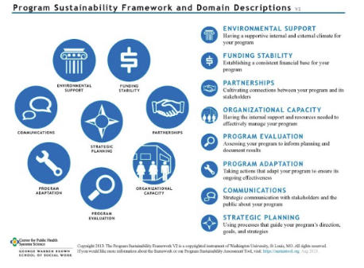
PSAT
Performance Sustainability Assessment Tool
Multiple domains of sustainability
Notes:
Review of this slide will be partially based on stages of partnership indicated in previous slide.
Tools exist to support your decision making, such the PSAT which is a free tool developed by University of Washington in St. Louis.

Slide 11
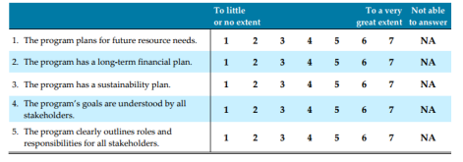
Utilization
Free access for individuals and/or groups up to 12
Anonymity for staff
https://sustaintool.org/
Notes:
PSAT was tested for reliability with more than 550 individuals and more than 250 unique programs at the state and local levels.

Slide 12
Partnership ≥ Planning
Start now
Designate planning groups
Vision and goals
Leverage data
Get specific about program costs
Identify revenue streams
Innovate
Next step -> implementation plan
Notes:
Information from a tool like the PSAT can fit into your overall process. Sometimes it is tempting to become swept away with an idea or a major funder, sometimes it can become difficult when no partners are interested in commitment. The good news is- success on both ends it often tied to the planning involved. Solid partnerships can dissolve over issues with data, and lack of funders can be addressed via a firm vision and set of goals. If you are in a discussion about partnerships consider these items as a checklist. Make sure to celebrate your and any team members contributions along the way.

Slide 13
Partnerships in Motion
Individual Sources/Grants
Service Contracts
Outcomes-Based
Referral service
Coordinated service
Joint Service
Linking to services, sharing some information
Shared clients, some shared service delivery, feedback loop
Integrated supports for clients, join staff and/or co-located, shared client information
Notes:
A key component of partnering, especially for CBOs and ASOs is figuring out what pathway the partnership could fall under. Differing types of partnering require differing levels of collaboration, for referral services you may only need an MOU whereas contracts, shared HR SOPs and more could be needed for joint services – particularly if staff are hired whose FTE’s will be split between organizations.

Slide 14
Poll
If you could pick 1 program to start or continue, that is tied to client health outcome improvement, what would it be?
Education/Outreach
Wellness/Holistic
Artistic/Experiential
Clinical/Dental/Behavioral Health
Internal Infrastructure/Staffing

Slide 15
Key Questions
Identify what you are starting/ continuing
Future scale
Future scope
Projected costs/actuals
Current resources
Barriers
Goals
Notes:
Workshop top category from previous poll- invite audience to workshop their own items, and to type specifics into chat box.

Slide 16
Innovative Options
Community, Nutrition, Stability, Health Outcomes, Safety, Hope Education, Jobs, Literacy, Adherence, Confidence, Quality of Life
Housing
Food Bank
Local Library
FQHC
Dental Clinic
Theater Company
Local Businesses
CCBHC
Notes:
Think about what you need to address, are they any of the options from the cloud? Then think of what types of concrete options can help you work towards that. It might be different partnerships then you’d originally consider. For instance- if you are helping clients with quality of life, you could invite a local theater company to host improv or other classes with clients to build a sense of community, confidence and positive associations with you- their medical home.

Slide 17
Shout out
What is the most innovative partnership you’ve thought of or learned about?
Let us know by typing it into the chat box

Slide 18
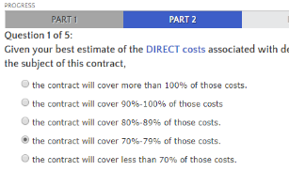
Funding Opportunity Assessment Tool
http://fmaonline.net/nonprofit-financial-management/financialresources/fundingtool/
Notes:
When decision making it can become critical to identify how and what to move forward one. Tools like this can serve multiple purposes- helping in discernment and allowing for broadening the discussion. This particular tool has a number of core areas that you can assess your organization across to better inform how (and if) to move forward.

Slide 19
Taking Action in “3’s”
Start early
Strategic
Specific
Notes:
Once you decide to partner it is critical to remember these 3 areas: You want to start early, be it with your contracting, billing, determining staffing FTE’s or structuring evaluation and data. If you chose not to start early with something be clear on why- and when you will begin that component. You’ll want to be strategic in how you approach taking action, in how you inform staff, clients and gain board buy-in as well as how you work in collaboration with your partner. Always consider how 1 good partnership can lead to more but 1 bad partnership can lead to none. And, don’t be afraid to be specific about what your goals will be. You might want to change everything overnight, but instead consider what are key outcomes you want to hone in on, changing everything can mean doing everything at once- and rarely is their capacity for that. Always consider the role a client advisory board can play in what your specific goals are- and remember to be SMART about any goals you develop.

Slide 20
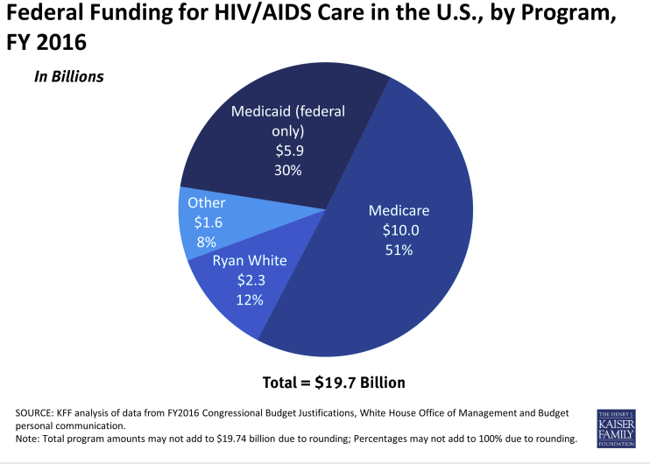
Sample caption
Notes:
Much of funding for ASO’s and CBO’s comes from Federal funding. The 8% represents items such as state specific funds and partnerships. While Federal funding is critical to programing, if you think of this in terms of your operation budget, you only have 8% ( or less) to fund activities that Federal funding may not reimburse for. This is a way to help staff establish a perspective on the value of bringing non earmarked funding in.

Slide 21
Partnership and Billing
Maximizing opportunities
Support clients with navigation of benefits
Assess current services
What is billable? Could something become billable?
Track everything
Notes:
Items to keep in mind- especially if partnering with FQ’s, BH, or PC organizations

Slide 22
Keeping the Focus
Sustaining partnership
Organizational capacity
Programs and services
Innovation and improvement
Relationship management
Notes:
Once you’ve selected a partner, sustaining that relationship can be complex. Maintaining requires a multi faceted approach whilst remaining oriented around how to move items forward.

Slide 23
Risk
Disclosures
Lacking client and staff buy in
No shared records management processes
Lack of non compete
Lacking evaluation
No definition of success
Notes:
When entering into a partnership there are a few major considerations, many organizations have a legal expert as part of their board, or in the community who is willing to offer legal guidance as part of a donation in kind. If you do have a contracting team or legal expert on staff be certain to loop them in.
It is also critical to have shared understandings of what successful outcomes will be or what type of evaluation information will be collected and how it will be shared. Be willing to have a spectrum of success, or to have key time markers.

Slide 24
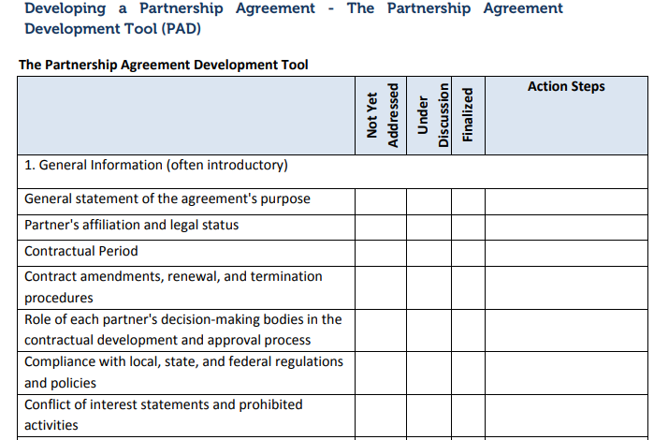
Safety First
Developing a Partnership Agreement - The Partnership Agreement Development Tool (PAD)
Notes:
https://www.hhs.gov/ash/oah/sites/default/files/1-4_developing_a_partnership_agreement-the_partnership_agreement_development_tool_0.pdf
On the topic of risk, there are resources you can utilize. The PAD is an example from HHS that you can download and use as a guide.

Slide 25
Considerations
Decision making
Community rapport
Staff buy-in
Board health
Organizational brand
Partnership plan
Your ASO/CBO brings value
Notes:
As you determine your risks, your impacts, and more, do keep in mind the items listed on the slide. Ensuring alignment and being realistic about these items upfront might seem basic, but can truly make a different.

Slide 26
Cultivating Partnerships:
practical tips in cultivating and maintaining partnerships to support your work

Slide 27
There are Many Kinds of Partnerships
Referrals/ Letters of Support
Volunteers
In Kind Donations
Joint Programs
Committees/ Coalitions
Events
Grant Partnerships
Notes:
Think about it as a spectrum

Slide 28
Developing Partnerships is Really About
COMMUNITY ORGANIZING!
(And community organizing is about building relationships)
Notes:
At Philly fight community organizing is a major part of how we approach the foundation of our partner relationships. It’s something you should consider as well.

Slide 29
Referrals/Letters of Support
These are typically built through regular interaction that staff is doing every day as part of their job.
Referrals can become your best source of Letters for Support for grants
Some of ours include:
Housing
Food
IDs
Mental health services
Youth HIV care
The Technology Learning Collaborative is a group that we help found of people working in digital literacy. We often get support letters from this group whenever we write grants for our digital literacy program.
For years, we had an adolescent program but never had an adolescent clinic. So we referred young people to CHOP. Every year, we updated an MOU with CHOP and frequently asked them for a LOS.

Slide 30
Volunteers and In Kind Donations
Both of these types of partnerships can bring a lot to the work.
But it can require a lot of staff time and effort to coordinate and not just on a Volunteer Coordinator.
Setting good expectations and having the right projects is key to successful partnerships with large volunteer groups
We recently partnered with Jefferson University’s College of Population Health. The students have taken on a number of tasks, from developing workshops in our Learning Center to answering prisoner letters. However, the training required and the workload on the staff has been immense.
We also recently partnered with Starbucks to provide free coffee in our Learning Center. This has been an amazing in kind donation.

Slide 31
Joint Programming
This can be a great way to bring in programs or meet your own grant deliverables.
However, without dedicated funding, these types of partnerships may be short-term or limited.
Some examples of how we have leveraged our relationships with outside groups includes:
Health and wellness workshops in our Learning Center
Expert speakers for our CHTA webinars
Guest speakers in our Project TEACH classes
We have also leveraged partnerships to meet our grant goals
Mobile computer labs
HIV community presentations at shelters and recovery houses

Slide 32
Committees/Collaboratives/Coalitions
This is one of the best sources of developing partnerships.
Most of the relationship building happens here.
People come together to address a larger problem or issue.
Some of the committees we formed or sat on include:
AEM Planning Committees
HepCAP
Prison Reentry Network
Youth Prevention Committees
Adult Literacy Alliance
The Digital Literacy Alliance
Faith Leaders Network
HIV planning committees
Every January, we invited hundreds of people to a breakfast and asked them to join an AIDS Education Month Committee.
These committees helped plan our major events, helped market our events, often contributed financially to them, and then attended our events.
To this day, this network forms the backbone of the work we do at FIGHT. We have over 100 partners that we work with and a list of 400+ people we reach out to join our committees.

Slide 33
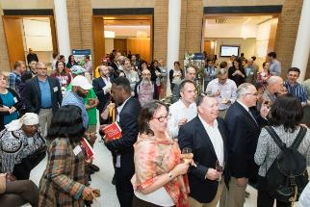
Events
Most of our events are collaborations.
We form an event committee and then do the work with the guidance and support of that committee.
HIV Prevention and Education Summit
Hip Hop for Philly
Anal Health Symposium
Reunion Project
Prison Reentry and Healthcare Summit
Lax Lecture
Community College Event
Kiki Ball

Slide 34
Partnerships Need to be Cultivated
For example, our AIDS Education Month Events require a lot of work to maintain our partnerships
Our Prevention Summit started with 600 attendees. We now have over 1300 every year.
Our partners get to promote their services, network, and showcase their great work
But we manage the work and we manage the process carefully so that partners don’t get too much on their plates.
We have had a steady group of over 20 attendees at every committee meeting for over 13 years.
These partners have become some of key collaborators in other ways.

Slide 35
Partnerships Need to be Cultivated
SAMPLE SCRIPT
IF THEY HAVE NOT YET CONFIRMED (this is everyone on the list during the first week of calls)
“Hello, how are you? My name is ___ and I’m calling from Philadelphia FIGHT, a comprehensive health care organization, focusing on HIV. We’re beginning to plan for this year’s AIDS Education Month in June and we are calling to invite you to come share your ideas and suggestions at our big kick-off planning meeting. The meeting will be on Wednesday, January 25th from 10:00am until noon at the Pennsylvania Convention Center (13th & Arch Streets on the northeast corner) in Room 113. We’ll provide a hot breakfast. We’d love to have you there! Can we count on you to come?
IF THEY CAN ATTEND
“Great! We’d like to update your contact information. Would you mind giving me your:
email address,
mailing address
best phone number and extension
Identify all the orgs/people who you want at the table.
Create a spreadsheet of orgs and people at those orgs that we know with email addresses and phone numbers
Create a script and call everyone on that list and invite them to the 1st Planning Meeting.
Create a listserv/googlegroup/mailchimp and add the names of everyone who wants to attend and/or can’t but wants to be part of it.
Call everyone 3 times over three weeks. (use volunteers and interns!)
Have Directors make cold calls to orgs that you don’t have a strong connection with.
Email at least 3 times as well

Slide 36
Partnerships Need to be Cultivated
At the 1st Planning Meeting and afterwards
At the first meeting, have food and snacks.
Set up the focus of the meeting. Come with an agenda.
Let folks ask questions and have them generate some ideas.
Create sub-committees if necessary
Hold meetings regularly with set dates/hours ahead of time (every other week or monthly)
Reminder calls and email regularly!!
Have the Committee members have key roles at the event (be on a workshop, be a speaker, etc…)

Slide 37
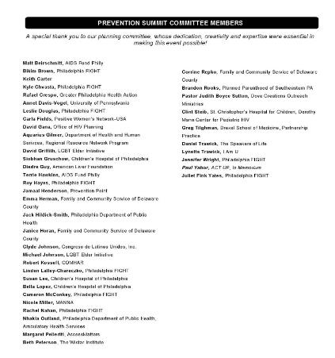
Partnerships Need to be Cultivated
Follow Up
Thank committee members with personal notes
Put them in the event program
Every year update the spreadsheet and do the entire process again.
Staff change, managers change. It is important to keep the list of people up-to-date.

Slide 38
Grant Partnerships: Multi-Year Example: CHOP and FIGHT partnership
We submitted a HRSA RWHAP SPNS application with CHOP 4 years ago for a youth social media demonstration project
CHOP had an app for HIV+ youth that they had developed called Treat Your Self.
FIGHT had a digital literacy workshop called APPlify Your Health and we wanted to find a way to support our digital literacy programs
CHOP had high overhead, so they approached us to be the lead agency on the grant.
This funding enabled us to support staff for this project and for other work we were doing.
It enabled CHOP to finish developing their app and do research on it – helping to support the faculty there.

Slide 39
Lessons Learned
Some challenges:
We developed a contract for both CHOP and our App developer at Drexel. The contracting piece was difficult.
The way that CHOP ended up creating the protocol didn’t allow us to do as much of the digital literacy piece as we had initially intended and the study recruitment took over our staff time in ways that we did not anticipate.
My team didn’t have a research background so there was a lot of confusion initially as we tried to figure out the roles.
What worked:
Everyone was extremely communicative
We held monthly meetings to check in with each other overall and weekly app development meetings
We had strong relationships going into the project so we had a lot of trust right off the bat.
Notes:
Over all, there will always be items that are challenges to overcome and items that will be successful. The good news is logistic barriers like contracting, protocols and staffing can be overcome via strong team work, building rapports and good communication.

Slide 40
Major Project Partners: Prevention Point and Philadelphia FIGHT
Both orgs have shared values.
Philadelphia FIGHT had a long and strong relationship with ACT UP Philly
Prevention Point was started from ACT UP agitating for syringe exchange.
Committee and Coalition Partner:
Prevention Point was a longtime AEM partner. They presented every year, they were on our committee.
Joint Programming:
In 2011, FIGHT got a small amount of money from the Health Department to do Latino TEACH and we chose PPP as our partner to run the program at their location.
Grant Partnerships:
We started Clinica Bienstar, an HIV clinic at Prevention Point with a SPNS grant
We got a CDC grant to do testing and linkage and with Prevention Point
Ongoing Partnerships:
We have a robust Hep C elimination partnership with Prevention Point
We are working with them to support Safe House, possibly the first ever safe injection site in the country.

Slide 41
Lessons Learned
Some Challenges
Communication has been a major challenge.
A lack of integrated systems
Staff with varying competing priorities and workplace cultures
What works
The Executive Directors of both organizations have a strong relationship
A project coordinator that is really devoted to making the joint initiatives work. This needs to be a strong, relational person who is highly organized.
A commitment to the work

Slide 42
Some Takeaways
Any small partnership can lead to big things.
Cultivation of partners can take a lot of staff time. Having a full-time coordinator responsible is critical.
Clearly articulate what each party will do. This can be as simple as an email exchange or a document like an MOU or short contract of deliverables.
Find the folks you work well with, build trust with them, and then this will carry you a long way.

Slide 43
Thank You!
Juliet Fink Yates
Chief Learning Officer
Philadelphia FIGHT
jjfink@fight.org

Slide 45
The Montrose Center is the LGBT community center in Houston with out-patient, behavioral health, wellness, anti-violence, youth and senior services and the gathering place.
WHO WE ARE
Gay
Lesbian
Bisexual
Transgender

Slide 46
MISSION
The Montrose Center empowers our community,
primarily lesbian, gay, bisexual and transgender
Individuals and their families and allies,
to enjoy healthier and more fulfilling lives.

Slide 47
1978
Grass roots effort to provide safe, affirming counseling for the gay community.
Joint Commission accredited for Behavioral Health
mental health
addiction
case management
behavioral health home
Certified Community Behavioral Health Clinic

Slide 48
PROGRAMS
Prevention Education
Community Services
Behavioral Health

Slide 49
PROGRAMS
Chemical Dependency Program
Licensed Intensive Outpatient Program
8 weeks x 4 nights/week + weekly individual
Transitional 12 weeks x 1 night/week + monthly individual

Slide 50
PROGRAMS
HIV Program
Counseling
Individual, Couples & Family, Group
Case Management
Housing Assistance
Prevention, Education & Testing

Slide 51
PROGRAMS
Anti-Violence Program
Counseling & Case Management
Sexual Trauma History
Sexual Assault
Domestic Violence
LGBT-specific shelter
Hate crimes
Human trafficking

Slide 52
PROGRAMS
LIFE Program
General Psychotherapy
Individual, Couples & Family, Group
Master & PhD Level Therapists
Women’s Programs
AssistHers, LHI, Kindred Spirits

Slide 53
PROGRAMS
Hatch Youth Program
Hatch Meeting
Tuesday, Friday, Sunday
GLBT & Questioning Youth
Ages 13 – 20
Safe Zones Project
NEST
Project Remix for LGBT Homeless Youth
Rapid Re-Housing

Slide 54
PROGRAMS
SPRY Seniors
Seniors Preparing for Rainbow Years
Healthy IDEAS
Peer & Professional Counseling
Montrose Diner
Hot-lunch program 3 days a week
Affordable Housing

Slide 55
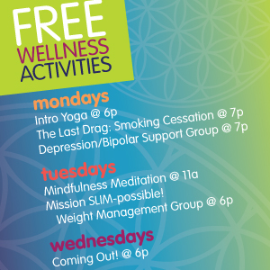
PROGRAMS
Wellness
Wellness
Tobacco Cessation, Yoga, Meditation, Fitness, Etc.
Health Screening
Primary Care
Through onsite FQHC partner

Slide 56
Partnerships
Legacy Community Health
Going back to 1980
Both started from same community town hall meeting
Collaborative grants
Co-located services – clinic on-site
FQHC
Primary Care

Slide 57
Partnerships
Incubator Program
Small community groups
Tenants of the community center
Fiscal agent for their financial management
Management advice
Grants Management
Other Partners
Dress for Success
Career Gear
Food Pantries
Residential Treatment
Dental Services
Shelters
Cultural/Language Specific Services
Rural Programs
Jails/Prisons

Slide 58
Practical Steps
Something to trade/provide to the other entity
They need help too
Benefit to their consumers
Template for agreement – know what you want and what funding sources need you to document
Set up a DocuSign or some other automated way to easily get signatures
Keep them current annually
Maintain the relationships not just the paper
Communicate your agreements to direct service staff
Ask direct service staff what collaborations they or their consumers need

Slide 59
Lessons Learned
Jump on staff changes so the relationship stays in place
These relationship take care and feeding at all levels
Get it in writing
Have a point person that manages the agreements
Be careful of entities that only want an agreement for a grant proposal and are just trying to increase their credibility on the subject area by piggy-backing on your reputation
Watch their marketing to ensure they are not using your logo or name inappropriately – set up a Google alert, review their website
If you are subcontracting – include all contract requirements, reporting and deadlines from your original contract
Set up a regular meeting with relevant staff at both agencies to negotiate work flows, requirements, communication paths, etc

Slide 60
Thank You!
Dr. Ann Robison
Executive Director
The Montrose Center
ARobison@montrosecenter.org

Slide 61
Lessons Learned
Careful planning
Strategic thinking
Utilize developed tools
Staff buy-in
Partnering is a process
Different types of partnership
Community work can equal community partners
Be aware of risks

Slide 62
Call to Action
Take 30 seconds and write down a partnership idea you have:
A potential organization
A service
An outcome you want to impact
Think of a co-worker who wasn’t on today’s webinar and commit to telling them your idea!
Notes:
It’s important to have a next step, from today’s webinar let’s start with a short call to action!

Slide 64
PCDC’s Sustainable Strategies Contact Information
hrsa@pcdc.org
212-437-3960
Sustainable Strategies TargetHIV Link: https://targethiv.org/ta-org/sustainable-strategies-rwhap-community-organizations

