Slide 2
Ryan White Program San Antonio TGA Applying Your Strategies
Holly Benavides, Asst. Director, Ryan White Program
Mary Kay Newman, Asst. Director, Ryan White Grants and Compliance

Slide 4
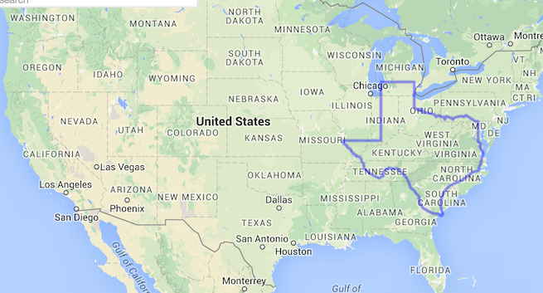
Service Area: Texas
268,581 square miles
773 miles wide
NYC to DC: 3.5X
150 miles from Mexican border (2.5 hours)
DC EMA | SA TGA
6,900 sq. miles | 3,129 sq. miles
6 million | 2.5 million

Slide 5
SATGA Epidemiological Profile

Slide 6
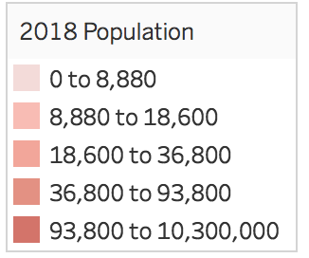
San Antonio TGA
The Ryan White Program (RWP) Administrative Agency (AA): University Health System (public district hospital)
Funding: Ryan White Part A (RWPA), Ryan White Part B (RWPB), and Housing Opportunities for Persons with AIDS (HOPWA), Ryan White Part D (RWPD), and Ryan White Part F (RWPF) and collaborates with locally funded Ryan White (RW) Parts C
Demographics:
63% Latino population; 7.5% Black (Bexar); less than 1% in Comal, Guadalupe, Wilson
35.2% of residents speak a language other than English at home.
Median age 35; 29%+ under 18; 29% btwn 25-44
6.2% per 1,000 households in Bexar County are same sex homes.
Comal County
Guadalupe County
Bexar County
Wilson County
Notes:
QuickFacts.” U.S. Census Bureau QuickFacts Selected: San Antonio City, Texas, www.census.gov/quickfacts/fact/table/sanantoniocitytexas/RHI725216#qf-headnote-b

Slide 7
SATGA, 2017: HIV/AIDS Prevalence Rates
PLWA
3,422 PLWA
PLWH
3,252 PLWH
PLWHA
6,674 PLWHA
Bexar – 6,284
Comal – 196
Guadalupe – 152
Wilson – 42
59% Hispanic/Latino
17% Black
85% Male
30% 25-34 yrs old
24% 35-44 yrs old
38% 45+ yrs old
62% Hispanic/Latino
14% Black
85% Male
12% 25-34 yrs old
20% 35-44 yrs old
68% 45+ yrs old
Notes:
^{PLWH by County:}
^{Bexar – 6,284}
^{Comal – 196}
^{Guadalupe – 152}
^{Wilson – 42}

Slide 8
SATGA Ryan White Part A Clients HIV Care Continuum
Notes:
SATGA Ryan White Part A HIV Care Continuum Definitions:
Diagnosed (HIV+ individuals): Number of people in the SATGA diagnosed with HIV/AIDS who received at least one Part A funded service in CY2017
Linked to Care (Evidence of Care): Number of PLWHA in the SATGA who received at least one medical visit funded by Part A in CY2017
Retained in Care (2 Visits, Labs, ARTs): Of those who received at least one Part A funded medical visit, the number of PLWHA in the SATGA that received at least two medical visits, 90 days apart, in CY2017. Of those who received one Part A funded medical visit, the number of PLWHA in the SATGA that were prescribed HIV Antiretroviral therapy in CY2017.
Achieved Viral Suppression: Of those who received one Part A funded medical visit, the number of PLWHA in the SATGA who have an HIV viral load less than 200 copies/ml at last viral load test in CY2017
***Latino gay and trans men are the only cohort to increase
*National data driven by 7 jurisdictions including TX with largest number of immigrants
Different strategies for addressing these concerns (patient navigation, peer navigation, provider education) have been developed but we have to look at the systems that effect the lives of our patients not their behaviors.

Slide 9
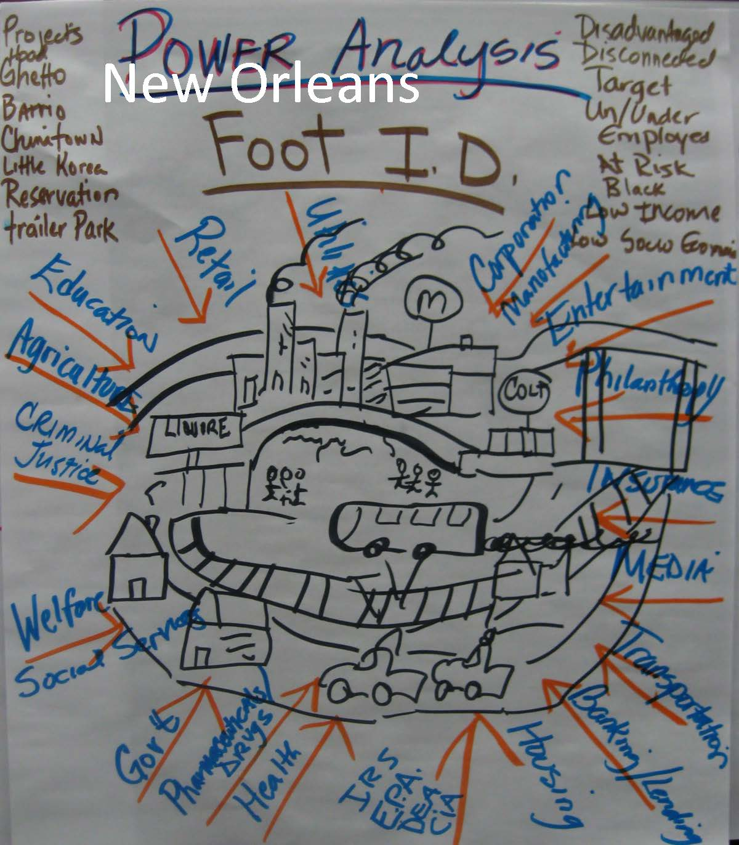
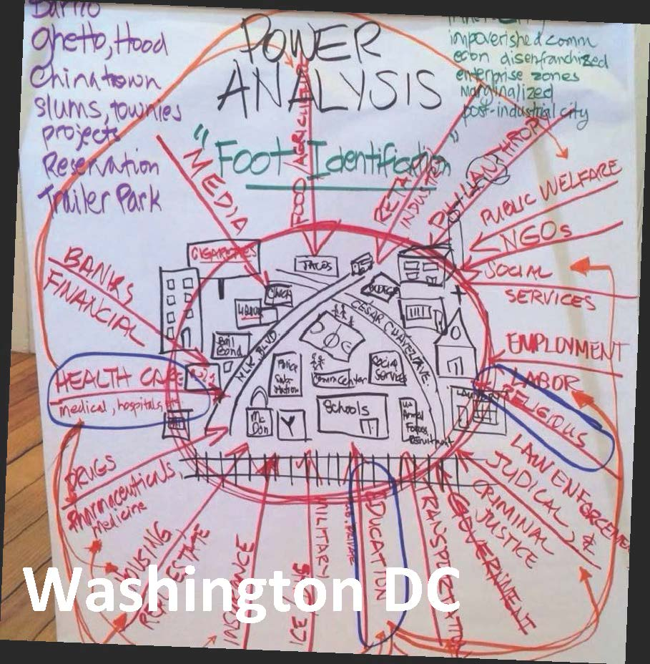
Identifying Community Cross-Systems: Impact on RW Patients
The People’s Institute for Survival and Beyond: Power Analysis from Undoing Racism®

Slide 10
Inequities Sustain the Epidemic in Our Communities, San Antonio TGA
Structural and System Inequities
Uninsured rates for SATGA is approximately 20.7% (Nat’l rate 15.5%)
1 in 6 adults does not have a high school diploma; 1 in 4 Latino(x) residents did not complete HS
Erasure of marginalized communities (data collection and research): Trans, gender non-conforming communities; inaccurate racial classification
Of the uninsured, 75% are Latino
72% RWPA clients are uninsured or insurance status unknown
Texas is a non-expansion Medicaid State
Culturally unaware providers
Inadequate public transportation
Economic segregation - San Antonio is the most economically segregated city in the nation.
Environmental injustice: gentrification, lack of clean drinking water
Poverty rates 15.6% (Nat’l rate 14%); 61% of PLWH in the SATGA who live below the FPL

Slide 11
Achieving Equitable Patient-Centered Care
Model rooted in community organizing:
Systemic Approaches:
Develop leadership
Maintain accountability to communities
Create networks
Understand the role of organizational gate-keeping as mechanism that upholds systems that create inequity.
- People’s Institute for Survival and Beyond

Slide 12
Engagement, Cultivation and Stewardship of Community Partnerships in SATGA

Slide 13
Leveraging Integrative Experiences:
Empowering people living with and/or affected by HIV
Building bridges between communities: Engage, cultivate, and steward
Centering and bringing people who are marginalized into leadership and decision making positions.
Developing resources and enhancing capacity of the community to engage.
Sharing power to build power
Evaluation of systems and shifting process approaches
Encouraging collaborative planning processes
Linking prevention, care, and treatment

Slide 14
San Antonio TGA HIV/Syphilis Task Force
Since 2009, the Task Force has brought community members together to:
Reduce duplication of outreach efforts
Increase coordination and collaboration;
Reduce gaps/barriers to linkage, care, treatment, EIS, and prevention services.
Meets monthly to discuss assessments, data collection, planning, coordination, cooperation, trainings, community input, and build testing activities capacity.
Serves as a conduit for improving referral relationships among a wide range of members
Began with 14 members and now exceeds 150 individuals representing a variety of entry points.

Slide 15
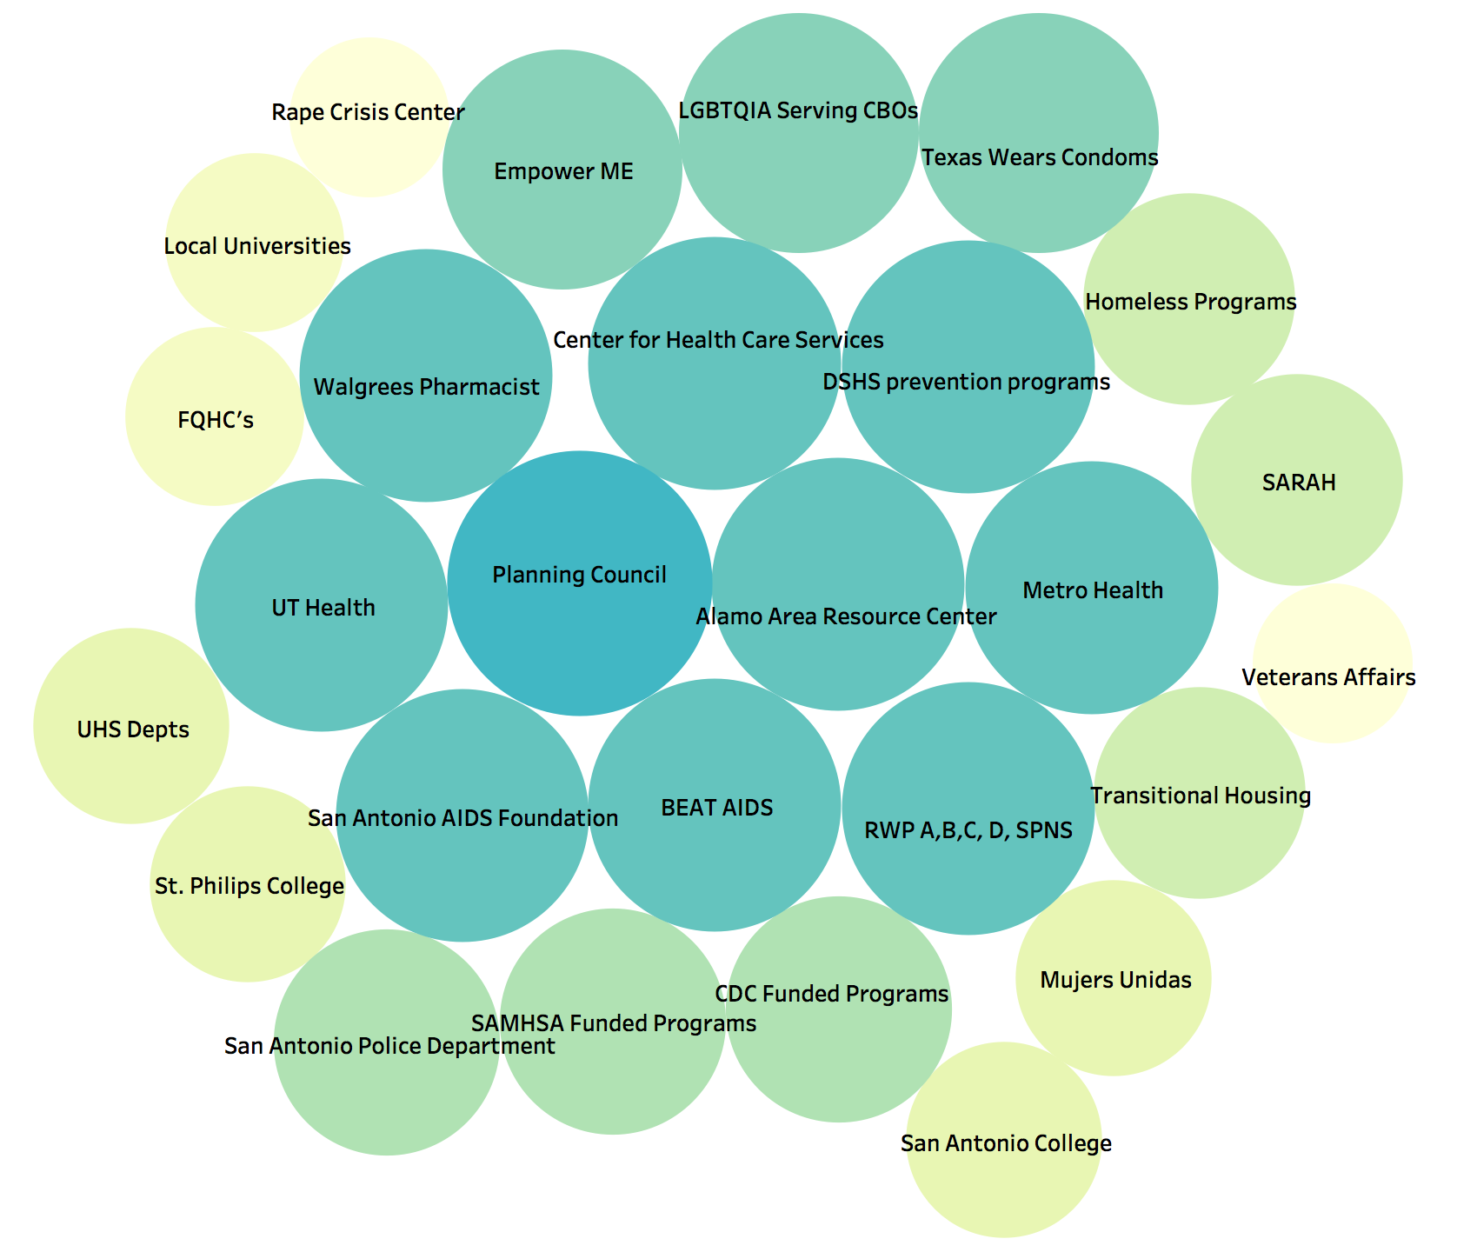
Task Force: Leadership and Members
Lead by two peer nominated and elected individuals.
Past chairs:
RW patients
Outreach staff
Health department
Advocates and community activists
New to the field
Medical Professionals

Slide 16
Taskforce Meeting Topics
Presentation from Texas Department of State Health Services on the results from an investigation of a Growing Molecular Transmission Cluster;
PrEP availability from the Walgreens Community Pharmacy;
Interactive sexual health and cultural competency demonstrations;
Linkage strategies;
Mobile outreach options;
UHS Missed Visits Project outcomes;
New Substance Abuse and Mental Health Services Administration funded programs;
Part D Project WORTH/Perinatal initiatives;
Community outreach initiatives focused on assisting people experiencing homelessness;
Sexual exploitation and trafficking in our community
How to prevent burn-out in staff;
Affordable Care Act;
Youth outreach technology and feedback

Slide 17
Bridging Gaps: Engagement
San Antonio AIDS Foundation and the San Antonio Police Department’s Homeless Outreach Positive Encounters (H.O.P.E.) Team
SAPD provides fingerprint identification as a resource to the community to help individuals access identification cards.
San Antonio AIDS Foundation was able to use their services for hospice clients. Client experienced physically limitation that prevented them from accessing resources to provide information about their citizenship. Without this information, the agency could not apply for state services that require U.S. citizenship documentation. The provision of the fingerprint identification ultimately assisted the client to apply for state benefits and allowed SAAF to transfer the client to another facility that would continue their care.

Slide 18
The Center for Health Care Services: Cultivation
The Center for Health Care Services (CHCS) utilizes social work interns to assist in their care delivery services and conduct research to identify areas in which needs of the community can be met.
Interns delivered their final results of a Housing Resources Project:
Identified current housing issues and the demographics of people experiencing homelessness, types of programs available, and the need for coordinated entry in order to get people housed immediately.
This research and the Housing Resource Guide developed by the Planning Council Needs Assessment Committee, then used in the Charrette on Strategic Plan to Prevent & End Homelessness. The attendees at the January HIV/Syphilis Testing Taskforce as well as the CHCS Interns were able to continue to develop their strategies and connections at the Charrette to address homelessness.
The Housing Resource Guide is a major staple to the materials that the AA makes available to all agencies and community partners.

Slide 19
Community Engagement Resulting in Responsive Programs and Systems Change: Addressing Stable Housing Needs

Slide 20
2016-2020 Five Year Consolidated Plan (HUD)
A Unique Opportunity
In April 2016, the Department of Community Resources Community Development and Housing Division began gathering surveys and data to produce their 2016-2020 Five Year Consolidated Plan
The Plan must include the area’s subpopulations, introducing a unique prospect to highlight PLWH as one of their subpopulations.
Notes:
The Ryan White Planning Council and Administrative Agency worked with the Bexar County Community Development and Housing Division and their consultant to develop an additional survey for PLWH and a Housing Needs Assessment to be included in the 2016-2020 Five Year Consolidated Plan
Housing Needs Assessment to address PLWH
Individuals who have special needs, including persons living with HIV/AIDS, are typically extremely low income and face tremendous challenges finding housing that they can afford. Individuals with special needs also require supportive services in addition to housing that they can afford. Public and private sources have much smaller funds available for these purposes, making it difficult for non-profit organizations to develop and operate housing and supportive service programs.

Slide 21
2016 PLWH Housing Needs Assessment
The target population was PLWH age 13 and above regardless of their current housing needs
The survey was available in both English and Spanish, print or online format, and disseminated between April 5, 2016 and April 29, 2016
A total of 322 responses were received, tabulated and analyzed
The survey consisted of 49 total questions regarding demographics, housing situations, housing needs, and housing stability
Housing Needs Assessment Quick Facts
90.1% were living in homelessness within the past three years
Nearly two-thirds (62.7%) are not employed at all
Nearly half (48.4%) claimed to have a long-term and serious medical condition, in addition to HIV/AIDS, that disable them
This research and the Housing Resource Guide developed by the Planning Council Needs Assessment Committee, then used in the Charrette on Strategic Plan to Prevent & End Homelessness.
Notes:
Recommendations:
Participate in Bexar County’s Strategic Plan to Prevent and End Homelessness (Charrette)
The Charrette (a community meeting) allowed for input from community stakeholders to address issues related to homeless prevention and homelessness. These issues were discussed over a two-day period with local and national experts and members of the community. The data gleaned from Charrette week, coupled with local housing and homeless data went into a final report that was released in February 2017.
Format and Print final Housing Matrix.
Format the matrix into a Housing Resource Guide.
Review information in the matrix and tailor it to the HIV Community.
Add the Housing Resource guide to the Ryan White Resource Guide when it is updated.
Conduct a Planning Council, Consumer, Community Stakeholder Workshop regarding Housing 101, Budget 101, etc.
Conduct a Case Manager Training regarding the Housing Study Results, Housing First, and the new Housing Resource Guide.
Complete a once page fact sheet from the Housing Study results.
Conduct a Housing Summit for Case Managers, Providers, Community Stakeholders, Consumers, Planning Council, AA Staff, etc.

Slide 22
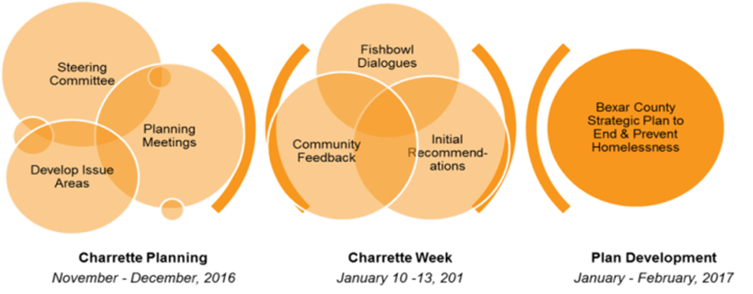
Bexar County’s Strategic Plan to Prevent and End Homelessness
Planning Council Members, the Ryan White Program Administrative Agency Staff, and Community Stakeholders took part in the Bexar County’s Strategic Plan to Prevent and End Homelessness (Charrette) on January 10-11 & 13, 2017
The Charrette showcased a fishbowl of local and national experts in the area of Housing on six pre-selected topics, of which one was Housing and Service Needs of People Living with HIV.
Notes:
The PC and the South Alamo Regional Alliance for the Homeless (SARAH) held a special joint meeting on February 2, 2017 to present the recommendations and implementation strategies of the Bexar County’s Strategic Plan to Prevent and End Homelessness (Charrette).
Develop System Coordination and Steering Committee, including Housing Opportunities for People with AIDS (HOPWA) and Ryan White providers, SARAH leadership, HMIS and key stakeholders, to drive data sharing across systems; CES Integration, considering the efficacy of creating access to housing and confidentiality; development of HIV/AIDS system performance dashboard in alignment with the outcomes of the broader homeless response system (e.g. retention and recidivism); development of strategies to braid funding with other systems, to increase permanent housing inventory for people living with HIV/AIDS (maximizing the use of Ryan White, HOPWA, TBRA and CoC resources)
Include HIV/AIDS specific training within Continuum of Care training series
Assess system wide policies to ensure equal access to Emergency Shelter, Transitional Housing, Rapid Rehousing and Permanent Supportive Housing and make needed adjustments to address any issues
Develop an administrative guide that is sensitive to the needs of people living with HIV/AIDS and combats the negative effects of stigma (e.g. not cutting checks with agency name that risks client privacy/confidentiality and having staff use Google phones so the agency name is not identified through caller identification system.)
Develop consumer input strategies (e.g. alumni association)
Promote community strategies across multiple systems that increase awareness and education focused on HIV/AIDS prevention
Ensure these three specific and medically critical services are incorporated into CoC programming serving people living with HIV/AIDS: preventing food insecurity, medical transportation, and access to PrEP (Pre-Exposure Prophylaxis)

Slide 23
HRSA/HAB Special Projects of National Significance (SPNS) Program
Bexar County’s Strategic Plan to Prevent and End Homelessness (Charrette) recommendation: development strategies to braid funding with other systems to increase the local housing inventory for PLWH.
Applied for HRSA/HAB, Special Projects of National Significance (SPNS) Program and the Secretary’s Minority AIDS Initiative Fund for Improving HIV Health Outcomes through the Coordination of Supportive Employment and Housing Services using the results from the Housing Needs Assessment in July 2017.
Notes:
HRSA awarded the SATGA, as a Demonstration Site Grant, funds for 2018-2020 to support the design, implementation, and evaluation of innovative interventions that coordinate HIV care and treatment, housing, and employment services to improve HIV health outcomes for low-income, uninsured, and underinsured people living with HIV (PLWH) in racial and ethnic minority communities.
The intervention will achieve a systematic transformation of the SATGA HIV service delivery model. The transformation will be sustained even after the conclusion of the three-year demonstration project. The AA proposed a unique partnership between the SATGA’s public and private sectors to develop innovative strategies to: 1) integrate HIV care; 2) promote housing stability; and 3) increase employment opportunities. These strategies will focus on SATGA’s racial and ethnic minority communities. Goals of the program are: 1) increase housing stability; 2) decrease rates of unemployment/underemployment; and 3) increase viral suppression rates. The AA proposed the following strategies to achieve the goals of the project: 1) Hiring dedicated staff and integrating them into the SATGA’s Ryan White Part A/B/D and HOPWA Care Continuum to coordinate housing, health care and employment services for racial and ethnic minority PLWH communities within the SATGA

Slide 24
Housing Summit - Housing is Healthcare Initiative Continued
Recommendation from the 2016 PLWH Housing Needs Assessment:
Conduct a Housing Summit for Case Managers, Providers, Community Stakeholders, Consumers, Planning Council, AA Staff, etc.
Notes:
Case Manager Training Workshop – February 15, 2018
Housing Resources Pre-Assessment
My Housing Services Journey, Personal stories from the Community
Development of the Housing Resource Guide with Q & A
Housing Resources Post- Assessment
Housing Summit – Housing is Healthcare – February 16, 2018
Overview of Ryan Programs and Housing
Housing is Healthcare: How the Journey Began
State of Housing by Mayor’s Housing Taskforce Chair
Connecting the Homeless to Housing – SARAH
Veterans Housing Services
Housing Authority of Bexar County
San Antonio Housing Authority
Housing Coordination in the Ryan White Program
Special Projects of National Significance (SPNS) Program
Finding an HIV+ Community Friendly Home

Slide 25
Mayor’s Housing Policy Task Force
In January 2018, the AA was invited to participate as one of the members of the Mayor’s Housing Policy Task Force.
Priority policy actions were presented as follows:
Recognize and quantify special populations and their housing gap
Commit sufficient resources to close gaps
Integrate special needs populations
Provide accountability and oversight; and Remove specific barriers.
The final report and recommendations were approved by the City Council in September 2018
The final document can be found here: https://www.sanantonio.gov/Portals/0/Files/HousingPolicy/Resources/SA-HousingPolicyFramework.pdf
More information Mayor’s Housing Policy Task Force on the can be found here: https://www.sanantonio.gov/HousingTaskForce
Notes:
San Antonio’s Mayor, Ron Nirenberg, created the Mayor’s Housing Policy Task Force because all San Antonians, regardless of income level, deserve opportunities to find quality affordable housing within city limits. His charge to the Task Force was simple: to develop a framework for a comprehensive, compassionate housing strategy for our city.
Mayor Nirenberg requested a roadmap to address the affordability gap so that an average San Antonio family can afford to buy a home. He urged the Task Force to provide recommendations that protect and connect neighborhoods amid the city’s historic growth. The local housing policies must align with existing public and private resources to rehabilitate existing housing stock that provides residents with the tools to age with dignity in their homes. But just as important – the Task Force must address these issues in a way that creates a housing system where sustainable affordable, quality housing is provided by the private sector and can be driven by the market.
The Task Force had full autonomy to determine what process and level of community input would best facilitate the objective.
The Task Force had 5 Technical Work Groups:
Providing housing for all, including special needs populations
Identifying new housing funding and financing mechanisms
Developing and preserving housing for stable, equitable and resilient neighborhoods
Creating a transparent, coordinated housing system
Removing barriers to housing affordability and supply
The AA staff member served on The Housing for All, Including Special Populations, Technical Working Group
The Housing for All, Including Special Populations, Technical Working Group was charged to identify vulnerable groups with unique housing needs; assess current efforts to quantify and meet needs; determine and propose policy changes; and identify models and strategies to ensure access to affordable, dignified and supportive housing.

Slide 26
San Antonio’s Housing Policy Framework
“Challenges, such as structural poverty, over-regulation, economic segregation and the cost of building in high opportunity areas create significant barriers in the city’s housing system. The city has numerous pockets of persistent intergenerational poverty. In many instances, these pockets reflect the legacy of redlining and align with racial/ethnic communities that historically have had limited (or been denied) access to capital, home loans, or financing for the upkeep of their homes. Even access to education, the banking system itself, and counseling were among these limitations, and the poor condition of housing in these areas is no coincidence.”

Slide 27
Continued Housing Efforts
Patient and Community Stakeholder Trainings
Life Skills (i.e. Finance 101, Housing 101, etc.)

Slide 28
Contact Us
Holly Benavides
Assistant Director, Ryan White Program
holly.Benavides@uhs-sa.com
210.358.6820
Mary Kay Newman
Assistant Director, Ryan White Grants and Compliance
mary.newman@uhs-sa.com
210.644.1362

Slide 29
Questions/Preguntas?

