Slide 1
Addressing barriers and facilitators accessing treatment and retention in care among HIV-positive Mexican MSM
Robyn Schweizer MSW, Bienestar Human Services, rschweizer@bienestar.org
Jeff Bailey MPH, APLA Health & Wellness, bailey@apla.org
Román Buenrostro, AIDS Foundation of Chicago, rbuenrostro@aidschicago.org

Slide 2
Disclosures
Presenter(s) has no financial interest to disclose.
This continuing education activity is managed and accredited by AffinityCE/Professional Education Services Group in cooperation with HRSA and LRG. PESG, HRSA, LRG and all accrediting organization do not support or endorse any product or service mentioned in this activity.
PESG, HRSA, and LRG staff as well as planners and reviewers have no relevant financial or nonfinancial interest to disclose.
Commercial Support was not received for this activity.

Slide 3
Learning Objectives
At the conclusion of this activity, the participant will be able to:
Identify and describe at least two methods staff and peers can employ to successfully engage and link HIV-positive Mexican MSM to HIV treatment and support services.
Identify the importance of how access to support services supports linkage and retention in HIV care.
Describe the importance of patient perspectives on retention in care for intervention and program development.

Slide 4
Obtaining CME/CE Credit
If you would like to receive continuing education credit for this activity, please visit:
http://ryanwhite.cds.pesgce.com

Slide 5
Proyecto Vida: Addressing Barriers in Accessing HIV Treatment Among Mexican Men Who Have Sex with Men
Robyn Schweizer, MSW
Bienestar Human Services
Los Angeles, CA

Slide 6
Bienestar Human Services: Who We Are

Slide 7
Bienestar Human Services
A grassroots, non-profit community service organization established in 1989
Created due to a lack of HIV/AIDS services for the Latino community in Southern California
Six offices located throughout Los Angeles County
Mission Statement:
"Bienestar Human Services is committed to enhancing the health and well-being of the Latino community and other underserved communities. Bienestar accomplishes this through: community education, prevention, mobilization, advocacy and the provision of direct social support services."

Slide 8
Bienestar Services
HIV/HCV/STI screening
Mental health treatment
Outpatient substance abuse treatment
Syringe exchange (mobile and storefront)
HIV linkage to care and peer navigation
Support groups
HOPWA case management
Food bank
PrEP/PEP navigation
HIV prevention programming and research

Slide 9
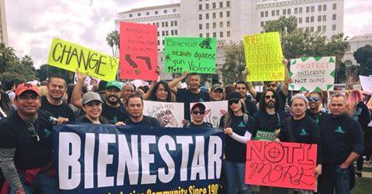
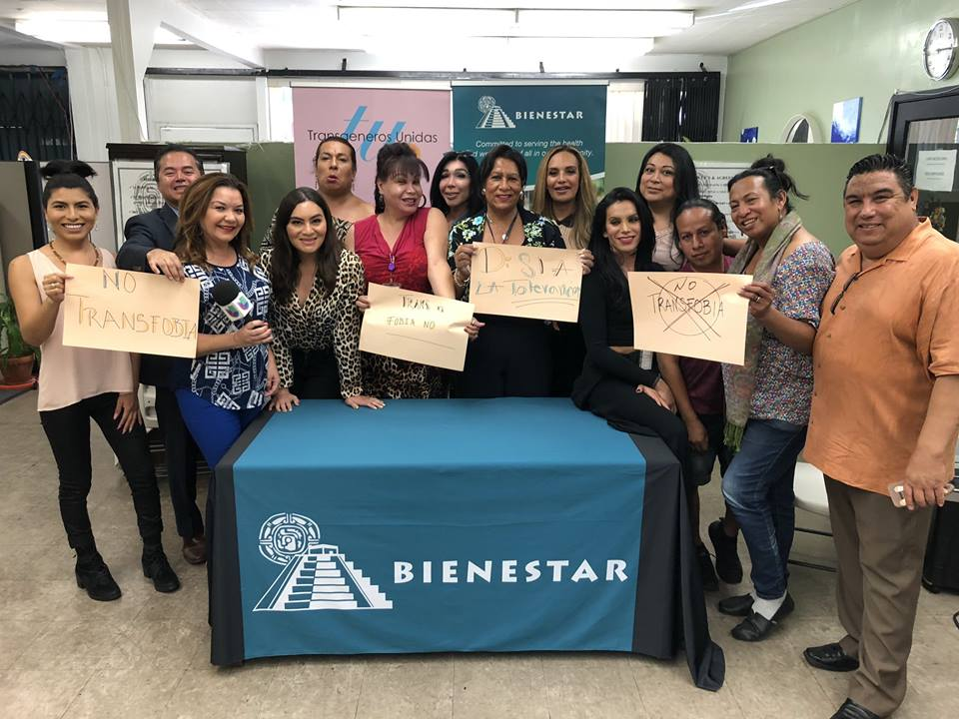
Social Justice

Slide 10
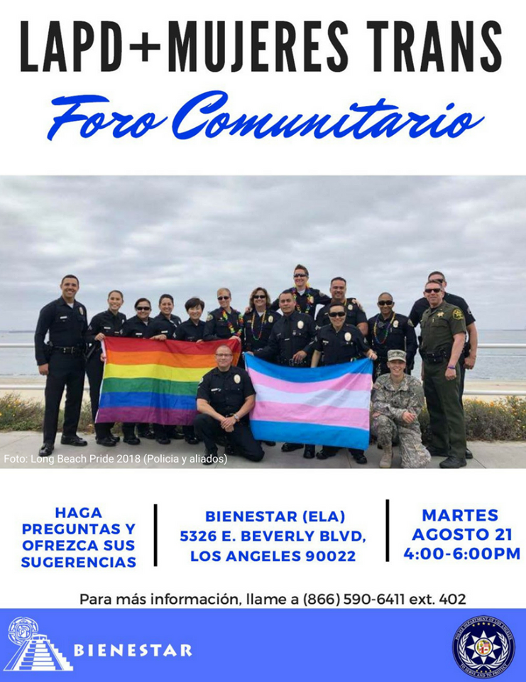
Community Education

Slide 11
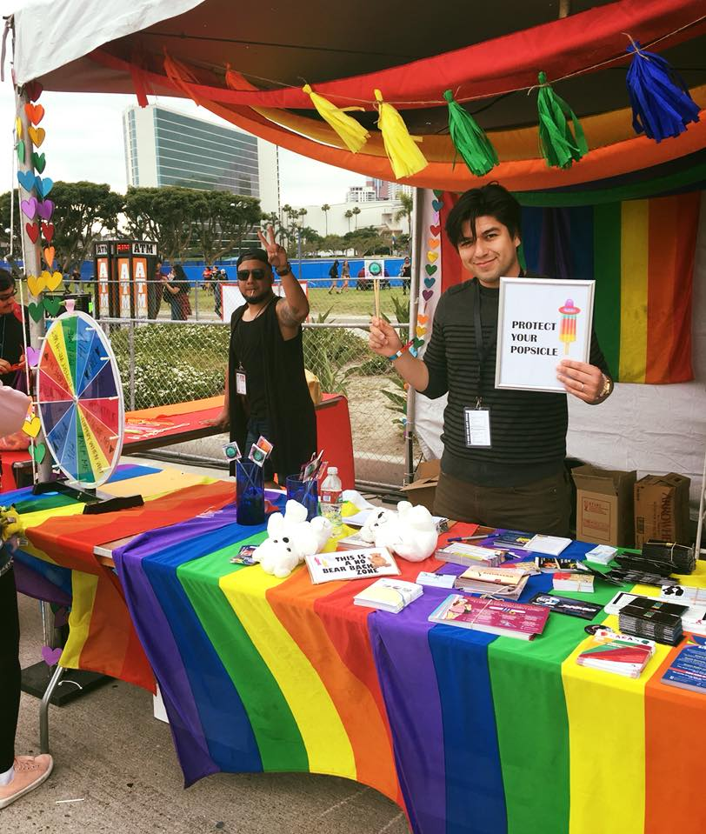
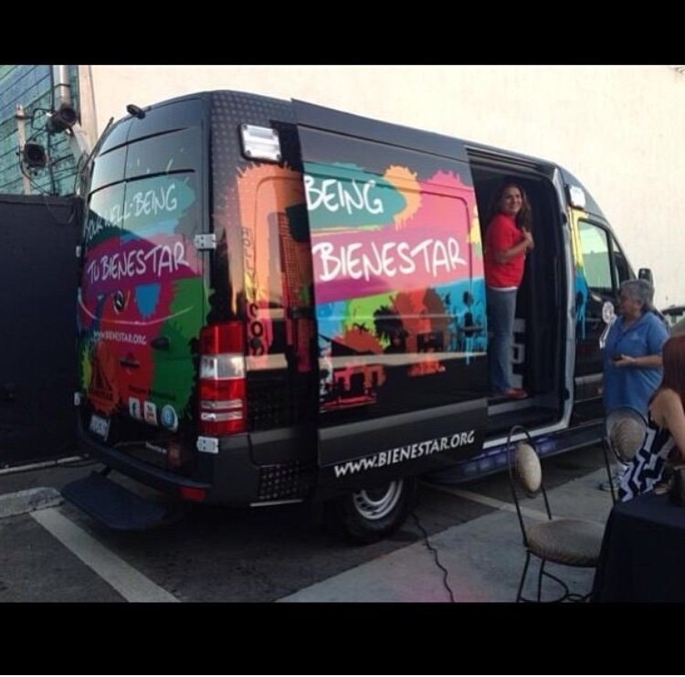
Community Outreach

Slide 12
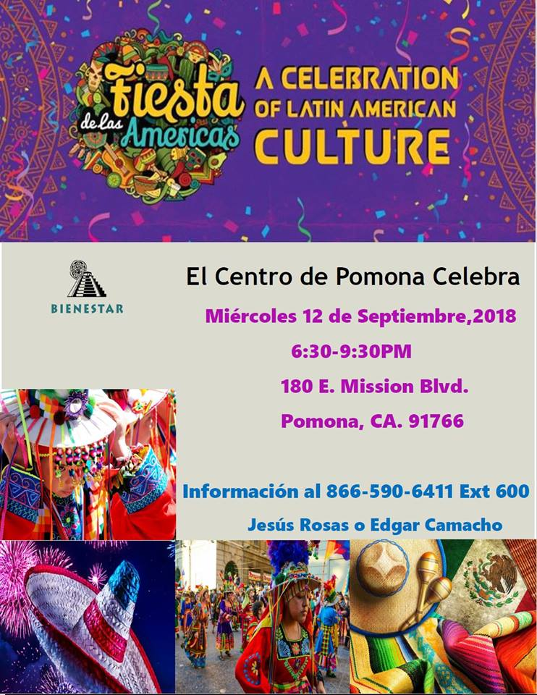
Social & Cultural Events

Slide 13
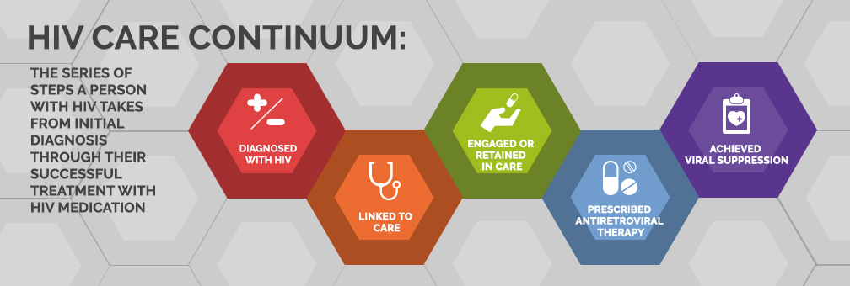
Proyecto Vida: Project Overview
A culturally-specific program designed to:
Improve the identification, timely entry, engagement and retention in quality HIV care for Mexican and other Latino MSM in Los Angeles County
Address individual, provider, and structural barriers to accessing and engaging in HIV care
Identify cultural factors, values and norms that may affect access to services

Slide 14
Proyecto Vida: Project Overview, cont.
IDENTIFY | ENGAGE | RETAIN
Targeted HIV testing Community outreach efforts in areas frequented by Latino MSM Social network testing and engagement Referrals from community partners | Link to medical care Peer navigation | Peer navigation Referrals to other programs and services Meet to complete incentivized ACASI (audio computer-assisted interviewing) follow-ups every 6 months of 24-month period of enrollment

Slide 15
Proyecto Vida: Project Overview, cont.
Of 104 total participants enrolled:
64 (62%) newly-diagnosed with HIV
40 (38%) re-engaged to care
95% linked timely to medical care
Ethnic background of participants:
1 Puerto Rican participant
21 Mexican-American participants
82 Mexican participants

Slide 16
Focus on Mexican Participants
Of the 82 participants from Mexico enrolled in the project:
49 (60%) were newly diagnosed with HIV
33 (40%) were re-engaged to HIV medical care
98% were linked timely to medical care

Slide 17
ACASI Surveys
Audio computer-assisted interviewing (ACASI) surveys were completed at baseline and every six months until completion of program at 24 months.
Data being presented are from ACASI baseline surveys conducted by 82 Mexican participants.

Slide 18
ACASI Survey Variables
HIV-Related Medical History
Past engagement in medical care
ART use
CD4 count and viral load
AIDS diagnosis
Transnational Identities (US-American and Country of Origin)
Communication in Spanish versus English
Cultural identity/identities and feelings associated with that identity/identities
Types of interactions and frequency of interactions with family and friends from country of origin
Risk Factors & Protective Factors for Engagement and Retention in Care
Support/lack of support of family and/or friends
Internalized stigma
Perceived and real discrimination
Mental health
Substance use
Documentation status
Income level
Transportation
Mexican cultural factors

Slide 19
Mexican Cultural Factors
Machismo
Caballerismo
Personalismo
Familismo
Helping Others
Religiosity
Personal Growth
Mexican Cultural Components | Interventions with Program Participants
 | Recruitment |  |  | Timely Entry/Engagement and Retention in Primary Medical Care
 | Social Network HIV Testing | Mobile HIV Testing | Community Outreach | Clinic Referrals | Social Network Engagement | Linkage | Peer Navigation
Conceptualizations of Masculinity (machismo/ caballerismo) | X | X | X | X | X | X | X
Personalismo | X | X | X | X | X | X | X
Helping Others | X |  |  |  | X
Religiosity |  |  |  |  |  | X | X
Familismo |  |  |  |  |  | X | X
Personal Growth |  |  |  |  |  | X | X

Slide 20
ACASI Baseline Findings

Slide 21
HIV Medical History
More than half of all participants declined to answer questions related to HIV medical history:
Taken ART: 1% no, 10% yes, 89% no answer
Taking ART: 5% no, 6% yes, 89% no answer
Lowest CD4: 12% less than 200, 1% 201-349, 7% 350-499, 9% 500 or higher, 18.3% don't know, 52% no answer
Last viral load result: 20% detectable, 22% undetectable, 6% don't know, 52% no answer

Slide 22
Risk Factors Impacting HIV Care
Potential barriers to engagement and retention in HIV medical care were identified and categorized into four levels:
Structural-Level Barriers
Provider-Level Barriers
Individual-Level Barriers
Cultural-Level Barriers

Slide 23
Structural-Level Barriers to Care
Household income at baseline​ | Client income​
Less than $50 per month​ | 33%​
Less than $51 to $249 per month​ | 11%​
Less than $250 to $499 per month​ | 6%​
Less than $500 to $957 per month​ | 17%​
Less than $958 to $1,273 per month​ | 10%​
2014 Federal Poverty Level Medicaid Eligibility ​
Less than $1,274 to $2,999 per month​ | 19%​
Less than $3,000 to $4,999 per month​ | 3%​
Less than $5,000 or more per month​ | 1%​
Poverty
Homelessness
Lack of transportation
Low levels of education
Lack of insurance coverage or inadequate coverage
HIV-related stigma

Slide 24
Provider-Level Barriers to Care
Language barriers
Cultural differences
Lack of flexible appointment times
Perceived discrimination

Slide 25
Individual-Level Barriers to Care
Lack of motivation or ambivalence to engage and remain in care
Mental health
Substance use

Slide 26
Cultural-Level Barriers to Care
Machismo
Fatalism

Slide 27
Protective Factors Improving HIV Care
Cultural Factors
Caballerismo
Personalismo
Familismo
Helping Others
Religiosity
Personal Growth
Structural Factors
Transportation
Regular income
Access to social capital
Documentation status
Housing
Provider Factors
Positive past experiences
Care in Spanish
Linkage Coordinator/Peer
Navigator assistance
Individual Factors
Knowledge of HIV
Knowledge of how to access care
Positive outlook
Mental health

Slide 28
US-American and Mexican Transnational Identities

Slide 29
What is Transnationalism?
Transnationalism can be defined as "those [activities] that take place on a recurrent basis across national borders and that require a regular and significant commitment of time by participants. Such activities may be conducted by relatively powerful actors, such as representatives of national governments and multinational corporations or may be initiated by more modest individuals, such as immigrants and their home country kin and relations. These activities are not limited to economic enterprises, but include political, cultural and religious initiatives as well" (Portes, 1999, p. 464).

Slide 30
Mexican Identity
Majority of clients (93%) strongly agree that they identify as Mexican and are proud of being Mexican. In addition:
83% strongly agree that they feel that they are a part of Mexican culture and 84% have a strong sense of being Mexican
73% communicate almost always in Spanish, and 20% often
84% listen to music from Mexico (31% sometimes, 26% often and 28% always)
77% use Facebook, Twitter, and/or other social media with people from Mexico (26% sometimes, 17% often and 34% always)
72% call, Skype, or text family in Mexico at least once a month
56% call, Skype, or text friends in Mexico at least once a month

Slide 31
US-American Identity
Although less than half of participants (43%) identified with being US-American:
33% strongly agree that feel that they are a part of US-American culture
32% strongly agree that they have a strong sense of being US-American
50% of participants reported feeling good about being US-American and that being US-American plays an important part in their lives
15% communicate in English almost always, and 24% often

Slide 32
How might the intersection of these identities affect
retention and engagement in HIV care?

Slide 33
How is a CBO like Bienestar uniquely suited to working with clients of transnational identities?

Slide 34
Nearly 30-year history in Los Angeles County
Community engagement, advocacy and outreach
Cultural events
Community partnerships
Holistic, culturally-informed and culturally-relevant client services
Referrals to meaningful and accessible community resources and services

Slide 35
How was Proyecto Vida successful at engaging clients into care?
Bienestar's 30-year history of working in Los Angeles County
Peer Navigation Model
Bilingual, culturally-competent and culturally-trained staff
Use of Transtheoretical Model of Change and Motivational Interviewing
Individualized peer support
Holistic, client-centered care
Incorporation of Mexican cultural components into program's design
Machismo versus caballerismo
Personalismo
Helping others
Religiousity
Familismo
Personal Growth
Fatalism

Slide 36
Recommendations for Service Providers
Service providers play an integral role in mitigating risk factors and strengthening protective factors
Engage community and hire from within the community
Maintain presence in community
Stay informed on issues that affect community and advocate for community
Local, state and federal policies
Health trends
Offer client-centered, culturally-appropriate resources and services and/or refer client to relevant resources and services

Slide 37
Next Steps in Evaluating Proyecto Vida
Obtain and analyze results of follow-up ACASI surveys
Obtain and analyze results of medical data extraction/WAVE data

Slide 38
Questions?
Robyn Schweizer, MSW
Rschweizer@bienestar.org

