Slide 2
Process Evaluation of a SPNS Practice Transformation Model
Mila C. González^{1,2}, MPH, Rebecca Schnall RN, MPH, PhD,² Susan Olender, MD, MS^{1,2}
¹NewYork-Presbyterian Hospital Columbia University Medical Center; ²Columbia University School of Nursing

Slide 3
Disclosures
I have received grant/research support from Gilead Sciences, Inc.
I do not intend to discuss off label use of any drug or treatment during this discussion.

Slide 4
Session Objectives
Describe the Practice Transformation Model
Describe the application of the Consolidated Framework for Implementation Research (CFIR) to evaluate implementation of Practice Transformation
Reflect upon barriers and facilitators associated with implementation of a Practice Transformation Model in an urban academic HIV clinic
Notes:
Ti
Between 2014 and 2018, the Comprehensive Health Program, an HIV primary care program at NewYork-Presbyterian Hospital (CHP-NYP) in New York City, was funded through the Special Projects of National Significance’s “System-level Workforce Capacity Building” initiative to develop and evaluate a practice transformation model (PTM). With the goal of improving the quality of HIV care, the PTM implemented a mix of patient-centered medical home standards including: 1) team-based care through the restructuring of Practice staff into five Clinical Care Teams; 2) panel management through team-based electronic dashboard reports; 3) care coordination by a RN to support transitions of care; and 4) use of quality improvement methodology to pilot system changes and drive HIV outcomes improvements. In this session, we will describe the application of the Consolidated Framework for Implementation Research as part of the qualitative process evaluation of the CHP-NYP PTM, which was conducted between April and May 2017, the 3rd year of the PTM implementation. The session will describe the data collection process through focus groups, codebook development, and approach for data analysis. The findings on progress towards implementation of the CHP-NYP PTM including the key barriers and facilitators of successful practice transformation will be presented.
Learning Objectives
Supply learning objectives: A minimum of three (3) learning objectives are required. Effective learning objectives (1) focus on the learner; (2) contain action verbs that describe measurable behaviors; and (3) indicate what the participant will be able to do at the conclusion of the activity e.g., “The learner will be able to define, recite, identify, describe,” etc.
Please provide three learning objectives (required):
At the conclusion of the oral presentation, participants will be able to:

Slide 5
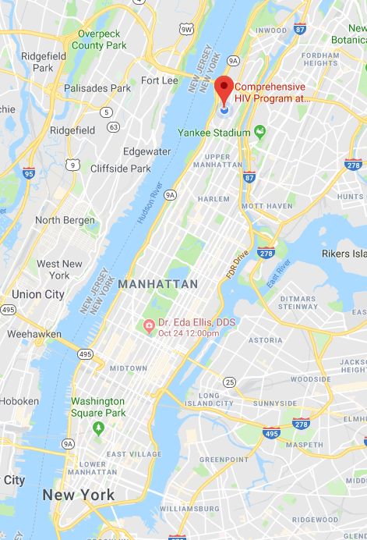
NewYork-Presbyterian Hospital’s Comprehensive Health Program (CHP)
HIV Care & Treatment
Sexual Health
STI Testing (including HIV & Hepatitis C)
Primary Care, Behavioral Health & Supportive Services
Linking to Hepatitis C Treatment
Serving individuals of all ages at risk of HIV infection
Targeting individuals with Hepatitis C mono-infection
Mental Health & Supportive Services while in Treatment
Hepatitis C Treatment for Co-infected Individuals
Serving Pediatric (including exposed infants and children), Adolescent, Young People, and Adults
Transition to Primary Care
PrEP, PEP, Primary Care, Mental Health & Supportive Services
In 2017, NYP served 2,966 clients living with HIV from New York City’s Upper Manhattan and the Bronx
Funding for Programs:
Figure 1. New York City Map.
Notes:
Provides outpatient & inpatient care to people living with or at-risk for HIV
All Dx Whole West Campus all locations: 2966 HIV patients touched our in 2017 campus for emergency services, hospitalizations, outpatient care
New dx or new to care in CHP (most in program with exception of a few new dx): 306
51 patients were newly diagnosed with HIV in 2017
255 new to care
Established pts CHP: 1784 of these patients (or 67%) were actively engaged in comprehensive HIV primary care at NYP-CHP
Full-time and part-time PCPs (34), RNs (5), RN Care Managers (2), MAs (4), LCSW/LMSW (6), sexual health and HIV care coordinators (10), nutritionist (1), psychiatrists (2), front desk staff (7), and other administrative staff

Slide 6
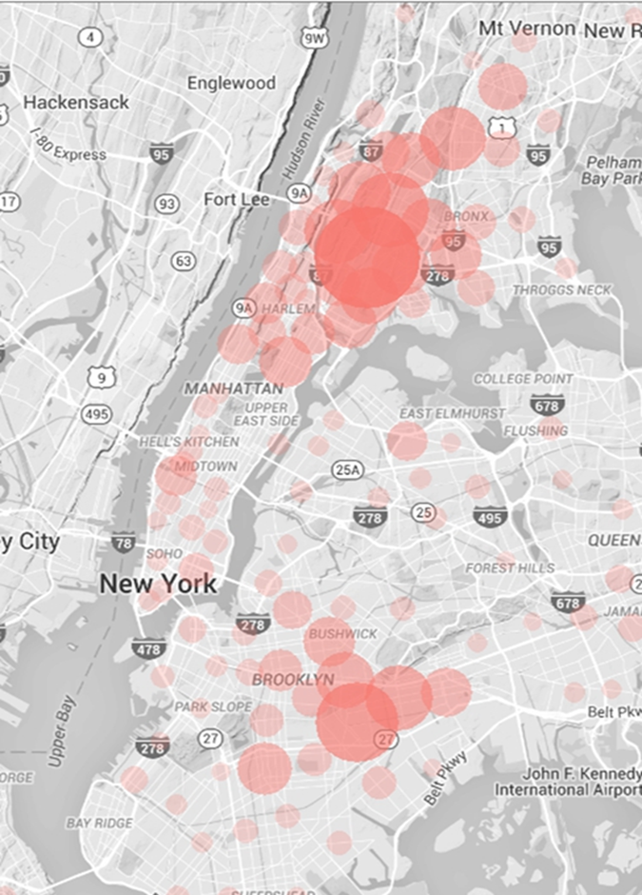
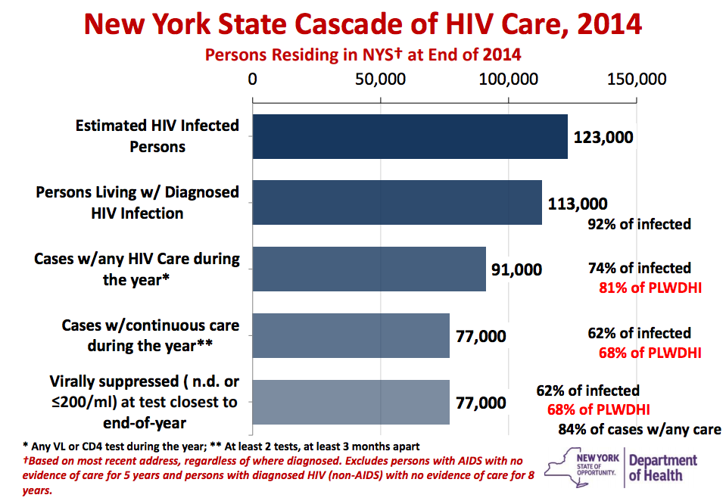
Why Practice Transformation at NYP-CHP?
Credit: Dan Feller, NYSDOH, 2015.
Notes:
Disparities in HIV care continuum outcomes by ethnicity/race, geography.

Slide 7
SPNS Workforce Initiative: 2014-2018
Multi-site initiative with 15 demonstration sites across the United States funded to design, implement, evaluate, and disseminate a “Practice Transformation Models” to create system-level workforce capacity for HIV care
NYP’s Comprehensive Health Program (CHP) was selected as demonstration site
Developed the “Stimulating Transformation of Technology and Team Structure to Reach People Living with HIV” (STaR) Project
Notes:
Design
Implement
Evaluate
Disseminate
Changing healthcare landscape
Hiv provider shortages, increased access
is a multi-site demonstration and evaluation of system-level changes in staffing structures to improve health outcomes along the HIV Care Continuum. The initiative's fifteen demonstration sites for four years to promote the design, implementation, and evaluation of innovative strategies to increase organizations’ workforce capacities and achieve efficient and sustainable service delivery practices that both optimize human resources and improve quality outcomes. The demonstration projects will implement and evaluate innovative Practice Transformative Models (PTMs) for the delivery of HIV treatment and comprehensive care services in order to better respond to the changing healthcare landscape, marked by shortages of HIV primary care physicians and increasing demand for access to quality HIV services. Evaluation of these innovative PTMs will identify best practices and methods to support other organizations to adapt and re-align their workforces, as well as factors that increase the potential for successful integration of HIV care into primary care and community healthcare settings serving vulnerable populations. The University of California at San Francisco is serving as the Evaluation and Technical Assistance Center (ETAC) for this initiative. The ETAC will coordinate the multi-site evaluation; provide programmatic technical assistance to the demonstration sites; and lead publication and dissemination efforts of best practices and lessons learned.

Slide 8
SPNS Workforce Initiative: 2014-2018
The STaR Project “Practice Transformation Model” consisted of:
System level staffing changes heavily based on Patient Centered Medical Home standards
Improvements to Practice’s capacity to care for people living with HIV, valuing efficiency and sustainability
Optimization of resources in changing healthcare landscape
Quality improvement efforts aimed at increasing the rates of linkage, engagement, retention in care, and viral load suppression
Notes:
Design
Implement
Evaluate
Disseminate
Changing healthcare landscape
Hiv provider shortages, increased access
is a multi-site demonstration and evaluation of system-level changes in staffing structures to improve health outcomes along the HIV Care Continuum. The initiative's fifteen demonstration sites for four years to promote the design, implementation, and evaluation of innovative strategies to increase organizations’ workforce capacities and achieve efficient and sustainable service delivery practices that both optimize human resources and improve quality outcomes. The demonstration projects will implement and evaluate innovative Practice Transformative Models (PTMs) for the delivery of HIV treatment and comprehensive care services in order to better respond to the changing healthcare landscape, marked by shortages of HIV primary care physicians and increasing demand for access to quality HIV services. Evaluation of these innovative PTMs will identify best practices and methods to support other organizations to adapt and re-align their workforces, as well as factors that increase the potential for successful integration of HIV care into primary care and community healthcare settings serving vulnerable populations. The University of California at San Francisco is serving as the Evaluation and Technical Assistance Center (ETAC) for this initiative. The ETAC will coordinate the multi-site evaluation; provide programmatic technical assistance to the demonstration sites; and lead publication and dissemination efforts of best practices and lessons learned.
The three-point plan: Announced June 2014 by the NYS Governor Coumo:
Identifies persons with HIV who remain undiagnosed and link them to health care.
Links and retains persons diagnosed with HIV in health care to maximize virus suppression so they remain healthy and prevent further transmission.
Facilitates access to Pre-Exposure Prophylaxis (PrEP) for high-risk persons to keep them HIV negative.
Ending the Epidemic (ETE) in New York State will maximize the availability of life-saving, transmission-interrupting treatment for HIV, saving lives and improving the health of New Yorkers. It will move New York from a history of having the worst HIV epidemic in the country to a future where new infections are rare and those living with the disease have normal lifespans with few complications.
Availability of Directly Acting Antivirals to treat and cure HCV with relative ease – and recognition of the UN-DIAGNOSED fraction of HCV. We have folded in both HCV Testing initiatives developing HIM technologies/orders and population and have very rececently begun to treat monoinfected at our site as well.
Important facet added is to integrate case management and care coord as central to our model. (cobra used to be separate). Complex care management – essential to ETE – to find that last 15% of unsuppressed and offer strategies to bridge the gap – food insecurity, housing, dot, incentives, navigation, mental health and chemical dependency….. And we have a terrific multi D team with terrific care coordination
Our 2017 estimates include nearly 3500 unique patients in all areas ….

Slide 9
Patient Care Coordination Challenges
Care coordination
Inefficiencies in identifying who to follow-up
Separate programs for adherence, care coordination, nursing care, medical
Untapped opportunities for efficiencies through HIT
Team communication
Complex communication patterns in clinic and across settings
Staff working at the top of their license
Nursing
Social work

Slide 10
Patient Access Challenges
Accessibility
Need for strengthening patient access to same-day walk-in care
Many providers are not on-site full time (fellows, researchers, etc.)
No-shows
High no-show rates resulting in lost capacity

Slide 11
STaR’s Practice Transformation Intervention Overview

Slide 12
Providing More Care Through Harmonious Practice Redesign
Enhanced
Communication
Across settings
Among staff
With patients
Efficient Use
of Clinical Space
Patient flow redesign
Open access
Panel-Based
Clinical Care Team
Organizing staff into dedicated teams for specific groups of patients
Engaging teams in Quality Improvement
Use of Health Information Technology (HIT) for
Population Management
Designing IT dashboard to summarize key indicators for each team
Coordinated Care Across Settings
Developing RN Clinical Care Coordinator Role
Notes:
Panel-based clinical care teams
Improve communication patterns
Shifting coordination of care to more RN-SW led model
Support coordination and education of the clinical care team with Clinical Care Coordinator
Centering medication adherence support with each team’s nurse
Clinical support for navigators and community health care workers
Coordination of care across care settings (inpatient, outpatient specialty, community) and provision of clinical supervision for field-based navigators.
Updates to HIT to support team discussions (population health) and create efficiencies
Enhanced walk-in and same day capacity for clinician visits
Expand capacity through patient centered use of clinical space
Improve communication with consumers (team information sheet, RHIO consent, myNYP)

Slide 13
STaR’s Practice Transformation Timeline
August
2014-2015
February 2016
October
2017
August 2018
September 2016-2017
Launch of eCOMPAS HIV CCTs Dashboard
(Panel Management)
First Steering Committee Meeting on Transformation of Social Work Role
Formation of Clinical Care Teams (Team-Based Care) & Weekly Meetings
Release of CCTs Dashboard Updates including ED/Inpatient
Indicator
Start of Collaborative Care Model for the Integration of Behavioral Health
Imagine Credit: RDE Systems; Github.

Slide 14
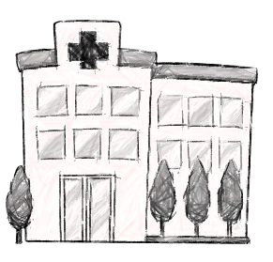
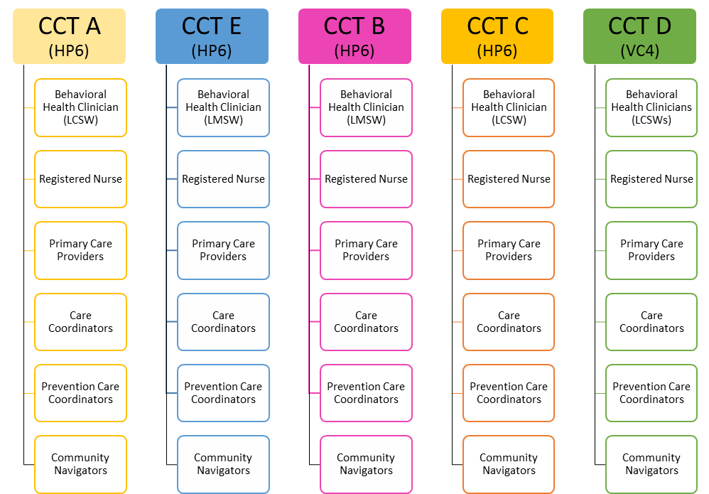
Empanelment and Team-Based Care Coordination Strategy
RN-Led Clinical Care Coordination/
Panel Management
Care Enhancements:
Better communication
Social Worker co-lead Clinical Care Teams
Medication adherence through Primary Care RN
Integration of HIV Prevention and HCV
Coordinated Services for People with Complex Co-Morbidities
Integration of Behavioral Health
RN Care Managers
(STAR and DSRIP):
Provides CCT structure and training
Supports Navigators, Community Health Workers and Peer Educators
Crosses settings and program boundaries
Work closely with CCT Prevention Coordinators to advance population strategies
Adherence Supervisor, Community Health Worker, Nutritionist, Psychiatrist, Patient Financial Advisors, Data, & Other Staff

Slide 15
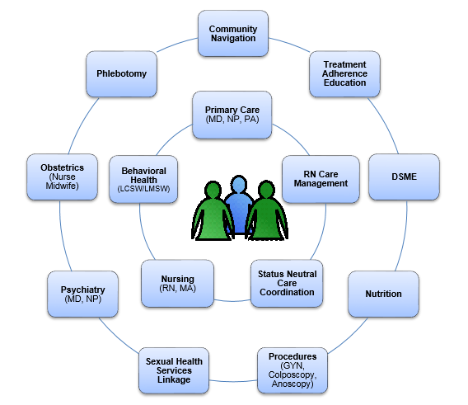
Team Based Care Coordination Model

Slide 16
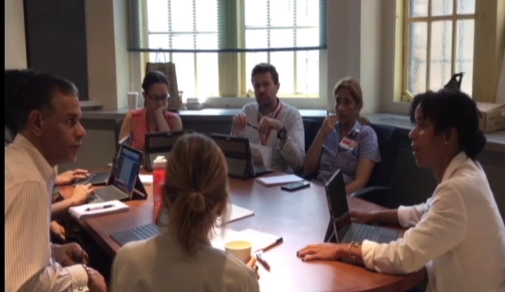
Clinical Care Team Meetings
RN Care Manager provided CCT structure and trainings
Prioritized care coordination resources for patients by level of risk utilizing CCT dashboard
Facilitated weekly case conferences

Slide 17
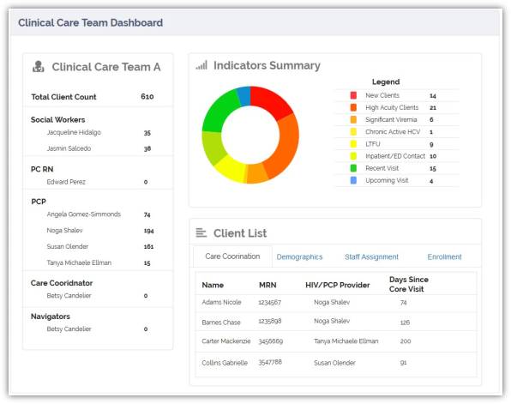
Data-Driven Panel Management Under Practice Transformation
Facilitated through eCOMPAS Clinical Care Team Dashboard
Review of panel Quality data at weekly inter-disciplinary care team meetings
Advantages:
Allows for expertise from all disciplines and roles
Optimization of resources to reach patients across settings for linkage & retention, reducing hospitalizations, etc.
Notes:
Pete and Maria

Slide 18
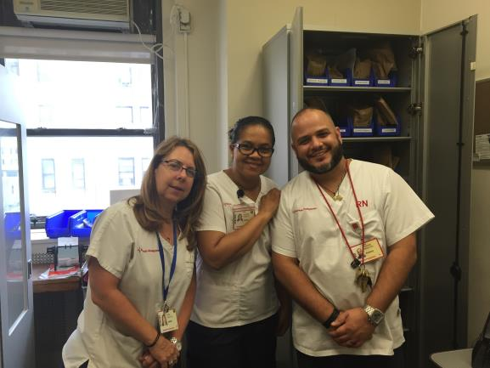
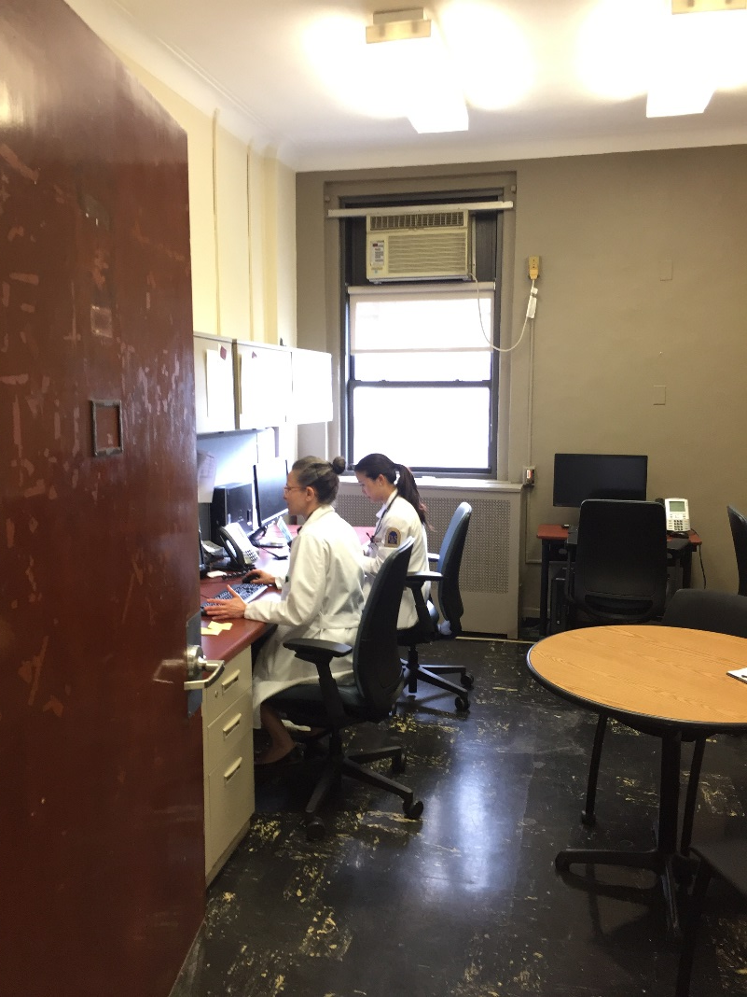
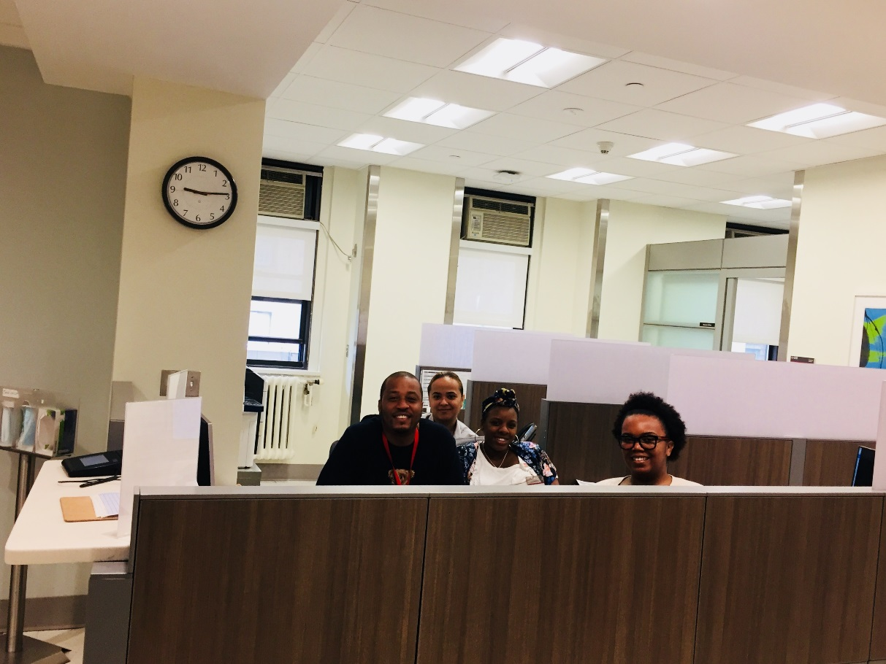
Clinic Flow Redesign and Expansion of Open Access

Slide 19
Evaluation of Practice Transformation Effects on Quality of Care

Slide 20
Focus Groups Eligibility Criteria
Practice staff who had been employed at the program for at least a month; and
Assigned to a Clinical Care Team

Slide 21
Qualitative Data Collection
6 focus group sessions conducted between May and June 2017 with 35 unique participants:
3/5 Clinical Care Teams (Multi-disciplinary)
Nursing (RNs and NA)
Behavioral Health (LCSW/LMSW, Psych Providers, Manager)
Medical Case Management (Care Coordinators, Navigators)

Slide 22
Focus Groups
Standard guide employed
Facilitator (Senior Evaluator)
2 Co-Facilitators (Trained MPH Students)
Sessions were recorded after collecting consent from participants
Each session lasted approximately 1 hour

Slide 23
Coding and Data Analysis
Use of Consolidated Framework for Implementation Research (CFIR) constructs and intervention-specific constructs
Deductive coding
Use of codebook
Several coders
Initially compared coding based 1 session transcript
Data organized in spreadsheet
Thematic analyses

Slide 24
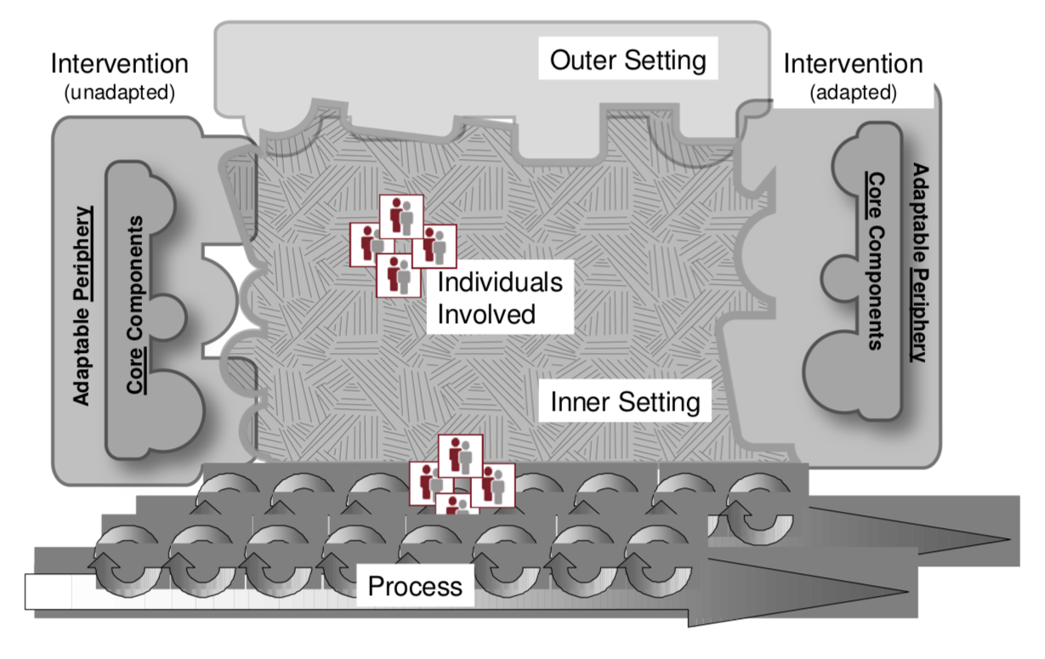
Consolidated Framework for Implementation Research (CFIR)
Advantages:
Focus on implementation
Can be used for process evaluation of interventions
Monitor barriers and facilitators of implementation
Assess progress toward implementation goals

Slide 25
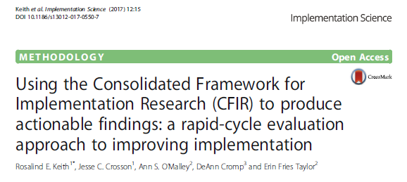
Codebook Development
Operational Codes (5)
Based on STaR Project Interventions
Barrier/Facilitator Codes (2)
CFIR Domains
Intervention Characteristics (8)
Outer Setting (4)
Inner Setting (12)
Characteristics of Individuals (5)
Process (8)
Final codebook excluded a number of CFIR codes that were not applicable to our data
Source: Rosalind E. Keith, Jesse C. Crosson, Ann S. O’Malley, DeAnn Cromp, and Erin Fries Taylor. Using the Consolidated Framework for Implementation Research (CFIR) to produce actionable findings: a rapid-cycle evaluation approach to improving implementation. Implementation Science (2017) 12:15.

Slide 26
Characteristics of PTM - Facilitators
Frequent team-based communication through weekly clinical care team meetings
“It used to be very lonely. It was just like everybody was doing their thing, but you didn’t really know how we could help each other. So I think… I personally feel way more supported since the care team all began.” (PCP)
“[…] it [team meetings] helps us be more cohesive and make sure that we know everything is being taken care of because every discipline is represented…..” (Social Worker)
Direct access to panel’s quality indicators, including ED/hospitalization through panel-based dashboard
“I mean that is incredible […] and I think that maybe that's why the meetings are much more effective now than they were in the pre-STaR. […] Like knowing which patients haven't been seen in a year, which patients are in the ER, which ones were admitted, etc. etc. It’s hard to keep track of all of that as a clinician.” (PCP)
“Also you see like a different, it’s like a complete list of those who are [viremic], who have high [viral load]. And it’s by provider, where you can see all of them. …. Why are their[viral load is) high? Are they picking up medications. Are they taking their medications? So it easier to find out who is, who has a high [viral load]. […] Who’s Hep C? Who is getting treatment and who’s not?” (Social Worker/Care Coordinator)
Notes:
eCOMPAS dashboard brings team together.
Embodies team and team-meeting/communication
Creates well defined teams (not previously possible) and well defined panels.

Slide 27
Characteristics of PTM - Barrier
Overlapping responsibilities with the addition of new HIV care coordination roles to the clinic
“With all the new people that have been hired, both as part of this transformation and the [DSRIP] stuff, they have sort of new job descriptions, also, for team members. I think that’s good in many ways, but it’s also challenging to know sort of who’s responsible for what; care coordinators, nurse care coordinators, navigators, social workers, social worker assistant. And everyone is, there's a ton of overlap. But I feel like sometimes I go to the wrong person and the wrong thing. And people are always willing to help out. But we only have… I think it’s good in some ways. We don’t have to put in… I think people feel like, you know, comfortable and are willing to do, arrange things.” (PCP)
Limitations of current HIT systems in differentiating patients based on HIV diagnosis status
“You cannot distinguish between positive and negative. […] So if you're pulling up a panel of patients and you see people for family planning once a year… How often they should come in is very different than someone who’s positive. […] So to say “lost to follow-up” isn't really fair because they're fine. They're not lost to follow-up. […]They just have a very different plan.” (PCP)

Slide 28
Outer Setting - Facilitator
Program alignment with regional goals for improvements in HIV care continuum including expansion of PrEP/PEP
“I mean people know about REACH, the REACH Collaborative, which is the DISRIP project that I work with, End the Epidemic. […] We’re trying to not compartmentalize in terms of having these really sharp demarcation lines between this grant and this grant, because it’s all about End the Epidemic. And so we’re trying to kind of blur those lines a lot.” (RNCC)
Outer Setting - Barriers
Complexity of integrating pay for performance initiatives and grant-funded activities within a team-based care structure
“it’s always our task for outreach. I think when we talk about the patient and we bring to the table sort of “hey this patient’s been lost to follow-up we can’t get in touch with them” we have certain deliverables we can only go up to. So let’s just say for a lost to follow-up patient for ours, we can only outreach to them for 8 weeks. After the 8 weeks, we have to suspend them or close their case and then we can’t provide services to them.” (Medical Case Management Care Coordinator)
“[…] And so it’s great to know what our other counterparts do, so that when we do [have] a patient… Like recently, we had a patient who tested positive. We’re able to talk him through the process. Because even though we don’t do that part of the care, we know what happens. […] And then that allows us to hand off the patient to another person who could then do the work with, instead of just going to a whole stranger […]. (PrEP Coordinator)

Slide 29
Inner Setting - Facilitator
Shared values on the importance and efficiency of conducting clinical care team meetings
“It provides for better communication. […] I think it’s an open conversation between different disciplines that are all working towards the same goal with the patient. So I think we eliminate side conversations where maybe we leave someone out.” (Care Coordination)
“Well, what I think is that our weekly meetings, I think they are very helpful for all of us because we can communicate. I know the providers, they have a very busy schedule. We work in the field. So we’re not here all the time. But actually, we are, being patient navigators, we go to their house, the patient’s house. So we’re the one who actually knows what's going on out of the clinic. So, it’s kind important to, sometimes to bring some information that we observe in the patient’s environment to the providers so they can have another idea about what's going on with this patient. So I think meeting once a week all together, we can disclose all this information and have a very, like a positive… I think it is amazing. I love it, because I don’t have to look for a provider, you know.” (Patient Navigator)
Notes:
Communication
Meetings
Compatibility with values of program

Slide 30
Inner Setting - Barrier
Alignment process of patient caseload between PCP and other team members was sometimes not compatible with programs or provider values
“I feel like even in my role, it’s difficult to stick to the panel-based care when something’s happening in real time. So the provider moves in and you're the only one there. And that’s okay. I mean you help out.” (Care Coordinator)
“The only issue about the navigators is that it’s almost unfair, right, because […] whoever is available at that time to sign that, enroll that patient into MCM and assign a navigator, that’s the way it is. So the MCM program is a little different in that sense. But as far as the social work team and the coordinator and the provider, it’s more aligned. (RN Care Manager)
"And this is brand new. This is brand new. It’s still new. So it’s going to take time. But like I said, it’s those patients that are already emotionally fragile. […] Like I have one that I said I'm not even going to tell him about the changes. I told the person that was doing the, assigning the social workers, I said; look. This patient is going to stay with me. He's very fragile. And he’ll freak out. He’ll freak out.” (Social Worker)
Notes:
Panel alignment

Slide 31
Characteristics of Individuals - Facilitators
Self-efficacy among non-PCP team members to execute care coordination tasks
“Like we see that a patient hasn’t been for six months. And then we see that the plan… So we use [the EMR]. We can go back and pull up from the [eCOMPAS] dashboard, [the EMR], to get more information. So let’s say a patient, the plan for a patient is follow-up in four weeks. And the patient hasn’t been here in two months. That’s the thing to be done. I mean that’s coordination right there. […] We don’t need the providers for that.” (RN Care Manager)
Willingness from team members to be available in real-time
“It’s the willingness to be available. I mean it’s really the place…I didn’t… I actually didn’t even know that [Team A Case Manager] wasn’t on my team. I’m made so many requests. […] There has never been a time where they’ve said no to help you. It’s always yes. And actually, always extremely effective. So it’s been fantastic.” (PCP)

Slide 32
Characteristics of Individuals - Barrier
Limited nurse care manager scope of knowledge around implementation of intensity of care coordination based on risk-stratification
“I would say that the conversation tends to be driven mostly by people who the viral load is not suppressed. We tend to talk about the same people habitually. And not that we shouldn’t. But there was one week when we did, like I think like hemoglobin A1C, for example. It’s sort of like you forget that for many people who are long-term HIV suppressed, still have an intense medical need that, you know, that we are not adequately meeting […]. So whereas somebody, I mean, not to be too nihilistic, but once you discuss the same person over and over again for two months and made plenty of attempts to outreach, etc., it’s almost like you're better off using your time discussing some other.” (PCP)
Notes:
Indicators
Team meetings
Facilitation
calendar

Slide 33
Process - Facilitators
Integration of HIT during care team meetings
“And adding the technology component. Because we didn’t have that. […] We had been using it up on HP-6 consistently. But we didn’t have the same projector or screen. We just didn’t have sort of the infrastructure. But we began using [individual tablets] now during our meetings here, which suffices because we really don’t.. Everybody doesn’t need to have their faces, you know, in the computer. But it does give us the information that we need to have our conversations.” (RN Care Manager)
“But then with the clinical care team, a team aspect, I think it’s more, with the team aspect, we have like the eCOMPAS right there. So, if we’re not sure about anything, it’s being pulled up right away. And we just discuss, you know, basically the same thing we were discussing before..” (Patient Navigator)

Slide 34
Process - Barriers
Development of program silos supported by fragmented HIT
“Like anyone can provide this service. It’s just virtue of location and…And age. Because a lot of older people are going to be seen on HP-6. Yeah. And a lot of older people aren’t seeking out PrEP. But I think a lot of the panels of the providers upstairs are like more than full with HIV positive individuals. And the PrEP visits are a lot. It’s every three months. So, you're asking providers not only to go outside their comfort zone both insurance-wise and everything… But it’s labor-intensive. But and it’s also like takes up a lot of slots on your panel.” (PCP)
“And that’s where our [PrEP Database] comes in handy. Because we… That’s the reason why we created it is because we can’t really have a way of pulling out our PrEP patients from [EMR] in a reasonable way. So the SharePoint database is a way for us to look at the status of our PrEP patients.” (PCP)
Limited participation of PCPs at the clinical care team meetings due to part-time status
“I think it’s a lot of activity for us…in our coordination…it can keep track of the patients that we’re touching, that we’re not touching. The only thing that we tend to focus on providers is the ones that attend the meetings; whereas the larger population of patients…we don’t look at them at all. We try to, but we also have to focus on the providers that are there.” (Social Worker)
Notes:
Silos
Many grants, many programs, Many dashboards
Unified approach needed
Participation bias based on provider panel –over represented and under represented pt panels

Slide 35
Key Findings
Data-driven solutions can improve focus, liberate clinical time and support the identity and notion of team-based care and each team’s panel
Selecting meaningful data indicators for a team-based dashboard allows team members to engage in productive discussions around improving quality of care
Highly protocolized funding initiatives can drive data systems, perspective and staff scope (+ and -)
Need for shared understanding of overarching vision/goals and how data and quality can support population health outcomes
Clarity and redefinition of team roles and responsibilities is essential and requires frequent review and reinforcement
Local dissemination is crucial

Slide 36
Ongoing Challenges in Improving the HIV Care Continuum
Notes:
Although VLS rates reached 85% in 2017, patient care coordination challenges remain especially as it relates to new and re-engaging patient populations.

Slide 37
Acknowledgements
Audrey Perez, RN, Nurse Care Manager, STaR Project
James Beltran, Data Coordinator, STaR Project
Mila Gonzalez, MPH, STaR Project Director and Quality Manager
Susan Olender, MD, STaR Principal Investigator and Quality Program Director
Peter Gordon, MD, Medical Director
Rebecca Schnall, PhD, RN, STaR Project Evaluator
William Seiling, MPH
Amber Gibbs, MPH
Jesse Thomas, RDE Systems, HIT Consultant
Anusha Dayananda, RDE Systems, HIT Consultant
Comprehensive Health Program Team!

Slide 38
Funding Acknowledgement:
This NYP-Columbia STaR project is supported by the Health Resources and Services Administration (HRSA) of the U.S. Department of Health and Human Services (HHS) under grant number H97HA27430, a Special Projects of National Significance (SPNS) entitled “System-level Workforce Capacity Building for Integrating HIV Primary Care in Community Health Care Settings - Demonstration Sites” for 1,189,500 from 2014-2018. This information and these conclusions are those of the authors and should not be construed as the official position or policy of, nor should any endorsements be inferred by HRSA, HHS or the U.S. Government.

Slide 39
Question?

