Slide 2
A Tale of Three Cities: Leveraging Text Messaging to Engage Young People Living with HIV in St. Louis, Los Angeles, and San Francisco
from the Special Projects of National Significance (SPNS)
Friends Research Institute, Inc; Los Angeles, CA
San Francisco Department of Public Health; San Francisco, CA
Washington University St. Louis; St. Louis, MO

Slide 3

E-VOLUTION: Connect. Engage. Thrive.

Slide 4


E-Volution Project Team
Katie Plax MD – Principal Investigator
Kimberly Donica LCSW – Project Director
Jeff Glotfelty MPH – Project Coordinator
Stacey Slovacek LCSW – Assistant Project Coordinator
Julia Schlueter MPH – Evaluator
Maria Freshman MA – Data Manager

Slide 5
Background: Mobile Health (mHealth)
Text messaging can be an effective tool to improve patient outcomes along the HIV care continuum.
Teens own a smart
phone
Cell phones have become indispensable tools
73%
African American teens
own a smart phone
>100
85%
TEXT MESSAGES
A DAY
1 in 3 adolescents
sends more than
Lenhart, Amanda, Pew Research Center, April 2015, “Teen, Social Media and Technology Overview 2015.” Available from http://www.pewresearch.org/wp-content/uploads/sites/9/2015/04/PI_TeensandTech_Update2015_0409151.pdf

Slide 6
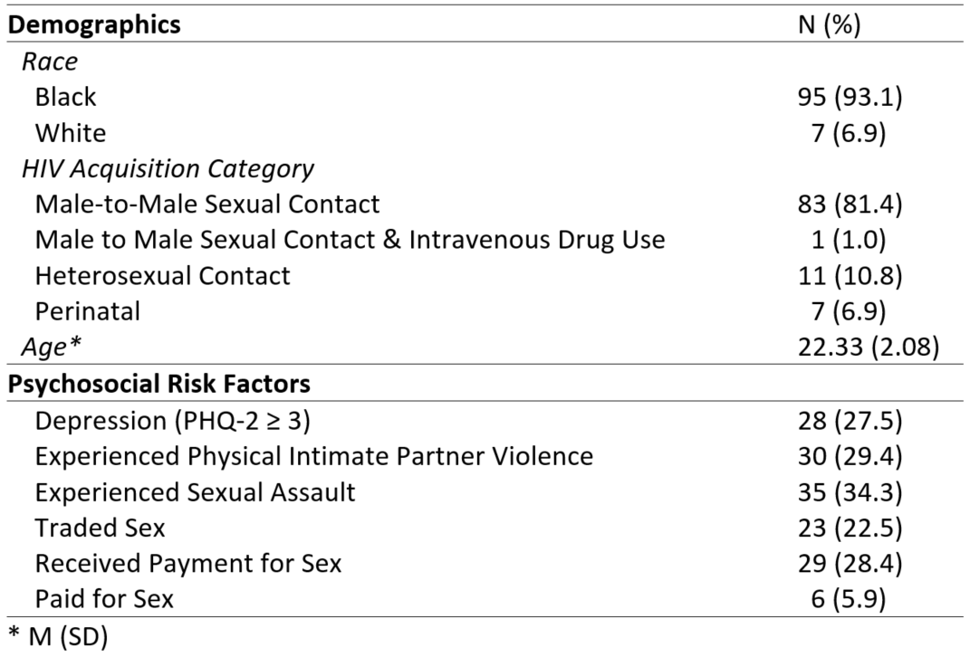
Participant Demographics and Risk Factors at Consent (n=102)

Slide 7

Medical Case
Manager to
Client
Shift communication to more youth friendly method – text messaging
  Built bi-directional mHealth HIV-specific modules which includes:
      Medication Reminders (Daily)
      Appointment Reminders (As Needed)
      General Mood Check-Ins (Twice Weekly)
      Housing/Bills Needs (Monthly)
Clients’ identified needs trigger alerts

Slide 8
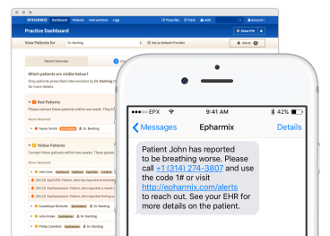
Intervention Description
Automated Text Messaging
  Medication Reminders
    “Did you take your medication at 9:00am?
    Please reply yes or no.”
  Appointment Reminders
    “Your appointment with The SPOT is in 2 days, on 12/28. If you cannot make the appointment for any reason,
    reply 1.”
  Mood Check-Ins
    “We are always here to help. How are you doing today? Reply 1 if better than usual, 2 if same, 3 if worse than usual.”
  Social Service Needs (Housing/Bills)
    “You once mentioned concerns about housing. Do you think you’ll have trouble with any upcoming bills?
    Please reply yes or no.”

Slide 9

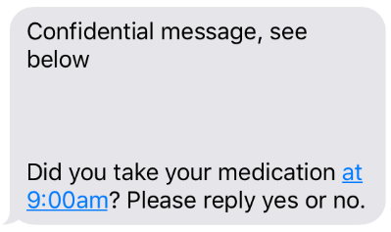
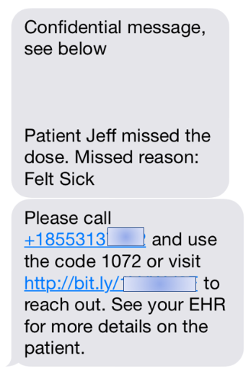

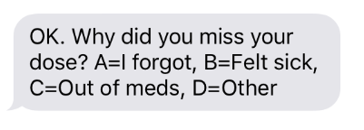

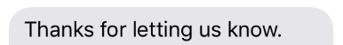
Automated Text Messaging
Care Team
Member
Phone
Patient Phone
<Messages (844) 555-1234 Details
<Messages (314) 555-1234 Details

Slide 10
Participant Engagement
Raw Number of Text Messages Sent:
  Appointment Reminders = 1,482
  Medication Tracking (includes mood check ins and social service needs) = 58,200
  Total Messages Sent = 59,682
“It helps me remember to take my medication.”
Notes:
10

Slide 11
Alerts
“Easy to talk to someone if I have a problem and response is usually pretty quick”
Number of Alerts
  Appointment Reminders = 115
  Medication Tracking (includes mood check ins and social service needs) = 280
  Total Alerts = 395
Top 3 alerts for medication tracking
  Need for help with housing/bills = 89
  Did not take medication (Reason: Other) = 64
  Did not take medication (Reason: Out of Meds) = 58
+ Number of alerts for Not Feeling Well (with requested follow-up) = 42
Top 3 reasons for missing medical appointment
  Miss due to work = 37
  Miss due to other reasons = 31
  Miss due to transportation = 15

Slide 12
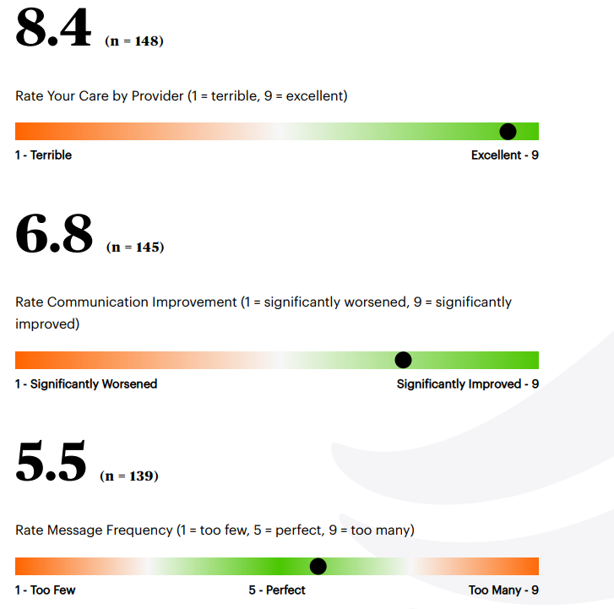

Participant Feedback
Client Feedback - Epharmix
“They care that someone else cares for me and trying to make sure I’m on top of my needs.”
“All the help that I didn’t know was available to use for people with illness/sickness. How everyone is so caring and energized and the doctors are awesome.”
“It’s something I can rely on if I don’t have anyone else or if I forget.”
“The service was excellent. Thanks to [my case manager] and her keeping me updated with appointments and messaging me I received the treatment necessary.”

Slide 13
Overcoming Challenges:
Privacy Concerns

Slide 14
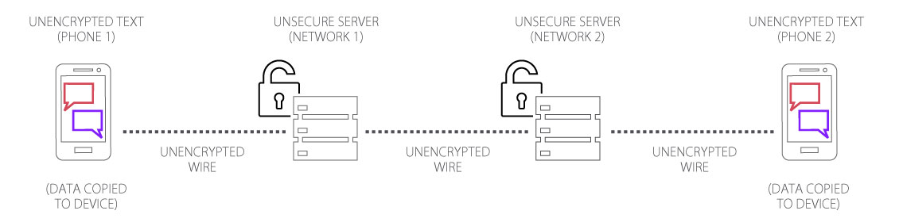
Strategies for Reducing Risks to Client’s Privacy
Mobile Device Management (MDM)
First Text in Person – Confirm
White Labelling
Collection/Deletion Policy
Proper disposal of the device
Staff Trainings
BAA with Automated Service
Encryption
Minimize PHI
Change to a phone call
Privacy Settings (Tip Sheet)
  Single User Phone
  Password
  Push Notifications
Updating if Number Changes
Notes:
On this slide and the following, replace the items in red with your information.
Look for instructions for each slide I this notes section.

Slide 15
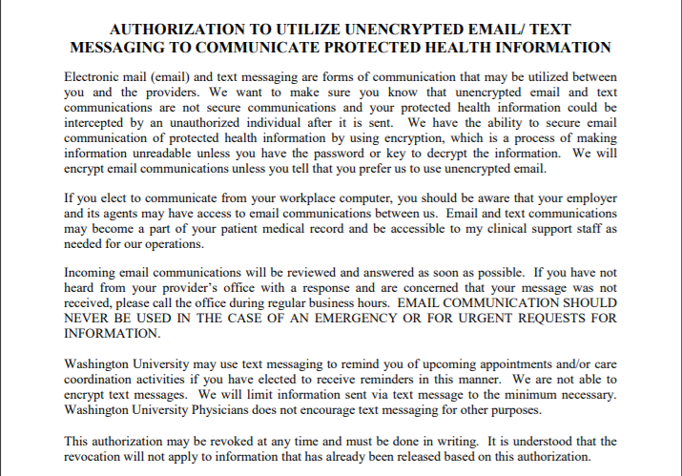
Informing Clients of the Risks of Texting
Notes:
On this slide and the following, replace the items in red with your information.
Look for instructions for each slide I this notes section.

Slide 16
Tool to Assess Potential Privacy Risks
Safety Screener
Developed by “GUY2GUY Phase Four Randomized Controlled Trial: Safety Appraisal Questions.” Center for Innovative Public Health Research; innovativepublichealth.org
  What do you think about the possibility of someone else (friend, partner, parent, etc) seeing messages about your healthcare?
  What would happen if someone (friend, partner, parent, etc) saw these kinds of messages (how are you feeling today, reminders for appointments, medication reminders, discussions with your case manager)?
  Do you know how to:
    Password protect your phone?
    Turn off “preview” push notifications?
    Identify apps that may give someone else access to your text messages?
Notes:
On this slide and the following, replace the items in red with your information.
Look for instructions for each slide I this notes section.

Slide 17
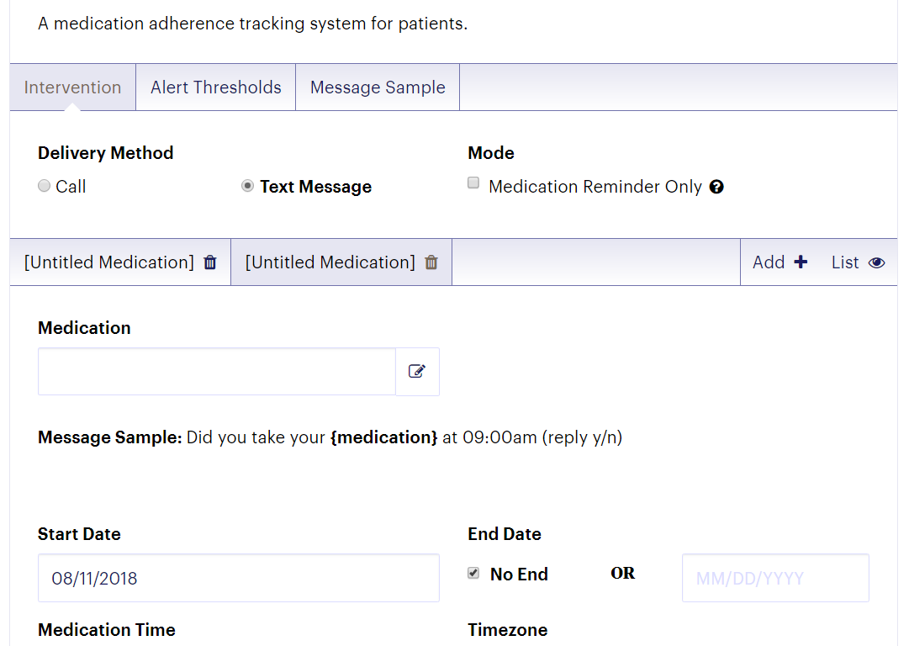
White Labelling
Notes:
On this slide and the following, replace the items in red with your information.
Look for instructions for each slide I this notes section.

Slide 18
Collection/Deletion Policy
Staff will not store protected client information or documents on the smartphone:
  Text Messages must be deleted from phone after 1 week max
  Pictures deleted from phones after 24 hours max
Notes:
On this slide and the following, replace the items in red with your information.
Look for instructions for each slide I this notes section.

Slide 19
Preliminary Evaluation Results
Average Viral Load – Difference in Mean (SD) Viral Load at Consent and 6 months
Sample (N) | Mean Viral Load (SD) | z score | p-value
Baseline (102) | 23,843.17 (72,661.09) | -2.45 | .014
6 mos (83) | 6,834.06 (26,002.05)
Excludes those that did not participate in the program for at least 6 months.
Notes:
Wilcoxon Signed Rank tests were used to determine if there was a significant difference between the viral loads collected closest to consent and those collected closest to the date that the participant had been in the E-VOLUTION program for six months. This non-parametric alternative to a dependent samples t-test was used due to the non-normal distribution of viral load data. The average 6-month viral load was significantly lower than the average viral load at consent. Table 1 below presents these results.

Slide 20
Preliminary Evaluation Results
Differences in Proportion of Suppressed vs. Unsuppressed Participants at Consent and 6 Months
Sample (N) | Suppressed v. Not Suppressed VL | Χ² | p-value
Baseline (102) | 50 v. 52 | 5.60 | .018
6 mos (89) | 59 v. 30
Excludes those that did not participate in the program for at least 6 months.
Notes:
McNemar exact tests were computed for each sample to determine if there was a significant difference in the number of participants with suppressed viral loads at 6-month follow-up compared to that taken at consent.
Results indicated that a significantly greater proportion of participants were suppressed at their viral load test closest to 6-months in the E-VOLUTION program compared to their viral load test at consent.
20

Slide 21
Contact Information
Principal Investigator:
Katie Plax, MD
plax_k@wustl.edu
Project Coordinator:
Jeffrey Glotfelty, MPH
jeffglotfelty@wustl.edu
Notes:
21

Slide 22


Slide 23

Project Team
Sean Arayasirikul, PhD – Principal Investigator and Evaluator
Erin Wilson, DrPH– Project Director
Dillon Trujillo, MPH(c) – Digital Navigator
Caitlin Turner, MPH – Data Manager
Victory Le– Medical Chart Abstractor

Slide 24
Intervention Description
Health eNav is a digital HIV care navigation intervention using SMS text messaging in San Francisco.
Our Digital HIV care navigation intervention is comprised of four main components:
  Provide short-term mobile phone access;
  Deliver asynchronous, non-traditional digital navigation through text messaging;
  Collecting ecological momentary assessment (EMA) data and integrating that into the digital navigation system in real-time ; and
  Integrate social media platforms to locate and retain participants in care.

Slide 25
Study Design
Baseline
3 Mo.
6 Mo.
12 Mo.
18 Mo.
Daily EMA Surveys
Follow-Up
Digital HIV Care Navigation

Slide 26
Digital HIV Care Navigation
Social Support
  Emotional
  Informational
  Instrumental
DIGITAL HIV CARE NAVIGATION
Linkage
Engagement
Retention
Personalized, In Context
On-Demand/Real-time
2-way text messaging
Motivational Interviewing
  Behavior Change
  Mental Health
  Substance Use

Slide 27
Ecological Momentary Assessments
90 Daily Text Message Surveys
Participants earn $1 per completed survey (up to a total of $90
If participants complete 80%+ surveys, they receive a bonus of $100
EMA: Mood and Mental Health (5 items)
EMA: Sexual Risk Behavior (3 items)
EMA: Substance Use (6 items)
EMA: Substance Use x Sex (6 items)
EMI Reminders: Treatment Adherence (3 items)

Slide 28
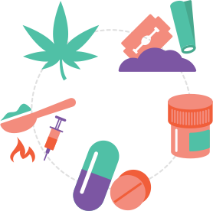
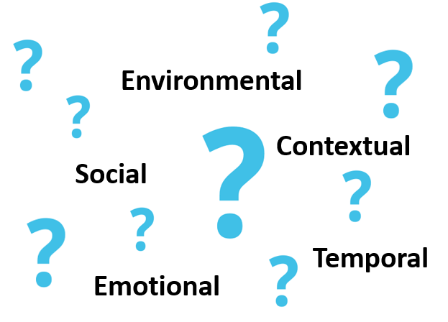







Ecological Momentary Assessments
Unknown Trigger(s)
Behaviors that Shape HIV Care Engagement
Real-Time, Personalized Digital HIV Care Navigation
90 Daily Text Message Surveys
Affect, Sexual Behaviors, Substance Use, Treatment Adherence, Social Support.
$1 earned per completed survey

Slide 29
Study Design
Baseline
3 Mo.
6 Mo.
12 Mo.
18 Mo.
Daily EMA Surveys
Follow-Up
Digital HIV Care Navigation

Slide 30
Study Design
Baseline
3 Mo.
6 Mo.
12 Mo.
18 Mo.
Daily EMA Surveys
Follow-Up
Personalized, Real-time Feedback
Digital HIV Care Navigation

Slide 31
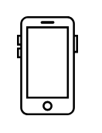
Engagement – Daily EMA Surveys
Cumulatively, participants provided complete responses to
Completed 70% or more of EMA surveys:
4,384
{40.6%}
EMA prompts
10,800
56/120
(46.7%)
40/120
(33.3%)
30/120
(25.0%)

Slide 32

Engagement – Daily EMA Surveys
Time to weeklong discontinuation:
  Average TTE: 42 days
85
{ or about 7 in 10 }
Experienced at least one weeklong discontinuation
120

Slide 33
Engagement – Digital Navigation
Number of Text Messages range from 1 to 467
Average Number of Text Messages = 109
 | # Messages | Percent
Little to No Engagement | 1-40 | 27.5%
Low Engagement | 41-90 | 24.2%
Medium Engagement | 91-150 | 23.3%
High Engagement | 150+ | 25.0%

Slide 34
Low Tech, High Touch Interventions are POWERFUL
Two-way text messaging is a ubiquitous technology and is low-tech
Personalized interaction is the best way to engage youth living with HIV and meet them where they are at
Emotionally intelligent, trained peers are critical

Slide 35
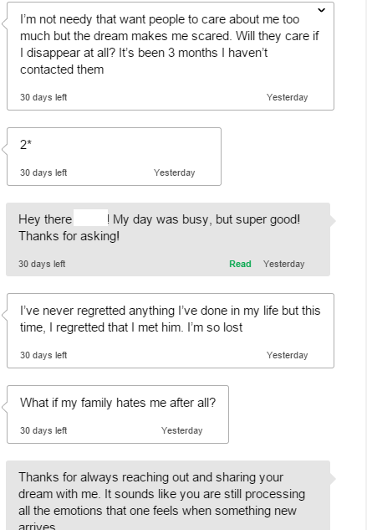
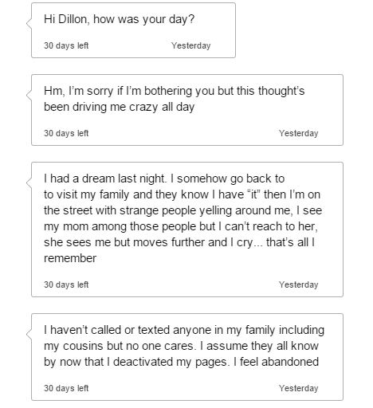
Ambivalence

Slide 36
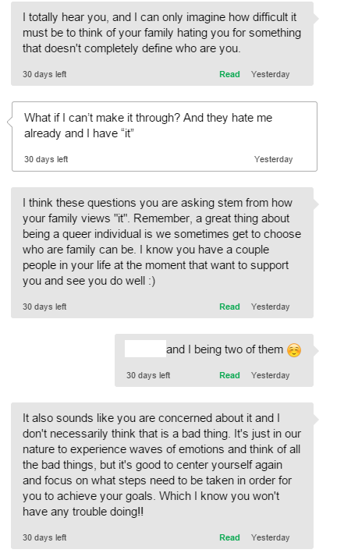
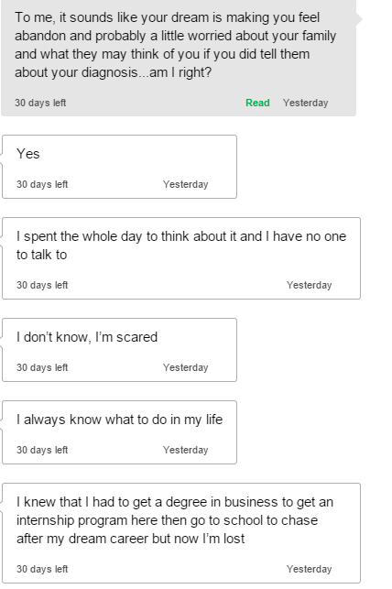
Empathy and reflective listening
Supporting self-efficacy and optimism

Slide 37
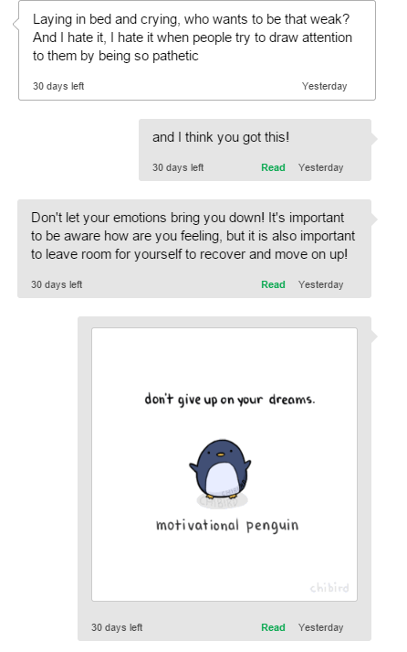
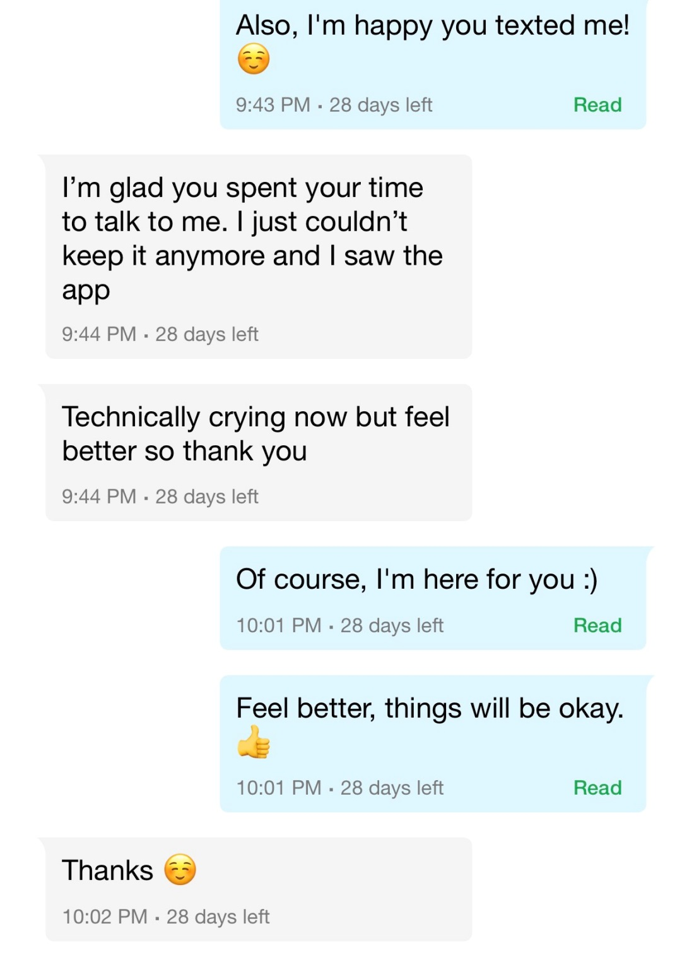

Slide 38





Slide 39


Text Me, Girl! Project Team
Cathy J. Reback, Ph.D. – Principal Investigator
Kimberly Kisler, Ph.D., MPH – Project Director
Ray Mata – Research Coordinator/Evaluator
Miranda Ramirez – Research Assistant
Triana Maldonado – Research Assistant
Jesse B. Fletcher, Ph.D. – Data Manager
Dennis Rünger, Ph.D. – Statistician

Slide 40


Recruitment Flyer
Portrait
and
Landscape

Slide 41
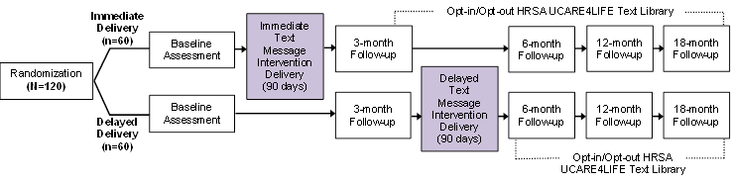
Study Design

Slide 42
Text Me Girl! - mHealth to Improve HIV Primary Care Outcomes
Ongoing Support
Participants can opt-in to receive ongoing retention/engagement messages
Theoretical Foundations
Social Support Theory
Social Cognitive Theory
Health Belief Model
Tailored to young adult trans women
In-Situ @ High Risk Hours
Low Cost, No Internet
Culturally Nuanced
Text-based mHealth Intervention
Linkage
Engagement
Retention

Slide 43
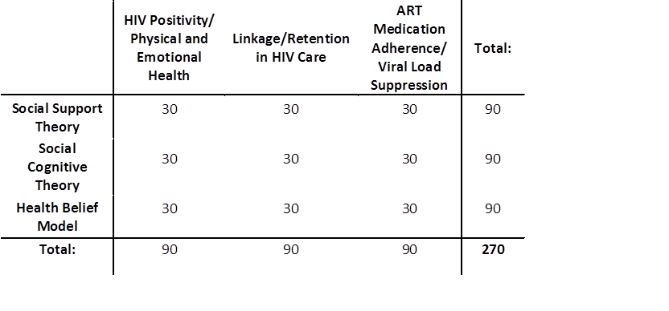
Intervention Description
  270 scripted theory-based text-messages
  HIV Care Continuum
    HIV positivity/physical and emotional health
    Linkage/retention in HIV care
    ART adherence/viral load suppression
Theoretical Model / Conceptual Framework
    Social Support Theory
    Social Cognitive Theory
    Health Belief Model

Slide 44
Targeted, Tailored, and Personalized
The intervention is targeted, tailored, and personalized specifically for young trans women living with HIV:
  Targeted: young trans women living with HIV along the HIV care continuum
  Tailored: Content (i.e., verbiage, content, delivery schedule, medium of delivery) specific to the needs of young trans women living with HIV
  Personalized: Participants can customize their 10-hour delivery timeframe (i.e., intervention time period), and can personalize their delivery platform to their cell phone or an email inbox

Slide 45
Delivery Methods and Frequency
Text messages are delivered either via phone or email
  Of the 130 enrolled:
    79 (61%) chose to receive messages via cell phone text delivery
    51 (39%) chose to receive messages via email delivery
Text messages are automated, unidirectional and delivered with a graduated delivery system
Messages are delivered 3 times/day, every 5 hours within a 10-hour period (default time period: 12:00 noon, 5:00 PM, 10:00 PM; the delivery time period can be personalized)
90-day intervention (3 messages/day x 90 days = 270 scripted messages)

Slide 46
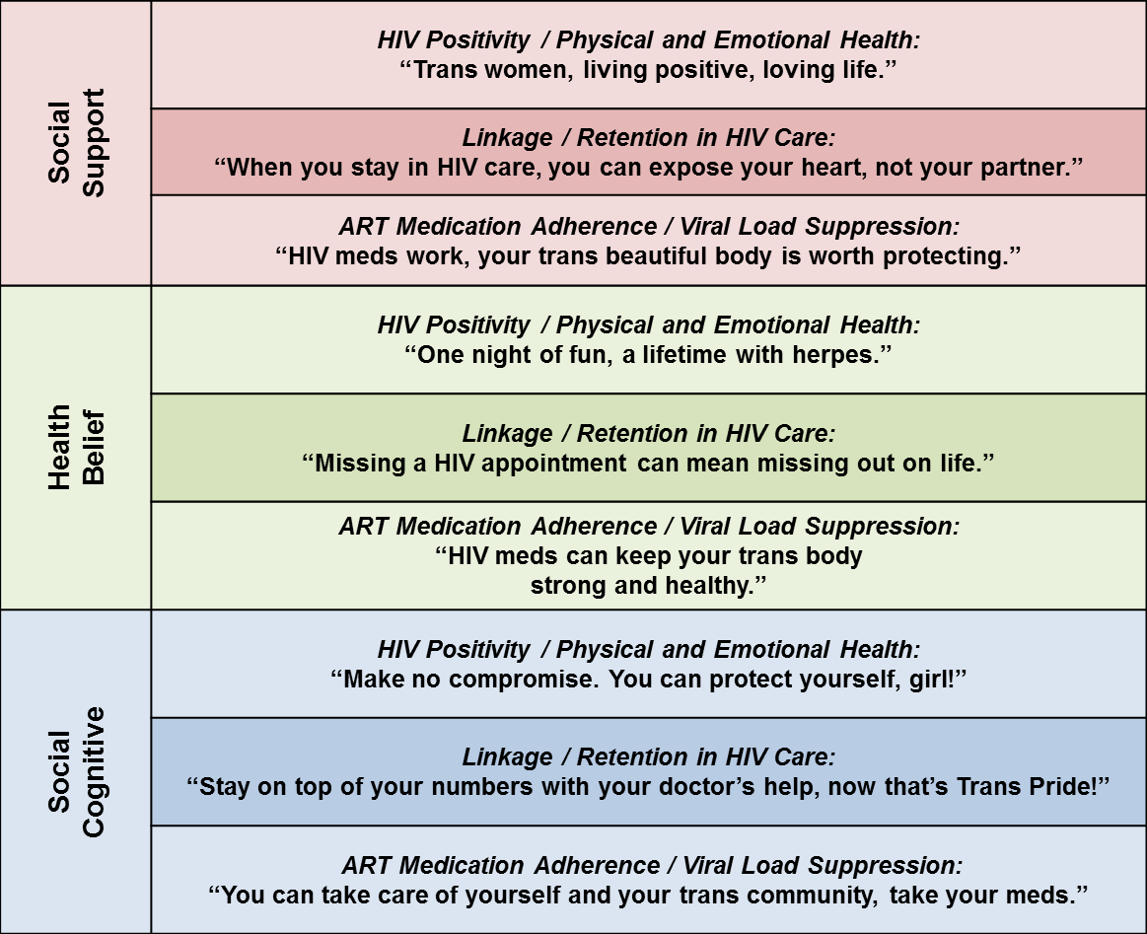
Sample Text Messages

Slide 47
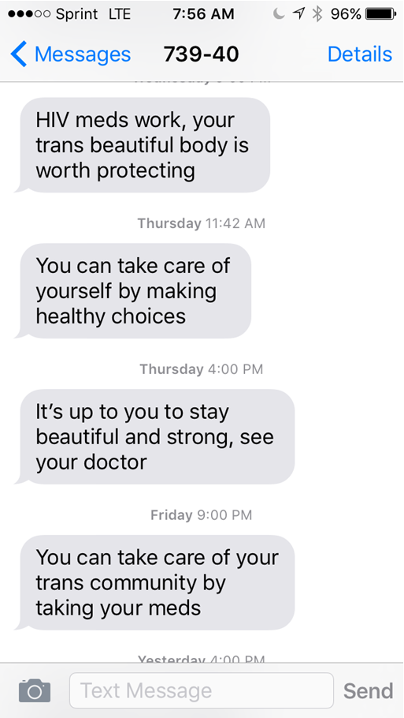
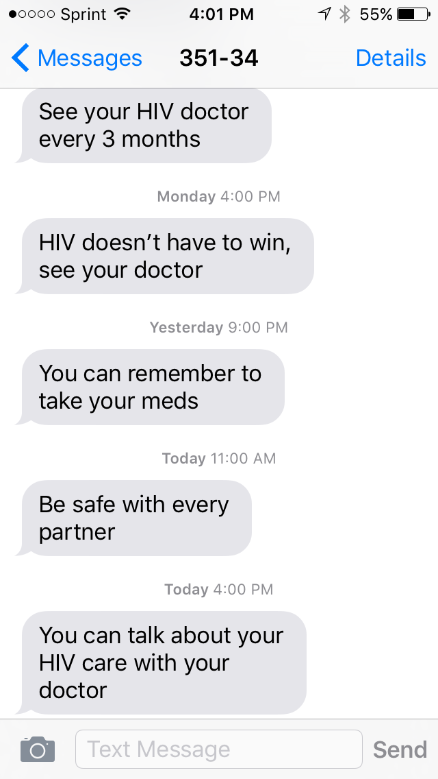
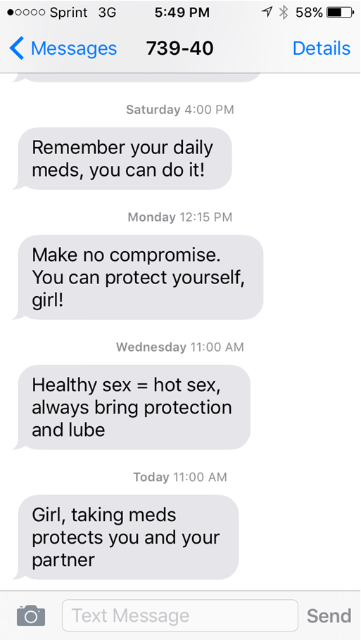
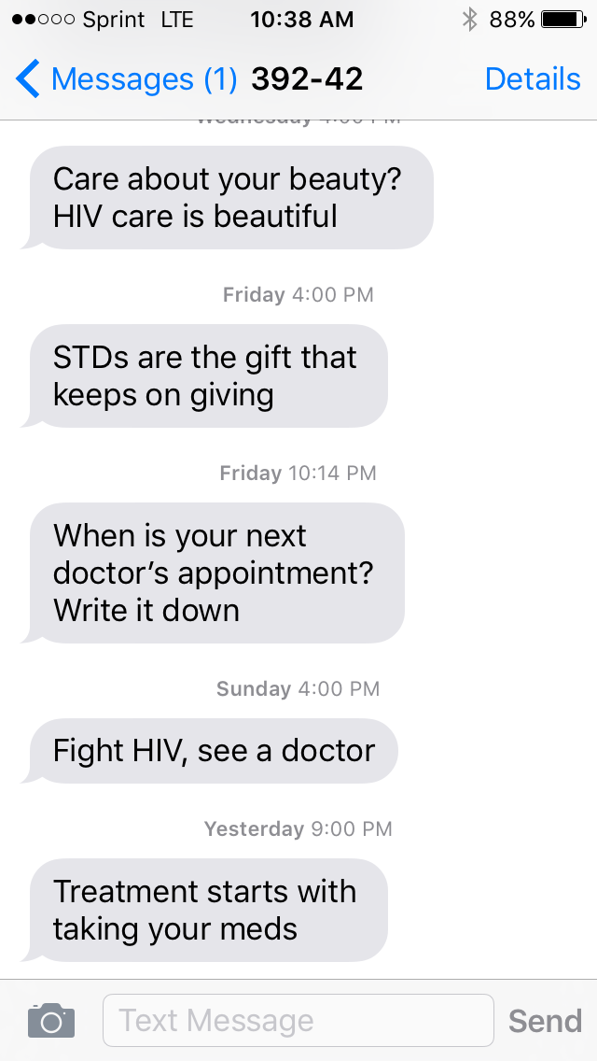
Screenshots

Slide 48
Recruitment
Six recruitment strategies were utilized to ensure enrollment targets are met and a diversity of participants are enrolled:
1) Online Recruitment: banner ads and digital flyers
2) Print Media
3) Street- and Venue-based Outreach
4) Poster Advertisement: placed at collaborating community-based organizations
5) In-services at collaborating community-based organizations and other programs at our site
6) Participant-incentivized Snowball Sampling
We anticipated most participants will be recruited from strategies #6, #3, and #5, in that order; however, #3 and #5 have been most successful

Slide 49
Sociodemographic Characteristics (N = 130)
 |  | N | (%)
Age | 18-24 25-29 30-34 | 16 38 76 | (12.3%) (29.2%) (58.5%)
Racial/Ethnic Identity | Hispanic/Latina African-American/Black Caucasian/White Multiracial/other | 56 49 14 11 | (43.1%) (37.7%) (10.8%) (8.5%)
Education | < High school High school/GED > High school | 53 45 32 | (40.8%) (34.6%) (24.6%)
Income (monthly) | < $500 ≥ $500 | 60 60 | (46.2%) (46.2%)
Housing Instability | Yes | 57 | (43.8%)

Slide 50
Baseline Substance Use and Sexual Risk Behaviors in the Past 6 Months (N = 126)
 |  | N or Med | (%) or (range, IQR)
Substance Use | Any substance Alcohol Marijuana Methamphetamine Amphetamines Poppers Cocaine | 54 38 38 30 18 11 9 | (42.9%) (30.2%) (30.2%) (23.8%) (14.3%) (8.7%) (7.1%)
Number of Sexual Partnersª |  | 0 | (0-320, 0-2)
Condomless Anal Intercourseª | Insertive Receptive | 21 21 | (16.7%) (16.7%)
Sex work | Yes | 29 | (23.0%)
ªPartner HIV status negative or unknown

Slide 51
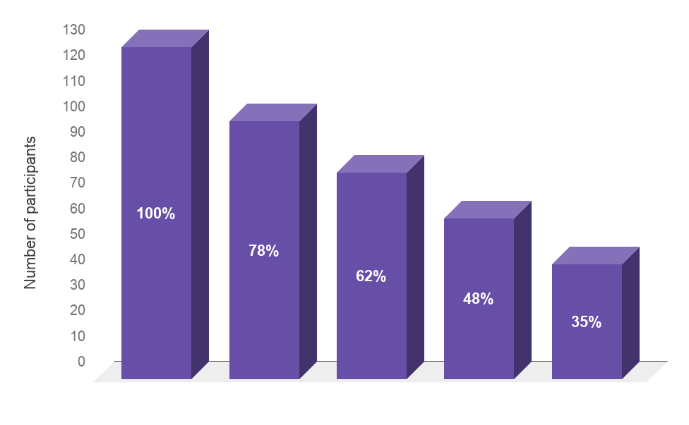
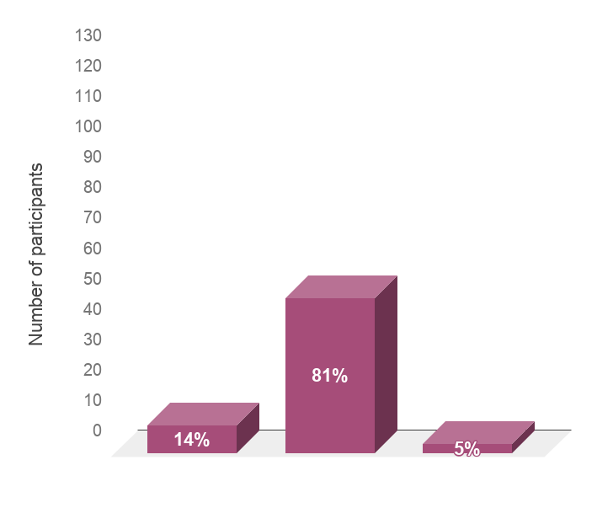
HIV Care Continuum and ART Adherence at Baseline
Ability to take HIV medication as prescribed in the past 20 days
Diagnosed
with HIV
Linked
to care
Engaged/
retained in care
ART
uptake
Viral suppression
Very poor/
poor
Fair/good/
very good
Excellent

Slide 52
Main Recruitment Challenge
Stigma related to disclosing HIV status.
  Solution: Carry flyers for multiple projects at Friends Community Center, including PrEP.
  Do not ask status but, rather, ask when was the last time tested?

Slide 53
Recruitment and Enrollment Outcomes
Recruitment began November 18, 2016, and the first participant enrolled on December 16, 2016.
At the end of the enrollment period, May 31, 2018, 130 participants enrolled in Text Me, Girl! (the enrollment goal was 120).
61 (47%) of the participants were randomized into the Immediate Delivery condition and 69 (53%) into the Delayed Delivery condition.
Referral Sources:
Outreach: 927
FCC Internal Referral: 67
Flyer/Poster/Card: 32
Word of Mouth: 8
In-Service: 6
Text Me, Girl! Participant: 38
Internet/FB/Social Media: 0
Print Ad: 0
Other: 5
Enrollment status:
Inquiries: 1,092
Screened: 229
Screened Eligible: 146
Screened Ineligible: 83
Enrollment/Eligibility Rate: 89% (130/146)

Slide 54
Monitoring Text Messages and Responsiveness
During the intervention period, monthly intervention exposure text message:
  “In the past month, how many of the text messages did you read? Please text back one of the following: 1) none; 2) some, but less than half; 3) about half; 4) a lot, but not all; 5) all.”
  Sent once per week by Research Assistant to eligible participants
As of October 9, 2018:
  ~30% of participants had responded to intervention exposure text/email messages
  Most (~88%) of those responded with a 4 or 5, indicating they are reading most or all of the intervention messages sent that month
3-month (Intervention Completion) Follow-up Evaluation intervention exposure question:
  “In the past 3 months, how many of the text messages did you read?”

Slide 55
Engagement: Participant Response Rates to Monthly Intervention Exposure Assessment

Slide 56
Post Intervention Retention/Engagement Messages: HRSA’s UCARE4LIFE Library
Participants can “opt-in” to receive continuing care via HRSA’s UCARE4LIFE text messages, delivered weekly.
Each of the two topic areas are transmitted once a week for a maximum of two weekly messages.
  HIV care linkage/retention support
  ART adherence reminders
118 participants have become eligible to opt-in to the continuing care message; of these, 30 (25.4%) have opted-in to receive these ongoing messages.

Slide 57
We Thank You!
E-volution
Health-e-Nav
Text Me, Girl!

