Slide 2
Community Based Dental Partnership: Innovation Through Collaboration, Coordination, and Communication
Jill A. York, D.D.S., M.A.S. and Steven Toth, D.M.D.
CBDPP Program Director, Rutgers, The State University of New Jersey
CBDPP Clinical Director, Rutgers, The State University of New Jersey

Slide 3
Learning Objectives
Identify the critical elements of a model that provides oral health care to people living with HIV/AIDS (PLWH) in the community
Examine the impact of collaboration, coordination, and communication on a dental program for PLWH
Recognize methods to improve the community based dental program in your organization

Slide 4
Community Based Dental Partnership
Increase access to oral health care for clients with HIV in areas that remain underserved, especially in communities without dental programs
Increase the number of dental providers capable of managing the oral health needs of clients with HIV, through community based service-learning experiences

Slide 5
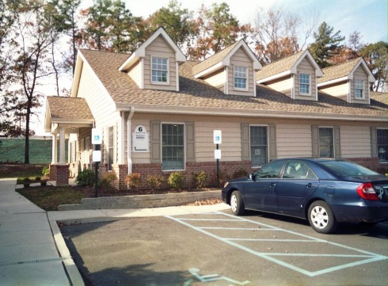
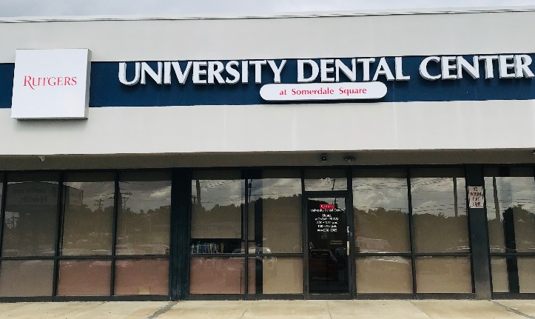
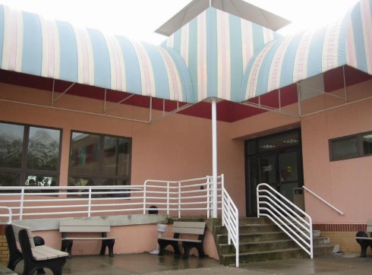

Slide 6
Community Oriented Dental Education
There are two main purposes: (1) To educate the student to care for the HIV-positive client in the clinical setting; and (2) To better understand the broader medical and social challenges for oral health care, along with greater cultural understanding of the oral health care needs of this population.
CODE Program: students spend the majority of their fourth year (30 hours per week) training at a community based site
CODE II Program: students spend two consecutive weeks (75 hours) in training at a community based site

Slide 7
Leader’s Guide to Innovation
Visualize: Picture the ideal future, the “Should-Be” state
Find Facts: Determine the “As-Is” state
Find Ideas: Brainstorm and do “Green-Light Thinking” for ideas
Find Solutions: Do “Red-Light Thinking” to determine the best idea or approach
Find Acceptance: Gain approval and support
Implement: Put the accepted solutions into action
Follow Up: Monitor the implementation
Evaluate: Identify and assess the end result

Slide 8
Best Practices
Collaboration: The process of shared creation; collectively creating something new that could not have been created by the individual users
Coordination: The actions of users directed by a coordinator to achieve a common goal
Communication: The exchange of ideas and information
Service Delivery
Partnerships
Education / Training
Consumer Involvement

Slide 9
Case Management Referral
Strategy 1: Educate case managers, providers and clients about the availability of oral health services offered by the RSDM
Strategy 2: Ensure confidentiality and maintain a system for control of HIV-positive client records
Strategy 3: Make referrals for all eligible clients
Strategy 4: Track and monitor all referrals
Strategy 5: Schedule dental appointments
Strategy 6: Facilitate transportation
Strategy 7: Assist with recall and follow-up appointment for clients
Access One, Inc.

Slide 10
Atlantic County Seniors Program
Strategy 1: Identify opportunities to improve oral health for low income senior citizens (60+ years old) from Atlantic County
Strategy 2: Provide Atlantic County residents with coordinated care through the Division of Intergenerational Services with an interdisciplinary team of health professionals that includes dental providers
Strategy 3: Provide comprehensive oral health care services that are designed to enhance the quality of life and autonomy for older adults
County of Atlantic, New Jersey

Slide 11
Training health providers in HIV screening in older populations and integration of key services
Prevention, education and outreach targeting older adults
Funding in line with the aging of the epidemic
Engagement of communities, community-based organizations and social service providers in outreach

Slide 12
PACE Program of All-inclusive Care for the Elderly
Strategy 1: Identify opportunities to improve oral health for low income senior citizens (over the age of 55) that qualify for home care nursing from counties in Southern New Jersey
Strategy 2: Provide PACE participants with coordinated care through an interdisciplinary team of health professionals that includes dental providers
Strategy 3: Provide comprehensive dental services to frail, community-dwelling elderly individuals, most of whom are dually eligible for Medicare and Medicaid benefits
AtlantiCare Health Services, Inc.

Slide 13
Participants receive all health care services from caring professionals. The service package includes:
Primary Medical Care Nursing Social Work Physical Therapy Occupational Therapy Speech Therapy Recreational Therapy Nutrition Counseling Personal Care Transportation Meals | Home Services Housing Home Healthcare Personal Care Chore Services Specialist Services Medical Specialist Audiology Dentistry Optometry Podiatry | Inpatient Services Hospital Nursing Home Inpatient Specialist Other Medical Services Prescriptions Lab Tests/Procedures Radiology Services/Procedures Durable Medial Equipment Outpatient Surgery Emergency Medical Care Medical Transportation/Escort

Slide 14
Cosmetic Dentistry Program
Strategy 1: Identify opportunities to improve health and well-being for clients
Strategy 2: Provide an alternative way, dental implants, to restore both tooth function and appearance
Strategy 3: Incorporate the latest technologies, the best production methods and finest materials into restoring smiles for PLWH
Neoss

Slide 15
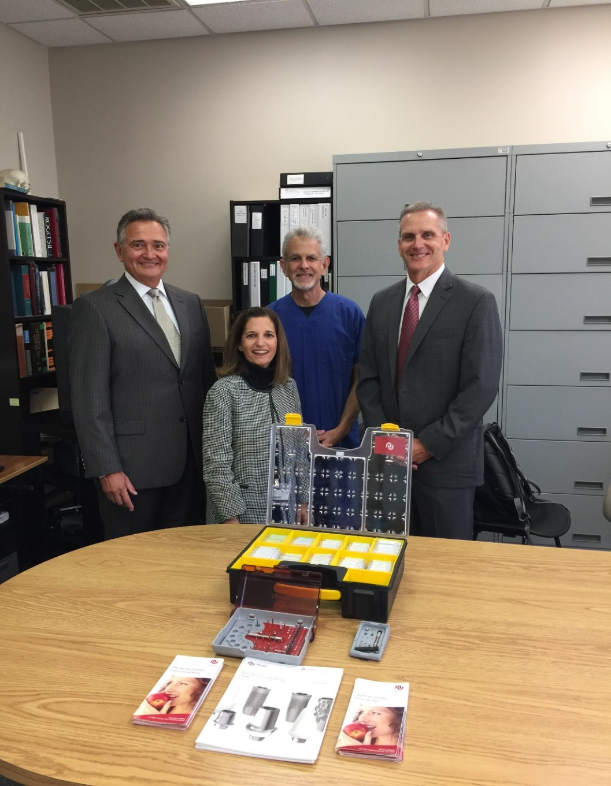
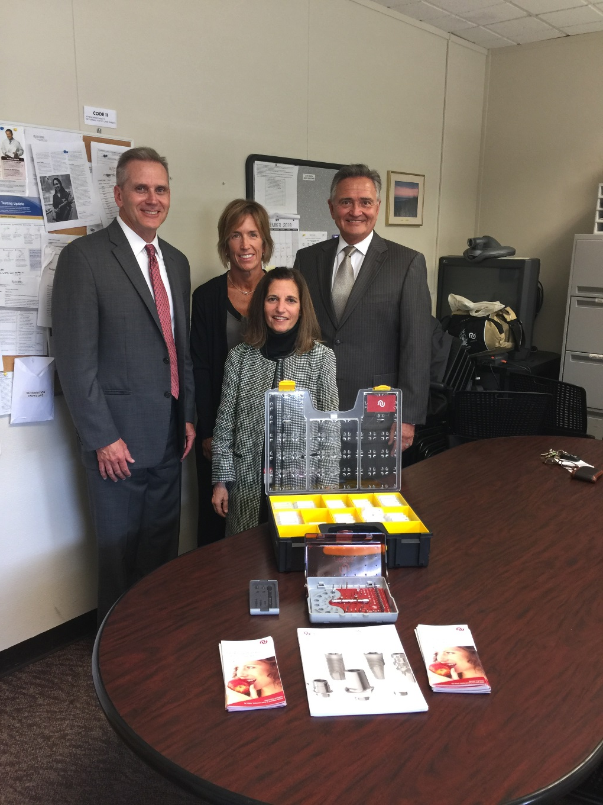

Slide 16
Recall Recovery Program
Strategy 1: Build greater value for the hygiene appointment by emphasizing all the care provided, including prophylaxis and screening for oral cancer
Strategy 2: Don’t refer to the appointment as a “cleaning” —it devalues the visit
Strategy 3: Make a concerted effort to schedule the next recall/hygiene appointment while clients are still in the office
Strategy 4: Confirm appointments two months in advance using postcards and 48 hours in advance using telephone reminders

Slide 18
Tobacco Prevention/Cessation Program
Strategy 1: Identify one faculty member from each of the three Rutgers dental clinics to take the Rutgers Tobacco Dependence Program
Strategy 2: Develop an intervention program to educate clients of the harmful effects of tobacco
First by preventing the start of its use and second by counseling for the cessation of tobacco use
Strategy 3: Implement the intervention program at each of the three extramural clinics by the trained faculty
American Dental Association Foundation / Rutgers School of Public Health

Slide 21
NJ HIV Trauma Informed Care Project
Strategy 1: Realize widespread impact of trauma and understand potential paths for recovery
Strategy 2: Recognize signs and symptoms of trauma in clients, staff and others involved with the system
Strategy 3: Respond to fully integrated knowledge about trauma into policies, procedures and practices
Strategy 4: Resist re-traumatization
Cicatelli Associates, Inc., in partnership with Hyacinth and NJ Department of Health

Slide 22
Universal Trauma Screening
■ Introduce Trauma Screening Tool to the client
Sample introduction to client: “Now I am going to ask questions about your experiences. We are asking these questions to everyone because we know that some experiences may affect people’s ability to take care of their health.”
■ Use trauma screening tool
■ Tally client’s responses and determine next steps based on agency protocol
Referrals
■ Offer referrals (internal or external) to additional services, such as psychoeducation session on trauma, a link to a community health worker, mental health services, housing, intimate partner violence resources, nutrition services, substance abuse treatment, others as needed
General Trauma Education Session
■ All clients will be offered a General Trauma Education Session (approximately 15 minutes in length)
■ This session covers general information about trauma and its impact, including prevalence of trauma among people living with HIV, and how to manage the effects of trauma to be adherent to care and treatment and improve quality of life
Psychoeducation Session(s):
■ Focuses on symptoms, triggers and developing safety and emotional regulation plans
■ Can be offered individually or in a group setting
■ Will provide tools/strategies to the client to help address the effects of trauma on adherence to care and treatment
■ Will include planning for the future, such as action planning and developing a safety plan

Slide 23
Service Learning Experience
Strategy 1: Prepare students in the early years of the dental school curriculum to acquire a deep appreciation for the needs of vulnerable populations that they use later in clinical rotations
Strategy 2: Provide students the opportunity to deliver a minimum requirement of 75 hours of direct patient care (full range of services/full mix of patients) at one of the RSDM extramural clinics
Strategy 3: Collaborate with other universities to develop pre/post-rotation survey questions regarding knowledge, attitudes and behavior with respect to treating PLWH and other underserved populations
U.S. Health Resources and Services Administration HIV/AIDS Bureau

Slide 26
Observership for Undergraduates
Strategy 1: Provide a valuable opportunity for students to learn about the profession of dentistry
Strategy 2: Deliver a program that increases the student’s understanding of the structure of the dental team and the latest dental technology used to provide care and treatment
Strategy 3: Strengthen the student’s knowledge about dental terminology and HIV/AIDS awareness

Slide 28
Community Health Worker Outreach
Strategy 1: Identify the role of the community health worker within a dental clinic
Strategy 2: Develop processes and mechanisms to identify clients lost to care
Strategy 3: Organize a summit with stakeholders to identify procedures and processes to maximize the efficiency of the process
Strategy 4: Implement a clear system for tracking outcomes to monitor gains obtained through the community health worker’s efforts
New Jersey Department of Health / AtlantiCare Regional Medical Center

Slide 30
Trauma Informed Care Research
Strategy 1: Determine the manner in which HIV-positive clients want to be treated and educated about trauma informed care
Strategy 2: Assess current dental practices for trauma informed dental care for HIV-positive clients
Strategy 3: Assess dental curriculum and determine dental students’ attitudes regarding trauma informed dental care
Strategy 4: Identify opportunities to define best practices for the implementation of trauma informed dental care
Rutgers Edward J. Bloustein School of Planning and Public Policy

Slide 31
Team Care Management
Client Care Management
Self Care Management
Sustainable,
Implemented
Trauma Care

Slide 32
Sound Machine Research
Strategy 1: Identify opportunities to improve client’s privacy in the dental setting
Strategy 2: Determine if clients will perceive an increase in privacy and confidentiality when white noise/sound machines are used in the treatment room of the dental office
Strategy 3: Determine the effectiveness of the white noise/sound machines on client perceptions of privacy and confidentiality in the dental office
Marpac

Slide 33
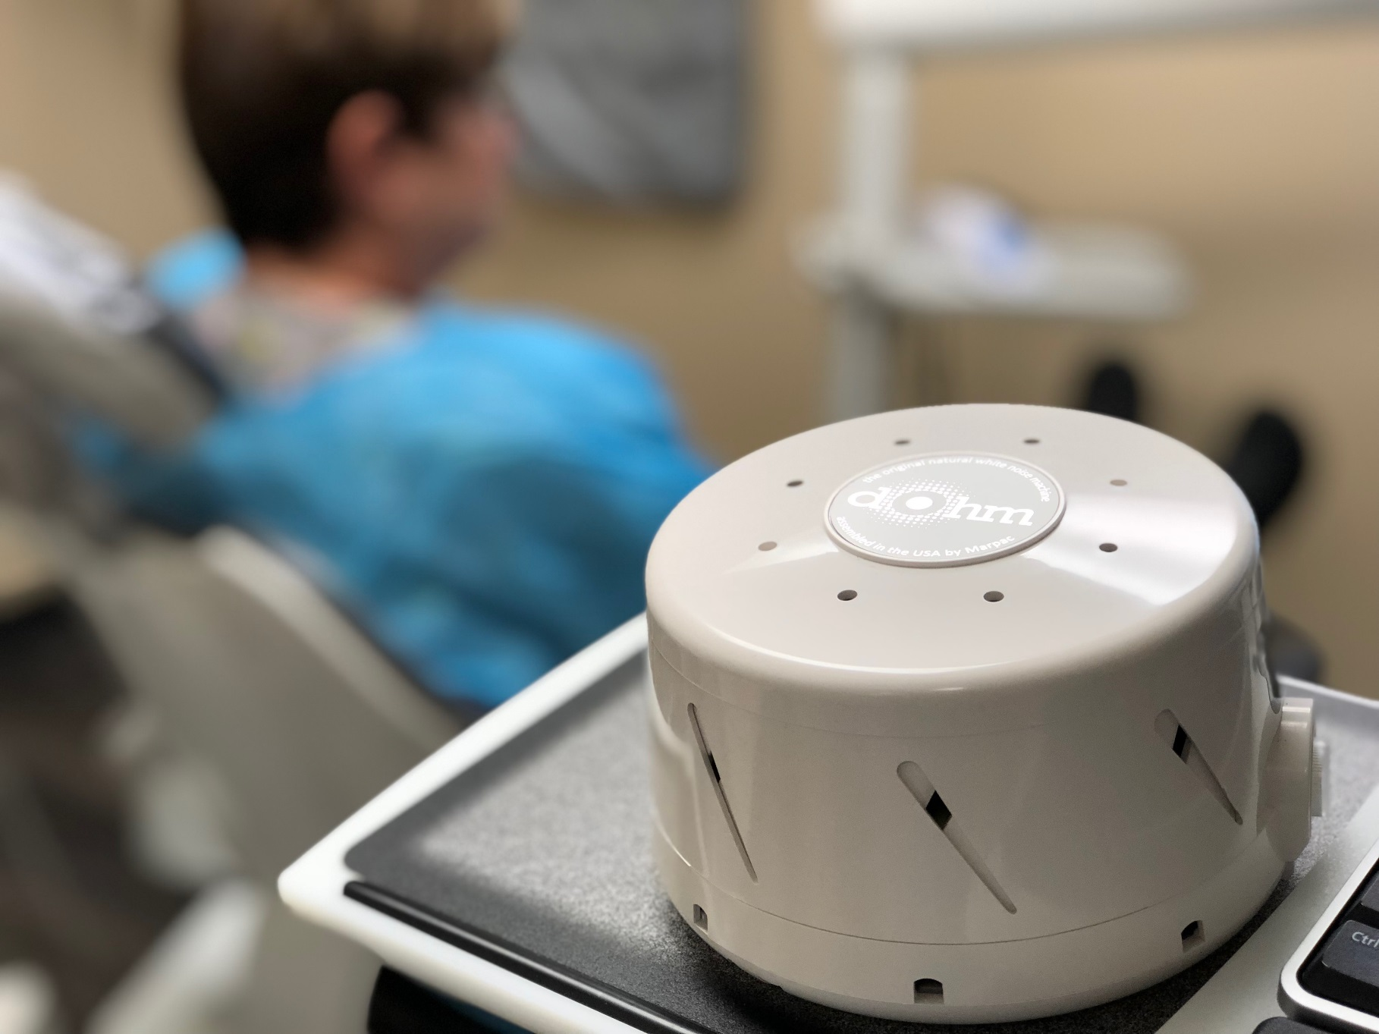

Slide 34
Patient Satisfaction Survey
Strategy 1: Provide the RSDM with information and insight about the services provided from the client’s viewpoint
Strategy 2: Identify a survey that asks the “right” questions
Strategy 3: Determine the sample size per the sample proportion, margin of error, and required confidence level
Strategy 4: Analyze data in a simple descriptive format
Strategy 5: Respond to specific consumer needs and address those needs that are not met by the program style and/or model design
Bureau of Primary Health Care

Slide 36
Oral Health Performance Measures
Strategy 1: Improve access to quality health care and services
Strategy 2: Identify patient record review items for each of the five HIV AIDS Bureau HIV performance measures oral health services
Strategy 3: Determine the sample size per the sample proportion, margin of error, and required confidence level
Strategy 4: Organize the collection of data that is stored and accessed electronically
Strategy 5: Develop an action plan to address improvements required
Philadelphia AIDS Activities Coordinating Office

Slide 37
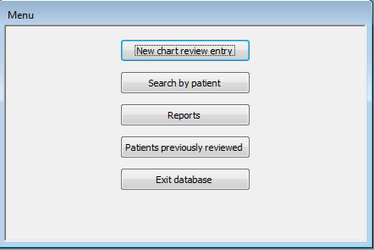
New chart review entry: “Oral Health Care Patient Review Form” where all data entry will be completed
Search by patient: search of records that have been entered either by using the dropdown or entering the patient name
Reports: written account of data entered --- performance report, not in numerator report, and annual report
Patients previously reviewed: report of all patients (including dentist and chart number) who have already been entered into the database in order to avoid duplicate reviews

Slide 39
Conclusion
Collaborate and coordinate between an accredited dental education program and community-based organizations and health care providers in the delivery of oral health services to individuals with HIV
Increase access to comprehensive and culturally competent oral health services for individuals with HIV
Provide quality comprehensive care through predoctoral, postdoctoral, faculty practice and outreach programs to all means and backgrounds
Establish and manage clinical rotations for dental students within community-based settings

Slide 40
Conclusion
Collect, manage, and report data that will access/describe the oral health service delivery and educational components of the program
Ensure confidentiality and establish a system for control of HIV-positive client records
Involve consumers as partners in their own care
Involve consumers in planning, implementing and evaluating the program

