Slide 2
Routine Opt-out HIV Screening and Detection of HIV Infection among Emergency Department Patients
Nada Fadul, MD¹; Ciarra Dortche, MPH²
¹University of Nebraska Medical Center; ²East Carolina University

Slide 3
Disclosures
I have received grant/research support from Gilead Sciences, Inc.
I do not intend to discuss off label use of any drug or treatment during this discussion.

Slide 4
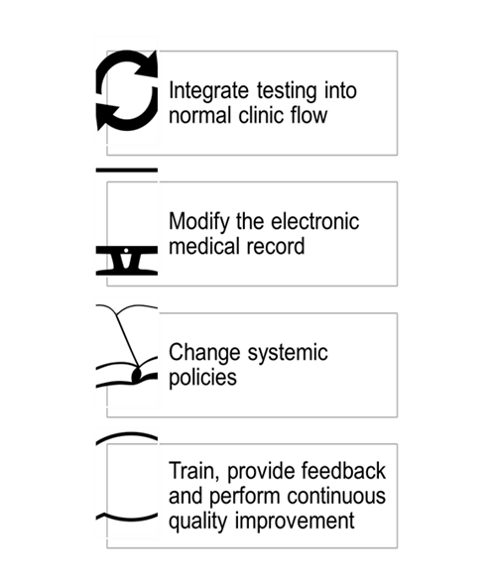
Presentation Objectives
Review rationale for routine HIV testing in various healthcare settings
Implementation processes using 4 pillars:
  Routinize HIV screening into normal clinic flow
  Integrate automated testing with other diagnostic screens
  Change systemic policies that normalize routine testing and linkage
  Collect information related to quality improvement and best practices to motivate staff
Describe lessons learned and review testing results of Vidant Medical Center’s Emergency Department & East Carolina University’s routine HIV testing program

Slide 5
WHO Screening Criteria
Important health problem for individual & community
Natural history of disease understood
Latent or early symptomatic stage
Acceptable screening test
Treatment exists & more beneficial if started earlier
Facilities for diagnosis and treatment available
Agreed policy on whom to treat
Cost economically balanced vs. other medical expenditures
Continuing process

Slide 6
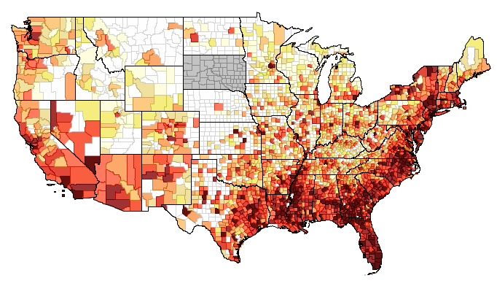

Background of HIV in the U.S.
Lack of timely testing is a significant contributing factor to the HIV spread and lower quality of healthcare.
Almost half of all new HIV infections are found in the Southern U.S.
Routine testing reduces missed opportunities for diagnosis and timely treatment into HIV care and supportive services.

Slide 7
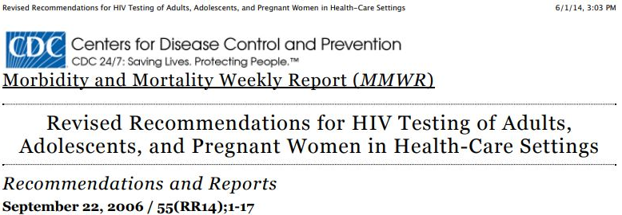
2006 CDC Recommendations
Routine, opt-out HIV testing of all persons 13-64 years of age in various healthcare settings
Repeat HIV screening of persons at least annually
Opt-out HIV screening with opportunity for patient to decline testing
Include HIV consent with general medical consent for care
Communicate tests results in similar way as other diagnostic tests
Prevention counseling not required

Slide 8
Rationale: Why the ED?
CDC recommends routine Opt-out HIV testing at in all health-care settings.
Emergency Department (ED) is one of the high utilization areas for routine medical care for underinsured, uninsured and those undiagnosed or at risk for HIV.
Missed opportunities for diagnosing Acute HIV infection

Slide 9
Implementing Routine Testing
ECU and VMC-ED have been implementing targeted testing in 2016
By the end of 2016, 126 HIV tests were performed in the ED
2015 cross-sectional survey among 72 ED providers found:
  51 greed that HIV screening in EDs would benefit patients
  46 never discussed HIV screening with patient in last 6 months
Concerns regarding HIV screening included:
  Encouraging misuse of the emergency department
  Putting additional strain on limited ED resources
  Arranging adequate follow up for positive patients
  Time constraints

Slide 10
Considerations for Successful Program Development

Slide 11
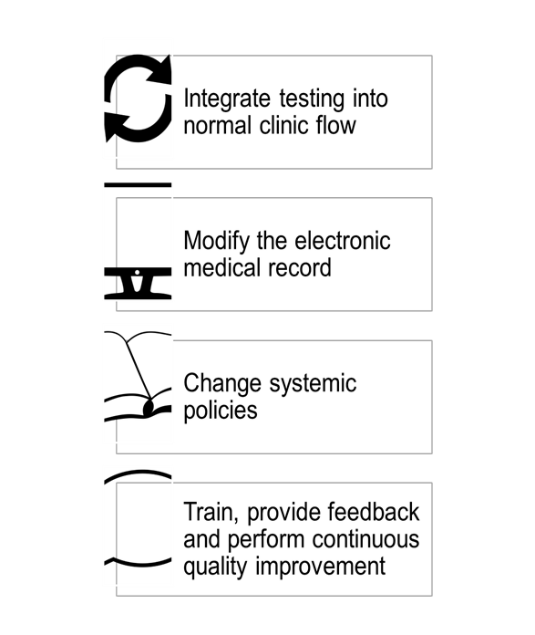
Program Development
Key Ingredients for Success:
  Working within a multidisciplinary team
  Develop EMR best practice alert or algorithm
  HIV Consenting Process and opt-out language
  Automate Testing
  Seamless Linkage to Care Process

Slide 12
Key Personnel Buy-in
Develop a working group
  Medical Directors, ED Directors, and/or Department Chairs
  Nursing Directors
  Laboratory Directors or Managers and/or pathologists
  HIV Clinics
  Health Department Directors
  Sponsored Programs/Grants’ Directors and/or Departments
  Ryan White stakeholders

Slide 13
Funding
Be prepared to write proposals/letters:
  Insurance Companies
  Public Health Departments
  Private Sectors
  HIV FOCUS Program
  Centers for Disease Control and Prevention

Slide 14
Protocol Development / Consent / Disclosure
Develop a testing protocol
Consent Issues
  Review state laws as they may apply
  Be wary of hospital policies that differ from state laws
Create a script for medical providers who obtain consent
Disclose test results and develop sustainable process

Slide 15
Script for Testing
HIV Testing Script for Staff
“As part of our routine blood work, an HIV test will be done during your visit today.”
“Everyone who comes into the ED will be tested for HIV regardless of reason for visit.”
“I see you’re having some blood work done today. An HIV test will be done as part of that blood work.”
*Before blood is drawn, the medical provider informs patients they will be tested unless they decline*

Slide 16
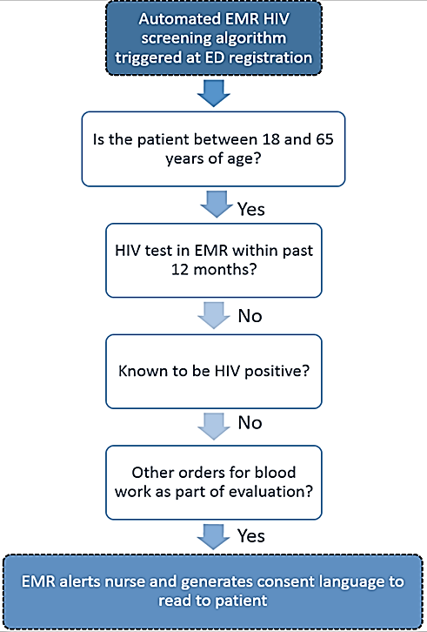
Policy-Driven EMR Algorithm
Upon patient registration, an EMR algorithm automatically screens patients presenting to the ED for HIV screening eligibility
Eligibility Criteria:
  Ages between18-64 years
  Not known to be HIV positive
  No history of HIV test documented in EMR within the past 12 months
  Bloodwork necessary as part of evaluation?

Slide 17
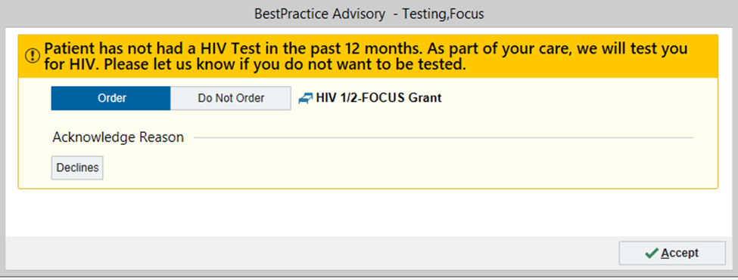
Automated HIV Screen EMR Order

Slide 18
Linkage to Care
How to do it
  Prior planning
  Tight communication system
  Close tracking of patient
Successful Linkage included:
  Prior planning
  Stakeholder involvement
  HIV provider visits at or near time of diagnosis
  Close tracking
  Multiple phone calls and potential home visits
EMR Identification
Notification to LTC Team
LTC Team Engages Patient

Slide 19
Key Components for Program Implementation
Project Lead
Knowing your data – patient demographics and prevalence
Buy-in from key personnel
Staff Education
Funding
Consent to test using Opt-Out language
Testing and disclosure
Linkage to care

Slide 20
Impact on ED HIV Screening
HIV testing has increased exponentially due to routine testing compared to total tests provided prior to implementing routine screening program
  8,365 total tests performed over first 16 months
  An average of 523 tests/month

Slide 21
Demographic Characteristics of Patients Testing Positive N = 51*,
3/2/2017 – 07/31/2018
 | Newly Diagnosed, n = 21 n (%) | Previously Diagnosed, n = 7 n (%)
Average Age in years (range) | 39 years (18-64 years) | 32 years (24-37 years)
Male | 18 (86) | 6 (86)
African-American | 19 (91) | 7 (100)
MSM¹ | 6 (29) | 1 (14)
Cisgender | 10 (48) | 4 (57)
Linked or Re-linked to Care | 20 (95) | 3 (43)
¹ MSM = men who identify as gay, bisexual or none of the two but have/have had sex with males.
*Remaining persons were already diagnosed and linked to care, but found by EMR alert.

Slide 22
Chief Complaints Reported,
3/2/2017 – 7/31/2018
 | # of times complaint reported
Chest/Abdominal pain or discomfort | 12
Cough | 8
Difficulty Breathing | 6
Sore Throat | 4
Fever/Chills /Flu-like symptoms | 7

Slide 23
Impact on Linkage to Care
Average of 1-2 new HIV diagnoses/month
Total HIV+ tests in first 16 months = 51
  Newly diagnosed = 21
      Linked to care = 20 or 95%
  Previously diagnosed = 30
      Already in care = 23
      Were out-of-care = 7
        Total linked = 3 or 43%
        Reasons patients not linked:
          2 refused to be linked or consistently deem “linked” to care
          1 incarcerated and 1 in progress to attend appointment after no-showing

Slide 24
Implementation Challenges
Making HIV matter to everyone
  Identify a champion team
  “Train the Trainer” (Champion)
  Add HIV on grand rounds/medical staff meetings
  Anticipate debate

Slide 25
Conclusions
Routine HIV testing is feasible using 2006 CDC guidelines
EMR algorithm improves testing uptake and prevents disruption of workflow
Linkage to care is an essential component of a testing program
Staff buy in is important for programmatic success
Sustainability of testing is currently under investigation

Slide 26
Next Steps…
Continue to provide routine HIV testing with necessary changes
  E.g., our program expanding testing to people as young as 16 years and as mature as 74 years
Continue to monitor testing throughout program
Determining the cost-effectiveness of our program is pending
Add HCV testing with similar testing algorithm as HIV

Slide 27
Champions for Success
Dr. Timothy Reeder – ED Director
Dr. Nada Fadul – PI/Ryan White Program Director
Dr. Diane Campbell – Ryan White Program Administrator
Kirby Elmore – Linkage Coordinator
Todd Stroud – IT Lead
Richard Baltaro – Pathology Lab Director
Chris Miller – Pathology Lab Manager
Barry White – Data Manager
Ari Mwachofi- Department of Public Health
ED and Ryan White Staff

Slide 28
Resources
1. Reif S, et al. State of HIV in the US Deep South. J Community Health;2006.
2. Branson BM, et al. Revised recommendations for HIV testing of adults, adolescents, and pregnant women in health-care settings. MMWR;2006.

Slide 29
Optimizing HIV Care Coordination through the Integration of ED Visits in the Care Team Dashboard
Susan Olender, MD¹, Mila C. González¹, MPH, Jesse Thomas²
¹NewYork-Presbyterian Hospital; ²RDE Systems

Slide 30
Disclosures
I have received grant/research support from Gilead Sciences, Inc.
I do not intend to discuss off label use of any drug or treatment during this discussion.

Slide 31
Outline
Describe process for integrating data within a Team-Based Care Model in the context of Practice Transformation
Explain how data was utilized optimize HIV care coordination of patients in the Emergency Department (ED)
Role of RN Care Managers in championing ED workflows to identify and re-engage patients into outpatient care
Provide lessons learned

Slide 32
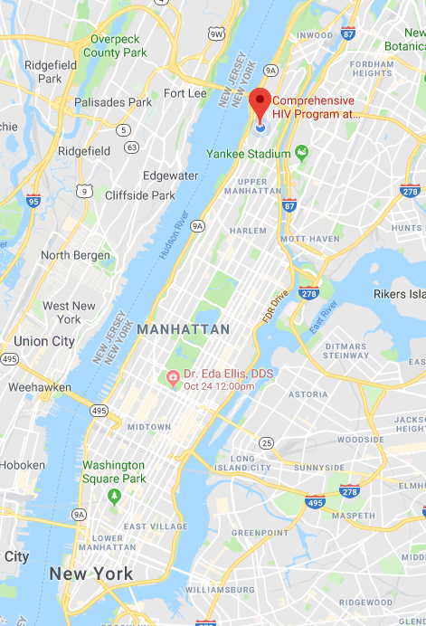




NewYork-Presbyterian Hospital’s
Comprehensive Health Program (CHP)
HIV Care & Treatment
Sexual Health
STI Testing (including HIV & Hepatitis C)
Primary Care, Behavioral Health & Supportive Services
Linking to Hepatitis C Treatment
Serving individuals of all ages at risk of HIV infection
Targeting individuals with Hepatitis C mono-infection
Mental Health & Supportive Services while in Treatment
Hepatitis C Treatment for Co-infected Individuals
Serving Pediatric (including exposed infants and children), Adolescent, Young People, and Adults
Transition to Primary Care
PrEP, PEP, Primary Care, Mental Health & Supportive Services
In 2017, NYP served 2,966 clients living with HIV from New York City’s Upper Manhattan and the Bronx
Funding for Programs:
Figure 1. New York City Map.
Notes:
Pete: Introductions and summary

Slide 33

SPNS Workforce Initiative: 2014-2018
Multi-site initiative with 15 demonstration sites across the United States funded to design, implement, evaluate, and disseminate a “Practice Transformation Models”
NYP’s Comprehensive Health Program (CHP) was selected as demonstration site
Developed the “Stimulating Transformation of Technology and Team Structure to Reach People Living with HIV” (STaR) Project
Notes:
Design
Implement
Evaluate
Disseminate
Changing healthcare landscape
Hiv provider shortages, increased access
is a multi-site demonstration and evaluation of system-level changes in staffing structures to improve health outcomes along the HIV Care Continuum. The initiative's fifteen demonstration sites for four years to promote the design, implementation, and evaluation of innovative strategies to increase organizations’ workforce capacities and achieve efficient and sustainable service delivery practices that both optimize human resources and improve quality outcomes. The demonstration projects will implement and evaluate innovative Practice Transformative Models (PTMs) for the delivery of HIV treatment and comprehensive care services in order to better respond to the changing healthcare landscape, marked by shortages of HIV primary care physicians and increasing demand for access to quality HIV services. Evaluation of these innovative PTMs will identify best practices and methods to support other organizations to adapt and re-align their workforces, as well as factors that increase the potential for successful integration of HIV care into primary care and community healthcare settings serving vulnerable populations. The University of California at San Francisco is serving as the Evaluation and Technical Assistance Center (ETAC) for this initiative. The ETAC will coordinate the multi-site evaluation; provide programmatic technical assistance to the demonstration sites; and lead publication and dissemination efforts of best practices and lessons learned.

Slide 34
SPNS Workforce Initiative: 2014-2018
The STaR Project “Practice Transformation Model” consisted of:
  System level staffing changes heavily based on Patient Centered Medical Home (PCMH) standards
  Improvements to Practice’s capacity to care for people living with HIV, valuing efficiency and sustainability
  Optimization of resources in changing landscape
  Quality improvement efforts aimed at increasing the rates of linkage, engagement, retention in care, and viral load suppression
Notes:
Design
Implement
Evaluate
Disseminate
Changing healthcare landscape
Hiv provider shortages, increased access
is a multi-site demonstration and evaluation of system-level changes in staffing structures to improve health outcomes along the HIV Care Continuum. The initiative's fifteen demonstration sites for four years to promote the design, implementation, and evaluation of innovative strategies to increase organizations’ workforce capacities and achieve efficient and sustainable service delivery practices that both optimize human resources and improve quality outcomes. The demonstration projects will implement and evaluate innovative Practice Transformative Models (PTMs) for the delivery of HIV treatment and comprehensive care services in order to better respond to the changing healthcare landscape, marked by shortages of HIV primary care physicians and increasing demand for access to quality HIV services. Evaluation of these innovative PTMs will identify best practices and methods to support other organizations to adapt and re-align their workforces, as well as factors that increase the potential for successful integration of HIV care into primary care and community healthcare settings serving vulnerable populations. The University of California at San Francisco is serving as the Evaluation and Technical Assistance Center (ETAC) for this initiative. The ETAC will coordinate the multi-site evaluation; provide programmatic technical assistance to the demonstration sites; and lead publication and dissemination efforts of best practices and lessons learned.

Slide 35

STaR’s Practice Transformation
August
2014-2015
February 2016
October
2017
August 2018
September 2016-2017
Launch of eCOMPAS HIV CCTs Dashboard
(Panel Management)
First Steering Committee Meeting on Transformation of Social Work Role
Formation of Clinical Care Teams (Team-Based Care) & Weekly Meetings
Release of CCTs Dashboard Updates including ED/Inpatient
Indicator
Start of Collaborative Care Model for the Integration of Behavioral Health
Imagine Credit: RDE Systems; Github.

Slide 36
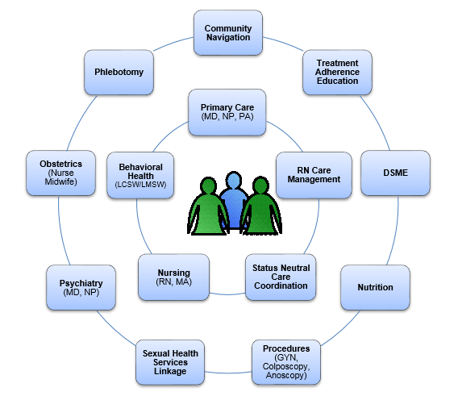
Team Based Care Coordination Model

Slide 37
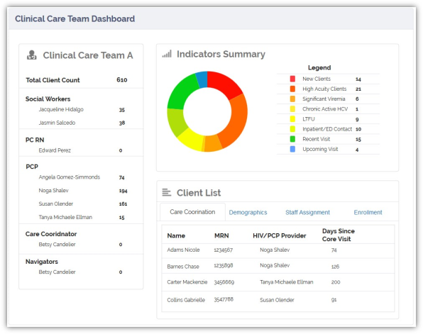
Data-Driven Panel Management Under Practice Transformation
Facilitated through eCOMPAS Clinical Care Team Dashboard
Review of panel Quality data at weekly inter-disciplinary care team meetings
Advantages:
  Allows for expertise from all disciplines and roles
  Optimization of resources to reach patients across settings for linkage & retention, reducing hospitalizations, etc.
Notes:
Pete and Maria

Slide 38
Deeper dive into HIT & HIE
A Measure of the challenge…

Slide 39


Slide 40


Slide 41
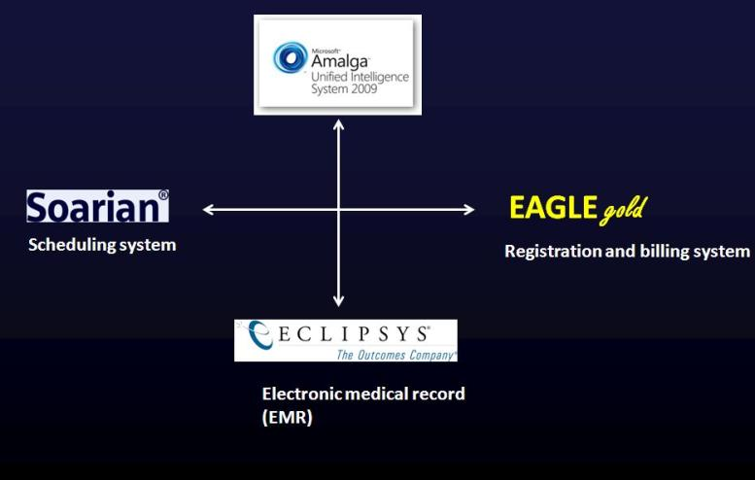
The ‘Medical Record’ is typically an amalgamation of multiple electronic systems, tied together by an IT network that exchanges information –a form of Health Information Exchange
Notes:
The ‘Medical Record’ is generally thought of as the repository of ‘all’ information, but actually as a single entity it often does not exist, rather it is a collection of IT systems linked together by an IT network. More on this later.

Slide 42

How much data?
NYP/Columbia must track and manage over 800,000 data elements annually for grant and regulatory reporting purposes:
HRSA, NYC DOHMH, AIDS Institute, CDC RSR, AIRS, eSHARE
95 ‘users’ who need to contribute, add, manage, and export data

Slide 43
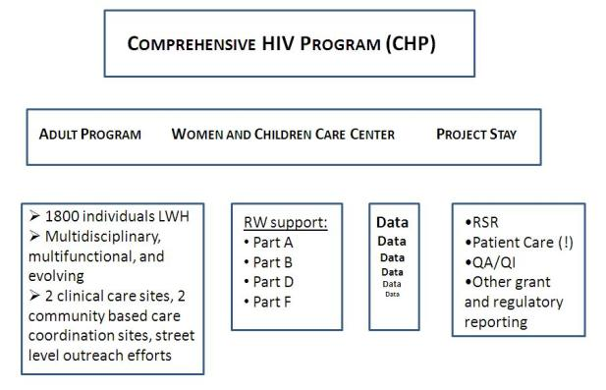
Where does the information come from in your program?
How much data?
What is the data?
Notes:
So

Slide 44
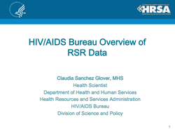
What is the data?
Demographic
Services
Clinical
Care Coordination

Slide 45



A typical workflow process at NYP/Columbia for how a patient gets scheduled, registered, documented in an EMR, and billed.
EAGLE gold
Scheduling system
Registration and billing system
Electronic medical record (EMR)

Slide 46
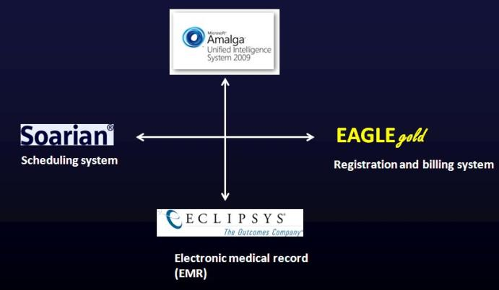


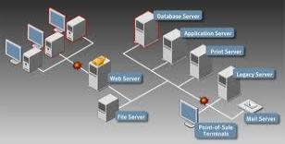
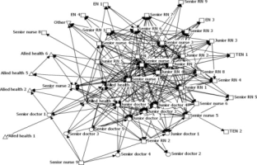

Slide 47
The eCOMPAS Approach

Slide 48
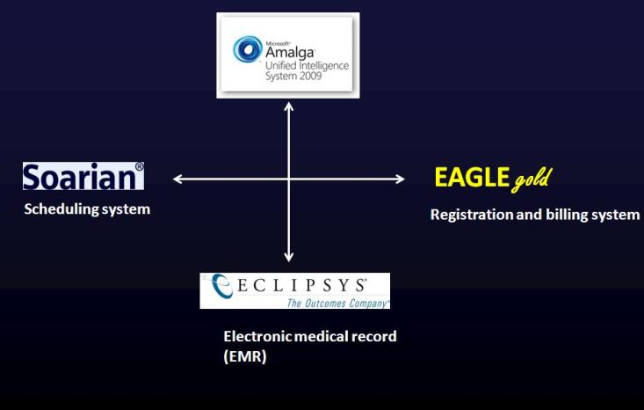


This is the way NYP/Columbia is making it work in the ‘real’ world of competing institutional priorities

Slide 49
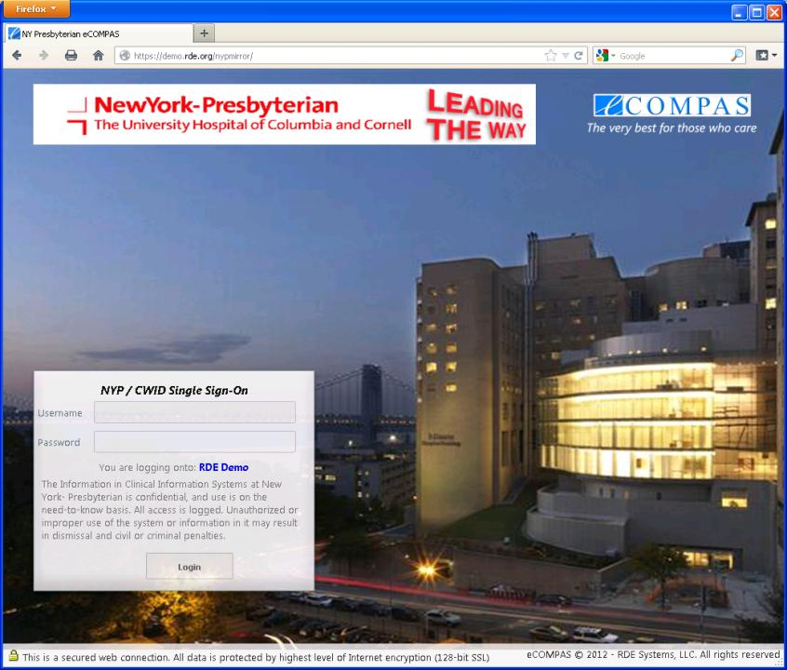

Slide 50
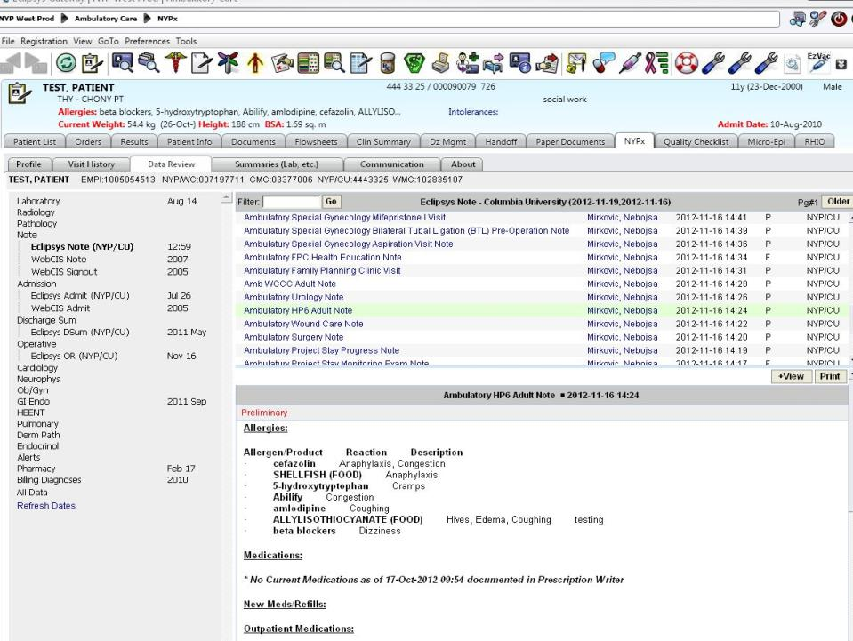

Slide 51
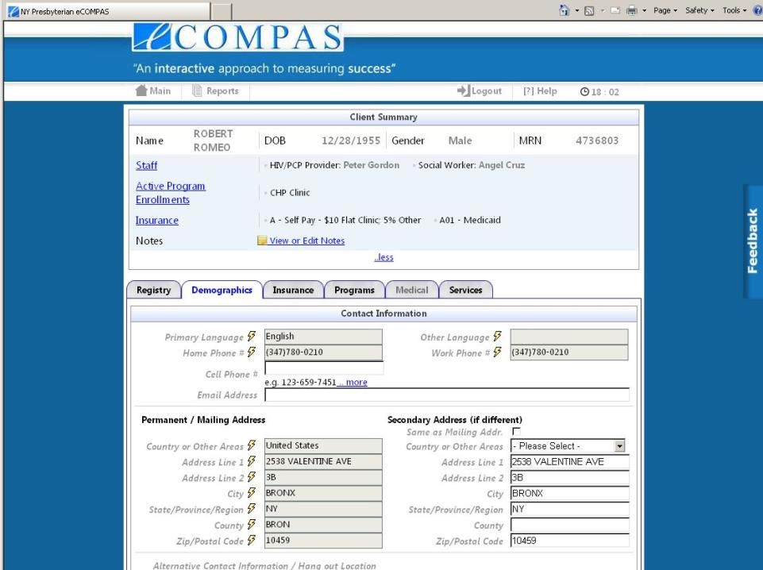
Obama, Barack

Slide 52
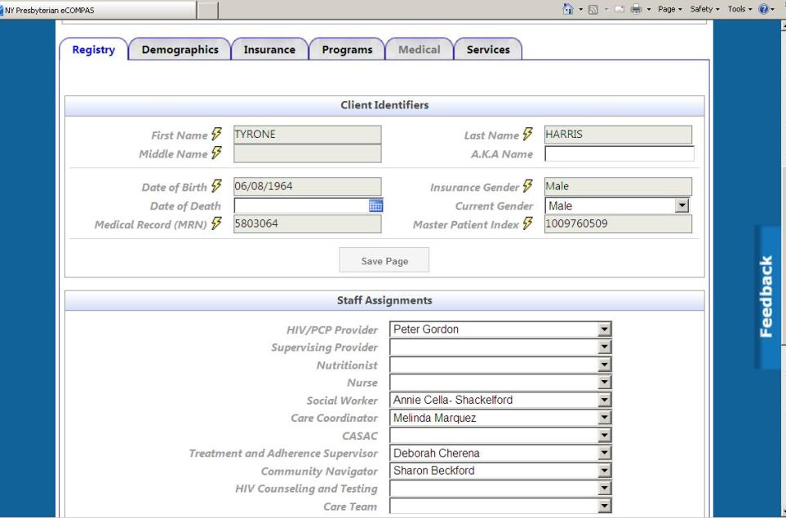

Slide 53

So what is the impact of this kind of HIE on NYP/Columbia’s program?
Time
Data Quality
Reporting
Population Management
Notes:
You can ask yourself what this approach might mean to your program in terms of manpower hours saved to devote to patient care and care coordination….. what this might mean in terms of data quality for reporting purposes as well as for your own QA/QI uses.

Slide 54
Time and Data Management: The Potential Impact of HIE
NYP/Columbia must track and manage over 800,000 data elements annually for grant and regulatory reporting purposes:
  HRSA, NYC DOHMH, AIDS Institute, CDC
  RSR, AIRS, eSHARE
  95 ‘users’ who need to contribute, add, manage, and export data
How utilizing HIE and implementing eCOMPAS has impacted
  125,293,634 data elements updated/added via HIE since March 2012 (demographics, visits/services, staff assignment)
  1000+ hours of data entry saved (very conservative)

Slide 55
Benefit 1
Feature: Integration of Health Information Technology (HIT) for Population Health Management
Benefit: Time saving. Data from different hospital systems are pulled into eCOMPAS thus making it a single stop for all client information.

Slide 56
Notes:
Pete and Maria

Slide 57
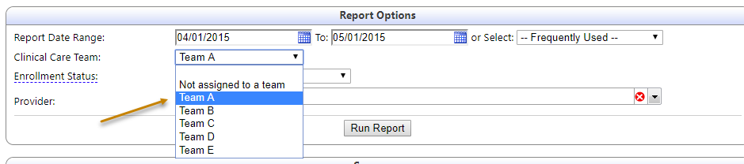
Feature 2
Feature: Dashboard for each Clinical Care Team that displays number of clients belonging to each Care Team.

Slide 58
Benefit 2
Feature: Dashboard for each Clinical Care Team that displays number of clients belonging to each Care Team.
Benefit: Improved care coordination and communication

Slide 59
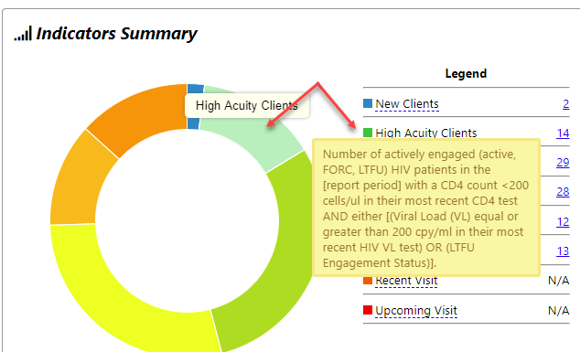
Feature 3
Feature: Dashboard displays total number of clients with High Acuity for each Clinical Care Team

Slide 60
Benefit 3
Feature: Dashboard displays total number of clients with High Acuity for each Clinical Care Team
Benefit: The Care Team can automatically see their most at risk clients in one click.

Slide 61
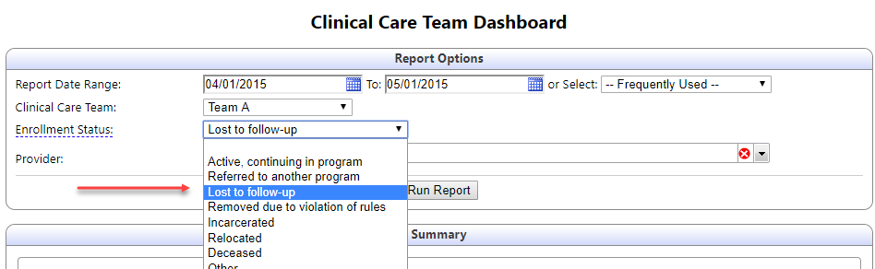
Feature 4
Feature: Dashboard displays total number of clients who are Lost To Follow up for each Clinical Care Team

Slide 62
Benefit 4
Feature: Dashboard displays total number of clients who are Lost To Follow up for each Clinical Care Team
Benefit: Helps identify which clients are falling out of care. The team breakdown help see which teams are not doing as well as others

Slide 63
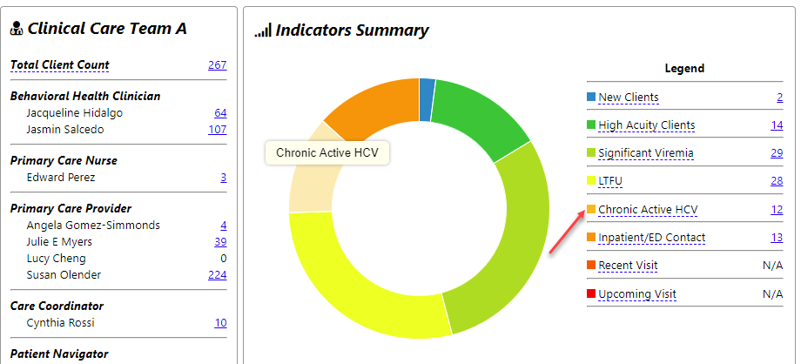
Feature 5
Feature: Dashboard displays total number of clients who are Chronic Active HCV for each Clinical Care Team

Slide 64
Benefit 5
Feature: Dashboard displays total number of clients who are Chronic Active HCV for each Clinical Care Team
Benefit: Helps care team and managers see which teams have most clients with Active HCV and which team don’t. Further review can help identify patterns and make decisions on team assignment.

Slide 65
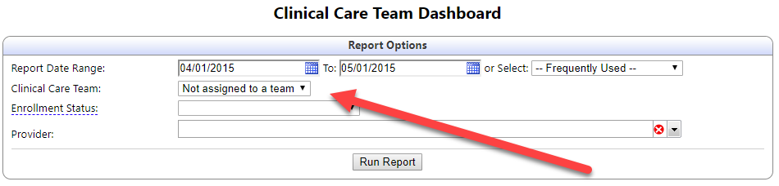
Feature 6
Feature: Dashboard displays total number of clients not assigned to any Care Team

Slide 66
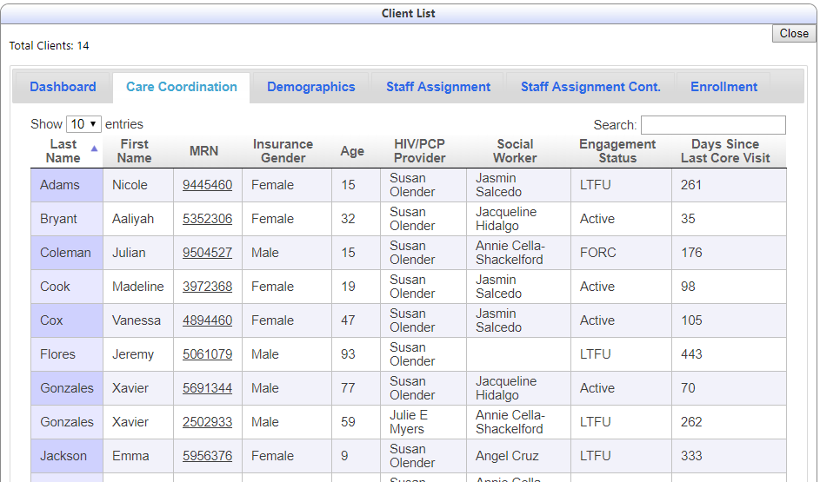
Feature 7
Feature: Client Drill Downs

Slide 67
Benefit 7
Feature: Client Drill Downs
Benefit: Ability to view the client list and related information thus saving time and minimizing effort to look for client information

Slide 68

ED QI Project Motivation
High rates of ED utilization and hospital readmissions
Prior authorizations for medications when in the ED
Patients needing care outside CHP’s clinic hours
Patient education in the ED on HIV treatment vs pre-/post-exposure prophylaxis (e.g., ARVs and resistance)
Limitations around PEP dose distribution in ED

Slide 69
ED QI Project Aims
Reduction in avoidable hospital and ED use
Improve outcomes across HIV Care Continuum

Slide 70

Identifying and Re-Engaging Patients
Workflow 1: Established Known HIV Patients
Twice daily checks by RN Care Managers of patients in the ED via CCT Dashboard
Workflow 2: New to Care Patients Visiting the ED
ED Navigator Referrals to RN Care Managers of:
  HIV-infected patients never engaged in care or LTFU
  Individuals at risk of HIV infection
ED Navigator
RN Coordinator

Slide 71
ED Population Management
Conducted five stakeholder meetings to review baseline data on ED patients collected by RN Coordinators
  Providers, RN Coordinators, Care Coordinators, Quality Manager
Categorized ED patients by
  Medical complexity
  HIV care engagement
  Health and psychosocial factors
  High ED utilization and readmissions
Identify potential intervention mix by ED patient type

Slide 72
QI Pilot Period:
9/30/16 – 12/5/16
N = 159
Average number per week of CHP patients with an ED contact = 15.5
9% patients identified through ED Navigator
> 50 hours in staff time in patient engagement, education, and follow-up
13% patients enrolled intensive medical case management
Notes:
Chart review - 14.75 hrs
In-person outreach - 11.83 hrs
Phone outreach - 5.22 hrs
Patient education - 5.75 hrs
Care Plan and Team Coordination - 9.00 hrs

Slide 73
RN Care Manager Average Time Spent on Daily ED Panel Review, Patient Outreach, and Re-Engagement
Activity | Average Time Spent (Minutes)
Daily running of CCT Dashboard and review of patient charts | 6.9
In-person outreach | 18.5
Phone outreach | 8.5
Patient education | 9.1
Care coordination with Clinical Care Team | 11.5
Care Team Activation through Dashboard Data
Prior to the ED QI Project, the CCT Dashboard indicators were run 186 times in September 2016.
After implementation, the CCT Dashboard indicators were run an average of 346 times per month.

Slide 74
Increase in Same Day Visits
“The walk-in has increased because now we emphasize patients will end up in the ED only if absolutely necessary. So we made an emphasis on all of those sorts of strategies. […] Especially when it’s for something small. Obviously, if it’s something urgent. But they have a walk-in. They want to come in. They come in the next day.
I just saw a patient yesterday in the ED, [...] and he just switched meds. I'm like; come in tomorrow. [Your provider is doing] walk-ins. You can tell her about your symptoms and what's going on. And he came this morning. […] I just happened to look at the dashboard this morning, then Allscripts. And so he came in. So, you know, that communication matters.”
(Nurse Care Manager)

Slide 75
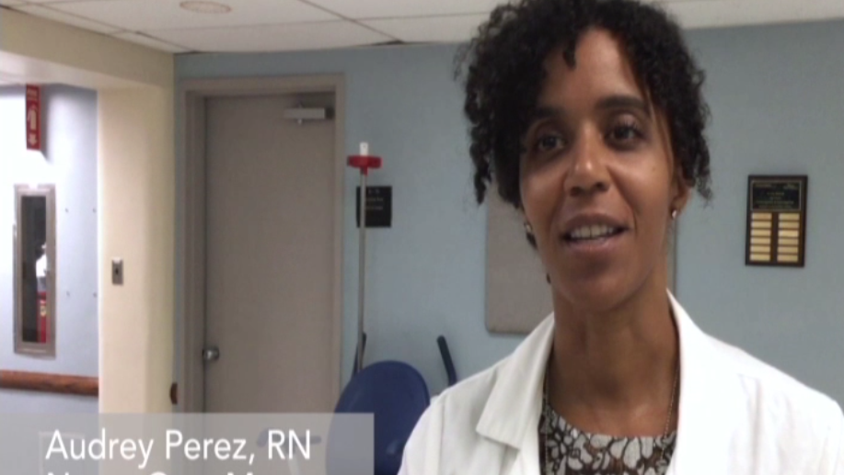
Our Journey Towards Practice Transformation through a Nurse Care Manager Perspective…
4 minute video

Slide 76
Lessons Learned from QI Project
Panel-based ED visit data contributed to activation of care coordination resources for identification and real-time re-engagement of patients while in the ED
Engagement of patients in real-time while at the ED is feasible and challenging (requiring ED champions)
Re-engagement of patients in outpatient clinic was possible through same day services
“Differentiated care” strategies by ED patient category can be used to optimize care team resources

Slide 77

STaR Practice Transformation ED QI Project Team
Audrey Perez, Nurse Care Manager, STaR Project
Stacey Gladstone, Nurse Care Manager, DSRIP Project
Mila Gonzalez, STaR Project Director/Quality Manager
Susan Olender, STaR Principal Investigator/Quality Program Director
Steve Chang, DSRIP Project Director
Peter Gordon, Medical Director
Jesse Thomas, RDE Systems, HIT Consultant
Anusha Dayananda, RDE Systems, HIT Consultant
Wayne Stewart, Principal Investigator, UCSF ETAC
Pamela Belton, Project Officer, HRSA-SPNS
Comprehensive Health Program Staff

Slide 78
Funding Acknowledgement:
This NYP-Columbia STaR project is supported by the Health Resources and Services Administration (HRSA) of the U.S. Department of Health and Human Services (HHS) under grant number H97HA27430, a Special Projects of National Significance (SPNS) entitled “System-level Workforce Capacity Building for Integrating HIV Primary Care in Community Health Care Settings - Demonstration Sites” for 1,189,500 from 2014-2018. This information and these conclusions are those of the authors and should not be construed as the official position or policy of, nor should any endorsements be inferred by HRSA, HHS or the U.S. Government.

Slide 79
Question?

Slide 80
Panel Discussion

