Slide 1
Trauma-Informed Approaches (TIA) to RWHAP ADAP and Part B Program
Mahelet Kebede, MPH
Manager, Health Care Access
NASTAD
Holly Hanson, MA
Ryan White Part B Program Manager
Iowa Department of Public Health
December 12, 2018

Slide 2
PRESENTATION OVERVIEW
Introduction
Understanding Trauma
Trauma-Informed Approaches (TIA) Toolkit
Population-Specific Focus: Engaging Black Men in Care
State Example: Iowa Department of Public Health
Discussion/Q&A
Activity

Slide 3
UNDERSTANDING TRAUMA

Slide 4
WHAT IS TRAUMA?
TRAUMA is broadly defined as experiences that produce intense emotional pain, fear, or distress, often resulting in long-term physiological and psychological consequences. Experiences of trauma, especially in childhood, can change a person’s brain structure, contributing to long-term physical and behavioral health problems.
TRAUMA-INFORMED: Being trauma-informed is an approach to administering services in care and prevention that acknowledges that traumas may have occurred or may be active in clients’ lives, and that those traumas can manifest physically, mentally, and/or behaviorally.
TIC vs TIA: trauma-informed care is one type of trauma-informed approach. There is SO much more you can do outside of the direct care you and/or your sub-recipients provide.

Slide 5
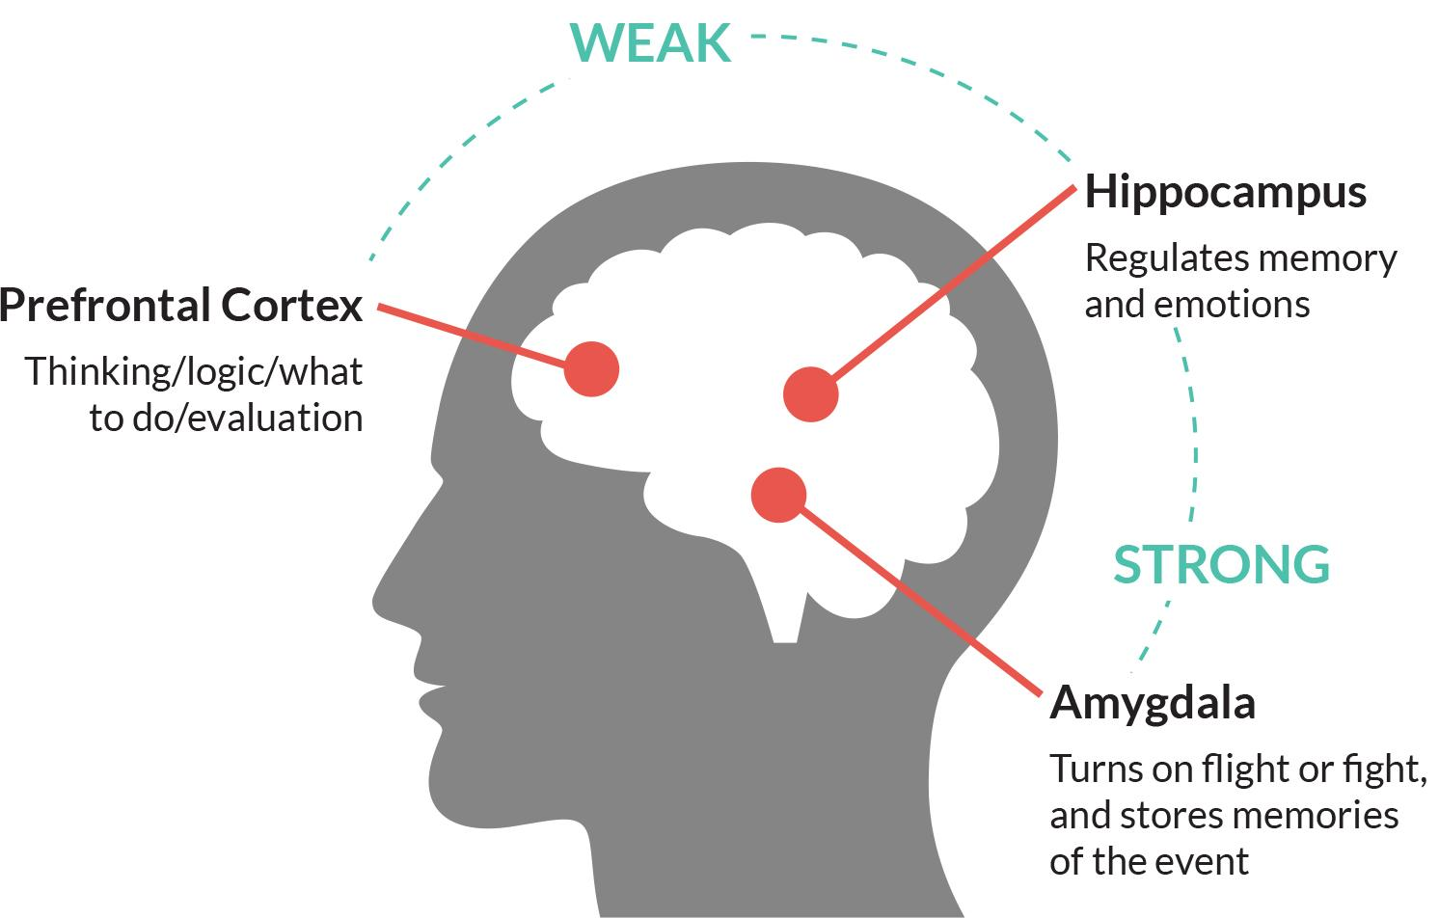
NEAR SCIENCE - NEUROBIOLOGY
Notes:
Has anyone ever heard of near science? Providers are developing a more comprehensive understanding of trauma, including through the concept of NEAR Science (neurobiology, epigenetics, adverse childhood experiences, and resilience). NEAR Science provides a holistic understanding of how trauma impacts health outcomes.
The prefrontal cortex, known as the “Thinking Center” When this area of the brain is strong, we are able to think clearly, make good decisions, and be aware of ourselves and others. Research indicates that after trauma, particularly during childhood, the prefrontal cortex experiences a loss of neuronal integrity and is less able to communicate with other parts of the brain.
The hippocampus, known as the “Emotion Regulation Center,” When this region is strong, we are able to manage difficult thoughts and emotions and recall and recognize memories. For example, when the smell of a perfume reminds you of your grandmother, it is likely your hippocampus in action. In contrast, individuals who have experienced traumatic stress may experience vivid memories or persistent thoughts that are reminiscent of a trauma. They may have a difficult time distinguishing between a memory and a current threat.
The amygdala, known as the “Fear Center,” responds to stress and anxiety and coordinates a behavioral response that helps to ensure survival, also known as the “fight, flight, or freeze” response. For example, imagine you are walking down a hiking trail and suddenly see a snake. With lightning speed, your amygdala reacts to that snake before you even consciously notice it. The amygdala helps you react quickly when there is a threat in the forest, but it can be a problem for someone who has experienced trauma. In the traumatized brain, the amygdala is on high alert, often leading to inappropriate, erratic, or defiant behavior as the brain is unable to access the prefrontal cortex and apply logic to a situation.

Slide 6
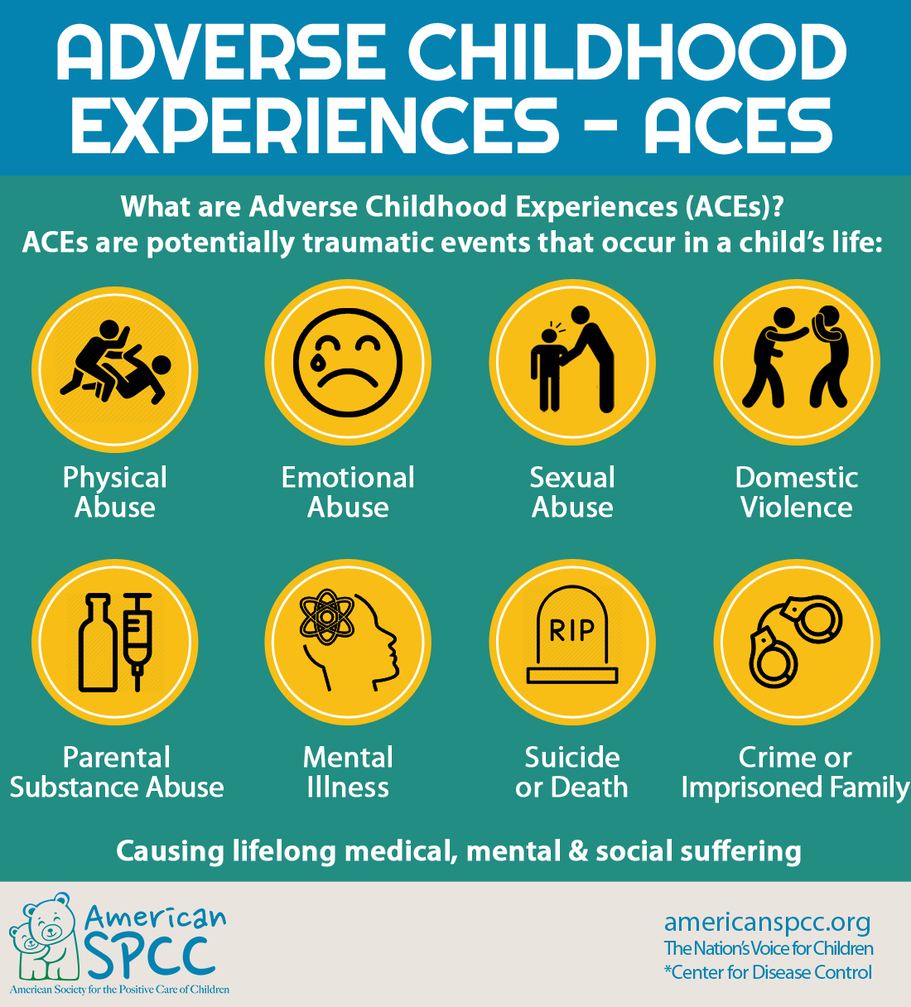
Notes:
The original ACE Study was conducted at Kaiser Permanente from 1995 to 1997 with two waves of data collection. Over 17,000 Health Maintenance Organization members from Southern California receiving physical exams completed confidential surveys regarding their childhood experiences and current health status and behaviors.
While you were growing up, during your first 18 years of life:
1. Did a parent or other adult in the household often …
Swear at you, insult you, put you down, or humiliate you?
Act in a way that made you afraid that you might be physically hurt?
2. Did a parent or other adult in the household often …
Push, grab, slap, or throw something at you?
Ever hit you so hard that you had marks or were injured?
Your family didn’t look out for each other, feel close to each other, or support each other?
Ever repeatedly hit over at least a few minutes or threatened with a gun or knife?
8. Did you live with anyone who was a problem drinker or alcoholic or who used street drugs?
9. Was a household member depressed or mentally ill or did a household member attempt suicide?

Slide 7
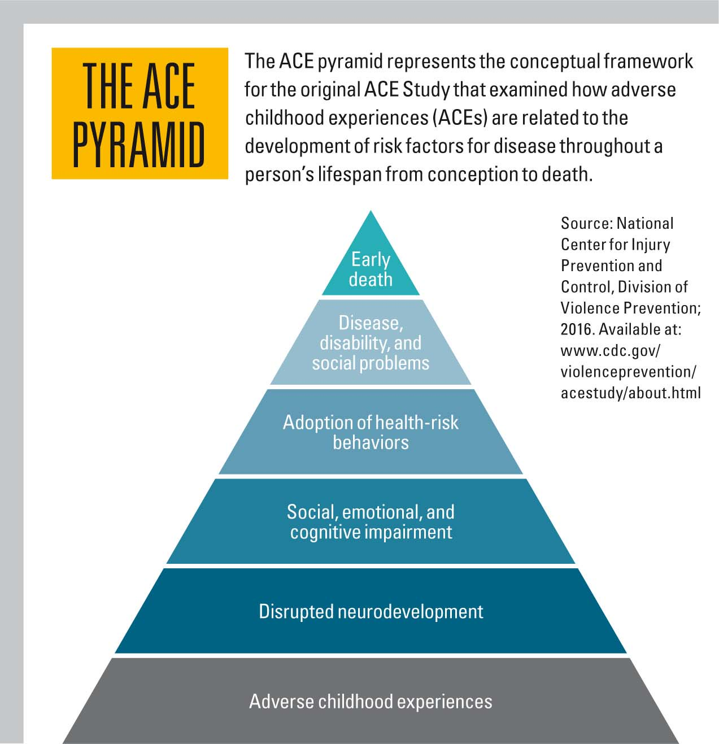
NEAR SCIENCE - ACEs

Slide 8
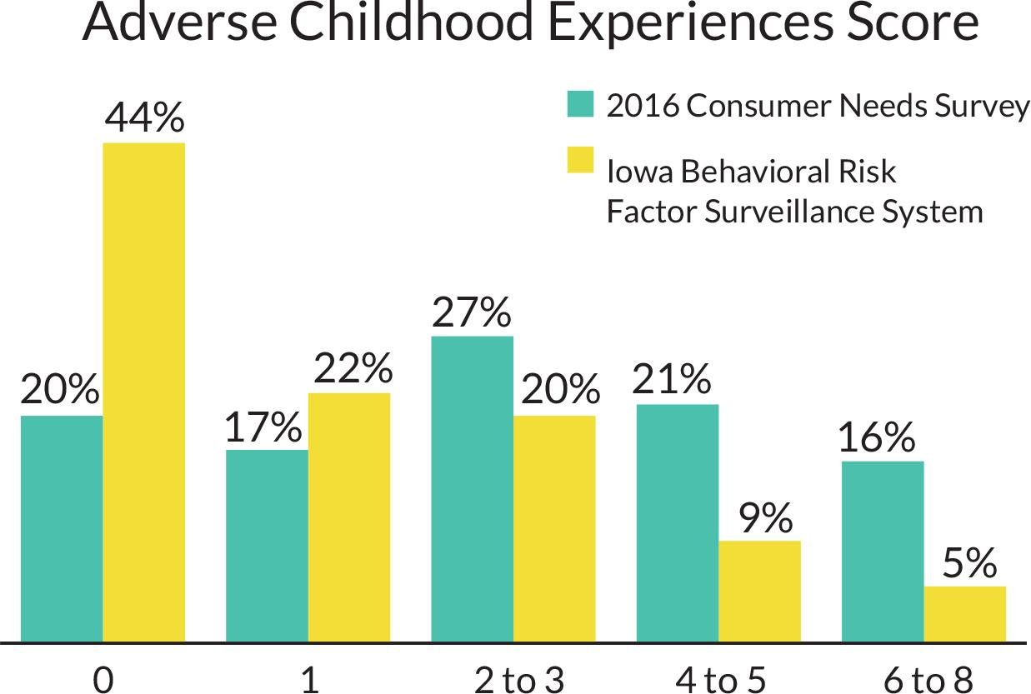
NEAR SCIENCE – ACEs: IOWA DATA

Slide 9
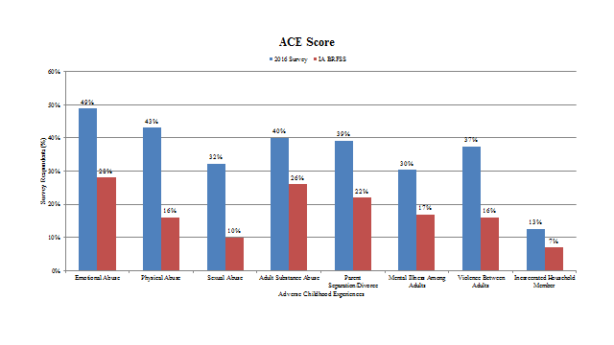
Iowa ACE’s Data by ACE Category

Slide 10
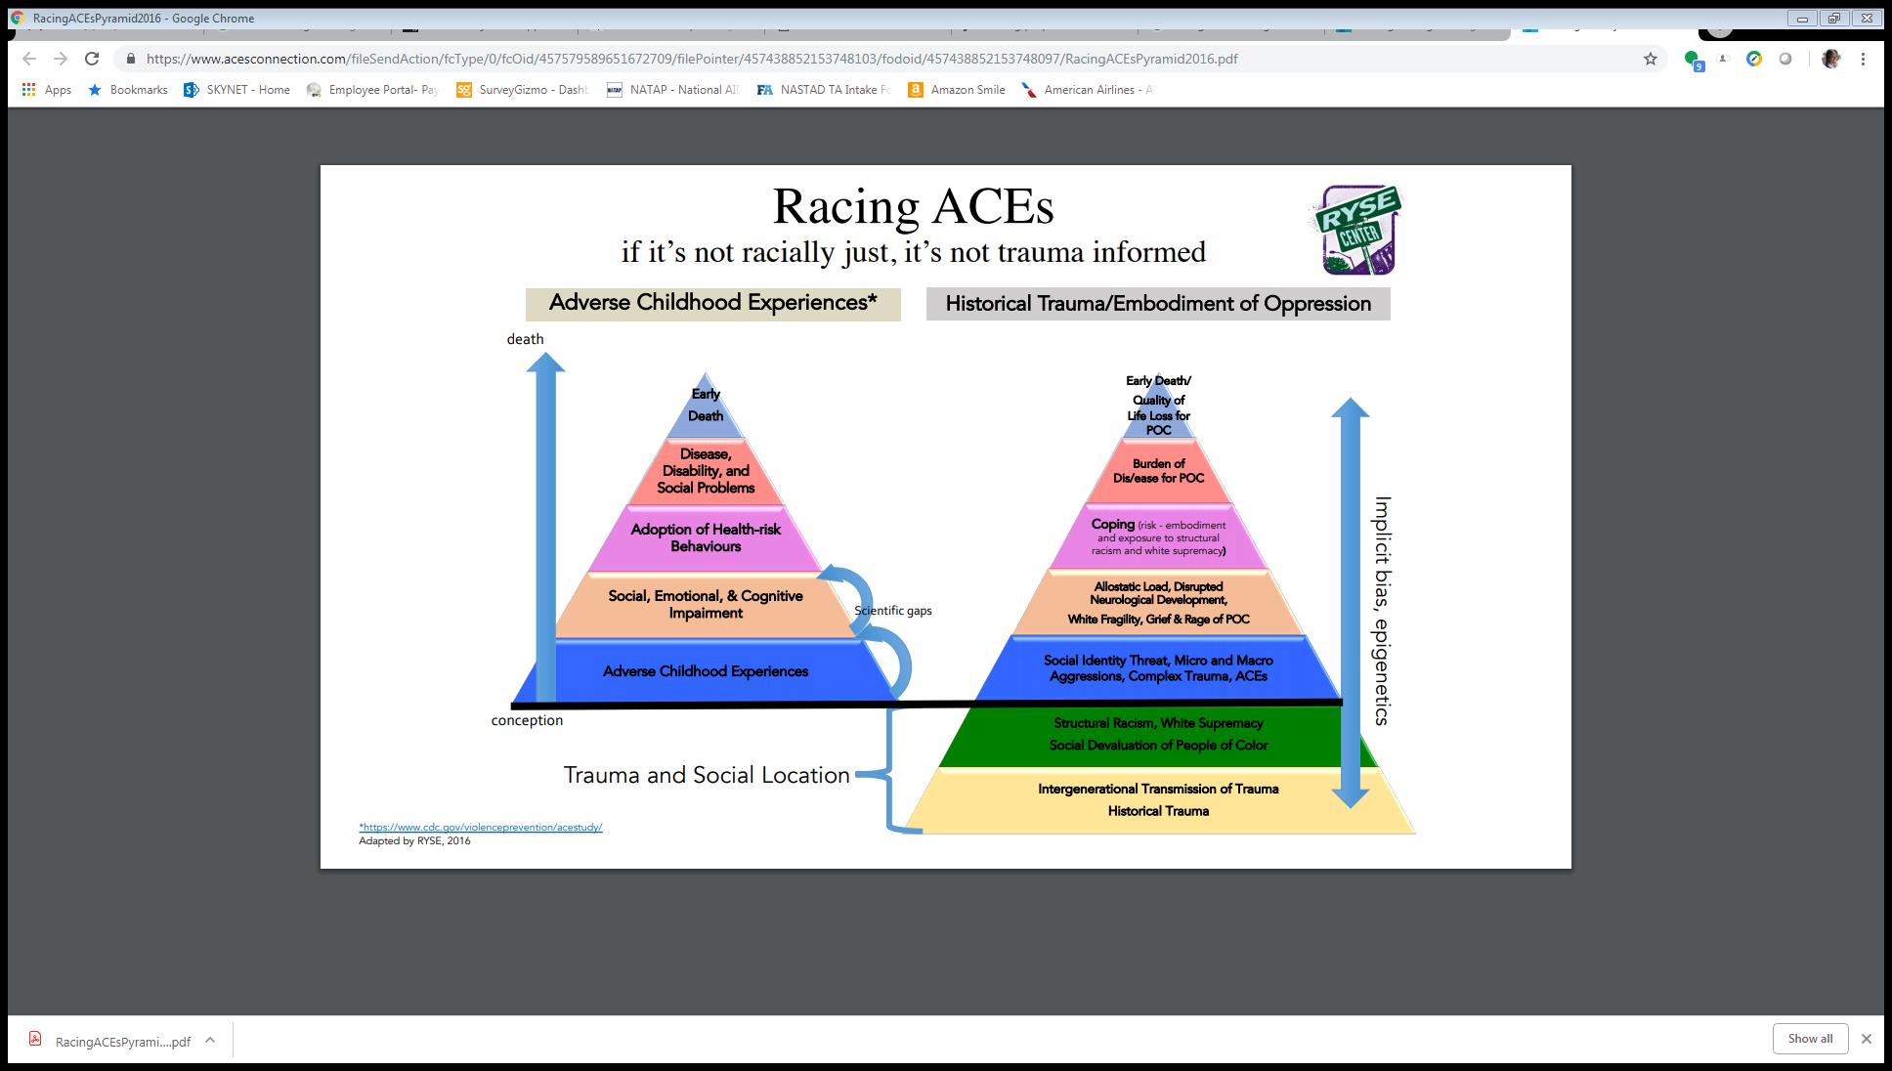
NEAR SCIENCE - EPIGENETICS

Slide 11
NEAR SCIENCE – RESILIENCY
There is no single accepted set of components of resilience, but this set of characteristics and contributing factors can provide a useful guide:
OPTIMISIM
ALTRUISM
MORAL COMPASS
FAITH & SPIRITUALITY
HUMOR
HAVING A ROLE MODEL
SOCIAL SUPPORTS
FACING FEAR
PURPOSE IN LIFE
TRAINING

Slide 12
INTERSECTIONALITY
Intersectionality is a theory that the overlap of various social identities, such as race, gender, sexual identity, disability, and class, contribute to systemic oppression and discrimination experienced by an individual.
GENDER IDENTITY
SEXUAL ORIENTATION
RACE
ADDICTION & MENTAL HEALTH
POVERTY & HOMELESSNESS
Notes:
Gender identity: Sexual abuse among women is common, affecting 15% - 25% of women.
Sexual orientation: Individuals who identify as lesbian, gay, or bisexual are likely to experience higher rates of trauma.
People of color: Communities of color are disproportionately impacted by trauma. The 2016 National Survey of Children’s Health (NSCH) found that 61% of Black, non-Hispanic children and 51% of Hispanic children have experienced at least one ACE, compared with 40% of White, non-Hispanic children
Addictions and Mental health: The link between trauma exposure and substance use and mental health challenges is well-established.
Poverty and homelessness: The experience of living with little to no income is traumatic

Slide 13
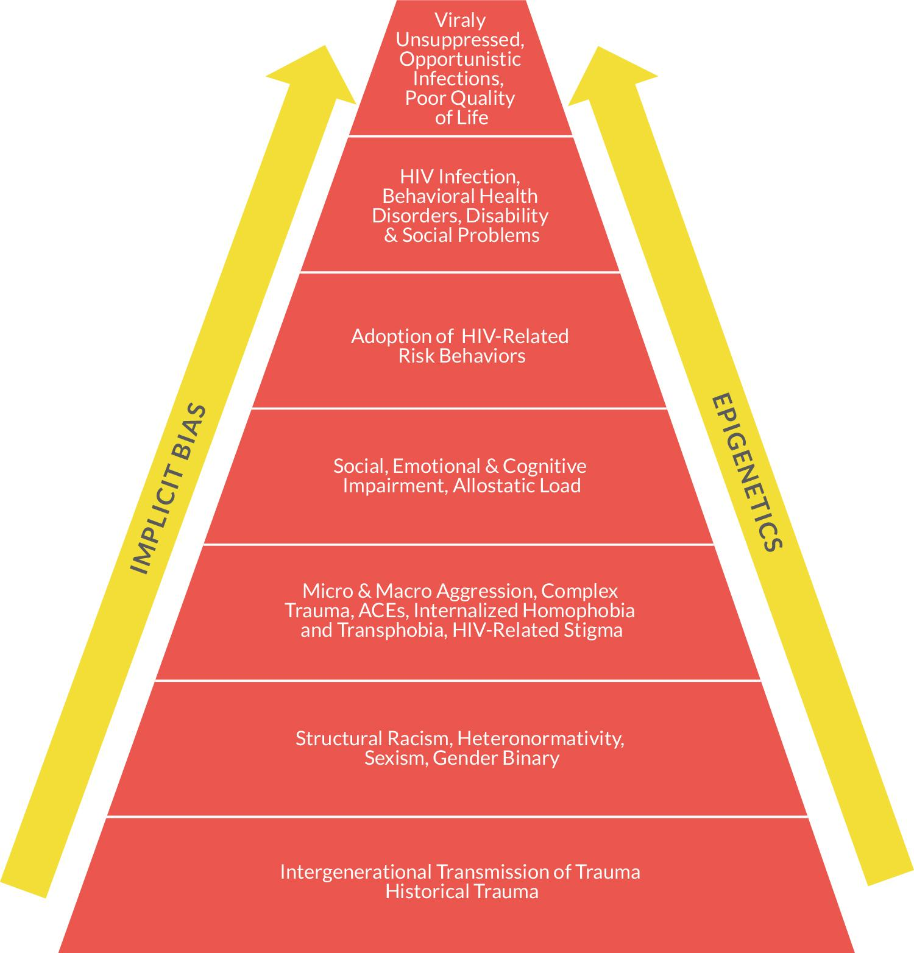
HIV ACEs PYRAMID
Notes:
Now that you’ve learned about NEAR Science and Intersectionality, what we have proposed here is an HIV ACEs pyramid -- Adapted from the ACEs and Racing ACEs pyramid, the following diagram illustrates the relationship between epigenetic trauma, systems of oppression, adoption of HIV-related risk behaviors, and progression of HIV disease. The base of the diagram indicates intersectional factors that influence a person’s health outcomes at the highest level (i.e., the “30,000-foot view,” so-to-speak). As you continue to read up the diagram, the factors listed indicate the structural, community, interpersonal and individual level influences and potential traumas that may lead to an HIV diagnosis and related health outcomes.

Slide 14
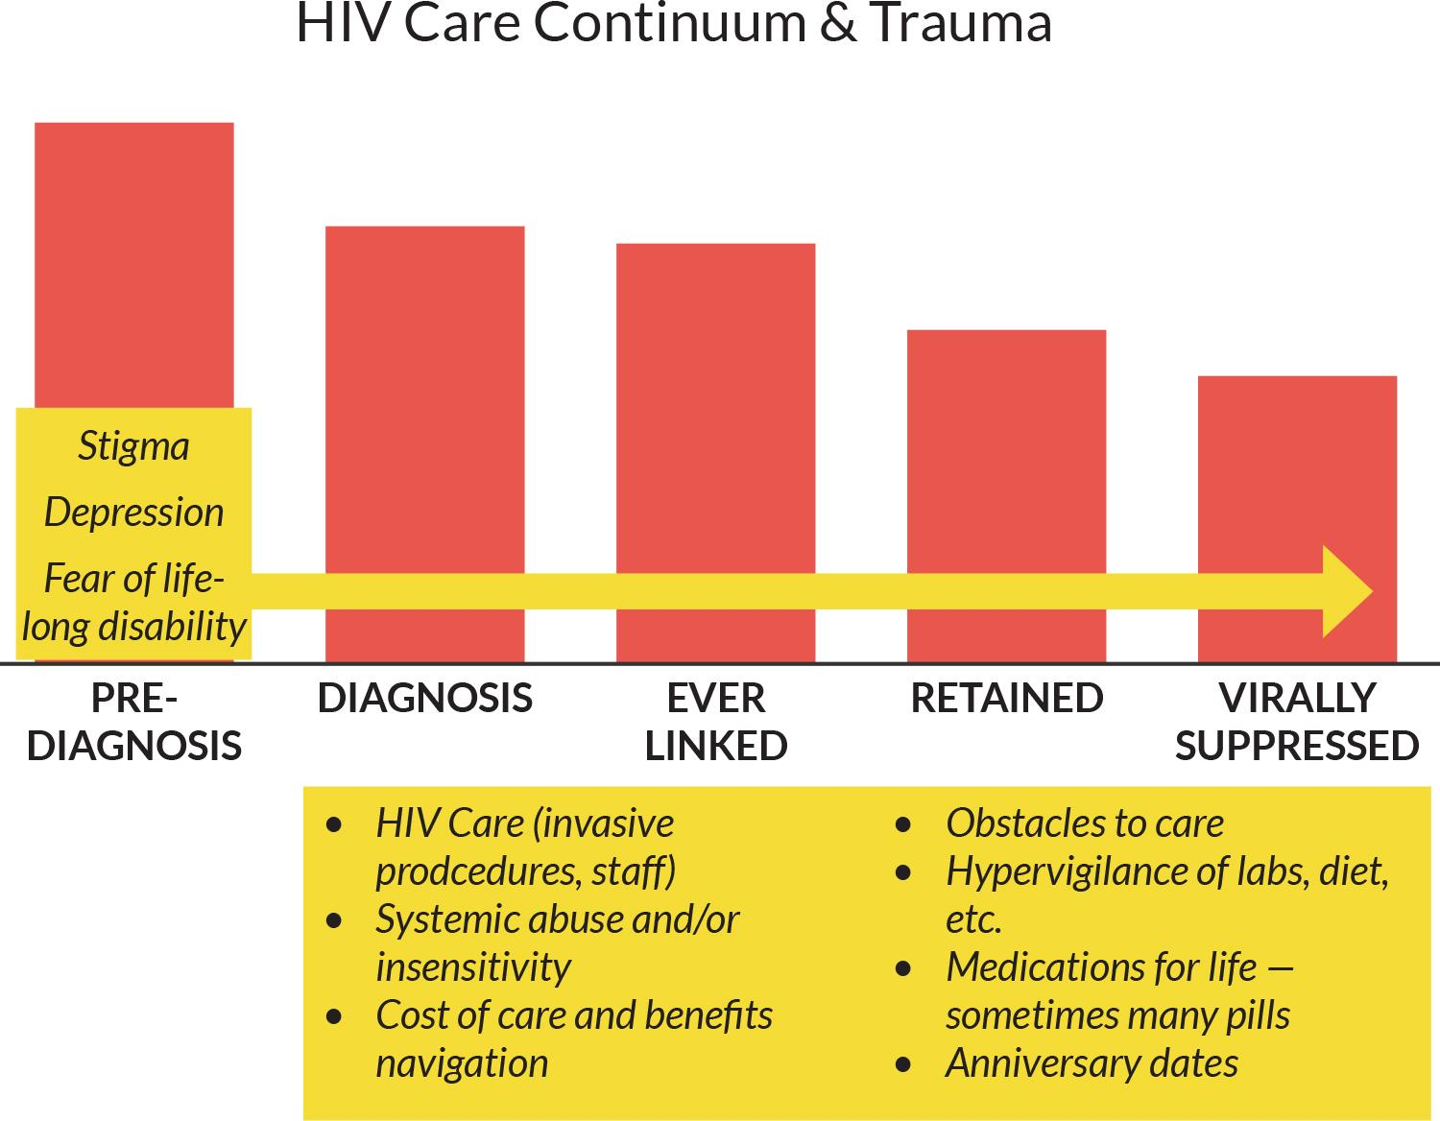
TRAUMA THROUGHOUT HIV CONTINUUM
Notes:
Past and current traumatic experiences have impacts along the HIV care continuum and contribute greatly to whether or not a person contracts HIV, is diagnosed, is linked to care, retained in care, and maintains viral suppression. When considered with comorbidities such as substance use disorders and mental health issues, addressing the effects of trauma at every stage of the continuum becomes imperative.

Slide 15
VICARIOUS TRAUMA
Vicarious trauma can occur in providers as a result of bearing witness to the experience of trauma in others. Providers are exposed to trauma through hearing about traumatic experiences or being witness to symptoms of trauma in their clients (e.g., aggression or anger).
Vicarious trauma can lead to various levels of burnout and compassion fatigue, impacting high rates of turnover in many organizations that serve PLWH.
Furthermore, many persons in helping professions are drawn to the work based on their own personal experiences, thus increasing risk for vicarious trauma.

Slide 16

Dr. Edward Machtinger, UCSF

Slide 17
TRAUMA-INFORMED APPROACHES TOOLKIT

Slide 18


Slide 19
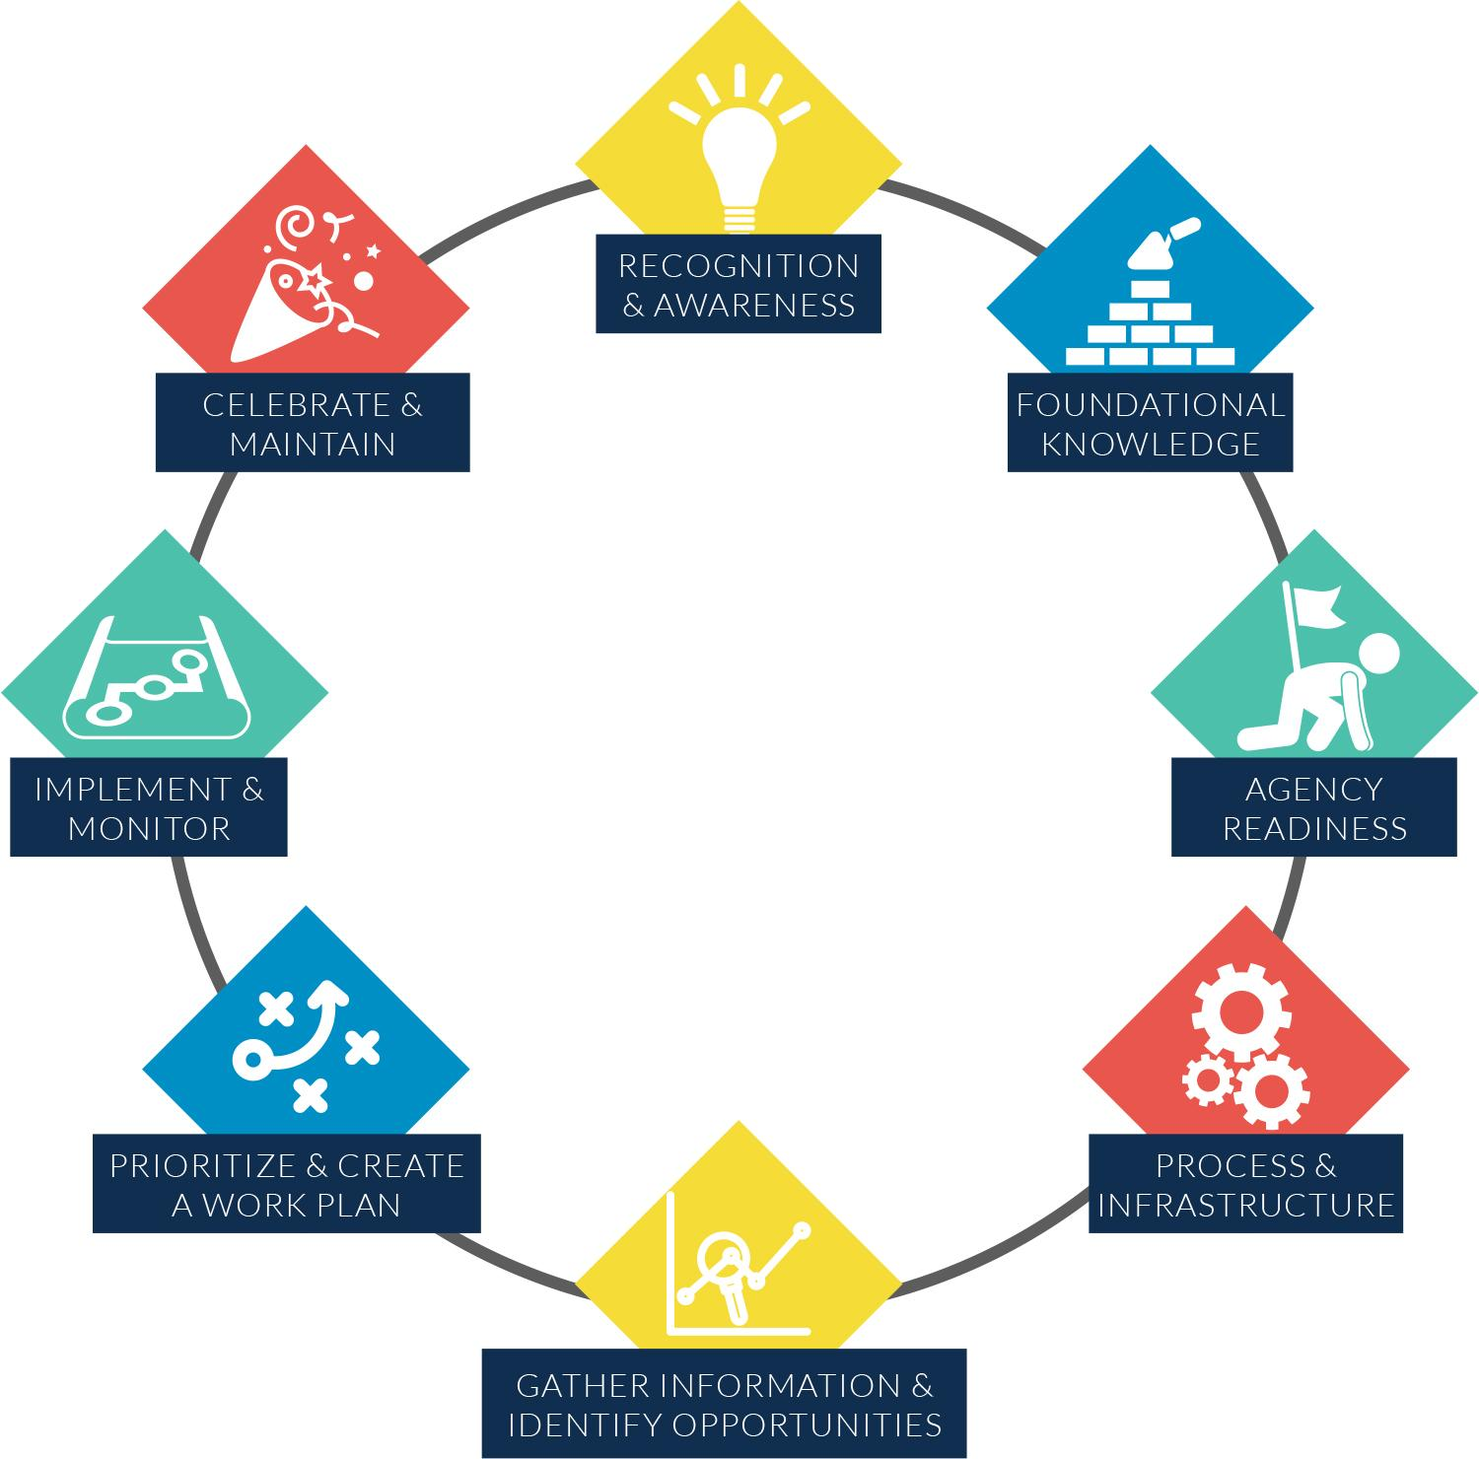
TIA MODULES
Notes:
Recognition & Awareness;
Foundational Knowledge;
Agency Readiness;
Process & Infrastructure;
Gather Information & Identify Opportunities;
Prioritize and Create a Work Plan;
Implement and Monitor;
Celebrate & Maintain

Slide 28
BLACK MEN LIVING WITH HIV
Notes:
Similar to our Aging PLWH segment, we are going to take a look at how ADAPs and Ryan White HIV/AIDS Program Part B Programs can support access to medications and tailor related services for Black men living with HIV. I’ll provides a summary of HRSA/HAB guidance related to outreach and education services for minoriti populations, specifically those from communities of color.

Slide 29
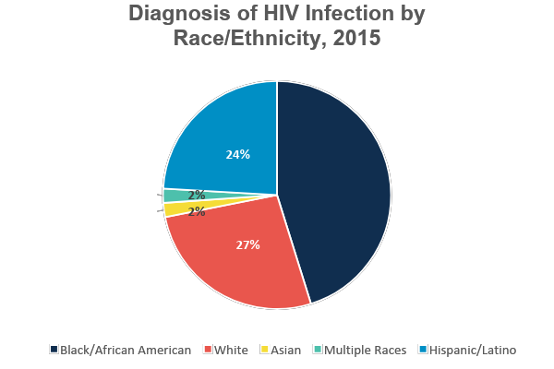
Black Men Living with HIV
Source: CDC HIV Surveillance Report: Diagnoses of HIV Infection in the United States and Dependent Areas, 2015; vol. 27. Race/Ethnicity groups representing less than 1% of HIV Diagnosis were note included (Native Hawaiian/Other Pacific Islander and American Indian/Alaska Native)
Notes:
Firstly, I want to set the tone for this conversation and share a bit about why we are focusing our efforts on Black men living with HIV. As you can see from this chart developed using 2015 surveillance data from the centers for disease control and prevention (CDC), Black people are disproportionately affected by the HIV epidemic.
Blacks/African Americans account for a higher proportion of new HIV diagnoses, those living with HIV, and those ever diagnosed with AIDS, compared to other races/ethnicities. In 2015, African Americans accounted for 45% of HIV diagnoses, though they comprise 12% of the U.S. population

Slide 30
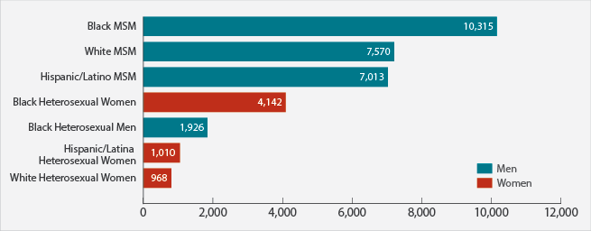
Black Men Living with HIV
New HIV Diagnoses in the United States for the Most-Affected Subpopulations, 2015
Source: CDC. Diagnoses of HIV infection in the United States and dependent areas, 2015. HIV Surveillance Report 2016;27. Subpopulations representing 2% or less of HIV diagnoses are not reflected in this chart. Abbreviation: MSM, men who have sex with men.
Notes:
When we take an even closer look, it is abundantly clear that Black men who have sex with men (MSM), specifically, are experiencing the highest burden of new infections.
In 2015, of those African Americans diagnosed with HIV, more than half (58%) were gay or bisexual men.

Slide 31
Treatment Needs of Black Men Living with HIV
Significant toxicities such as high cholesterol, diabetes, and excess cardiovascular comorbidity, present challenges for providers managing HIV care.
  Black men experience these comorbid conditions at disproportionately higher rates.
    These disproportionate outcomes are largely due to social determinants of health (i.e., social and economic factors, physical environments, and health behaviors).
Notes:
Research indicates that HIV affects the body in a way that results in an increased risk of cardiovascular disease compared to HIV- negative persons. Although HIV infection can now be treated effectively with combination antiretroviral (ARV) medications, significant toxicities such as high cholesterol, diabetes, and excess cardiovascular co-morbidity, present challenges for providers managing HIV care.
Black men experience these co-morbid conditions at disproportionately higher rates. Taken together, these issues affect clients’ adherence to ARV treatment and, in turn, their viral load suppression.
One thing to bear in mind as we proceed, these disproportionately poor health outcomes are largely due factors outside of health care (i.e., social and economic factors – such as education and employment, physical environments – such as housing options and transit systems, and health behaviors – such as sexual activity and alcohol and drug use), however, access to health care can improve health outcomes.

Slide 32
RWHAP Policy and Program Considerations
ADAPs’ Support of Treatment Access via Formularies
  RWHAP Section 2616(c)(6) of the Public Health Service Act
RWHAP Part B Minority AIDS Initiative (MAI)
  Targeted activities
  Targeted audiences
  Traceable clients
Access, Adherence, and Monitoring Services (ADAP Flex)
  Funds improve access to medications, increase adherence to medication regimens, and help clients monitor progress.
Notes:
Through the Ryan White HIV/AIDS Program Section 2616(c)(6) of the Public Health Service Act and HRSA policy, requirements placed on ADAP formularies enable them to include medications for many comorbid conditions that may impact PLWH, including those comorbid conditions disproportionately experienced by Black men.
Next, as stated in the HRSA ADAP Manual, “RWHAP legislation states that Minority AIDS Initiative (MAI) funds awarded to RWHAP Part B recipients are “for grants used for supplemental support education and outreach services to increase the number of eligible racial and ethnic minorities who have access to treatment through (ADAP)” This legislation states that racial and ethnic minorities include African Americans, among other groups. There are three key components of Part B MAI-funded services, which are Targeted activities; Targeted audiences; Traceable clients
States are required to describe planned education and outreach services when submitting a MAI Annual Plan with a level of detail that includes deliverables, specific locations of and types of agencies and staff to provide services, coordination with existing services and service providers, and the involvement of targeted minority populations in implementation of the plan. The amount of the RWHAP Part B MAI award is determined by a formula based on the number of reported living minority HIV/AIDS cases for the most recent calendar year as confirmed by the Centers for Disease Control and Prevention (CDC). RWHAP Part B MAI funds provide states an opportunity to tailor outreach and education activities to the needs of Black men living with HIV, and provide culturally centered service. In a few minutes, I’ll discuss the importance of tailoring activities, specifically outreach activities, for this population.
3. While ADAP funds are largely devoted to paying for HIV medications and health insurance, a limited amount of funds can, with approval from HAB, be used to improve access to medications, increase adherence to medication regimens, and help clients monitor their progress in taking HIV-related medications. HAB Policy Notice 07-03, The Use of RWHAP, Part B ADAP Funds for Access, Adherence, & Monitoring Services, provides further guidance on spending limits and circumstances. States who want to use ADAP funds under the Flexibility Policy must request permission to do so in the ADAP Flexibility section of the RWHAP Part B Base application. This funding affords states an additional opportunity to retain and virally suppress Black men living with HIV, among other groups.

Slide 33
Drug and Service-Specific Information
ADAP
RWHAP Part B
Cardiac medications
HCV treatment medications
Mental health treatment medications
Metabolic agents
Medical Case Management
Mental Health Services
Outreach Services
Non-Medical Case Management
Psychosocial Support Services
Notes:
RWHAP Part B recipients can address a number of comorbid conditions commonly experienced by Black men living with HIV, and respond to the needs of Black men living with HIV through ADAP formulary coverage of medications that treat comorbid conditions, and through services that fit under allowable RWHAP Part B program service categories.
Cardiac Medications: African American men suffer disproportionately
from high blood pressure, a known risk factor for heart disease and stroke. Nearly 44% of African American men have some form of cardiovascular disease that includes heart disease and stroke.
Metabolic Agents: Type 2 diabetes is also independently associated with chronic inflammation caused by HIV. People with African American family background are at greater risk for Type 2 diabetes. The rate of diagnosed diabetes in Black men has almost tripled since 1980.
ADAPs should provide access to these treatments with the full complement of related and allowable RWHAP Part B core medical and support services. The provision of treatment medications, although vital, is solely insufficient.
Mental Health Services (Core Medical): Mental Health Services are the provision of outpatient psychological and psychiatric screening, assessment, diagnosis, treatment, and counseling services offered to clients living with HIV. Mental health issues, including depression, affect medication adherence, particularly among young, Black MSM.
Psychosocial Support Services (Support): Psychosocial Support Services provide group or individual support and counseling services to assist eligible PLWH to address behavioral and physical health concerns. These services may include: HIV support groups, and pastoral care/counseling services. These services are especially important as social support appears to create a sense of community for health issues among African American men. Furthermore, African American ministers are considered trusted “gatekeepers” for providing pastoral counseling and referring community members to specialty care as needed.

Slide 34
STATE EXAMPLE: IOWA DEPARTMENT OF PUBLIC HEALTH

Slide 35

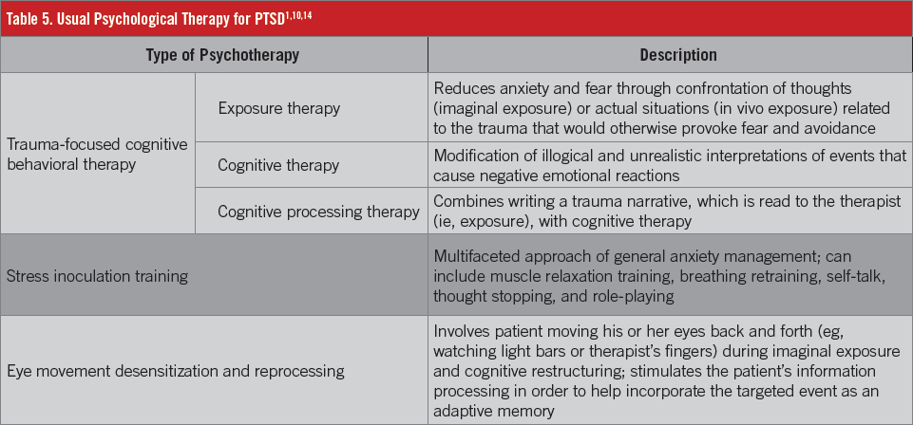

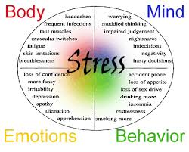
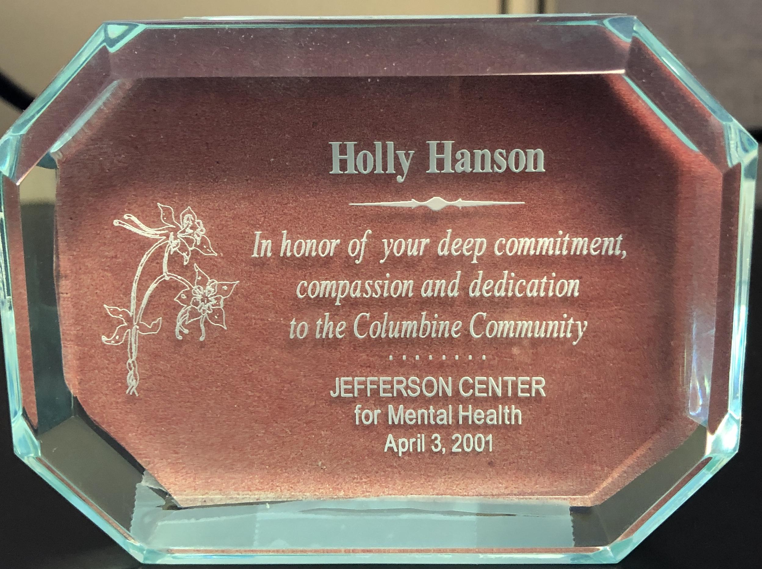
HISTORY LESSON-HOLLY’S PERSPECTIVE

Slide 36
Iowa’s Journey to Integrating
Trauma Informed Principles into Part B Services
TIC included in the Integrated Comprehensive Plan.
Iowa received Part B Supplemental money.
Hired Trauma Informed Coordinator.
Holly begins at IDPH as RW Part B Manager.
First Trauma Informed Excellence Training for all Part B Case Managers
2001
2016
2011
1999
2008
2015
2017-18
Shooting at Columbine High School on 4/20/1999. Holly works at Columbine Connections until May 2001.
Began MCM Certification for all Iowa Part B Case Managers with organization out of Colorado. Met Matt Bennett.
Included ACE’s Questions in the HIV Consumer Needs Assessment.
Started IDPH TIC Workgroup
Hired consultant for development of trauma informed strategic plan
TIE expanded to include Bureau and testing sites
Statewide, multi-sector group formed

Slide 37
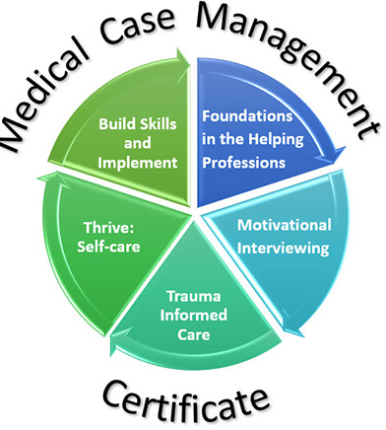
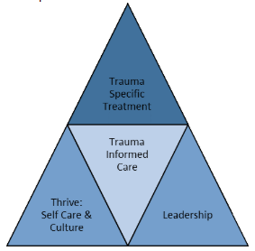
Trauma Training for
Part B Subrecipients
Core component of Medical Case Management Certification
from Coldspring Center- Blended Learning of
online curriculum + 2-day in-person training
Trauma-informed excellence, or TIE, model
is a required extensive online training required
of all RW subrecipients. One cohort per year is offered.

Slide 38
Formation of IDPH Workgroup
HIV
Early Childhood Mental Health
Tobacco Control
Domestic/Sexual Violence
Substance Use (Prevention and Treatment)
Health Equity
Nutrition and Physical Activity
Chronic Disease Prevention and Management
Emergency Management Services
Planning Services
Vision - Healthy Iowans in trauma-sensitive communities
Mission - Create a trauma-sensitve culture that promotes action based on the evidence connecting trauma, health, and well-being.

Slide 39
Next Steps for Part B Subrecipients-
Develop strategies to ensure these areas of focus are met and sustained.
Prioritize Changing Organizational Culture
Promote staff self-care to prevent burnout
Integrate ‘Universal Precautions’ for ACE’s and Chronic Stress
Create a trauma-informed workplace
Utilize and organizational assessment tool to determine baseline and create strategies.
Compassion fatigue and burnout is a real problem in the helping professions. Promoting self-care on and off the clock is critical.
Deliver trauma-responsive services
Assuming most or all of our clients have experienced traumatic events and/or chronic stress ensures our services don’t retraumatize them.
Accomplished through training and hiring practices
Having a system of on-site treatment, referrals to trauma sensitive treatments, warm-handoff to trained professionals
1
3
4
2
5

Slide 40
Q&A
DISCUSSION
Notes:
Who is currently thinking of/implementing TIA into their program?
What challenges or successes are you experiencing?
What does your process look like if you are in the implementation phase?
How did you gain buy-in from key stakeholders?
What are your fav TIA resources or training?

Slide 41
TRAUMA-INFORMED ACTIVITY

Slide 42

PATIENTS AT UCSF
Notes:
STOP AT 2:30 or 3:40

Slide 43
CONTACT INFORMATION
Mahelet Kebede, MPH
Manager, Health Care Access
202.434.8098 | mkebede@NASTAD.org
Connect with us: LinkedIn | Facebook | Twitter | YouTube
NASTAD | 444 North Capitol Street NW, Suite 339 | Washington, DC 20001| NASTAD.org

