Slide 2
TAVIE RED: Virtual Coaching Application for Smart Phones for Rhode Island Ryan White
Paul Loberti, Chief Administrator Office of HIV/AIDS & Viral Hepatitis State of RI
Jeana Frost, Director of Research, 360Medlink
Ezzat Saad, Chief Medical Officer, 360Medlink
Andre Parker, Program Manager, OHHS RI
Panel

Slide 3
Agenda
Team
Context and Population
Approach and strategy
The platform
Reactions and experience
Discussion

Slide 4
Team
Paul Loberti, MPH
Chief Admin OHHS
Andre Parker
Program Manager and Technologist
Ezzat Saad, PhD, MD
Chief Med Officer
Jeana Frost, PhD
Head of Research
Claire Kamoun, MPH
Sr. Dir Patient & Med-Affairs

Slide 5
Our Goal: Programs to achieve Triple Aim
1. Improve health outcomes
Improve:
Health outcomes.
Patient experience and engagement.
Efficient spending.
RI Medicaid and the Ryan White program adopted these measures assertively pre PPACA, and they continue to exist today.
Medicaid benefits from Ryan White Part B performance measures, and Ryan White Part B benefits from the Medicaid efficiency measures.
3. Promote efficient spending
2. Improve patient experience and engagement

Slide 6
A Bi-Product of Reform:
The opportunity to harness Digital Health Innovation

Slide 7
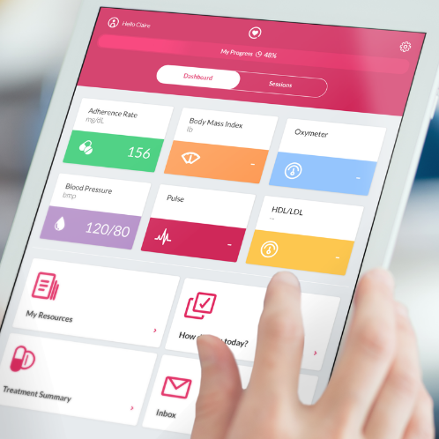
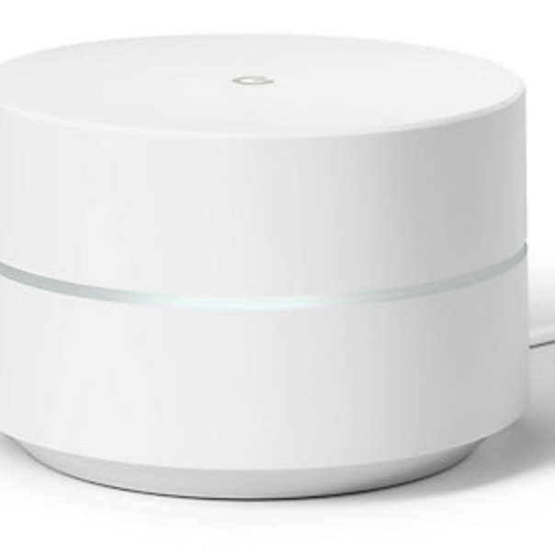
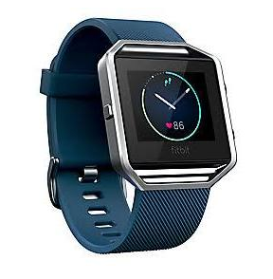
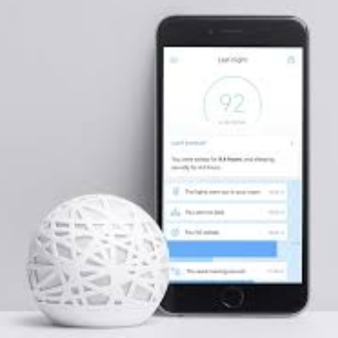
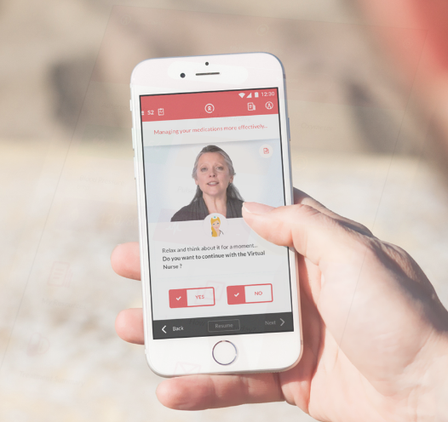
Context: Growing body of evidence that Technology can support positive health outcomes
Tablets
Smart home devices
Smart Watches
Health Sensors
Digital health applications

Slide 8
BUT: Our clients rarely have access
Asked to use what is freely available.
We learned the real price of “free”

Slide 9
We came to a different conclusion
3
selection
1
Wants &
Needs
2
options
RI state government search around PPACA implementation to effectively:
Communicate/monitor/enhance health outcomes
Engage in telehealth opportunities
Evaluate performance measures.
Conducted a 12 month review of existing products and smart phone applications.
We were looking for more than an application.
We wanted an innovative application coupled with a programmatic bent that directly interfaced with our consumers.
After research stage, RI procurement allowed for a Sole Source with TAVIE^{RX}.

Slide 10
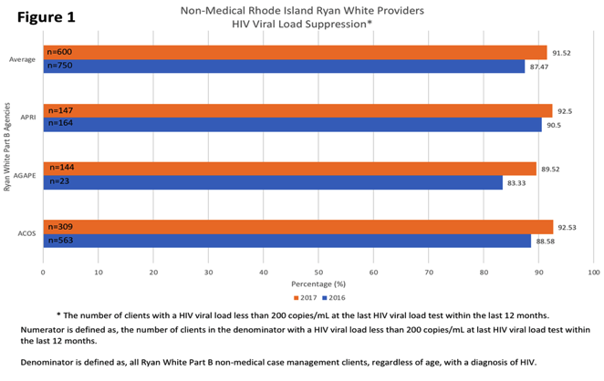
Good News: Viral Load
92% of respondents had a viral load below 200
Levels improving over time
Reported through clinical assessment used for Quality Management Performance Measures.

Slide 11
However, Our population is vulnerable
Social isolation
80%
Single, divorced or widowed
80% of users single divorced or widowed
Only 22% college educated
21% in unstable housing or homeless
5% are uninsured
Low technical literacy
At risk of slipping out of care
Under-educated
Unstable housing
Un or under-insured
22%
21%
5%
College educated
Homeless
Uninsured
Many people living with HIV in RI with lower income (and other social determinants) did not have smartphones or computers.
* Source: Baseline assessment survey. ** In other surveys, RI clients living with HIV have reported upwards of 32% homelessness.

Slide 12
Need: Psychological, QOL, Technological, and for Connection
Clients report being socially isolated, struggling with mental health, and burdened with symptoms of pain, sleep issues, and fatigue.
They report low self efficacy in getting help from the community and managing symptoms
Source: Baseline assessment
33%
Clinically depressed
Report symptoms. Most report low self-efficacy managing symptoms
Had a smartphone. Tech literacy is low
50%
0.5%

Slide 13
Our Approach

Slide 14
Approach:
The First Clinically Validated Virtual Nurse Interactive Coach, TAVIE.
Customized PRO collection
Tailored virtual coach for each user
Treatment reminders
Symptom tracking
Theory-driven interventions

Slide 15
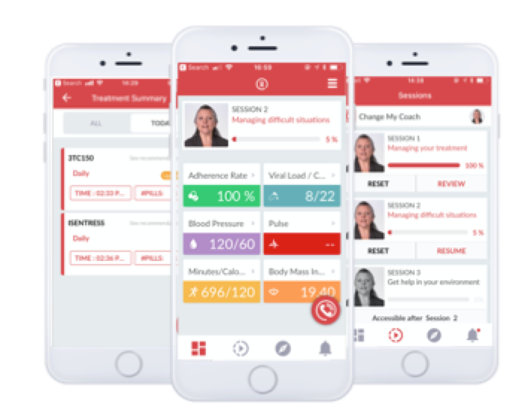
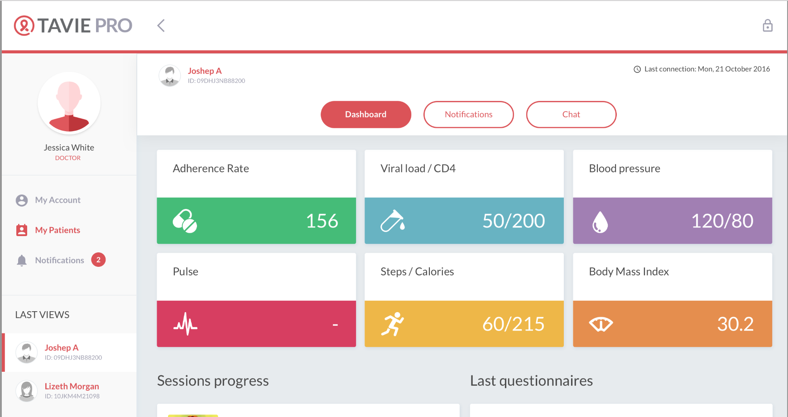
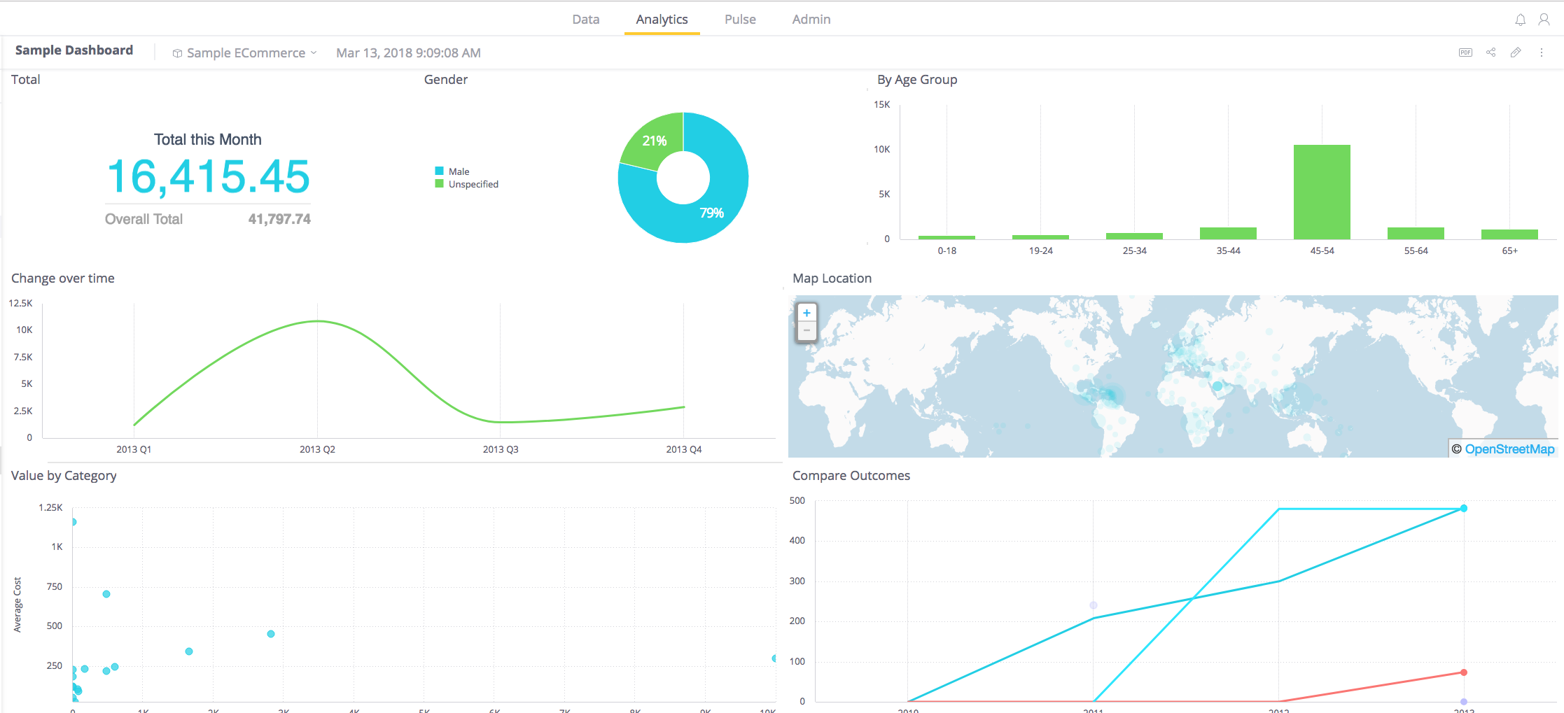
Approach: Platform connects clients and case managers. Progress reviewed through analytics.
Clinically Validated Virtual Nurse App for Patients. Users receive personalized coaching sessions, treatment reminders and tracking tools
Provider Console to Monitor and Intervene. An interface for case managers and providers to stay in touch and assist patients.
Stakeholder Analytics. Customizable dashboard to track performance measures, view clinical outcomes and track engagement to inform decision-making.

Slide 16
Platform Evolution (talk tomorrow)
1. Validated Platform
Developed and validated at University of MTL Medical Center
2. Initial Adaptation
Adapted the content and trackers for U.S. vulnerable population
3. Second Release
Based on input and need to address SODH, increase engagement and delight

Slide 17
Modular Design
01
2. Trackers and Feedback
Symptom assistance
Treatment reminders
Physical activity
Viral load, weight, BP, +
1. Virtual Coaching
Treatment adherence
Patient education
Side-effect management
02
03
3. Whole Health
Psycho-social support
Symptom management
Service acquisition (food insecurity, housing, engagement with healthcare)
4. Gamification
Interactive Quests
Dynamic Feed
Upgrading reminders and notifications
Alerts for care managers
04

Slide 18
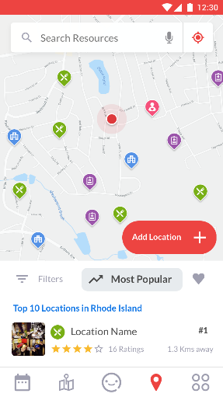
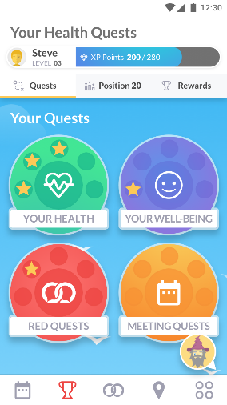
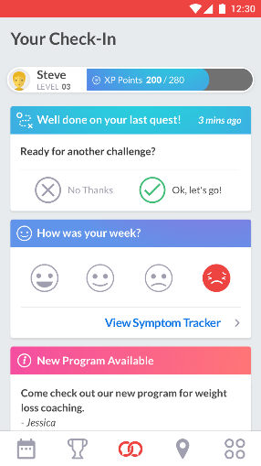
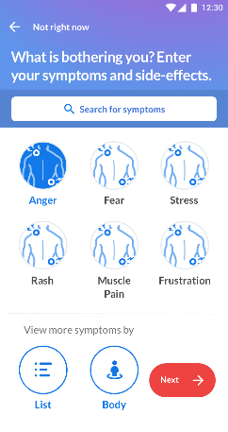
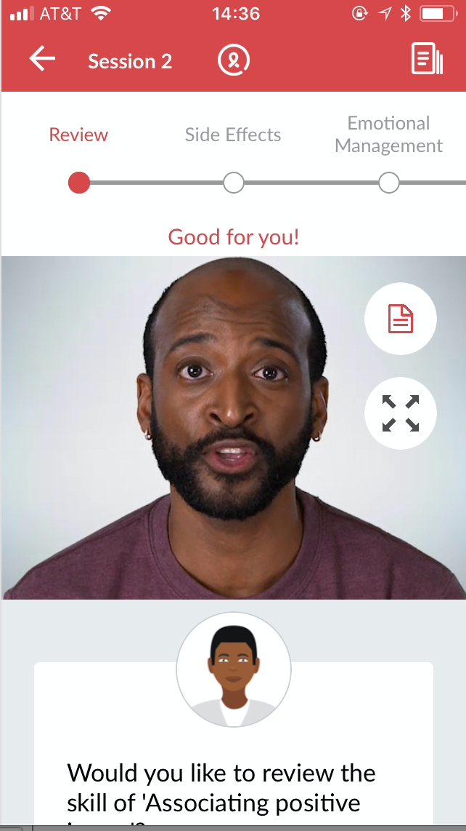
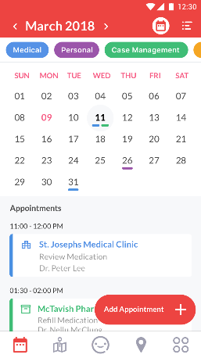
TAVIE RED: A Client Companion
Engage
A “feed” page shows interactive content and announcements from case managers
Assist
Virtual nurse coach, a resource map, announcements, and calendar with reminders help users manage care day-to-day
Delight
Users practice and solidify skills through health-related “quests” and gain rewards as they progress

Slide 19
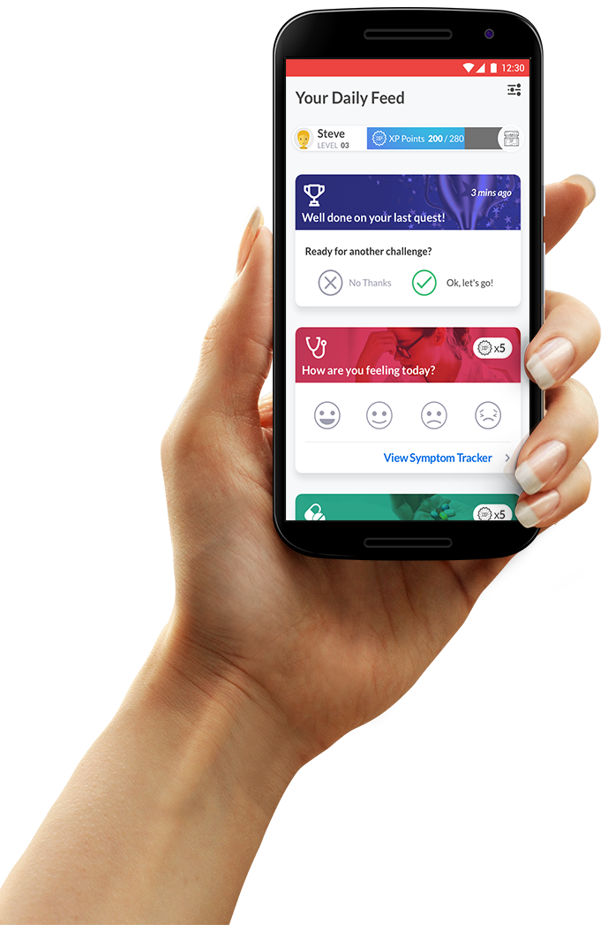
1. Engage: Feed
Dynamic view of app content with next steps for the client.

Slide 20
1. Engage: Announcements
Case managers can send clients announcements, short messages with yes or no responses.

Slide 21
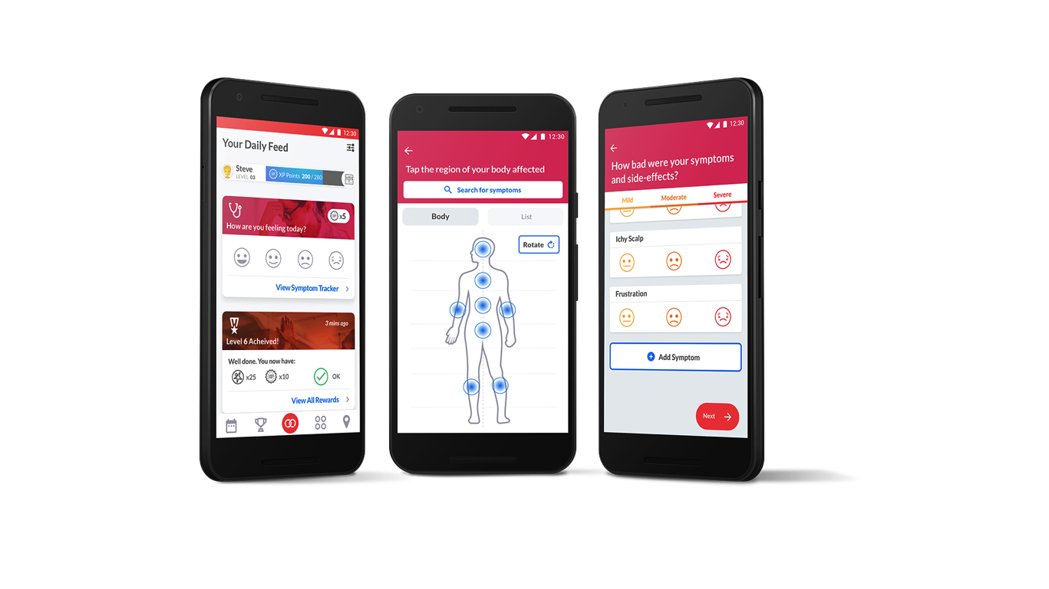
2. Assist Coaching and Tracking
Virtual coach delivers educational content and support
Symptom assistant
Medication tracker and reminders
CD4 and Viral load charting tool

Slide 22
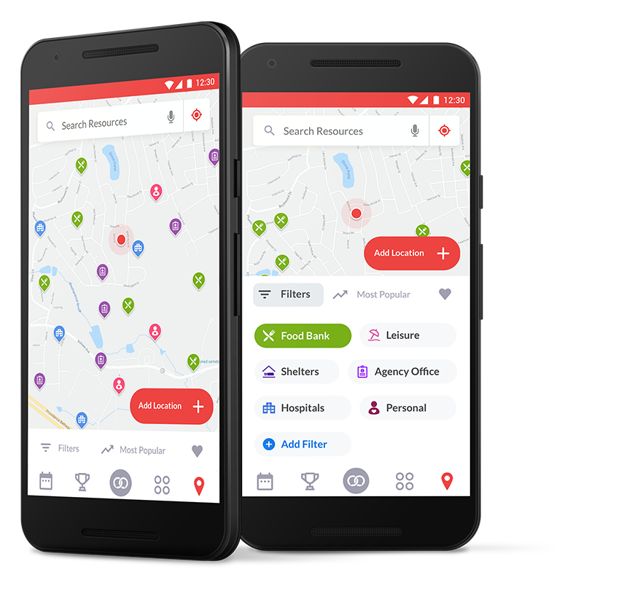
2. Assist: Resource Map
Clients can locate services recommended by case managers.

Slide 23
2. Assist: Calendar and Appointments
Clients and case managers can add appointments to the calendar.
Clients can receive reminders before the appointment begins.

Slide 24
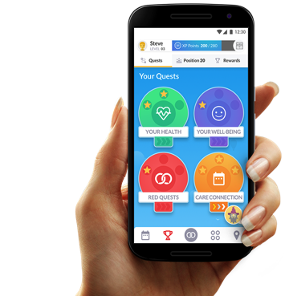
3. Building rituals: Playful engagement and Gamification
User actions are incentivized through points and rewarded through raffles.
Users rehearse healthy behaviors as they complete quests.

Slide 25
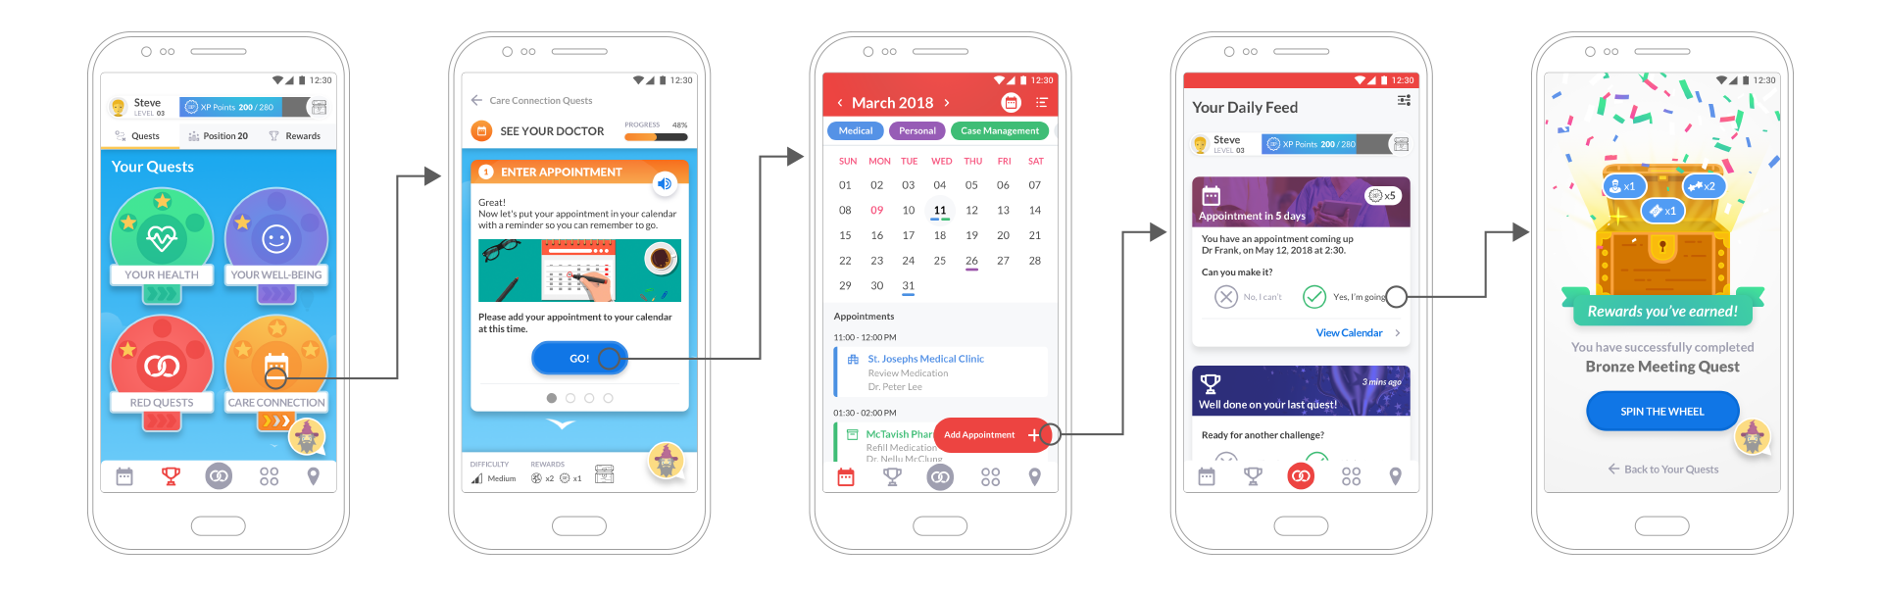
3. Delight: Serious Game Quest
Client chooses the prepare for a doctor visit quest
Quest is launched to help the client create and prepare for the appointment
Appointment is saved in the in-app calendar
Client receives reminders for the appointment in the feed
Quest Completed!

Slide 26
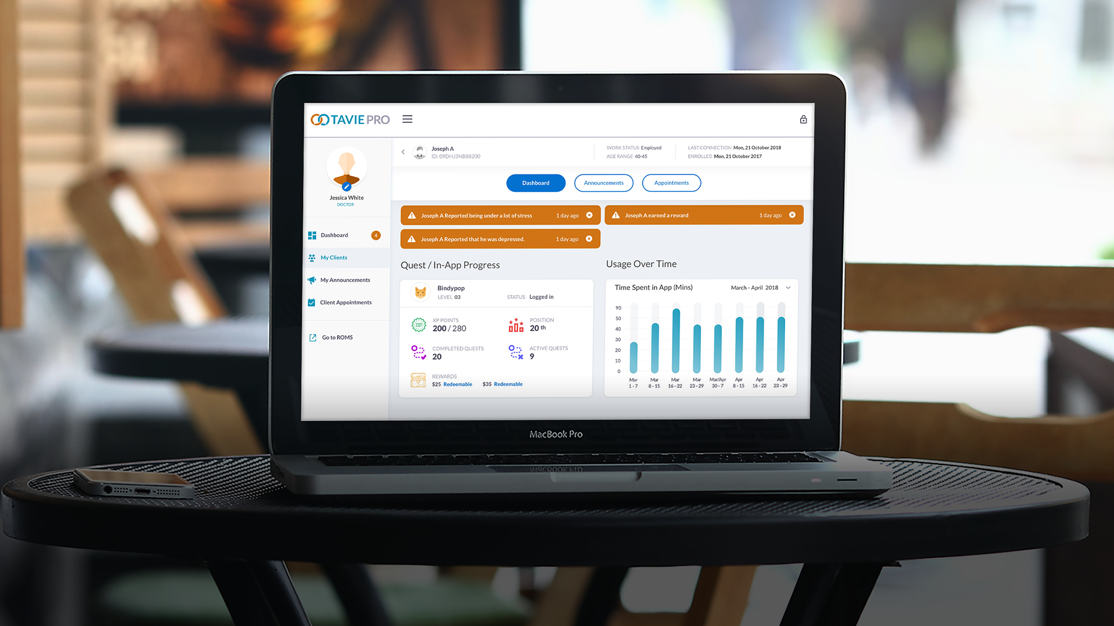
Discussion

Slide 27
TAVIE Pro
Case managers:
Review progress and stay connected with clients
Send messages to keep clients informed
Make and review appointments with clients

Slide 28
Experiences to Date
Protocol:
Targeting 600 clients using the platform
Clients receive phones preloaded with the application.
Case managers track progress and follow-up with clients
Project Status:
50% to our target:
150 users of a first version of the app (TAVIE HIV)
167+ users of TAVIE RED
Feedback gathered through:
In-app assessments
Analytics

Slide 29
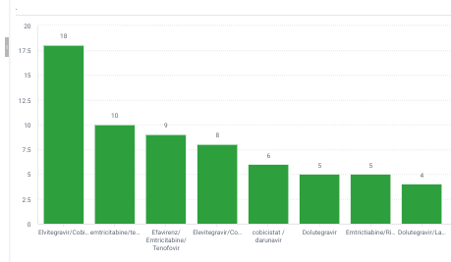
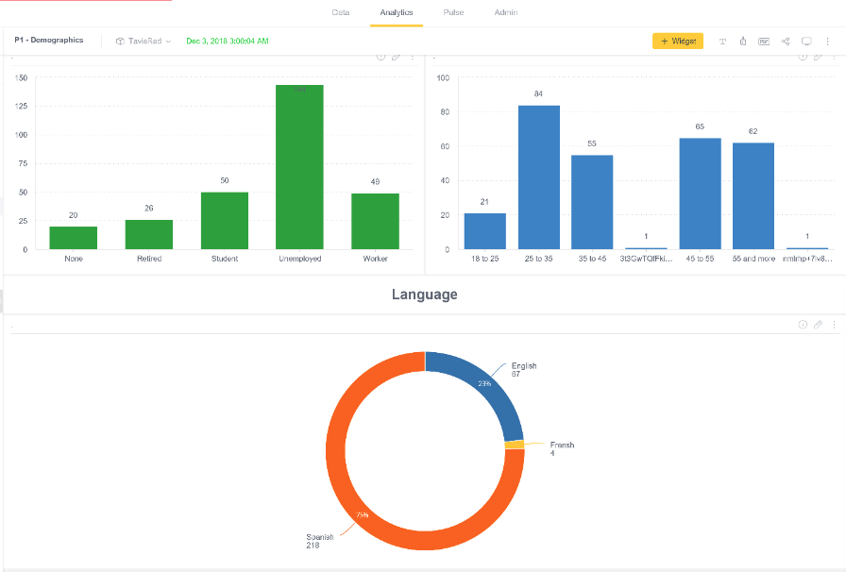
Findings 1: Real time data reporting and metrics
Demographics and characteristics of the population
Treatment regimens, adherence levels, symptomology, comorbities…
Real-time understanding of user needs and symptomology
Engagement with the application and progress through educational materials

Slide 30
Findings: Patients Engaged
90% of other health apps unopened
Most RED users actively engaged with the application
Clients using the functionality
Clients engaging over time with the gamified elements

Slide 31
Findings: User Response Through In-App Assessment
88%
80%
82%
56%
Would Recommend
Agree Helps Manage Medication
Agree Helps Manage Condition
Agree Helps with Managing Appointments
41 users completed, 68% male, 29% female, 2% trans, Distributed across age, 61% unemployed

Slide 32
Feedback

Slide 33
Summary Findings
Ability to design to Needs & performance measures
New mechanisms to improve CM-client communication
Vehicle to achieve performance measures
Social determinants are inextricably linked to the performance measures – moving from isolation of a SDoH to a solution
Greater Understanding of the population
In-app assessments
Patient-reported outcomes
Contextual data
Performance measures
Greater understanding of clients’ needs, challenges and abilities
Positive Assessments and Outcomes
21% of users did not have a phone before
88% of early users would recommend, now more positive
Helps people take medication, manage their condition, and use tech generally

Slide 34
Lessons Learned
Implementation reveals barriers & challenges
Vulnerable populations deserve and thrive with advanced technology
Unexpected cost saving: Evaluation and Performance measures
Procurement in state government is critical

Slide 35
Questions?

Slide 36
Thank you!
Paul Loberti
Jeana Frost
Ezzat Saad
Andre Parker

