Slide 2
Using a Bilingual HIV Telenovela
(Sin Vergüenza) to train
US/Mexico border Promotores
Tom Donohoe, MBA
Professor of Family Medicine
Director, Los Angeles Region Pacific AIDS Education and Training Center (LA PAETC)
Associate Director, UCLA Center for Health Promotion and Disease Prevention

Slide 3
Educational Objectives
At the end of this training, participants will be able to:
Discuss the role of border Promotores in enhancing the HIV Care Continuum
Explain how telenovelas can be useful tools for motivating and teaching about HIV on the US/Mexico border and in other communities
Consider culturally appropriate HIV education approaches through discussion of a bilingual HIV telenovela, Sin Vergüenza
Discuss cultural and socio-economic factors that impact the HIV epidemic in Latinx communities
Increase HIV knowledge, educational capacities, and referral skills in local Latinx communities

Slide 4
What is your primary HIV work role?
Clinician
Case Manager
Patient Navigator
Peer Support
Administrator
Counselor
Educator/Teacher/Trainer
Other

Slide 5
I have seen a telenovela
Strongly agree
Agree
Neither agree nor disagree
Disagree
Strongly disagree

Slide 6
I can explain what Promotores do.
Yes 100%
Yes 50-99%
Yes A little
No
¿What are Promotores?

Slide 7
Have you seen Sin Vergüenza?
Yes Season 1
Yes Season 2
Yes Seasons 1 and 2
Yes bits and pieces
No

Slide 8
If yes, in which language?
English
Spanish
Both

Slide 9
Have you used Sin Verguenza in your HIV work?
Yes Season 1
Yes Season 2
Yes Seasons 1 and 2
Yes bits and pieces
No

Slide 10


About the Series
Created in 2012, the series encourages people to seek HIV testing by featuring character stories highlighting the impact HIV has on Latino families.
7-episode Telenovela web series
Bilingual: English and Spanish
Available at
Svseries.com
Image: Promotional flyer of Sin Verguenza.

Slide 11

PURPOSE
Develop a culturally competent education tool to:
Address health disparities Latino communities related to HIV.
Disseminate HIV prevention messages in an innovative, nontraditional, accessible manner.
Engage communities in conversations about HIV.

Slide 12
Sin Vergüenza = Without Shame
SHAME Informs you of an internal state of inadequacy, unworthiness, dishonor, or regret about which others may or may not be aware.
Another person, circumstance, or situation can trigger shame in you, but so can a failure to meet your own ideals or standards whether or not they are perfectionist.

Slide 13

Meet The Salazars
Image: Screenshot of Sin Verguenza.

Slide 14

Season I Messages
HIV AFFECTS US ALL
Routine HIV Testing targets all individuals regardless of risk factors.
Benefits: testing individuals who may not suspect they are at risk:
1. Normalizes HIV testing
2. Diagnosing them at early stages of HIV

Slide 15
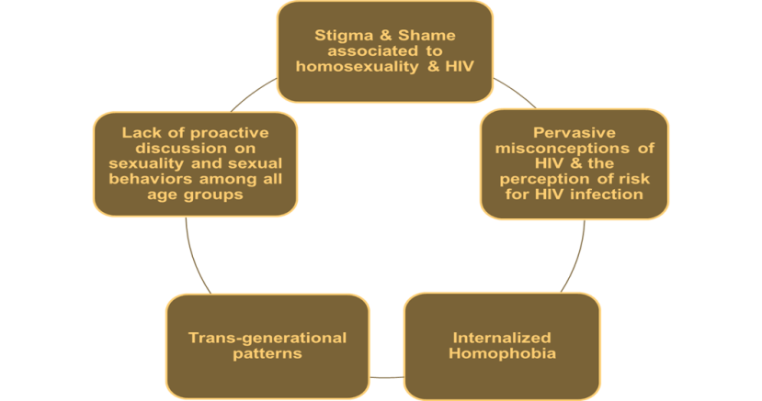
Themes/Contributors of Risk
Image: Sin Verguenza’s themes and contributors of risk diagram

Slide 16

Season II Messages
TREATMENT AS PREVENTION
Importance of HIV Medical Care and Treatment
Combating Stigma and Shame tied to HIV
Prevention methods to reduce Mother to Child transmission
PrEP is an effective prevention method

Slide 17


Season II Themes
TREATMENT AS PREVENTION
Addressing barriers to care
LGBT Care
Stigma & Shame
Fear
Homophobia
Substance Abuse
Images: Promotional flyers of Sin Verguenza.

Slide 18


















Media Coverage
Images: Media logos, a variety of media coverage for Sin Verguenza.

Slide 19
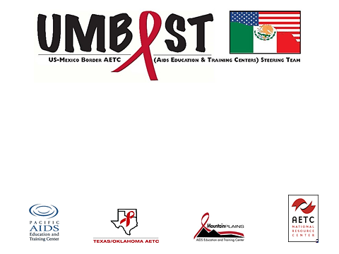
Pacific AETC---Tom Donohoe
South Central AETC---Tracy Jungwirth & Pedro Coronado
AETC National Coordinating Resource Center (NCRC)—Nicolé Mandel
HRSA HIV/AIDS Bureau

Slide 20
What’s the HRSA definition of the US Border region?
5 miles above Mexico
25 miles above Mexico
50 miles above Mexico
62 miles above Mexico
100 miles above Mexico

Slide 21
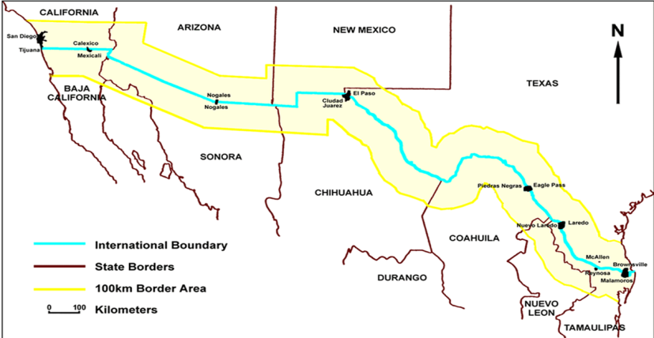
US and Mexico Border
Image: US and Mexico Border Map

Slide 22
Border Promotores Focus Groups
Border Promotores Focus Groups were conducted across California, Arizona, New Mexico, and Texas to assess the Promotores HIV training needs. Results will guide the development and implementation of an HIV training curriculum for Promotores de Salud using a linguistically, contextually, and culturally appropriate telenovela as a frame of reference.

Slide 23
Focus Groups Questions
Image: Table of focus group questions

Slide 24
Sin Verguenza border work
FOCUS GROUPS
Bilingual Workshops

Slide 25
Capacitación de VIH para los
Promotores de la Frontera
www.aidsetc.org

Slide 26
Learning and Teaching Domains
Image: Chart of Learning and Teaching Domains

Slide 27
What body fluid can NOT transmit HIV?
Blood
Saliva
Breast milk
Semen
Pre-ejaculatory fluid

Slide 28
An HIV-positive person is defined as having progressed to AIDS, when they get an AIDS-defining illness or if their CD4 cells fall below…
1,500
1,000
500
200
50

Slide 29
If someone has an “undetectable” viral load, it means there is no virus in their blood.
True
False

Slide 30
Which group has the highest rate of HIV-infection in the U.S.?
Men who have sex with men (any age)
Women over 65
Married women under 65
Heterosexual men (any age)
Single women (any age)

Slide 31
HIV medications are available to all that need them in the United States.
True
False

Slide 32
HIV medications are available to all that need them in Mexico.
True
False

Slide 33
Someone living with HIV who finds out early and receives treatment can have a normal lifespan.
True
False

Slide 34
In 2018, which medication is approved for PrEP (Pre Exposure Prophylaxis) for HIV?
Nuvada
Malvida
Anvida
Truvada
I don’t know what PrEP is.

Slide 35
What year was PrEP for HIV approved in the US?
2017
2016
2015
2014
2013
2012
I don’t know what PrEP is.

Slide 36
If someone takes their PrEP medication everyday as prescribed, what is the percentage protection against HIV?
80%
85%
90%
95%
99%
More than 99%

Slide 37
I feel I can comfortably explain PrEP.
Strongly agree
Agree
Neither agree nor disagree
Disagree
Strongly disagree

Slide 38
I feel I can comfortably explain HIV infection.
Strongly agree
Agree
Neither agree nor disagree
Disagree
Strongly disagree

Slide 39
I feel I can comfortably explain HIV medication.
Strongly agree
Agree
Neither agree nor disagree
Disagree
Strongly disagree

Slide 40
HIV Related Themes
Homophobia
Sexuality
Stigma
Gender roles
Trans-generational
patterns
Image: Basic Venn Diagram of HIV Related Themes

Slide 41

Sin Vergüenza
Sin Vergüenza was created in 2012 by AltaMed. The series encourages people to get tested as a routine part of their medical care and to seek HIV medical care should they test positive.
Available: http://svseries.com/

Slide 42
Season 1, Episode 1

Slide 43
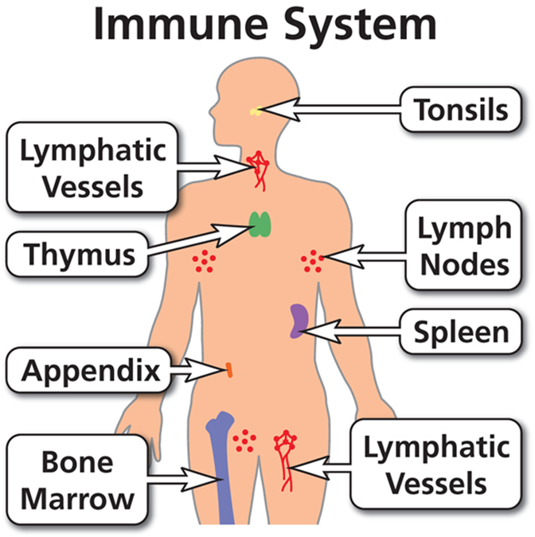
Immune System
Immune System:
A complex network of specialized cells, tissues, and organs that recognize and defend the body from foreign substances, primarily disease-causing microorganisms such as bacteria, viruses, parasites, and fungi. Organs and tissues of the immune system include the bone marrow, spleen, thymus, tonsils, mucous membranes, and skin. Granulocytes, macrophages, and T lymphocytes are examples of specialized cells. The lymphatic vessels of the immune system carry immune cells, which converge in lymph nodes found throughout the body. A swollen lymph node often indicates an active immune response to a foreign substance (AIDSinfo).
Source: AIDSinfo, U.S. Department of Health and Human Services (HHS)
https://aidsinfo.nih.gov/
Image: The immune system (lyphatic vessels, thymus, appendix, bone marrow, tonsils, lymph nodes, spleen, and the lymphatic vesels)

Slide 44
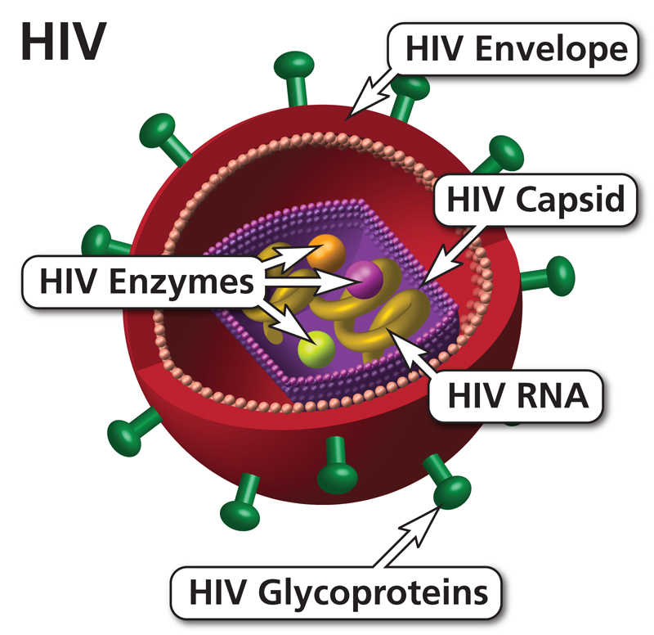
HIV Virus
Human Immunodeficiency Virus (HIV):
The virus that causes AIDS, which is the most advanced stage of HIV infection. HIV is a retrovirus that occurs as two types: HIV-1 and HIV-2. Both types are transmitted through direct contact with HIV-infected body fluids, such as blood, semen, and vaginal fluids, or from a mother who has HIV to her child during pregnancy, labor and delivery, or breastfeeding (AIDSinfo).
Source: AIDSinfo, U.S. Department of Health and Human Services (HHS)
https://aidsinfo.nih.gov/
Image: HIV virus (HIV enzymes, Hiv envelope, HIV capsid, HIV RNA, and HIV Glycoproteins

Slide 45
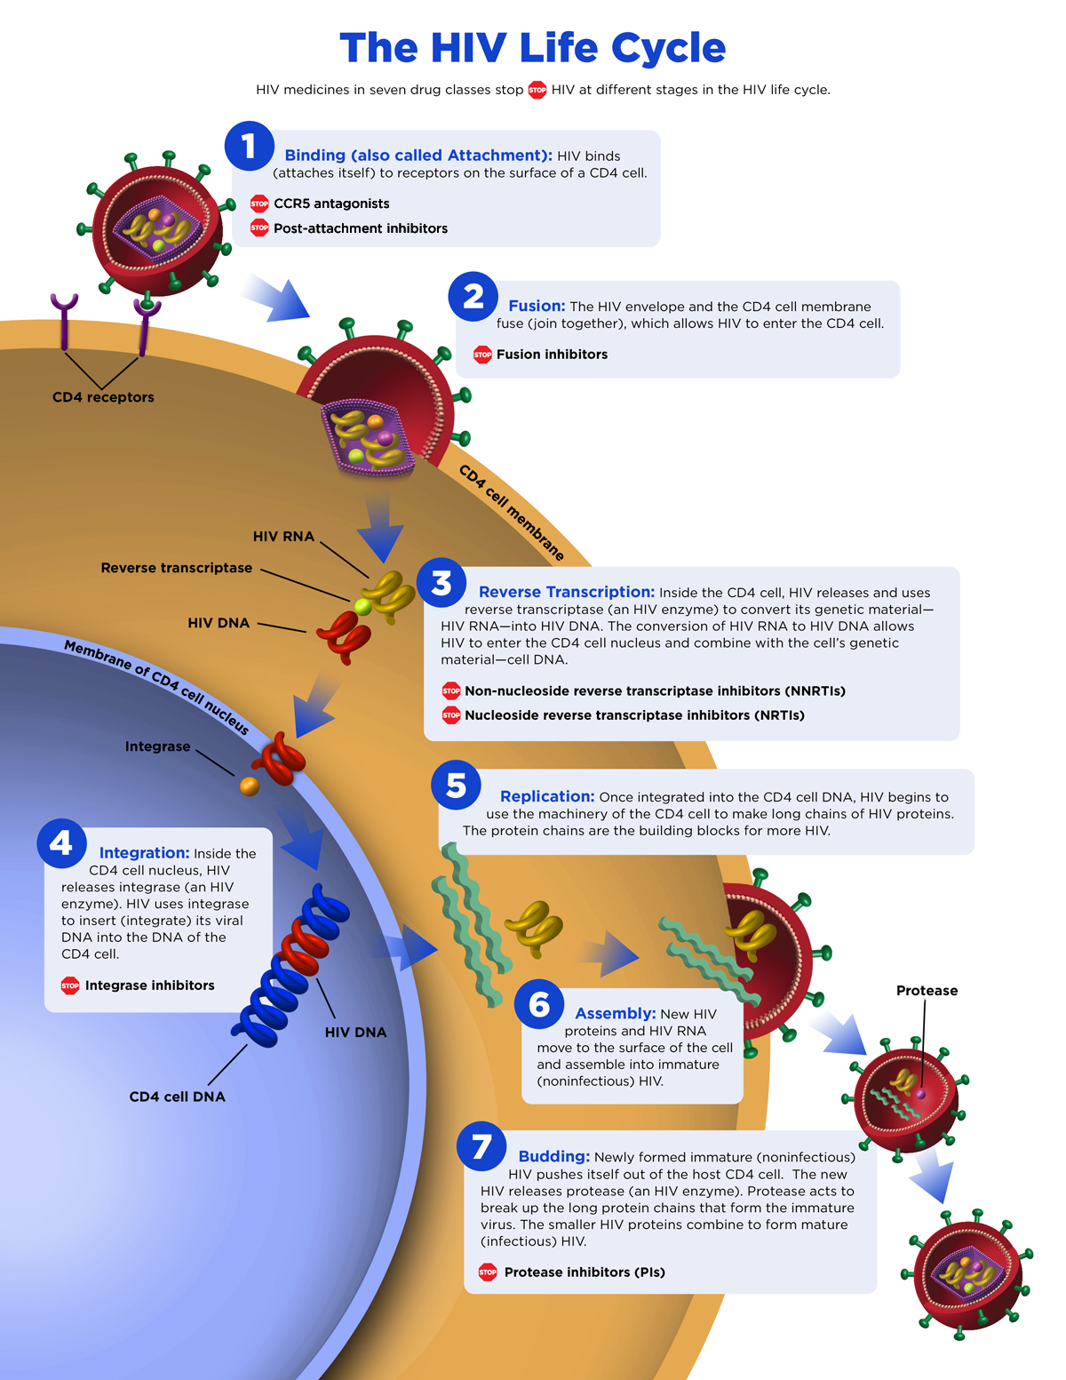
Source: AIDSinfo, U.S. Department of Health and Human Services (HHS)
https://aidsinfo.nih.gov/
Image: The HIV Life Cycle flow chart

Slide 46
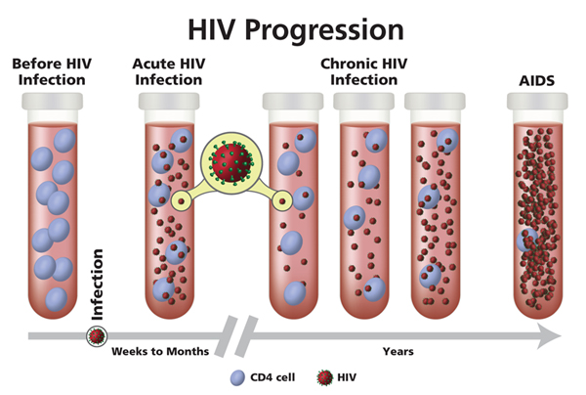
Stages of HIV
CD4 T Lymphocyte:
A type of lymphocyte. CD4 T lymphocytes (CD4 cells) help coordinate the immune response by stimulating other immune cells, such as macrophages, B lymphocytes (B cells), and CD8 T lymphocytes (CD8 cells), to fight infection. HIV weakens the immune system by destroying CD4 cells (AIDSinfo).
Virus:
A microscopic infectious agent that requires a living host cell in order to replicate. Viruses often cause disease in humans, including measles, mumps, rubella, polio, influenza, and the common cold. HIV is the virus that causes AIDS (AIDSinfo).
Source: AIDSinfo, U.S. Department of Health and Human Services (HHS), https://aidsinfo.nih.gov/
Image: HIV progression time line and viral load

Slide 47
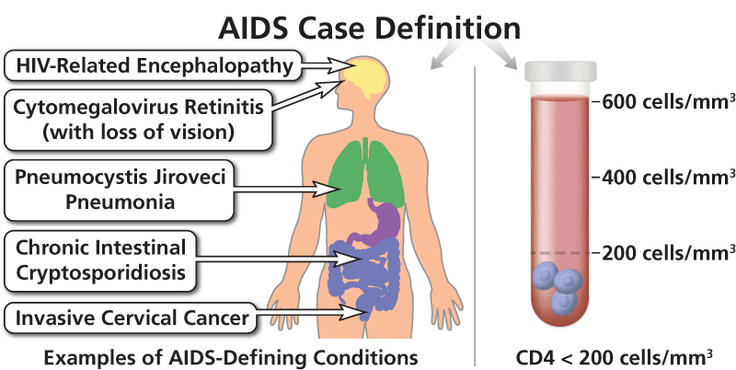
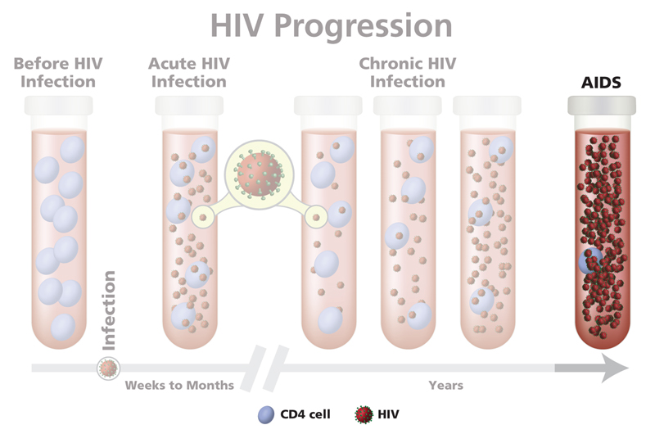
Acquired Immunodeficiency Syndrome (AIDS)
Acquired Immunodeficiency Syndrome (AIDS):
A disease of the immune system due to infection with HIV. HIV destroys the CD4 T lymphocytes (CD4 cells) of the immune system, leaving the body vulnerable to life-threatening infections and cancers. Acquired immunodeficiency syndrome (AIDS) is the most advanced stage of HIV infection. To be diagnosed with AIDS, a person with HIV must have an AIDS-defining condition or have a CD4 count less than 200 cells/mm3 (regardless of whether the person has an AIDS-defining condition).
Source: AIDSinfo, U.S. Department of Health and Human Services (HHS) https://aidsinfo.nih.gov/

Slide 48
HIV Transmission
Sex
Any unprotected sex
More than one sex partner ever
Hx of any sexually transmitted infection
Pregnant
Receive Blood
Receive blood or other blood products before 1985 or from areas without secure blood supply
Handled blood or body fluids as a routine parts of their job
Infants whose mothers are infected with HIV
Exposure to Injection / Piercing
Unclean needles, particularly if shared (ex. injected steroids)
Unclean drug equipment
Tattoos inked with needles not properly cleaned and sterilized
Piercing of ears or body parts with needles not properly cleaned and sterilized
Other
A sex partner with one or more of the above risk factors

Slide 49
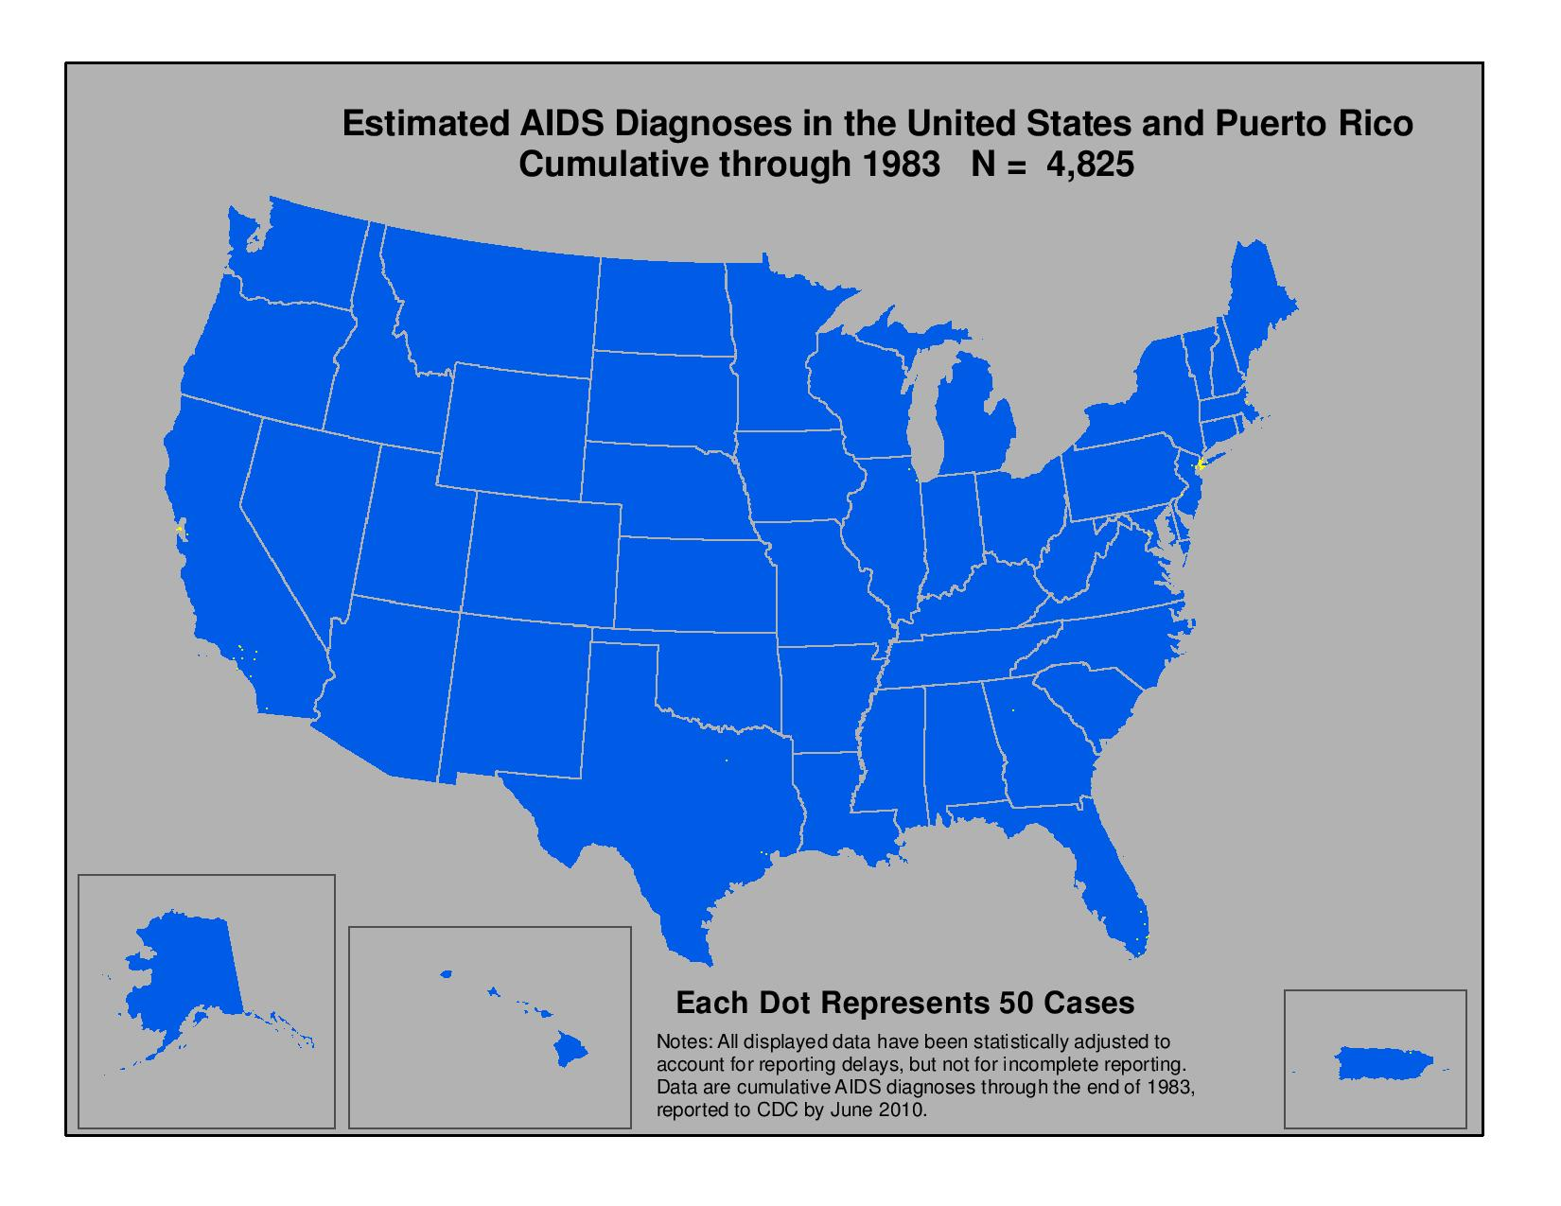
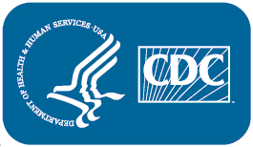
AIDS Diagnoses, 1983
Image: Cumulative cases of AIDS diagnoses through out the years in the US

Slide 50

AIDS Diagnoses, 1985
Image: Cumulative cases of AIDS diagnoses through out the years in the US

Slide 51
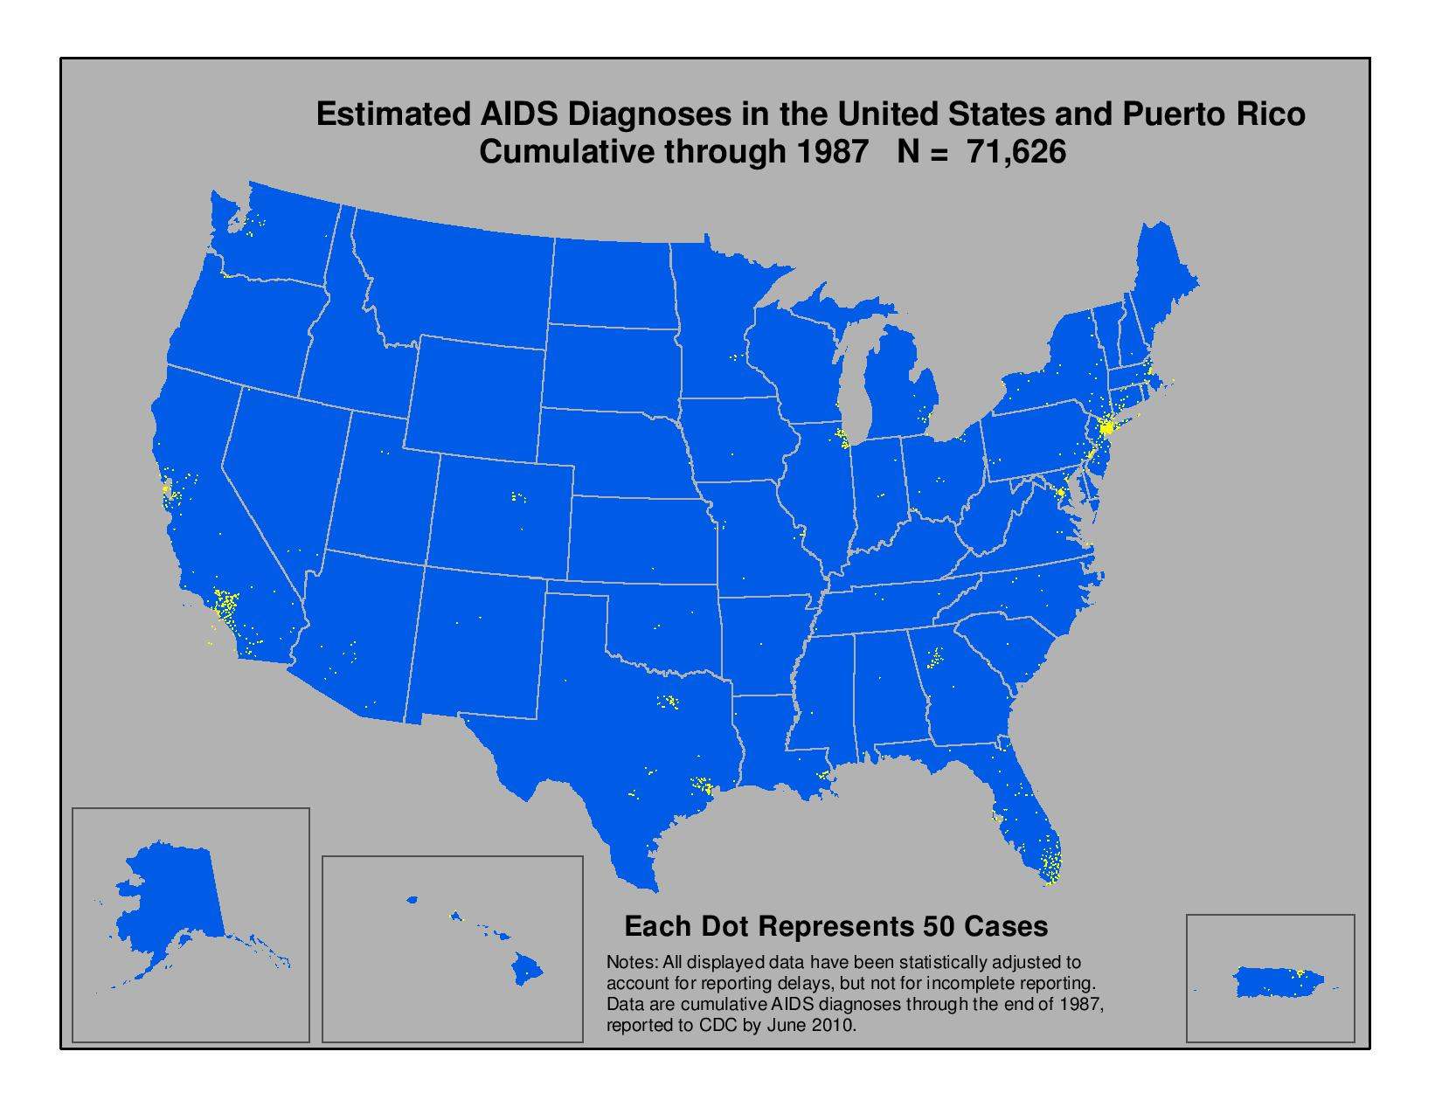
AIDS Diagnoses, 1987

Slide 52

AIDS Diagnoses, 1989
Image: Cumulative cases of AIDS diagnoses through out the years in the US

Slide 53

AIDS Diagnoses, 1991
Image: Cumulative cases of AIDS diagnoses through out the years in the US

Slide 54
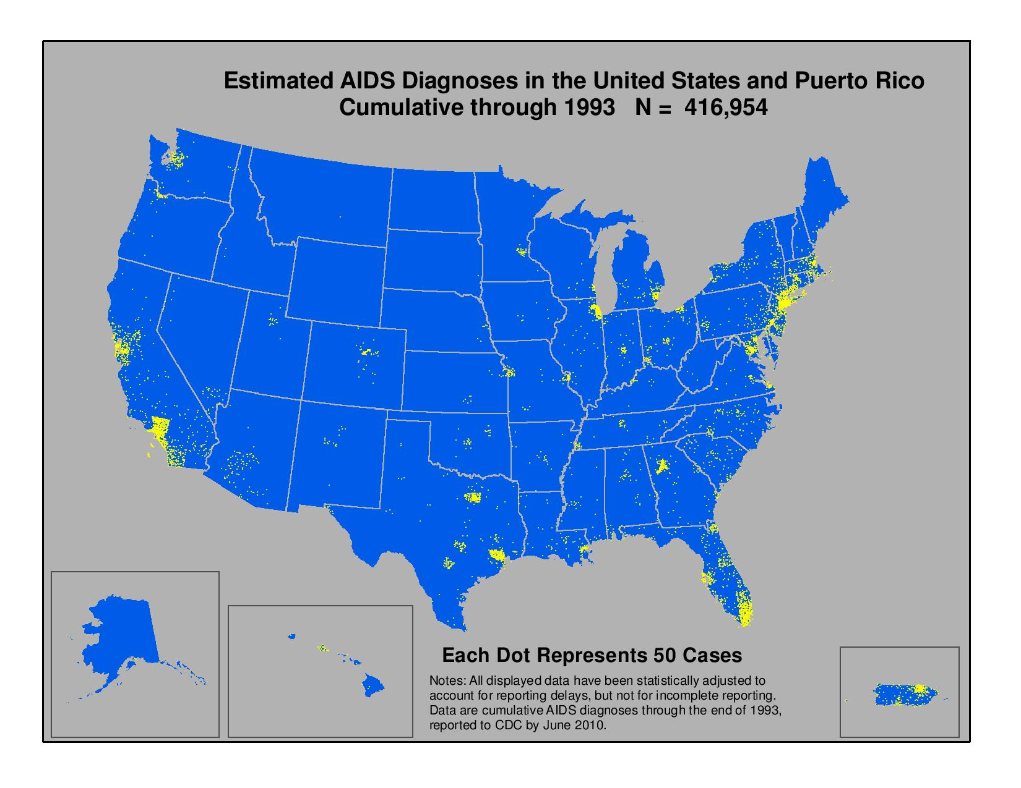
AIDS Diagnoses, 1993
Image: Cumulative cases of AIDS diagnoses through out the years in the US

Slide 55

AIDS Diagnoses, 1995
Image: Cumulative cases of AIDS diagnoses through out the years in the US

Slide 56

AIDS Diagnoses, 1997
Image: Cumulative cases of AIDS diagnoses through out the years in the US

Slide 57

AIDS Diagnoses, 1999
Image: Cumulative cases of AIDS diagnoses through out the years in the US

Slide 58

AIDS Diagnoses, 2001
Image: Cumulative cases of AIDS diagnoses through out the years in the US

Slide 59

AIDS Diagnoses, 2003
Image: Cumulative cases of AIDS diagnoses through out the years in the US

Slide 60

AIDS Diagnoses, 2005
Image: Cumulative cases of AIDS diagnoses through out the years in the US

Slide 61

AIDS Diagnoses, 2007
Image: Cumulative cases of AIDS diagnoses through out the years in the US

Slide 62

AIDS Diagnoses, 2009
Image: Cumulative cases of AIDS diagnoses through out the years in the US

Slide 63
Season 1, Episode 2

Slide 64
Who do you think is HIV positive?
Adriana (mother)
Cesar (father)
Esther (grandmother)
Enrique (son)
Christina (daughter)
Both, Adriana and Cesar

Slide 65
Do you know anyone who is HIV positive?
Yes
No

Slide 66
Estimated HIV Prevalence in United States, 2007-2013
Source: Centers for Disease Control and Prevention. Monitoring selected national HIV prevention and care objectives by using HIV surveillance data--United States and 6 U.S. dependent areas, 2014. HIV Surveillance Supplemental Report. 2016;21(No. 4):1-87. Published July 2016.
Image: Estimated HIV Prevalence in the US 2007 – 2013 Bar Chart

Slide 67
New HIV Diagnoses in the United States, 2010-2015
Source: Centers for Disease Control and Prevention. Diagnoses of HIV infection in the United States and dependent areas, 2015. HIV Surveillance Report, 2015; vol. 27:1-114. Published November 2016.
Image: New HIV Diagnoses in the US 2010 – 2015 Bar Chart

Slide 68
Proportion of Persons with Undiagnosed HIV Infection in United Sates, 2007-2013
Source: Centers for Disease Control and Prevention. Monitoring selected national HIV prevention and care objectives by using HIV surveillance data--United States and 6 U.S. dependent areas, 2014. HIV Surveillance Supplemental Report. 2016;21(No. 4):1-87. Published July 2016.
Image: Proportion of Person with Undiagnosed HIV Infection in the US 2007 – 2013 Bar Chart

Slide 69
1 in 99
The lifetime risk of a person in the United States to receive an HIV diagnosis.
Source: CDC. Lifetime risk of HIV diagnosis [press release]. February 23, 2016.

Slide 70
1 in 6 (MSM)
1 in 4 (Latino MSM)
1 in 2 (Black MSM)
Men who have sex with men (MSM) in the United States will be diagnosed with HIV during their lifetime.
Source: CDC. Lifetime risk of HIV diagnosis, 2016.
1 in 4 Latino men who have sex with other men: Overall they are at risk of being diagnosed with HIV in their lifetime if current diagnostic rates persist.
Source: CDC. Lifetime risk of HIV diagnosis, 2016.
1 in 2 African-American men who have sex with other men: Overall they are at risk of being diagnosed with HIV in their lifetime if current diagnostic rates persist.
Source: CDC. Lifetime risk of HIV diagnosis, 2016.

Slide 71
Lifetime Risk of HIV Diagnosis by Race and Ethnicity
1 in 20
1 in 48
1 in 48
1 in 227
1 in 132
1 in 888
Lowest Risk
Highest Risk
Source: CDC. Lifetime risk of HIV diagnosis, 2016.
Image: Lifetime Risk of HIV Diagnosis by Race and Ethnicity Chart

Slide 72
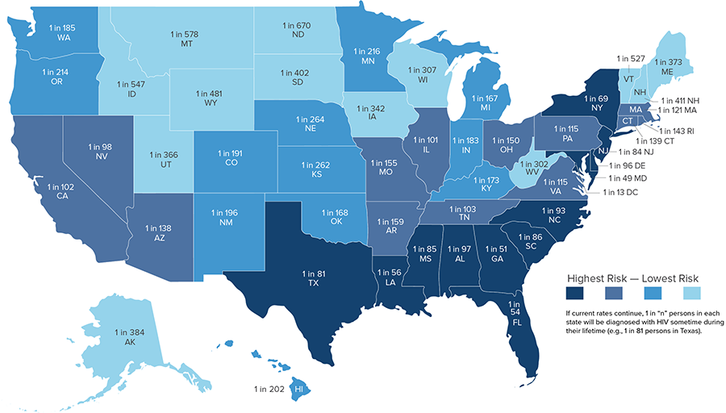
Lifetime Risk of HIV Diagnosis by State
Source: CDC. Lifetime risk of HIV diagnosis. February 23, 2016.
Image: Lifetime Risk of HIV Diagnosis by State Map
Notes:
https://www.cdc.gov/hiv/statistics/overview/geographicdistribution.html

Slide 73
Season 1, Episode 3

Slide 74
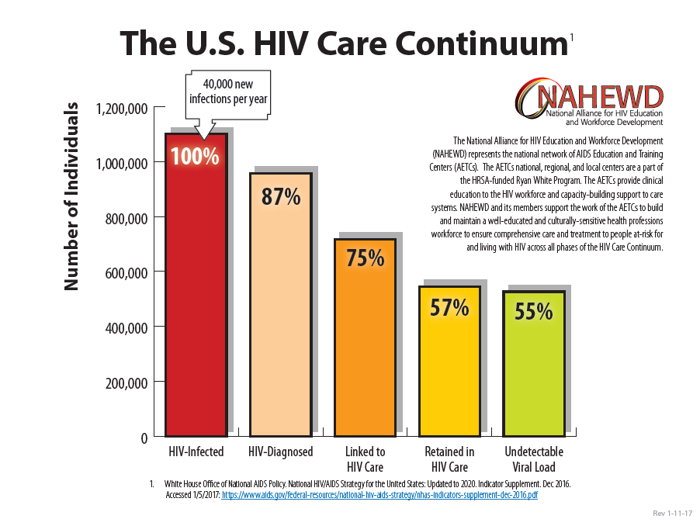

1
2
3
4
5
Image: The US HIV Care Continuum Chart (At Risk for HIV, HIV-Infected, HIV-Diagnoses, Linked to HIV Care, Retained in HIV Care, and Undetectable Viral Load)

Slide 75
Goals of Routine HIV Screening
Improve Survival & Quality of Life
HIV
Screening
HIV
Diagnosis
Link to Care
Prevent New HIV
Infections
Source: AETC. National HIV Curriculum, HIV Screening Recommendations. 2017
Image: Routine HIV Screening Flow Chart (HIV Screening, HIV Diagnosis, Link to Care, and Improve Survival of Quality of Life or Prevent New HIV Infections

Slide 76
Who should get tested for HIV?
Everyone ages 13 to 64 should get tested at least once
Pregnant or planning to get pregnant
An at risk person should frequently get tested (at least once a year) who is:
Sexually active gay or bisexual man
Had sex with an HIV positive partner
Had more than one partner
Shared needles
Exchanged sex for drugs or money
Had another sexually transmitted disease, hepatitis,
or tuberculosis
Had sex with anyone who has done the above or had sex with someone with an unknown sexual history
Source: CDC. HIV Testing Guidelines. https://www.cdc.gov/hiv/basics/testing.html

Slide 77
Persons Living with Diagnosed and Undiagnosed HIV in U.S., 2013*—HIV Transmission Category
Source: Centers for Disease Control and Prevention. Monitoring selected national HIV prevention and care objectives by using HIV surveillance data--United States and 6 U.S. dependent areas, 2014. HIV Surveillance Supplemental Report. 2016;21(No. 4):1-87. Published July 2016.
Image: Persons Living with Diagnosed and Undiagnosed HIV in the US 2013 Pie Chart

Slide 78
Relatively Few People Report Getting Tested for HIV Regularly
Source: Kaiser Family Foundation Survey of Gay and Bisexual Men on HIV (conducted July 17 - August 3, 2014) and Kaiser Family Foundation Health Tracking Poll (conducted July 15-21, 2014).
Image: People Who Report Getting Tested for HIV Regularly Bar Chart

Slide 79
Disproportionate Transmission of HIV in Persons Unaware of HIV Status
Unaware of HIV Infection
Aware of HIV Infection
Source: Source: Marks G, Crepaz N, Janssen RS. Estimating sexual transmission of HIV from persons aware and unaware that they are infected with the virus in the USA. AIDS. 2006;20:1447-50.
Image: Persons Aware and Unaware of HIV Status Bar Chart

Slide 80
Why test patients for HIV?
Better for the patient
People living with HIV can live long, healthy lives if HIV infection is identified early and treated
Early treatment reduces HIV related illnesses
Better for the community
Change in behavior
HIV treatment is prevention
“Across three different studies, including thousands of couples and many thousand acts of sex without a condom or pre-exposure prophylaxis (PrEP), no HIV transmissions to an HIV-negative partner were observed when the HIV-positive person was virally suppressed.”
-Eugene McCray, MD
Director, Division of HIV/AIDS Prevention, CDC
Sources: National Vital Statistics Reports, 2012; PLoS One, 2013; and Journal of the American Association, 1993.
Images: Average years of life for a diagnosed in a current medication and diagnosed not in a current HIV medication vs a person without HIV.
U=U logo.

Slide 81
Season 1, Episode 4

Slide 82
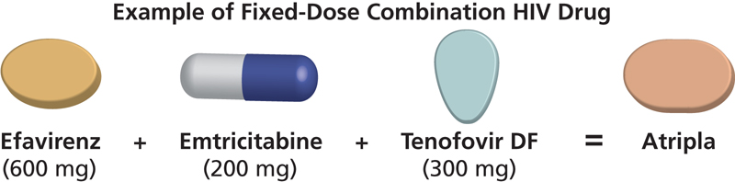
One pill a day
Source: AIDSinfo, U.S. Department of Health and Human Services (HHS)
https://aidsinfo.nih.gov/
Image: Example of Fixed Dose Combination HIV Drug ( Efavirenz + Emtricitabine + Tenofovir = Atripla)

Slide 83
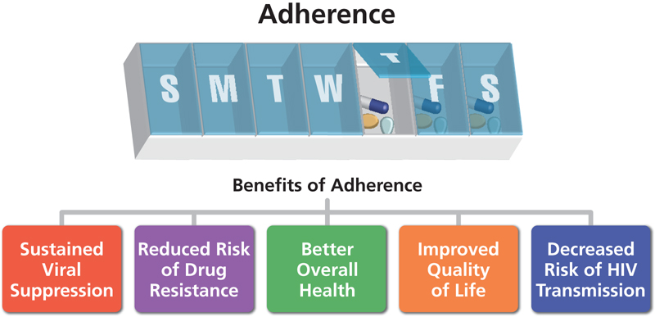
Adherence
Source: AIDSinfo, U.S. Department of Health and Human Services (HHS)
https://aidsinfo.nih.gov/
Image: Benefits of Adherence (Sustained Viral Load, Reduced Risk of Drug Resistance, Better Overall Health, Improved Quality of Life, and Decreased Risk of HIV Transmission)

Slide 84
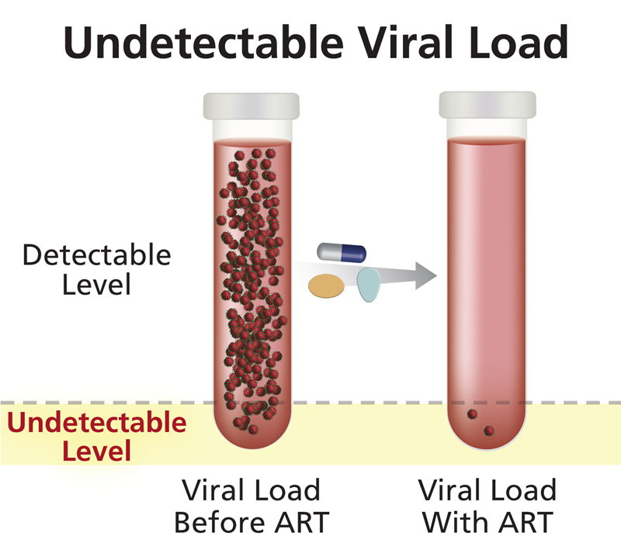
Undetectable Viral Load
Source: AIDSinfo, U.S. Department of Health and Human Services (HHS)
https://aidsinfo.nih.gov/
Image: Undetectable Viral Load Before ART and with ART

Slide 85

Treatment is Prevention
96% reduction in transmission when HIV-positive partner starts treatment early
Source: Ping et al. HIV-1 transmission when HIV-positive partner starts treatment early. 2013.
Image: Provider prescribing medication to a female patient.

Slide 86
Season 2, Episode 5

Slide 87
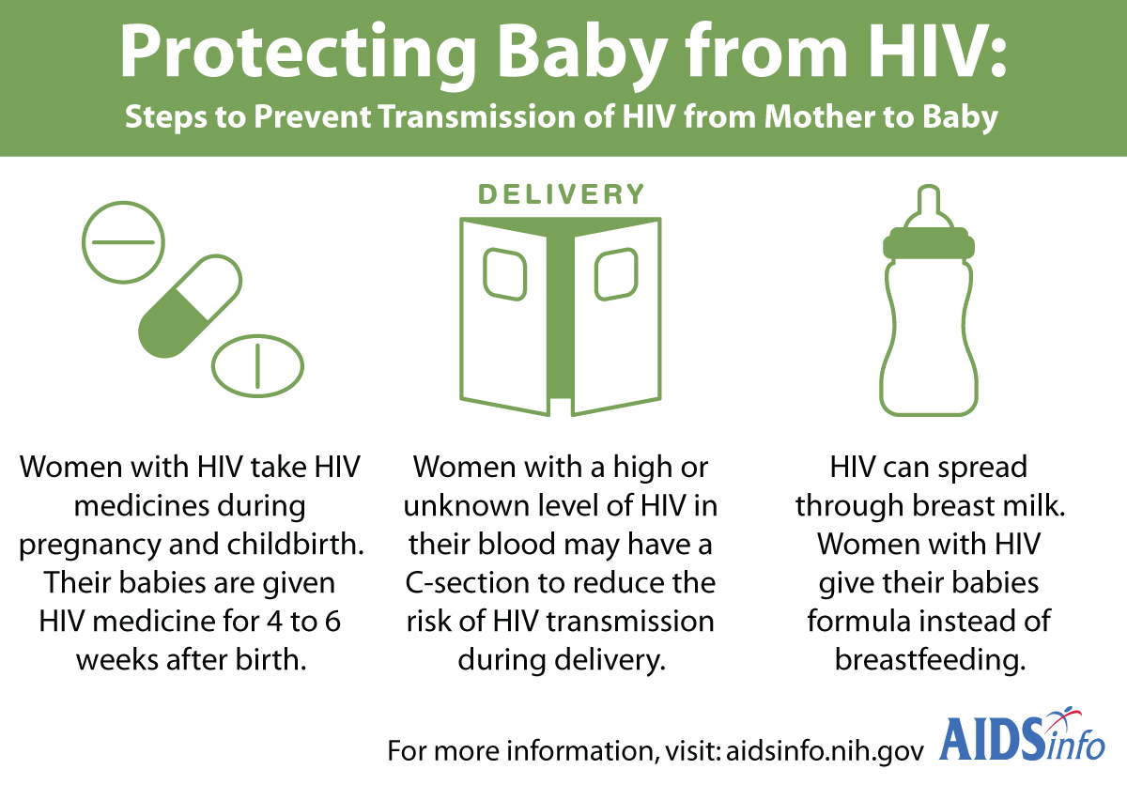
Source: AIDSinfo, U.S. Department of Health and Human Services (HHS)
https://aidsinfo.nih.gov/
Image: Steps to Prevent Transmission of HIV from Mother to Baby (HIV medicine, C-section, and formula milk)

Slide 88
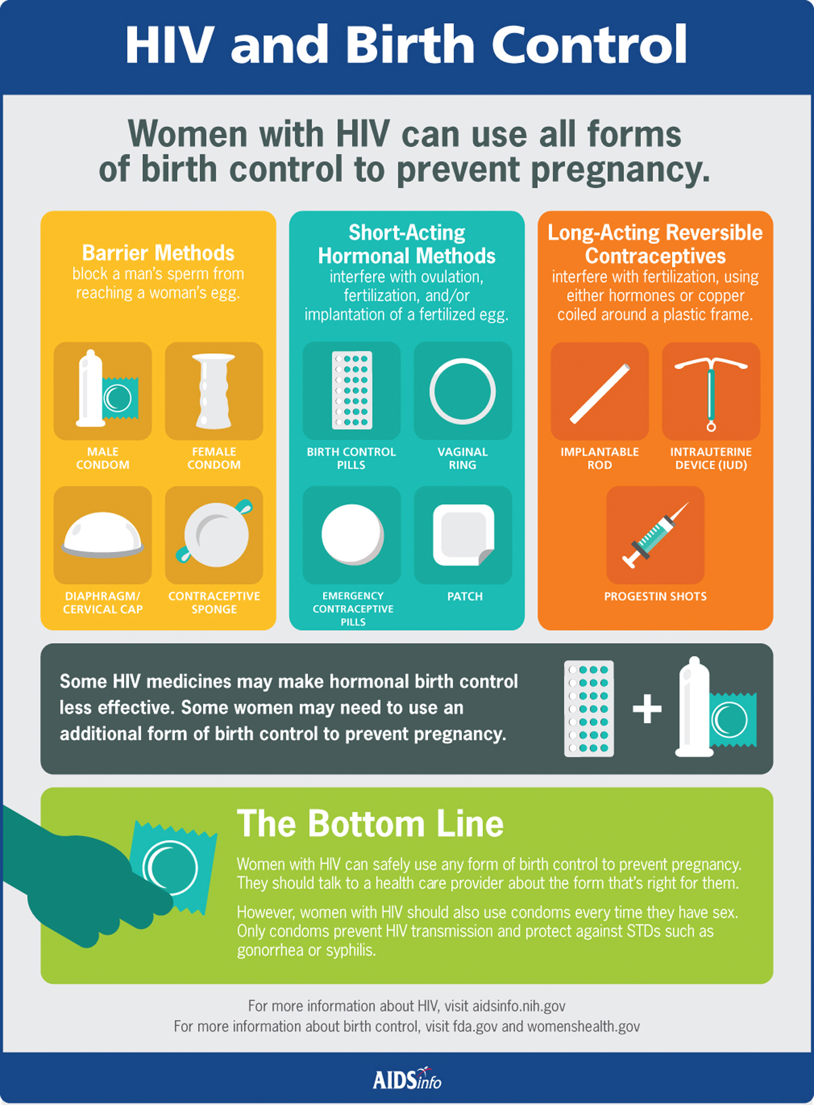
Source: AIDSinfo, U.S. Department of Health and Human Services (HHS)
https://aidsinfo.nih.gov/

Slide 89
Season 2, Episode 6

Slide 90
HIV Prevention
Safer-sex counseling: understanding risk
Condoms and lubricant
Sterile syringes and avoiding sharing
HIV testing
STI testing and treatment
PEP (post-exposure prophylaxis)
PrEP (pre-exposure prophylaxis)

Slide 91
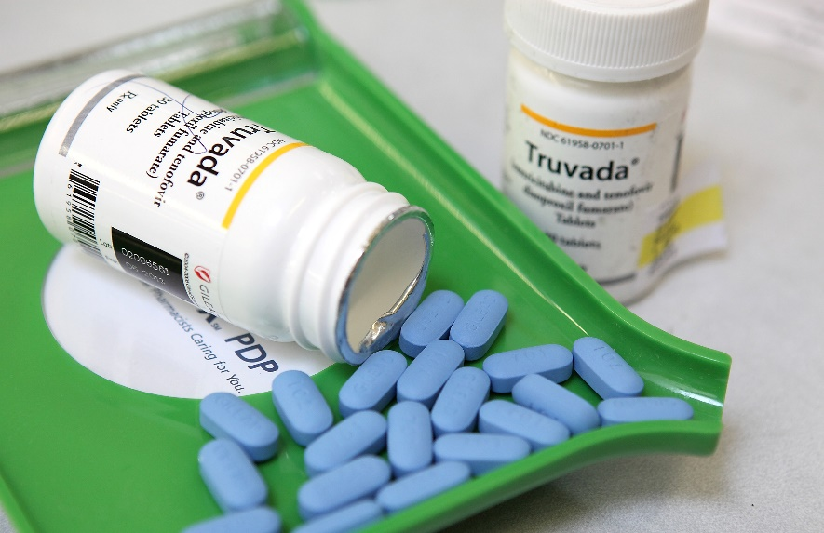
What is PrEP?
Pre-exposure prophylaxis (or PrEP) is when people at very high risk for HIV take HIV medicines daily to lower their chances of getting infected. A combination of two HIV medicines (tenofovir and emtricitabine), sold under the name Truvada® is approved for daily use as PrEP to help prevent an HIV-negative person from getting HIV from a sexual or injection-drug-using partner who’s positive. Studies have shown that PrEP is highly effective for preventing HIV if it is used as prescribed. PrEP is much less effective when it is not taken consistently (CDC).
Source: AIDSinfo, U.S. Department of Health and Human Services (HHS)
https://aidsinfo.nih.gov/
Image: Truvada pills

Slide 92
PrEP patient status
No signs or symptoms of acute HIV infection
No signs or symptoms of other Sexually Transmitted Infections
Antibody test against HIV antigen - negative
Negative pregnancy test
Negative screen of hepatitis B
Chemistry panel - normal liver and kidneys
Negative urine test
Start PrEP

Slide 93
Understanding PrEP
Oral Contraceptive (“The Pill”) | Pre-Exposure Prophylaxis (PrEP)
Prevents pregnancy if taken before sex. Does not work as morning-after pill. | Prevents HIV infection pre-exposure. Will not work if already exposed.
Does not always start working immediately. | Does not start working immediately.
Must take daily – cannot skip doses. | Must take daily – cannot skip doses.
Only helps prevent pregnancy, will not prevent STIs (should still use condoms). | Only helps prevent HIV – will not prevent other STIs (should still use condoms).
Very effective at preventing pregnancy, but not 100% effective. | Very effective at preventing HIV infection, but not 100% effective.
Should be taken by anyone who is sexually active (at risk for becoming pregnant) | Should be taken by anyone who could be exposed to the HIV virus (at risk for HIV)

Slide 94
Season 2, Episode 7

Slide 95
Q/A
Next Steps
Evaluation

