Slide 2
Applying Implementation Science to a Multi-Intervention, Multi-Site Study Linking and Retaining People Living With HIV in Care
Alexis Marbach, Abt Associates; Jane Fox, Abt Associates
Supported by grant #U90HA29236, "Dissemination of Evidence Informed Interventions", though the U.S. Department of Health and Human Services Administration's HIV/AIDS Bureau

Slide 3
Project Background
Five-year Cooperative Agreement to Boston University with HRSA’s Special Projects of National Significance (SPNS)
Replicates best practices identified in four previously implemented SPNS initiatives

Slide 4
AIDS United: Implementation and Technical Assistance Center (ITAC)
Select & Fund 12 Sites
Provide
TA
Coordinate
Experts

Slide 5

Boston University: Dissemination and Evaluation Center (DEC)
Adapt and design 4 intervention models for replication.
Design and implement multi-site evaluation
Studying both patient outcomes (including retention in care and viral suppression) and implementation findings (what works in practice and what facilitates/hinders implementation)
Publish and disseminate final adapted interventions and study findings
Notes:
Adapts each intervention based on lessons learned, evaluation data and updated science
Develops intervention manuals for each initiative
Coordinates national evaluation for the DEII
Individual health outcomes
Implementation Science

Slide 6
DEC Team Members
Current Team Members:
Serena Rajabiun, PI and Site Liaison
Jane Fox, Co-PI and Site Liaison
Alexis Marbach, Project Manager and Site Liaison
Ellen Childs, Site Liaison
Howard Cabral, Biostatistician
Clara Chen, Data Management
Marena Sullivan, Research Assistant
Past Team Members
Brena Sena, Research Assistant
Sally Bachman, Evaluation Advisor
Mari-Lynn Drainoni, Implementation Science Advisor
Intervention-Specific Consultants:
Transitional Care Coordination:
  Alison Jordan
  Jackie Cruzado
Buprenorphine
  Chinazo Cunningham
  Paula Lum
Patient Navigation and Peer Linkage
  Janet Myers
  Janet Goldberg
Communications
  Sarah Cook-Raymond and Impact Marketing + Communications (Communications)

Slide 7
DEC Project Timeline
Year 1: Design of implementation manuals and evaluation materials for the adapted interventions (data collection tools and evaluation plan), site selection, pre-implementation at the site level
Years 2-4: Site-level implementation of adapted intervention and evaluation activities, ITAC implementation of training and technical assistance activities, DEC implementation of implementation science activities
Year 5: DEC data analysis, publication and dissemination, producing revised implementation manuals (CATIs: Care and Treatment Interventions)

Slide 8
Timeline of Year 1
Grant awarded
Kick off meeting with Boston University (DEC) and AIDS United (ITAC) held at HRSA
Oct. 2015
Adapted intervention summaries produced
DEC team works with consultants to produce and finalize summaries for each intervention
Nov. - Dec. 2015
Implementation plans produced
DEC team works with consultants to produce and finalize implementation plans (including staffing plan, logic model, and workplan) for each intervention
Jan. - Feb. 2016
Implementation manuals produced
DEC team works with consultants to produce implementation manuals for each intervention
Feb. - March 2016
Evaluation tools and plan produced
DEC and consultant team develop evaluation tools and plan (using an IS approach)
Jan. – July 2016
Site selection
ITAC, DEC, and HRSA meet to select Peer, PN, and TCC sites in April, and Buprenorphine sites in May
April – May 2016
Sites awarded pre-implementation funding
Sites funded for a three- month formative phase to complete hiring, training, and systems readiness activities
June 2016

Slide 9




Interventions
Notes:
JANE

Slide 10
Notes:
Sites:
Chester, PA;
Chicago, IL;
Nashville ,TN; Atlanta, GA;
Los Angeles, CA;
Newark, NJ;
UNC-Chapel Hill and Wake County;
Camden, NJ;
Las Vegas, NV;
Ponce, PR; C
leveland, OH;
Lexington, KY

Slide 11
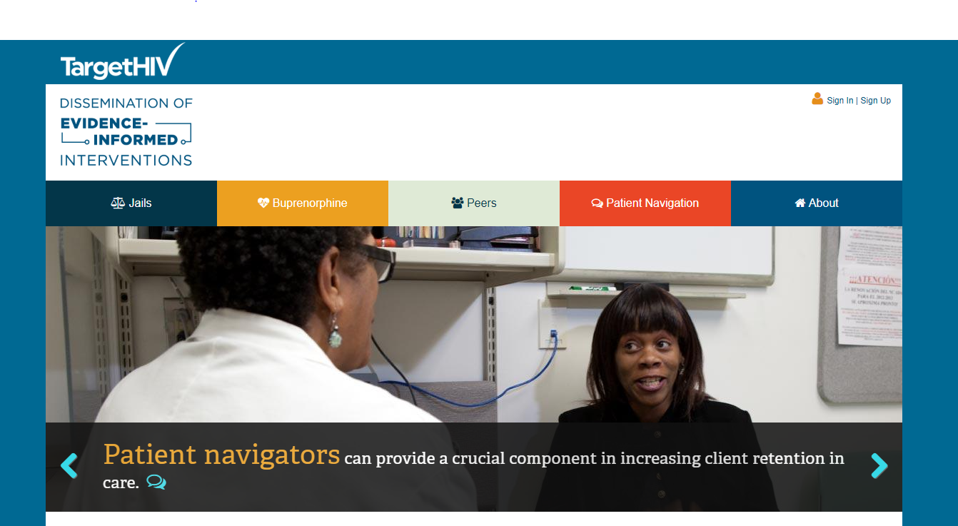
Materials Available at TargetHIV.org
Adapted intervention summaries and draft implementation manuals are available at:
https://nextlevel.targethiv.org/
Notes:
Available for download now

Slide 12
What are your evaluation priorities?
Implementation
Outcomes
Patient-level Outcomes
CD4
Viral Load
Process of implementation
Notes:
Ask participants for how they allocate their time/effort in terms of evaluation.

Slide 13
What are the drivers of your evaluation work?
Clinic level demands
Experience
Funding
Notes:
Ask participants to share their experiences

Slide 14
Implementation Science:
A shift in perspective
Notes:
Shifting the focus from outcomes to implementation

Slide 15
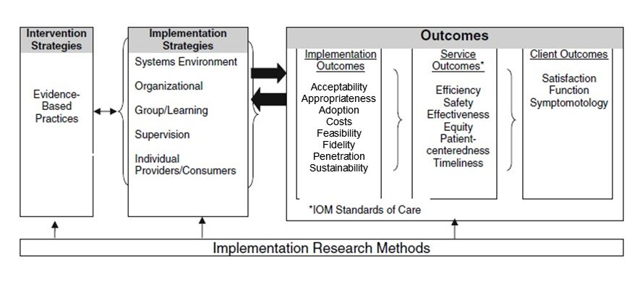
Implementation Science Approach: Proctor Model
Notes:
The Proctor Model, visually depicted above, posits that improvements in outcomes are dependent not only on the evidence-based interventions that are implemented but on the implementation strategies used to implement those interventions. The model distinguishes between the intervention strategy (evidence-based practice), different types of implementation strategies (e.g. environment or organizational setting), and three levels of outcomes (implementation, service, and client). Using the Proctor Model, one can infer that the quality and type of implementation strategies will affect implementation outcomes, and that successful implementation will result in improved service outcomes, which in turn should ultimately lead to better client outcomes. The appropriate outcome measures used in each category (implementation, service, and client) depend upon the specific evidence-based practice (in this case, the intervention model) and local context.
According to the Proctor Model, implementation strategies may occur at one or more levels of the program or organization, including: 1) the larger systems (regulatory, legal, policy) environment in which the program operates; 2) the organization in which the intervention is proposed (clinic, FQHC); 3) the group or learning level (which includes focusing on issues related to coordination, cooperation and shared knowledge instead of having a singular focus on intervening with individuals to change their individual practices); 4) supervisory practices (informal, formal); and 5) the individual provider level (physician, navigator).

Slide 16
Proctor Model Implementation Outcome Domains
acceptability – To what degree are site providers, staff, and leadership willing and able to take on the full terms of the intervention?
appropriateness – To what degree does the provider think the intervention is the appropriate intervention for the target population?
adoption – To what degree are providers and staff willing to implement the intervention by following the protocol outlined in the implementation plan?
cost – What does it cost to implement the intervention?
feasibility – What are the barriers and facilitators to effective implementation of the intervention?
fidelity – To what degree is the intervention being implemented as outlined in the implementation plan?
integration – To what degree do sites integrate the intervention into their other ongoing efforts to improve outcomes along the HIV Care Continuum? (*note – this is a merger of penetration and sustainability
Notes:
Include handout

Slide 17

Proctor Model in Action
Imagine this scenario: Alexis is making a new year’s resolution to go to bed earlier.
Her plan is to:
Shut off all devices by 8 pm
Have a cup of sleepytime tea between 8 and 9 pm
Be in bed at 9 pm with the lights off by 9:30
She plans on following this exact plan EVERY NIGHT for 30 days.
Notes:
Run through the implementation outcomes: who would adopt this, who would find it acceptable, etc.

Slide 18
Assessing Implementation in Your Setting
Break into pairs
Take turns assessing a project you are implementing at your organization through the Proctor Model lens
Notes:
Alexis to make a one-pager for participants to fill out during their dyads with the implementation outcome, the definition, and spaces for them to take notes.
Q: How will you know? Who will you ask? What data will you use? What data are available?

Slide 19
How the DEC team implemented this approach

Slide 20
Implementation Data Collection Sources
Organizational Readiness to Change Assessment
Monthly Call Forms and Site Visit Reports
Key Informant Interviews
Encounter Forms
Audio Recordings
Patient Care Plans
Notes:
Refer to handouts

Slide 21

Organizational Readiness to Change Assessment (ORCA)
Implemented during the pre-implementation phase at each demonstration site.
Completed by a diverse range of site staff (administration, leadership, intervention team members)
Knowing what we know now…
Better sense of players within the clinic
All intervention staff hired
Conduct follow-up

Slide 22
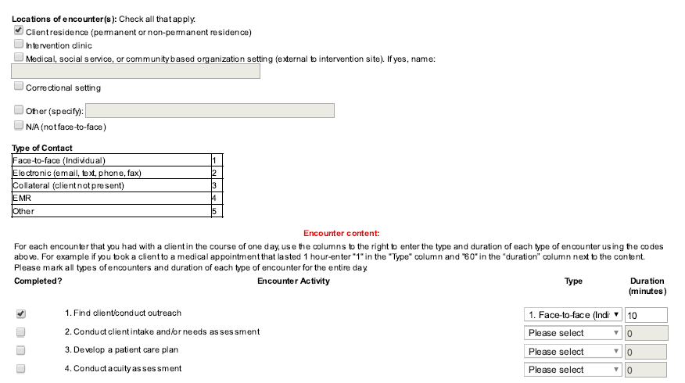
Encounter Forms
Filled out by the interventionists
Knowing what we know now…
Pre-test with intervention staff or engage intervention staff in design
Bin “other” category on a routine basis
Notes:
Design detailed protocol with specific example
Question for the audience: What data sources do you have internally that you could pull data from? What does this look like in your clinic?

Slide 23
Top Reported Encounters
Transitional Care Coordination
Relationship building
Conducting client intake or needs assessment
Discussing medical appointments with clients
Arranging HIV primary care appointments
Finding clients and conducting outreach
Peer Linkage and Re-Engagement
Discussing medical appointments with clients
Providing coaching on living skills
Relationship building
Providing appointment reminders
Providing HIV treatment education and support

Slide 24
Top Reported Encounters
Enhanced Patient Navigation
Relationship building
Integration of Buprenorphine
Relationship building
Providing appointment reminders
Conducting client intake and/or needs assessment
Patient Education Session 1: HIV, the Viral Life Cycle, and Understanding ART
Patient Education Session 2: Communicating with Providers, Adherence, and Managing Side Effects
Conducting monitoring appointment
Developing a patient care plan
Conducting client intake and/or needs assessment
Follow up with provider to discuss client

Slide 25
Monthly Site Forms and Site Visit Reports
Monthly site forms:
Sites complete a form each month to collect data on implementation, staffing changes, local dissemination, de-identified case studies, and dissemination and sustainability efforts. As of December 5, we’ve collected 299 monthly forms.
Site Visit Reports
Completed by the sites prior to each site visit to frame the conversation. Finalized by the ITAC and DEC post site visit
Knowing what we know now…
Create an online form (vs. using a word document)

Slide 26
Key Informant Interviews
Qualitative interviews conducted with key intervention staff
Domains of the interview:
Patient population
Implementing the evaluation
Patient centeredness and patient experience in the intervention
Integration of the intervention into the larger clinic setting
Knowing what we know now…
We’re still learning! We are currently in the process of collecting these interviews.

Slide 27
Audio Recordings
Used to conduct fidelity monitoring: Measuring implementation fidelity, the degree to which an intervention is delivered as designed, by reviewing how the intervention staff perform intervention activities (Carroll, Patterson, Wood, Booth, Rick, Balain, 2007).
Time span: April 2017 – March 2018
Total audio recordings reviewed: 106
30% of clients who have consented to being recorded are randomly selected to be recorded
Interventionists record every interaction they have with selected clients
Interventionists have 72 hours to upload recordings to the data system
10% of uploaded recordings are selected to be reviewed
Notes:
Fidelity monitoring is an essential component of implementation science, and well-conducted fidelity monitoring improves the likelihood of successful replication. Through fidelity monitoring, the DEC will be able to determine what it takes to implement consistently with a high level of quality, across varying implementation sites and their subsequent local contexts (Glasgow, Lichtenstein, & Marcus, 2003). Fidelity monitoring will provide insight to unintended program outcomes (attributed to a Type III error or flaw in the intervention program theory). This monitoring takes place throughout the implementation.
Each intervention has core elements that must be implemented in a consistent way across the intervention cohort. Each element will be monitored by the DEC throughout implementation to measure:
adherence to the intervention plan and the training provided by the ITAC
quality of program delivery
patient responsiveness and engagement throughout the intervention
Pros
Less invasive and produces less reactivity than other means of collecting fidelity data (Breitenstein, Gross, Garvey, Hill, Fogg, Resnick, 2010).
Cost effective (Breitenstein et al., 2010)
Allows for multiple reviewers
Cons
Produces a degree of reactivity
Cannot capture nonverbal cues or environmental factors (Breitenstein et al., 2010)
Cannot entirely capture activities (Wojewodka, Hurley, Taylor, Noble, Ridsdale, Goldstein, 2017)
1. Developed intervention-specific Fidelity Checklists
2. Trained three DEC staff on using Fidelity Checklists
3. Selected audio recordings to review on a monthly basis
4. Two DEC reviewers completed and compared Fidelity Checklists
5. Reviewers convened with DEC team to address concerns and to
inform TA and training needs

Slide 28
Audio Recordings
Knowing what we know now…
Collecting Recordings
Barriers:
  Fear of HIV-related stigma
  Interventionist apprehension, especially in peers
Facilitators:
  Academic medical settings
  Local evaluators familiar with audio recording protocols
Reviewing Recordings
Barriers:
  Measuring the quality of the client-interventionist interaction
  Measuring fidelity in a non-scripted intervention
Facilitators:
  Maintaining detailed notes of the interaction to measure quality
  Training audio recording reviewers

Slide 29
Cost study
Payer perspective: Does not include societal costs for client time and preferences
Start-up & Recurrent annual costs: Program only, excludes Study evaluation costs
Standardized spreadsheet with cost elements
  Personnel
    Includes data management time for out of care list
    Medical personnel as relevant for intervention
  Overhead rates
  Direct costs (transportation, staff-client communication expenses, tangible reinforcements, printing for materials)
  Facilities/space as necessary

Slide 30
Cost study
Intervention encounter forms
  Document the number of contacts
  Direct staff and collateral contacts
Cost per contact
Cost per outcomes linked to HIV care continuum
  Cost per linkage to care
  Cost per retention in care
  Cost per viral suppression
Notes:
Limitations—time motion study?

Slide 31
Lessons Learned: Collecting Implementation Science Data
Important to have a firm evaluation plan and a shared-knowledge with all team members to execute the various tasks
Team needs training on the implementation science approach to know what to look and listen for on calls, in email exchanges, and during site visits, and what kind of follow-up questions should be asked back to the sites
Strong relationships with sites facilitates data collection
  Sites will only share their barriers and facilitators to implementation if they trust that they will be supported regardless of the information they share
Notes:
Additional takeaway – more work happens at the ETAP level than at the site level with this approach

Slide 32

Pre-implementation Data
Pre-implementation data:
Organizational Readiness to Change Assessment (ORCA)
Monthly monitoring call forms
Site visit reports

Slide 33
Pre-implementation Lessons Learned
Staff turnover is challenging for the sites and for the individual interventionists. Once the in-person training opportunity has passed (convening), onboarding new staff is labor and resource intensive.
In future iterations of the manuals, include more customizable tools such as clinic assessments, workflow diagrams.
Training topics that should be addressed in future iterations of the interventions prior to implementation: boundary setting, confidentiality, trauma informed care, vicarious trauma, harm reduction, motivational interviewing

Slide 34
Pre-implementation Lessons Learned: Transitional Care Coordination
Facilitators of successful implementation:
Strong leadership from clinic administration and supervisors
Existing collaborative relationships with the jails
Proactive and engaged staff that have existing relationships with the jails
Barriers to implementation:
Lack of leadership
Policies specific to each jail setting (for example, people being released from the jail in the middle of the night)

Slide 35
Pre-implementation Lessons Learned: Integration of Buprenorphine
Facilitators of successful implementation:
Overwhelming need for this service due to the epidemic
Commitment and engagement from all intervention team members and clinic leadership
Barriers to implementation:
Issues with prior authorizations persist
Barriers to creating collaborative relationships (historical RW funding cuts)
Stigma of accessing substance abuse treatment in smaller communities, geographic barriers (urban clinic treating patients from rural areas)

Slide 36
Pre-implementation Lessons Learned: Patient Navigation
Facilitators of successful implementation:
By being part of larger clinic settings, the PNs have large out of care lists to draw from
Barriers to implementation:
PNs are serving clients with high acuity and are having to address basic needs as priority and patient education sessions having to wait until these needs are addressed. If the level of acuity of clients seen continues to be relatively high, we'll want to monitor for when the patient education sessions are being completed.
EMR and technology access
Transitioning to SOC (Roles of the PN)

Slide 37
Pre-implementation Lessons Learned: Peers
Facilitators of successful implementation:
Clinical supervisor role/ provision of clinical supervision
Barriers to implementation:
Administrative (HR policies related to job description; peer readiness; compensation and balancing issues around disability benefits and disclosure; difficult to fill the peer positions)
Dedicated space
Variation among the experiences/professional backgrounds of the peers
Comfort with documentation
Challenges with patient recruitment –out of care list

Slide 38
Implementation Lessons Learned

Slide 39
Implementation Lessons Learned: Transitional Care Coordination
Sites with strong implementation teams and strong leadership have been able to smoothly weather staff turnover/transitions.
The intervention requires constant tending to the relationship with the jail (admin, medical, and officers). Staff turnover within the jail setting can impact intervention staff.
Adaptations have been necessary to “fit” the model into each setting.
Post release challenges are many and addressing them is key to retaining clients in HIV care. Challenges include: homelessness/unstable housing, mental health disorders, substance use disorders, transportation, and ongoing engagement with the criminal justice system.
Notes:
Keep body minimal whenever possible; edit for size and positioning to be flush next to photos. Photos can bleed right off the edge of the slide.

Slide 40
Implementation Lessons Learned: Integration of Buprenorphine
Enrollment is dependent on provider and clinical coordinator capacity.
The landscape of MAT is constantly changing, and it is important for sites to have a champion/advocate to make sure they are “at the table” for conversations about expanding MAT within their clinic/local area.
  State and local regulations will be important to factor in to future implementation efforts.
  Access to multiple forms of MAT, as opposed to focusing on buprenorphine, may be necessary as providers assess which treatment options may best facilitate their patients’ success.
  Access to MAT for people not living with HIV is a concern, as partners or family members’ opiate use can impact patients’ success.

Slide 41
Implementation Lessons Learned: Integration of Buprenorphine
The role of the clinical coordinator needs to have its own implementation materials/manual.
  Clinical coordinators have coordinated group therapy sessions, in addition to individual counseling, which can support patients in establishing sober support systems.
  Barriers to implementation include stigma of accessing substance use treatment in smaller communities, geographic barriers (urban clinic treating patients from rural areas), and prior authorization challenges.

Slide 42
Implementation Lessons Learned: Patient Navigation
Co-located services improve service delivery and client retention (comparison between USC Keck and Grady).
Onboarding and hiring of the patient navigators is key to success.
  Access to EMRs makes PNs more efficient and effective, and elevates their role on the clinical team.
  Includes tending to professional development of the PNs throughout the initiative.
It takes time to build relationships and to build trust.
Patients with high acuity need to have basic needs addressed prior to initiating the patient education session. PNs need to be flexible with their timelines and need to establish healthy boundaries while engaging with patients and then when transitioning patients to the standard of care.

Slide 43
Implementation Lessons Learned: Peers
Strong clinic leadership and an internal champion are necessary for initial launch as well as navigating potential challenges in implementation.
Hiring and onboarding of peers is key to success.
  Including supporting staff transition from state and federal benefits to full-time employment.
  Peer teams need continuous support and training to engage hard to reach women.
Case management needs to be in place prior to implementation.
Notes:
Keep body minimal whenever possible; edit for size and positioning to be flush next to photos. Photos can bleed right off the edge of the slide.

Slide 44
Implementation Lessons Learned: Peers
Clear, strong, and consistent communication between team members and the larger clinic team is crucial to working with women who are at risk for falling out of care or have struggled to link.
Mobility outside of the clinic is an effective strategy for finding and engaging with clients.
Transportation assistance is crucial to help clients get to appointments and meetings with Peers.
Notes:
Keep body minimal whenever possible; edit for size and positioning to be flush next to photos. Photos can bleed right off the edge of the slide.

Slide 45
Nov 1, 2018
Last day to enroll clients in the multi-site evaluation
April 30, 2018
Data collection ends
Starting February 2019
Next Steps for DEII
Analysis of patient outcomes
Starting Fall 2018
Analysis of implementation findings
Starting Fall 2018
Adaptation of the implementation manuals for the four intervention models
Starting Summer 2020
Dissemination of the revised implementation models

Slide 46
Questions?

Slide 47
Questions to the group
What makes you excited about using this approach?
What are your reservations about using this approach?

Slide 48
Contact Information
Presenters:
Alexis Marbach, alexis_marbach@abtassoc.com
Jane Fox, jane_fox@abtassoc.com
DEC PI:
Serena Rajabiun, Rajabiun@bu.edu

Slide 49
References
Breitenstein, S. M., Gross, D., Garvey, C. A., Hill, C., Fogg, L., & Resnick, B. (2010). Implementation fidelity in community-based interventions. Research in Nursing and Health, 33, 164-173.
Carroll, C., Patterson, M., Wood, S., Booth, A., Rick, J., & Balain, S. (2007). A conceptual framework for implementation fidelity. Implementation Science, 2(40). doi: 10.1186/1748-5908-2-40
Proctor, E. K., Landsverk, J., Aarons, G., Chambers, D., Glisson, C., & Mittman, B. (2009). Implementation research in mental health services: An emerging science with conceptual, methodological, and training challenges. Administration and Policy in Mental Health and Mental Health Services Research, 36(1), 1-17. doi: 10.1007/s10488-008-0197-4
Wojewodka, G., Hurley, S., Taylor, S. J. C., Noble, T. J., Ridsdale, L., & Goldstein, L. H. (2017). Implementation fidelity of a self-management course for epilepsy: Method and assessment. BMC Medical Research Methodology, 17, 1-10. doi: 10.1186/s12874-017-0373-x

