Slide 1
National Implementation of Evidence-Informed Interventions for People Living with HIV across 26 Sites
The Fenway Institute | AIDS United | University of California, San Francisco
Alex Keuroghlian | Erin Nortrup | Janet Myers
Linda Marc |  | Beth Bourdeau
Massah Massaquoi |  | Mary Guzé
Sean Cahill |  | Starley Shade
Notes:
[presented by: ]

Slide 2
Disclosures
Presenter(s) has no financial interest to disclose.
This project is supported by the Health Resources and Services Administration’s (HRSA) HIV/AIDS Bureau (HAB) of the U.S. Department of Health and Human Services (HHS) under grant number U69HA31067 and grant number U90HA31099. The national Training and Technical Assistance is funded for $5,324,429.00 and 0% financed with nongovernmental sources. The national Evaluation is funded for $2,200,000.00 and 0% financed with nongovernmental sources. This information or content and conclusions are those of the author and should not be construed as the official position or policy of, nor should any endorsements be inferred by HRSA, HHS or the U.S. Government.
Notes:
[presented by: Alex ]

Slide 3
Outline
Learning Objectives
Program Overview
Project Goals
Intervention Components
Organizational Assessment
Framework for Rapid Implementation
Sites’ Experiences
Q&A
Notes:
[presented by: Alex ]

Slide 4
Learning Objectives
At the conclusion of this activity, the participant will be able to:
Describe the core elements of evidence-informed interventions that increase engagement and retention in care for people living with HIV
Identify programmatic areas where organizations need capacity building to deliver interventions for transgender women, Black men who have sex with men, behavioral health integration into primary medical care, and identifying and addressing trauma
Discuss strategies for adaptation and rapid implementation of evidence-informed interventions for people living with HIV
Notes:
[presented by: Alex ]

Slide 5
Program Overview
Four-year initiative to facilitate the implementation of evidence-informed interventions to reduce HIV health disparities and improve HIV health outcomes in four focus areas:
Improving HIV health outcomes for transgender women living with HIV
Improving HIV health outcomes for Black men who have sex with men (MSM) living with HIV
Integrating behavioral health with primary medical care for people living with HIV (PLWH)
Identifying and addressing trauma among PLWH
Notes:
[presented by: Alex ]
The Evidence-Informed Interventions Initiative is a four-year initiative to facilitate the implementation of evidence-informed interventions to reduce HIV health disparities and improve HIV health outcomes. The goals of this initiative include:
Improving retention, treatment adherence, and viral suppression among PLWH across four focus areas
Improving HIV health outcomes for transgender women
Improving HIV health outcomes for Black men who have sex with men (MSM)
Integrating behavioral health with primary medical care for people living with HIV (PLWH)
Identifying and addressing trauma among PLWH

Slide 6
Program Overview Cont.
Project Aims:
Implementation of effective and culturally tailored evidence-informed interventions that address social determinants of health
Dissemination of findings, lessons learned, and implementation toolkits to promote replication of successful evidence-informed interventions across the Ryan White HIV/AIDS Program (RWHAP)
Notes:
[presented by: Alex ]

Slide 7
Project Goals: Year 1 & 2
Provide technical assistance (TA) to 26 Ryan White HIV/AIDS Program sites to help facilitate the successful implementation of evidence-informed interventions
Collect data and evaluate the impact of intervention implementation on HIV health outcomes
Notes:
[presented by: Alex ]

Slide 8
E2i Structure
HRSA/HAB
Coordinating Center for Technical Assistance
Evaluation Center
The Fenway Institute
AIDS United
University of California San Francisco
Notes:
[presented by: Alex ]
The Fenway Institute, in partnership with AIDS United, was selected to serve as the Coordinating Center for Technical Assistance (CCTA). In consultation with HRSA HAB, the CCTA selected 26 intervention sites to fund via awards of up to $170,000 to support implementation of an evidence-informed intervention. The CCTA will provide technical assistance to the selected sites in implementing the interventions and provide support to the sites to create a plan for addressing the long-term sustainability of successful interventions.
The University of California San Francisco (UCSF) Center for AIDS Prevention Studies (CAPS) was selected to serve as the Evaluation Center (EC). In consultation with HRSA HAB, the EC will coordinate the evaluation of this initiative, focusing on the process of implementation, while also evaluating the ability of specific interventions to improve the HIV care continuum outcomes of retention and viral suppression among client participants.

Slide 9
E2i Project Team
Notes:
[presented by: Alex ]

Slide 10
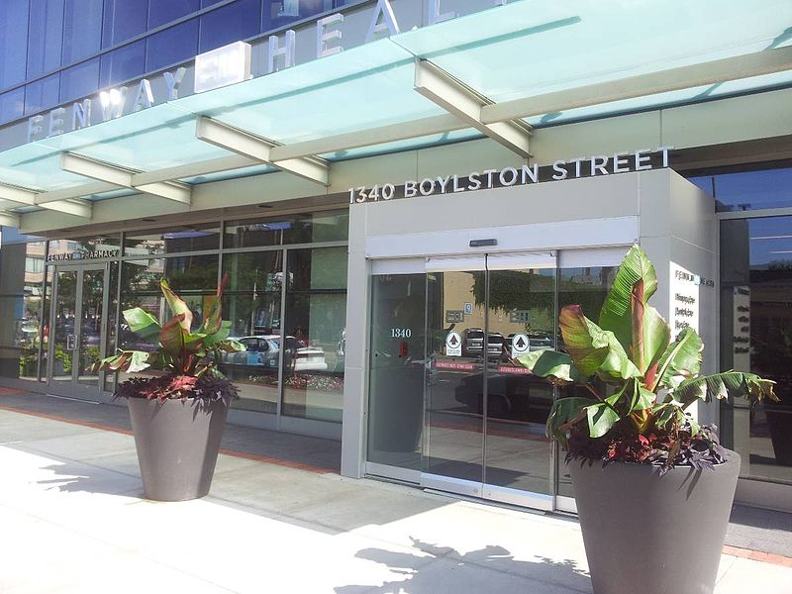
The Fenway Institute
Fenway Health
Founded 1971
Mission: To enhance the wellbeing of the LGBT community as well as people in our neighborhoods and beyond through access to the highest quality health care, education, research and advocacy
Integrated primary care model, including HIV services and transgender health
The Fenway Institute
Research, Education, Policy
10
Notes:
[presented by: Alex ]
Fenway Health was founded in 1971 with a group of students and community members in the Boston area
Its growth was fueled by people coming here from all over New England with what turned out to be the early signs and symptoms of HIV/AIDS
Fenway Health has worked hard at its mission to keep the entire LGBTQ community in focus, and also serves other marginalized and disenfranchised communities who are diverse across race, ethnicity, housing, socioeconomic and immigration status
Currently, about 50% of patients identify as LGBTQ
We’ve always used an integrated primary care model serving over 2000 patients living with HIV (2200 patients), 4000 people who self-identify as trans or gender non-conforming (4000 patients) and behavioral health
The Fenway Institute was established to focus our efforts in education, research and policy. We celebrated 15 years as an Institute in March 2017

Slide 11
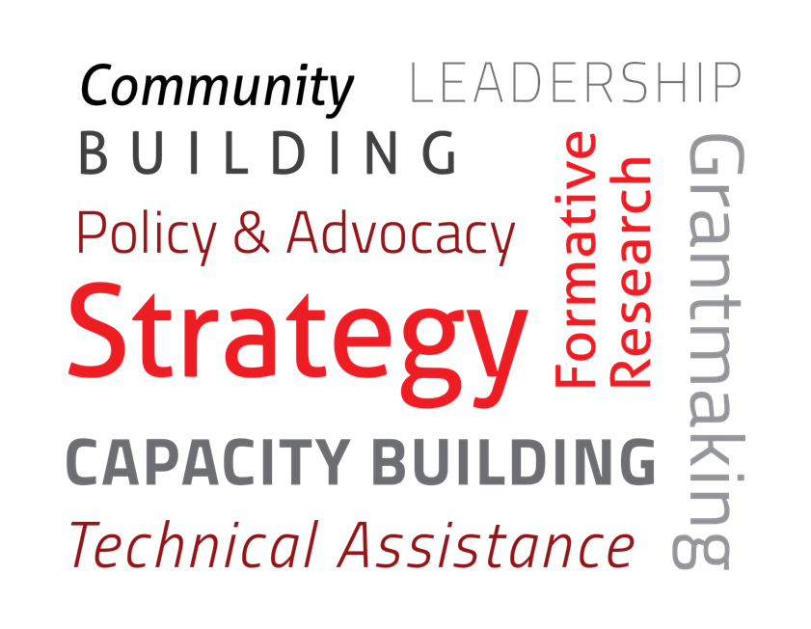
AIDS United
AIDS United’s mission is to end the AIDS epidemic in the United States.
Notes:
[presented by: Erin ]
AIDS United’s mission is to end the AIDS epidemic in the United States through strategic grant making, capacity building, policy, technical assistance, and formative research.
Through this initiative AIDS United will facilitate the grants management process including comprehensive oversight of sub award sites’ use of federal funds.
HOW WE DO IT:
We advance advocacy based on sound public policy; strategic grant making to affected communities; targeted & tailored capacity building for organizations responding to the epidemic; and, research & evaluation to inform the field
We work within a social justice framework that challenges the foundational issues of racism, sexism, homophobia and transphobia, socioeconomic inequality, gender discrimination, and stigma

Slide 12
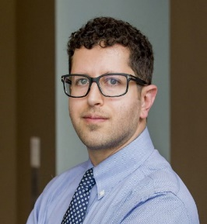
The Coordinating Center for Technical Assistance (CCTA)
Alex Keuroghlian, MD, MPH
Principal Investigator/ Project Director
Linda Marc, ScD, MPH
National Implementation Director
Massah Massaquoi, MPH
National Coordinator
Sarah Mitnick
Operations Manager
Ken Mayer, MD
Director of HIV Interventions
Sari Reisner, ScD
Associate Director of HIV Interventions
Sean Cahill, PhD
Director of Curriculum and Policy
Conall O’Cleirigh, PhD
Lead Faculty – Trauma Interventions
Jessie Milan Jr., JD
President & CEO
Valerie Rochester
Vice President for Program Strategy
Erin Nortrup, LCSW
Director of Program Operations
Alicia Downes
LCSW
Sr. Program Manager
Hannah Bryant
MPH
Program Manager
Joseph Stango
Program Manager
Notes:
[presented by: Erin ]

Slide 13
UCSF: Center for AIDS
Prevention Studies
Mission: To end the HIV epidemic and associated health and social disparities by conducting high impact HIV prevention science and building capacity among researchers and communities to effectively address HIV.
CAPS comprises 5 service and administrative cores designed to support multidisciplinary and high-impact HIV research, enhance the excellence of research projects, train a new generation of HIV scientists, and assist implementing partners.
13
Notes:
[presented by: Janet/Beth? ]

Slide 14
The Evaluation Center (EC)
Janet Myers, PhD
Principal Investigator and Trauma Liaison
Carol Dawson-Rose, PhD, RN
Co-Investigator and Trauma Liaison
Greg Rebchook, PhD
Co-Investigator and Transwomen Liaison
Mary Guzé, MPH
Data Manager
Starley Shade, PhD
Quantitative Evaluator
Beth Bourdeau, PhD
Project Manager and BHI Liaison
Kim Koester, PhD
Qualitative Evaluator and BMSM Liaison
Notes:
[presented by: Janet/Beth? ]

Slide 15
Objective 1
Components of the 11 Interventions
Notes:
[presented by: Sean ]

Slide 16
Transgender Women Focus Area
Notes:
[presented by: Sean ]

Slide 17
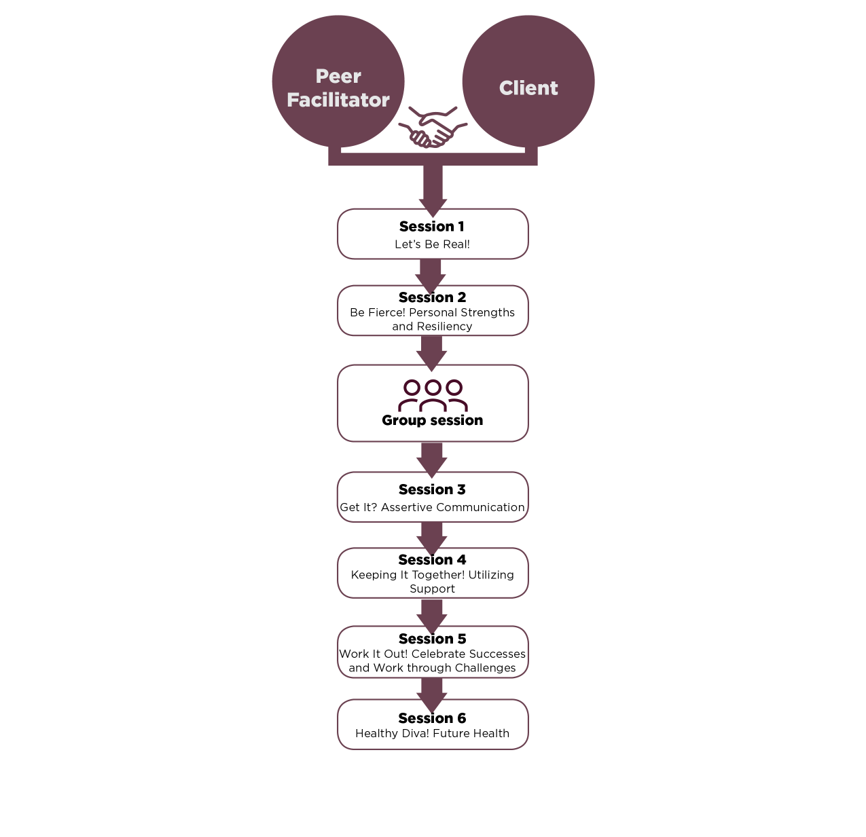
Healthy Divas (DIVAS)
Description:
Gender affirmation model
6 individual sessions
1 group workshop
Peer facilitators
Health care providers
Notes:
[presented by: Sean ]
Healthy Divas is an evidence-informed intervention that provides information, support, and skills building to transgender women living with HIV and empowers them to identify and accomplish individualized health care goals related to gender affirmation and HIV care. Healthy Divas consists of 6 peer-facilitated individual sessions and 1 group workshop led by a peer facilitator and two health care providers.
Developed by the Center of Excellence for Transgender Health at the University of California, San Francisco, with input from transgender community members, a pilot of Healthy Divas showed effectiveness with transgender women of color. The intervention is based on the Gender Affirmation Model (the process by which individuals are affirmed in their gender identity through social interactions) and the Model of Health Care Empowerment (a framework to understand patient and provider roles in facilitating health care empowerment—i.e., the process and state of being engaged, informed, collaborative, committed, and tolerant of uncertainty regarding health care).

Slide 18
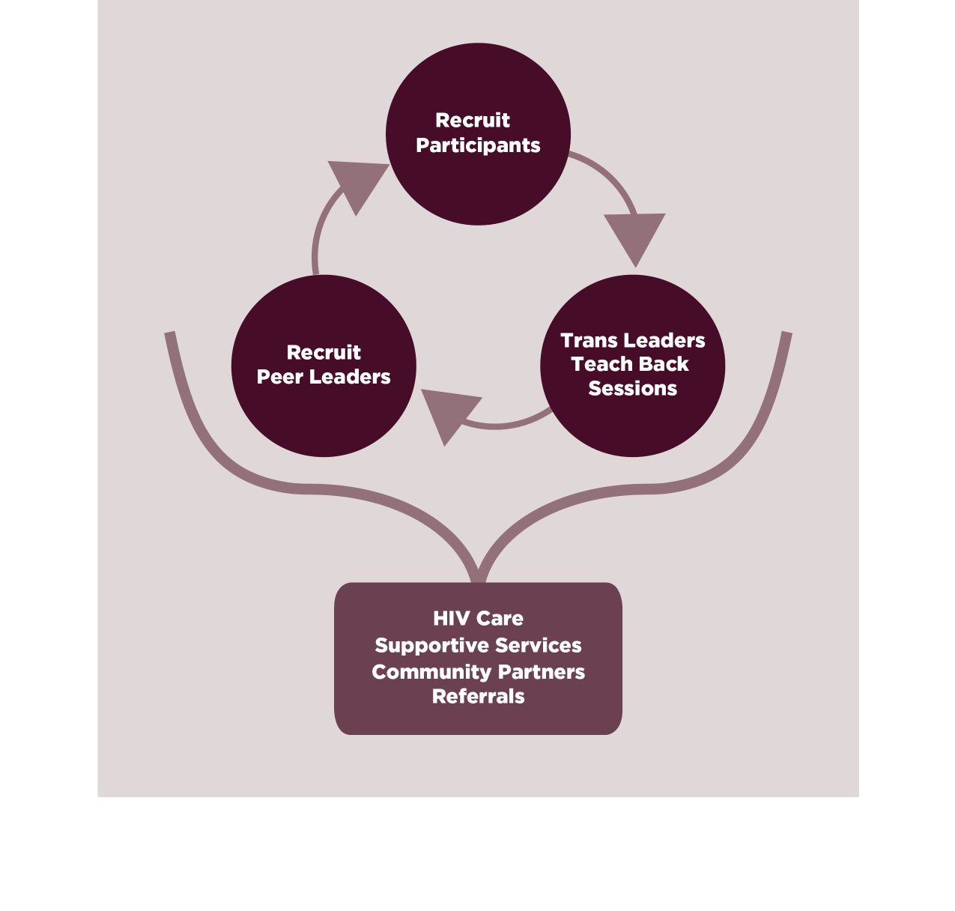
Transgender Women Engagement and Entry to Care Project (TWEET)
Description:
Peer Leaders
Linkage to care
5 educational sessions
Notes:
[presented by: Sean ]
T.W.E.E.T. (Transgender Women Engagement and Entry to Care) is an evidence-informed intervention that links transgender women to HIV care by empowering them to become their own advocates. Peer leaders conduct outreach to other transgender women living with HIV and bring them into weekly group educational and discussion sessions on HIV and other health and wellness topics. T.W.E.E.T. staff link participants to HIV primary care and provide them with supportive services, such as name change, legal services, and referrals. Participants who complete 5 educational sessions can become peer leaders who recruit more participants, lead sessions, and provide support.

Slide 19
Black Men Who Have Sex with Men (MSM) Focus Area
Notes:
[presented by: Sean ]

Slide 20
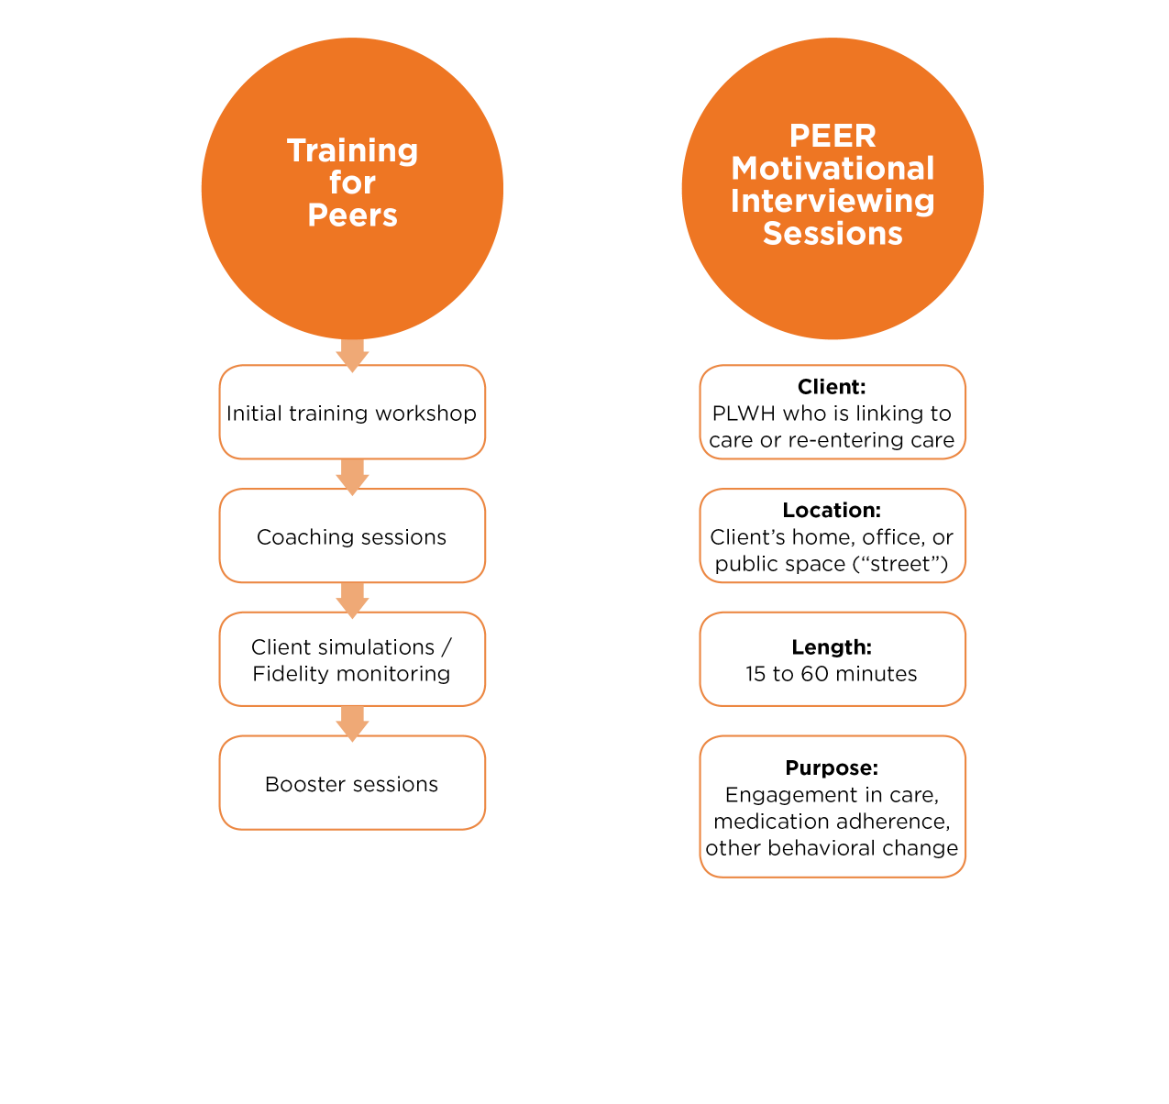
Peer Motivational Interviewing (PEERS MI)
Description:
Brief single sessions
Black MSM living with HIV deliver MI
Focus on medication adherence
Notes:
[presented by: Sean ]
PEERS MI is an evidence-informed intervention comprised of brief single sessions led by peer-level staff to encourage engagement and retention in care for PLWH at the time of initial linkage or at re-entry into care. The intervention may also address medication adherence and other target behaviors relevant to self-management. The intervention is based on Motivational Interviewing (MI), which is “a collaborative conversation style for strengthening a person’s own motivation and commitment to change”. MI conversational style may also be thought of as guiding a person to change, rather than directing them to follow change.

Slide 21
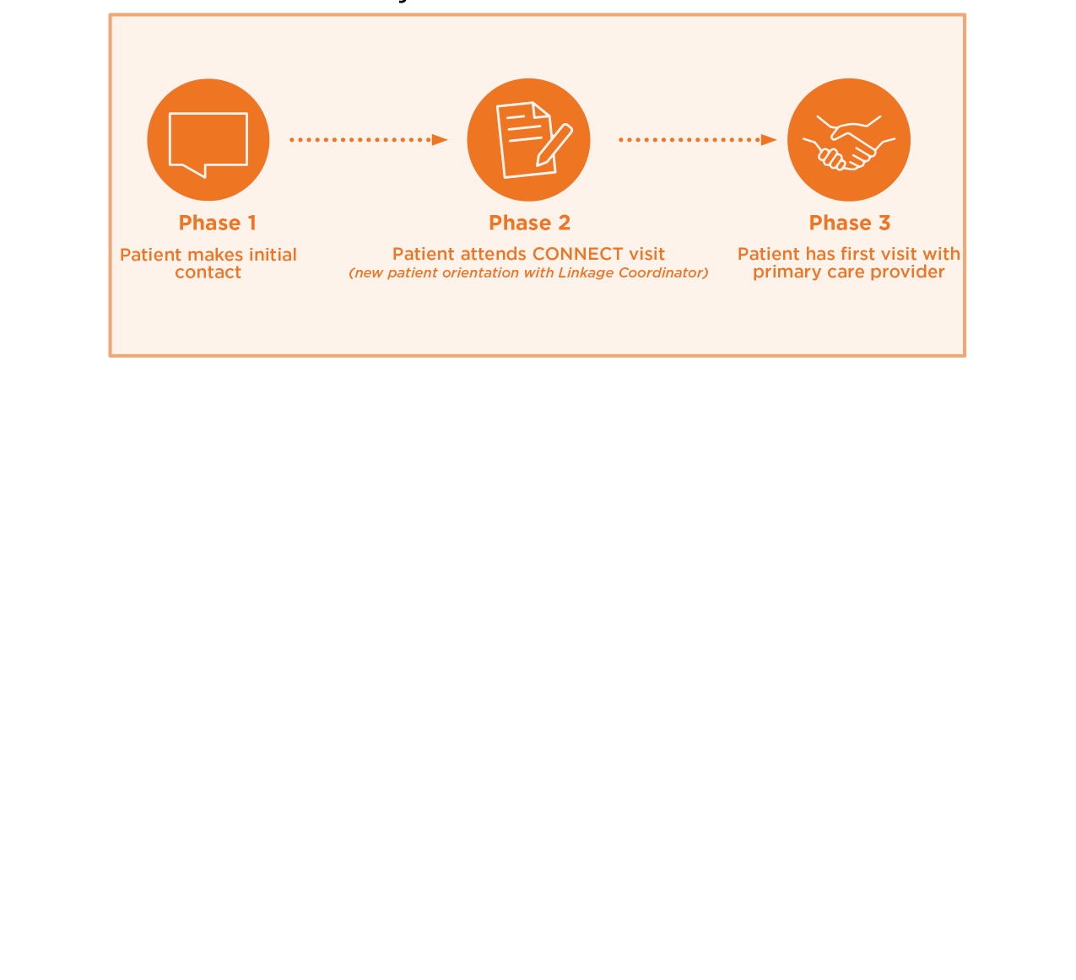
Project CONNECT (CONNECT)
Description:
Newly diagnosed/Re-engaged PLWH
New patient orientation
Linkage to care
Care management
Notes:
[presented by: Sean ]
The Project CONNECT intervention guides newly-diagnosed, newly-transferred, or newly-reengaged people living with HIV (PLWH) into primary medical care by scheduling a new patient orientation (the CONNECT visit) with a linkage coordinator within 5 business days of initial clinic contact. The linkage coordinator builds rapport with the patient, takes a medical and psychosocial history, prepares the patient for their first primary care visit, and provides referrals.

Slide 22
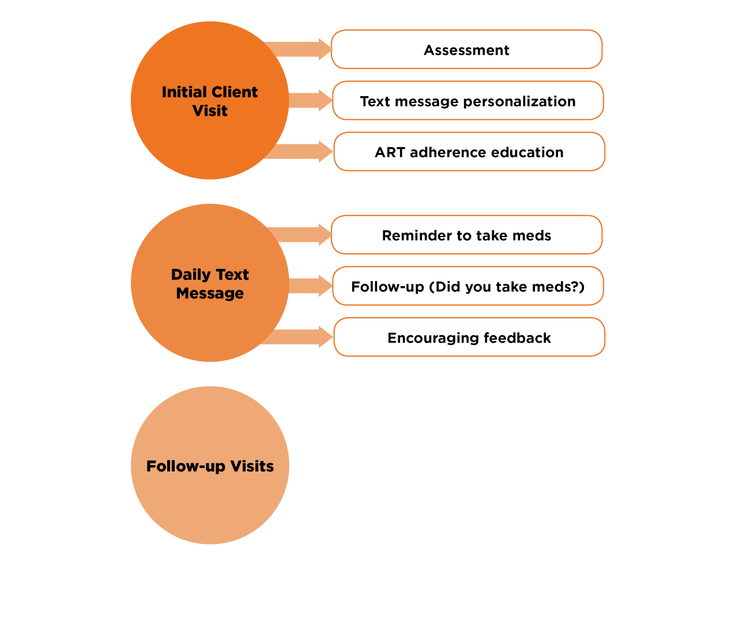
Text Messaging Intervention to Improve Antiretroviral Adherence among HIV-Positive Youth (TXTXT)
Description:
Medication adherence
Bi-directional text messages
Reminders
Confirmation
Encouragement
Notes:
[presented by: Sean ]
TXTXT is an evidence-informed daily, two-way text messaging intervention to promote adherence to HIV medications. An automated text messaging platform sends a series of bi-directional text messages to individual clients to: 1) remind them to take their medication, 2) confirm the medication was taken, and 3) encourage them to stay adherent. The client helps design the content of the messages to be meaningful and motivating to them, and to reflect their medication regimen.

Slide 23
Identifying and Addressing Trauma Focus Area
Notes:
[presented by: Sean ]

Slide 24
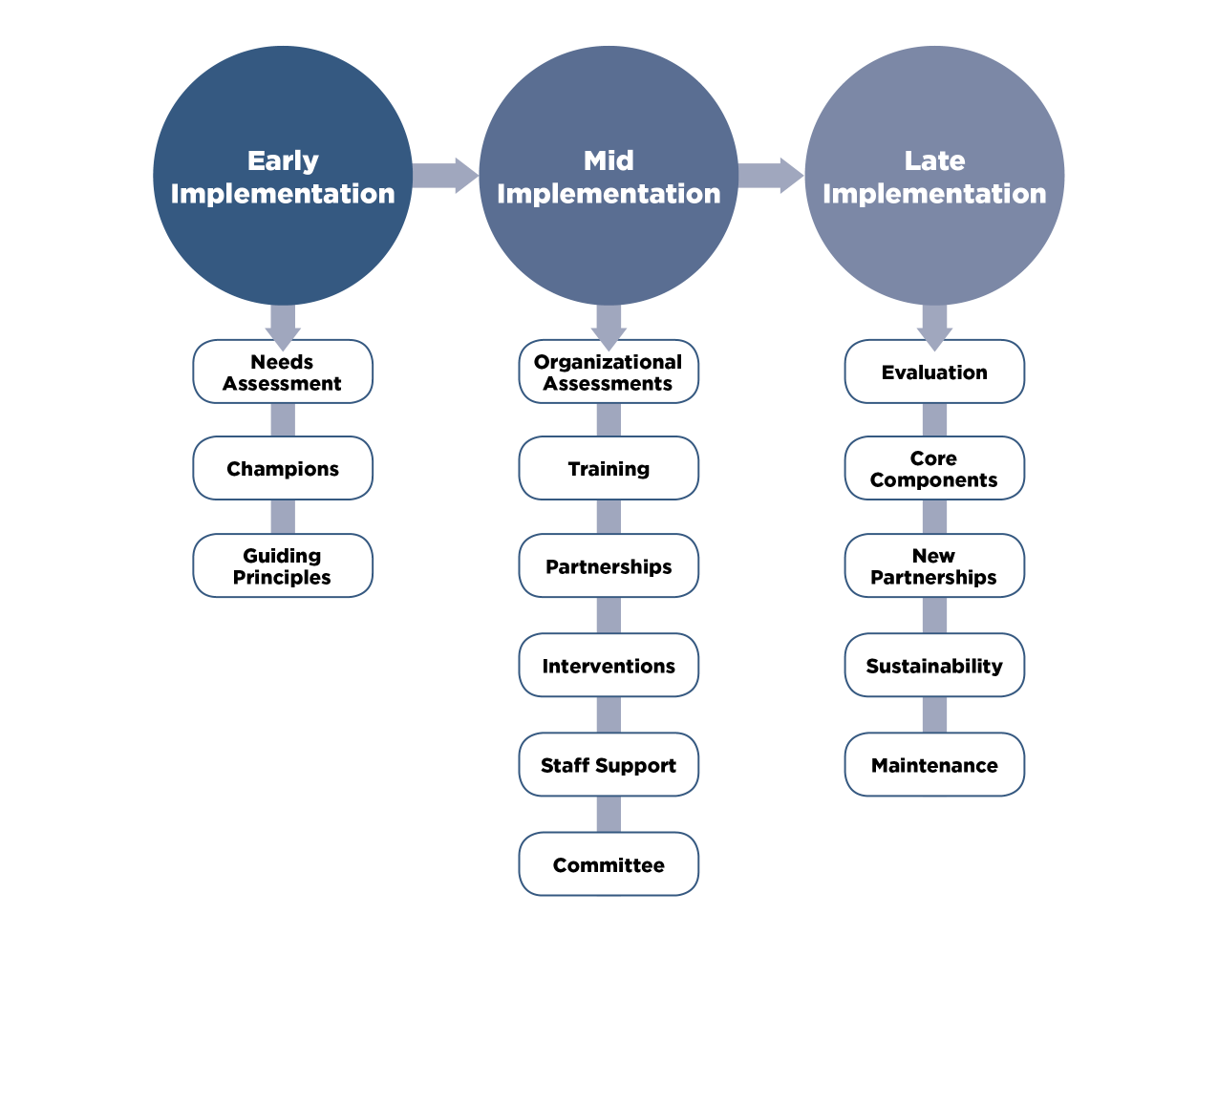
Trauma Informed Approach & Coordinated HIV Assistance and Navigation for Growth and Empowerment (TIA/CHANGE)
Description:
Resilience enhancement
Strength-based approach
Trauma-informed care
Notes:
[presented by: Sean ]
TIA/CHANGE is a resilience-focused and strength-based approach to HIV service provision that involves understanding, recognizing, and responding to the effects of trauma. While TIA/CHANGE was originally developed for women, HIV care providers can use TIA/ CHANGE for PLWH of all genders.
There is no one-size-fits-all approach to trauma-informed care. As such, an organization must tailor its efforts to develop a model of trauma-informed care that is mission-driven and effective for their local community of PLWH.
TIA/Change is a systems-level intervention guided by trauma-informed principles and practices that become embedded within the organization.

Slide 25
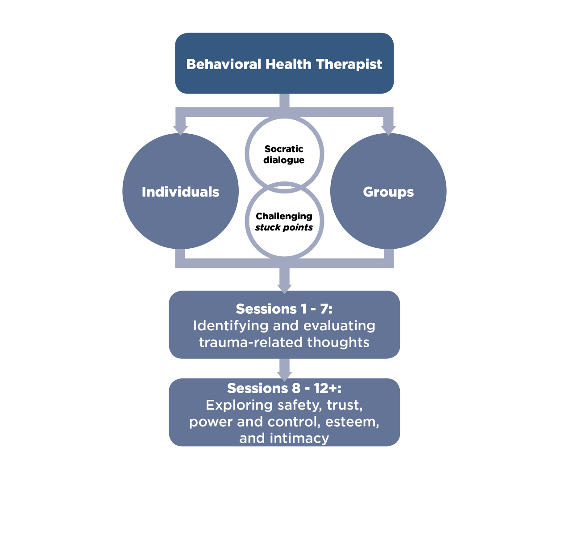
Cognitive Processing Therapy for Treating Posttraumatic Stress Disorder (CPT)
Description:
PTSD treatment
Approximately 12-sessions
Trauma-informed approach
Gold standard therapy
Notes:
[presented by: Sean ]
Cognitive Processing Therapy (CPT) is an evidence-informed cognitive behavioral treatment for PTSD that occurs over approximately 12 individual or group treatment sessions. Through CPT, clients learn about symptoms of PTSD, the connection between trauma-based thoughts and feelings, and how trauma affects their daily lives. CPT therapists engage clients to recognize and challenge unrealistic thoughts, referred to as “stuck points,” throughout the course of treatment. CPT is a gold-standard therapy for people who have experienced trauma, including interpersonal violence, sexual trauma, childhood abuse, and combat. CPT improves quality of life by reducing intrusions, avoidance, worsening cognition and mood, and hyperarousal.
.

Slide 26
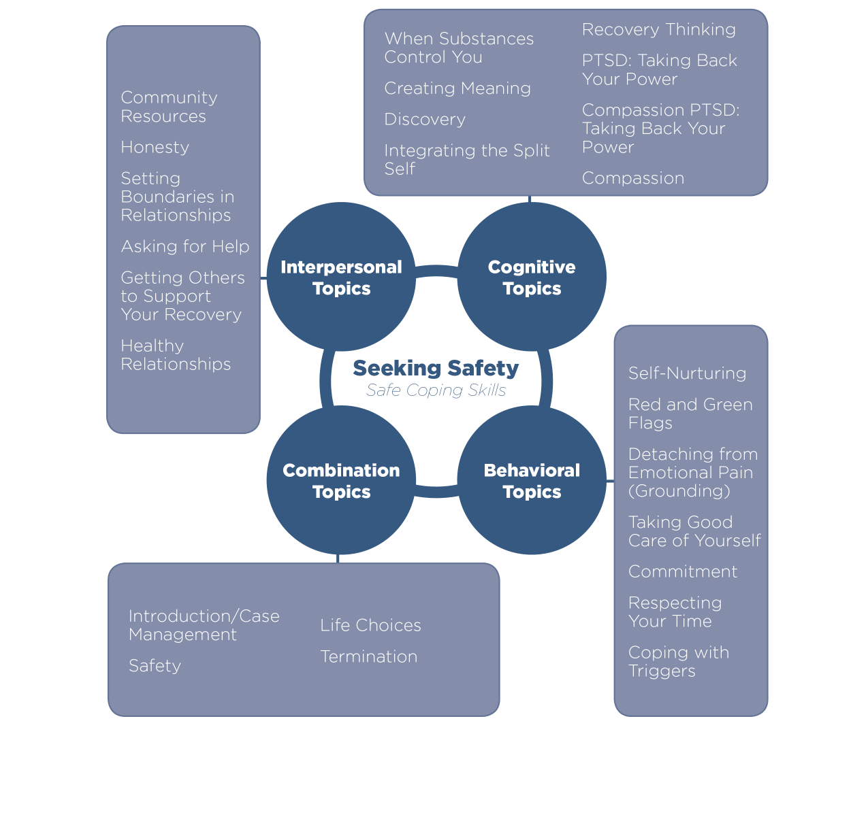
Seeking Safety (SAFETY)
Description:
Coping skills approach
Offers 25 topics in four domains:
Cognitive
Behavioral
Interpersonal
Case Management
Open/closed groups or individual sessions
Notes:
[presented by: Sean ]
Seeking Safety is a coping skills approach to help people attain safety from trauma and/or addiction. It is designed to be safe, optimistic, and engaging. The treatment offers 25 topics, each representing a safe coping skill relevant to trauma and substance use disorders. Topics address cognitive, behavioral, interpersonal, and case management domains, and can be covered in any order. Seeking Safety is highly flexible and can be conducted in a group or with individuals, in open or closed groups, with any gender, and with adults or adolescents.
Seeking Safety addresses themes that are very relevant to PLWH, including taking good care of yourself, staying safe, and understanding how trauma and addiction may play a role in living with HIV. A detailed guide on using Seeking Safety with PLWH is available from the Seeking Safety website.
Both E2i Seeking Safety Sites choose 12 of the 25 topics offered in the four domains.

Slide 27
Behavioral Health Integration Focus Area
Notes:
[presented by: Sean ]

Slide 28
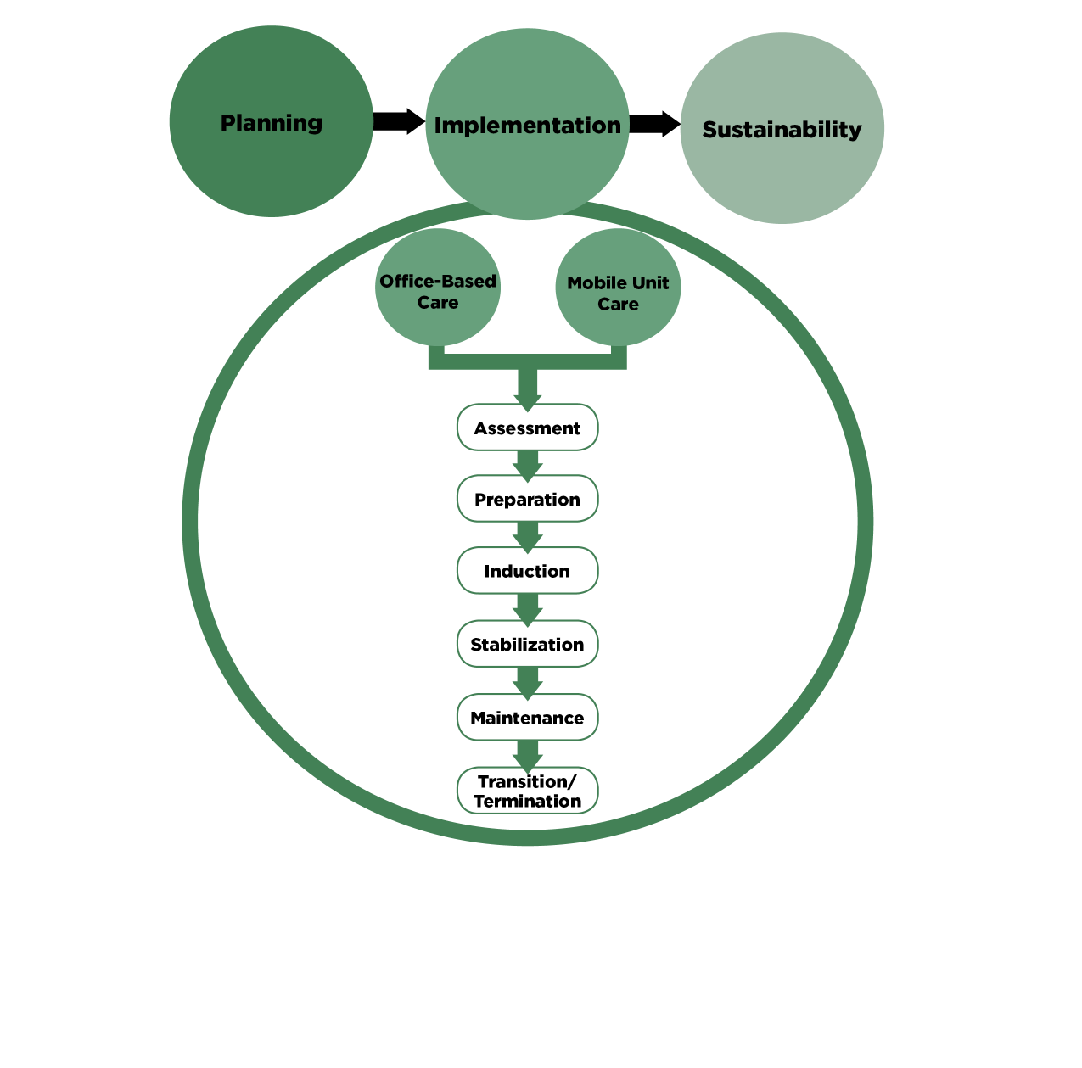
Buprenorphine Treatment for Opioid Use Disorders (BUPE)
Description:
Team-based primary care intervention
Reduce opioid use and overdose
Clinic-based setting
Mobile health unit setting
Notes:
[presented by: Sean ]
Buprenorphine Treatment for Opioid Use Disorders in HIV Primary Care (BUPE-HIV) is an evidence-informed, team-based primary care intervention that allows patients to readily access comprehensive HIV and addiction services in a single setting. The goal of this intervention is to reduce opioid use and overdose among people living with HIV while improving patient engagement in HIV care and behavioral health care.
Opioid use disorders interfere with antiretroviral treatment (ART) adherence and impede HIV viral suppression, making buprenorphine treatment an excellent option for PLWH. Compared to methadone, buprenorphine has lower likelihood of side effects, lower overdose potential, and more predictable drug–drug interactions with antiretroviral medications. On of the two sites implementing BUP is using a mobile van to provide care to hard to reach homeless populations.

Slide 29
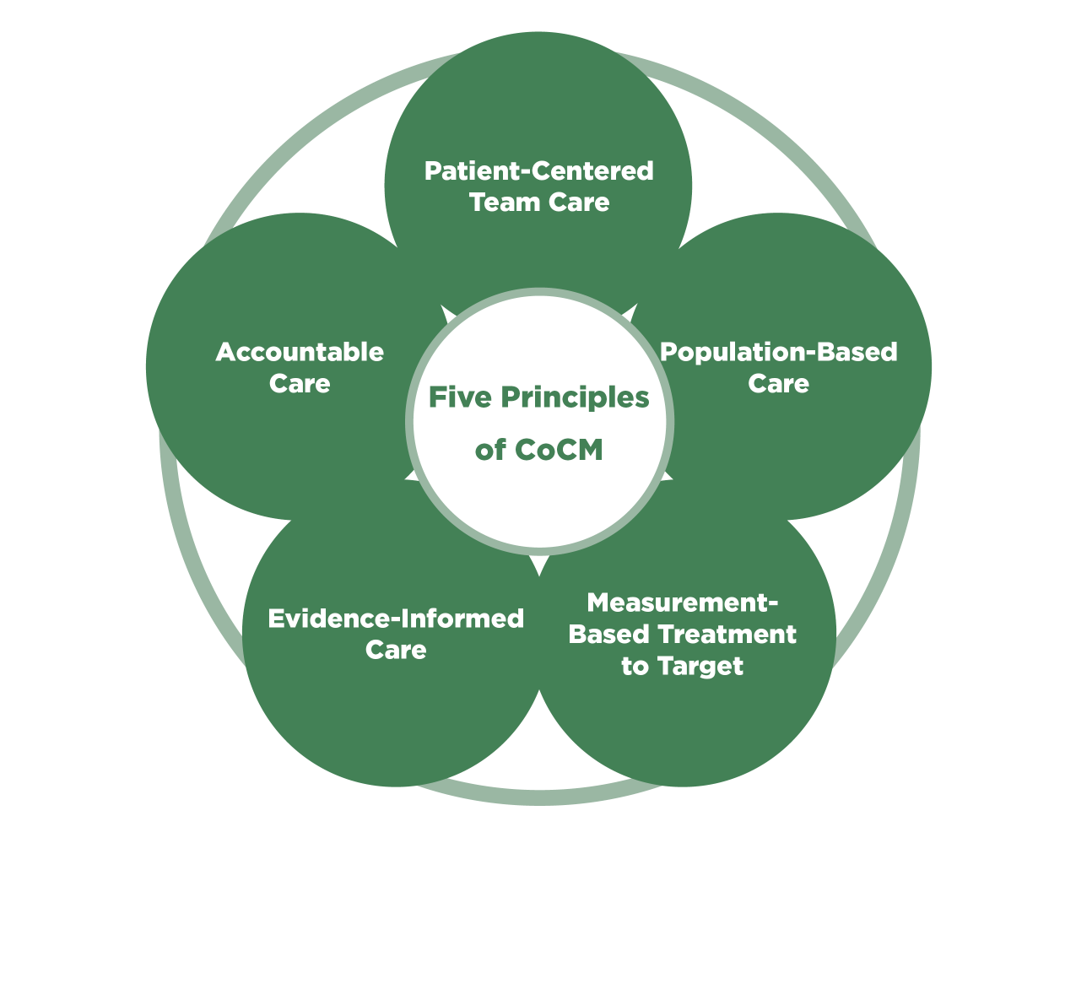
Collaborative Care Management for Behavioral Health (CoCM)
Description:
Team-based approach
Medical provider
Behavioral health provider
Consulting psychiatrist
Treatment for wide range of behavioral health disorders
Notes:
[presented by: Sean ]
Psychiatric Collaborative Care Management (CoCM) is more than just bringing a mental health provider to a primary care setting. In CoCM, a team of providers, including the patient’s medical provider, a behavioral health provider, and a psychiatric consultant, work together to provide evidence-informed mental health care to populations of patients. Primary care teams see their patients improve much more quickly in a successful CoCM program than in usual care.
To provide CoCM, a group of providers must function as a team and share a workflow to provide evidence-informed mental health or substance use disorder treatment. Strategies, staffing arrangements, and clinic work flows in implementing CoCM may be different among HIV service organizations, but the core principles to operationalize a successful and evidence-informed CoCM program are the same.
CoCM is now recognized as effective in treating a wide range of behavioral health problems— not just depression. A team-based CoCM approach can also help address bipolar disorder, chronic pain, anxiety disorders, and trauma- and stress-related disorders, attention deficit hyperactivity disorder, and substance use disorders including alcohol and opioids.

Slide 30
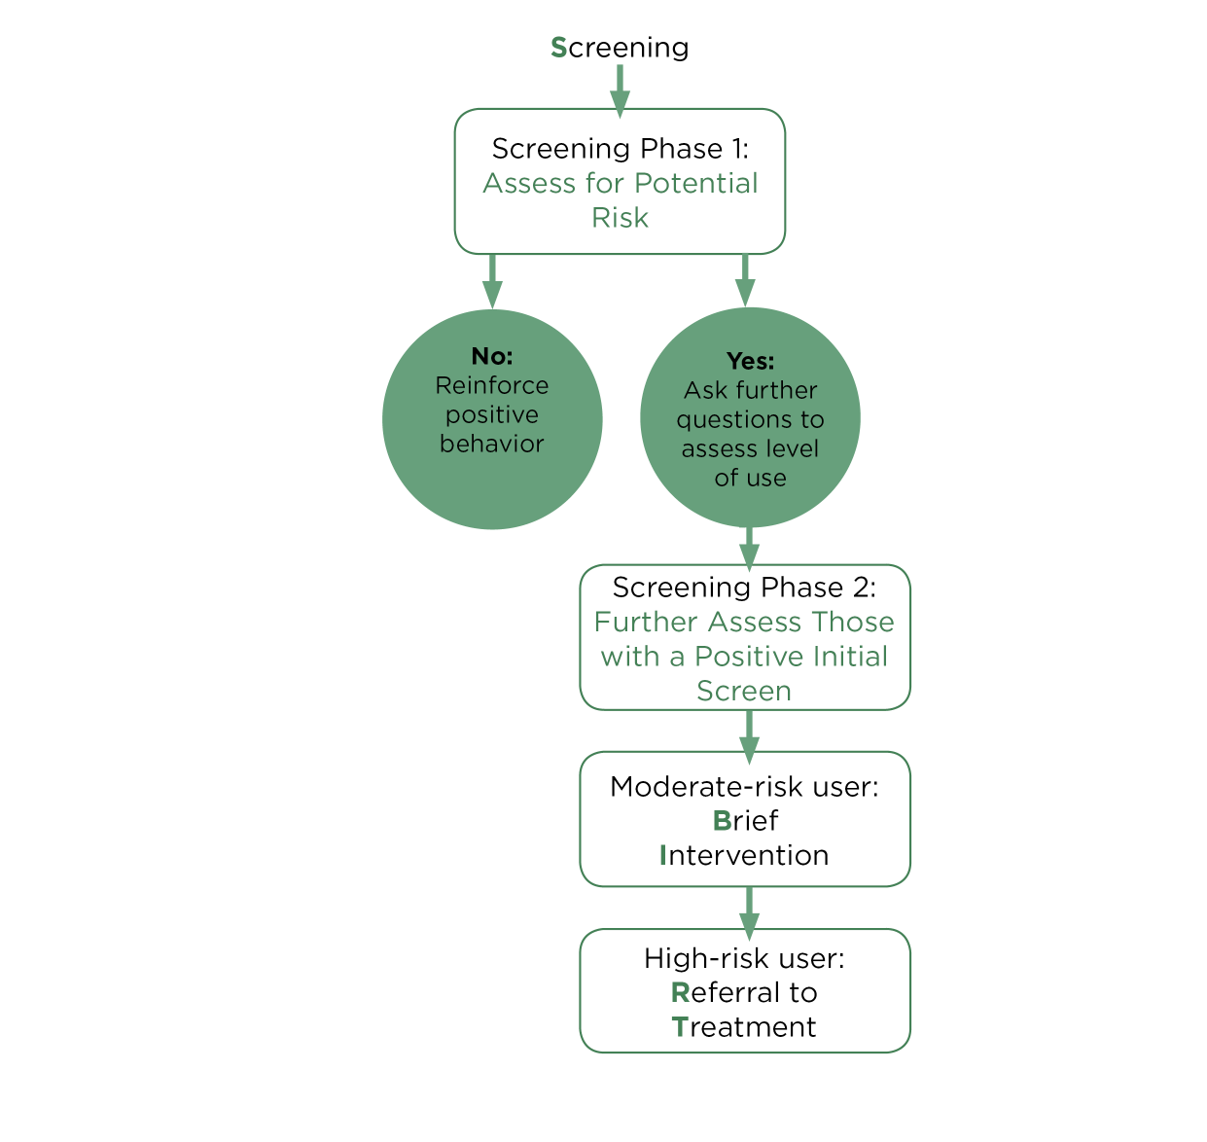
Screening, Brief Intervention, and Referral to Treatment (SBIRT)
Description:
Substance use screening
Alcohol & other drugs
Behavioral health integration
Notes:
[presented by: Sean ]
Screening, Brief Intervention, and Referral to Treatment (SBIRT) is an evidence-informed intervention in which a health care provider screens clients for substance use (alcohol and other drugs), provides brief motivational counseling, and refers to treatment if needed. When integrated into the standard delivery of HIV health care and social services, each part of the SBIRT process provides information and assistance tailored to individual clients and their needs. Just as checking a client’s blood pressure can reveal potential health problems and guide recommendations for a healthier lifestyle, SBIRT for substance use provides early insight into potential health problems and a chance to address problems before they worsen.

Slide 31
Learning Objective 2 Organizational Assessment

Slide 32
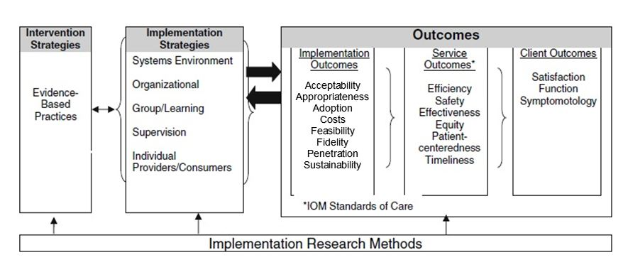
Framework: Proctor Model

Slide 33
Assessing Implementation
Characteristics of sites that may have influence on successful implementation and/or improvement in patient outcomes
Organizational Assessment Survey
Completed by Project Leadership

Slide 34
Implementation Strategies
Practical methods, techniques, and contextual factors that make implementing an intervention in a specific setting successful

Slide 35
Systems/Environment
 | Behavioral Health | Black MSM | Transgender Women | Trauma
Number of sites | 8 | 6 | 6 | 6
Year established | 1923-1987 | 1955-1992 | 1915-2001 | 1988-2015
Overall staff | 22-600 | 18-93 | 11-264 | 7-2,870
Overall patients | 1,200-155,000 | 500-4,085 | 190-8,400 | 225-16,000

Slide 36
Organizational
 | Behavioral Health | Black MSM | Transgender Women | Trauma
HIV staff | 15-30 | 10-68 | 6-264 | 4-100
HIV patients | 260-2,627 | 104-1,950 | 23-2,265 | 125-1,450
Sites w/ workflow change | 4 | 1 | 2 | 4
Number of changes | 0 – 4 | 0 | 0 – 3 | 0 – 12

Slide 37
Group/Learning
 | Behavioral Health | Black MSM | Transgender Women | Trauma
Responsibilities defined | 6 | 2 | 4 | 6
Policies written | 4 | 1 | 2 | 4
Barriers | Hiring staff | Physical space | Patient retention | Hiring staff
 | Adequate training |  |  | Adequate training
 | Staff capacity |  |  | Staff capacity

Slide 38
Supervision
 | Behavioral Health | Black MSM | Transgender Women | Trauma
Average strategies | 3.38 | 2.83 | 3.17 | 3.17
Most common | Huddles > weekly | Team meetings weekly | Huddles weekly | Huddles > weekly
 | Team meetings weekly | Individual > weekly | Team meetings weekly | Team meetings weekly
 | Individual weekly |  | Individual weekly | Individual weekly

Slide 39
Implementation Outcomes
The effects of deliberate and purposive actions to implement a new intervention

Slide 40
Elements of Readiness
Acceptability: agreement on selection of intervention
Appropriateness: degree of fit to the site and to their patients/clients
Adoption: intention to implement intervention
Feasibility: site has the resources needed to accomplish implementation
Fidelity: implemented as originally intended
Penetration: integrated into site’s practice and procedures
Sustainability: long-term viability
Cost: resources needed to implementation components

Slide 41
Baseline: Readiness
List of statements related to organizational readiness
1 = not even close
2 = some way to go
3 = nearly there
4 = we’re there
All sites considered together averaged between ‘nearly there’ and ‘we’re there’ on all 8 scales

Slide 42
Overall Readiness
 | Behavioral Health | Black MSM | Trauma | Transgender Women
Acceptability | 3.53 | 3.61 | 3.58 | 3.41
Appropriateness | 3.88 | 4.00 | 3.83 | 4.00
Adoption | 3.59 | 3.58 | 3.58 | 3.75
Feasibility | 3.51 | 3.75 | 3.43 | 3.52
Fidelity | 3.56 | 3.41 | 3.50 | 3.67
Penetration | 3.48 | 3.53 | 3.26 | 3.17
Sustainability | 3.47 | 3.33 | 3.67 | 3.50
Cost | 3.38 | 3.33 | 3.00 | 2.83
Tested for statistically significant differences and none found

Slide 43
Strengths
Acceptability: Leadership support by designating implementation lead
Acceptability: Organization’s mission is supportive of evidence informed intervention
Acceptability: Intervention is aligned with organizational, regional, or system goals
Appropriateness: Senior leadership consider intervention addressing an important gap in service
Adoption: Senior leadership is convinced of value of intervention
Feasibility: Good rationale for selection of staff
Penetration: Intention to use outcome data

Slide 44
Areas for Growth
Acceptability: All stakeholders have been consulted
Feasibility: Concerns about technical assistance

Slide 45
Learning Objective 3
Adaptation & Rapid Implementation
Notes:
[presented by: Linda ]

Slide 46
Framework for Adaptation
Notes:
[presented by: Linda ]
A process of modifying key characteristics of an intervention, such as recommended activities and delivery methods, without competing with or contradicting the core elements, theory, and internal logic of the intervention thought most likely to produce the intervention’s main effects.
Source: McKleroy et al. (2006). AIDS Education and Prevention: Vol. 18, No. supp, pp. 59-73.

Slide 47
5 Phases of Adaptation
Assessment Phase
Selection Phase
Prepare Phase
Pilot Phase
Implementation Phase
Source: McKleroy et al. (2006). AIDS Education and Prevention: Vol. 18, No. supp, pp. 59-73.
Notes:
[presented by: Linda ]
A process of modifying key characteristics of an intervention, such as recommended activities and delivery methods, without competing with or contradicting the core elements, theory, and internal logic of the intervention thought most likely to produce the intervention’s main effects.
Source: McKleroy et al. (2006). AIDS Education and Prevention: Vol. 18, No. supp, pp. 59-73.
Assessment Phase Consult with key experts and stakeholders about core elements of the intervention
Selection Phase (a) Identify intervention components to adapt with site; (b) Determine whether intervention adaptation influences implementation
Preparation Phase (a) Prepare with selected site to adapt (if needed); (b) Identify site gaps
First Cycle (defined by site) (a) Plan the implementation (of adapted curriculum, if applicable); (b) Initial data collection for: process, outcome, quality, and assess fidelity measures
Continuous Implementation (a) Collect process, outcome and quality measures; assess fidelity (b) Seek technical assistance (as needed)

Slide 48
Mechanisms for Assessing
Adaptation Needs
Pre-Site
Visit Call
Site Visit
Consultation Report
Notes:
[presented by: Linda ]
Pre-site Visit Calls Monthly through Month 6 of implementation; every other month thereafter to monitoring delivery of intervention activities, fidelity to original intervention model, and provide technical assistance
Site Visits E2i staff will make yearly visits to all 26 sub-grantees to monitor the sites compliance with federal requirements and programmatic expectations
Consultation Report Designed to assess sites readiness to deliver intervention activities with fidelity and identify sites need to adapt intervention model for successful implementation to population of focus

Slide 49
Framework for Rapid Implementation
Notes:
[presented by: Linda ]
A method of delivering time-compressed solutions for implementing 11 evidence-informed interventions.

Slide 50
Steps for Rapid Implementation
Over 12 Months
Intervention Selection
Site Selection
Identifying Capacity Building Opportunities
Intervention Trainings
ADMINISTRATIVE REVERSE SITE VISIT
Notes:
[presented by: Linda ]
A method of delivering time-compressed solutions for implementing 11 evidence-informed interventions.

Slide 51
Intervention Selection
Focus Areas | Number of Reviewers | Number of Interventions | Completed Evaluations | Anticipated Evaluations | Difference
Transgender Women | 8 | 14 | 99 | 112 | 13
Black MSM | 6 | 11 | 64 | 66 | 2
Behavioral Health Integration† | 6 | 9 | 45 | 54 | 9
Identifying and Addressing Trauma† | 8 | 14 | 98 | 112 | 14
Total | 28 | 48‡ | 306 | 344 | 38
†A reviewer who expected to submit scores was unable to because of technical difficulties. ‡There were 44 unique interventions reviewed, with 4 interventions assigned across multiple focus areas.
51
Notes:
[presented by: Linda ]
The Fenway Institute staff and a consultant created the initial central repository identifying over 100 interventions using search engines such as PubMed, Harvard Library, and Google Scholar.
An internal scoring and review of these interventions was done by staff from AIDS United, The Fenway Institute, and a consultant, which paired down to 60 interventions that were aligned with the eligibility criteria for Ryan White HIV/AIDS Prgram site activities.
Based upon an implementation science framework the CCTA developed a scoring rubric to assess suitability for implementation in RWHAP settings, which ultimately lead to 44 unique interventions being selected by the CCTA to be reviewed by faculty.
The CCTA leveraged their network of academic and community-based partners and engaged a dedicated group of 28 experts to serve as the faculty and community advisory board. The faculty came from various backgrounds including researchers, medical and behavioral health providers, and community leaders; collectively with decades of experience in the study and implementation of evidence-informed interventions to improve HIV-related health outcomes for people living with HIV (PLWH).
This faculty was tasked with scoring the 44 interventions, 4 were duplicates across focus areas, making the number of interventions reviewed 48. In total, there were 306 completed evaluations, which helped to pairing down the number of intervention to 32, having 8 per focus area.
During the National Convening the CCTA Advisory Board selected 16 final interventions, then from these 11 were elected and have target outcomes along the HIV Continuum Cascade.

Slide 52
Site Eligibility Criteria
Currently-funded Ryan White HIV/AIDS Program recipients or sub-recipients Not currently implementing the same or a similar intervention as the one selected under this RFP for funding Must demonstrate a pre-existing relationship with an Outpatient Ambulatory Health Services (OAHS) provider or in-house OAHS
Notes:
[presented by: Erin ]

Slide 53
Review Committee Considerations
Sites should have the ability to reach and serve the population that they have selected to serve Geographic distribution Meaningful involvement / engagement of PLWH Readiness to implement the selected interventions Ability to collect data for evaluation
Notes:
[presented by: Erin ]

Slide 54
E2i Interventions and Sites
Notes:
[presented by: Massah ]
Thank you Erin, next we will discuss the E2i intervention sites

Slide 55
E2i Intervention Sites
Transgender Women
HEALTHY DIVAS
CAL-PEP (CA)
Rutgers New Jersey Medical School (NJ)
Birmingham AIDS Outreach Inc. (AL)
T.W.E.E.T.
CrescentCare (LA)
Henry Ford Health System (MI)
Centro Ararat (PR)
Black MSM
CONNECT
AIDS Taskforce of Greater Cleveland(OH)
PEERS MI
HOPE Center (GA)
Broward House, Inc. (FL)
University of Mississippi Medical Center (MS)
TXTXT
UNIFIED-HIV Health & Beyond (MI)
Research Foundation SUNY HEAT Program (NY)
Trauma Informed Care
TIA/CHANGE
Alaska Native Tribal Health Consortium (AK)
Chicago Women's AIDS Project (IL)
COGNITIVE PROCESSING THERAPY
Western North Carolina Community Health (NC)
Positive Impact Health Centers (GA)
SEEKING SAFETY
Multicultural AIDS Coalition (MA)
The Regents of the Univ. of Calif., U.C. San Diego (CA)
Behavioral Health Integration
BUPRENORPHINE
Consejo de Salud de Puerto Rico Inc. dba Med Centro (PR)
Greater Lawrence Family Health Center (MA)
CoCM
La Clinica del Pueblo, Inc (DC)
Oklahoma State University Center Health Sciences (OK)
Health Emergency Lifeline Programs (MI)
Our Lady of the Lake Hospital, Inc. (LA)
S.B.I.R.T.
The Poverello Center Inc. (FL)
North Jersey Community Research Initiative (NJ)
Notes:
[presented by: Massah ]
During a national convening in November 2017 the E2i advisory board selected 16 interventions that were included in the E2i request for proposals. Eligible sites were allowed to apply for 1 intervention across the 4 focus areas.
Among the 114 applications we received, listed here are the 26 sites and 11 interventions that were scored highly and selected given the review committee’s considerations.

Slide 56
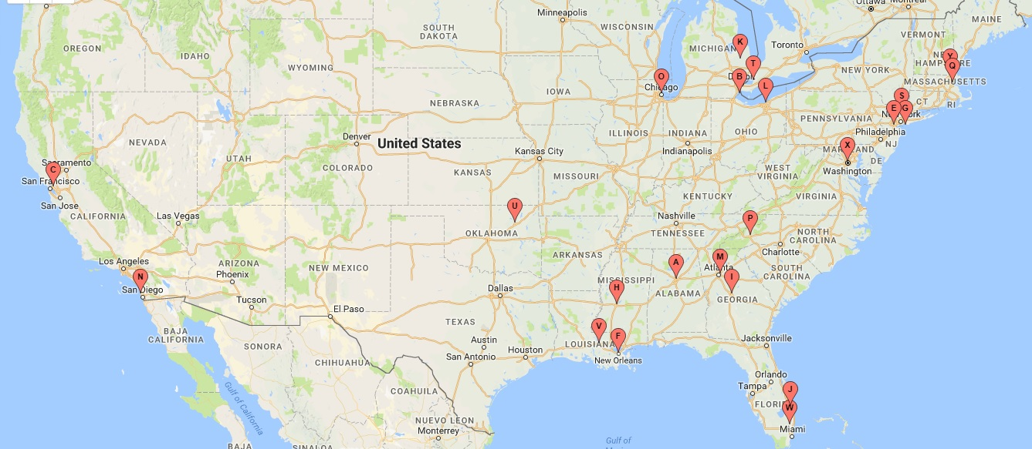
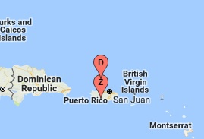
Geographic Distribution of Sites
Notes:
[[presented by: Massah ]
2017 surveillance data reported, across the 50 states and the District of Columbia, the majority of people who receive an HIV diagnosis live in urban areas.
Also in 2017 the South made up 52% (19,968) of the new HIV diagnoses in the US, followed by the West, the Northeast, and the Midwest
As you can see here the E2i geographic distribution of sites maps fairly well onto the 2017 surveillance data with many sites located in the South, Northeast, and urban areas.

Slide 57
Intervention Cohort Trainings
Purpose of Intervention Core Elements of Intervention Strategies for Implementation Activities of Intervention Measures Key Staff
Notes:
[presented by: Massah ]
Sites also participated in intervention cohort trainings where intervention developers and/or experts led a 1-3 day training to overview
The purpose of the intervention
Core elements of the intervention
Strategies for implementation
Activities of the intervention
Measures of the intervention and
Describe the key staff members roles for the given intervention

Slide 58
Identification of Capacity Building Opportunities
Annual Site Visit
Formative Phase Report
Quarterly & Annual Reports
Notes:
[presented by: Massah ]
We also identified opportunities for capacity building for E2i sites led by technical assistance leads and evaluation center liaisons.
Throughout the funding period the CCTA conducts annual site visits where reports are generated that summarize successes, weakness, and challenges identified during the site visit
Sites were tasked to complete a formative phase report describing readiness for intervention implementation and customization
Lastly the sites are tasked to complete quarterly reports that summarize accomplishments, milestones, and administrative updates from the previous 3-month or annual reporting period

Slide 59
Site Implementation Readiness
26 Sites
CCTA
EC
Trainers
Notes:
[presented by: Massah ]
To assess the sites readiness for implementation, the CCTA completed post training consultation calls with the trainers, Evaluation Center and sites resulting in the development of a site specific consultation report.
After sharing with the all members of the team,
The trainers were given the opportunity to identify gaps in implementation at the sites that received their training, and propose solutions to the identified gaps
The sites were then given the opportunity to respond the consultation report where they could request
Additional coaching,
Make revisions to their workflow,
Develop policies and procedures that address the identified gaps
And redefine their staff roles
The Evaluation Center then confirmed the front line staff, data managers, and back-up data mangers were trained and had access to the intervention exposure tools.
Once these steps were completed, the TA leads then confirmed the sites readiness for the delivery of the intervention and provided the date in which the sites would begin implementing and collecting data for their selected intervention.

Slide 60
Site Experiences
Notes:
[presented by: Massah + Sites]
Next we will hear from the sites, who will share their early experiences implementing their selected evidence informed interventions.
1) give an overview of their site 2) discuss any areas where they have built the capacity of their staff to implement the intervention (as ties into EC presentation) 3) adaptations they have made on a site level 4) process of rapid implementation + early results or stories

Slide 61
Questions?
Notes:
[presented by: Alex (15 mins)]

Slide 62
Acknowledgments
Hannah Bryant | AIDS United
Alicia Downes | AIDS United
Sarah Mitnick | The Fenway Institute
Neeki Parsa | The Fenway Institute
Joseph Stango | AIDS United
Kelly Stevens | AIDS United
Notes:
[presented by: Alex ]

Slide 63
E2i Contact Information
Coordinating Center for Technical Assistance:
Evaluation Center:
CCTA@fenwayhealth.org / CCTA@aidsunited.org
E2iEvaluationCenter@ucsf.edu
Notes:
[presented by: Alex ]

