Slide 1
Building a Better ADAP
How to Enhance Your Program with a Robust Medical Benefits Management Program
Krystal Sterling
Benefit and Provider Relations Coordinator
Washington State Department of Health
Notes:
Good morning, before begin I would like to acknowledge with respect the Pamunkey and Piscataway nations on whose traditional territory we gather today. We acknowledge them as the past, present, and future caretakers of this land.
I am Krystal Sterling. I am the Benefit and Provider Relations Coordinator for the Washington State ADAP program. I would like to thank you all for coming to learn more about Washington State’s ADAP program and how we have incorporated our Medical Benefits Management Program to promote better health outcomes for people living with HIV in Washington State.

Slide 2
Learning Objectives
At the conclusion of this activity, the participant will be able to:
Understand the benefits of an ADAP medical benefits management program
Foundational understanding of how to implement a medical benefits management program
Knowledge of available resources for implementing and managing a medical benefits management program
Notes:
With a show of hands, who here is part of an ADAP program that provides funding for client’s medical care beyond medications?
*ask to define what cost chare is

Slide 3
Washington State ADAP
Established in 1994
Medical cost shares started in 1998
3828 amount of people on ADAP, utilized by 3034 clients
Viral suppression rate of 90%
Established Centralized Eligibility System
PrEP Drug Assistance Program
Notes:
EIP interchangeable ADAP
*EHIP is IBM and Ramsell is PBM

Slide 4
Benefits of an In-House Medical Benefits Program
Higher adherence to medication
Higher suppression rates
Comprehensive health care
Culturally competent providers
Client and case manager burden
Advocacy
Detailed data
Notes:
colonoscopy and karposi
Culturally competent providers- expand and address POC
**what type of data are you capturing ?

Slide 6
Considerations
What kind of cost share program do you want?
IE: expansive, preventative care, etc.
Funding
Capacity for employees
Rates
System for processing
Provider agreements
Policies and Procedures

Slide 7
WA Funding of Medical Claims
Rebate dollars
Ryan White Grant
Medical $919,857
Dental $518,069
General Fund State Dollars for PrEP DAP
Notes:
*approximate dollars
PrEP DAP claims- are we paying the same?

Slide 8
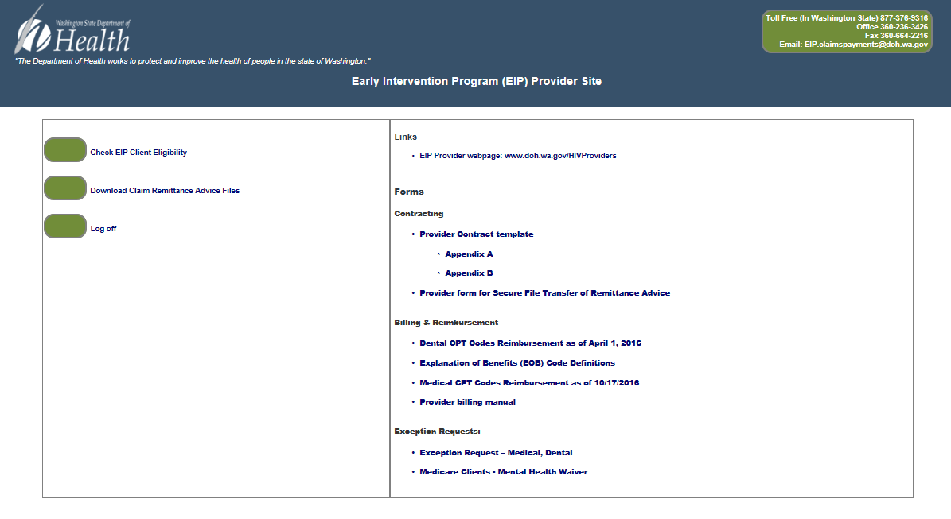
Provide Database
Provide Enterprise, Groupware Technologies, Inc.
Created for Ryan White Programs
Consolidated
Eligibility Processing
Contracting
IBM/PBM
Claims and Payments
Provider Portal
Centralized Eligibility
Notes:
*houses HIV care and prevention data
*PBM info sent out 3x a day and drug adjudication sent back 1x a day
*EHIP real time
*We hold and determine all eligibility for state RW programs
*clients don’t have to recertify many places 2x a year to meet guidelines
*fully implemented 1st of year

Slide 9
FTE Roles
Benefit and Provider Relations Coordinator
Claims Lead
Contracts and recruits Providers
Determines benefits
Dispute resolution
Claims Processor
Adjudicates claims
Manages claim organization
Administrative Assistant
Opens and stamps incoming claims
Notes:
Define FTE

Slide 10
Resources
State Medicaid program
HRSA guidelines
HIV Clinical Care guidelines
FairHealth Consumer
Wasserman Physicians’ Fee Reference
Notes:
33% of Medicaid- why
Why the services we chose

Slide 11
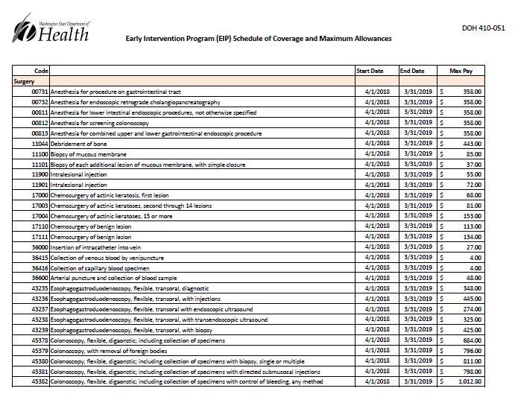
Notes:
*balance billing

Slide 12
Putting it Together
Policies and Procedures
Fee Schedule
Contract Providers
Services Rendered
Claims Submitted
CMS1500, UB04/92
Claims Processed
Claims Paid

Slide 13
Building a Better ADAP
The benefits of an ADAP medical benefits management program
Implementing a medical benefits management program
Available resources for implementing and managing a medical benefits management program
Notes:
Benefits- adherence to medication, higher viral suppression and data
Implementing- funding, capacity, policies
Resources- Medicaid, HRSA and Wasserman Physicians guide

Slide 14
Questions?
Krystal Sterling
Benefit and Provider Relations Coordinator
Washington State Department of Health
Krystal.Sterling@doh.wa.gov
360-236-3421

