Slide 1
Perinatal HIV: A Wrap Around Model of Care
Cheri R Booth, RN, MSN, MPH, PHN &
Laura Hoyt, MD
Children’s Hospitals and Clinics of MN

Slide 2
Disclosures
Presenters have no financial interest to disclose.
This continuing education activity is managed and accredited by AffinityCE/Professional Education Services Group in cooperation with HRSA and LRG. PESG, HRSA, LRG and all accrediting organization do not support or endorse any product or service mentioned in this activity.
PESG, HRSA, and LRG staff as well as planners and reviewers have no relevant financial or nonfinancial interest to disclose.
Commercial Support was not received for this activity.

Slide 3
Learning Objectives
At the conclusion of this activity, the participant will be able to:
Identify ways to improve care coordination between health systems
Recognize opportunities to partner with community organizations/health providers to address complex patient needs
Discuss the challenges that pregnant women living with HIV face and identify strategies to overcome barriers

Slide 4
National Picture of HIV
Of the over 1.1 million people are living with HIV in the United States- approximately 25% are women
80% of women infected are childbearing age (15-44)
An estimated 1 in 5 of all people infected with HIV do not know their status.
Many women learn their HIV status during prenatal testing

Slide 5
Perinatal HIV Transmission

Slide 6
Perinatal Transmission
Many men and women with HIV infection want to have children
Prevention of transmission to partners and babies is very possible, but requires a “team effort”
Coordinated care delivery/ team
Patient (and partner)
OB provider
HIV provider
Hospital
Pediatric HIV specialist
Well child care
Social and support services / case management

Slide 7
Perinatal Transmission
Mom’s status is what matters
Amount of virus in mom’s system
Whether HIV infection is established or infection occurred during pregnancy or post-partum period (if breastfeeding)
Whether or not HIV is well controlled, with undetectable VL
Mechanism of transmission
Perinatally (in utero): 25%-40%
Typically with NEW infection
Intrapartum (during labor and delivery): 60%-75%
Additional risk associated with breastfeeding: 5-15%
Notes:
Mom’s HIV status:
Amount of virus in mom’s system
Whether HIV infection is established or new infection with pregnancy
Infection during pregnancy or during post-partum period
Whether or not HIV is well controlled, with undetectable VL
Primary maternal infection:
1. New infection with pregnancy
Intrapartum transmission:
1. Associated with exposure to maternal fluids during delivery.

Slide 8
Perinatal HIV Prophylaxis
Without antiretroviral (ARV) drugs during pregnancy, mother-to-child transmission (MTCT) has ranged from 16% - 25% in North America and Europe
In 1994 transmission rate was 21%
February 1994, ACTG 076 Protocol (Zidovudine, ZDV, Retrovir, AZT)
Transmission:
25% in placebo arm
8% in AZT treatment arm, p=0.00006
With the change in practice, transmission dropped to 11% in 1995
MN: The rate of transmission has decreased from 15% between 1994 and 1996 to 1.6% in the past three years (2014-2017)

Slide 9
HIV testing in pregnancy

Slide 11
CDC (USPHS) recommendations for HIV testing of pregnant women
Prenatal: routine, all, unless patient declines (opt out)
Repeat screening in the 3rd trimester:
“Known to be at high risk for acquiring HIV”
High prevalence jurisdictions
Signs/symptoms of acute HIV disease (“mono,” “influenza-like”)
Labor & delivery: routine rapid testing of all pts when HIV status is unknown
Postnatal: rapid testing of all infants if mother’s status is unknown
Discordant couples
MMWR September 22, 2006/Vol. 55/No. RR-14

Slide 12
Additional HIV Testing goals: Partner testing
Adult HIV care providers
Conversations about the role of fatherhood: value individual and cultural expectations about parenthood. Make this conversation about intention or desire to become parent part of routine care.
Ensure men with HIV understand particular high risk to female partners and infants if she is infected during pregnancy or while breastfeeding.
OB – Encourage conversations about male-partner testing during pregnancy/ pregnancy planning.

Slide 13
Factors which influence risk of MTC transmission
Little or no prenatal care
HIV infection undiagnosed/ No HIV-specific care
Acute maternal HIV infection during pregnancy or breastfeeding
Other infections : chorion, amniotic membranes, reproductive tract
Use of drugs/smoking during pregnancy
Invasive procedures, such as amniocentesis or CVS, fetal scalp monitoring, use of forceps
Artificial rupture or prolonged rupture of membranes
Breastfeeding
Discussion about U=U in context of pregnancy and breastfeeding

Slide 14
MN Specific Information
Non centralized care, both for OB and HIV care. Hundreds of care sites across many systems
No unified medical records system
State mandated reporting of an HIV+ screening in a pregnant woman to the state department of health.
“Minnesota law, specifically Minnesota Rules Chapter 4605.7044, requires the reporting of pregnancy in a person chronically infected with HIV, including AIDS, to the Minnesota Department of Health within one working day of knowledge of the pregnancy.” Via the online reporting form
Purpose of the mandate- To facilitate a care coordination model that can address the gaps.
Annually, 65,000 births; only about 70 are to HIV pos women, therefore our expectation is not that every provide know the recommendations, but that they know we are a resource of centralized expertise.

Slide 15
MN: Births to HIV-Infected Women and Number of Perinatally Acquired HIV Infections* by Year of Birth, 2007 - 2017

Slide 16
Perinatal Client Profile: MN 2007-2017

Slide 17
Goals for HIV positive pregnancy
Linguistically and culturally competent care
HIV positive identified through routine preventative care or early prenatal care in first trimester
Patient is established with ID care and appropriate supporting services (pharmacy, social work, and mental health)
Case report submitted by ID and OB to state health officials
Referral made to care coordination services. Health insurance active, or enrolled upon pregnancy diagnosis.
Education and ongoing coordination of care provided to patient. Monitoring of viral load and engagement in OB and ID care.

Slide 18
Goals cont’d
Delivery plan created, updated, and adapted to client needs submitted to delivery hospital by 32nd then 35th week of pregnancy.
Mom’s privacy/ disclosure preferences outlined. - avoid accidental disclosure of mom’s HIV status to family/ visitors
Infant care provider identified by 35th week and provided care plan for medication and care of/screening of HIV exposed newborn.
Coordination of mother’s and infant’s medication- verified and in- stock at delivery hospital and community pharmacy identified by patient. (IV AZT in stock if needed, liquid AZT for baby).
Pediatric care team often is not included in prep, coordination benefits infant care. Delivery plan includes instructions for baby’s care- avoids testing and medication errors

Slide 19
Challenges : Client based
Lack of health insurance
Culture/ language barriers, difference in OB care expectations
Stigma and lack of disclosure to community/family
Social factors (poverty, homelessness, domestic violence, addiction)
Lack of engagement with care coordination or case management services
Maternity ‘deserts’: According to the American College of Obstetricians and Gynecologists (ACOG), in 2008 only 6.4% of obstetricians and gynecologists practiced in rural settings; and by 2010 almost half of all U.S. counties (most of which are rural) lacked an ob-gyn. Forty-five percent of rural counties no longer have hospitals with maternity wards.

Slide 20
Challenges: Provider based
Inexperienced with perinatal HIV expertise- small % of births
Recommendation is to screen all women during pregnancy at beginning of prenatal care, and again during the 3rd trimester in setting of ongoing risk.
Reporting of all positive HIV screens to MDH
Unaware of MN Perinatal and Pediatric HIV program.
Requires signed referral and release of information (ROI)
Social/ systemic barriers to accessing and retaining in care – providers need education about these barriers in order to change practice accordingly
Ex: trauma informed care, flexibility of appointments, etc
Facilitation of care coordination btw systems- active role in exchange
Provider concern about losing patients
Educating that care remains with them, not ‘taking patients’.
If not coordinated care often cause for last minute consultation with Phys Access MD (could be avoided)

Slide 21
Challenges: Systems based
Maternity deserts- require a great deal more care coordination, fewer provider options to choose from
ID care access- some areas have only one or two ID providers and reduced number of available appointments.
Retention in care is difficult for those experiencing inconsistent housing, food insecurity, lack of transportation and child care.
Insurance access is very complicated, especially for those new to the country or for whom English is not primary language.
Stigma prevents many from accessing available support services that may alleviate some of the former concerns. This includes stigma around substance use.

Slide 22
Challenges- Systems based, MN specific
Multiple systems of care across a large geographic area
Usually at least two are involved but, sometimes for mother/baby care, four or more care systems are involved.
Health information management systems have variable requirements/protocols
Multiple ROIs must be completed (and kept updated) during pregnancy
Some systems require that their specific systems ROI be used

Slide 23
MN Perinatal & Pediatric HIV Program
Funded through Ryan White Parts A & D, MDH. Wrap- around services:
Nursing care coordination for HIV+ pregnant women
During pregnancy, L&D, post-partum up to 6 mos
Coordination of care across providers, health systems
Development of delivery plan
Health education
Coordination of care/screening of HIV-exposed infant
Preconception risk counseling and services
Clinical and community education on HIV and pregnancy, families
Family HIV medical case management
Peer navigators
Mental health support services
HE/RR: Health Education and Risk Reduction

Slide 24
Children’s Perinatal HIV program: Nursing Care Coordination
Nursing care coordination
Intake and assessment
Individual care plan
Gather medical records and synthesize
Make referrals to supportive services, care
Ongoing education, support
Customized delivery plan
Care planning with delivery hospitals L & D unit as well as pharmacy
Infant care plan submitted to pediatrician
Monitoring infant screenings and medication
Reporting to state health department

Slide 25
Perinatal HIV Care coordination, MN
In MN there is care coordination for HIV positive pregnant women provided across the state by 2 coordinators. One for the Hennepin County Medical Center, and one for the rest of the state.
Coordination is available to anyone who meets Ryan White criteria, however referrals are required.
If, after 20th week of pregnancy, referral not made by OB or ID provider, care coordinator is notified by department of health staff and provided contact info for pt. At this time, the RN can contact pt and offer care coordination services. If declined, no further contact can be made.
Delivery plan is created with available info from the state and submitted to the delivery hospital no later than 35th week or as soon as possible in cases after 35th week. Confirm with delivery hospital the medications are available/ ordered.

Slide 26
Nursing Care Coordination: Delivery plan
Maternal care:
Mode of delivery
Hospital planned for delivery
Physicians: OB, Infectious Disease
Current HIV medications & dosing
Recent lab results: VL, CD4 count (T-cell)
Standard maternal medications for delivery
Newborn care:
Medications
Recommended feeding
Labs
Follow-up

Slide 27
Nursing Care Coordination: After Delivery
Essential to set up follow-up appointments for mom (HIV, OB) and baby (well child, HIV screening)
HIV+ women can be more prone to “baby blues” (postpartum depression)
Continued social support and case management
Discuss family planning / reproductive health needs. Ensure mom has support and education on reproductive choices. Some OBs will address family planning needs, but not all. HIV providers generally do not.
Consult with mom and HIV and OB provider on mom’s postpartum appts and encourage/assist mom to prioritize those appts for her own health.
Moms may need additional assistance to make/keep appts after delivery
“Mom brain”
Lack of sleep, stress of new infant

Slide 28
Children’s Perinatal HIV program: Case Management
Assess for eligibility to supportive programs and services (food, transportation, housing, SA counseling, medications assistance etc).
Assist with enrolling clients in targeted services
Assist with enrollment and retention of health insurance for patient and family
Individualized case management plan- for the patient and family
Mental health assessment and referral
Ongoing assistance with appointments, transportation, etc
Disclosure counseling, care advocacy, transition planning/ skill building

Slide 29
Children’s Perinatal HIV Program: Peer Navigators
Available for phone and in person sessions.
Screened and hired by Children’s
Non- medical
4 peer navigators- specialized experiences to support pregnancy, youth, LGBTQ, and for families adopting HIV positive children

Slide 30
Coordination – Systems and providers
Recognize opportunities to partner with community organizations/health providers to address complex patient needs
Work with L and D coordinators throughout the state
Pharmacy- medications needed for delivery/ infant
Monthly meetings with two larger ID practices
Integral relationship with state health department
Local and statewide trainings to bring awareness about perinatal HIV and referral options
Individual clinic/provider education- identification of ‘champions’
Physician Access Line for provider consultation
Ability to travel- meet clients at home, clinics, treatment facilities, etc
Referrals – Ex: Birth support doulas

Slide 31
Future goals and directions
FIMR- Fetal and Infant Mortality Review: Assesses, reviews, and works to improve process and service systems. Example: IV AZT access
Champions- Identification of OB, Peds, and Adult HIV providers who are well trained and versed in HIV perinatal and pediatric care provision
Testing partners- Ongoing goal to improve adult HIV and OB provider’s screening of partners during pregnancy or preconception period
Administrative support- Dedicated admin to assist nurse, case manager, and peer navigators in order to expand capacity of the team to provide direct patient services.
Reduce percentage of clients LTFU after infant screening period.
Breastfeeding- Future development of individual risk reduction strategies and recommendations

Slide 32
Questions/Case studies

Slide 33
Complex patients: Case study 1
1st pregnancy
Lupus- recent hospitalizations for ‘flares’
Substance use- THC
Inconsistent housing
Has been unable to maintain consistent work
Familial support- Partner and mother are aware of HIV status
Care coordination and case management services provided

Slide 34
Complex Patients: Case study 2
Outstate MN resident. Distance to care provider >1 hour
Foreign born
Married, Partner negative
Recent HIV diagnosis <6 months
Multiple prenatal care providers (out of state and out of country)
Preterm delivery @ 32 weeks
Alternative health beliefs/ practices
No care coordination or case management services provided

Slide 35
Complex Patients: Case study 3
US born
Metro/ suburban metro resident
Unexpected/ unplanned pregnancy
OB and ID care provided by different systems. HIV viral suppression
Partner and adult child of client unaware of client’s HIV status
Complicated cesarean delivery
No care coordination or case management services provided

Slide 36
Clinical Resources
National Perinatal HIV Consultation and Referral Service
(24 hrs, 7 days/wk)
800- 448-8765
MN Physician’s Access Line for consultation
612-343-2121
Minnesota Department of Health, HIV/AIDS Division, Perinatal HIV Transmission
www.health.state.us/divs/idepc/diseases/hiv/hivperinatal.html

Slide 37
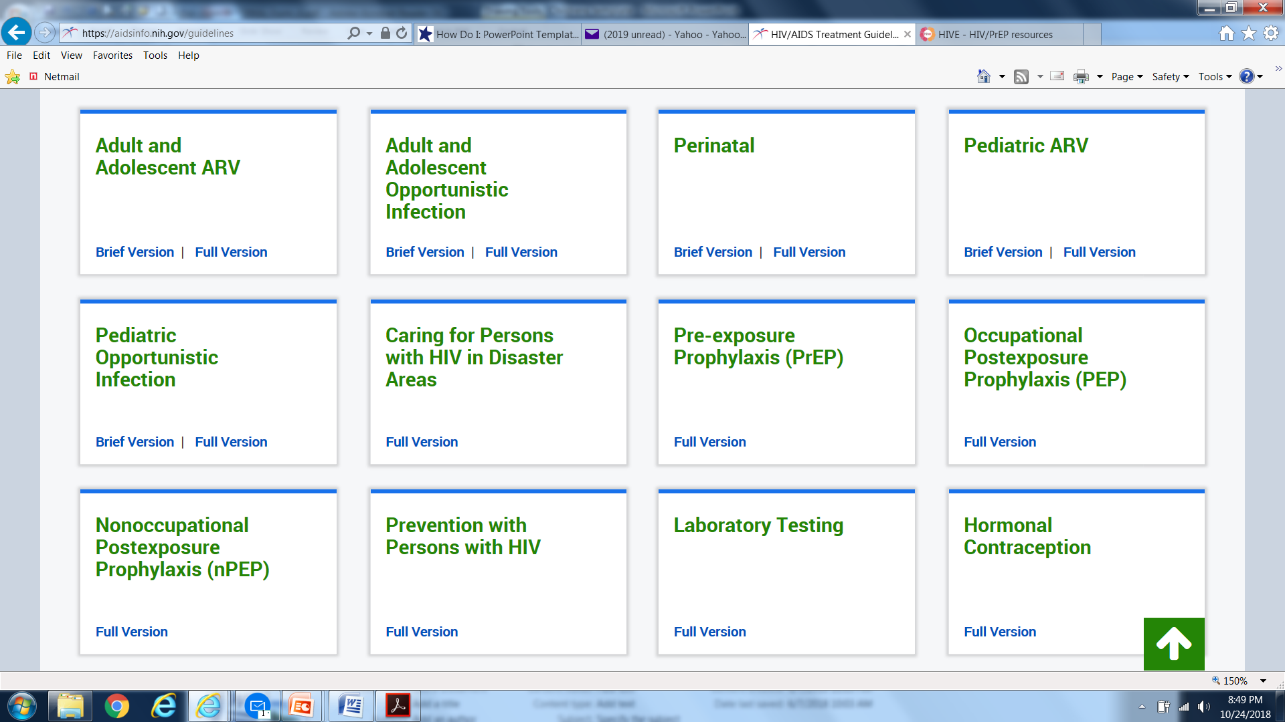
Resources
For guidelines about perinatal HIV
https://aidsinfo.nih.gov/guidelines and select ‘perinatal’

Slide 38
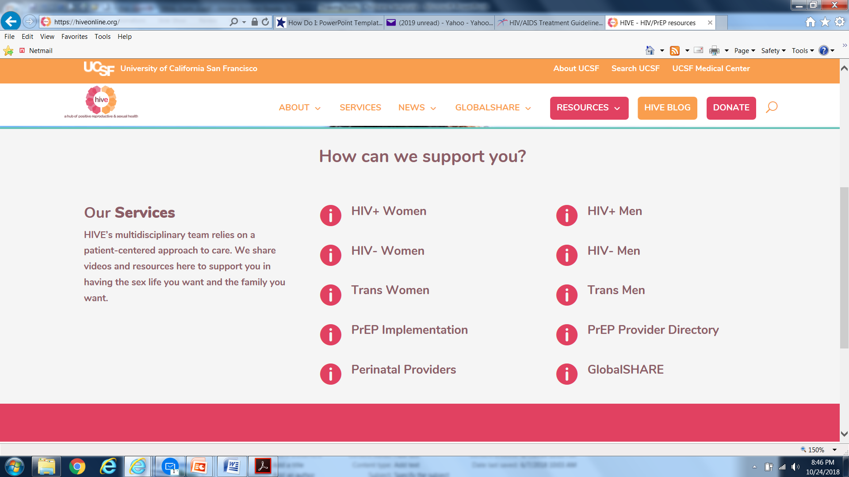
Resources The Hive: ‘Hub of positive reproductive and sexual health’. Patient friendly

Slide 39
Thank you for your time!
Please call or email with questions:
Cheri Booth, RN, MSN, MPH, PHN
Perinatal HIV Nurse Coordinator (612) 387-2989
Cheri.Booth@childrensmn.org
Laura Hoyt, MD
Clinical Director (612) 343-2121
laura.hoyt@childrensmn.org

Slide 40
Obtaining CME/CE Credit
If you would like to receive continuing education credit for this activity, please visit:
http://ryanwhite.cds.pesgce.com

