Slide 2
Training Community Health Workers and Supervisors to Improve Linkage and Retention in HIV Care
Serena Rajabiun, Boston University
Alicia Downes, LMSW
Stephanie Kennedy, CrescentCare

Slide 3
Presenter Disclosers
Serena Rajabiun
Alicia Downes
Stephanie Kennedy
The following personal financial relationships commercial interests relevant to this presentation during the past 12 months:
No relationships to disclose

Slide 4
Learning Objectives
At the conclusion of this activity, the participant will be able to:
1. Describe the core training competencies for CHWs and their supervisors working in HIV care
2. Gain skills on training approaches for CHWs and supervisors
3. Obtain resources for strengthening organizational capacity to integrate CHWs as part of the HIV care team.

Slide 5
Obtaining CME/CE Credit
If you would like to receive continuing education credit for this activity, please visit:
http://ryanwhite.cds.pesgce.com

Slide 6
About the Project
Improving Access to Care: Using Community Health Workers to Improve Linkage and Retention in HIV Care
Funded through the Secretary’s Minority AIDS Initiative Fund (SMAIF)
Administered by HRSA, HIV/AIDS Bureau, Division of Community HIV/AIDS Program (DCHAP)
Boston University funded as the Technical Assistance and Evaluation Center (TAEC) for the project.

Slide 7
Project goals (2016-2019)
Increase the utilization of CHWs to strengthen the health care workforce, improve access to healthcare and health outcomes for racial and ethnic minority people living with HIV (PLWH)
Assist Ryan White HIV/AIDS Program-funded (RWHAP) medical provider sites with the support needed to integrate CHW into an HIV multidisciplinary team model
Develop tools, materials and resources to increase the use of CHWs in health care teams
Evaluate the effectiveness of CHW on linkage and retention in care for PLWH and assess the CHW models implemented by RWHAP providers

Slide 8
Key Project Components
10 Ryan White HIV/AIDS Program funded agencies
Technical Assistance and Training
Learning Sessions
Evaluation

Slide 9
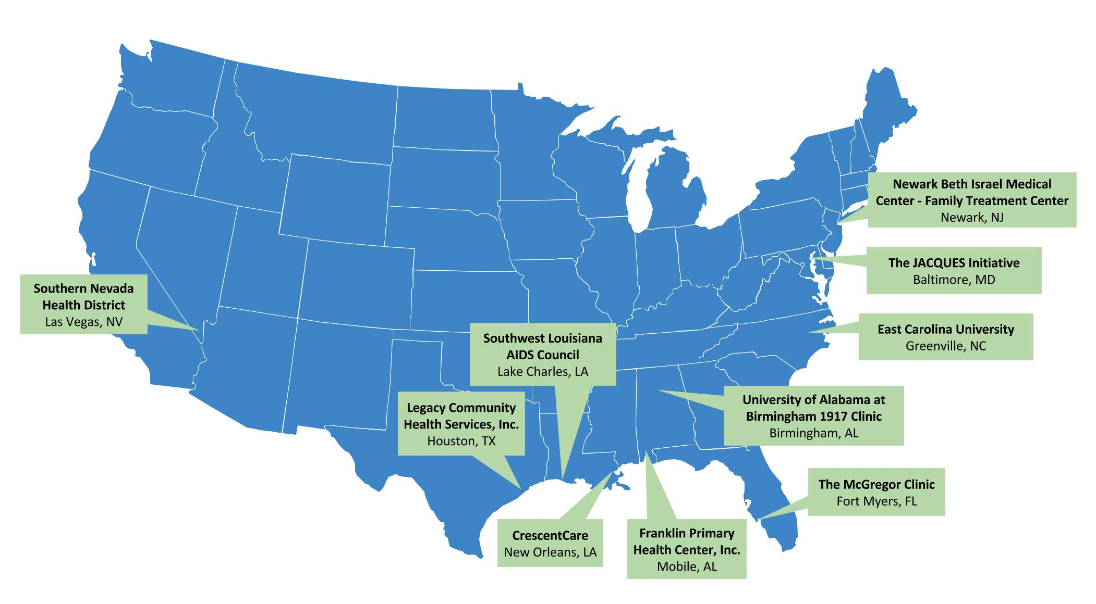
Project sites
Notes:
Ten Ryan White HIV/AIDS program funded agencies were selected to participate in the project.
Each site is implementing its own CHW program and decides its focus population.

Slide 10
Training Program: Goals
Build the knowledge and skills as Community Health Workers & Supervisors to provide quality care and services to people living with HIV/AIDS in our communities
Build the capacity of the HIV care team to integrate CHWs effectively with the goal of achieving the National Goals to end the HIV/AIDS Epidemic
Link the National CHW Association Training (C3) Goals to the Ryan White Program

Slide 11
Training Program
Community Health Worker Training
Aim to provide 64 hours in C3 competencies
16 hours of HIV specialty training
In-person (64 hours)
Facilitated webinar (16 hours)
Supervisor Training
2 day-program for Administrative Supervisors
Continuing Education webinars

Slide 12
Training team

Slide 13
Training Framework
Link HIV and C3 core competencies
Linkage to care
Retention in care
Adherence to treatment
Viral suppression
Based on principles of Popular Education
Self care & evaluation at end of each day

Slide 14
Training Curricula: Sample Topics
CHW Curricula
Role of CHWs in the HIV care team
Communication skills
Cultural Humility
Trauma Informed Care
HIV
Role of CHW in achieving the continuum of care
Educating on HIV and treatment adherence
Stigma and Discrimination
Building community networks and advocacy for people living with HIV
Supervisor Curricula
Role of CHWs in the HIV care team
What does it mean to be a CHW supervisor?
Types of supervision
Trauma informed Supervision
Mentoring & Giving Feedback
Boundaries
CHW involvement on planning councils, advocacy groups

Slide 15
Training & TA Modality
Core In-person 16 hours
Joint sessions with CHWs
Working as a Interdisciplinary team
Supervisor only
Address Supervision cases in real-time
Community of practice Supervision call quarterly
Virtual continuing education (Spring 2019)
Trauma-informed Supervision
Motivational Interviewing Fidelity Monitoring
Mixed method training evaluation

Slide 16
Demonstration: CHW Training Activity

Slide 17
Activity: CHWs & the HIV Care Continuum
Instructions:
Review the C3 roles for a community health worker
Write 3-5 tasks on sticky notes that could improve the HIV Care Continuum outcomes
Place your sticky note on the care continuum
Notes:
Think pair share: Ask participants review the C3 roles that they might do as community health worker and a concrete activity they could do with a person living with HIV/AIDS or in the community to improve the outcomes at each stage. For example, what are things that you do that might help people learn their HIV status?
Write 3-5 tasks on sticky notes that could improve the HIV Care Continuum outcomes
Ask for volunteers to share their CHW role and tasks to achieve the outcomes
Discuss: Did we miss any key task?
Show final slide and refer to C3 Roles
Activity
Have volunteers place their sticky notes on the care continuum
Ask, “What are some tasks that you could work with a person living with HIV individually to achieve the goals of the care continuum?”
Ask, “What are some roles that a CHW could do within the HIV care team and your staff in your agency to on the care continuum?”
Ask, “What are key roles for you as a CHW on the community level to impact the HIV Care Continuum?”
Discussion
Ask, “How do roles and skills relate to HIV care continuum in your region?”
Question and answer

Slide 18
Activity: CHWs & the HIV Care Continuum
What are some tasks that you could work with a person living with HIV individually to achieve the goals of the care continuum?”
What are some roles that a CHW could do within the HIV care team and your staff in your agency to on the care continuum?
What are key roles for you as a CHW on the community level to impact the HIV Care Continuum?
How do roles and skills relate to HIV care continuum in your region?

Slide 19
Demonstration: Supervision Activity

Slide 20
Staying in Your Lane = Boundaries
What are boundaries?
Types of boundaries
Notes:
2. Gain skills on training approaches for CHWs and supervisors
• CHW –Exercise: the HIV Care continuum and examples where community health workers fit 15 minutes (Alicia or Serena)
• Supervisor (Alicia) Exercise on boundaries and confidentiality 15 minutes

Slide 21
Boundaries Activity
Instructions:
Each person gets an activity sheet
You have 5 minutes to complete the activity sheet
Read each scenario and assess how you would respond to each situation:
Always okay
Never okay
Sometimes okay
Debrief the activity

Slide 22
Guidelines for Healthy Boundaries
The following guidelines for healthy boundaries may help CHW set boundaries:
• Stay within the behavioral constraints of the organization’s policies and procedures.
• Be able to articulate what constitutes taking too much responsibility for someone else’s health.
• Discuss openly interactions and reactions in providing CHW support services with supervisors.
• Devote a similar amount of time and effort to each person served while also being aware of the possibility of exceptions when necessary (e.g., a person in crisis).
• Respect your own limits by prioritizing self-care.
What else would you add to the list?
What strategies can you implement to meet these guidelines?
Adapted from SAMHSA Access to Recovery

Slide 23
Application in the field

Slide 24
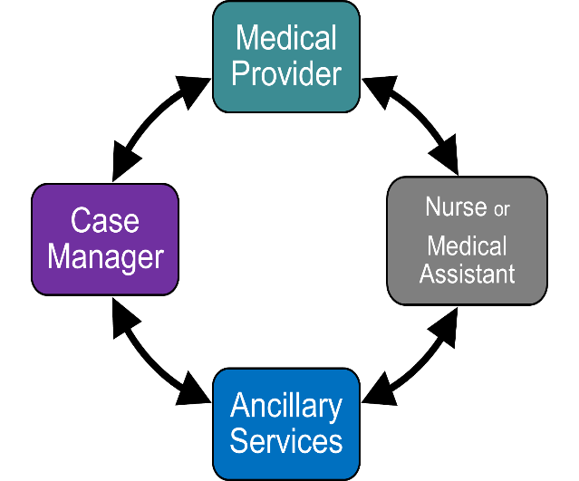
CHW Supervision at CrescentCare
Care Team Approach to HIV Care
CHW
CHW
CLIENT
CHW
CHW

Slide 25
CHW Supervision at CrescentCare
How?
Individual (Supervisor and CHW)
Group (CHW’s and CHW supervisors)
Face to face
When?
Weekly/Monthly Consistency is key!
What/Why?
Discuss successes and opportunities
Discuss challenges with integration
Care coordination/Case consultation

Slide 26
CHW Supervision at CrescentCare
Needs-based Training
Boundaries
Supervisor CHW
CHW Co-worker
CHW Client Boundaries can help empower our clients!
Forum for Supervisors
Identify common challenges in CHW supervision
Idea exchange
Prioritizing self-care for Supervisors (We get tired too, y’all!)

Slide 27
CHW Supervision at CrescentCare
Utilizing CHW and programmatic resources to fill gaps in services
Life Skills for Continued Learning
Life Skills for Continued Learning is a CrescentCare community-based weekly gathering used to learn, share, and connect. It is a people-oriented learning community in which we choose the skills or topics we want to learn about in order to build the power in ourselves to respond to our individual and collective needs. We believe we can never have enough learning and have made it our mission to share skills and information with each other and our communities.
Black Leadership Advisory Committee (B.L.A.C.)
Increased outreach and linkage efforts in the Black community in New Orleans
Strengthening leadership, capacity, and cultural humility within the agency

Slide 28
CHW Supervision at CrescentCare
Lessons Learned
Expect and embrace challenges
Theory ≠ Application
Utilize your resources
Remember your “Why”

Slide 29
Acknowledgments With Thanks to
Alicia Downes, Rosalia Guerrero, Allyson Baughman, Sara S. Bachman, Rachel Bowers-Sword, Maria Campos Rojo, Mari-Lynn Drainoni, Mari-Lynn Drainoni, Serena Rajabiun, Boston University
All the Supervisors & CHWs at Project Sites
CrescentCare, East Carolina University, Franklin Primary Health Center, Inc., Legacy Community Health Services, Inc., Newark Beth Israel Medical Center – Family Treatment Center, Southern Nevada Health District, Southwest Louisiana AIDS Council, The JACQUES Initiative, The McGregor Clinic, University of Alabama at Birmingham-1917 Clinic

Slide 30
Training Evaluation Results

Slide 31
Our CHWs
Race Ethnicity African-American/Black White Other | 81.8% 9.1% 9.1%
Education High school/GED Some College College | 9.1% 63.5% 27.4%
Years as a CHW New More than 3 years | 45.5% 54.5%
Years work/volunteer with PLWH Less than 1 year More than 3 years | 18.2% 81.8%

Slide 32
Supervisors
Race Ethnicity African-American/Black Asian White | 69.2% 7.7% 23.1%
Education Some College College Graduate/Professional School | 23.1% 15.9% 61.5%
Years as a supervisor Less than 3 year more than 3 years | 15.4% 84.6%
Years as supervisor in HV Less than 3 years More than 3 years | 30.8% 69.2%

Slide 33
Evaluation Methodology
Quantitative survey:
Pre survey on Confidence and Comfort with skills
Two post survey: I & 3 months post training event
Qualitative survey:
What three things worked well?
What 3 things could be improved?
What information covered today were most impactful/helpful?
What information do you wish we had covered?

Slide 34
Skills used by CHWs from Training
Reported by CHWS:
Motivational Interviewing Skills
Trauma Informed Care
Mastering Self-Care

Slide 35
Skills used by Supervisors from Training
Reported by Supervisors:
Coaching
giving honest direct feedback and helping 'supervisees' develop strategy to address the issue at hand.
Effective Communication
Active Listening
Boundaries and feedback
Practicing clearer professional boundaries
Strengths Based Feedback

Slide 36
CHW & Supervisor Training- 9/2017

Slide 37
Resources: Summer 2019
Training Curricula
80 hours for CHW
16 hours for Supervisors
Self-paced virtual training
16 hours HIV content
16 hours Supervisor training

Slide 38
Contact Information
Serena Rajabiun
Boston University
Rajabiun@bu.edu
(617) 638-1934
Alicia Downes, LMSW
aliciad8904@gmail.com
(816)304-3000
Stephanie Kennedy
CrescentCare
Stephanie.kennedy@crescentcare.org
(504)821-2601

