Slide 2
Using a Transnational Framework to Improve Engagement in the SPNS Latino Transnational Initiative (101), 12899
John A. Sauceda, Ron Brooks, Patricia Aguado, Martha Guerrero, Manisha Maskay, Natalie A. Solomon-Brimage
University of California, San Francisco, University of California, Los Angeles, Chicago, Prism Health North Texas, & Health Resources and Service Administration

Slide 3
Culturally appropriate interventions of outreach, access, and retention among Latino/a populations.
Goal - A multi-site demonstration and evaluation of culturally-specific service delivery models for Latinos/as living with HIV.
Nine sites designed, implemented, and evaluated their models to identify Latinos/as who are HIV+ and improve their access, timely entry, and retention in HIV care.
  Cities: Los Angeles, Dallas, Chicago, Chapel Hill, New York City, & Philadelphia.
Evaluation and Technical Assistant Center (ETAC) at UC San Francisco – Coordinating the multi-site evaluation and provided technical assistance to the demonstration sites.
A first major adaption of the transnational framework for public health research.

Slide 4
Activities in the Initiative
Each demonstration site selected and tailored their intervention for Mexicans (or Mexican Americans) or Puerto Ricans.
Tailoring activities were specified to be guided by the transnational framework.
  Transnational framework recognizes, acknowledges, and builds upon the connections that Latino/as use to maintain ties to their countries/places of origin while living in the continental U.S.
The ETAC members with relevant expertise provided technical assistant to each site on the application of transnationalism.
Separate members at this research center are conducting a rigorous multi-site evaluation of outcomes along the HIV Care Continuum (linkage, retention and viral suppression) and costs of these ten interventions.

Slide 5
Evaluation of Initiative
Aggregated outcomes assess improvements across the HIV Care Continuum from 2015 to 2018) on 6-month intervals (8 waves).
Qualitative and quantitative data are used to evaluate the effectiveness of these interventions between sites.
Surveys and medical chart data include patient characteristics, intervention exposure (type and amount of service received), individual, interpersonal, and cultural and community- level barriers and facilitators to care, and clinical data.
  Incorporating transnational elements (discussed next) will help move beyond outdated assumptions about Latino/a culture and its influence on health outcomes.
The goal is to conduct a rigorous and standardized evaluation.

Slide 6
Overview of Tailoring Interventions

Slide 7
What is tailoring?
Bernal et al., 2009 - defined cultural tailoring or adaptation as the systematic modification of an evidence-based intervention or protocol to consider language, culture, and context in such a way that it is compatible with the client’s cultural patterns, meanings, and values.
Difficulty is defining what is a cultural pattern, a cultural meaning of some health factor, and properly measuring a person’s cultural values.

Slide 8
The Goal of Tailoring
Initiative – Efficacious interventions were selected and modified for each site.
Challenge – When it is necessary, and how much change is enough or too much.
  ETAC and expertise within each site collaborated to help achieve this balance.
Interventions strived to have balance between tailoring and fidelity to core elements – active ingredients of an intervention.

Slide 9
Avoiding the Pitfalls of Failed Interventions
Sites fully understand their populations, and have diverse research experiences and expertise
ETAC has experts in Latino/a health research and intervention development.
Barrera and Castro (2006) - Interventions “fail to be generalized…because of differences in…”
  A) Engagement- the ability of procedures to reach potential participants and involve them fully;
  B) Outcome – ability of intervention to change targeted variables;
  C) Content and process changes.
Recognize where pitfalls may occur and avoid them.

Slide 10
Transnationalism and Latino/a Cultural Elements
Not all elements of Evidence Based Interventions need to be tailored, just where there is poor fit (i.e., “sources of mismatch”).
Changes should be guided by evidence, (quantitative and qualitative) and judgment.
Adaptation occurs under one of four conditions:
  1) ineffective clinical engagement, which may include not being aware of treatment availability;
  2) entry or enrollment into treatment, participating in treatment or clinical trials and activities;
  3) issues of retention and completion of treatment, unique risk or resilience factors: adding new features or deleting features;
  4) unique symptoms of a common group.

Slide 11
Ecological Validity Model
Language
Context
Persons
Methods
Culturally
Sensitive
Elements
Metaphors
Goals
Content
Concepts
Notes:
Source: Bernal et al., 2009
The first known framework proposed in the literature is the
ecological validity model (Bernal et al., 1995). This model, which
was originally conceptualized for Latino populations, consists of
eight dimensions of interventions (language, persons, metaphors,
content, concepts, goals, methods, and context)

Slide 12
Overview of Transnationalism in the Latino SPNS Initiative

Slide 13
Outline
Defining transnationalism
Transnational:
  Social spaces
  Life
  Practices
  Social transformation
Influences on transnational practices
Transnational Exploration Tool
Integrating transnationalism into HIV care interventions

Slide 14

Transnationalism
Defined as “the processes by which immigrants forge and sustain multi-stranded social relations that link together their societies of origin and settlement.”
Framework to describe immigrants who maintain long-term and psychological ties to their place of origin.
Sources: Basch et al., 1994, p. 6, Mouw et al., 2014
Notes:
Since the early 1990s, transnationalism has been adapted as a theoretical framework across various disciplines such as sociology and anthropology for undertaking research on immigrant populations. It gained momentum because of its focus on the trans-border and transnational activities of immigrant populations.
Defined as “the processes by which immigrants forge and sustain multi-stranded social relations that link together their societies of origin and settlement.” (basch et al. (1994, p. 6) in Levitt et al., 2007).
Transnationalism gained popularity among researchers as a way to describe immigrants who maintain long-term and psychological ties to their place of origin (Mouw et al., 2014).

Slide 15
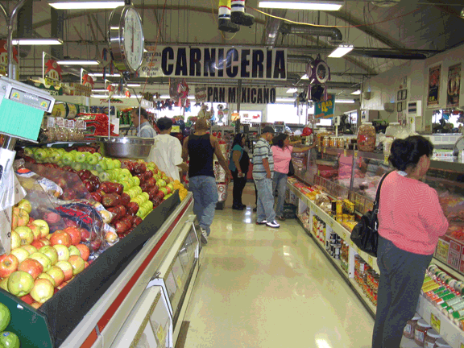
Transnational Social Spaces/Fields
“The transnational social field is constructed through the daily life and activity of immigrants affecting all aspects of their life, from their economic opportunities, to their political behavior, to their individual and group identities.”
José Itzigsohn et al. 1999. “Mapping Dominican Transnationalism: Narrow and Broad Transnational Practices.” Ethnic and Racial Studies 22, no.2: 316-339.
Levitt 2001; Levitt & Glick Shiller, 2004; Levitt et al., 2007; Pries, 2005; Smith, 2005
Notes:
“The transnational social field is constructed through the daily life and activity of immigrants affecting all aspects of their life, from their economic opportunities, to their political behavior, to their individual and group identities.”

Slide 16
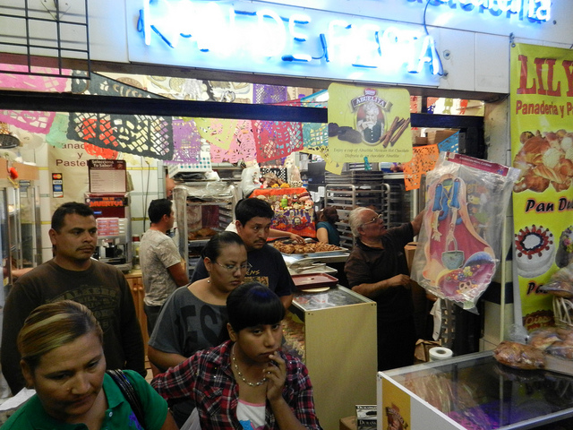
Transnational Social Spaces/Fields
The social space emphasizes the importance of considering the broader social world surrounding an individual migrant in both the sending and host countries.
Sources: Levitt et al., 2007; Levitt 2001
Notes:
The social space emphasizes the importance of considering the broader social world surrounding an individual migrant in both the sending and host countries.
Recent scholarship understands transnational migration as taking place within fluid social spaces that are constantly reworked through migrants’ simultaneous embeddedness in more than one society (Levitt & Glick Schiller 2004, Pries 2005, Smith 2005). (Source: Levitt et al., 2007).
The social space emphasizes the importance of considering the broader social world surrounding an individual migrant in both the sending and host countries.

Slide 17

Transnational Life
Transnational life is used to include practices and relationships that link migrants and their children with their country of origin, where such practices have significant meaning and are regularly observed.
Immigrants use their transnational connections as a primary point of reference that informs their cultural understandings
Transnational connections and activities also compel immigrants to deeply assess the cultures that exist in their country of origin and compare them with those that they perceive as the prevailing culture of the host country.
Carrillo, 2012; Levitt et al., 2007; Smith, 2006
Notes:
Transnational life is used to include practices and relationships that link migrants and their children with their country of origin, where such practices have significant meaning and are regularly observed.
Immigrants use their transnational connections as a primary point of reference that informs their cultural understandings and shapes those of their children.
Transnational connections and activities also compel immigrants to deeply assess the cultures that exist in their country of origin and compare them with those that they perceive as the prevailing culture of the host country.

Slide 18
Transnational Practices
Transnationalism is best exemplified by the cross-border activities, practices and attachments of immigrants.
Transnational practices can include informal and formal social, political, economic, cultural and religious practices.
Migrants will engage in selective transnational practices, usually in response to particular life events.
Most migrants are occasional transnational activists.
Levitt, 2014; Levitt et al., 2007;
Notes:
Transnationalism is best identified by the cross-border activities, practices and attachments of immigrants.
Transnational practices can include informal and formal social, political, economic, cultural and religious practices.
Migrants will engage in selective transnational practices, usually in response to particular life events such as economic downturn in place of origin, life cycle events such as marriage or illness, or climatic disasters
Most migrants are occasional transnational activists. At some stages in their lives they are more focused on their countries of origin while at others they are more involved in their countries of reception.

Slide 19
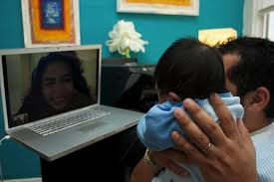
Transnational Practices
Communication
One of the basic ways in which immigrants maintain ties with their home countries is through contact with relatives and/or friends and associates.
Technologies and social media (e.g., email, Skype, Facebook) have helped to increase the intensity of this activity.
Murphy, 2004
Notes:
Communication with relatives and/or friends and associates is one of the basic ways in which immigrants maintain strong ties with their home countries. For many immigrants this communication happens on a regular basis.
And it is the advances in communication technology and social media (e.g., email, Skype, Facebook) that have really helped to increase the intensity of this transnational practice.

Slide 20
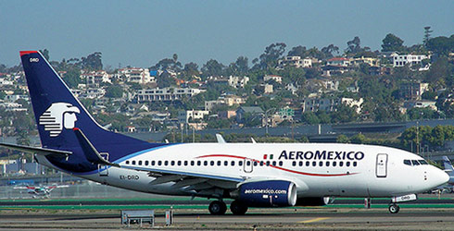
Transnational Practices
Travel
Maintaining social ties may also involve traveling back home to visit family and friends, or providing assistance to family and friends to visit.
Murphy, 2004
Notes:
Travel: In order for immigrants to maintain social ties may travel back home to visit family and friends, or provide assistance to family and friends to visit.

Slide 21
Transnational Practices
Economic and Social Remittances
Money send by migrants to their homeland may be used individually or collectively. They may support family members who stay behind; fund small and large businesses; support public works and social service projects in sending communities.
  Social remittances (e.g., ideas, norms, practices, and identities) may flow back from place of settlement to place of origin
Levitt et al., 2007
Notes:
Families will send money to family members who have stayed behind.
Money send by migrants to their homeland may be used individually or collectively. They may support family members who stay behind; fund small and large businesses; support public works and social service projects in sending communities.
Social remittances (e.g., ideas, norms, practices, and identities) may flow back from place of settlement to place of origin

Slide 22
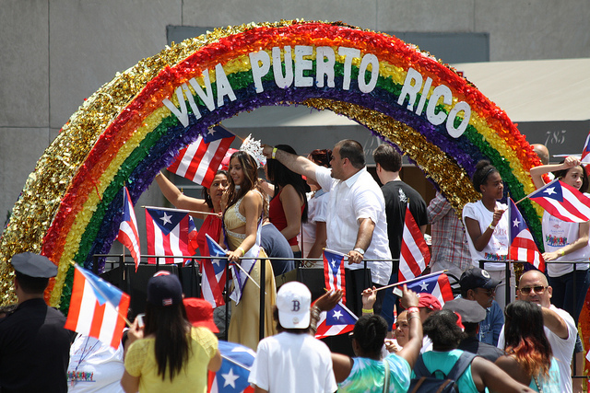
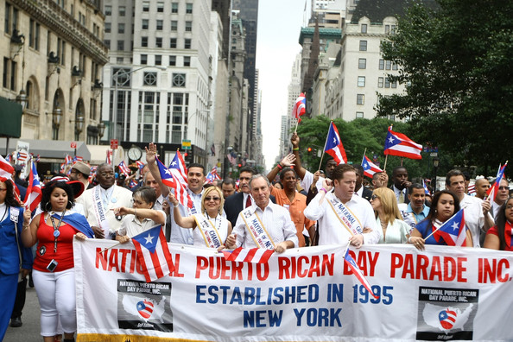
Transnational practices
Politics
Migrants’political transnational practices can include a variety of activities such as electoral participation, membership in political associations, parties or campaigns in two different countries.
Levitt et al., 2007

Slide 23
Transnational Practices
Social Transformation
Transnational migration influences transformations in family structure that inform constructions of class, gender and race.
  Research in this area has focused on living arrangements, finances, and generational reproduction in the everyday lives of transnational families.
Levitt et al., 2007; Viruell-Fuentes, 2006
Notes:
Transnationalism (that is living in a different society with different cultural values) creates social transformation among immigrant popuations.

Slide 24
What Influences Transnationalism?
Length of time in the U.S.
Greder et al. (2009) found that Latino immigrants who most engaged in transnational activities were also those who had lived in the United States for the least amount of time.
  Those Latinos who had lived in the U.S. for the longest amount of time had the lowest amounts of engagement in transnational activities.

Slide 25
What Influences Transnationalism?
Generational impact
Transnational practices and attachments have been and continue to be widespread among the first generation, but few researchers think these ties persist among subsequent generations.
  Transnational activities will not be central to the lives of most of the second or third generation, and they will not participate with the same frequency and intensity as their parents.
Levitt et al., 2007; Pries, 2004
Notes:
Generational impact: Many scholars of migration now accept that transnational practices and attachments have been and continue to be widespread among the first generation, but far fewer think these ties persist among subsequent generations.
Clearly, transnational activities will not be central to the lives of most of the second or third generation, and they will not participate with the same frequency and intensity as their parents. But the same children who never go back to their ancestral homes are frequently raised in households where people, values, goods, and claims from somewhere else are present on a daily basis. (Pries 2004)(Source: Levitt et al., 2007).

Slide 26
Transnational Exploration Session and Tool
Notes:
The ETAC created a Transnational Exploration Tool to help intervention staff explore participants’ transnational identity.

Slide 27
Transnational Exploration Session/Tool
Sound measurement requires systematic collection of discrete constructs – Designed to capture a level of transnationalism.
This tool was used to explore…to learn about or familiarize oneself with a person’s Transnational Profile – or spark new ways of collecting this information.
The Transnational Profile was a source of information for:
  Intervention staff to incorporate into their intervention (in ways useful to them);
  To understand the facilitators and barriers to linkage and engagement in HIV care, ART adherence and clinical outcomes.
  And promote acceptability and fit of the intervention.

Slide 28
Transnational Exploration Session/Tool
An example:
Step 1: Client is eligible and consents to participate.
Step 2: At intake, interventionist and client work through the Transnational Exploration Checklist.
Step 3: Interventionist summarizes client’s profile in their own words, adds to their notes, and uses this information through their contact with the client to problem solve.

Slide 29
Integrating transnationalism into HIV care interventions
Understanding a participant’s level of transnational identity.
Recognizing the points of reference of participants regarding their health beliefs and health care seeking behaviors (e.g., place of origin or settlement)
Understanding who in the lives of HIV+ participants knows their status. Do they disclose to family/friends from their place of origin?
Notes:
Having basic information related to transnationalism will allow intervention facilitators to tailor the intervention to meet the needs of participants who are highly transnational.

Slide 30
Integrating transnationalism into HIV care interventions
Recognizing the importance of transnational connections to support their current HIV health care behaviors (e.g., retention in medical care and medication adherence)
Helping participants address the issue of HIV disclosure with transnational social support members (e.g., family and friends in place of origin).
Help participants adapt their health care beliefs and behaviors to the available U.S. HIV health care model
Notes:
Recognizing the importance of transnational connections for social support for current HIV health care behaviors (retention in medical care and medication adherence).
Help participants address the issue of HIV disclosure with transnational social support members (e.g., family and friends in place of origin).
Help participants adapt their health care beliefs and behaviors to the available U.S. HIV health care model when a participant’s point of reference about health care is their place of origin (e.g., participant does not feel respected or understood by U.S. medical providers and believes he or she would receive better care in place of origin, or there is a mismatch between U.S. providers’ and immigrant consumers’ expectations of health care provision).
These are just a few ways transnationalism was integrated into the interventions.

Slide 31
From Theory to Application: A Description of Transnationalism in Culturally-Appropriate HIV Interventions of Outreach, Access, and Retention Among Latino/a Populations. Journal of Immigrant Minority Health, May 2018
Thank You!
This project is/was supported by the Health Resources and Services Administration (HRSA) of the U.S. Department of Health and Human Services (HHS) under grant number U90HA26507, Special Projects of National Significance (SPNS) Culturally Appropriate Interventions of Outreach, Access and Retention Among Latino/a Populations Initiative Evaluation and Technical Assistance Center, in the amount of $2,151,872 awarded to the University of California, San Francisco. This information or content and conclusions are those of the author and should not be construed as the official position or policy of, nor should any endorsements be inferred by HRSA, HHS or the U.S. Government.
Questions?
Notes:
For more information about application of transnationalism in these interventions please see our publication:
From Theory to Application: A Description of Transnationalism in Culturally-Appropriate HIV Interventions of Outreach, Access, and Retention Among Latino/a Populations. Journal of Immigrant Minority Health, May 2018

Slide 32
References
Basch L, Glick Schiller N, Blanc-Szanton C, eds. 1994. Nations Unbound: Transnational Projects, Postcolonial Predicaments, and Deterritorialized Nation-States. London: Gordon & Breach.
Duany, J. (2003). Nation, migration, identity: The case of Puerto Ricans. Latino Studies, 1, 424-444.
Duany, J. (2011). Blurred borders: Transnational migration between the Hispanic Caribbean and the United States. Chapel Hill: The University of North Carolina Press.
Greder K, et al. (2009). Exploring relationships between transnationalism and housing and health risks of rural Latino immigrant families, Family & Consumer Sciences Journal, 34(2), 186-206
Kessing L L, Norredam M, Kvernrod A, et al. (2013). Contextualising migrants' health behaviour - a qualitative study of transnational ties and their implications for participation in mammography screening. BMC public health, 13, 431-.

Slide 33
References Cont.
Levitt P, Glick Schiller N. 2004. Conceptualizing simultaneity: a transnational social field perspective on society. Int. Migr. Rev. 38:1002–39.
Levitt P. 2001. The Transnational Villagers. Berkeley: Univ. Calif. Press.
Levitt P. 2004. I feel I am a citizen of the world and of a church without borders: the Latino religious experience. Presented at Lat. Past Influence, Future Power. Conf. Tomas Rivera Policy Inst., Jan. 31–Feb. 1, Newport Beach, CA.
Levitt, P & Jaworsky N. (2007). Transnationalism migration studies: past developments and future trends. Annual Review of Sociology, 33, 129-156.
Menjıvar C. 2002a. Living in two worlds? Guatemalan-origin children in the United States and emerging transnationalism. J. Ethn. Migr. Stud. 28:531–52.

Slide 34
References Cont.
Murphy, E J, & Mahalingam, R. (2004). Transnational ties and mental health of Caribbean immigrants. Journal of immigrant health, 6(4), 167-78.
Parrenas RS. 2001. Servants of Globalization: Women, Migration and Domestic Work. Stanford, CA: Stanford Univ. Press
Pries L. 2004. Determining the causes and durability of transnational labour migration between Mexico and the United States: some empirical findings. Int. Migr. 42:3–39
Pries L. 2005. Configurations of geographic and societal spaces: a sociological proposal between ‘methodological nationalism’ and the ‘spaces of flows.’ Global Netw. 5:167–90
Sánchez, L. (2009). The new Puerto Rico?: Identity, hybridity and transnationalism within the Puerto Rican diaspora in Orlando, Florida. VDM Verlag.

Slide 35
References Cont.
Sanon, M, Spigner, C, & McCullagh, M C. (2014). Transnationalism and Hypertension Self-Management Among Haitian Immigrants. Journal of transcultural nursing,
Smith MP. 2005. Transnational urbanism revisited. J. Ethn. Migr. Stud. 31:235–44.
Smith RC. 2006. Mexican New York: Transnational Lives of New Immigrants. Berkeley: Univ. Calif. Press.
Stone, E., Gomez, E., Hotzoglou, D., & Lipnitsky, J. Y. (2005). Transnationalism as a motif in family stories. Family Process, 44(4), 381–398.
Tamaki, E. (2011). Transnational Home Engagement among Latino and Asian Americans: Resources and Motivation. The International migration review, 45(1), 148-173.
Viruell Fuentes, E A, & Schulz, A J. (2009). Toward a dynamic conceptualization of social ties and context: implications for understanding immigrant and Latino health. American journal of public health, 99(12), 2167-75.

Slide 37

Proyecto Promover
Patricia Aguado, PhD, LCSW
The Core Center/ Hektoen Institute for Medical Research

Slide 38

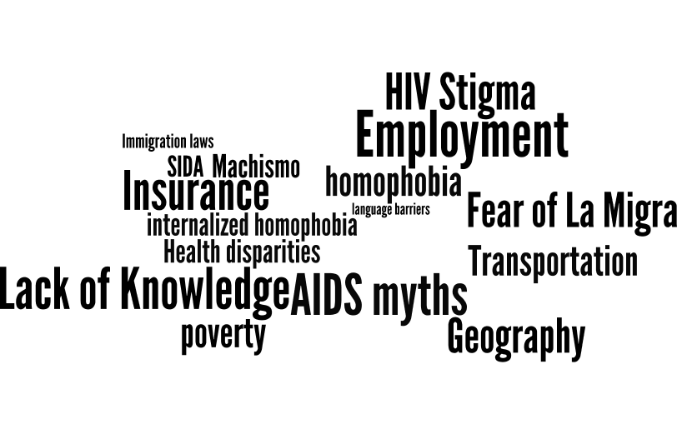
Perceived HIV Care Barriers
BARRIERS
Fatalismo
Isolation
Stigma/Fear
Hopelessness
SECRETS
Denial
Anger
Competing Responsibilities
Shame
Remordimiento
Notes:
What types of mental health/stigma/substance use issues have come up for them?
Shame: overarching issue is stigma (internalized and anticipated)- HIV associated with reduced self confidence and self esteem.
Feelings of worthlessness or/and guilt; what will people think? J
Judgment? Self hatred- Men who often have at times felt shame over their sexual behaviors/ MSM and then interpret HIV as the “consequence” or “punishment” for engaging in MSM. Many of our patients have not disclosed their sexual orientaion which makes it especially difficult to disclose dx as they will be asked how they were infected? Which opens up a uncomfortable dialogue about sexuality…. Leading to more secrets and burden…..
Hopelessness: Negative world view of future; no relationship potential “who will love me?” “No one will love me with this.”
Nervios-Anxiety- Fear: Disclosure -rejection by potential partners, family, friends, dying, becoming sick, who will take care of me? Who will take care of my family?
Anger: internal and external- at times men have disclosed not caring about engaging in safer sex as they want to hurt others the way they have been hurt.
Risky Behaviors: Increased promiscuity -No sence in using protection when one is already positive
Abrupt dis-engagemnet
People will be able to physicall tell I am sick/ infected???
Social Isolation: Withdraw from family and friends; decreased participation in activities that used to bring joy to life (playing soccer, clubbing/ partying with friends, working on cars…)
Need to fit in aggression or anger as a way of coping- further impacts social relationships-: social isolation for fear that people will know they are positive
Minimize/ deny issues: everything is ok; I’m fine; won’t talk about feelings; shuts down: contradictions in charla discussion (I’m coping well…..when you try to explore coping skills- they have a difficult time talking about feelings, tied to machismo, not used to exposing vulnerability.. Experiences have not modeled showing vulnerability; grown up in culture where to be a man you don’t show emotion.
Secrets: disclosure burden- Emotional/physical Burden of disclosure on family; and pt…do not want others to worry, fear that family will not be able to handle it “my mother is old, she’ll get sick if I tell her”…… this then leads to guilt because they are lying/ withholding….. This is part to their compartmentalized life where you are one thing with one and another with others
“REMORDIMIENTO”

Slide 39
Proyecto Promover
Intervention Overview
Community
Social marketing
Testing
Community charlas
Clinic
One-on-one clinical Patient Navigation (Charlas & Check-Ins); five intervention sessions
Support
Knowledge
Self management
Target: Mexican identified individuals of all sexual and gender identities in the Chicago EMA.

Slide 40

Migration history, diagnosis experience, identity, social support and connections to Mexico beginning exploration around disclosure, HIV knowledge, work lives, current living situation, early healthcare and HIV care experiences, treatment planning, barriers assessment
Charla 1
Notes:
CHARLAS : 5 series, one on one, 60 minute culturally tailored discussions to identify and address structural and psychological barriers to care…to increase support, knowledge, self-management to increase adherence in care and improved health outcomes
Charla – build relationship with patient, explore factors in their livves – many of which are cultural and transnational, then engage in collaborative treatment planning and aimed at individualized support and education
So conversations help to connect with patients and guide conversation, vehicle of connections and rapport, validate, reinforce strengths
(de) emphasize aspects of the charlas (care and benfits knowledge concerns – id’d from barriers inventory cue navigator to focus more on orientation to care, case management, provider patient relationship; )
Isolation – social support global, fragmented self, internalized stigma,
Presenting a contrary model to what they are expecting –

Slide 41
Structured and unstructured Interviewing around substance use, depression, PTSD, trauma and violence
Charla 2
Notes:
CHARLAS : 5 series, one on one, 60 minute culturally tailored discussions to identify and address structural and psychological barriers to care…to increase support, knowledge, self-management to increase adherence in care and improved health outcomes
Charla – build relationship with patient, explore factors in their livves – many of which are cultural and transnational, then engage in collaborative treatment planning and aimed at individualized support and education
So conversations help to connect with patients and guide conversation, vehicle of connections and rapport, validate, reinforce strengths
(de) emphasize aspects of the charlas (care and benfits knowledge concerns – id’d from barriers inventory cue navigator to focus more on orientation to care, case management, provider patient relationship; )
Isolation – social support global, fragmented self, internalized stigma,
Presenting a contrary model to what they are expecting –

Slide 42
Stigma & Disclosure (partners, family, friends); may include role play
Charla 3-4
Notes:
CHARLAS : 5 series, one on one, 60 minute culturally tailored discussions to identify and address structural and psychological barriers to care…to increase support, knowledge, self-management to increase adherence in care and improved health outcomes
Charla – build relationship with patient, explore factors in their livves – many of which are cultural and transnational, then engage in collaborative treatment planning and aimed at individualized support and education
So conversations help to connect with patients and guide conversation, vehicle of connections and rapport, validate, reinforce strengths
(de) emphasize aspects of the charlas (care and benfits knowledge concerns – id’d from barriers inventory cue navigator to focus more on orientation to care, case management, provider patient relationship; )
Isolation – social support global, fragmented self, internalized stigma,
Presenting a contrary model to what they are expecting –

Slide 43
Lessons learned; areas for on-going consideration; referrals as needed
Charla 5
Notes:
CHARLAS : 5 series, one on one, 60 minute culturally tailored discussions to identify and address structural and psychological barriers to care…to increase support, knowledge, self-management to increase adherence in care and improved health outcomes
Charla – build relationship with patient, explore factors in their livves – many of which are cultural and transnational, then engage in collaborative treatment planning and aimed at individualized support and education
So conversations help to connect with patients and guide conversation, vehicle of connections and rapport, validate, reinforce strengths
(de) emphasize aspects of the charlas (care and benfits knowledge concerns – id’d from barriers inventory cue navigator to focus more on orientation to care, case management, provider patient relationship; )
Isolation – social support global, fragmented self, internalized stigma,
Presenting a contrary model to what they are expecting –

Slide 44
Proyecto Promover Key Ingredients
Culturally Tailored Discourse
Flexibility and Accessibility
Education

Slide 45
Transnational Integration Strategy
ID Cultural Strengths & Weaknesses
Exploration of support & barriers to retention
Storytelling
Relationship
Mirroring Cultural Values
Exploring identity in migration story
Culturally Tailored
Discourse
Notes:
Culturally Tailored Approach
Mirroring Personalismo/confianza/Familismo/Respeto
Building Relationship and rapport
Acknowledging the importance of personal stories
Exploring individuals support and barriers to retention
Identifying cultural strengths and weaknesses
Normalizing HIV status
Culturally Tailored Support
Being knowledgeable about important beliefs in the Mexican community like personalismo, familismo, confianza, and respeto helped with relationship building and rapport among the CPN and participant.
It was further solidified with acknowledging the participants story and emphasizing their resilience.
We also identified cultural strengths and weaknesses which allowed the participant to look at their HIV in a different perspective and create a new normal which resulted in retention in care.

Slide 46
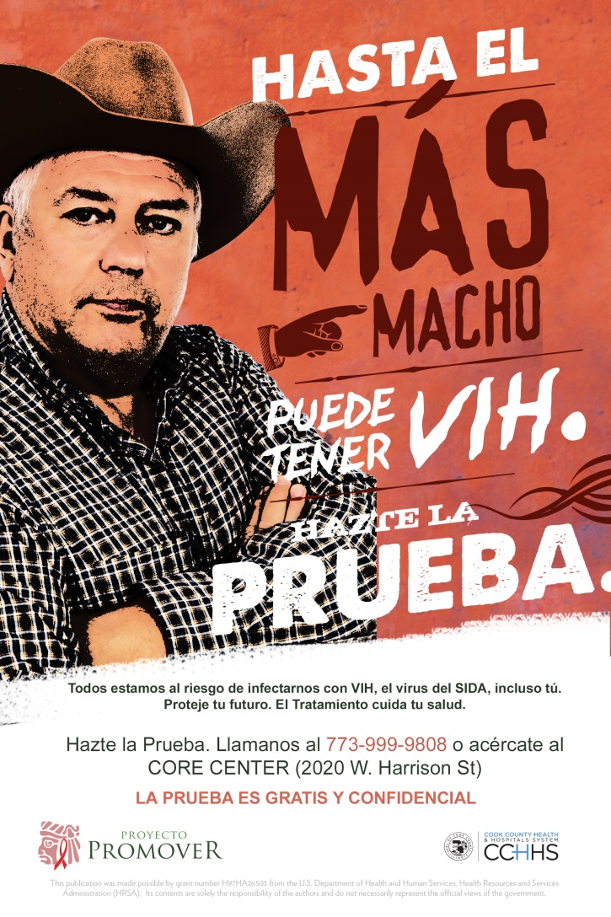
Transnational Exploration of Barriers
Barriers to HIV Care Assessment- 24 Q.
  Unaware of Resources
  Assumptions about Medical Care
  Coping with HIV diagnosis or treatment
  Stigma of HIV
Assessment of Migration History Stressors
  Open ended questions related to migration decision
  Current experience as a Mexican national living in US
Notes:
The relationship between CPN and pt is at the core of our intervention. Building rapport > building trust > it is the relationship that allows for the intervention movement and knowledge building
Integration of Migration story help to establish rapport and understand barriers to retention as it gives us insight as to health care seeking practices in Mexico, migration trauma and how that influences care in the US.
Migration story helps us understand:
How people are still connected to Mexico?
How and if their migration influences their life today?
The good and bad of migration
Reflection on their life today

Slide 47

Perceived HIV Care Barriers
Stigma
Lack of
knowledge
Fear
Fatalism
Not feeling sick
Notes:
Perceived Barriers to Initiate HIV Care
barriers to healthcare scale adapted from a previous SPNS project (see Eastwood , 2015) and initially adapted from Patel and colleagues (2008).
Cervantes, R. C., Padilla, A. M., & Salgado de Snyder, N. (1991). The Hispanic stress inventory: A culturally relevant approach to psychosocial assessment. Psychosocial Assessment: A Journal of Consulting and Clinical Psychology, 3, 438-447.
Eastwood, E.A., Fletcher, J., Quinlivan, E.B., Verdecias, N., Birnbaum, J.M., Blank. A. (2015). Baseline social characteristics and barriers to care from a Special Projects of National Significance Women of Color with HIV Study: A comparison of urban and rural women and barriers to HIV care. AIDS Patient Care and STDs, 29, Supplement 1, S4-S10.
Patel S, Weiss E, Chhabra R, et al. The Events in Care Screening Questionnaire (ECSQ): A new tool to identify needs and concerns of people with HIV/AIDS. AIDS Patient
Care STDs 2008;22:381–393.
Preliminary data – we still need to explore factors but are here conceptually grouping…for instance there are a number of items we believe related to stigma
So far it appears that
Stigma
Lack of knowledge
Fear
Fatalism
Not feeling sick
Are common barriers….
Have baseline survey data write up on hand (printed) if you want to provide some examples

Slide 48
Transnational Integration Strategy
Design around competing responsibilities
Communication
Scheduling
Work Hours
Engagement in Community
Flexibility and Accessibility
Notes:
Culturally Tailored Approach
Mirroring Personalismo/confianza/Familismo/Respeto
Building Relationship and rapport
Acknowledging the importance of personal stories
Exploring individuals support and barriers to retention
Identifying cultural strengths and weaknesses
Normalizing HIV status
Culturally Tailored Support
Being knowledgeable about important beliefs in the Mexican community like personalismo, familismo, confianza, and respeto helped with relationship building and rapport among the CPN and participant.
It was further solidified with acknowledging the participants story and emphasizing their resilience.
We also identified cultural strengths and weaknesses which allowed the participant to look at their HIV in a different perspective and create a new normal which resulted in retention in care.

Slide 49
Transnational Integration Strategy
Harness Coping Skills to Engage in Care
Tailored Education
Human Rights
Psycho, Social, Structural,
Education
Notes:
Culturally Tailored Approach
Mirroring Personalismo/confianza/Familismo/Respeto
Building Relationship and rapport
Acknowledging the importance of personal stories
Exploring individuals support and barriers to retention
Identifying cultural strengths and weaknesses
Normalizing HIV status
Culturally Tailored Support
Being knowledgeable about important beliefs in the Mexican community like personalismo, familismo, confianza, and respeto helped with relationship building and rapport among the CPN and participant.
It was further solidified with acknowledging the participants story and emphasizing their resilience.
We also identified cultural strengths and weaknesses which allowed the participant to look at their HIV in a different perspective and create a new normal which resulted in retention in care.

Slide 50
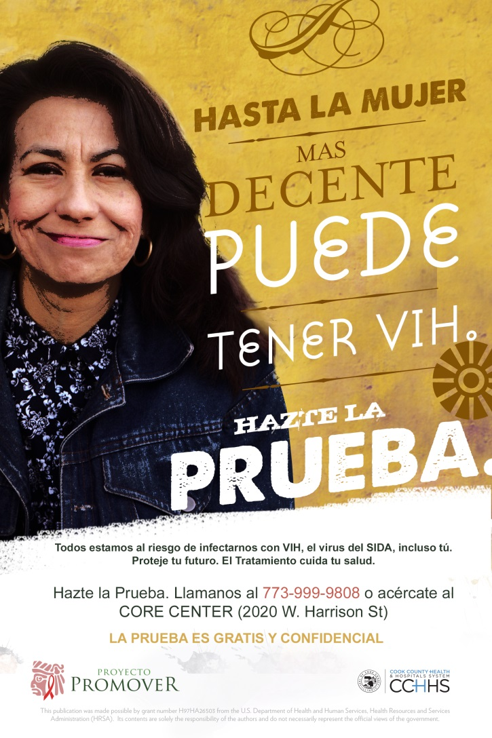
Retention (MSE) Snapshot
 | Clients Enrolled
Total Enrollment | 114
Baseline | 96% (109/114)
6-month MSE | 82% (94/114)
12-month MSE | 68% (78/114)
18-month MSE | 55% (63/114)
24-month MSE Completion | 30% (34/114)
80% (90/114) of participants completed the patient navigation intervention
Notes:
Not statistically significant but a noted gap here that is on clinical importance…

Slide 51
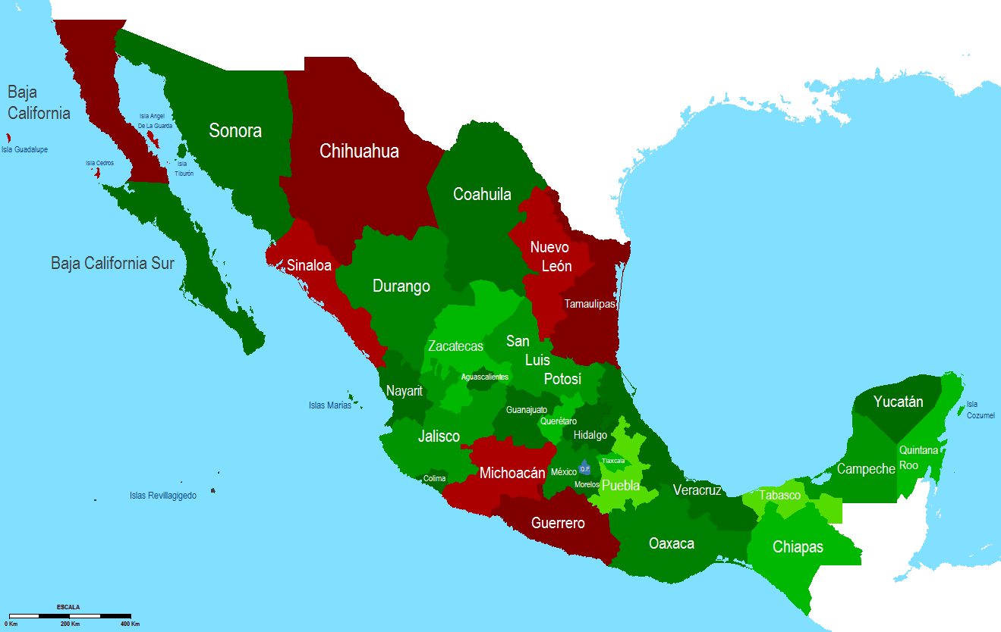
Migration
Michoacán | 15
Guerrero | 12
Jalisco | 8
Morelos | 7
Mexico City/ D.F. | 6
Puebla | 5
Estado de Mexico | 4
Veracruz | 3
Durango; San Luis Potosi; Guanajuato; Zacatecas | 2
Cuernavaca; Nuevo Leon; Monterey; Chiapas; Baja California; Oaxaca; Yucatan | 1
Notes:
Of the 77 participant whose Mexican origin is known, the overwhelming majority are coming from the Lower and Central Regions of Mexico;

Slide 52
Retention in Intervention & Care
 | Enrollment (Percent of Total Enrollment) | Patient Navigation Intervention Completion (% by subgroup) | Baseline Suppression | 12-month Retention in Care | 12-month Retention Adjusted for Retention in Intervention | 12-month Suppression < 200 | 12-month Suppression Adjusted for Retention in Care & Intervention
Clients Enrolled | 114 | 80% (90/114) | 11% (12/114) | 80% (91) | 96% (86/90) | 73% (83) | 86% (74/86)
Newly Diagnosed | 55% (63/114) | 81% (51/63) | 5% (3/63)ª | 84% (53/63) | 98% (50/51) | 80% (50/63) | 94% (47/50)^{b}
Out-of-Care | 45% (51/114) | 77% (39/51) | 18% (9/51)ª | 75% (38/51) | 92% (36/39) | 65% (33/51) | 75% (27/36)^{b}
Male | 90% (103/114) | 78% (80/103) | 10% (10/103) | 79% (81/103) | 96% (77/80) | 72% (74/103) | 87% (67/77)
Women | <10 | - | - | - | - | - | -
Transgender Woman | <10 | - | - | - | - | - | -
Notes:
Sig dif as expected in baseline suppression by care continuum status. Returning to care participations more likely to be suppressed when compared to newly diagnosed
(ª Chi square 4.97, p <.05).
12 mo retention in care (unadjusted) Not statistically significant but a noted gap here btwn newly diagnosed and out of care folks that is of clinical importance…gap appears to disappear for those engaged in the patient navigation intervention.
Important differences in suppression by care continuum status. Trend (p<.10) in unadjusted rate and sig dif in adjusted rate (^{b} Chi square 6.29, p <.05); however important/clinically sig gains made for those retained in care and intervention.

Slide 53
Retention & Suppression

Slide 54
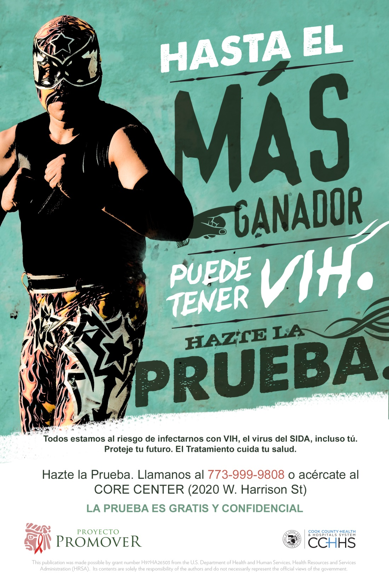
Transnational Integration
Charlas are a culmination of…
  Personal rapport in a safe, familiar space
  Identification of cultural strengths and weaknesses
  Barriers: Identification, validation and amelioration
  Discourse with a trusted person
  Patient-centered…..

Slide 55
Thank You..
This project is/was supported by the Health Resources and Services Administration (HRSA) of the U.S. Department of Health and Human Services (HHS) under grant number #H97HA26503, Special Projects of National Significance (SPNS) Culturally Appropriate Interventions of Outreach, Access and Retention Among Latino/a Populations Initiative Evaluation and Technical Assistance Center, in the amount of $????? awarded to the Ruth M. Rothstein Core Center, Hektoen Institute for Medical Research. This information or content and conclusions are those of the author and should not be construed as the official position or policy of, nor should any endorsements be inferred by HRSA, HHS or the U.S. Government.

Slide 58
Operationalizing the Transnational Framework and Recommended Best Practices
Manisha H. Maskay, PhD
Principal Investigator / Prism Health North Texas
Martha A. Guerrero, BA
Viviendo Valiente Program Director / Prism Health North Texas

Slide 59
HRSA Statement
This project is/was supported by the Health Resources and Services Administration (HRSA) of the U.S. Department of Health and Human Services (HHS) under H97HA26497, Special Projects of National Significance (SPNS) Culturally Appropriate Interventions of Outreach, Access and Retention Among Latino/a Populations Initiative, in the amount of $1,489,500. This information or content and conclusions are those of the author(s) and should not be construed as the official position or policy of, nor should any endorsements be inferred by HRSA, HHS or the U.S. Government.

Slide 60
Prism Health North Texas formerly known as AIDS Arms, Inc.
Serves 12 North Texas counties
Operates 5 service sites
Two clinics – Primary HIV medical care and integrated behavioral health care
Mobile & onsite – Case management, psychosocial support services, testing and risk reduction counseling
HIV Empowerment Center – for PLWH in community
Local health department – PHNTX case manager available to facilitate expeditious linkage to HIV care
Notes:
[Presenter]
Before reviewing how Viviendo Valiente incorporated transnationalism into its intervention,
it is important to understand the foundation upon which our efforts were developed and implemented
and where we are now recommending the integration of best practices.
Prism Health North Texas, formerly known as AIDS Arms…

Slide 61
Prism Health North Texas
Provides integrated care and services
Outreach to and testing for those at high risk for HIV
Linkage to HIV medical care and psychosocial services
HIV/STI prevention – risk reduction and treatment
Pre-exposure prophylaxis (PrEP)
HIV primary medical care with integrated behavioral health care, and psychosocial support services
Builds collaboration with partner agencies to ensure bi-directional referrals and respectful care for clients
Notes:
[Continued from Slide 2]

Slide 62
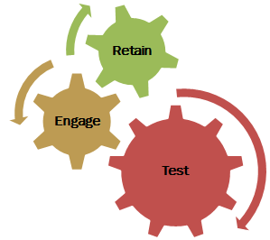
Viviendo Valiente –
A Program for People of Mexican Origin
Multi-level intervention
  Individual
  Group
  Community
Program goals
  Increase HIV testing
  Increase engagement in HIV treatment
  Increase retention in HIV treatment
Notes:
Prism Health North Texas was selected to develop a Latino SPNS program that was named Viviendo Valiente – which is Spanish for “Living Valiantly/Courageously”. [Present to slide content]

Slide 63
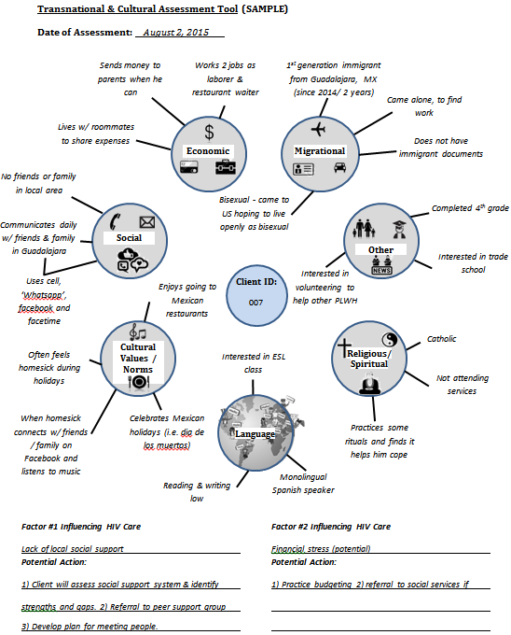
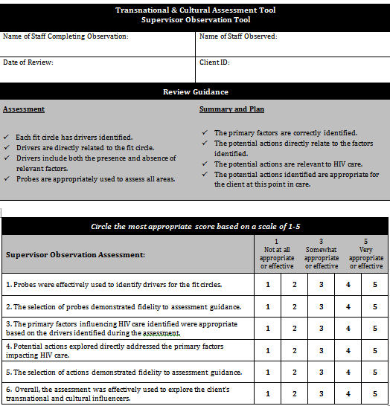
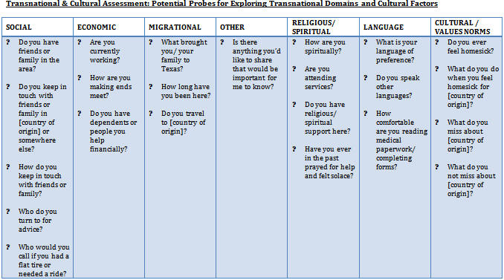
Viviendo Valiente –
Incorporating Principles of Transnationalism
Developed tools
  Transnational and Cultural Assessment Tool
  Support materials
    Instructions
    Potential Probes
    Potential Drivers
  Supervisor Observation Tool
Tested tool
Notes:
How we incorporated transnationalism into our intervention – [Refer to slides]
------------------------------------------------------------------------------------------
Transnationalism “…process by which immigrants forge and sustain multi-stranded social relations that link their societies of origin and settlement. We call these processes trans-nationalism to emphasize that many immigrants today build social fields that cross geographic, cultural and political borders.”
(Source: Nations Unbound - Transnational Projects and the De-territorialized nation-state, Basch et al, 1994:7)

Slide 64
Transnational and Cultural Assessment Tool
Notes:
The Transnational and Cultural Assessment tool was influenced by Multisystemic Therapy (MST)*
*An intensive community based treatment program that focuses on addressing all environmental systems that impact an individual. It was developed for use with chronic and violent juvenile offenders. MST recognizes that each system (schools, family, friends, community, etc.) plays a critical role in the individual’s world and that each system requires attention when effective change is needed to improve an the individual’s quality of life.
(Source: http://mstservices.com)
-----------------------------------------------------------------------

Slide 65
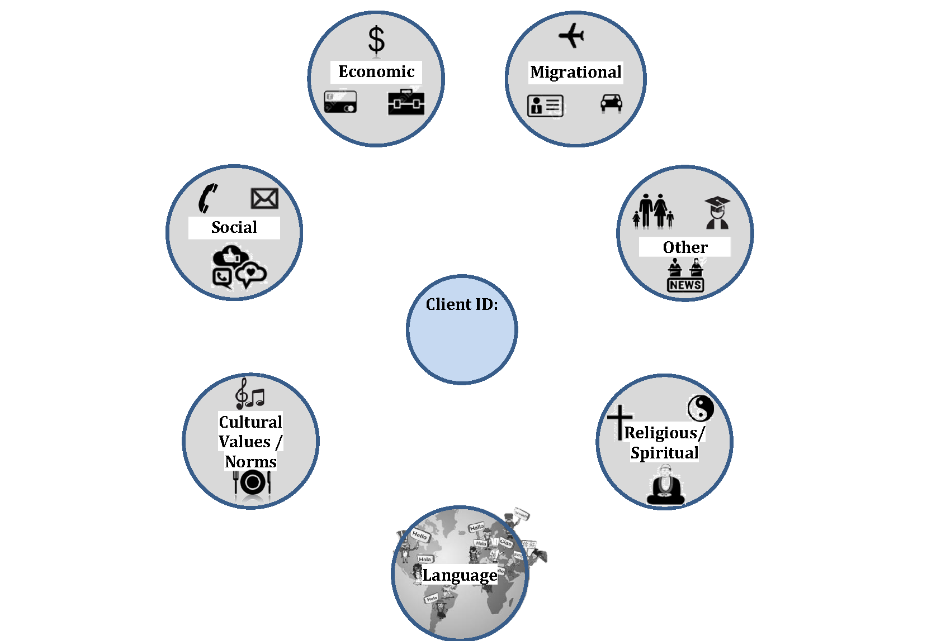
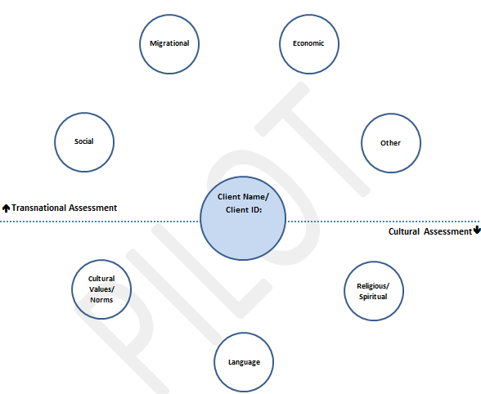
Evolution of the Tool
Notes:
Tool modifications – Original vs. final
Removed cue for patient’s name
Simplified; eliminated the separation of transnational domains from the cultural elements.
Graphics were added for the benefit of the client to serve as cues for potential considerations.
The tool was completed by the client and PdS together.
Using the tool helped PdS examine areas that acted as support or barriers to retention in care. Thus, allowing CT and the PdS to plan around potential issues that may arise related to retention efforts.
Standard guidance was developed for probes for each domain to facilitate the assessment.

Slide 66
Programmatic Integration of Transnationalism Principles
Use of the Transnational and Cultural Assessment Tool to Inform Care
  Initial comprehensive assessment
  Care planning
  Assessment entered in Electronic Health Record (EHR)
  Ongoing client contact
  Comprehensive re-assessment
    including transnational and cultural assessment
  Referral and follow-up
  Case closure/graduation
Notes:
How we incorporated transnationalism into our intervention –
Integration into processes
Comprehensive reassessments (GOAL - every 6 months or as needed)

Slide 67
Recommended Best Practices
  Utilize visual cues and probes such as those used in the transnational tool to engage the client in discussions to assess current and future needs to promote engagement and retention in care.
Notes:
Recommended Best Practices I
Utilize visual cues and probes such as those used in the transnational tool to engage the client in discussions to assess current and future client needs to promote engagement and retention in care.

Slide 68
Evolution of Client Level Assessment
14 assessment areas
Medical/clinical access
Basic necessities/life skills
Mental health/psychosocial
Substance/alcohol use
Housing
Support system
Insurance benefits
Transportation
HIV-related legal
Cultural/linguistic
Self-efficacy
HIV education/prevention
Employment/income
Medication adherence
Notes:
[Continued from previous slide]
Some of the best practices in incorporating transnationalism into your service delivery model
Utilizing the assessment tool served as a visual cue for both the PdS and client for transnational & culturally relevant considerations.
The physical tool aids with client engagement/ is visually appealing
More beneficial for initial/ early encounters
Recommended integration:
In the state of Texas there are 14 RW CM standard assessment areas.
An evolution of the transnational tool that includes all 14 areas would improve both patient engagement & encourage greater thought on behalf of the patient as it pertains to not only current needs, but potential barriers to retention in care in the future. This would improve the care planning partnership between the CM and the patient.
* State standards for RW providers

Slide 69
Recommended Best Practices – 2 of 2
  Develop interactive tool to promote effective integration of best practices into Case Management
    Use visual cues
    Use appropriate probes for enhanced care planning
  Educate case management teams about
    Transnationalism
    Effective use of tool for greatest impact
  Integrate use of tool in standard of care
    At initial assessment and as needed

Slide 70
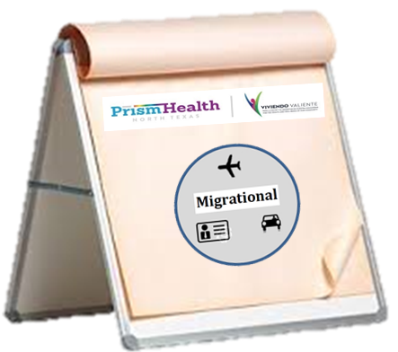
Next Steps
Development of Interactive Provider Tool
  Front facing side: client visuals
  Provider facing side: list of probes
Dissemination of Tool
  Prism Health North Texas providers
  Community partners
  Ryan White funded agencies/programs

Slide 71
Snapshot of Local Outcomes
Preliminary Data

Slide 72
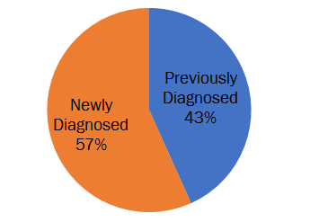
HIV Status at Enrollment (n=104) –
Preliminary Data

Slide 73
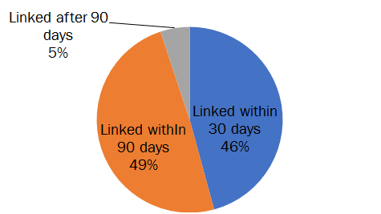
Linkage of Newly Diagnosed Participants (n=59) – Preliminary Data

Slide 74
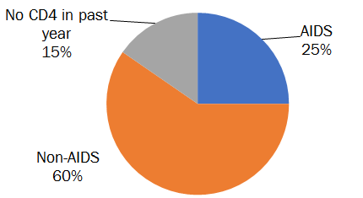
With AIDS Diagnosis at Baseline (n=104)– Preliminary Data

Slide 75
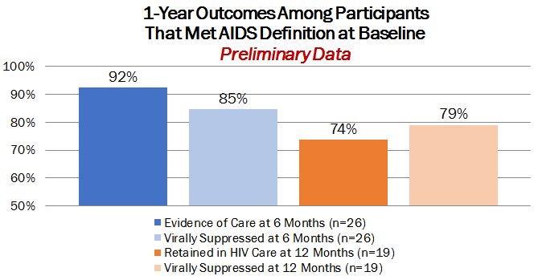
1-Year Outcomes among Participants with AIDS Diagnosis at Baseline – Preliminary Data

Slide 76
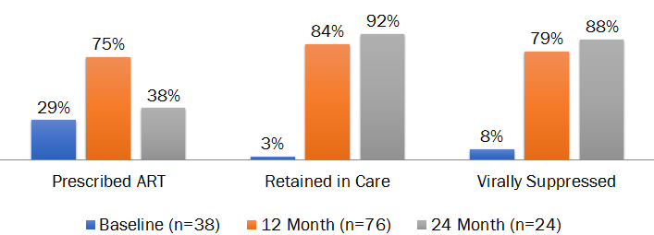
Individual Level Outcomes – Continuum of Care
Preliminary Data

Slide 77
Questions?
____________________
Thank you!

