Slide 1
RWHAP and the Opioid Epidemic: Outcomes of an Opioid Technical Expert Panel December 12, 2018 4:00 – 5:30 PM
Antigone Dempsey, Elise Young, and Glenn Clark
HIV/AIDS Bureau (HAB)
Health Resources and Services Administration (HRSA)

Slide 2
Health Resources and Services Administration (HRSA) Overview
Supports more than 90 programs that provide health care to people who are geographically isolated, economically or medically vulnerable through grants and cooperative agreements to more than 3,000 awardees, including community and faith-based organizations, colleges and universities, hospitals, state, local, and tribal governments, and private entities
Every year, HRSA programs serve tens of millions of people, including people living with HIV/AIDS, pregnant women, mothers and their families, and those otherwise unable to access quality health care

Slide 3
HRSA HIV/AIDS Bureau (HRSA HAB)
Vision
Optimal HIV/AIDS care and treatment for all.
Mission
Provide leadership and resources to assure access to and retention in high quality, integrated care, and treatment services for vulnerable people living with HIV/AIDS and their families.

Slide 4
HRSA’s Ryan White HIV/AIDS Program (RWHAP)
Provides comprehensive system of HIV primary medical care, medications, and essential support services for low-income people living with HIV (PLWH)
More than half of people living with diagnosed HIV in the United States – more than 550,000 people – receive care through the Ryan White HIV/AIDS Program
Funds grants to states, cities/counties, and local community based organizations
Recipients determine service delivery and funding priorities based on local needs and planning process
Payor of last resort statutory provision: RWHAP funds may not be used for services if another state or federal payer is available
84.9% of Ryan White HIV/AIDS Program clients were virally suppressed in 2016, exceeding national average of 60%
Source: HRSA. Ryan White HIV/AIDS Program Annual Client-Level Data Report 2016; CDC. HIV Surveillance Supplemental Report 2016;21(No. 4)

Slide 5
RWHAP and the Opioid Epidemic: Outcomes of an Opioid Technical Expert Panel
Background and Data

Slide 6
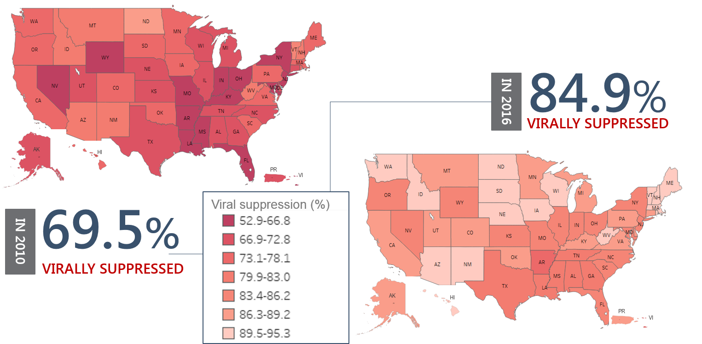
Viral Suppression among RWHAP Clients, by State, 2010 and 2016—United States and 2 Territoriesª
Viral suppression: ≥1 OAHS visit during the calendar year and ≥1 viral load reported, with the last viral load result <200 copies/mL.
ª Puerto Rico and the U.S. Virgin Islands.
Source: HRSA. Ryan White HIV/AIDS Program Services Report (RSR) 2016. Does not include AIDS Drug Assistance Program data.
Notes:
The maps on this slide show the variation in viral suppression by state in 2010 as compared to 2016, with darker red indicating lower percentages of viral suppression and lighter shades indicating higher percentages.
While viral suppression continues to vary by state, you can see that between 2010 and 2016, increases in viral suppression occurred across all states.
------
Viral suppression is defined as ≥1 outpatient/ambulatory health services visit during the calendar year and ≥1 viral load reported, with the last viral load result <200 copies/mL.
The two territories include Puerto Rico and the U.S. Virgin Islands. Due to low numbers, data for Guam are not presented.

Slide 7
Ryan White HIV/AIDS Program Clients Aged ≥13 Years with HIV Infection Attributed to Injection Drug Use, 2016—United States and 3 Territoriesª
Data represent clients who reported injection drug use as their transmission risk category data may not reflect current behavior.
ª Guam, Puerto Rico, and the U.S. Virgin Islands.
^{b} Includes male-to-male sexual contact, heterosexual contact, perinatal infection, hemophilia, blood transfusion, male-male sexual contact and injection drug
use, and any sexual contact among transgender persons including sexual contact and injection drug use.

Slide 8
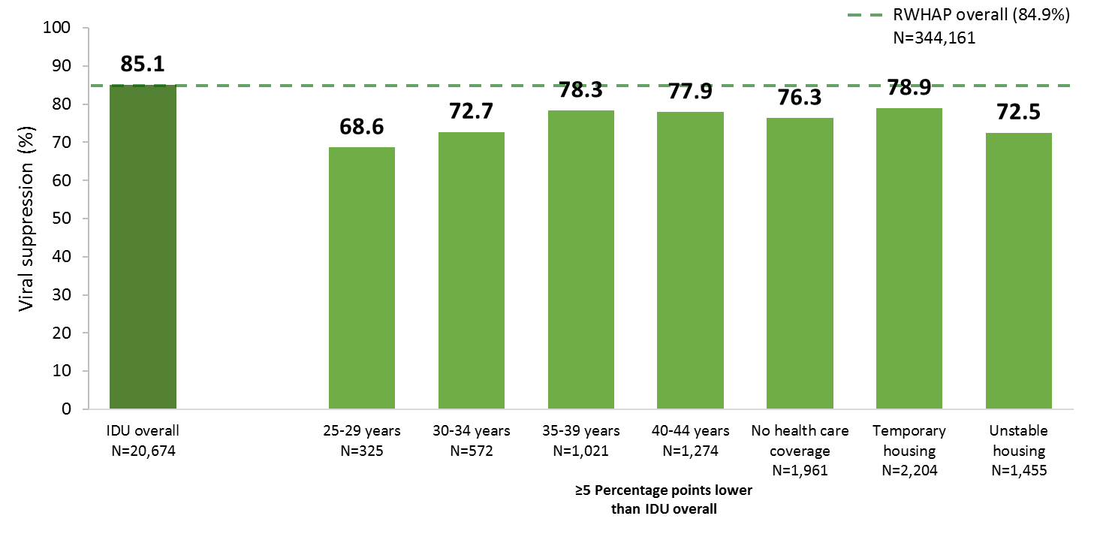
Viral Suppression among Clients with HIV Infection Attributed to Injection Drug Use Aged ≥13 Years Served by the Ryan White HIV/AIDS Program, 2016—United States and 3 Territoriesª
IDU, injection drug use.
Data represent clients who reported injection drug use as their transmission risk category; data may not reflect current behavior. Data do not include male-to-male sexual contact and injection drug use nor sexual contact and injection drug use among transgender clients.
N represents the total number of clients in the specific subpopulation.
Viral suppression is defined as ≥1 OAHS visit during the calendar year and ≥1 viral load reported, with the last viral load result <200 copies/mL.
ª Guam, Puerto Rico, and the U.S. Virgin Islands.
Notes:
Among these clients, viral suppression was 85.1%, which is consistent with the national average. Each 5-year age group from 25-44 years had lower percentages of viral suppression (68.6% to 78.3%) compared to that for clients with IDU transmission risk overall (85.1%). In addition, lower percentages of viral suppression were among those with no health care coverage (76.3%) and those with temporary (78.9%) and unstable (72.5%) housing.
~~~~~~~
ADDITIONAL NOTES
Data represent clients who reported injection drug use as their transmission risk category; data may not reflect current behavior. Data do not include male-to-male sexual contact and injection drug use nor sexual contact and injection drug use among transgender clients.
N represents the total number of clients in the specific subpopulation.
Viral suppression is defined as ≥1 outpatient ambulatory health services visit during the calendar year and ≥1 viral load reported, with the last viral load result <200 copies/mL.
The three territories include Guam, Puerto Rico, and the U.S. Virgin Islands.

Slide 9
HRSA RWHAP Behavioral Health Services
 | Providers (N=1,550)* |  | Clients (N=551,567) |  | Total Client Visits
Service category | N | % | N | % | N
Mental health | 613 | 39.5 | 68,684 | 12.5 | 353,896
Any substance abuse – outpatient or residential | 278 | 17.9 | 20,228 | 3.7 | --
Substance abuse - outpatient | 257 | 16.6 | 19,152 | 3.5 | 173,926
Substance abuse - residential | 37 | 2.4 | 1,329 | 0.2 | --
*Number of providers that provided any service in the given year. Note, total number of funded providers: 2,164 (2016)
Source: HRSA. Ryan White HIV/AIDS Program Services Report (RSR) 2016. Does not include AIDS Drug Assistance Program data.
Notes:
As you know, the work of improving HIV-related health outcomes involves far more than providing medication and visits to a health care provider. You also well know the same is true in the case of substance use disorders. Outpatient Ambulatory Health Services, ADAP, Mental Health Services, Outpatient Substance Abuse Services, Residential Substance Abuse Services, and Housing Services, are all allowable costs within HRSA RWHAP. As such, RWHAP related resources (rebate funds and/or program income) can be used to provide these services to RWHAP eligible clients. Having said that, we know that lack of access to behavioral health related services in some communities is certainly a barrier.
In 2016, nearly 70,000 RWHAP clients received mental health services (13% of clients) from over 600 RWHAP providers and approximately 20,000 RWHAP clients received substance abuse services (either outpatient or residential - 4% of clients) from nearly 300 RWHAP providers. The RWHAP ensures that recipients have access to behavioral health services either directly or through coordination with recipients providing these services. In addition, through the RWHAP Part F Special Projects of National Significance Program, innovative models of HIV care and treatment are developed that integrate behavioral health approaches with HIV primary care to respond to emerging needs of PLWH.

Slide 10
RWHAP and the Opioid Epidemic: Outcomes of an Opioid Technical Expert Panel
Expert Panel Overview and Key Questions

Slide 11
Key Framing Questions
What are the successes/facilitators, barriers/gaps, and opportunities for addressing opioid addiction in the context of the RWHAP?
What barriers and facilitators exist at the clinic level for addressing opioid addiction needs for RWHAP clients and patients?
What are the barriers and facilitators that exist at the EMA/TGA and state levels to address the opioid crisis in metropolitan areas, state jurisdictions, and rural areas?

Slide 12
Technical Expert Panel – Community
Fred Brason
Project Lazarus
Moravian Falls, NC
Daniel Daltry
Vermont Department of Health
Burlington, VT
Judith Feinberg, MD
West Virginia University
Morgantown, WV
Marwan Haddad, MD
Community Health Center
Middletown, CT
Rick Hardwood
National Association of State Alcohol and Drug Abuse Directors
Washington, DC
Pamposh Kaul, MD
Ohio Regional AETC
Cincinnati, OH
Taanya Mannain LISW-CP
Little River Medical Center
Little River, SC
Geetika Nadkarni, MPH
The Association of State and Territorial Health Officials
Arlington, VA
Daniel Raymond
Harm Reduction Coalition
New York, NY
Pam Sylakowski
Metro Public Health Department
Nashville, TN
Coleman Terrell
Philadelphia Department of Public Health
Philadelphia, PA
Alice Thornton, MD
Bluegrass Cares Clinic
Louisville, KY
Justin Trevino, MD
Ohio Department of Mental Health and Addiction Services
Columbus, OH
Emily Zarse, MD
Eskenazi Health Centers
Indianapolis, IN

Slide 13
Technical Expert Panel – HRSA Participants
CAPT Sophia Russell
Bureau of Health Workforce
Health Resources and Services Administration
CAPT Christopher Bersani, PsyD
Office of Regional Operations
Health Resources and Services Administration
Michael Blodgett
Federal Office of Rural Health Policy
Health Resources and Services Administration
Aaron Lopata, MD
Maternal and Child Health Bureau
Health Resources and Services Administration
Alexander Ross, ScD
Office of Planning, Analysis and Evaluation
Health Resources and Services Administration
Judith Steinberg, MD, MPH
Bureau of Primary Health Care
Health Resources and Services Administration
HRSA HAB Sponsoring Participants
Stacy Cohen, MPH
Division of Policy and Data
HIV/AIDS Bureau
Health Resources and Services Administration
Antigone Dempsey, MEd
Division of Policy and Data
HIV/AIDS Bureau
Health Resources and Services Administration
Heather Hauck, MSW, LICSW
HIV/AIDS Bureau
Health Resources and Services Administration
Marlene Matosky, MPH, RN
Division of Policy and Data
HIV/AIDS Bureau
Health Resources and Services Administration
HRSA HAB Behavioral Health Workgroup
CAPT Elise Young, LICSW, DCSW - Chair
Glenn Clark, MSW - Chair

Slide 14
Technical Expert Panel – Federal Partners
Danae “Dee” Bixler, MD
Division of Viral Hepatitis
Centers for Disease Control and Prevention
John Brooks, MD
Division of HIV/AIDS Prevention
Centers for Disease Control and Prevention
Humberto Carvalho
Addiction Technology Transfer Centers
Substance Abuse and Mental Health Services Administration
Steve Daviss, MD
Office of the Chief Medical Officer
Substance Abuse and Mental Health Services Administration
Senad Handanagic, MD, MPH
Division of HIV/AIDS Prevention
Centers for Disease Control and Prevention
Anne Herron, MS
Division of Regional and National Policy Liaison
Substance Abuse and Mental Health Services Administration
Richard Jenkins, PhD
Prevention Research Branch
National Institute on Drug Abuse
Chideha Ohuoha, MD
Center for Substance Abuse Treatment
Substance Abuse and Mental Health Services Administration
Gerlinda Somerville
Center for Substance Abuse Treatment
Substance Abuse and Mental Health Services Administration
CDR Meena Vythilingam, MD
Office of the Assistant Secretary for Health

Slide 15
Overdose Deaths per 100,000 in the United States 1999-2015

Slide 16
Overdose Deaths in the United States 2015

Slide 17
United States Prescribing Rates by State 2016

Slide 18
Overdose Deaths Involving Opioids, by Type of Opioid, United States, 2000-2016

Slide 19
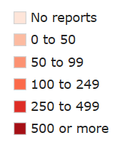
2015 Reported Law Enforcement Fentanyl Encounters

Slide 20
RWHAP and the Opioid Epidemic: Key Themes

Slide 21
Barriers for PLWH with OUD
RWHAP and OUD: Defining the Patient Population and Data Gaps
Stigma Related to Opioid Use
Negative Attitudes Toward MAT
Need for Increased Clinical Training Regarding OUD
Workforce Shortages

Slide 22
Facilitators to Support PLWH with OUD
Leveraging telemedicine
Systems approach across sectors
Housing, transportation, and food supports
Using peers in a transformational ways (mutual aid and support)
Education and training for all clinical staff from registration to staff nurse practitioners, and physician assistants
Innovative strategies for working with active addiction

Slide 23
Contact Information
Antigone Dempsey
Director, Division of Policy and Data
HIV/AIDS Bureau (HAB)
Health Resources and Services Administration (HRSA)
Email: adempsey@hrsa.gov
Phone: 301-443-0360
Web: hab.hrsa.gov

Slide 24
Connect with HRSA
To learn more about our agency, visit
www.HRSA.gov
Sign up for the HRSA eNews
FOLLOW US:

