Slide 1
Integrating HCV Cure into HIV Care: Cross-Jurisdictional, Multi-Level Lessons
Elizabeth Lazo, MPH, François-Xavier Bagnoud Center, Rutgers School of Nursing

Slide 2
Learning Objectives
Identify methods used to engage clinical teams to increase prevention, diagnosis, and cure of hepatitis C virus (HCV) in people living with HIV (PLWH).
Utilize a toolkit to assist in removing barriers to preventing, diagnosing, and curing HCV in HIV/HCV co-infected individuals of color.
Apply a multi-level approach to integrating HCV care into RWHAP clinical settings.

Slide 3
Jurisdictional Approach to Curing HCV Among HIV/HCV Co-infected People of Color
To address the disparities in HCV prevalence, treatment, and cure among people of color living with HIV
Collaborative initiative between the AETC Program and the Special Projects of National Significance (SPNS) Program was started in 2016
Supports 3 RWHAP Part A recipients and 2 Part B recipients, along with the associated regional AETCs & the AETC NCRC
Notes:
To increase jurisdiction-level capacity to provide comprehensive screening, care, and treatment for HCV among HCV co-infected RWHAP clients. Goal is to increase numbers of HIV/HCV co-infected people who are diagnosed, treated, and cured of HCV infection.
Part A grant recipients: Hartford Department of Public Health, New York City Department of Health and Mental Hygiene, Philadelphia Department of Public Health
Part B grant recipients: North Carolina Department of Health & Human Services, Louisiana Department of Public Health,
Regional AETCs: MidAtlantic AETC, New England AETC, Northeast/Caribbean AETC, South Central AETC and Southeast AETC

Slide 4
HIV/HCV Co-infection Community of Practice and Learning
Monthly virtual meetings beginning in November 2015
Focus on training, technical assistance, capacity building, development and dissemination of resources and, addressing programmatic challenges related to HCV cure among PLWH
Members include the 5 partnering regional AETCs, the 5 jurisdictional sites, National Alliance of State & Territorial AIDS Directors (NASTAD), and HRSA HAB

Slide 5
HIV/HCV Co-infection Developed Resources
HIV/HCV Co-infection: An AETC National Curriculum
Passport to Cure Brochure (Available in English and Spanish)
Hep C Free Postcard (Available in English and Spanish)
HCV Screening and Treatment Flyer
Myths About Treating Substance Users with Hepatitis C Virus (HCV) Infographic
Available online for download (www.aidsetc.org); printed copies can be ordered (https://aidsetc.org/community/order)
Notes:
In 8/2016, the AETC NCRC was asked by HRSA HAB to facilitate and coordinate the development of a national curriculum that would assist regional AETCs and demonstration site grantees of the SPNS initiative. The AETC NCRC hosted a curriculum working group that included representatives from the regional AETCs with a demonstration site within the region (New England AETC, Northeast/Caribbean AETC, and MidAtlantic AETC). 6 core competencies. The jurisdictional sites were included in the review of the curriculum; there were 9 outside reviewers representing the jurisdictional sites. Launched on 7/12/17. Continuing Medical Education (CME) and Continuing Nursing Education (CNE) credits available.
Discuss the other resources, background on their development. (Will have them available for distribution)

Slide 6
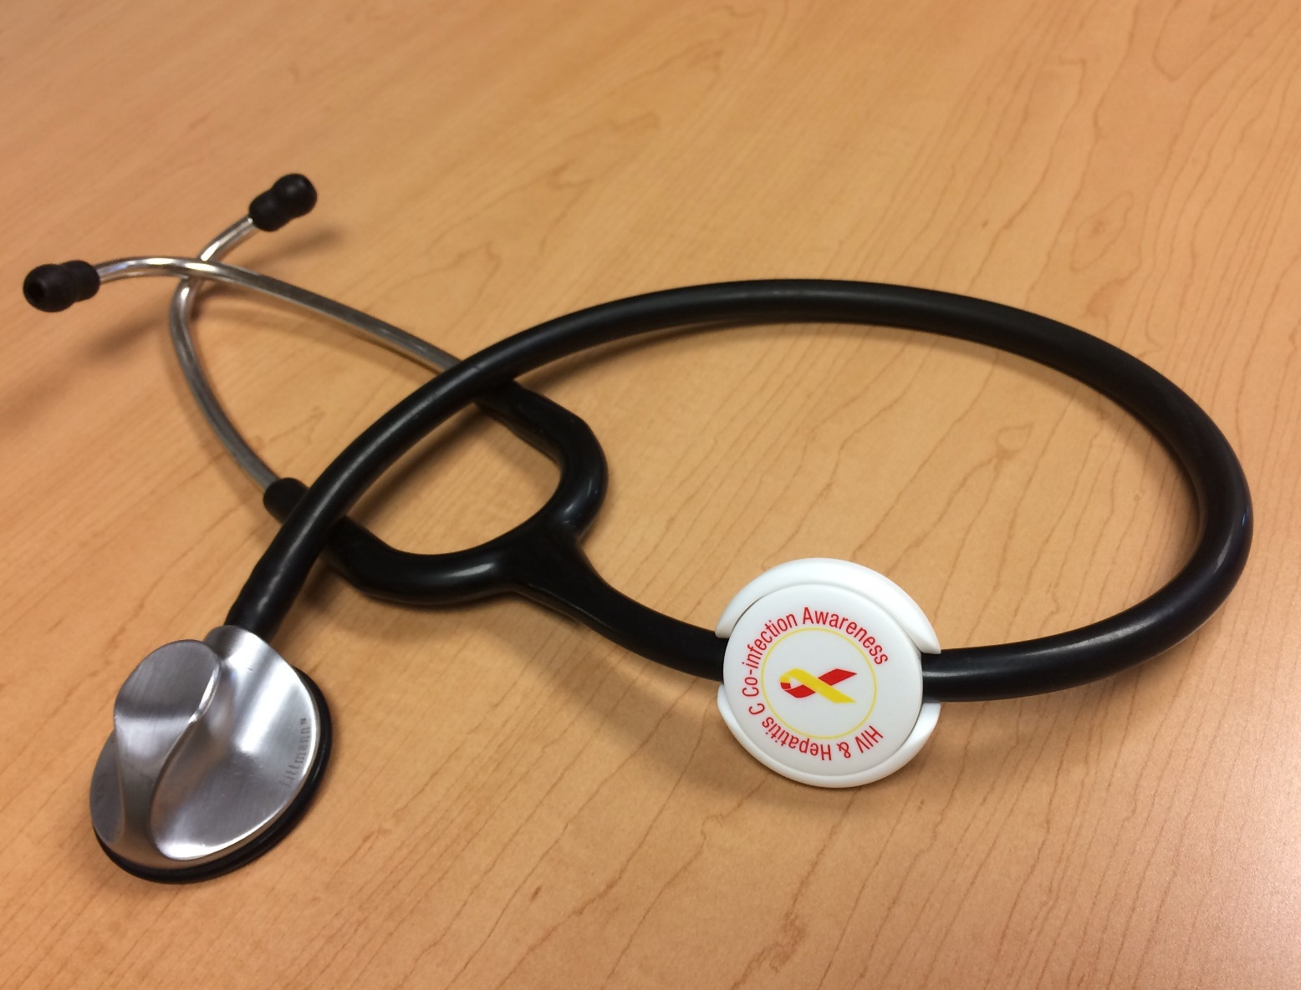


Provider Awareness

Slide 7

HIV/HCV: Treat Both, Treat Now
Notes:
The purpose will be to provide other US jurisdictions healthcare providers and public health organizations with identified barriers and facilitators to eliminating HCV infection among PLWH. Highlights successes and challenges related to the SPNS initiative.

Slide 8



C YA!
Philadelphia EMA’s Plan to Connect our
Co-infected Community to a Cure for HCV
Alex Shirreffs, MPH – HIV/HCV Project Coordinator
AIDS Activities Coordinating Office, Philadelphia Department of Public Health
Susan Thompson – Training Director
Mid-Atlantic AIDS Education & Training Center;
Regional Partner, Health Federation of Philadelphia

Slide 9
ACKNOWLEGEMENT OF SUPPORT
Philadelphia’s C Ya! Project is supported by the Health Resources and Services Administration (HRSA) of the US Department of Health and Human Services (HHS) under grant number U90HA305-18-01: Jurisdictional Approach to Curing Hepatitis C Among People of Color Living with HIV. This information or content and conclusions are those of the author and should not be construed as the official position or policy of, nor should any endorsements be inferred by HRSA, HHS or the US Government.

Slide 10
C YA: Philadelphia’s Plan to Connect our Co-infected Community to a Cure
  Jurisdictional Approach to Curing HCV Among HIV/HCV Co-Infected People of Color
        3-year HRSA/SPNS cooperative agreement; September 2016 – September 2019
  Increase capacity to provide HCV screening, care and treatment in the HIV service system
  Increase number of HIV/HCV co-infected people who are diagnosed, treated and cured of HCV
CAPACITY
CURE
ELIMINATON
Notes:
Moved three DDC hepatitis staff over to AACO
Allowed us to expand our pool of hep experts at DOH
Retain staff who would have been laid off due to surveillance funding cut
Hep team housed at AACO can focus on sustainable, systems-level changes
Ongoing data matching, analysis allows us to target activities
Partnering with local AIDS Education and Training Center to share best practices
Philadelphia Dept of Public Health
AIDS Activities Coordinating Office
Division of Disease Control
Viral Hepatitis Program
STD Program

Slide 11
C Ya: Philly’s Plan to End HCV in PLWH
ELIMINATION
Data & Evaluation
C Who is Co-Infected
Training & Capacity Building
Cross train staff to address HCV
Re-Engagement in Care
Connecting PLWH to HCV Cure
Service Integration
Continuity & Sustainability
Notes:
Moved three DDC hepatitis staff over to AACO
Allowed us to expand our pool of hep experts at DOH
Retain staff who would have been laid off due to surveillance funding cut
Hep team housed at AACO can focus on sustainable, systems-level changes
Ongoing data matching, analysis allows us to target activities
Partnering with local AIDS Education and Training Center to share best practices

Slide 12
HIV Infrastructure Boosts HCV Outcomes In PLWH
Source: Philadelphia Department of Public Health, AIDS Activities Coordinating Office & Viral Hepatitis Program
Notes:
Moved three DDC hepatitis staff over to AACO
Allowed us to expand our pool of hep experts at DOH
Retain staff who would have been laid off due to surveillance funding cut
Hep team housed at AACO can focus on sustainable, systems-level changes
Ongoing data matching, analysis allows us to target activities
Partnering with local AIDS Education and Training Center to share best practices

Slide 13
Philadelphia’s HCV Continuum Is Improving in DAA Era
50% of HCV RNA+ Patients Have Resolved Their HCV Infection!
59%
Source: Philadelphia Department of Public Health, AIDS Activities Coordinating Office & Viral Hepatitis Program
Notes:
Moved three DDC hepatitis staff over to AACO
Allowed us to expand our pool of hep experts at DOH
Retain staff who would have been laid off due to surveillance funding cut
Hep team housed at AACO can focus on sustainable, systems-level changes
Ongoing data matching, analysis allows us to target activities
Partnering with local AIDS Education and Training Center to share best practices

Slide 14
What’s the Story Behind the Data?
20 site visits to local RW clinics to identify best practices and needs:
  Helped us recruit clinicians for training to start treating HCV
  Process of collecting info from stakeholders gets buy in, builds relationships
Qualitative data helps us identify:
  What’s working: Local best practices, HCV champions
  What can be improved: Gaps in services, opportunities to provide support
Baseline survey of RW practices showed high level of integration
  Reflex Testing (19 care sites): 8 in 2016 → 15 in 2018
  Onsite Treatment (22 care sites): 14 in 2016 → 18 in 2018
Notes:
Obvious answers:
RW provides safety net to engage people in care
PLWH prioritized for new treatments when they first came out ($$)
Most HIV providers in Philadelphia have already integrated hep C care
“We’ve started treatment on our first co-infected patient, got the medication approved, he is starting this week. He thanks you for your help!!”

Slide 15
“We’re Just Here to Learn”: Provider Input Helps Us Prioritize
 | HCV Antibody | HCV RNA | HCV Care | HCV Treatment | HCV Prevention
Facilitators | Screen on intake EMR prompts Standardized re-screening policies Pharma grants support routine testing programs | Reflex testing If HIV provider is not PCP, have PCP do HCV labwork before referral | Integrate into HIV care Keep clients informed through tx process In house case managers Bridge to feed info from EMR to CAREware | Integrated into HIV care If new to tx, start small Designate staff to manage Prior Auths 340B rebates = $ incentive Collaborative, team approach Who can treat NO LONGER restricted under PA Medicaid | Access to Harm Red Visual, simple materials; avail in multiple languages Posters preferable to pamphlets Cured clients promote tx via word of mouth
Barriers | Limited HCV testing at HIV test sites Limited resources to fully support systems level integration Inconsistent re-screening policies | Req patients to come back for RNA test No institutional support for reflex Not giving test results to clients No help making referrals/appts | HCV not priority for MCMs Providers lack time to provide patient edu Not offering support or f/u to clients Communication btw HIV & HCV provider if client referred out | Referring out for care Prior Auth time consuming Not all providers comfortable treating active sub users Clients w insecure housing, mental health or addiction more likely to be out of care Need for real time updates on tx, PA policies | No harm reduction resources in SE PA, not enough in Phila, NJ Lack of resources targeted to MSM Wordy or English only info; materials that visibly say HIV/HCV not liked by clients
Notes:
Showcasing local providers and their best practices
Variety of models to share
Empowering clinicians to be leaders

Slide 16
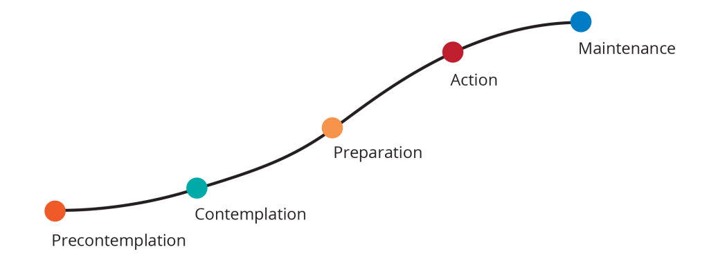
Capitalize on Existing Relationships and Resources
Partnership with local AETC built into C Ya project
  Provider relationships and logistics support an asset
  Partnership allows quick turnaround between identifying challenge and offering support
  HCV easy to integrate into existing training methodologies
Advantages of Peer to Peer Learning
  Showcase local providers and their best practices
  Empower clinicians doing great work to be leaders
“I treat but want strategies to reach ‘hard to engage’ patients…”
“I’m ready to start with 1 patient…”
“I don’t have time for prior auths; drugs cost too much…”
“HCV should be treated by a specialist…”
Notes:
Hep C built into existing AETC modalities
Peer to peer learning via didactic lessons and preceptorship
Plans for follow up and ongoing support
Variety of models to share
Two primary pools of clinicians to train:
Novice Sites: Scaling new sites up to treat
Start Small! 1 site, 1 provider, 1 patient
Experienced Sites: Treatment onsite already, adding providers
Addressing turnover, building practice capacity
(ex: Ana Lapp, David Koren…)
WH prioritized for new treatments when they first came out ($$)

Slide 17
Case Study: RW Practice within a FQHC System
FQHC system with sites in Philadelphia and suburbs
  Over 40,000 patients across 8 sites
  Mid-size RW practice: 100-500 HIV+ clients; <10 co-infected clients left to treat
Ready for change: saw value of scaling up HCV services
  Implemented reflex testing
  Recognized untreated clients weren’t going to specialist referrals
  Understood treating co-infected a starting point for HCV tx in whole FQHC system
Site visits an opportunity to discuss HCV tx concerns in more detail:
  Medication management; time and effort of Prior Authorization process
  Buy-in from clinic management
Notes:
Patients don’t making referrals to HCV specialist
Implemented reflex testing (result of presentation on hep C integration in HIV settings)

Slide 18
What helped this FQHC decide to say C YA?
Policy change: Pennsylvania’s final Medicaid restrictions removed
Leadership buy-in from PDPH’s HIV Program gave authority to C Ya project
    Health department staff went out to clinics; met with FQHC leaders to show support
Opportunity for HIV clinicians to learn new skills AND cure patients
    Focus on clinician empowerment
    Encouraged to start small – 1 patient at 1 site is ok!
Customized training and education support from regional AETC
    Various methodologies offered: preceptorship, clinic observation
    Facilitates access to local experts for ongoing support
340B rebate adds financial incentive to integrate HCV care
Notes:
Patients don’t making referrals to HCV specialist
Implemented reflex testing (result of presentation on hep C integration in HIV settings)

Slide 19
How can YOU end HCV among PLWH?
Relationships & collaboration essential to HCV elimination with limited resources!
  Already working on HCV?
      Promote yourself as a local expert
        Contact your regional AETC: let them know are interested in helping build local capacity
      Create a micro-elimination plan for your agency or help create one for your community
Need help scaling up HCV services?
      Reach out to experts for help!
        Local: AETC; Viral Hepatitis Prevention Coordinator at health department
        National: NVHR, NASTAD
      Remember: It’s ok to start small
        Pilot projects can lead to bigger initiatives, bring in new resources
Notes:
Example: HepCAP helped remove abstinence requirement for hep C treatment access

Slide 20
HIV/HCV Resources
Philly HIV/HCV Resource Center: www.hepcap.org
National HIV/HCV Curriculum: www.aidsetc.org/hivhcv
HCV Testing for HIV Providers: www.aahivm.org/hcv-testing-screening/
HCV Treatment Guidelines: www.hcvguidelines.org
HCV Treatment Access Information:
  NVHR & CHLPI State of Medicaid Access Report Cards: www.stateofhepc.org
  NASTAD: https://www.nastad.org/resource/adap-hcv-decision-tree

Slide 21

THANK YOU!
Philadelphia Department of Public Health
Viral Hepatitis Team
AIDS Activities Coordinating Office
C Ya, CoRECT & C Change Teams
Community Partners
HepCAP
MidAtlantic AETC
  Philadelphia Performance Site at Health Federation
Philly’s HIV Service Providers
Philadelphians living with HIV & Hep C
National Partners
HRSA & RAND

Slide 22
Alex Shirreffs, MPH
HIV/HCV Project Coordinator
AIDS Activities Coordinating Office
Philadelphia Department of Public Health
Alexandra.Shirreffs@phila.gov
215-685-5381
Susan Thompson
Training Director
MidAtlantic AETC
Regional Partner, Health Federation
sthompson@healthfederation.org
215-557-2101

Slide 23

Achieving Comprehensive Coverage Early, Systematically and Sustainably
Jurisdictional Approach to Curing Hepatitis C among HIV/HCV Co-infected People of Color
Cecil Tengatenga, MAR Project Manager/ Project ACCESS
City of Hartford Health and Human Services, Ryan White Part A Program

Slide 24
Disclosures
Presenter(s) has no financial interest to disclose.
This continuing education activity is managed and accredited by AffinityCE/Professional Education Services Group in cooperation with HRSA and LRG. PESG, HRSA, LRG and all accrediting organization do not support or endorse any product or service mentioned in this activity.
PESG, HRSA, and LRG staff as well as planners and reviewers have no relevant financial or nonfinancial interest to disclose.
Commercial Support was not received for this activity.

Slide 25

PROJECT OVERVIEW
7 Ryan White Clinics enrolled to implement patient navigation, medication adherence and provide ID care for low income individuals co-infected with HIV/HCV throughout the Hartford Transitional Grant Area (TGA).
Surveillance
Coordinated
Response
Notes:
We reached out to the 8 health facilities that we fund under the Ryan White Part A program in our TGA
These providers have been treating HCV among their Ryan White patient population since the 90s. (The oldest co-infection case was reported in 1991!)
However, treatment really pick up with the introduction of the DAA in 2014
Balancing Priorities
This exclusive focus on HCV is not only new in our TGA—notwithstanding the HAB measure requirement for one-time HCV testing for enrolled RW consumers—but presented challenges as our HCV state surveillance was lagging, like the other jurisdictions excluding the 18 the CDC had been funding—and we are proud to be learning from three that are part of our cohort—Louisiana, New York and Philly.
We are also a city that was embattled by the threat of bankruptcy at the municipal level and a state budget stalemate that went well through Thanksgiving. Couple of the congress’ inaction on community health center funding and the emergent uncertainty due to hospital mergers and acquisitions, we have a slow start in certain areas of our implementation.
Moreover, our thin and innovative staff had to leverage minimal womanpower to two major department departures—the Health Director and our Contract Manager.
Hence our response was to coordinate this project through an advisory board of 30 volunteers, with three ad-hoc workgroups.

Slide 26
Project Goals
Localization of HCV surveillance in CAREWare. Project ACCESS will use surveillance data to identify, select, and prioritize patients at 5 Ryan White funded HIV health service facilities and assigned to patient navigation and HCV care and treatment. In conjunction with a QM Nurse and ad-hoc quality management advisory group, Project ACCESS staff will provide training and tailored technical assistance to improve HCV screening, diagnostic testing, linkage to care, and treatment rates at these sites. Additional CAREWare measures (HCV RNA, HCV Medication Initiation, HCV Treatment Referral, HCV Medication Adherence, Achievement of SVR, Post SVR12 Follow-up) were added to collect this information.
Implementation of Project ECHO. Project ACCESS will adapt the National AETC curriculum into a telehealth mentoring program that provides remote HCV education to HIV providers in a collaborative community of practice utilizing video conferencing and case-based learning. provide HCV care technical assistance and training to HIV providers. The cohort of providers meets bi-weekly and each intervention site is responsible for presenting at least 3 de-identified clinical cases.
Engagement of Patient navigation. Project ACCESS will provide HCV clinical training for HIV clinical providers and HCV basics and patient navigation training for non- clinical providers to improve HCV screening, diagnostic testing, linkage to care, and treatment rates jurisdiction-wide. 6 patient navigators are being funded at 6 of the intervention sites to provide patient outreach, linkage to care, adherence support and community education.
Direct patient outreach education. Project ACCESS will create culturally relevant patient education materials and coordinate peer group activities to address disease stigma and access to treatment.

Slide 27
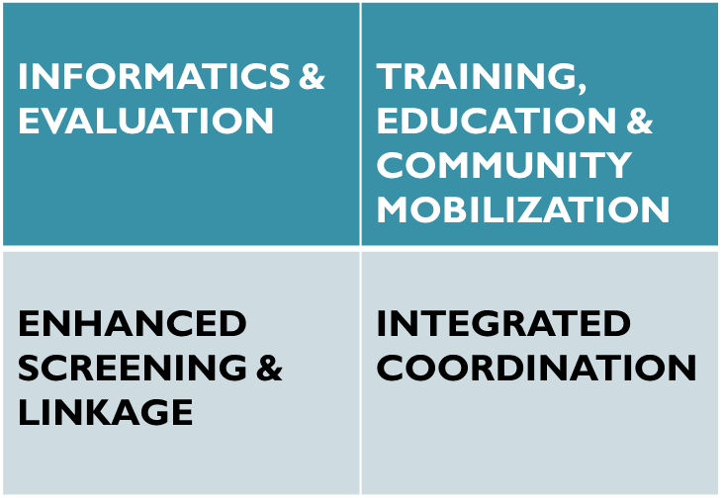
PROJECT IMPLEMENTATION PLAN
Intervention sites implementing:
Patient Navigation
Medication Adherence
Treatment Management
Jurisdiction-wide implementing:
HCV workforce development
Community awareness
PILLARS

Slide 28
Evolving Surveillance
The Viral Hepatitis Action Plan benchmarks 2015 for the national HCV surveillance project
The Hartford TGA benchmarks July 1, 2016 for its CAREWare HCV surveillance project

Slide 29
RW Hartford TGA Co-infection Profile

Slide 30
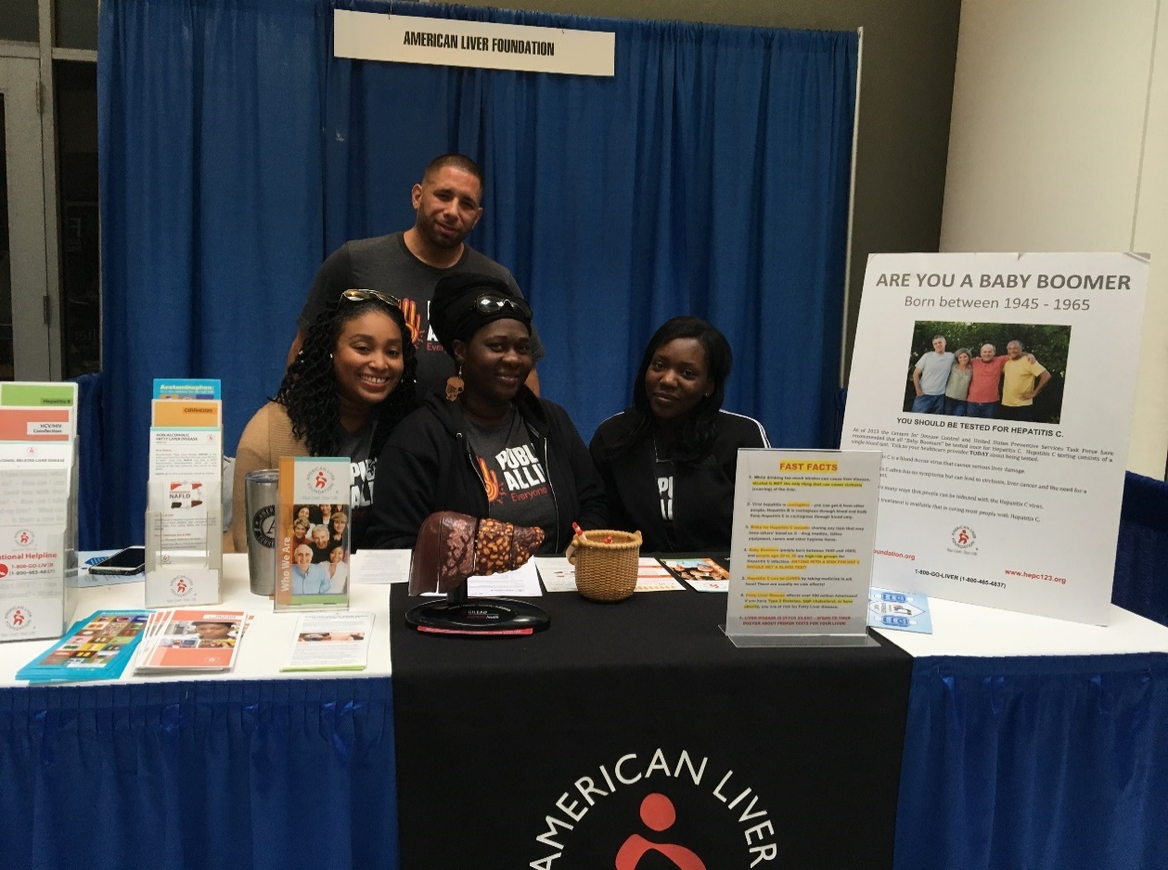
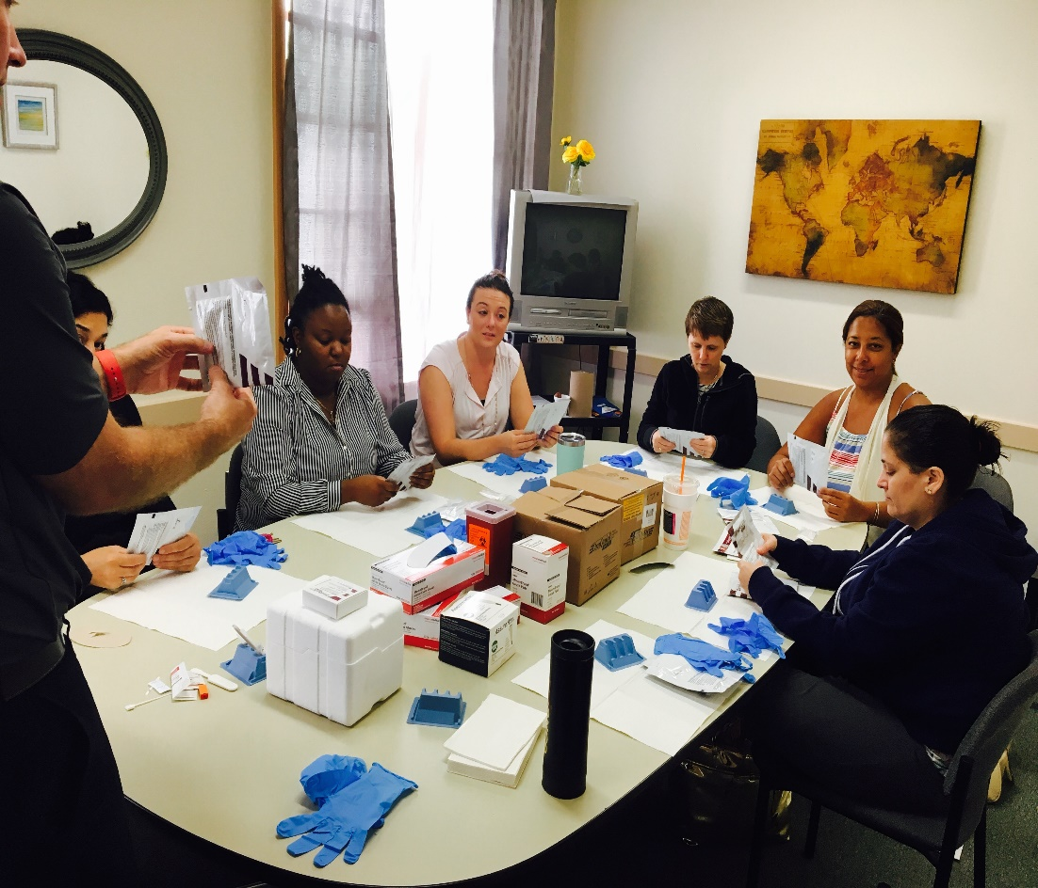
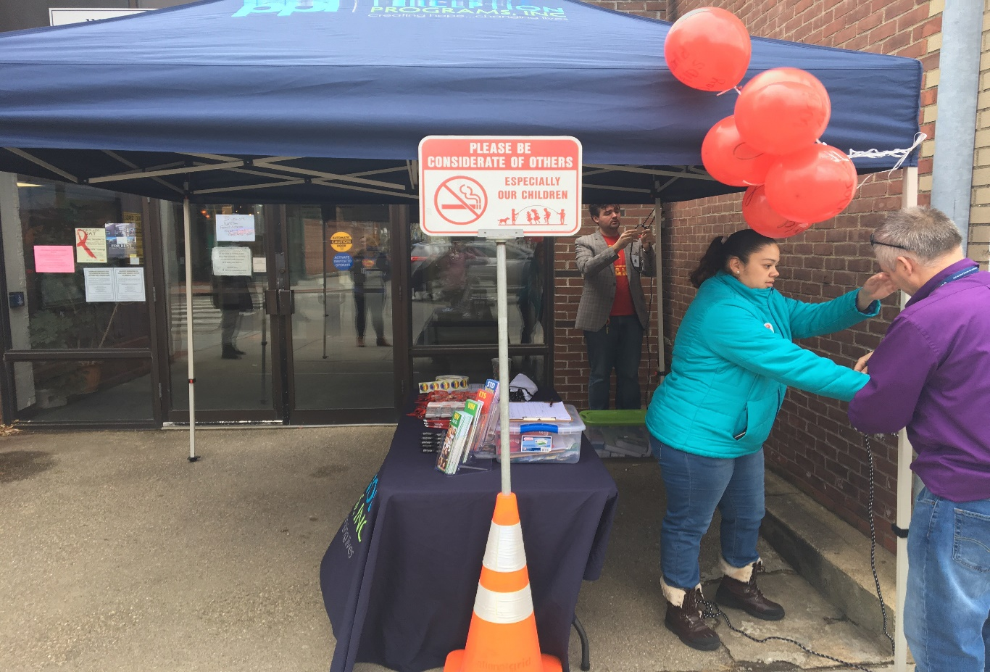
Community Awareness
Community Collaboration
Fostering community collaborations to reach broader audience
Testing Capacity Development
Training behavioral and housing providers to identify and educate the community
Visibility & Stigma
Celebrating treatment successes publicly in community

Slide 31
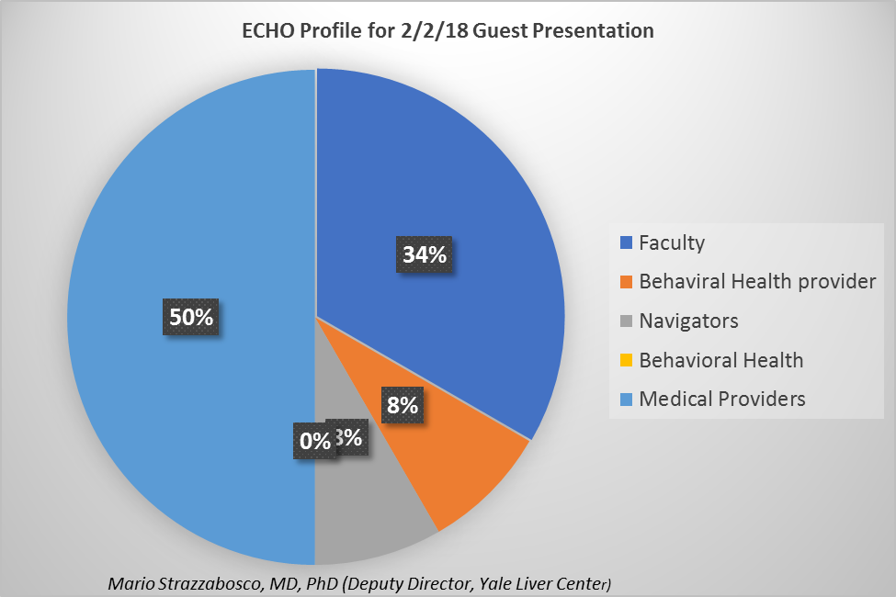
PROVIDER EDUCATION
We are implementing the AETC curriculum through Project ECHO in partnership with the Weitzman Institute at Community Health Center, Inc. which meets bi-weekly and offers guest lectures quarterly on treatment guidelines and emergent issues in hepatology and HIV, cultural competency.
Notes:
Here is the attendance breakdown from the 2/2 session:
9 total participants + 4 faculty members= 13
10 medical providers
2 behavioral health providers
1 Patient Navigator
1 Pharmacist
7 clinics
2 states
----------------------------------------------------------------
Trainees: 5

Slide 32
Identifying, Linking, Supporting Patients
Step 1: Integrated HCV surveillance between CAREWare and EHRs from data migration to identify co-infection through HAB measures.
Step 2: Enhanced CAREWare with additional HIV/HCV subservices fields to track patients along the care continuum.
Step 3: Developed clinical performance indicators as part of comprehensive quality management plan
Notes:
Brownstone Clinic
Two sero-converted:
One moved away to P.E.
One had to undergo aggressive substance use treatment

Slide 33
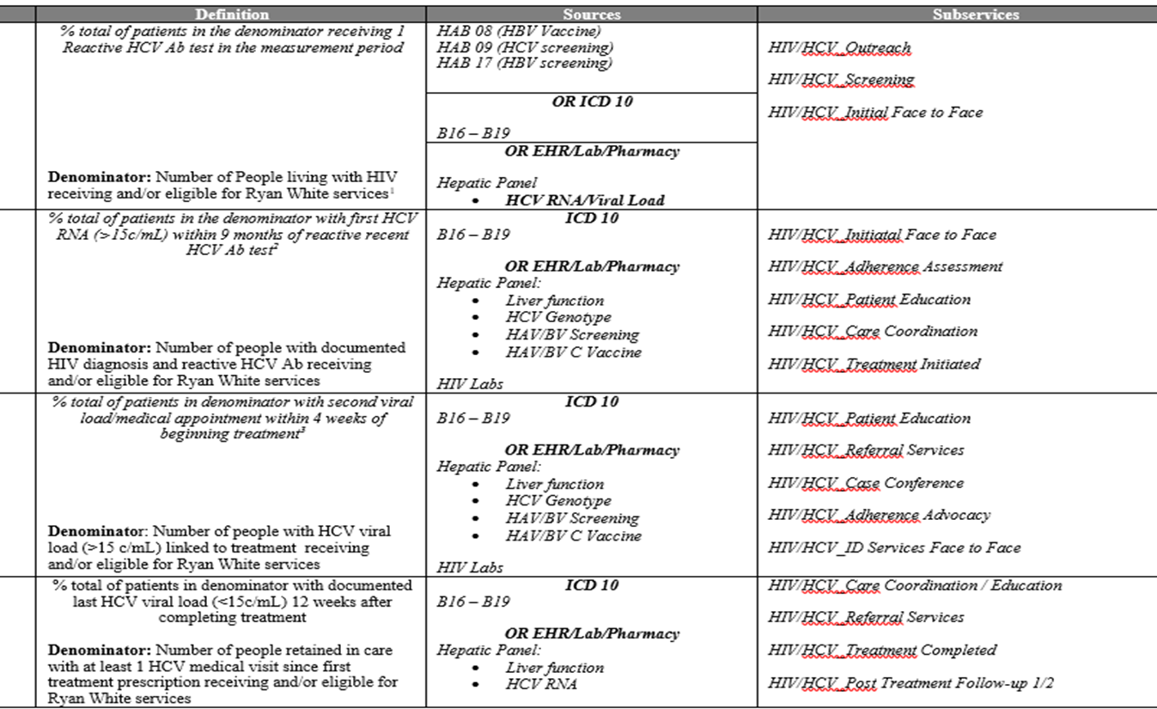
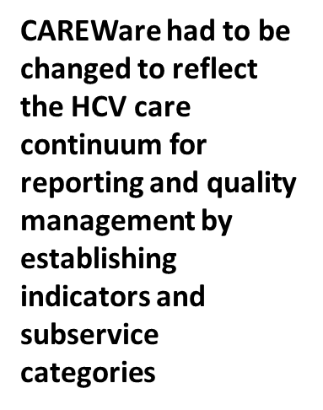
CAREWare

Slide 34
Disclaimer:
THANK YOU!!
Hartford Project ACCESS Team
  Angelique Croasdale, Principal Investigator/Project Director
  Cecil Tengatenga, Project Manager
  Peta-Gaye Nembhard, Systems Analyst
  Thomas Williams, Financial Officer
  Anila Ceka, Contract Manager
  Camille Thomas, Project Coordinator/Patient Education
  Isabelle Alexandre, Intern
  Marcie Berman, Project Evaluation, Institute of Community Research
  Kavita Prabhakar, Chief Clinical Officer, University of Connecticut
  Durkia Hudson, HRSA Project Officer
This initiative is funded through the U.S. Department of Health and Human Services (HHS) Secretary’s Minority AIDS Initiative Funding (SMAIF) and administered through the Health Resources and Services Administration (HRSA)’s HIV/AIDS Bureau (HAB) through the Special Projects of National Significance (SPNS) Program (Grant number U90HA30517). This information and its conclusions are those of the authors and should not be construed as the official position or policy of HRSA or the U.S. Government. Responsibility for the content of this report rests solely with the named authors.

Slide 35


Scaling Up Co-Infection Care & Eliminating Ethnic Disparities
Amber J Casey, MPH, Deputy Director/Project SUCCEED Director
HIV Care & Treatment Program, NYC Dept of Health and Mental Hygiene

Slide 36
Disclosures
Presenter(s) has no financial interest to disclose.
This continuing education activity is managed and accredited by AffinityCE/Professional Education Services Group in cooperation with HRSA and LRG. PESG, HRSA, LRG and all accrediting organization do not support or endorse any product or service mentioned in this activity.
PESG, HRSA, and LRG staff as well as planners and reviewers have no relevant financial or nonfinancial interest to disclose.
Commercial Support was not received for this activity.

Slide 37
Goals and Objectives
Goal: to eliminate HCV among PLWH in NYC and reduce racial/ethnic disparities in access and treatment
Objectives:
  Promote HCV screening, rescreening, and diagnostic testing according to guidelines
  Educate HIV patients about the risks of HCV, and the benefits of cure
  Increase HIV clinical and non-clinical provider HCV knowledge and care management skills
  Support organizations to identify, return to care, and treat all HCV patients
  Conduct case investigation and linkage to care for patients who can not be returned to care by an organization

Slide 38
Project SUCCEED Approach
Education &Training
Practice Transformation
Technical assistance
Case Investigation & Linkage to Care
Finding lost patients
Clinical and non-clinical provider training
Patient education
Return to care support
Community of Practice and Learning
Data monitoring
HCV Toolkit
Direct outreach and linkage to care
Dear Colleague Letter
Notes:
This presentation should be 20 minutes with 10 minutes left for discussion
This presentation should include:
Patient Knowledge Assessment
Provider Knowledge Assessment
Structural Barriers

Slide 39
Intervention Scope
Jurisdiction wide
Intervention Sites
  Offering information and resources to all clinical and non-clinical providers
  Providing education to patients in high risk settings
  Recruiting organizations with greatest number of HIV/HCV patients in need of treatment
  Will gain commitment and develop a formal agreement

Slide 40
Identifying Clinical Providers
Based on HIV Clinical Care Site - Care Continuum Dashboard Sites
69% received continuous HIV care at the same facility in 2015
  72% received this care at a CCD site
Create HCV Care Continuums for co-infected patients at HIV CCD sites
Find top sites with high number and/or proportion of RNA unknowns (for screening outreach) and treatment uninitiated
Notes:
This presentation should be 20 minutes with 10 minutes left for discussion
This presentation should include:
Patient Knowledge Assessment
Provider Knowledge Assessment
Structural Barriers

Slide 41
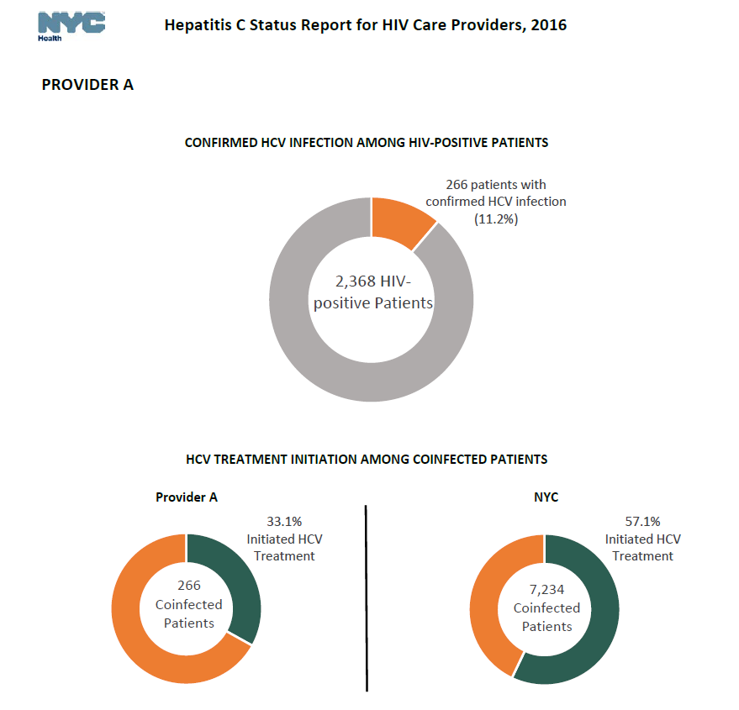
HCV Dashboards for HIV Care Providers
Dashboards were created for 47 HIV health care facilities, showing:
% HIV patients co-infected with HCV
% co-infected patients at facility who initiated treatment vs. treatment initiation rates across NYC
These clinics were offered surveillance based lists of their own co-infected patients to promote HCV treatment

Slide 42
Distributing Patient Lists
23 facilities accepted a list of their co-infected patients (799 patients in total)
Facilities were asked to:
  Review list and promote HCV treatment
  Return the list to the health department with patient status (i.e. HCV care status of each patient, treatment barriers)

Slide 43
Site Selection for Intervention
Using surveillance data, the health department:
Selected top 15 facilities with highest number or percentage of patients not yet treated for HCV
10 facilities made formal commitments to receive Practice Transformation intervention
Generated a full list of facilities with co-infected patients in need of HCV treatment
4 community health centers
6 hospitals
404 co-infected patients

Slide 44
HCV Services Improvement Plans (7 Sites)
Improve Utilization of Existing Facility Resources
Support referral to HIV or HCV navigation, case management and care coordination programs available at the facility
Leverage 340B to support HCV navigation staff
Utilize incentives and other priority resources to promote engagement in care
Systems Changes
Develop and implement QI tools to monitor patient status/outcomes and provide feedback to staff
Improve EHR systems (alerts, order sets, auto ordering, patient panels)

Slide 45
Disclaimer:
THANK YOU!!
New York City Project SUCCEED Team
  Nirah Johnson, Director, Program Implementation & Capacity Building
  MaNtsetse Kgama, HIV/HCV Project Manager
  Natalie Octave, HIV/HCV Project Coordinator
  Kizzi Belfon, Surveillance & Evaluation Analyst
  Alexis Brenes & Farma Pene, Access to Care Specialists
  Jessie Schwartz, Viral Hepatitis Clinical Coordinator
  Katherine Penrose, Senior Research Analyst
  Angelica Bocour, Director of Viral Hepatitis Surveillance
  Ann Winters, VHP Medical Director
  Graham Harriman, Director, HIV Care & Treatment Program
  Sera Morgan, New York EMA’s HRSA Project Officer
This initiative is funded through the U.S. Department of Health and Human Services (HHS) Secretary’s Minority AIDS Initiative Funding (SMAIF) and administered through the Health Resources and Services Administration (HRSA)’s HIV/AIDS Bureau (HAB) through the Special Projects of National Significance (SPNS) Program (Grant number U90HA30517). This information and its conclusions are those of the authors and should not be construed as the official position or policy of HRSA or the U.S. Government. Responsibility for the content of this report rests solely with the named authors.

Slide 46
Addressing HIV/HCV Co-infection:
Key Activities of the Northeast/Caribbean AETC
Francine Cournos, MD
Principal Investigator, Columbia University, Department of Psychiatry HIV Center

Slide 47
Collaboration on Project SUCCEED
NECA AETC collaborated with the NYCDOHMH
  Participating in community of practice and learning sessions and sharing resources
  Reviewing Project SUCCEED curriculum and tools and giving feedback
  Working on co-presentations, including an all-day conference that highlighted the national curriculum on HIV/HCV co-infection

Slide 48
HIV/HCV Co-infection: Key Activities
Offering HIV/HCV didactic and skills building presentations in the NECA region (NJ, NY, PR and USVI)
Reaching out and collaborating with forensic settings
Offering preceptorships in managing HIV/HCV co-infection in the NECA region
Developing and maintaining up-to-date guides on drug interactions and drug toxicities for HIV and HCV antiviral medications

Slide 49
Drug Interaction Guides: http://necaaetc.org/content/clinical-support-tools
Our regional pharmacist, John Faragon, creates and maintains up-to-date guides on drug interactions between HCV medications, HIV medications, and other commonly prescribed drugs. There are currently five guides.
  Elbasvir/Grazoprevir (ZepatierTM)
  Glecaprevir/Pibrentasvir (MavyretTM)
  Ledipasvir/Sofosbuvir (Harvoni®)
  Sofosbuvir/Velpatasvir (Epclusa®)
  Sofosbuvir/Velpatasvir (Vosevi®)

Slide 50
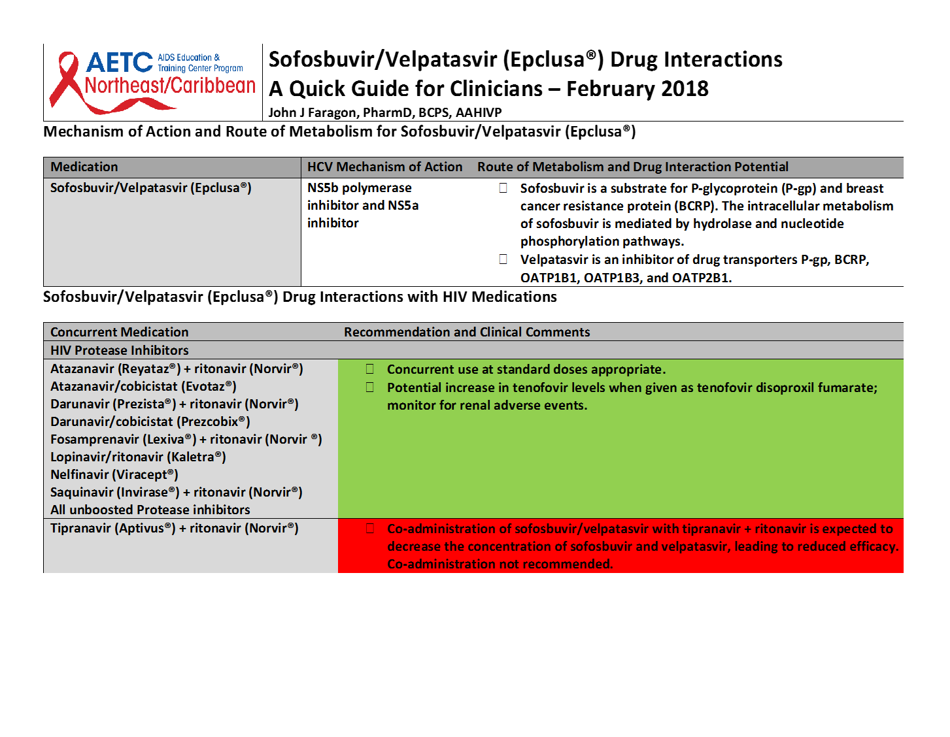

Slide 51

Partnership for Ongoing Clinical Support: The National Clinician Consultation Center (CCC)
Cristina Gruta, PharmD, AAHIVP
Senior Consultant
Clinician Consultation Center (CCC)

Slide 52

Acknowledgement of Support
This project is supported by the Health Resources and Services Administration (HRSA) of the U.S. Department of Health and Human Services (HHS) under grant number U1OHA30039-01-00 (AIDS Education and Training Centers National Clinician Consultation Center) in partnership with the HRSA Bureau of Primary Health Care (BPHC) awarded to the University of California, San Francisco.

Slide 53

Disclosures
Presenter(s) has no financial interest to disclose.
This continuing education activity is managed and accredited by AffinityCE/Professional Education Services Group in cooperation with HRSA and LRG. PESG, HRSA, LRG and all accrediting organization do not support or endorse any product or service mentioned in this activity.
PESG, HRSA, and LRG staff as well as planners and reviewers have no relevant financial or nonfinancial interest to disclose.
Commercial Support was not received for this activity.

Slide 54


Who we are
Our mission: to improve patient health outcomes by building the capacity of healthcare providers through expert clinical consultation and education
FREE clinical decision support to U.S.-affiliated clinicians for 25+ years
Multidisciplinary, inter-professional teams → 500+ collective years of direct clinical experience in substance use, HIV, and HCV
Wrap-around/”one-stop” resource for expert consultation
Practical, point-of-care assistance!

Slide 55
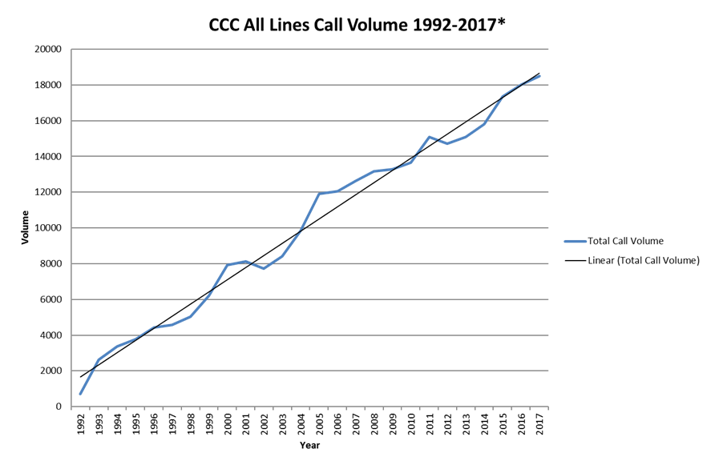





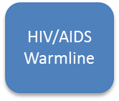
What we do
Notes:
Personal, not an “abstract”/faceless resource- catered to specific pt (and caller/practice)- numbers don’t reflect that every single caller gets individualized attention, that is CASE SPECIFIC

Slide 56

HCV Consultation Services
(844) 437-4636 | 9AM-8PM ET, M-F nccc.ucsf.edu
The Clinician Consultation Center (CCC) provides up-to-date expert clinical advice to support primary care providers managing complex patients with hepatitis C (HCV) and co-morbidities such as HIV co-infection or substance use disorder. Advice provided is based on Federal treatment guidelines, current medical literature, and clinical best practices.

Slide 57
HCV Warmline: Primary Goals
Support any clinical professional, especially ones in primary care-oriented practices, regarding managing patients with hepatitis C (HCV) and co-morbidities such as HIV or substance use
Free
Confidential
Immediate
Clinical decision support
Telephone or web-based
* We’ll help with “simple” cases too!!

Slide 58
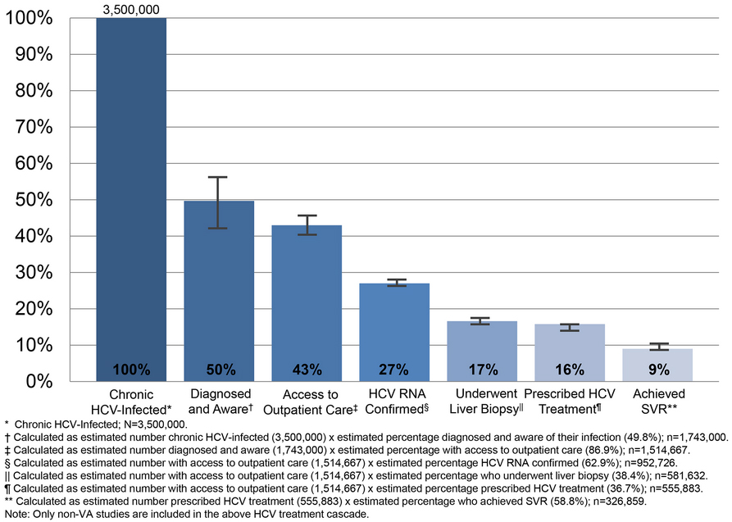
HCV Consultation Service (HEPline):
Guidance Across Entire HCV Continuum
Yehia, et al. Plos ONE. 2014

Slide 59

HEPline: Consultation Topics
Screening and diagnosis
Pre-treatment
evaluation
- Liver disease staging
- Patient education/counseling
Strategies for Rx approval
Healthcare maintenance
Regimen selection
- Drug interactions
- Treatment history status
Transmission &
re-infection prevention
Monitoring (toxicity, response)
1/3 cases: pts with significant fibrosis or cirrhosis
2/3 cases: treatment-experienced patients
“Special populations”, i.e. HIV or HBV co-infection, substance use, kidney disease, pregnancy/ postpartum/ breastfeeding

Slide 60
HCV Line: Case 1
Caller an MD in NYC– provides primary care to PLHIV, wishes to start treating HCV
Pt is a 55 yo male HIV/HCV co-infected, dx HCV+ in 2008, h/o IDU but has been on methadone maintenance X 10 yrs
GT1a, treatment-naïve; HCV VL 3.99 million (Aug 2018)
FIB-4→ 1.48; APRI→ 0.33; Fibrometer→ 0.53 (bridging fibrosis); abdominal ultrasound→ normal liver
Meds– ABC/3TC/DTG (Triumeq®), methadone, sildenafil PRN
QUESTIONS
  How do you choose among the many options for treating GT1a infection?
  How does HIV-infection affect my treatment choice?

Slide 61
HCV Line: Case 2
Caller is RN care coordinator at a community health center in Northern CA
Pt is 34 yo female who is a PLWH; she is 25+5 weeks pregnant presenting to care for the first time in caller’s clinic.
HIV records are scattered and pt is a poor historian; on TRV + DTG, unclear when started, HIV VL 31,000
Earlier in pregnancy was also newly dx HCV+ with HCV VL 10 million, RF= IDU
Pt also started on buprenorphine in the past few weeks
QUESTIONS
  Please help us with her care plan

Slide 62
Where do I start??
Do I still need to check a HCV genotype?
How to get treatment approved?
How do I stage my patient’s liver disease?
Monitoring during/after treatment?
Medication interactions?
Do I need to screen for HCC?
Other clinical education/ resources?
Do I vaccinate if only HBcAb+?
Patient resources?
How to address co-occurring substance use and chronic pain?
What should I do about our medication agreement?
How do I apply for a DATA 2000 waiver?
Should I taper my patient’s pain medications?
How long does waiver training take?

Slide 63



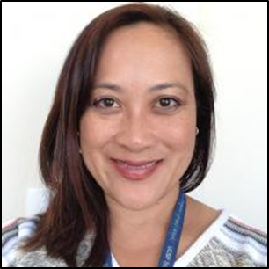

CCC Team Members (HIV, HCV)
Michele Tana, MD, MHS is a hepatology specialist who provides consultation on viral hepatitis and other liver/GI disorders.
Jason Tokumoto, MD is an Infectious Diseases specialist who has provided care at the Native American Health Center and the Asian/Pacific Islander Wellness Center in San Francisco.
Betty Dong, PharmD is a clinical pharmacist who provides HIV and hepatitis C consultation. She sees patients at ZSFG’s Family Health Center as well as the UCSF Liver Clinic.
Carolyn Chu, MD, MSc, AAHIVM is the Clinical Director of the CCC. She is an AAHIVM-credentialed HIV Specialist. She provides expert HIV and HCV consultation. Previously she was the medical director at a large network of federally qualified health centers in Manhattan. Her clinical work is with zSFG’s Family Health Center.
Cristina Gruta, PharmD is a clinical pharmacist who specializes in HIV and HCV. She sees patients at UCSF’s 360 Wellness Center.

Slide 64
Thank you!
To learn more, please visit: nccc.ucsf.edu
Questions/marketing materials? Email marliese.warren@ucsf.edu
Substance Use Warmline 855-300-3595
Substance use evaluation and management
HEPline 844-HEP-INFO
HCV testing, staging, monitoring, treatment
HIV/AIDS Warmline 800-933-3413
HIV testing, ARV decisions, complications, and co-morbidities
PrEPline 855-HIV-PrEP
Pre-exposure prophylaxis for persons at risk for HIV
Perinatal HIV Hotline 888-448-8765
Pregnant women with HIV or at-risk for HIV & their infants
PEPline 888-448-4911
Occupational & non-occupational exposure management

