Slide 1
Health and Social Services Recovery Support Function – Puerto Rico se Levanta! 12992 December 14, 2018
Mae Rupert
Branch Chief, Northeast Region
Division of Metropolitan HIV/AIDS Programs (DMHAP)
HIV/AIDS Bureau (HAB)
Health Resources and Services Administration (HRSA)

Slide 2
Health Resources and Services Administration (HRSA) Overview
Supports more than 90 programs that provide health care to people who are geographically isolated, economically or medically vulnerable through grants and cooperative agreements to more than 3,000 awardees, including community and faith-based organizations, colleges and universities, hospitals, state, local, and tribal governments, and private entities
Every year, HRSA programs serve tens of millions of people, including people living with HIV/AIDS, pregnant women, mothers and their families, and those otherwise unable to access quality health care

Slide 3
HIV/AIDS Bureau Vision and Mission
Vision
Optimal HIV/AIDS care and treatment for all.
Mission
Provide leadership and resources to assure access to and retention in high quality, integrated care, and treatment services for vulnerable people living with HIV/AIDS and their families.

Slide 4
Ryan White HIV/AIDS Program
Provides comprehensive system of HIV primary medical care, medications, and essential support services for low-income people living with HIV
More than half of people living with diagnosed HIV in the United States – more than 550,000 people – receive care through the Ryan White HIV/AIDS Program (RWHAP)
Funds grants to states, cities/counties, and local community based organizations
Recipients determine service delivery and funding priorities based on local needs and planning process
Payor of last resort statutory provision: RWHAP funds may not be used for services if another state or federal payer is available
84.9% of Ryan White HIV/AIDS Program clients were virally suppressed in 2016, exceeding national average of 59.8%
Source: HRSA. Ryan White HIV/AIDS Program Annual Client-Level Data Report 2016; CDC. HIV Surveillance Supplemental Report 2016;21(No. 4)

Slide 5
Welcome to the Emergency Preparedness Institute

Slide 6
Speaker Introductions
Joshua Barnes
Acting Director
Recovery Division
Department of Health and Human Services
Assistant Secretary for Preparedness and Response (ASPR)
CAPT Todd Lennon
Emergency Coordinator
Division of Security Services
Health Resources and Services Administration
Chaunetta Jones, PhD, MPH
Health Scientist, Research & Evaluation
FDA Center for Tobacco Products
Office of Health Communication & Education
U.S. Food and Drug Administration
Mae Rupert
Branch Chief, Northwest Region
Division of Metropolitan HIV/AIDS Programs
HIV/AIDS Bureau
Health Resources and Services Administration

Slide 7
Emergency Preparedness Institute Learning Objectives
Examine ways for RWHAP recipients across Parts A – D and Part F to maximize federal resources through coordination and community planning.
Raise awareness of the need to incorporate disaster preparedness in RWHAP planning processes and continuity of operations.
Ensure recipients and people living with HIV (PLWH) know how to access technical assistance (TA) resources related to disaster preparedness and emergency management.

Slide 8
Institute Format
Emergency Preparedness 101
Listen to and learn from the experiences of RWHAP providers who have worked through a natural disaster or local emergency, such as Hurricanes Harvey, Irma, and Maria.
Identify strategies to prepare for, respond to, and recover from natural disasters and local emergencies.
Discuss the important elements of an Emergency Plan and its impact on risk management, client retention in care, continuity of operations, and federal communication.
Emergency Preparedness 201
Learn from the RWHAP Part A and Part B recipients about their efforts related to the 2017 Atlantic hurricanes.
Identify strategies to prepare for, respond to and recover from disasters and emergencies.
Describe implications for RWHAP at the city, county and state levels.
Emergency Preparedness 301
Identify and describe the nine core mission areas of the HSS RSF within the National Disaster Recovery Framework (NDRF) and applicability to Puerto Rico recovery.
Describe key components of the Puerto Rico Recovery Plan.
Describe emergency preparedness plan implications for RWHAP.
Notes:
The institute includes 3 different 90-minute workshops. These workshops will build upon each other. The objectives for each of the three workshops are as follows:

Slide 9
Learning Objectives
At the conclusion of this activity, the participant will be able to:
Identify and describe the nine core mission areas of the Health and Social Services (HSS) Recovery Support Function (RSF) within the National Disaster Recovery Framework (NDRF).
Describe key components of the Puerto Rico Recovery Plan.
Describe emergency preparedness and plan implications for RWHAP.

Slide 10
Health and Social Services (HSS) Recovery Support Function (RSF)
Joshua Barnes
Acting Director, Recovery Division
DHHS/ASPR
December, 14, 2018

Slide 11
Overview
National Disaster Recovery Framework (NDRF)
+
Health and Social Services (HSS) Recovery Support Function (RSF)
Notes:
All federal recovery coordination activities are guided by the National Disaster Response Function. A key facet of the National Disaster Recovery Framework (NDRF) is how it builds on lessons learned from past disasters and looks at recovery from a thematic perspective as opposed to an organizational one.
The structures, roles, and responsibilities described in the NDRF can be partially or fully implemented in the context of a threat or hazard, in anticipation of a significant event, or following an incident.
Effective implementation of the NDRF involves close collaboration between federal, state, and local agencies – as well as private stakeholders. Such collaboration is the cornerstone of successful recovery efforts in disaster affected communities.
A major change that came with the NDRF was the creation of six Recovery Support Functions (RSFs) to direct the federal government to align its capabilities and resources along thematic recovery issues.

Slide 12
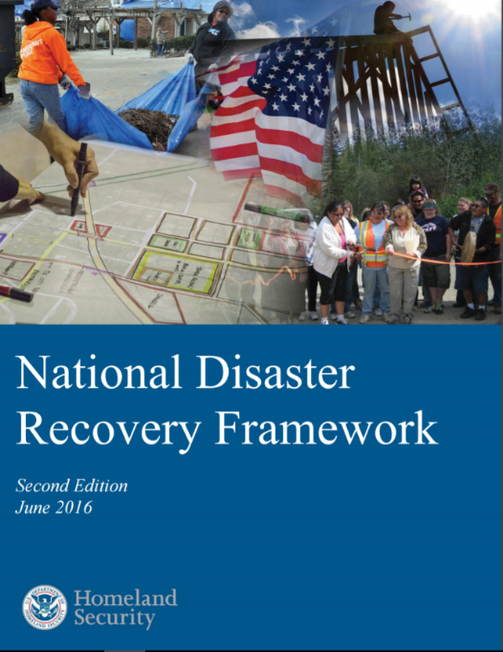
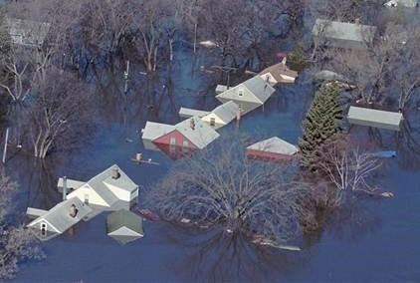
National Disaster Recovery Framework
Established September 2011 (refreshed June 2016)
Shifted recovery from an dispersed, agency-specific approach to an integrated, sector-based approach
Emphasizes local primacy, unity of effort, and pre-disaster planning
Notes:
Restate the slide

Slide 13
National Disaster Recovery Framework Concepts
Recovery starts with response
Recovery supports ESF actions
Recovery actions begin with situational awareness and impact evaluation – often through interagency coordination
Notes:
Short-term recovery is really the bridge and heavily response-focused.

Slide 14
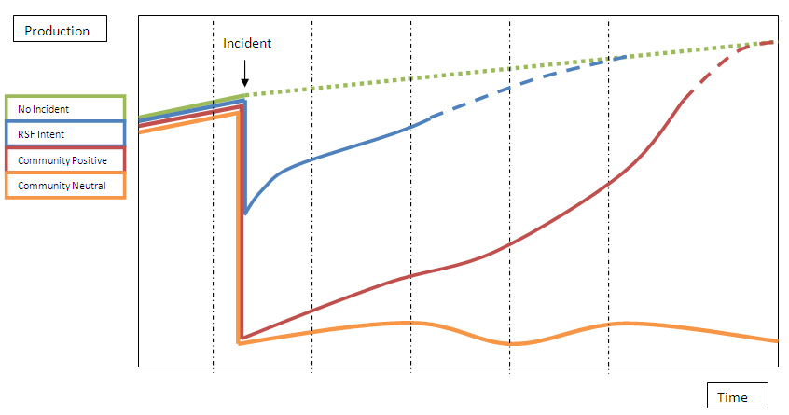
National Disaster Recovery Framework Concepts (2)
Impacted communities will endure the recovery regardless
RSF-model, led by ASPR, reduces the “transaction costs” for the community (and state) through targeted technical assistance and resource coordination
Notes:
Simply put, both pre- and post-recovery planning are key to a well-orchestrated recovery process at the local, State and Tribal levels.
Communities are more likely to succeed when recovery is deliberate and intentional. The benefits of this kind of coordination and pre-planning can extend far beyond their use in disaster recovery.
Incorporate recovery planning into land use:
Master Plan
Capital Improvement
Mitigation
Economic Development
Other “typical” community, regional, state, or tribal planning efforts
Pre-disaster planning
Establish Relationships (peacetime) – slide mentions some key stakeholders/partners:
Non-profits, private sector, local government, individuals and families, State, Tribal, Federal
Everyone has a role in recovery efforts.
Understand your pre-disaster baseline.
What’s important to your community?
What are the most valuable qualities that define your community?
What in your community is at risk?
What do you want to improve?
How can you protect those things that are important?
Post-Disaster Planning
Goals and Milestones to measure and document progress?
Charting a course, setting expectations, celebrating success and making adjustments
Identifying the roles, requirements and resources needed
Building clear, consistent, and meaningful communication pathways to the Whole Community
Answering the question, “Who do we want to be as a community? What is our ‘new normal?”

Slide 15
Recovery Support Functions
Recovery Support Functions
Community Planning and Capacity Building
Federal Emergency Management Agency
Economic
Department of Commerce
Infrastructure Systems
United States Army Corps of Engineers
Housing
Department of Housing and Urban Development
Natural and Cultural Resources
Department of the Interior
Health and Social Services
Department of Health and Human Services
The NDRF organizes federal departments and agencies into six Recovery Support Functions (RSFs). Each RSF is led by a designated federal department or agency known as the Coordinating Agency. RSFs are coordinated by a Federal Disaster Recovery Coordinator.
Notes:
The NDRF organizes federal departments and agencies into six Recovery Support Functions or (RSFs). Each RSF focuses on a key functional aspect of recovery and provides the coordination structure for providing relevant federal assistance. Each RSF is led by a designated federal department or agency called the Coordinating Agency. These agencies guide the efforts of their respective RSF while ensuring close coordination with the others. The six RSFs are Community Planning and Capacity Building, Economic, Infrastructure Systems, Housing, Natural and Cultural Resources, and Health and Social Services. These RSF’s are led, respectively, by the Federal Emergency Management Agency (FEMA), the Department of Commerce, the US Army Corps of Engineers, the Department of Housing and Urban Development, the Department of the Interior, and the Department of Health and Human Services.

Slide 16
HSS RSF Scope – Nine Core Mission Areas
To fulfill its Core Functions, the HSS RSF focuses on 9 Core Mission Areas :
Public Health
Healthcare Services
Environmental Health
Behavioral Health
Food Safety and Regulated Medical Products
Social Services
Referral to Social Services / Disaster Case Management
Long-Term Recovery Impacts to First Responders
Children in Disasters (Schools, Children, and Youth)
Notes:
To fulfill its Core Functions and Capabilities, the HSS RSF focuses on nine Core Mission Areas. These are: public health, health care service impacts, environmental health impacts, behavioral health impacts, food safety and regulated medical products, social service impacts, referral to social services / disaster case management, long-term recovery impacts to first responders, and children in disasters (including schools, children, and youth).
The following remarks will examine, in detail, the sub-tasks involved in each of these Core Mission Areas.

Slide 17
Recovery Implementation
HSS Recovery carries out three basic steps:
Conduct a Mission Scoping Assessment – In partnership with the state, capture the overarching issues as it relates to health and social services recovery
Develop a Recovery Support Strategy – In partnership with the state, document the federal capabilities available to be leveraged to support health and social services recovery
Implement/Facilitate the Recovery Support Strategy – Undertake those initiatives identified in the Recovery Support Strategy and work with the state to facilitate the transition to steady-state operations
RSF activities fall into three major categories:
Technical assistance – (e.g., Peer-to-peer planning workshops)
Information sharing – (e.g., connecting the dots between disparate data sources – providing the state a strategic view across the mission areas)
Leveraging existing resources – (e.g., working with federal program staff to retool planned initiatives to also support immediate recovery needs)

Slide 18
The HSS RSF has 10 Primary and 7 Supporting Agencies
Primary
Department of Health and Human Services
Corporation for National and Community Service
Department of Agriculture
Department of Commerce
Department of Homeland Security
Department of Housing and Urban Development
Department of the Interior
Department of Justice
Department of Labor
Environmental Protection Agency
Supporting
American Red Cross
Department of Education
Department of Transportation
Department of the Treasury
Department of Veterans Affairs
National Voluntary Organizations in Disaster
Small Business Administration

Slide 19
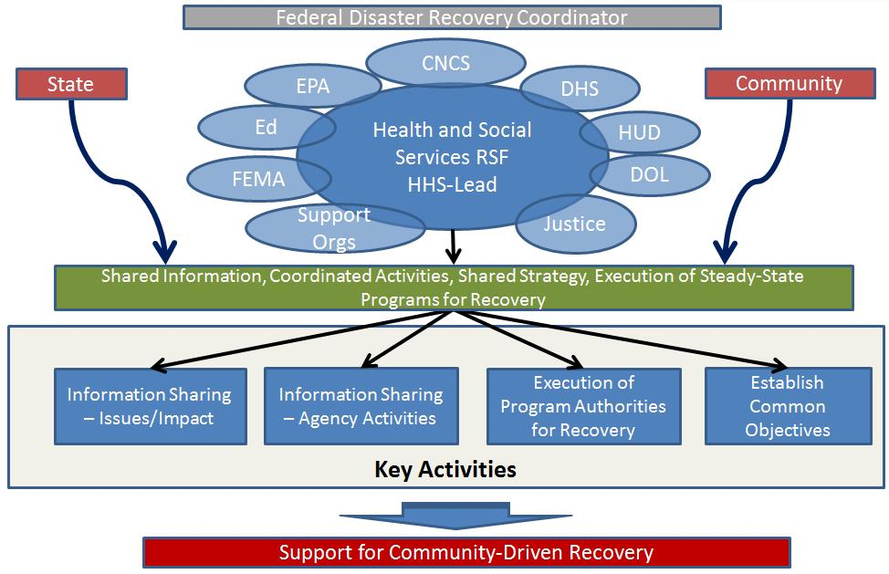
Recovery Coordination Model
HHS serves as a central integrator to collect impact information, build a shared strategy, and coordinate health and social services to better support the impacted community.
Notes:
HHS serves as a central integrator to collect impact information, build a shared strategy, and coordinate health and social services to better support the impacted community.

Slide 20
Top 3 Mission Priorities
Health and Social Services RSF mission should accomplish:
Supporting state departments of health, social services, and education to better understand/describe the extent and nature of HSS recovery issues (with evidence).
Identify short term, actionable courses of action.
Document a transition plan that outlines future potential courses of action, by issue area, to support the state in undertaking further recovery implementation activities.

Slide 21
Ultimate Goal - Locally-Led Recovery Efforts
HSS RSF focuses on building a local capabilities to lead their recovery by:
Facilitate local stakeholder participation and promote intergovernmental and public-private partnerships.
Organize and request assistance and/or contribute resources and solutions.
Integrate steady state planning and resources to identify and resolve on-going recovery issues.
Notes:
Together, the RSFs help facilitate local stakeholder participation and promote intergovernmental and public-private partnerships. RSFs and stakeholders organize and request assistance and/or contribute resources and solutions. Relevant stakeholders and experts from all six RSFs are brought together during steady state planning and when activated post-disaster to identify and resolve.

Slide 22
Contact Information
Joshua Barnes
Acting Director
Recovery Division
Department of Health and Human Services
Assistant Secretary for Preparedness and Response (ASPR)
Email: Joshua.barnes@hhs.gov
Phone: 202-260-6123
Notes:
(202) 260-6123

Slide 23
HRSA Emergency Coordination CAPT Todd Lennon

Slide 24
Agenda
HRSA’s Role
Emergent Event Activities
Preparedness
Response
Recovery

Slide 25
HRSA’s Role
Mission: To improve health and achieve health equity through access to quality services, a skilled health workforce, and innovative programs
Steady state programs contribute significantly to community health resilience, enabling underserved communities to better respond to and recover from emergent events
No funding or authority specifically for emergency preparedness, response, or recovery activities
Activities led or coordinated by HRSA’s Emergency Coordinator with significant input and support from program offices
Stakeholders include recipients, communities, populations, and ASPR

Slide 26
Emergent Event Activities: Preparedness
Situational awareness and analysis
Departmental-level working groups (e.g., ASPR)
Developing relationships and processes with internal and external partners
Program-level education and encouragement to become involved in community-level emergency preparedness and response activities

Slide 27
Emergent Event Activities: Response
Information management
Provider and community status
Requests for information
Support ESF #8
Clinical care support
Programmatic technical assistance
Personnel
Administration of supplemental funding

Slide 28
Emergent Event Activities: Recovery
Support HSS RSF
Essentially the same as response, but with less frequency and with a focus on helping affected communities use HRSA’s steady state programs to strengthen their health care infrastructure
Information management
Clinical care support
Programmatic technical assistance
Personnel
Administration of supplemental funding

Slide 29
Contact Information
CAPT Todd Lennon
Emergency Coordinator
Office of Operations
Health Resources and Services Administration (HRSA)
Email: tlennon@hrsa.gov
Phone: 301-443-2013

Slide 30
HSS RSF Behavioral Health Human Services Chaunetta Jones

Slide 31
Health and Human Services Recovery Support Function Behavioral Health Chaunetta Jones

Slide 32
Behavioral Health
VISION
Make Puerto Rico a Role Model for Behavioral/Mental Health Care and Service Delivery

Slide 33
Behavioral Health
Understand the landscape of behavioral, emotional, and mental health unmet needs among different sectors of the Puerto Rican population
Goals
Promote empowerment and post-disaster stress-reduction through peer-to-peer interaction
Promote Psychological First Aid (PFA) Training for First Responders
Identify opportunities and solutions to address unmet B/E/M Health needs across Puerto Rico
Collaborate with ASSMCA (Administración de Servicios de Salud y Contra la Adicción), the PR Department of Health (PRDOH) and other behavioral/mental health care delivery stakeholders

Slide 34
Behavioral Health Accomplishments
Participated in HSS RSF Partner Listening Visits and visits to critical healthcare facilities to gather information and data on BH needs and opportunities to coordinate BH services across community settings including schools, outpatient clinics, hospitals and social services organizations
Coordinated the distribution of SAMHSA educational materials throughout Puerto Rico via the Crisis Counseling Program (CCP)
Ongoing compilation of a repository of behavioral health resources collected to-date, including potential assessment tools and health communication materials
Notes:
Inventory –
Created a unique database of public (owned and administered), private nonprofit, and private for-profit healthcare facilities in Puerto Rico through the reconciliation of multiple data sources. This comprehensive database did not exist prior to the recovery, though its contents were fragmented in databases provided by different offices within the PRDOH.
This database was/will be critical to assist FEMA and the PRDOH in determining which facilities were eligible for Public Assistance and for future decision-making regarding mitigation or potentially building new PRDOH-owned healthcare facilities.
Assessment
Developed a Critical Healthcare Facility Discussion Tool and Schedule to document current operational status, preparedness, and recovery. Published in Survey123, which helped us confirm the GIS coordinates of critical healthcare facilities.
HCS Branch assessment teams visited a total of 172 healthcare facilities, including 62 hospitals across the main island, and 4 FQHCs, 97 CDTs, and 9 other facilities across all health regions, and located in 56 municipalities.
This was of particular importance for RWHAP recipient as identified critical healthcare organizations with damages that could apply for FEMA public assistance

Slide 35
Behavioral Health Accomplishments
Submitted a proposal to provide evidence-based PFA and mental health hygiene across Puerto Rico
Initiated the compilation of a database of vetted, trained volunteers who can provide community-level psychological first aid services
Developed a Storytelling (“Cuéntame”) project to promote empowerment and post-disaster stress-reduction through peer-to-peer interaction
Initiated a public service announcement (PSA) media campaign to educate the public about the realities of disaster reactions and point to resources available from ASSMCA, PRDOH, FEMA and the HSS
Notes:
Inventory –
Created a unique database of public (owned and administered), private nonprofit, and private for-profit healthcare facilities in Puerto Rico through the reconciliation of multiple data sources. This comprehensive database did not exist prior to the recovery, though its contents were fragmented in databases provided by different offices within the PRDOH.
This database was/will be critical to assist FEMA and the PRDOH in determining which facilities were eligible for Public Assistance and for future decision-making regarding mitigation or potentially building new PRDOH-owned healthcare facilities.
Assessment
Developed a Critical Healthcare Facility Discussion Tool and Schedule to document current operational status, preparedness, and recovery. Published in Survey123, which helped us confirm the GIS coordinates of critical healthcare facilities.
HCS Branch assessment teams visited a total of 172 healthcare facilities, including 62 hospitals across the main island, and 4 FQHCs, 97 CDTs, and 9 other facilities across all health regions, and located in 56 municipalities.
This was of particular importance for RWHAP recipient as identified critical healthcare organizations with damages that could apply for FEMA public assistance

Slide 36
Health and Human Services Recovery Support Function Human Services

Slide 37
Human Services
VISION
Enhance and ensure the accessibility to human and social service programs across the lifespan for Puerto Ricans

Slide 38
Human Services
Enhance PR Department of the Family (PRDF) emergency preparedness, response, and recovery planning and operations
Goals
Similarly, support PR Department of Education (PRDE) throughout recovery
Monitor prevalence of food insecurity and potential nutrition deficiencies
Support special populations during disaster recovery including:
Children and families
At-risk and vulnerable
Work environment for PRDF staff
Seniors

Slide 39
Human Services Accomplishments
Worked with FEMA Hazard Mitigation and PA to identify a process for remediating and digitizing PRDF records contaminated by mold
Educated PRDF staff on post-disaster environmental health threats posed by mold in buildings damaged by the Hurricane Maria
Monitored USDA waivers related to increased NAP funding to encourage awareness of available food programs
Supported PR authorities in requesting an extension or transitioning off of WIC, NAP and Children’s Nutrition Program waivers
Launched analysis of anticipated increase in food costs due to loss of crops
Notes:
Inventory –
Created a unique database of public (owned and administered), private nonprofit, and private for-profit healthcare facilities in Puerto Rico through the reconciliation of multiple data sources. This comprehensive database did not exist prior to the recovery, though its contents were fragmented in databases provided by different offices within the PRDOH.
This database was/will be critical to assist FEMA and the PRDOH in determining which facilities were eligible for Public Assistance and for future decision-making regarding mitigation or potentially building new PRDOH-owned healthcare facilities.
Assessment
Developed a Critical Healthcare Facility Discussion Tool and Schedule to document current operational status, preparedness, and recovery. Published in Survey123, which helped us confirm the GIS coordinates of critical healthcare facilities.
HCS Branch assessment teams visited a total of 172 healthcare facilities, including 62 hospitals across the main island, and 4 FQHCs, 97 CDTs, and 9 other facilities across all health regions, and located in 56 municipalities.
This was of particular importance for RWHAP recipient as identified critical healthcare organizations with damages that could apply for FEMA public assistance

Slide 40
Human Services Accomplishments
Convened biweekly workgroup in partnership with the Ombudsman for the Elders (OPPEA) to identify priorities for seniors’ recovery and preparedness
Received current list of all senior housing across Puerto Rico
Supported transition of the Children and Youth Task Forces (CYTF) to local leadership at the Instituto del Desarrollo de la Juventud
Collaborated with local partners to identify needs and recovery gaps for shelters that provide services to victims of domestic violence
Notes:
Inventory –
Created a unique database of public (owned and administered), private nonprofit, and private for-profit healthcare facilities in Puerto Rico through the reconciliation of multiple data sources. This comprehensive database did not exist prior to the recovery, though its contents were fragmented in databases provided by different offices within the PRDOH.
This database was/will be critical to assist FEMA and the PRDOH in determining which facilities were eligible for Public Assistance and for future decision-making regarding mitigation or potentially building new PRDOH-owned healthcare facilities.
Assessment
Developed a Critical Healthcare Facility Discussion Tool and Schedule to document current operational status, preparedness, and recovery. Published in Survey123, which helped us confirm the GIS coordinates of critical healthcare facilities.
HCS Branch assessment teams visited a total of 172 healthcare facilities, including 62 hospitals across the main island, and 4 FQHCs, 97 CDTs, and 9 other facilities across all health regions, and located in 56 municipalities.
This was of particular importance for RWHAP recipient as identified critical healthcare organizations with damages that could apply for FEMA public assistance

Slide 41
Human Services Accomplishments
Coordinated logistics for a team from the NYC Department of Health and Mental Hygiene to provide mental hygiene training and train-the-trainer workshops to 1,527 individuals through 27 sessions across Puerto Rico
Provided materials to PRDE for distribution to students and teachers related to hurricane preparedness, post-traumatic event resources and materials for students, human trafficking, and bullying
Advocated for the ASSMCA CCP Grant to include specific focus on children through the inclusion of a Child Coordinator
Notes:
Inventory –
Created a unique database of public (owned and administered), private nonprofit, and private for-profit healthcare facilities in Puerto Rico through the reconciliation of multiple data sources. This comprehensive database did not exist prior to the recovery, though its contents were fragmented in databases provided by different offices within the PRDOH.
This database was/will be critical to assist FEMA and the PRDOH in determining which facilities were eligible for Public Assistance and for future decision-making regarding mitigation or potentially building new PRDOH-owned healthcare facilities.
Assessment
Developed a Critical Healthcare Facility Discussion Tool and Schedule to document current operational status, preparedness, and recovery. Published in Survey123, which helped us confirm the GIS coordinates of critical healthcare facilities.
HCS Branch assessment teams visited a total of 172 healthcare facilities, including 62 hospitals across the main island, and 4 FQHCs, 97 CDTs, and 9 other facilities across all health regions, and located in 56 municipalities.
This was of particular importance for RWHAP recipient as identified critical healthcare organizations with damages that could apply for FEMA public assistance

Slide 42
Contact Information
Chaunetta Jones, PhD, MPH
Health Scientist, Research & Evaluation
Office of Health Communication and Education
FDA Center for Tobacco Products
Email: Chaunetta.Jones@fda.hhs.gov
Phone: 240-402-0427

Slide 43
HSS RSF Healthcare Services Restoration Public Health and Environmental Services Mae Rupert

Slide 44
Health and Human Services Recovery Support Function Healthcare Systems Restoration

Slide 45
Healthcare Systems Restoration
VISION
Realize a fully recovered, prepared, and response-ready healthcare system in Puerto Rico that saves lives and protects the Commonwealth’s citizens during and after real-world events

Slide 46
Healthcare Systems Restoration
Understand current public policies in delivery of care
Understand the Healthcare Workforce and brain drain impact on health care system
Identify and assess affected health care services, and the applicability of programs and waivers that support the recovery of Puerto Rico Healthcare System
Goals
Understand the current health and social services landscape

Slide 47
Healthcare Landscape Assessment
Identified critically impacted municipalities based on social vulnerability index, wind damage, and other data.
Conducted visits to 21 municipalities, including 91 healthcare, education and social services facilities to assess health and social services needs impacting recovery.
Notes:
Assessment
Developed a Critical Healthcare Facility Discussion Tool and schedule to document current operational status, preparedness, and recovery. Published in Survey123, which helped us confirm the GIS coordinates of critical healthcare facilities.
Conducted and completed landscape needs assessments/Partner Learning Visits (PLVs) of facilities in the impacted area, to identify major issues of concern and focus recovery efforts. Sites selected for the PLVs were prioritized based on input from local governments and stakeholders.
From December 11, 2017 to February 13, 2018, PLVs were performed in 97 facilities in 21 out 78 municipios. These facilities included after school programs (2), behavioral/mental health programs/clinics (6), centros de diagnóstico y tratamiento (CDTs, government-owned or -managed primary care clinics) (8), FQHCs (13), other outpatient medical facilities (3), children development service facilities (12), children transitional housing (3), comprehensive community services (3), emergency operations centers (2), homeless services (3), schools (22), senior services facilities (14), specialty clinics or services (3), and abuse victims services (2).

Slide 48
Healthcare Systems Accomplishments
Created an inventory of critical healthcare facilities in Puerto Rico
Performed in-depth assessments of the operational status (administration and clinical services), capacity, and capability for preparedness and recovery of public and private nonprofit healthcare facilities that reported damages.
Facilitated public assistance awareness and FEMA application process for eligible critical healthcare organizations.
Notes:
Inventory –
Created a unique database of public (owned and administered), private nonprofit, and private for-profit healthcare facilities in Puerto Rico through the reconciliation of multiple data sources. This comprehensive database did not exist prior to the recovery, though its contents were fragmented in databases provided by different offices within the PRDOH.
This database was/will be critical to assist FEMA and the PRDOH in determining which facilities were eligible for Public Assistance and for future decision-making regarding mitigation or potentially building new PRDOH-owned healthcare facilities.
Assessment
Developed a Critical Healthcare Facility Discussion Tool and Schedule to document current operational status, preparedness, and recovery. Published in Survey123, which helped us confirm the GIS coordinates of critical healthcare facilities.
HCS Branch assessment teams visited a total of 172 healthcare facilities, including 62 hospitals across the main island, and 4 FQHCs, 97 CDTs, and 9 other facilities across all health regions, and located in 56 municipalities.
This was of particular importance for RWHAP recipient as identified critical healthcare organizations with damages that could apply for FEMA public assistance

Slide 49
Healthcare Workforce
Held Workforce Recruitment and Retention workshop to understand the attrition, migration of healthcare professionals from Puerto Rico, healthcare professional specialty needs, and potential solutions to increase their recruitment and retention in the Commonwealth.
Implementing workforce study to assess impact
Collaborating with Infrastructure Sector to understand the pharmaceutical manufacturing impacts, dependencies, and economics and how to mitigate impact during future disasters.
Notes:
Need text for bullet 2

Slide 50
Healthcare Policy and Planning
Collaborated with PRDOH to support regional planning efforts for disaster preparedness and recovery efforts in each of the Puerto Rico health districts.
Hosted seven regional community planning workshops with hospitals, clinics, dialysis centers, and other key healthcare stakeholders.
Develop regional plans that build redundancy and support on-going recovery efforts in Puerto Rico’s health districts.
Notes:
Developed and hosted seven regional workshops of the Recovery and Resilience Healthcare Systems Network throughout July and August 2018. Representation from regional hospitals, Centers for Diagnosis and Treatment (CDTs) (private-owned and government-owned), Federally Qualified Health Centers (FQHCs), Independent Practice Associations (IPAs), dialysis centers, Coalition Liaisons, and Regional Director of Arecibo attended the workshops.

Slide 51
Health and Human Services Recovery Support Function Public Health and Environmental Health Services

Slide 52
Public and Environmental Health Services
VISION
Support Puerto Rico Government and stakeholders in the recovery efforts that would strengthen public health and environmental health management and disaster preparedness

Slide 53
Public and Environmental Health Services
Goals
Provide support to Puerto Rico Department of Health (PRDOH) in identifying and building strategies to address public health and environmental health issues
Provide support to PRDOH and their Communication Division
Provide support to PRDOH in establishing immunizations programs throughout the island

Slide 54
Public Health Accomplishments
Developed the Comprehensive Disaster Assessment and Readiness Tool (CDART) to capture a readiness assessment 72 hours prior to a disaster from a facility and a rapid post-disaster assessment
Provide support to PRDOH in re-establishing immunizations programs throughout the island
Conducted 5 Regional Workshops that trained leadership spokespersons from 78 municipalities to enhance Puerto Rico’s crisis and emergency risk communication (CERC) capacity

Slide 55
Environmental Health Accomplishments
Provided expert/advisory support to the PRDOH in identifying and building strategies to address public health and environmental health issues
Provided support to PRDOH’s lab to assess, design, and coordinate the re-establishment of services
Assisted in the structural assessment of 62 public health facilities.
Notes:
Provided expert/advisory support to the PRDOH in identifying and building strategies to address public health and environmental health issues. Collaborated with EPA Power Up and Repair Group working on providing generators to non-PRASA systems in the municipio of Naranjito and other municipios.
Developed a tool to calculate needed chlorine tablets (and cost) for non-PRASA community wells (initial cost, and monthly operational cost).
Developed distribution map of disinfection status in non-PRASA facilities to help PRDOH coordinate efforts and help prioritize communities with lack of disinfection.

Slide 56
Resources
Facilities can use
On Assistant Secretary for Preparedness and Response (ASPR) Technical Resources, Assistance Center, & Information Exchange (TRACIE) www.asprtracie.hhs.gov
“Hurricane Resources at Your Fingertips” document
On Joint Commission www.jointcommission.org
“Emergency Management Healthcare Environment Checklist”
Individuals can use
Ready.gov and Listo.gov
Notes:
ASPR TRACIE Healthcare Facility Resources for Hurricane Preparedness and Response
Hospitals and other healthcare facilities facing potential effects from Hurricane Florence can find a number of hurricane- and flood-related resources on the ASPR TRACIE Select Hurricane Resources Page. The most immediately relevant information for pre-storm actions can be found in the Hurricane Resources at Your Fingertips document – key lessons learned from previous storms are on page 2— and the Major Hurricanes: Potential Public Health and Medical Implications resource, which describes potential effects in time-phased sections.
You can also access The Joint Commission Emergency Management Healthcare Environment Checklist, which outlines facility components healthcare emergency preparedness professionals need to assess in order to sustain the healthcare environment and provide clinical services following a storm or other incident.
Department of Health and Human Services (HHS), Assistant Secretary for Preparedness and Response (ASPR)
Technical Resources, Assistance Center, & Information Exchange (TRACIE)
1844-5-TRACIE (587-2243) | askasprtracie@hhs.gov | asprtracie.hhs.gov
ASPR TRACIE is a healthcare emergency preparedness information gateway that ensures all stakeholders—at the federal, state, local, tribal, and territorial government levels and non- and for-profit organizations—have access to information and resources to improve preparedness, response, recovery, and mitigation efforts.
Ready.gov and Listo.gov
www.cms.gov/Medicare/Provider-Enrollment-and-Certification/SurveyCertEmergPrep/index.html
Note that the JOINT COMMISSION conference 2019 is on EMERGENCY PREPAREDNESS …
The 2019 conference will be held on April 23-24 at the Washington Hilton in Washington, D.C.
Related link is https://www.jointcommission.org/assets/1/6/EM_Healthcare_Environment_Checklist_copyright.pdf
^ The Joint Commission and Joint Commission Resources (JCR) are seeking proposals [DUE SEPT 1 2018] for practitioner-based, change-focused processes and practices for the 2019 Emergency Preparedness Conference. The focus of the session(s) should include new processes, technologies, techniques and/or tools, creativity, and innovation used within any health care setting. The presentation should demonstrate a successful approach to at least one of the following four phases of emergency preparedness:
• Mitigation
• Preparation
• Response
• Recovery
^

Slide 57
Contact Information
Mae Rupert
Branch Chief, Northeast Region
Division of Metropolitan HIV/AIDS Programs (DMHAP)
HIV/AIDS Bureau (HAB)
Health Resources and Services Administration (HRSA)
Email: Mrupert@hrsa.gov
Phone: 301-443-8035
Web: hab.hrsa.gov
Notes:
MR

Slide 58
Connect with HRSA
To learn more about our agency, visit
www.HRSA.gov
Sign up for the HRSA eNews
FOLLOW US:

Slide 59
https://twitter.com/PHEgov/status/1069696714058227718

