Slide 2
How the Boston Public Health Commission created a client level data system that providers actually use
HIV/AIDS Services Division
Infectious Disease Bureau
Boston Public Health Commission

Slide 3
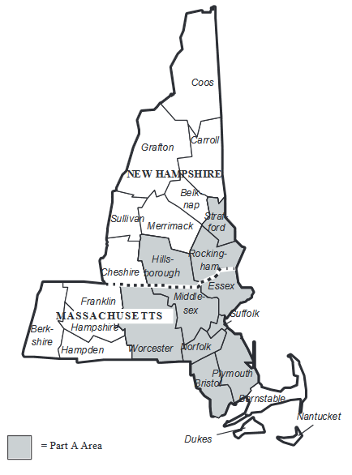
Jurisdictional Profile
The Boston EMA is a 10-county region, comprising 7 counties in MA and 3 counties in NH.
The Boston EMA Planning Council is the community planning body, which prioritizes and allocates funds to service categories.

Slide 4
Jurisdictional Profile
Boston Public Health Commission (BPHC) is designated as the Part A recipient.
The FY 2018 Award for the Boston EMA was $14.8M.
BPHC funds 32 direct service providers, including 65 programs.

Slide 5
A Measure of the Challenge
In Building e2Boston…

Slide 6
Stakeholders
  Clients served and the whole Community
  Funded agency front-line staff
  Funded agency supervisors and administrators
  Grantee Program Staff: Ryan White
  Grantee Researchers and Evaluators
  Grantee Policy and Planning
  Grantee Administration
  Federal Funding Sources (HRSA)
  Grants Managers
  Quality Managers
  Information Technology
  Department / Leadership
  Planning Groups (Planning Council, etc)
  …
Notes:
Started programming 20 years ago

Slide 7
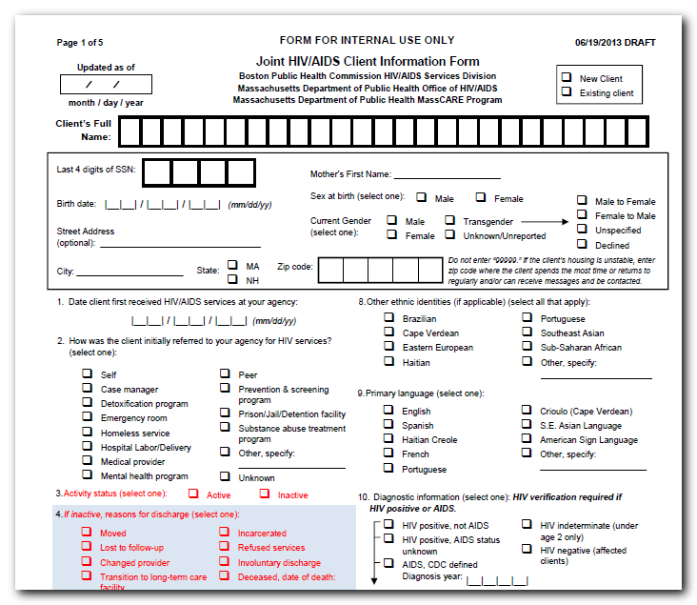
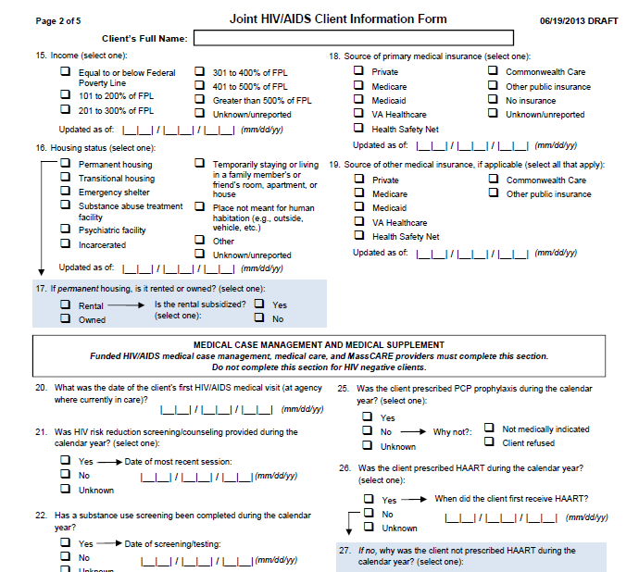
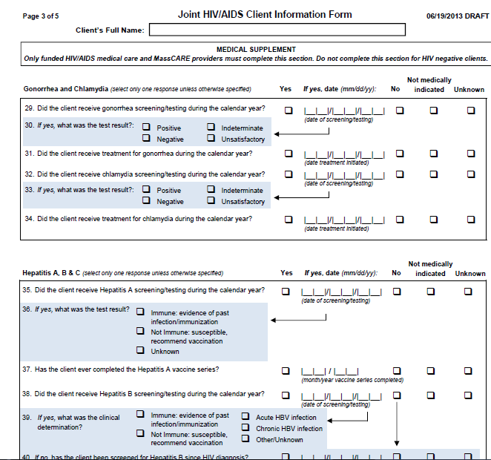
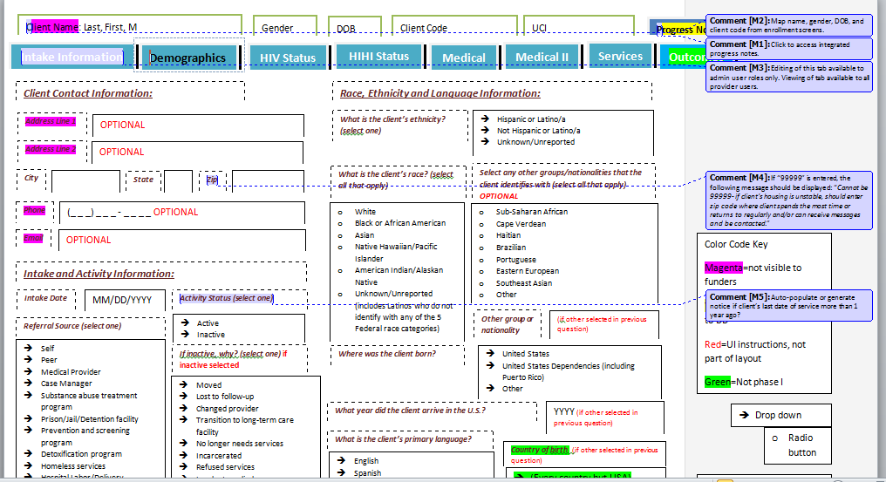
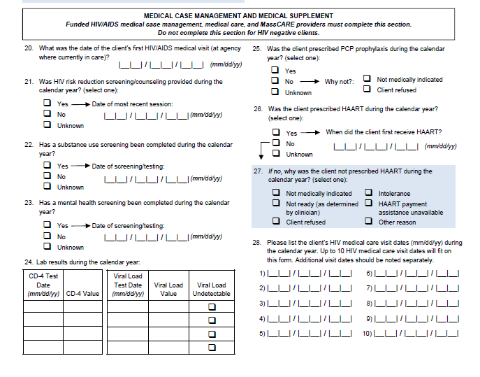
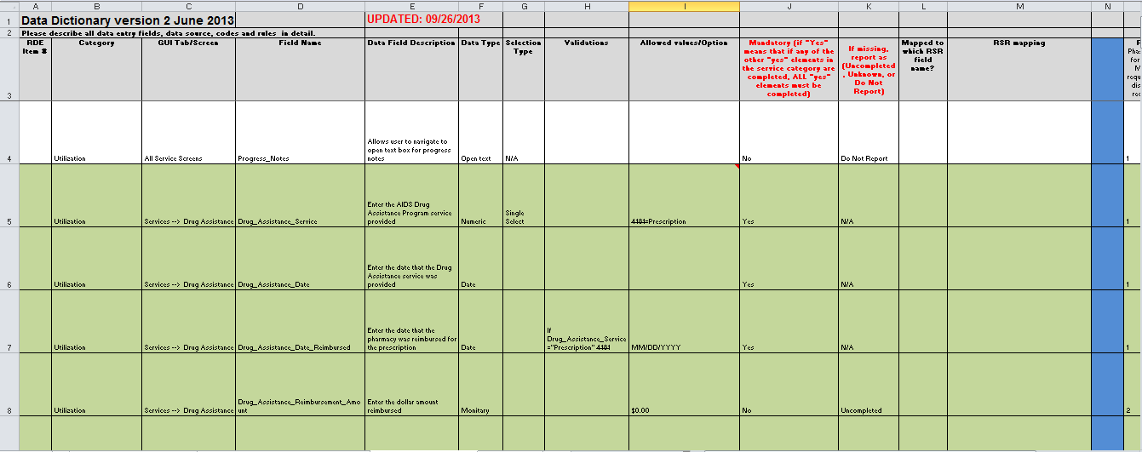
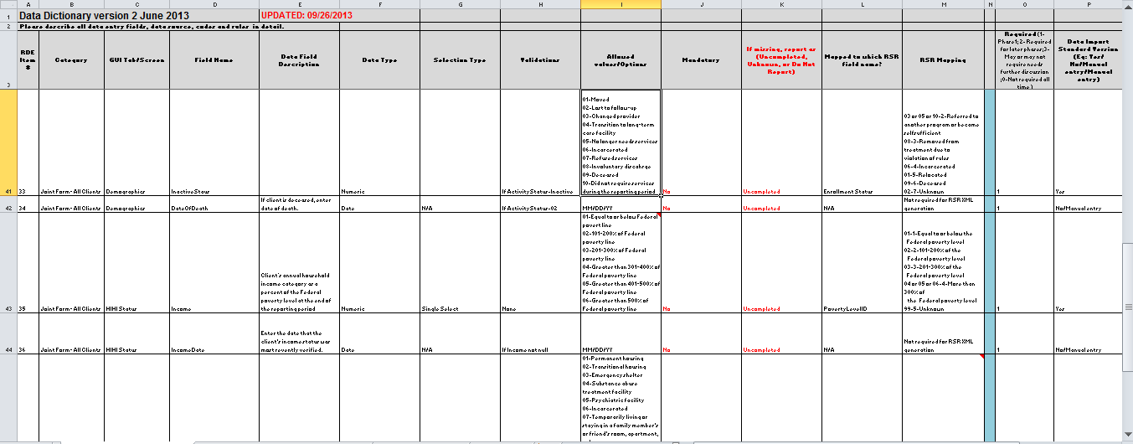

Slide 8
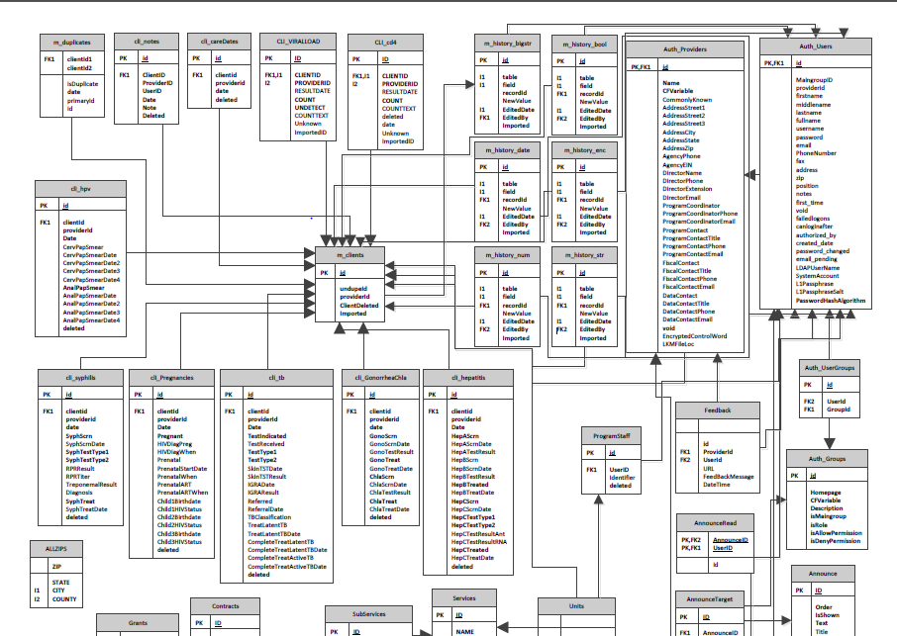

Slide 9
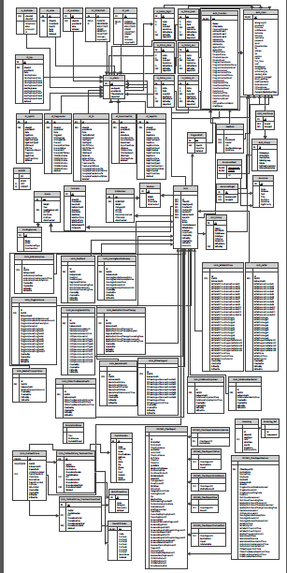

Slide 10
e2Boston Timeline
  January 4, 2013 e2Boston Kickoff
  May 14, 2013 Onsite RDE Stakeholder Engagement
  March, 2014 ← Provider Training and e2Boston Launch! ☺
                (About 9 months after onsite!)
  July, 2014 Data Import Launch!

Slide 11





Slide 12
Success! Challenges Overcome!
Design and Development
Timeline
IT / Security
Stakeholder Engagement
HRSA Requirements

Slide 13
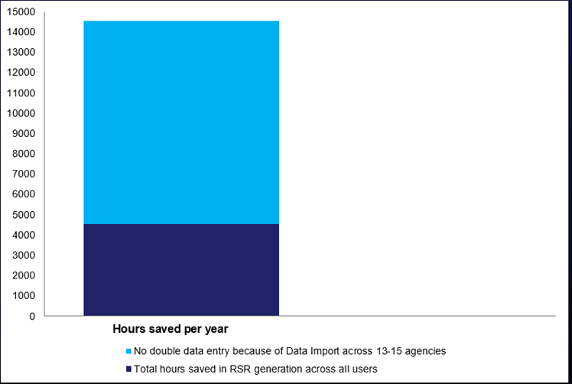
Time Savings of e2Boston (Hours)
14,225 hours saved since e2Boston launch
Data Exchange
9,810 hours
One-Click RSR
4,415 hours

Slide 14
What do end users think?
  Any problems or barriers with using the system?
  To what degree is the system saving you time?
  To what degree is the system reporting effective for you?
  How is technical assistance and support for you?
  If not a “10”, what can we do to make it a “10”?
  “The fact that someone calls me to make sure that all is well and to see if I have any ideas is just great.”

Slide 15
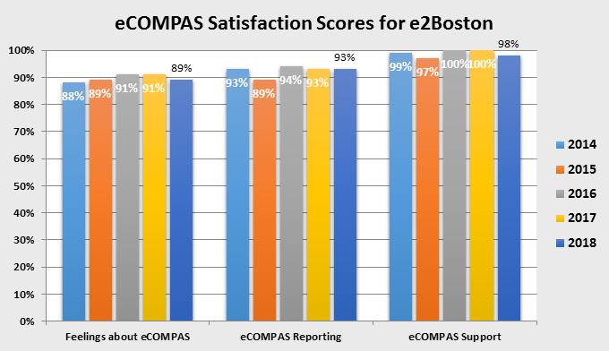

Slide 17
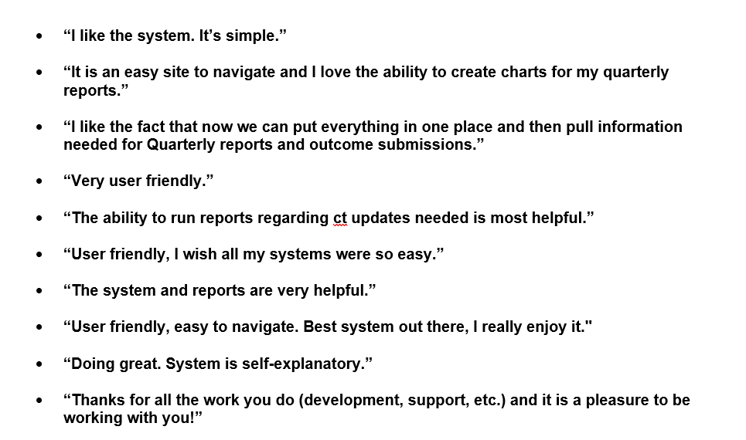

Slide 18
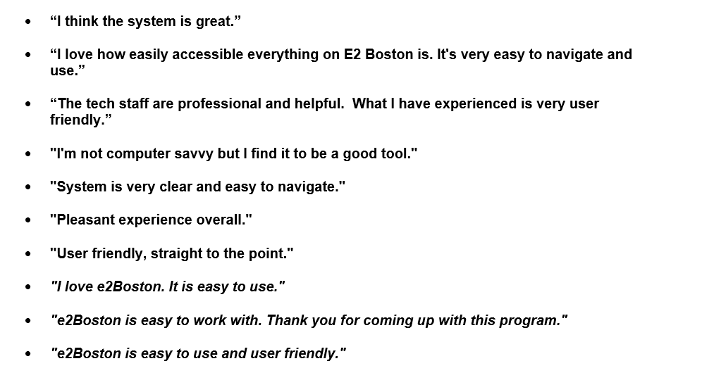

Slide 19
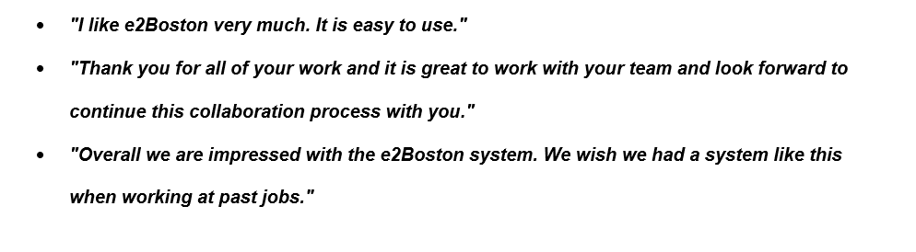
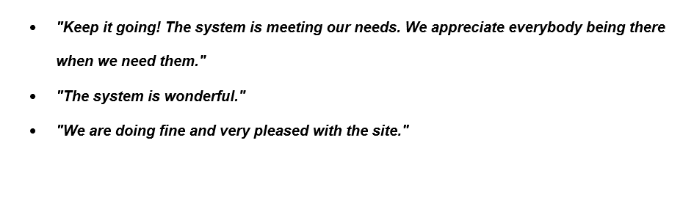

Slide 20
e2Boston utilizes an open data standard to provide user choice.
Larger agencies, such as health centers, already utilize an existing EMR and using e2Boston as a primary system may not be an option.
BPHC and RDE worked to develop a data dictionary and data import standards that allow agencies to export data from their existing systems into a database file, which can be directly uploaded onto the e2Boston website.
Users can import client demographic, service utilization, and/or health outcome data.

Slide 21
Data import is a highly prized functionality within e2Boston.
8 of 32 agencies import their data.
These agencies typically serve between 100-500 clients annually.
The biggest time saver is to import service utilization data, especially for programs that provide a high volume service, such as daily congregate or home-delivered meals, office visits, or support group meetings.
Importing data is also helpful during RSR season when RSR-specific data elements must be updated for a majority of clients.

Slide 22
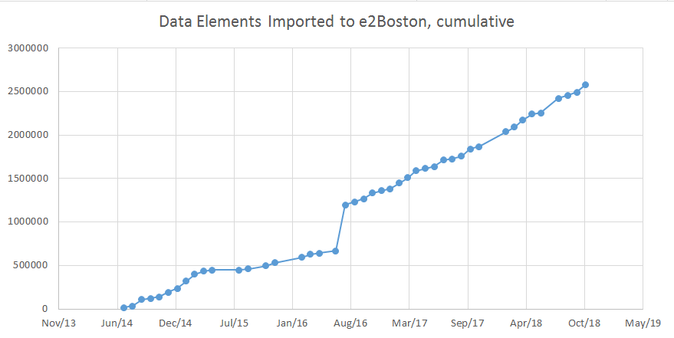
Seventeen import users imported over 2.5 million data elements since launch.
2.5+ Million

Slide 23
Experience with e2Boston: Using the Data
Breakdowns by service category and providers
Useful in developing QM activities
Easy user experience
Exportability
Examples

Slide 24
Users can enter and see their data in real time.
All users can run reports at any time to review any previously entered data, whether it’s two years ago or 10 minutes ago.
Providers can enter their work for the week, run a report showing total volume of services, and then send a copy of that report to their supervisor.
e2Boston also features advanced visual analytics that allow users to generate tables and graphs for internal usage, BPHC reporting, or data for grant applications.

Slide 25
The HIV Care Continuum is everywhere and now it’s in e2Boston.
In March 2015, BPHC released a health outcomes module, which allows providers to use the same interface to now submit client demographic, service utilization, and outcomes data.
Data import for outcomes was available at launch.
Some of BPHC’s outcomes include: HIV viral suppression, housing status, last medical visit date, mental health.

Slide 26
Viral suppression is the ultimate goal.
VS is tracked on the client level within e2Boston. Providers can identify individuals or cohorts that are not suppressed and target them for services.
BPHC has dramatically shifted its focus on improving viral suppression (VS) and requires agencies to review the VS rates among their clients. From FY17 data, 88% of Part A clients reported an undetectable* viral load.
BPHC now proactively provides comparative performance measures to subrecipients quarterly.
* Undetectable = less than 75 copies/mL.

Slide 27
Lessons learned through this process:
Building a system that people will actually use and be mindful of the user experience
In order for providers to fully take advantage of any data system, they must have real-time access to their own data – this is essential for tackling viral suppression
Share the data to all stakeholders.
Manage turnover wisely.
Collaboratively and continuously develop the vision.

Slide 28
e2Boston will keep evolving.
One-Click HAB Measures Report: Drill down data by VL, Race, Ethnicity, Transmission Mode, Age
One-click HIV care continuum at agency, service category, and EMA levels
Client enrollment data sharing, allowing providers to send RW eligibility information to others in the Part A network

Slide 29
Contact Information
Katherine D’Onfro
Senior Program Coordinator, Quality Management
Ryan White Services Division
Boston Public Health Commission
kdonfro@bphc.org
Alison Jordan
Executive Director, Transitional Health Care Coordination
New York Health + Hospitals
ajordan@nychhc.org
Jesse Thomas
Jesse@rde.org
973-773-0244 x1001
www.e-compas.com

