Slide 2
Learnings from Implementation and Integration of Interventions from the SPNS Latino Transnational Initiative (Session 2)
Natalie Solomon-Brimage, HRSA/SPNS
Andres Maiorana, University of California, San Francisco
Román Buenrostro, AIDS Foundation Chicago
Jeff Bailey, Carlos Aguas-Pinzon, APLA Health
Alison O. Jordan, New York City H+H, NY

Slide 3
Acknowledgement:
This project was supported by the Health Resources and Services Administration (HRSA) of the U.S. Department of Health and Human Services (HHS) under grant number U90HA26507, Special Projects of National Significance (SPNS) Culturally Appropriate Interventions of Outreach, Access and Retention Among Latino/a Populations Initiative Evaluation and Technical Assistance Center, in the amount of $2,151,872 awarded to the University of California, San Francisco.
Disclaimer:
This information or content and conclusions are those of the author and should not be construed as the official position or policy of, nor should any endorsements be inferred by HRSA, HHS or the U.S. Government.

Slide 4
Outline of Workshop
Introduction to SPNS “Culturally Appropriate Interventions of Outreach, Access, and Retention Among Latino/a Populations Initiative”
Learnings from implementation of the interventions
- AIDS Project of Los Angeles Health (APLA Health)
- AIDS Foundation of Chicago (AFC)
- New York City H+H, NY

Slide 5
Demonstration Site | Project Name | Population
AIDS Project Los Angeles, L.A, CA. | Fuerza Positiva (Positive Force) | MSM
Bienestar, L.A, CA. | Proyecto Vida (Life Project) | MSM
AIDS Foundation of Chicago, Chicago, IL. | Salud y Orgullo Mexicano (Health and Pride) | MSM
Core Center, Chicago, IL. | Proyecto Promover (Promote Project) | All genders
Prism Health, Dallas, TX. | Viviendo Valiente (Living Brave) | All genders
University of North Carolina, Chapel Hill, NC. | Enlaces por la Salud (Linked together for health) | MSM/trans women
Gay Men’s Health Crisis, New York City | LINK II | MSM
New York City H+H, NY. | Warm Transitions for Puerto Ricans After Incarceration | Incarcerated population All genders
Philadelphia Fight, Philadelphia, PA. | Clínica Bienestar (Wellness Clinic) | Substance users All genders
Notes:
Demonstration projects and intervention sites were located across the US in Los Angeles, Chicago, Dallas, North Carolina, New York City and Philadelphia and implemented by CBOs, medical settings or universities.
6 interventions targeted populations of Mexican origin (first, second or third generation). Those are in yellow.
And 3 in light blue, targeted populations of Puerto Rican origin (first, second or third generation).

Slide 6
Description of the Interventions
Intervention Components:
Outreach/Community engagement/stigma reduction
Linkage and retention in HIV care
Notes:
This is a snapshot of the interventions.
As part of the HRSA mandate for this Initiative, all interventions included two main components:
An Outreach. Community Engagement and stigma reduction component that also served to reach out and identify Latino/as living with HIV to engage them in the second component of the interventions which was Linkage and Retention in HIV care

Slide 7
Outreach/Community Engagement/Stigma Reduction
Social marketing: Printed materials & other media | ALL SITES
In-reach within agency | ALL SITES
Community partnerships/Outreach to stakeholders | ALL SITES
Social Media advertising, education, and recruitment | SOME SITES
Social Networking -Venue-based/Community Outreach: Health education/Stigma reduction group/individual educational sessions and presentations | SOME SITES
Referrals and collaboration w/HIV testing services (non-RWHAP funded) | FEW SITES
Medical providers (jail and community) trained on culturally appropriate care to Puerto Ricans in jail | 1 SITE
-
Notes:
For the Community engagement component and for project promotion ALL SITES used social marketing, in reach within their organizations and partnerships with stakeholders
SOME SITES used social medial and venue based community outreach, including either one-on-one or group-level educational and stigma reduction presentations.
A FEW SITES also used referrals or collaboration with HIV testing services to identify potential participants
And ONE SITE trained medical providers for community engagement and stigma reduction

Slide 9
Linkage/Retention in HIV Care
-
One-on-one navigational services and emotional support | ALL SITES
One-on-one educational/empowering sessions | 4 SITES
Support/skills building group | 1 SITE
Social Network Strategy to leverage trust and engage in conversations about HIV testing and care | 1 SITE
Co-location: HIV primary care, Hep. C & subst. abuse treatment, syringe exchange & case management services | 1 SITE
Medical providers in jail and community trained on culturally appropriate care to Puerto Ricans in jail and leaving jail | 1 SITE
Notes:
ALL SITES provided one-on-one navigational services as part of their Linkage and Retention HIV care interventions.
4 SITES also included one-on-one educational sessions w/ a structured curriculum, and 1 SITE included a support group together with their navigational services.
1 SITE used Social network recruitment to leverage relationships of health promoters to identify people in friend and family networks living with HIV but not in care.
AT 1 SITE the co-location of different services was part of their intervention strategy
And once again, the intervention at 1 site was to train Medical providers in jail and community on culturally appropriate care to Puerto Ricans in jail and leaving jail

Slide 10
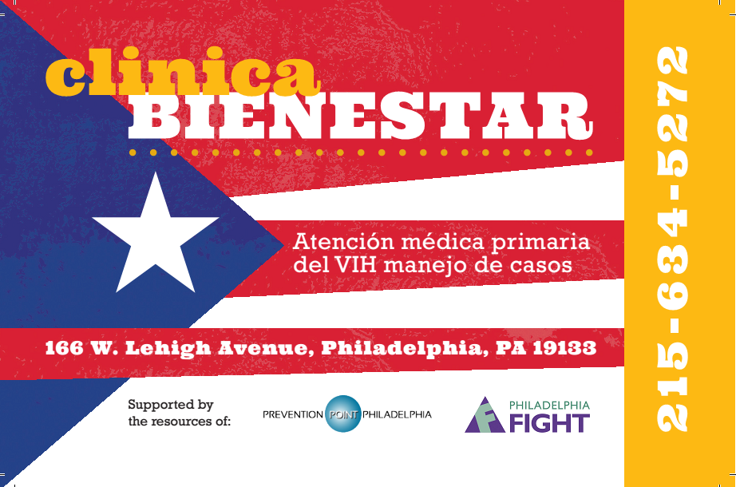

Slide 11
Design and implementation elements common to all interventions
Targeting populations of Mexican or Puerto Rican origin
Application of transnational framework
Utilization of Latino cultural elements
Activities in English and Spanish
Culturally competent interventionists (bilingual and bicultural)
Notes:
The interventions targeted populations of Mexican or Puerto Rican origin.
As part of their design and implementation, the interventions applied a transnational framework to situate the interventions in the context of participants’ lives that bridge the continental US and their countries of origin.
Overlapping with a transnational framework, the interventions applied Latino cultural elements to make the the interventions culturally appropriate. As part of the cultural tailoring, the intervention activities were delivered both in Spanish and in English but culturally competent interventionists who were bilingual and bicultural.

Slide 12
Participant Eligibility Criteria
At least 18 years of age
Self-identify as of Puerto Rican or Mexican origin
Newly diagnosed with HIV (in the last six months), or
Diagnosed with HIV more than six months ago (but with at least one gap in care lasting six months or more in the past two years)

Slide 13
Transnationalism
Ongoing and fluid processes by which immigrants forge and sustain multi-stranded social relations that link them to their place of origin and settlement
Basch L, Glick Schiller N, Blanc-Szanton C, eds. 1994. Nations Unbound: Transnational Projects, Postcolonial Predicaments, and Deterritorialized Nation-States. London: Gordon & Breach.
Notes:
Since the early 1990s, transnationalism has been adapted as a theoretical framework across various disciplines such as sociology and anthropology for undertaking research on immigrant populations. It gained momentum because of its focus on the trans-border and transnational activities of immigrant populations.
Defined as “the processes by which immigrants forge and sustain multi-stranded social relations that link together their societies of origin and settlement.” (basch et al. (1994, p. 6) in Levitt et al., 2007).
Transnationalism gained popularity among researchers as a way to describe immigrants who maintain physical, emotional and psychological ties to their place of origin (Mouw et al., 2014).
Recent scholarship understands transnational migration as taking place within fluid social spaces that are constantly reworked through migrants’ simultaneous embeddedness in more than one society (Levitt & Glick Schiller 2004, Pries 2005, Smith 2005). (Source: Levitt et al., 2007).
Migration
Travel
Communication
Economic remittances
Impacted by individual and structural factors
May change over time depending on connection with families and engagement with place of origin

Slide 14
Evaluation and Technical Assistance Center, UCSF: Multi-Site Evaluation Components
Quantitative Evaluation
Patient Survey
Intervention Exposure
Qualitative Evaluation
Secondary Data Analysis
Key Informant Interviews
Economic Analysis
Costing
Staff Time Survey
Patient Medical Charts
Participant Interviews
Notes:
To what extent are interventions associated with improvements in linkage and retention in HIV care and viral suppression over the 24- month study period?
What are characteristics of and the barriers and facilitators to effective implementation of the interventions?
What is the cost, efficiency and cost-effectiveness of each intervention?

Slide 15



Slide 16

Best Practices: Lessons learned from providing culturally appropriate services to Mexican Clients
Román Buenrostro, Banita McCarn, MEd
AIDS Foundation of Chicago

Slide 17
This project was supported by the Health Resources and Services Administration HRSA) of the U.S. Department of Health and Human Services (HHS) under H97HA26498 under the Special Projects of National Significance Latino Access Initiative 2013-2018 for $1,200,000 with no portion financed with non-governmental sources.
This information or content and conclusions are those of the author and should not be construed as the official position or policy of, nor should any endorsements be inferred by HRSA, HHS or the U.S. Government.

Slide 18
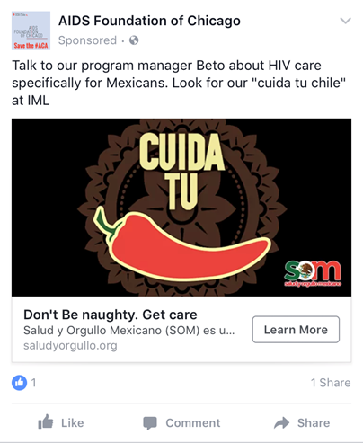
Program Overview
SOM is a peer navigation program
Includes 5 individual level standardized sessions
Goal is linkage and retention of clients in HIV primary care, increase support, decrease stigma
Peer (promotors) role is to provide peer education, support and navigation services
  Referral to Ryan White case manager as needed for other services/referrals (e.g., housing, employment, etc.)
Notes:
In 2013, AFC signed on to participate in a Special Project of National Significance (SPNS) demonstration project with HRSA. This particular initiative called for sites across the country to use culturally-appropriate interventions with a transnational approach to improve health outcomes for Latinos and Latinas living with HIV. Sites either focused on Mexican or Puerto Rican populations; our project is focused on HIV+ Mexican Men and is called Salud Y Orgullo Mexicano (or SOM for short)– which translates as “Mexican Health and Pride.”
SOM is a peer-navigation program, providing peer education and peer support to HIV+ Mexican Men. The program seeks to increase Mexican Men’s access to HIV testing, link and retain positive Mexican men in HIV medical care, and to reduce HIV-related stigma in the Mexican community in Chicago. We do though through a peer education model that addresses the transnational realities of clients lives and that seeks to provide culturally-appropriate information, materials, and delivery. Participants go through a series of sessions with their peers [EXPLAIN PEERS] that provides everything from HIV education, medication adherence, and appointment adherence, to navigating dating, social support, and making decisions about disclosure, to addressing HIV care options in Mexico, budgeting for HIV-care with the added expense of remittances, not letting herbal home remedies interfere with medication, and opportunities for affordable care for clients who are undocumented. The whole time they receive peer support in helping them navigate case management and medical care at Erie.

Slide 19
Intervention
Peer Navigation Services
  Individualized health education
  Skills building around patient-provider relationship
  Communication
  Accompanying participants to medical appointments
  Navigating available resources: housing, substance use, employment services
Notes:
SOM Promotores are trained in various stages. The first stage of training involves a four-day People-to- People training facilitated by the AIDS Foundation of Chicago (AFC). People to People is a peer-to-peer education program that supports individuals living with HIV and AIDS. People to People is intended to improve the health of those living with HIV/AIDS by providing trained, quality peers to the community and building local organizations’ capacity to use peers. The program targets HIV-positive individuals who reflect the epidemic in each local area. Training includes HIV transmission, disease progression, treatment adherence, and clinical preceptorships to address identified needs. As a peer-oriented popular education program, this training captures crucial elements of AFC’s SOM Project by informing peer navigation services for Promotores.

Slide 20

Cultural Tailoring- Transnationalism
Focus group activities and work with marketing company led us to the use of Lotería within marketing campaign
  To evoke sense of shared familial and common experience
  To trigger recall of culturally-specific game played in Mexico and in Chicago

Slide 21

Cultural Tailoring- Ejemplos vivos
Real-life scenarios impacting care
  Pedro’s Story
  Pedro was diagnosed with HIV within the past 6 months and currently not on HIV treatment yet. He has a high CD4 count and does not want to start treatment because he is concerned with the side effects. However, he does not want an HIV diagnosis.
  What are the benefits of understanding the importance of treatment for HIV? Can you relate to Pedro’s story? How?
Notes:
The scenarios serve as a safe third party to project concerns or issues on and attempt to create solutions to HIV care barriers
Important to gauge the knowledge and understanding of the participant, which cultural or transnational elements may be facilitators or barriers to HIV care and HIV healthy decision making
Case studies deal with issues of identity, health and wellness, and stigma
SOM created a manual for supporting and training Promotor on structured disclosure during the education sessions

Slide 22
Anti-immigrant rhetoric
I’m opposed to new people coming in. We have to take care of the people who are here. Source: nytimes.com/library/politics , Dec 10, 1999
Mexico is beating us economically. They are not our friend, believe me. But they're killing us economically. The U.S. has become a dumping ground for everybody else's problems. When Mexico sends its people, they're not sending their best. They're sending people that have lots of problems, and they're bringing those problems. They're bringing drugs. They're bringing crime. They're rapists. And some, I assume, are good people. Source: 2015 announcement speeches of 2016 presidential hopefuls , Jun 16, 2015
How crazy - 7.5% of all births in U.S. are to illegal immigrants, over 300,000 babies per year. This must stop. Unaffordable and not right! — Donald J. Trump (@realDonaldTrump) August 21, 2015

Slide 23
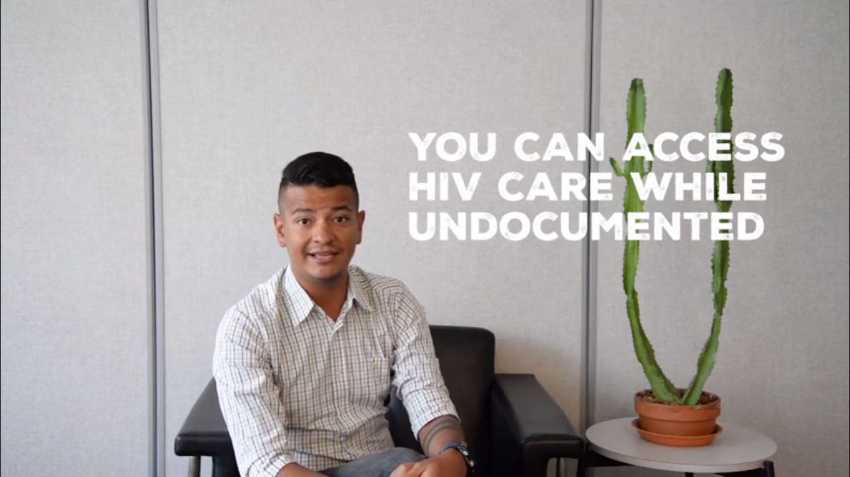
Addressing our political environment
As recruitment evolved and our social environment changed we focused on immigration narratives
  Infused information on obtaining services throughout intervention
  Used language throughout marketing/website that affirms HIV care despite immigration status

Slide 24
Adaptations
Surprises:
  Influences of Mexico not as strong as we anticipated
  Less connected to family/traditions of Mexico
  More concerned about relationships and disclosure/stigma issues
Changes over time:
  Began to assess transnationalism as a construct and address degrees of transnationalism within individual sessions
    For example, how to access HIV care and medication while in Mexico
  Continue to attend significant cultural festivals and celebrations
  Focus on out of care individuals
Current incorporation:
  Promotores share their experiences and tailor sessions to meet clients where they are at in terms of transnationalism
  Strength of peer-model→ promotores add cultural components as they have experienced them

Slide 25
Lessons learned
Give time and money to support promotores LWH
Lots of training is needed for promotores
Be flexible and adaptable
Offer options for clients to select what they learn
Notes:
In developing and implementing a peer-based navigation program it is critical to ensure proper start up time and staff supervision structure.
A large amount of training is needed for peer health workers, which pays off in terms of skills developed and participant outcomes in the long view. Having a peer with a similar Mexican background as clients helps facilitate relationships and trust.
In developing a culturally appropriate intervention it is important to be flexible and adaptable.
Our program team conducted three rounds of qualitative research in order to continue to refine our approach. We also learned that including a wide range of topics in education sessions allowed clients to focus on what was important to them, rather than having project staff dictate what is important.

Slide 26
Contact us:
Román Buenrostro
Director of Special Projects and Planning
rbuenrostro@aidschicago.org
Direct: 312-334-0960
Banita M. McCarn, Med
Sr. Research & Evaluation Manager
Bmccarn@aidschicago.org
Direct: 312-784-9098

Slide 28


Best Practices / Lessons Learned from Providing Culturally
Appropriate Services HIV-Positive Latino MSM of Mexican Origin
Jeff Bailey MPH, Principal Investigator
Carlos Aguas-Pinzon, Project Coordinator
Jorge Montoya PhD, Evaluator

Slide 29
Acknowledgement
This project is/was supported by the Health Resources and Services Administration (HRSA) of the U.S. Department of Health and Human Services (HHS) under grant number U90HA26507, Special Projects of National Significance (SPNS) Culturally Appropriate Interventions of Outreach, Access and Retention Among Latino/a Populations, 2013-2018, in the amount of $1.489.000, to APLA Health.
Disclaimer
This information or content and conclusions are those of the author and should not be construed as the official position or policy of, nor should any endorsements be inferred by HRSA, HHS or the U.S. Government.

Slide 30
Intervention Overview
Site Location: Los Angeles, CA
Target Population: HIV-Positive Latino MSM of Mexican Origin
Agency: At the time of the funding award, APLA was a traditional CBO but became an FQHC in 2014; however, the clinic is not a Ryan White provider.

Slide 31
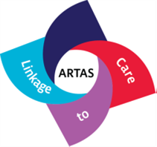

Intervention Overview
Recruitment & Engagement
Patient Navigation
Emotional Support
Initial Contact - Encounter
Enrollment
Individual Service Plan
Linkage to care
Retention in care
Venue-based outreach:
In-Reach
Community Partnerships
Social Marketing:
ARTAS 2.0
Crisis intervention
Social support
Supportive Services
Flexibility
Confianza

Slide 32
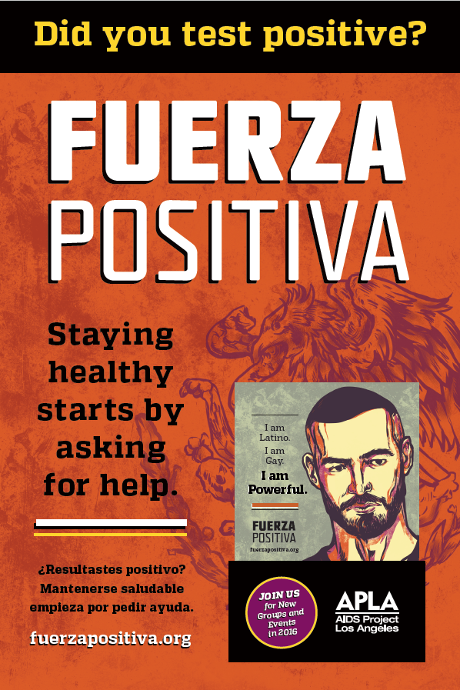
Adaptation and Changes
Scheduling
  Employment
  Field-based enrollment – follow-up
Communication: (text, phone, email)
Recruitment and Engagement
  Social media
  Newly diagnosed v. out of care
  Increased non-cash incentive
Less emphasis on group-level intervention
  Expanded participation in community events

Slide 33





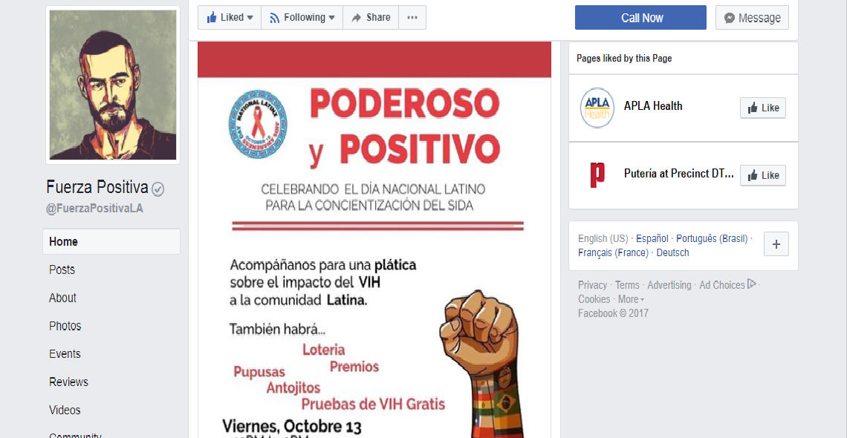

Adaptation and Changes- Engagement

Slide 34
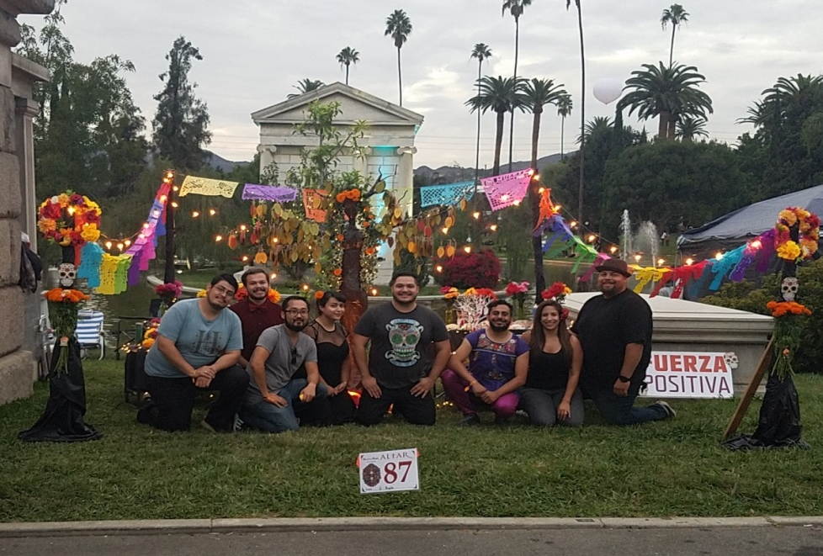
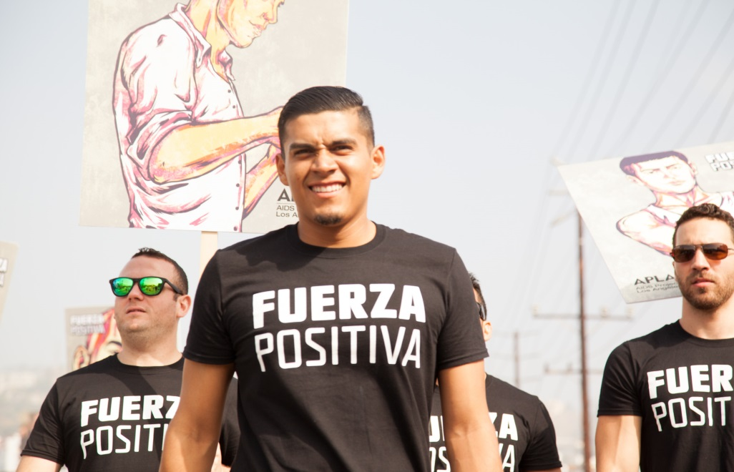
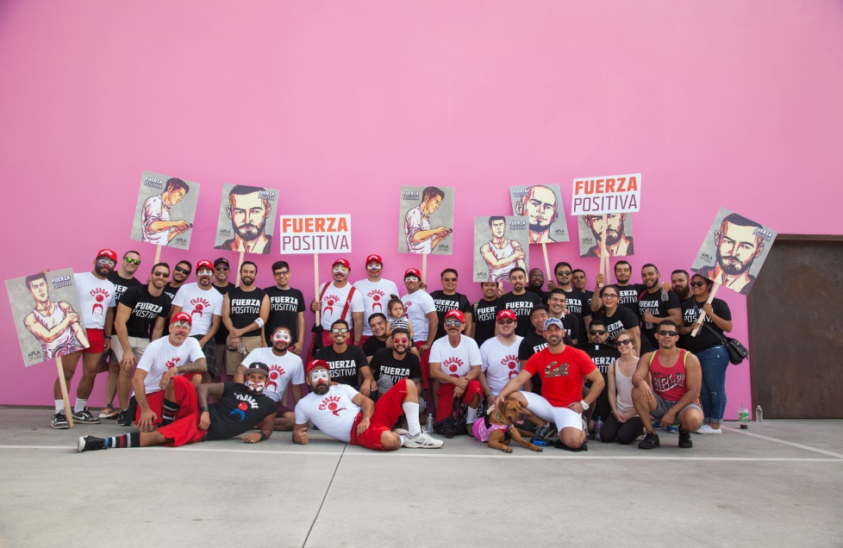
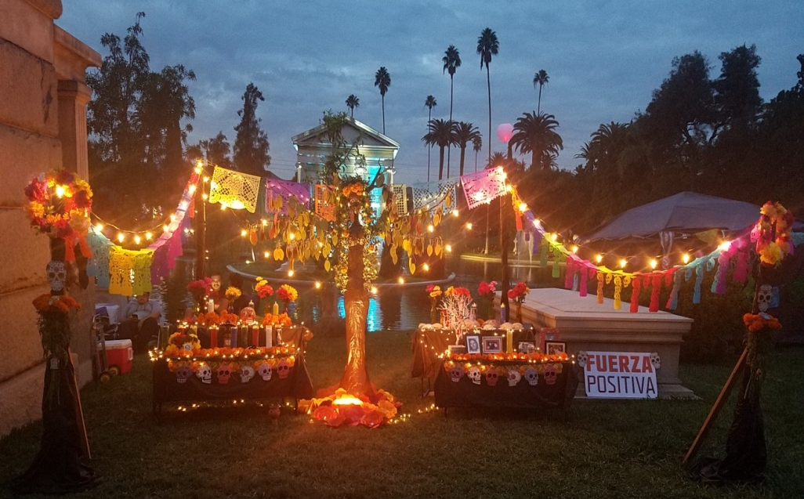

Slide 35
Value Added - Most Useful Elements
Warm
Genuine
Polite
Personal-Contact
Flexibility and accessibility
Allow the client to set the tone of the session while staying faithful to intervention
Making time and creating a safe space

Slide 36
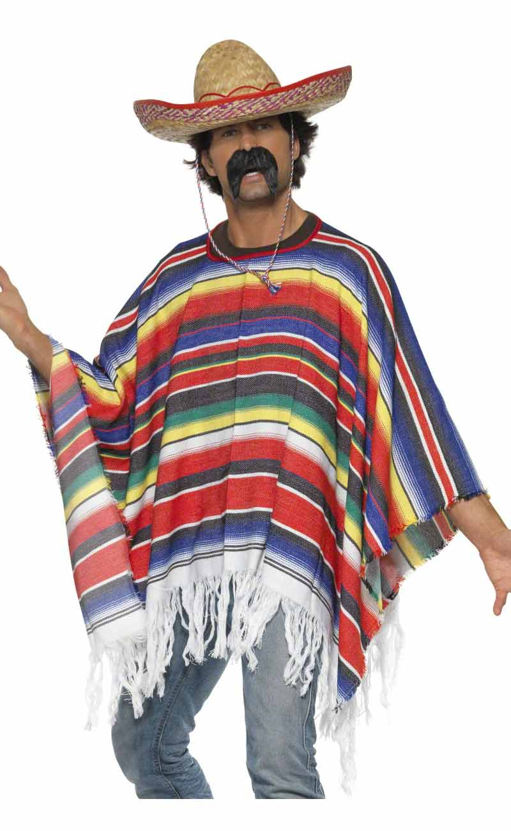
Best Practices - Incorporating Culture
Not forcing the
“Mexicaness”

Slide 37
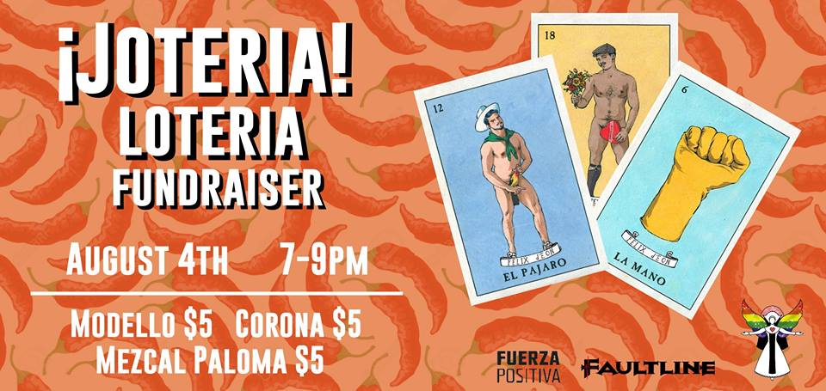
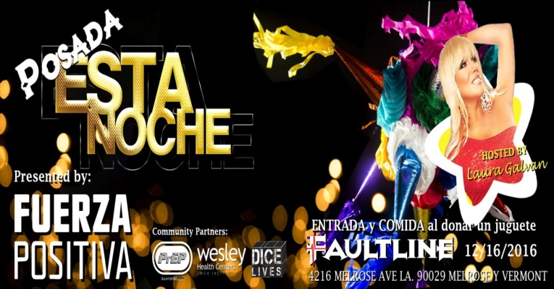
Best Practices - Incorporating Culture
Celebrating cultural through inclusive reinterpretations
Humanistic approach – celebrate uniqueness of each client
Language
Let the client be the driver
Environment

Slide 38
Findings N = 66
Participant Demographics
Mean Age | 37
Ethnicity | Total | %
Mexican | 50 | 76
Mexican American | 14 | 21
Chicano | 2 | 3
Country of Origin | Total | %
Mexico | 36 | 54
USA | 25 | 38
Other (One or both parents are Mexican origin) | 5 | 8

Slide 39
Findings N = 66
Care Status at Enrollment | Total | %
Newly Dx – Never in Care | 21 | 32
Fallen out of care A: (HIV+, no care visit last 6 months, last viral load >200 copies/mL) | 16 | 24
Fallen out of care B: (no HIV primary care visits in 12 months) | 29 | 44
Are you seeking a new HIV medical provider? | Yes | No
Fallen out of care A: (HIV+, no care visit last 6 months, last viral load >200 copies/mL) | 12 | 4
Fallen out of care B: (no HIV primary care visits in 12 months) | 17 | 10

Slide 40
Lessons Learned
“Please, for the love of everything good in the world, keep it simple. It’s important to avoid difficult language, and to make the process as uncomplicated as it can be.”
David Kirchhoff, CEO of Snap Kitchen.
From the NEJM Catalyst event Patient Engagement: Behavioral Strategies for Better Health at the University of Pennsylvania, February 25, 2016.

Slide 41
Acknowledgements
Participants enrolled in Fuerza Positiva
Intervention Staff
  Carlos Aguas-Pinzon
  Erika Alfaro
  Ernesto Ayala
  Ruben Garcia
  Vanessa Jacuinde
  Ruben Martinez
  Carlos Reynoso
  Adrian Rodriguiez
  Elvis Rosales
Evaluation
  Jorge Montoya PhD
  Emerald Green MPH
Graphic Design
Mike Lucas

Slide 43
Lessons Learned from Training Providers on Culturally Appropriate Care for Puerto Ricans in Jail and Leaving Jail
NYC Correctional Health Services, NY
Alison O. Jordan LCSW, Principal Investigator
Janet Wiersema DPH, MPH, Project Director/Evaluator
Jacqueline Cruzado-Quiñones, TA Consultant
Paul A Teixeira, DrPH, MA, Local Evaluator

Slide 44
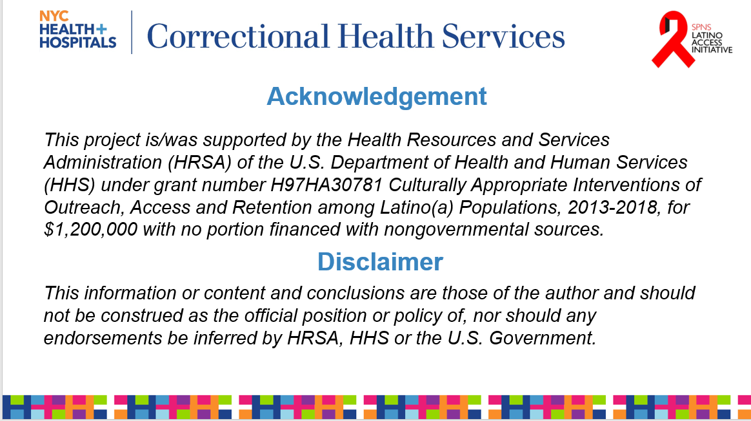

Slide 45
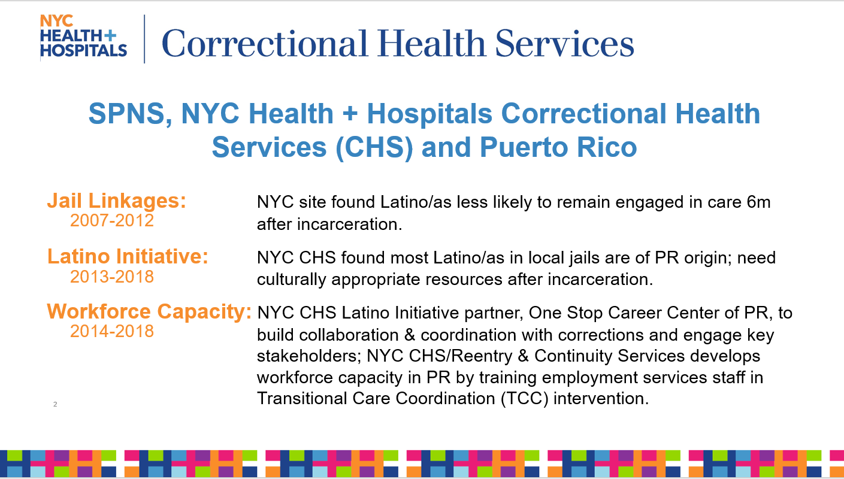

Slide 46
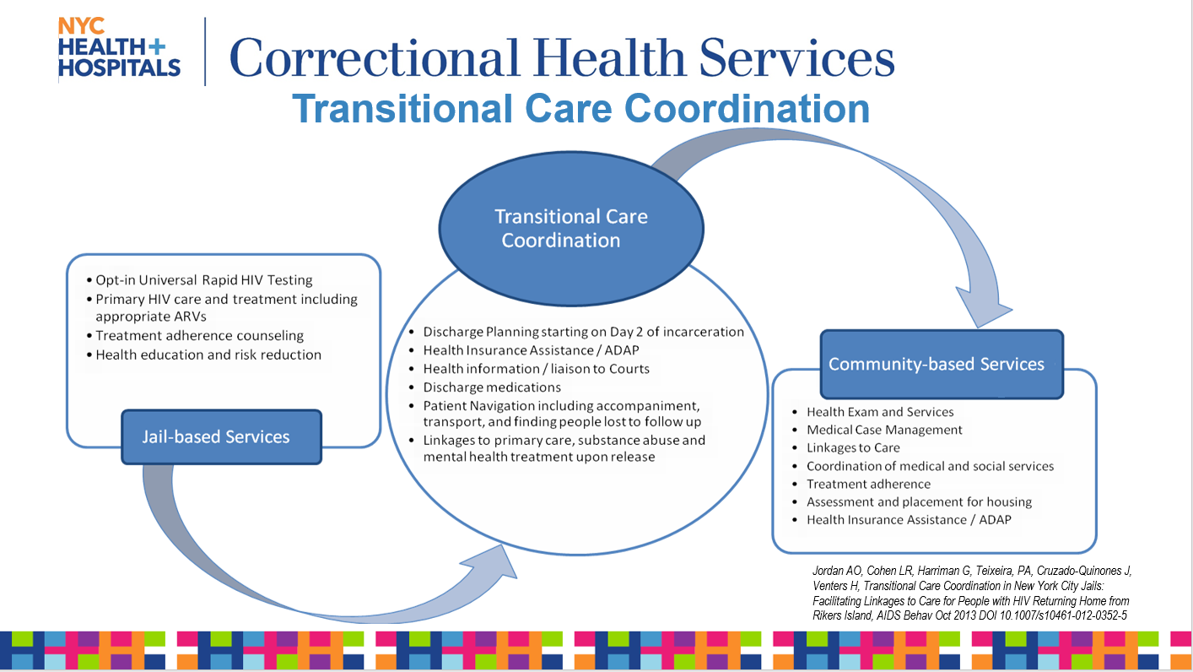

Slide 47
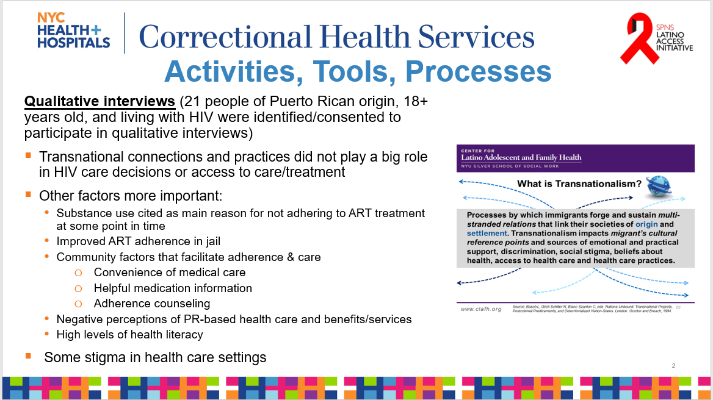

Slide 48
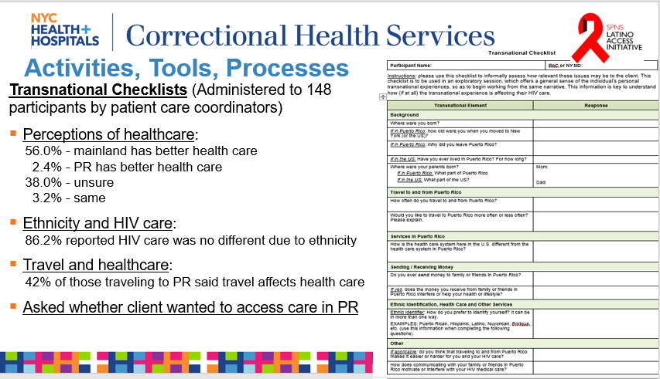

Slide 49
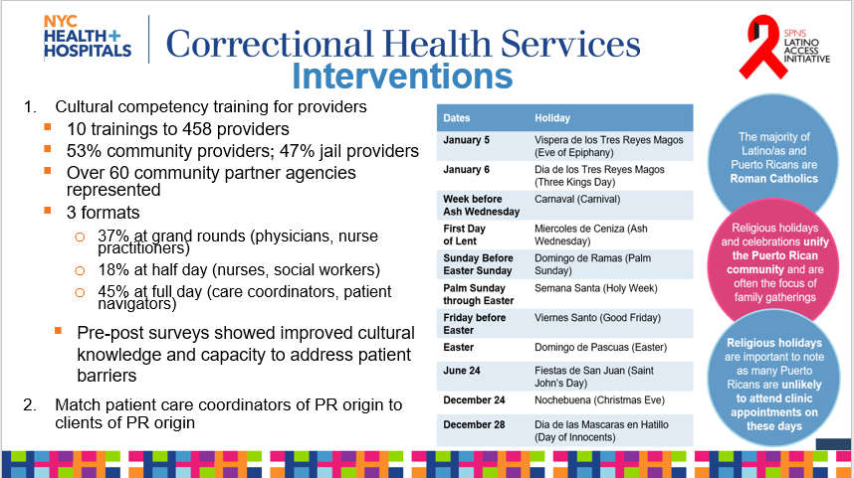

Slide 50
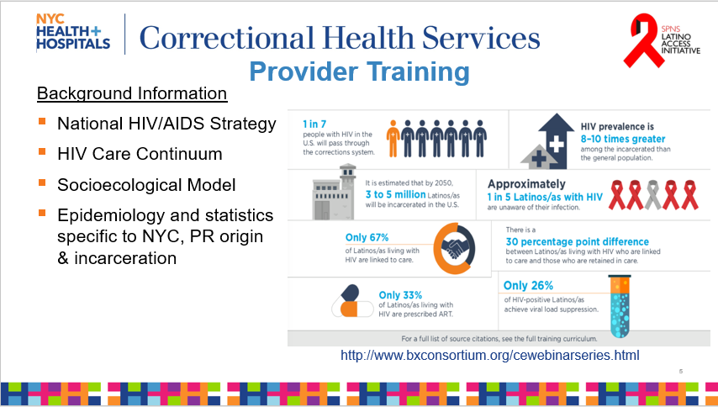

Slide 51
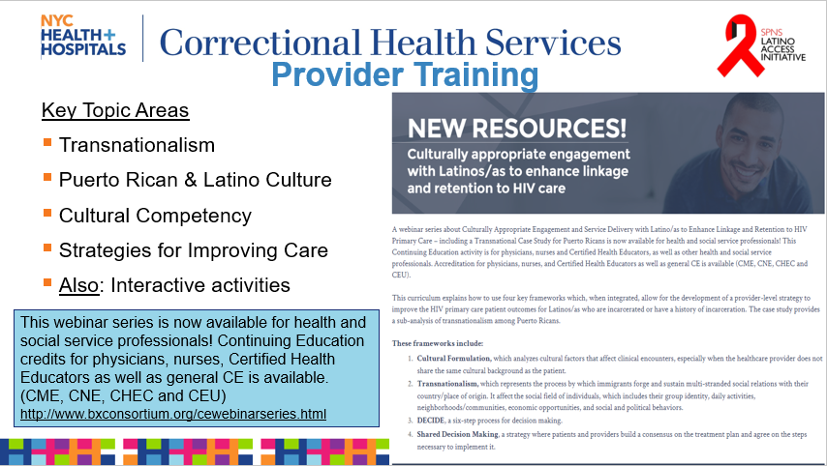

Slide 52
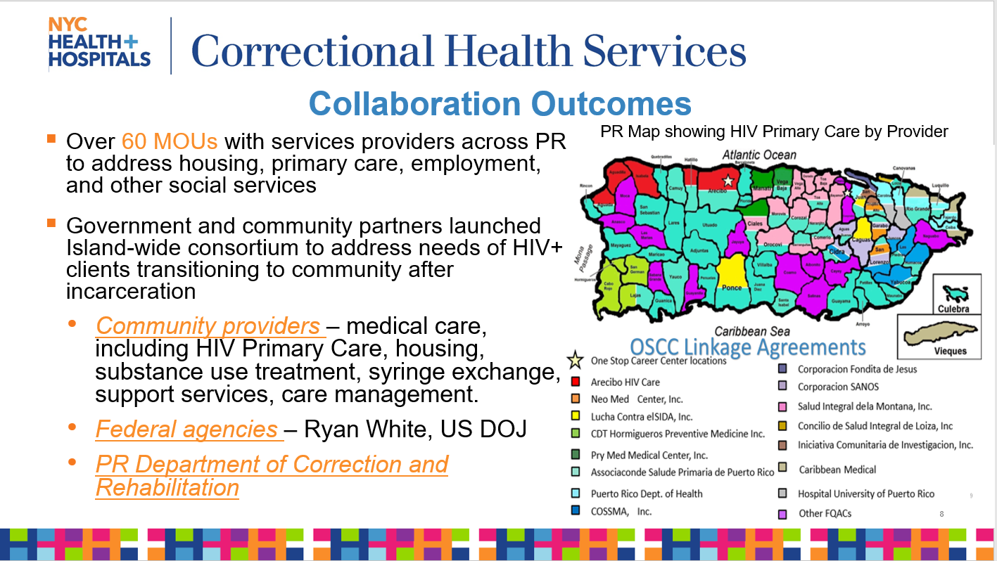

Slide 53
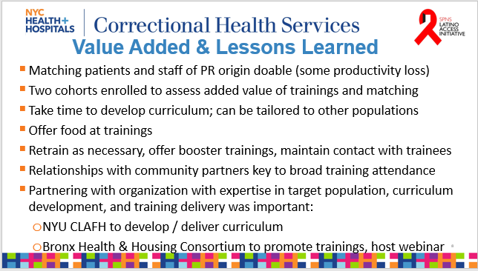

Slide 54
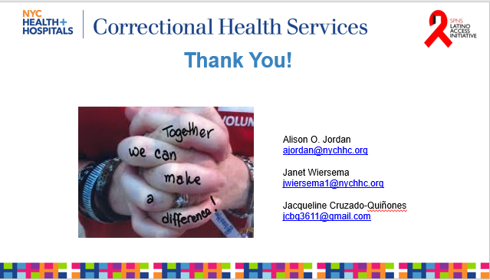
Anusha Dayananda
Anusha@rdesystems.com

