Slide 2
Integrated HIV Prevention and Care Planning and Resource Allocation
Stewart Landers, JD, MCP & Ann Marie Rakovic, MSW
Integrated HIV/AIDS Planning Technical Assistance Center
JSI Research & Training Institute, Inc. (JSI)

Slide 3
Session Objectives
Describe how Integrated HIV Prevention and Care Plans can inform joint planning, resource allocation, evaluation, and continuous quality improvement within jurisdictions
Identify at least 2 promising practices, innovations, or tools and resources which can support priority setting and resource allocation along the HIV care continuum

Slide 4
Got Questions?
Do you have any questions about the Resource Allocation process?
Let us know who you are! Please list your name, where you are from, and email address.
Are you affiliated with a RWHAP part A and/or part B?
Are you involved with integrated planning?

Slide 5
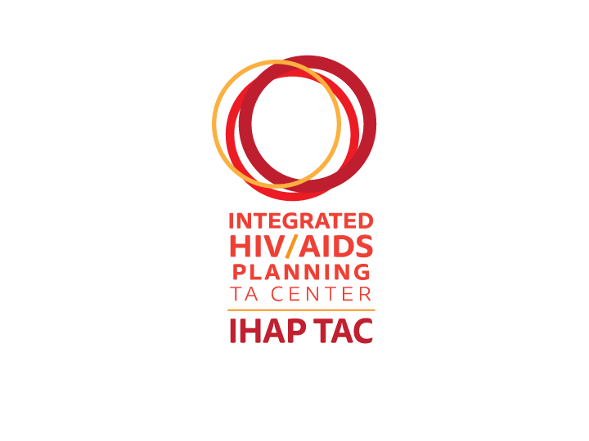
About the Integrated HIV Planning (IHAP) Technical Assistance Center (TAC)
3-year
project
Supports
Conducts
national & targeted
Ryan White HIV/AIDS Program Parts A & B recipients and their respective planning bodies with integrated planning including implementation of their Integrated HIV Prevention and Care Plans
began
July 1, 2016
training and technical assistance activities
This project is supported by the Health Resources and Services Administration (HRSA) of the U.S. Department of Health and Human Services (HHS) under grant number U69HA30144, Ryan White HIV/AIDS Program Integrated HIV Planning Implementation. This information or content and conclusions are those of the author and should not be construed as the official position or policy of, nor should any endorsements be inferred by HRSA, HHS or the U.S. Government.
Notes:
Julie: As a reminder, the IHAP TAC is a three year cooperative agreement to support jurisdictions and their planning bodies with implementation of the Integrated HIV Prevention and Care Plans, including both national and targeted TA activities.

Slide 6
Support available through the IHAP TAC
Integrating HIV prevention and care at all levels
Strategies for implementing Integrated Plan activities
Publicizing and disseminating progress of Integrated Plan activities to stakeholders
Identifying roles and responsibilities for Integrated Plan activity implementation
Monitoring and improving Integrated Plan activities
Collaborating across jurisdictions
Notes:
- Integrating HIV prevention and care at all levels
- Strategies for implementing Integrated Plan activities
- Publicizing and disseminating progress of Integrated Plan activities to stakeholders
- Identifying roles and responsibilities for Integrated Plan activity implementation
- Monitoring and improving Integrated Plan activities
- Collaborating across jurisdictions

Slide 7
Laying the Groundwork for Integrated Planning

Slide 8
National HIV/AIDS Strategy (NHAS): 2020 Goals
Four primary goals
Reduce new HIV infections
Increase access to care and optimize health outcomes for people living with HIV (PLWH)
Reduce HIV-related health disparities and health inequities
Achieve a more coordinated national response to the HIV epidemic
Increase the coordination of HIV programs across the Federal government and between Federal agencies and State, territorial, Tribal, and local governments.
www.hiv.gov/federal-response/national-hiv-aids-strategy/nhas-update
Notes:
The fourth goal of the National AIDS/HIV Strategy (NHAS) is to achieve a more coordinated national response to the HIV epidemic.

Slide 9
CDC and HRSA’s Alignment of Goals and Expectations Facilitates Integration
Integrated HIV Prevention and Care Plan Guidance, including Statewide Coordinated Statement of Need (SCSN) released in 2015 for 2017-2021 Integrated HIV Prevention and Care Plans
Integrated Plan is a living document serving as a roadmap to guide each jurisdiction’s HIV prevention and care service planning throughout the year
An underlying goal of integrated planning is to better leverage resources and improve efficiency and coordination of HIV prevention and care service delivery
Reduce reporting burden and duplicated efforts
Streamline work of health department staff and HIV planning groups
Promote collaboration and coordination in the use of data

Slide 10
Legislative/Program Requirements for Integrated Program Planning and Resource Allocation

Slide 11
Integrated HIV Prevention and Care Plans
Every RWHAP Part A and B recipients and CDC prevention funded grantee required to submit an Integrated HIV Prevention and Care Plan
Jurisdictions within state were encouraged to submit a plan together
Format and planning process is flexible; must include:
Goals: anticipated long-term impact, consistent with NHAS
Objectives: specific statements of desired results
Strategies: approaches for achieving objectives
Activities: ways to implement strategies
Resources: what’s needed to carrying out activities
Notes:
Each HRSA and CDC-funded jurisdiction needs to participate in the completion and submission of an Integrated Plan, and several jurisdictions within each state (e.g. local municipalities and state health departments) are encouraged to submit a plan together. Jurisdictions funded by both CDC DHAP and HRSA HAB should submit a single Integrated HIV Prevention and Care Plan, including the Statewide Coordinated Statement of Need; however, jurisdictions may submit separate plans to the CDC and HRSA if local structural factors impede the development of one plan.
The Integrated HIV Prevention and Care Plan presents the jurisdiction's approach to meeting its HIV prevention, treatment, and care goals. The Integrated HIV Prevention and Care Plan must align with the goals of the National HIV/AIDS Strategy (NHAS), use the principles of the HIV Care Continuum (HIV diagnosis, linkage to care, retention in care, antiretroviral use, and viral suppression), and respond to the needs identified in the Statewide Coordinated Statement of Need (SCSN). The SCSN must be submitted along with the Integrated Plan. While there is no set format, the Integrated Plan should articulate: 1. Goals: a broad statement of purpose that describes the expected long-term effects of efforts consistent with the NHAS and covering a period of 5 years; 2. Objectives: measurable statements that describe results to be achieved (must identify at least 2 objectives for each NHAS goal); 3. Strategies: the approach by which the objectives will be achieved (must identify at least 3 strategies for each objective); 4. Activities: describing how the objectives will be achieved, and metrics used to assess progress; 5. Resources: committed toward implementing the activities The plan should describe the collaborative process used to develop the plan, and specifically explain the involvement of PLWH to ensure that services are responsive to local needs. The plan also should describe the jurisdiction's approach to monitoring and evaluating implementation of the plan itself.

Slide 12
Integrated HIV Prevention and Care Plans: SCSN
Part B jurisdictions must complete a Statewide Coordinated Statement of Need (SCSN), a joint needs assessment coordinated by Part B recipients including:
Epidemiologic Overview
HIV Care Continuum
Financial and Human Resource Inventory
Needs/Gaps/Barriers to HIV Services
Data Sources
The Integrated HIV Prevention and Care Plan must respond to needs identified in SCSN

Slide 13
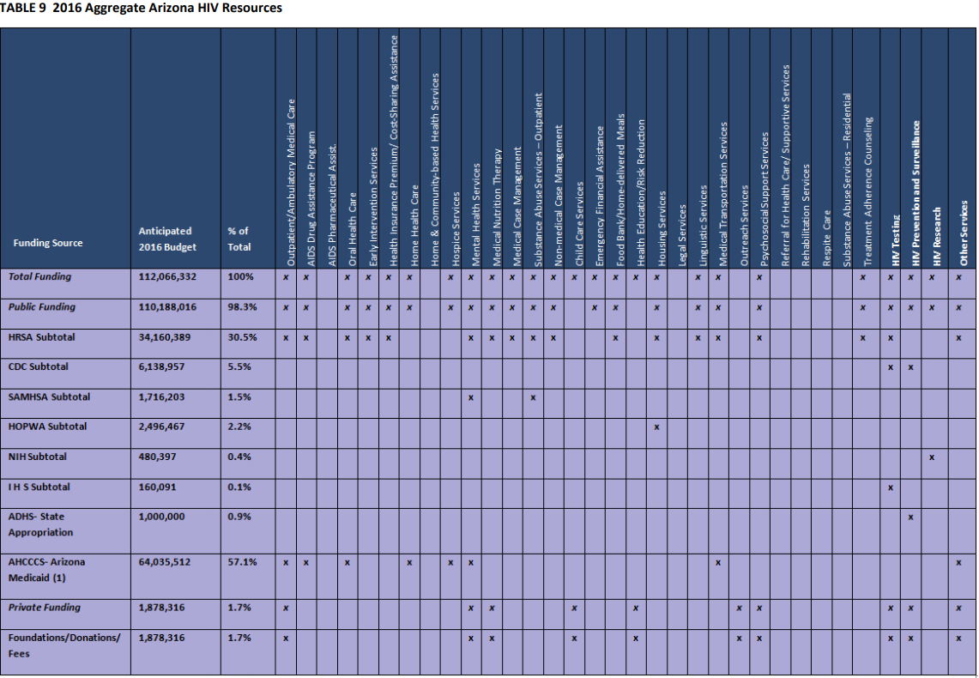
Integrated HIV Prevention and Care Plans: Resource Allocation
Jurisdictions must prepare Financial and Human Resources Inventory of all available funding sources, both public and private, for HIV prevention, care, and treatment services
HIV Statewide Advisory Group and the Phoenix EMA (2016): “The 2017 to 2021 Integrated HIV Prevention and Care Plan for Arizona” p.37
Notes:
Sample Resource Inventory is from Arizona’s Integrated Plan (by HIV Statewide Advisory Group and the Phoenix EMA)

Slide 14
RWHAP Parts A and B: Resource Allocation Requirements
Component | Budget Requirement
Core medical services | at least 75%
Support services | 25%
Grant administration | 10% for Part As 15% for Part Bs (includes planning and evaluation)
Quality management activities | 5% of award or $3 million (whichever is less)

Slide 15
RWHAP Parts A and B: Resource Allocation Requirements
RWHAP is payer of last resort.
Fill gaps in non-RWHAP HIV services.
Recipients must provide matching (non-RWHAP) funds
Other funding sources include Medicaid, Medicare, CHIP, Veterans Affairs, HOPWA, SAMSA, CDC, WIC, state and local public health programs, private funding
Must apply a sliding scale for client charges, which should be applied to all clients above 100% of the FPL

Slide 16
RWHAP Part A: Resource Allocation Requirements
Planning done by HIV Health Services Planning Council whose composition is mandated by law:
e.g. Council must represent local demographics; at least 33% of members must be people living with HIV who receive RWHAP services
Policies and procedures must be documented
RA process must be documented in writing.
Council must gather input from community stakeholders, e.g. hold open meetings
Notes:
PLWHA on Council must be "unaffiliated" (without conflict of interest, and are not staff/consultants of grantee)

Slide 17
RWHAP Part B: Resource Allocation Requirements
Recipient may oversee planning on its own through statewide or regional planning bodies, or through consortia
Consortia: associations of public and nonprofit health-care and support service providers and community-based organizations that the State contracts with to provide, for a specific region(s) or the entire State, planning, resource allocation and contracting, program and fiscal monitoring, and required reporting
Recipient must gather stakeholder input on RA
Notes:
Even if grantee doesn’t use a planning group, grantee must gather stakeholder input.

Slide 18
Resource Allocation Support through the IHAP TAC
Three step process
Step 1: Information gathering and resource identification
Step 2: Dissemination of models and best practices
Step 3: Technical assistance and Training

Slide 19
Information Gathering: Literature Search
Compiled repository of nearly 50 relevant resources:
RWHAP policies, RWHAP recipients’ planning documents, technical briefs, job aids, and academic articles
More RA guidance available for Part A RWHAP recipients (usually as “PSRA”) than for Part B recipients
Most TA resources published between 2010 and 2018
Includes sample RA models, ADAP rebate guide, and substantial literature on HIV service RA in international settings

Slide 20
How Did We Get Here?
In the beginning…. There was legislatively mandated Priority Setting and Resource Allocation for Part A recipients and Planning Councils
However…. There has been relatively little guidance with respect to resource allocation for Part B entities, beyond the Statewide Coordinated Statement of Need (which isn’t actually a Resource Allocation process activity, but a coordinating one)
HIV RAMP: Inter-agency exploration of a model to allocate prevention resources
Technical Expert Panel: Held by HRSA with both Part A and Part B recipients in June 2017
Notes:
Stewart
- Integrating HIV prevention and care at all levels
- Strategies for implementing Integrated Plan activities
- Publicizing and disseminating progress of Integrated Plan activities to stakeholders
- Identifying roles and responsibilities for Integrated Plan activity implementation
- Monitoring and improving Integrated Plan activities
- Collaborating across jurisdictions

Slide 21
Information Gathering
Step 1: Information gathering and resource identification
Thorough review of TargetHIV.org
Literature search including domestic and international resources
Review of relevant prevention and care resources in the public domain
Review of Integrated HIV Prevention and Care Plans
Consultations:
Key informants
Subject matter experts
Stakeholders
HRSA/CDC
Priority setting and resource allocation from other HAB-funded Technical Assistance Centers

Slide 22
Preliminary Findings
Most RA processes focus on allocation of funding to meet the needs of RWHAP clients for key services
While modeling has been used by global health programs for resource allocation at the country level, it has less prominence within the United States
With RA being data-driven, some jurisdictions are linking resource allocation to Integrated HIV Prevention and Care Plan objectives

Slide 23
Let’s talk rebates and program income!

Slide 24
What does HRSA say about rebates?
“The recipient may only use rebates for the purposes and under the conditions of the RWHAP Part B program. These statutorily permitted purposes include core medical services including ADAPs, support services, CQM, and administrative expenses, including planning and evaluation.” (priority given to ADAP)
In addition, allowable uses of rebates include:
State match requirement;
State MOE requirement; and
Costs for allowable services that exceed the RWHAP Part B implementation work plan
(Section 2612(a) of the Public Health Service (PHS) Act)
Notes:
(Section 2612(a) of the Public Health Service (PHS) Act)

Slide 25
Rebates in Resource Allocation planning
Rebate funds should be treated just like any other RWHAP Part B award
“At the beginning of each year, often in April to correspond with the RWHAP Part B and ADAP grant year (also known as the budget period), states, in conjunction with their finance departments, should project the amount of rebates expected that year and develop a budget based on that amount”
Barriers when considering rebates during resource allocation
Difficulty estimating how much recipients will receive in rebates when accounting for them in the RA process
RWHAP programs are not on the same funding cycle
Notes:
Considering these points when

Slide 26
Examples of how RWHAP recipients can use rebate funds
Systematic/Administrative Assistance:
AIDS Education and Training Centers
Alterations and Renovations
Data Systems
Data-to-Care/Re-engagement
HIV-related Health Inequities
Marketing as Targeted Program Outreach
State Match and/or Maintenance of Effort Requirements
Needs-Assessment
Core Medical and Support Services:
Enhanced Medication Access through ADAP
Early Intervention Services
Medical Case Management
Mental Health Services
Substance Use Care
Housing Support
Interpretation and Translation
Health Education/Risk Reduction
Notes:
NASTAD provided these examples of how recipients used RWHAP rebate funds. This is helpful to consider when going through the resource allocation process.

Slide 27
What does HRSA say about Program Income?
“Program income means gross income earned by the non-Federal entity that is directly generated by a supported activity or earned as a result of the Federal award during the period of performance except as provided on 45 CFR § 75.307(f). Program income includes but is not limited to income from fees for services performed, the use or rental of [sic.] real or personal property acquired under Federal awards, the sale of commodities or items fabricated under a Federal award, license fees and royalties on patents and copyrights, and principal and interest on loans made with Federal award funds.”
Policy Clarification Notice (PCN) #15-04
Notes:
Utilization and Reporting of Pharmaceutical Rebates Policy Clarification Notice (PCN) #15-04 Relates to Policy #12-02 Relates to Policy #15-03
https://hab.hrsa.gov/sites/default/files/hab/Global/pcn_15-04_pharmaceutical_rebates.pdf

Slide 28
Let’s Talk Rebates
Questions for discussion
What are some of the challenges with planning and implementing your resource allocation process related to rebates?
What effective rebate related tools, practices, and models are you using for your resource allocation planning, implementation, and evaluation processes?

Slide 29
Let’s Go To The Polls
Does your jurisdiction:
Have an established resource allocation process?
Involve planning bodies in the resource allocation planning process?
Tie resource allocation planning to your Integrated HIV Prevention and Care Plan?
Utilize a contingency planning process that incorporates both CDC and HRSA resources in developing resource allocations?

Slide 30
What do you know, what do you need?
Open discussion:
Let’s review our poll findings and discuss implications
Established resource allocation process?
Planning body involvement?
Integrated Plan integration?
Contingency planning?
What types of resource allocation TA/Training would be most beneficial?

Slide 31
Thank you!
Contact us at ihaptac@jsi.com!
Obtain more information, join our mailing list, request TA or to share your experiences or resources.
This project is supported by the Health Resources and Services Administration (HRSA) of the U.S. Department of Health and Human Services (HHS) under grant number U69HA30144, Ryan White HIV/AIDS Program Integrated HIV Planning Implementation. This information or content and conclusions are those of the author and should not be construed as the official position or policy of, nor should any endorsements be inferred by HRSA, HHS or the U.S. Government.

