Slide 1
AIDS Service Organizations and Trauma-Informed Care
Alex S. Keuroghlian MD MPH
Director of Education and Training Programs, The Fenway Institute
Assistant Professor of Psychiatry, Harvard Medical School
Tuesday May 24, 2017
By the National Center for Innovation in HIV Care
Under HRSA HIV/AIDS Bureau Cooperative Agreement U69HA27176

Slide 2
Learning Objectives
By the end of this session, learners will be able to:
  Understand the disproportionate prevalence of trauma- and stress-related disorders among people living with HIV.
  Describe the relationship of trauma to decreased engagement in HIV care services.
  Apply best practices in trauma-informed care to improve engagement of clients in HIV care services.

Slide 3
Syndemic of HIV and Trauma
People living with HIV (PLWH) experience disproportionate trauma, which often leads to posttraumatic stress disorder (PTSD) (Seedat, 2012).
A trauma history and PTSD increase risk of acquiring and transmitting HIV, and are linked to disease progression and poor quality of life (Singer and Clair, 2003).
  HIV infection and trauma are a syndemic illness, i.e., synergistic epidemics whose interaction contributes to excess burden of disease.
Without well-informed care, trauma among PLWH can lead to highly detrimental health consequences at individual and population-health levels (Brezing and Freudenrich, 2015).

Slide 4
Epidemiology of HIV and Trauma
Approximately half of PLWH report childhood physical or sexual abuse, which is 1.5–2 times more than the general population (Whetten et al., 2006; Wilson et al., 2014).
Up to 90% of PLWH report at least one or more lifetime severe traumatic events (Pence et al., 2007).
Among HIV-positive women, 55.3% lifetime prevalence of intimate partner violence (5 times national average) and 30% recent prevalence of PTSD (2 times national average) (Machtinger et al., 2012a).

Slide 5
Epidemiology of HIV and Trauma
Prevalence of acute stress disorder among HIV-positive women is 55%, versus 38% among HIV-positive men (Israelski et al., 2007).
68% of HIV-positive women report past sexual assault, versus 35% of HIV-positive men (Kalichman et al., 2002).
66% of HIV-positive women report childhood physical or sexual abuse; 25% report abuse by a partner in adulthood; 10% report abuse while pregnant (Villar-Loubet et al., 2014)

Slide 6
Epidemiology of HIV and Trauma
While a trauma history is less common among HIV-positive men than HIV-positive women, it is still more common than trauma among HIV-negative men (Brezing and Freudenrich, 2015).
35% of HIV-positive men who have sex with men (MSM) report childhood sexual abuse, which was associated with higher prevalence of dissociative symptoms, and more than 55% of this group met the criteria for PTSD (Kamen et al., 2012a).
There is comparable trauma prevalence among MSM and men who have sex with women, but MSM have more prevalent posttraumatic stress symptoms, including dissociation (Kamen et al., 2012b).

Slide 7
Stigma, Stress, and Health
General Psychological Processes
External Stigma-Related Stressors
Mental Health Problems
Physical
Health
Problems
Internal Stigma-Related Stressors
Adapted from Hatzenbuehler, 2009

Slide 8
Trauma and Risk Behaviors among PLWH
History of trauma and development of posttraumatic stress symptoms is linked with high-risk behaviors.
Trauma associated with higher incidence of HIV transmission among both PLWH and HIV-uninfected people (Brezing and Freudenreich, 2015).
Among HIV-positive MSM, condomless anal intercourse with casual partners associated with a history of sexual abuse (Kamen et al., 2013).

Slide 9
Trauma and Risk Behaviors among PLWH
HIV- positive gay and bisexual men with PTSD more likely to have HIV transmission behaviors than their counterparts without PTSD (O’Cleirigh et al., 2013).
Trauma related to discrimination due to race, sexual orientation, or HIV status is linked with condomless anal intercourse among HIV-positive Black men (Fields et al., 2013).
Among HIV-positive Black men who have sex with both men and women, increased sexual risk behaviors are associated with PTSD symptom severity (Glover et al., 2013).

Slide 10
Trauma and Antiretroviral Adherence
Poor adherence to antiretroviral therapy (ART) is correlated with more frequent childhood trauma, sexual abuse before onset of puberty, depression, and PTSD (Whetten et al., 2013; Meade et al., 2009).
HIV-positive women with recent trauma are four times more likely to experience ART failure (Machtinger et al., 2012b).
Having a history of trauma is also predictive of mortality among PLWH (Pence et al., 2012).

Slide 11
Trauma and Antiretroviral Adherence
Sexual trauma is associated with greater likelihood of HIV treatment failure.
  Traumatic stress adversely impacts the immune system and overall physical and mental well-being (McEwan and Seeman, 1999).
  A study with African American men with HIV demonstrated that PTSD correlated with elevated biomarkers of stress, including cortisol and catecholamines (Glover et al., 2013).
  PTSD symptom severity and psychological dissociation symptoms are associated with lower ART adherence (Keuroghlian et al., 2011).

Slide 12
PTSD and Antiretroviral Adherence
Recruited individuals with HIV from community-based clinics for cross-sectional study;
Self-reported adherence measured with AIDS Clinical Trials Group Adherence Questionnaire;
Greater PTSD associated with lower odds of ART adherence even after controlling for depression;
PTSD symptoms associated with lower odds of adherence in individuals with high levels of psychological dissociation but not low levels of dissociation.
Keuroghlian et al., 2011

Slide 13
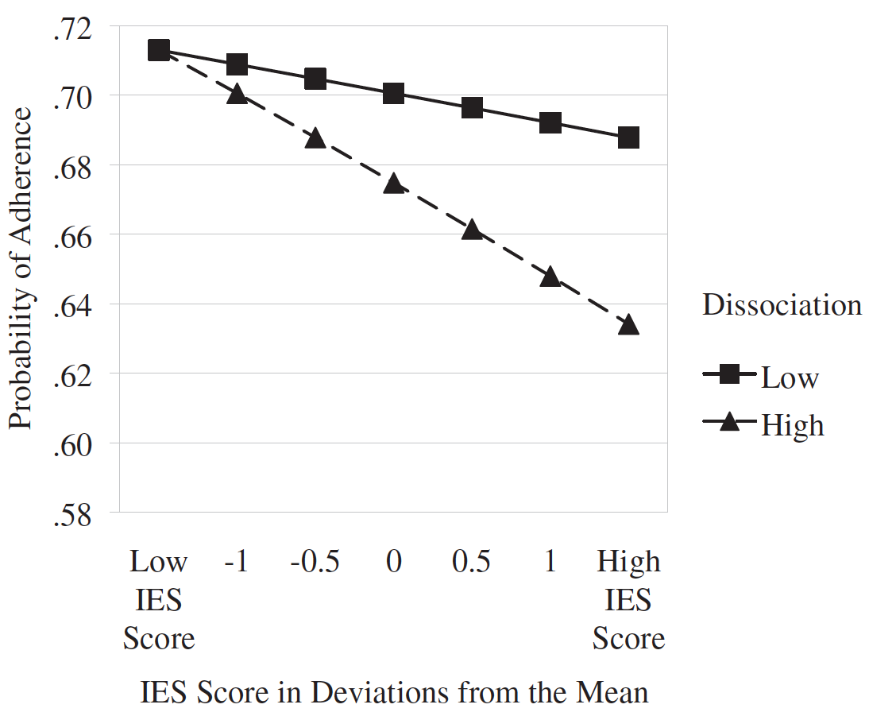
PTSD and Antiretroviral Adherence
Interaction Effect of PTSD and Dissociation
On Antiretroviral Medication Adherence
PTSD
Keuroghlian et al., 2011

Slide 14
PTSD and Antiretroviral Adherence
Importance of psychosocial interventions that target posttraumatic stress symptoms to maximize antiretroviral adherence in community populations;
Integration of trauma-focused treatment services into antiretroviral medication management may effectively improve adherence.

Slide 15
Bio-behavioral HIV Care
Tailored behavioral interventions exist for antiretroviral adherence (e.g., Life-Steps; Safren et al., 2001);
Combined biomedical and behavioral HIV treatment strategies are optimal;
Behavioral health treatments that restructure distressing cognitions can improve self-care and physical health outcomes.

Slide 16

Substance Use and Posttraumatic Stress
Co-occurrence of substance use disorders (SUDs) with posttraumatic stress symptoms is highly prevalent:
  Associated with increased treatment costs, decreased treatment adherence, and worse physical and mental health outcomes (McCauley et al, 2012);
Substance use is a common avoidance strategy for posttraumatic stress.

Slide 17
Definition of Trauma-Informed Care
According to the Substance Abuse and Mental Health Services Administration (SAMHSA, 2014), a trauma-informed service organization:
  Realizes widespread impact of trauma and understands potential paths for recovery;
  Recognizes signs and symptoms of trauma in clients, staff, and others involved with the system;
  Responds by fully integrating knowledge about trauma into policies, procedures, and practices;
  Seeks to actively resist re-traumatization.

Slide 18
Trauma-Informed Care: An Emerging National Priority
Emergence of several evidence-informed treatments designed to improve posttraumatic stress symptoms (Brezing and Freudenreich, 2015).
Implementation of these strategies to target effects of trauma on health has been inconsistent, including at ASOs.
This issue has recently gained more national prioritization with increasing concerns about consequences of posttraumatic stress among veterans.

Slide 19
Trauma-Informed Care for PLWH
Trauma-informed approach should incorporate the following (Brezing and Freudenreich, 2015):
  A trauma-sensitive practice environment
    Trainings to ensure a sense of safety in all patient interactions with staff members, including physicians, clinical, and administrative staff.
  Identification of trauma and its mediators
    Sequelae of posttraumatic stress, including poor adherence to treatment and high-risk behaviors.
  Education for PLWH about connection between trauma and its negative behavioral and physical health outcomes
  Linkage to suitable resources and referrals for more specialized treatment as needed

Slide 20

Integrated Treatment for Addictions and Trauma
Recent shift in focus toward trauma-informed care created a favorable environment in community SUD treatment settings for evidence-based integrated therapies that also target trauma and stress (Killeen et al., 2015; McGovern et al., 2015; Roberts et al., 2015; Institute of Medicine, 2008).
Integrated treatments for SUDs and posttraumatic stress are well tolerated and improve both SUDs and PTSD.

Slide 21
National Center for Trauma-Informed Care
In 2005, SAMHSA developed the National Center for Trauma Informed Care
  Promotes awareness and implementation of best practices
  Disseminates resources for and referrals for trauma-focused treatments
  Defines trauma-informed care as an organizational approach rooted in principles that focus on being mindful of and responding to people who have experienced or may be at risk of trauma; rather than a particular set of rigid procedures
SAMHSA, 2014

Slide 22
Trauma-Informed Service Environment
Priority is to promote a sense of safety
Prior traumatic experiences influence reaction in subsequent interactions, such as the process of seeking care
A history of interpersonal trauma can contribute to mistrust of caretakers and increased likelihood of being re-traumatized.
Retention in care for PLWH trauma histories requires engagement through collaboration, transparency, trust, and consistent supportiveness.
Brezing and Freudenreich, 2015

Slide 23
Screening for and Identifying Trauma and Its Mediators
Screening all PLWH for a trauma history
  Extra attentiveness for subpopulations at even higher risk of trauma, who may have heightened sensitivity.
  Screening for intimate partner violence.
If trauma is identified, care team ought to assess specifically for posttraumatic stress symptoms
  Hypervigilance; avoidance, numbing, re-experiencing through intrusive thoughts, flashbacks, nightmares; psychological dissociation, including amnesia, depersonalization, and derealization.
Brezing and Freudenreich, 2015

Slide 24
The Primary Care PTSD Screen (PC-PTSD)
SAMHSA, 2014

Slide 25
Intimate Partner Violence Screening Tool
SAMHSA, 2014

Slide 26
The PTSD Checklist
SAMHSA, 2014

Slide 27
Screening for Mediators and Sequelae of Trauma
Screening for high-risk behaviors, inadequate medication adherence, and poor health outcomes.
  Incorporated into the treatment plan for proactive intervention.
For PLWH with negative trauma screening results, primary prevention through education about increased risk of traumatization
Brezing and Freudenreich, 2015

Slide 28
Educating Clients about Trauma and HIV
Understanding the relationship of trauma to poor health outcomes is critical for PLWH
Helps cultivate insight about how prior traumatic experiences influence current health behaviors

Slide 29
Educating Clients about Trauma and HIV
Randomized control trial of women living with HIV who had trauma histories (Puffer et al., 2011):
  Showed that psychoeducation about relationship of traumatic experiences to current distress and high-risk transmission behaviors empowered participants.
If referral to specific treatment for trauma, SUDs, or other mediators is not accessible:
  Education can enhance patients' self-awareness and capacity to enhance self-care and decrease likelihood of transmission (Brezing and Freudenreich, 2015).

Slide 30
Resources and Referrals for Additional Services
If ASO has access to psychiatric, substance use disorder, and social services:
  Prompt referrals for specialized trauma- and mediator-specific treatments.
Tailoring interventions for a customized approach to symptom reduction, including strategies to prevent relapse, can significantly enhance ART adherence and mitigate high-risk behaviors.
Brezing and Freudenreich, 2015

Slide 31
Resources and Referrals for Additional Services
Evidence-based treatments are available for:
  Trauma recovery
  Co-occurrence of trauma and substance use disorders
  Co-occurrence of trauma and nonsubstance-related psychiatric disorders
  Skills to manage dysregulated affect and tolerate distress in the context of trauma.
Enhanced cognitive and behavioral coping skills contribute to higher patient satisfaction, lower distress, and a reduction in high-risk behavior.
Brezing and Freudenreich, 2015

Slide 32
Cognitive Processing Therapy for PTSD
Adapting selected components of cognitive processing therapy for PTSD (Resick et al., 1992)
Focus:
  Education about posttraumatic stress;
  Writing an Impact Statement to help understand how trauma influences beliefs;
  Identifying maladaptive thoughts about trauma that are linked to emotional distress;
  Decreasing avoidance and increasing resilient coping.

Slide 33
Cognitive Triad of Traumatic Stress
SAMHSA, 2014

Slide 34
Resources and Referrals for Additional Services
Staff can familiarize themselves with the variety of services available in their region.
Time-limited, focused interventions can still lead to significant reduction in symptoms.
  Among PLWH, a 4-session guided written emotional disclosure protocol led to improvements in depression, posttraumatic stress, and bodily symptoms (Ironson et al., 2013).
For resource-limited areas, SAMHSA’s website lists hotlines, referral options, tools for online treatment, and support services on trauma-informed care:
  Website: www.samhsa.gov/nctic

Slide 35
Promoting Resilience in Trauma-Informed Care
Resilience: This term refers to the ability to bounce back or rise above adversity as an individual, family, community, or provider. Well beyond individual characteristics of hardiness, resilience includes the process of using available resources to negotiate hardship and/or the consequences of adverse events.
SAMHSA, 2014

Slide 36
Promoting Resilience through Strengths-Oriented Questions
Potential strengths-oriented questions include:
The history that you provided suggests that you’ve accomplished a great deal since the trauma.
What are some of the accomplishments that give you the most pride?
What would you say are your strengths?
How do you manage your stress today?
What behaviors have helped you survive your traumatic experiences (during and afterward)?
What are some of the creative ways that you deal with painful feelings?
You have survived trauma. What characteristics have helped you manage these experiences and the challenges that they have created in your life?
If we were to ask someone in your life, who knew your history and experience with trauma, to name two positive characteristics that help you survive, what would they be?
What coping tools have you learned from your _____ (fill in: cultural history, spiritual practices, athletic pursuits, etc.)?
Imagine for a moment that a group of people are standing behind you showing you support in some way. Who would be standing there? It doesn’t matter how briefly or when they showed up in your life, or whether or not they are currently in your life or alive.
How do you gain support today? (Possible answers include family, friends, activities, coaches, counselors, other supports, etc.)
What does recovery look like for you?
SAMHSA, 2014

Slide 37
Promoting Resilience in Trauma-Informed Care
SAMHSA, 2014

Slide 38
Recruiting Social Supports
Identifying and involving family and other social supports is important during treatment plan implementation for PLWH who have trauma histories.
For serodiscordant couples, individual treatment of trauma may not be as successful as strategies that include both the HIV-positive person and their significant other (Jones et al, 2013).
Friends and family can be helpful in detecting problems early and often function as advocates for PLWH seeking services (Brezing and Freudenreich, 2015).

Slide 39
THANK YOU!
Alex S. Keuroghlian, MD MPH
The National Center for Innovation in HIV Care
1340 Boylston Street, 8th Floor
Boston, MA 02215
Phone: (617) 927-6354
Email: nationalhivcenter@fenwayhealth.org

Slide 40
References
Brezing C and Freudenreich O: The Syndemic Illness of HIV and Trauma: Implications for a Trauma-Informed Model of Care. Psychosomatics 2015; 56: 107-118.
Fields EL, Bogart LM, Galvan FH, Wagner GJ, Klein DJ, Schuster MA: Association of discrimination-related trauma with sexual risk among HIV-positive African American men who have sex with men. Am J Public Health 2013; 103 (5):875–880
Glover DA, Williams JK, Kisler KA: Using novel methods to examine stress among HIV-positive African American men who have sex with men and women. J Behav Med 2013; 36(3):283–294
Hatzenbuehler ML: How does sexual minority stigma “get under the skin”? A psychological mediation framework. Psychological bulletin. 2009; 135(5):707-730.
Jones DL, Kashy D, Villar-Loubet OM, Cook R, Weiss SM: The impact of substance use, sexual trauma, and intimate partner violence on sexual risk intervention outcomes in couples: a randomized trial. Ann Behav Med 2013; 45(3):318–328

Slide 41
References
Kalichman SC, Sikkema KJ, DiFonzo K, Luke W, Austin J: Emotional adjustment in survivors of sexual assault living with HIV-AIDS. J Trauma Stress 2002; 15(4):289–296
Kamen C, Bergstrom J, Koopman C, Lee S, Gore-Felton C: Relationships among childhood trauma, posttraumatic stress disorder, and dissociation in men living with HIV/ AIDS. J Trauma Dissociation 2012a; 13(1):102–114
Kamen C, Flores S, Taniguchi S, et al: Sexual minority status and trauma symptom severity in men living with HIV/ AIDS. J Behav Med 2012b; 35(1):38–46
Kamen C, Etter D, Flores S, Sharp S, Lee S, Gore-Felton C: Sexual risk behaviors by relationship type and trauma history among HIV-positive men who have sex with men. Arch Sex Behav 2013; 42(2):257–265
Keuroghlian AS, Kamen CS, Neri E, Lee S, Liu R, Gore- Felton C: Trauma, dissociation, and antiretroviral adher- ence among persons living with HIV/AIDS. J Psychiatr Res 2011; 45(7):942–948

Slide 42
References
Institute of Medicine (US). Committee on Treatment of Posttraumatic Stress Disorder. Treatment of posttraumatic stress disorder: An assessment of the evidence. National Academies Press, 2008.
Ironson G, O'Cleirigh C, Leserman J, et al: Gender-specific effects of an augmented written emotional disclosure intervention on posttraumatic, depressive, and HIV- disease-related outcomes: a randomized, controlled trial. J Consult Clin Psychol 2013; 81(2):284–298
Israelski DM, Prentiss DE, Lubega S, et al: Psychiatric co-morbidity in vulnerable populations receiving primary care for HIV/AIDS. AIDS Care 2007; 19(2):220–225
Machtinger EL, Wilson TC, Haberer JE, Weiss DS: Psychological trauma and PTSD in HIV-positive women: a meta-analysis. AIDS Behav 2012a; 16(8):2091–2100
Machtinger EL, Haberer JE, Wilson TC, Weiss DS: Recent trauma is associated with antiretroviral failure and HIV transmission risk behavior among HIV-positive women and female-identified transgenders. AIDS Behav 2012b; 16 (8):2160–2170

Slide 43
References
McCauley, Jenna L., et al. "Posttraumatic stress disorder and co-occurring substance use disorders: Advances in assessment and treatment." Clinical Psychology: Science and Practice 19.3 (2012): 283-304
McEwen BS, Seeman T: Protective and damaging effects of mediators of stress. Elaborating and testing the concepts of allostasis and allostatic load. Ann N Y Acad Sci 1999; 896:30–47
McGovern MP, et al. A randomized controlled trial of treatments for co‐occurring substance use disorders and post‐traumatic stress disorder. Addiction 2015; 110 (7): 1194-1204.
Meade CS, Hansen NB, Kochman A, Sikkema KJ: Utilization of medical treatments and adherence to antiretroviral therapy among HIV-positive adults with histories of childhood sexual abuse. AIDS Patient Care STDS 2009; 23(4):259–266
O'Cleirigh C, Traeger L, Mayer KH, Magidson JF, Safren SA: Anxiety specific pathways to HIV sexual transmission risk behavior among young gay and bisexual men. J Gay Lesbian Ment Health 2013; 17(3):314–326

Slide 44
References
Pence BW, Reif S, Whetten K, et al: Minorities, the poor, and survivors of abuse: HIV-infected patients in the US deep South. South Med J 2007; 100(11):1114–1122
Pence BW, Mugavero MJ, Carter TJ, et al: Childhood trauma and health outcomes in HIV-infected patients: an exploration of causal pathways. J Acquir Immune Defic Syndr 2012; 59(4):409–416
Puffer ES, Kochman A, Hansen NB, Sikkema KJ: An evidence-based group coping intervention for women living with HIV and history of childhood sexual abuse. Int J Group Psychother 2011; 61(1):98–126
Roberts NP, et al. Psychological interventions for post-traumatic stress disorder and comorbid substance use disorder: a systematic review and meta-analysis. Clinical psychology review. 2015; 38: 25-38.
Resick, PA and Schnicke MK. Cognitive processing therapy for sexual assault victims. Journal of consulting and clinical psychology 1992; 60(5):748-756.

Slide 45
References
Safren SA, Otto MW, Worth JL, Salomon E, Johnson W, Mayer K, Boswell S. Two strategies to increase adherence to HIV antiretroviral medication: life-steps and medication monitoring. Behaviour research and therapy. 2001; 39(10):1151-1162.
SAMHSA. A Treatment Improvement Protocol: Trauma-Informed Care in Behavioral Health Services. 2014. Available at: https://store.samhsa.gov/product/TIP-57-Trauma-Informed-Care-in-Behavioral-Health-Services/SMA14-4816 (last accessed May 24th, 2017)
Seedat S: Interventions to improve psychological function- ing and health outcomes of HIV-infected individuals with a history of trauma or PTSD. Curr HIV/AIDS Rep 2012; 9(4):344–350
Singer M, Clair S: Syndemics and public health: recon- ceptualizing disease in bio-social context. Med Anthropol Q 2003; 17(4):423–441
Villar-Loubet OM, Illa L, Echenique M, et al: Prenatal and mental health care among trauma-exposed, HIV-infected, pregnant women in the United States. J Assoc Nurses AIDS Care 2014; 25(1 Suppl):S50–S61

Slide 46
References
Whetten K, Leserman J, Lowe K, et al: Prevalence of childhood sexual abuse and physical trauma in an HIV- positive sample from the deep south. Am J Public Health 2006; 96(6):1028–1030
Whetten K, Shirey K, Pence BW, et al: Trauma history and depression predict incomplete adherence to antiretroviral therapies in a low income country. PLoS One 2013; 8(10): e74771
Wilson SM, Sikkema KJ, Ranby KW: Gender moderates the influence of psychosocial factors and drug use on HAART adherence in the context of HIV and childhood sexual abuse. AIDS Care 2014; 26(8):959–967

