Slide 1
Housing as a Determinant of HIV Health Outcomes
Results from a Systematic Review of Research 1996-2014
& Implications for Policy and Program
April 2017
Angela A. Aidala, Mailman School of Public Health, Columbia University
Virginia Shubert, Housing Works
By the National Center for Innovation in HIV Care
Under HRSA HIV/AIDS Bureau Cooperative Agreement U69HA27176
Notes:
Housing as a determinant of health for people with HIV: A systematic
review of the literature
Angela A. Aidala¹
Virginia Shubert^{6,7}
Sergio Rueda^{2,8}
David Gogolishvili²
Anne Bozack¹
Jason Globerman²
Michael G. Wilson^{,2,3,4}
Maria Caban¹
Sean B. Rourke²
Angela A. Aidala¹
Virginia Shubert^{6,7}
Sergio Rueda^{2,8}
David Gogolishvili²
Anne Bozack¹
Jason Globerman²
Michael G. Wilson^{,2} ^{,3,4}
Maria Caban¹
Sean B. Rourke^{2,3,10}

Slide 2
Housing is unique as a social determinant of health shaping our daily lives – but also manifestation of broader, antecedent, structural processes of inequality and marginalization that are fundamental drivers of HIV vulnerability and poor outcomes among the infected

Slide 3
INTRODUCTION
Housing is an (intermediary) social determinant of health and health equity
Fundamental determinants of health are macro level social, cultural, economic, political policies and dynamics that affect
Socioeconomic positions of individuals, groups, communities within society
- determines access to education, work, income
- Influenced by gender, race/ethnicity, other bases of social inclusion/ exclusion
Socioeconomic status determines exposure to health compromising or health promoting conditions - to "intermediary" social determinants
Notes:
The socioeconomic position will determine differences in exposure and vulnerability to intermediary health-affecting factors (i.e. what is call the ‘social determinants of health’ in a limited and specific sense).
Housing occupies a strategic position as an intermediate structural factor, linking “upstream” economic, social, and cultural determinants to the more immediate physical and social environments in which we carry out our day-to-day lives.⁸⁻¹⁰ Housing comprises more than just physical shelter. Where we live is where our personal, social, and economic lives come together. People who lack stable, secure, adequate housing lack a protected space to maintain physical and psychological wellbeing; finding themselves consistently in stress-producing environments with consequences for mental health and immunological functioning. The press of daily needs can be a barrier to use of available services. Home structures the private sphere: the lack of stable housing is a barrier to forming and maintaining stable intimate partner relationships and networks of social support.

Slide 4
INTRODUCTION
Housing links “upstream” economic, social, and cultural determinants to the more immediate physical and social environments in which we carry out our day-to-day lives
Housing is where our economic, social, and personal, lives come together
"Our health is determined by resources and supports available in our homes, neighborhoods, and communities" --Healthy People 2020
The "housing system” as well as the health system affects exposure and vulnerability to broader social determinants of disease or injury as well as their consequences
Notes:
Housing occupies a strategic position as an intermediate structural factor, linking “upstream” economic, social, and cultural determinants to the more immediate physical and social environments in which we carry out our day-to-day lives.⁸⁻¹⁰ Housing comprises more than just physical shelter. Where we live is where our personal, social, and economic lives come together. People who lack stable, secure, adequate housing lack a protected space to maintain physical and psychological wellbeing; finding themselves consistently in stress-producing environments with consequences for mental health and immunological functioning. The press of daily needs can be a barrier to use of available services. Home structures the private sphere: the lack of stable housing is a barrier to forming and maintaining stable intimate partner relationships and networks of social support.
Differences in material circumstances (including housing and neighborhood factors) are probably the most important intermediary factor since these can have a direct and significant impact on the health status of marginalized groups. Housing and neighborhood contexts influence facilitate or impeding health promoting or risky behaviors; Psychosocial stressors include negative life events, stressful living circumstances and lack of social support. These could be perceived as threatening or frightening and partly explains the long-term patterns of social inequalities in health.

Slide 5
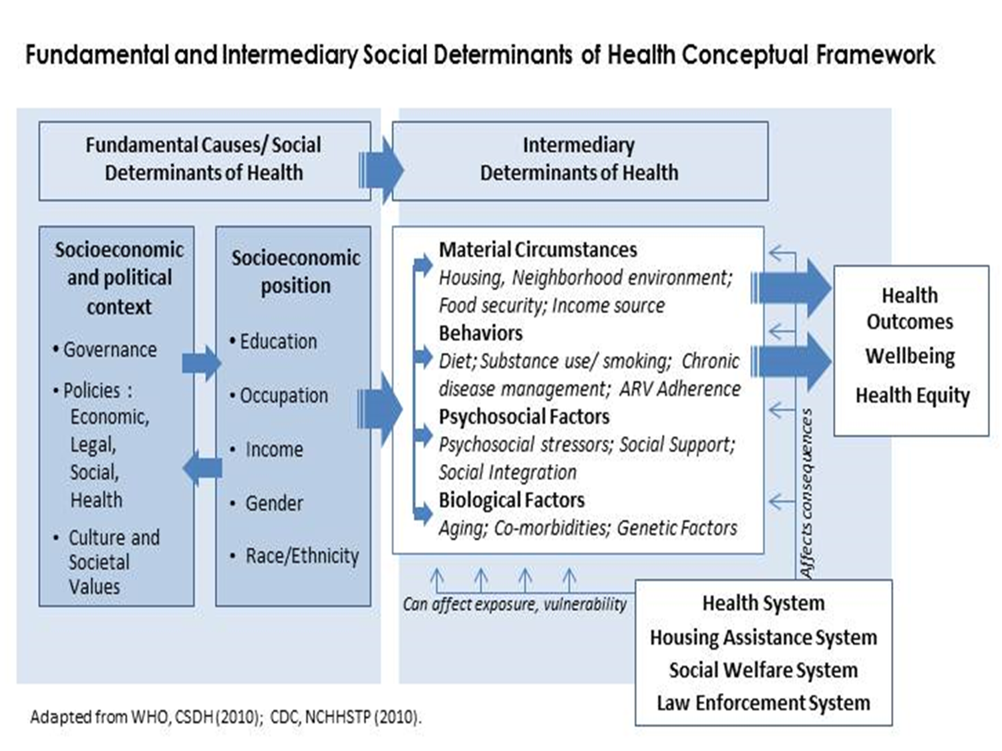

Slide 6
Macro level structural determinants of health that affect socioeconomic positions of individuals and communities →
SES determines our access to resources, life conditions, and life chances (the ‘social determinants of health’ as usually understood) →
Intermediary determinants of health link the ‘upstream’ economic, social, cultural determinants to the more immediate physical and social environments in which we carry out our day-to-day lives
Notes:
Housing occupies a strategic position as an intermediate structural factor, linking “upstream” economic, social, and cultural determinants to the more immediate physical and social environments in which we carry out our day-to-day lives. Housing comprises more than just physical shelter. Where we live is where our personal, social, and economic lives come together. People who lack stable, secure, adequate housing lack a protected space to maintain physical and psychological wellbeing; finding themselves consistently in stress-producing environments with consequences for mental health and immunological functioning. The press of daily needs can be a barrier to use of available services. Home structures the private sphere: the lack of stable housing is a barrier to forming and maintaining stable intimate partner relationships and networks of social support.
Differences in material circumstances (including housing and neighborhood factors) are probably the most important intermediary factor since these can have a direct and significant impact on the health status of marginalized groups. Housing and neighborhood contexts influence facilitate or impeding health promoting or risky behaviors; Psychosocial stressors include negative life events, stressful living circumstances and lack of social support. These could be perceived as threatening or frightening and partly explains the long-term patterns of social inequalities in health.

Slide 7
Direct and Indirect Effects of Housing
Lack of stable, secure, adequate housing:
Lack of protected space to maintain physical and psychological well-being
Constant stress producing environments and experiences
Neighborhoods of disadvantage and disorder
Compromised identity and agency
Press of daily needs - barrier to service use when available
Lack resources for nutritious food, medical costs
Transiency - barrier to stable sources of social support
Structuring the private sphere– lack of housing is barrier to forming stable intimate relationships

Slide 8
Systematic Review of the Research
Pulling together the evidence
Increasing number of studies have shown housing is linked with the risk for HIV exposure and transmission, and the care and health of persons living with HIV/AIDS
Canadian and US researchers conducted a systematic review to examine and summarize available evidence
Why systematic review?
Synthesizing all of the available research evidence reduces the likelihood of being misled by a single or a few studies and increases confidence in the findings
Helpful knowledge translation tool - allows knowledge users to go to one source to access research evidence about a particular question
Notes:
Guided by the ‘Re-AIM’ framework (Glasgow et al) designed to organize and integrate
internal and external validity dimensions that are
important in the translation of research to practice
for health promotion interventions

Slide 9
Methods
SEARCH STRATEGY
(housing OR dwelling OR homeless OR homelessness
OR living accommodation OR residence OR residential)
AND
(HIV OR PHA OR PWHA OR PLWA OR PLWHA)
DATABASES
Medline, PsychInfo, Healthstar, Embase, Sociological Abstracts and Social Science Abstracts, CINAHL and the Cochrane Library
DATES 1996 - April 2014
Also contacted experts to identify any additional relevant studies
Aidala AA et al. Am J Public Health, 2016 Jan; 106(1):e1-23. http://ajph.aphapublications.org/doi/pdf/10.2105/AJPH.2015.302905
Notes:
We searched eight electronic databases from 1996 to April 2010 (Medline, PsychInfo, Healthstar, Embase, Sociological Abstracts, Social Science Abstracts, CINAHL, Cochrane Library) and contacted experts to identify relevant studies published through June 2012. Results were reviewed and data was extracted from included studies by two independent reviewers.
We defined housing status as any measure of homelessness, marginal housing, stable housing, or quality of housing.
Verification of extracted data was completed by a second reviewer.
http://ajph.aphapublications.org/doi/pdf/10.2105/AJPH.2015.302905

Slide 10
Selection Criteria
Sample must include people living with HIV/AIDS
will do separate review with people at-risk for HIV/AIDS
Studies with analysis of empirical data with at least:
one measure of housing status as an independent variable
at least one quantitative health outcome as a dependent variable
Conducted in high resource country
U.S. Canada, Europe, etc.
Notes:
EXCLUSION CRITERIA
•Case studies
•Qualitative studies
•Secondary studies (e.g., systematic reviews)
***No exclusions were made based on publication language, publication type (e.g., ‘grey’ literature) or jurisdiction

Slide 11
Definitions
Housing status: any measure of homelessness, marginal housing, housing instability, or quality of housing
Health-related outcomes:
HIV medical care (e.g. access to treatment and care, service utilization, adherence to treatment)
Clinical health outcomes (e.g. CD4 count, viral load, mortality)
Other health outcomes (e.g. co-morbidities, mental health, physical health functioning, quality of life)
HIV drug and sex risk-behaviors
Notes:
Health-related outcomes: physiological or clinical measures of:
--health outcomes (e.g. CD4 count, viral load, morbidity, quality of life, physical or mental health status)
--medical care, social determinants of health or other health mediating variables (e.g. access to treatment and care, service utilization, adherence to treatment)
--behavioral health outcomes (e.g. HIV risk-behaviors)

Slide 12
Flow chart for included articles
Databases/
experts
N=5548
References
Screened
N=5289
Full-text articles
N=1273
Articles Reviewed N=152
Duplicates excluded
N=252
Not meet criteria
N=4016
Not meet criteria
N=1121
From 5289 studies screened, 152 meet review criteria
112 in USA, 27 in Canada, 12 in Europe, 1 S Korea
Represents 139,757 HIV positive study participants
Notes:
Excluded
•Case studies
•Qualitative studies
•Secondary studies (e.g., systematic reviews)
REVIEWING
•Two reviewers independently assessed the titles and abstracts
•Full-text of all included or unclear articles reviewed by two independent reviewers
•Any disagreements between reviewers were resolved by consensus or by a third independent reviewer
•Data extraction from included articles completed by one reviewer (and will be independently checked by another reviewer)

Slide 13
Reviewing and Quality Appraisal
Two independent reviewers determined eligibility, two assessed methodological quality of each article
Considered appropriate methods for measuring exposure, outcomes, and methods to control confounding
exposure (i.e. housing) good =clear and replicable definition of housing status including time specifier
outcome measures (i.e. HIV care, viral load, etc.) good= objective measure based on clinical assessment or validated self-report measure
controls for confounding good= appropriate analytic methods to control for other variables known to be associated with outcome including at least one SES indicator (e.g. poverty, type insurance) and one behavioral health indicator (substance use, mental health symptoms)

Slide 14
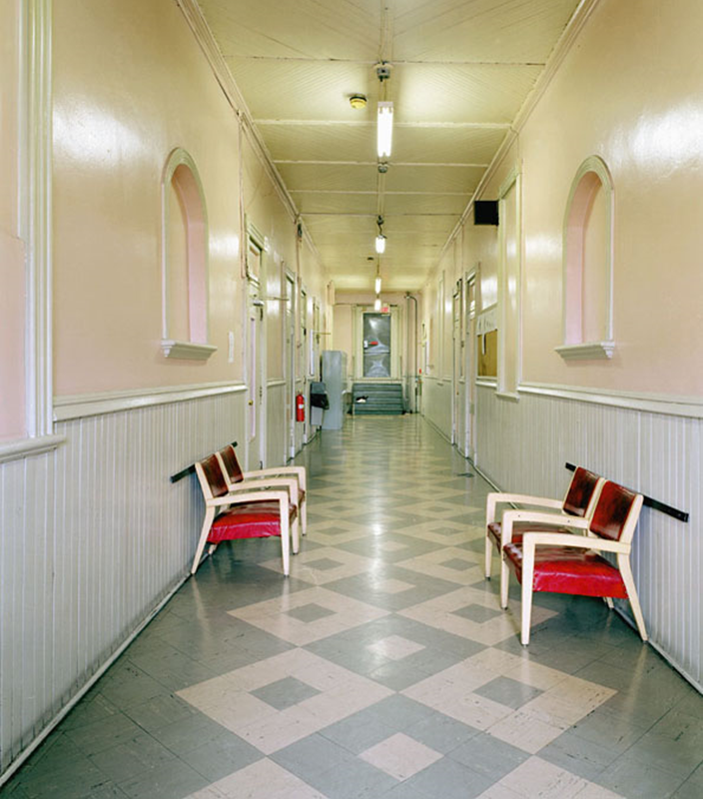
HOUSING & HIV MEDICAL CARE

Slide 15
Health Care Outcomes
35 papers examined access to HIV medical care and medications, service utilization
33 (94%) found worse HIV medical care outcomes among those who were homeless/ unstable/ inadequately housed compared to PLWH 'better' housing
29 (83%) reported statistically significant differences comparing homeless/ unstable/ inadequate housed PLW and those with stable, appropriate housing

Slide 16
HIV Health Care Outcomes
 |  |  | Health Care Access / Utilization
Study Design |  |  | Negative outcome¹ |  | Stat Signif |  | % Stat Signif
RCT Housing Interventions |  |  | 1/1 |  | 0/1 |  | 0.0%
Longitudinal Studies |  |  | 9/11 |  | 9/11 |  | 81.8%
Cross-sectional Studies |  |  | 23/23 |  | 20/23 |  | 87.0%
Total number of papers |  |  | 35 |  | 29 |  | 82.9%
1 Worse outcomes for homeless/ unstably/ inadequately housed PHAs compared to others among studies that considered this outcome
Notes:
1 Worse outcomes for homeless/ unstably/ inadequately housed PHAs compared to others among studies that considered this outcome

Slide 17
Adherence
30 papers examined housing status and adherence to ARV treatment regimens
28 (93%) found worse adherence among those who were homeless or unstably housed
24 (80%) reported statistically significant differences in adherence comparing homeless/ unstable PLW and those with stable housing

Slide 18
Adherence
 |  |  | ART Adherence
Study Design |  |  | Negative outcome¹ |  | Stat Signif |  | % Stat Signif
RCT Housing Interventions |  |  | 0/1 |  | 0/1 |  | 0.0%
Longitudinal Studies |  |  | 10/11 |  | 9/11 |  | 81.8%
Cross-sectional Studies |  |  | 18/18 |  | 15/18 |  | 83.3%
Total number of papers |  |  | 30 |  | 24 |  | 80.0%

Slide 19
ER Visits/Hospital Stays
13 papers examined housing status emergency room visits and/or hospital inpatient stays among PLWH
13/13 (100%) found higher rates of ER visit or inpatient stays among those who were homeless or unstably housed
12/13 (92%) reported statistically significant differences comparing homeless/ unstable PLW and those with stable housing
ER/ Inpatient service utilization indicator of poor engagement with HIV primary care with implications for health of PLWH and health care cost savings

Slide 20
HIV Clinical Outcomes

Slide 21
HIV Clinical Health Outcomes
27 papers looked at HIV-related health outcomes CD4 counts, viral load, opportunistic infections, mortality
24 (89%) found worse HIV-related health outcomes among those who were homeless or unstably housed
20 (74%) reported statistically significant differences comparing homeless/ unstable PLW and those with stable housing
5 of 8 mortality studies found housing status associated with HIV mortality risk - studies that assessed lifetime homelessness or poor housing at diagnosis less likely show association with mortality

Slide 22
HIV Clinical Outcomes
 |  |  | Viral load / CD4 count
Study Design |  |  | Negative outcome¹ |  | Stat Signif |  | % Stat Signif
RCT Housing Interventions |  |  | 2/2 |  | 2/2 |  | 100.0%
Longitudinal Studies |  |  | 13/15 |  | 10/15 |  | 66.7%
Cross-sectional Studies |  |  | 9/10 |  | 8/10 |  | 80.0%
Total number of papers |  |  | 27 |  | 20 |  | 74.1%

Slide 23
Other Health Outcomes
27 papers looked at other health outcomes – mental health, health comorbidities, health functioning or quality of life etc.
26 (96%) found higher rates of other health outcomes among those who were homeless or unstably housed
25 (93%) reported statistically significant differences comparing homeless/ unstably housed PLW and those with stable housing
Notes:
e.g., drug risk behaviours: drug equipment sharing, using unsterilized equipment and sexual risk behaviours such as number of partners, condom usage, trading sex for money, drugs or housing).

Slide 24
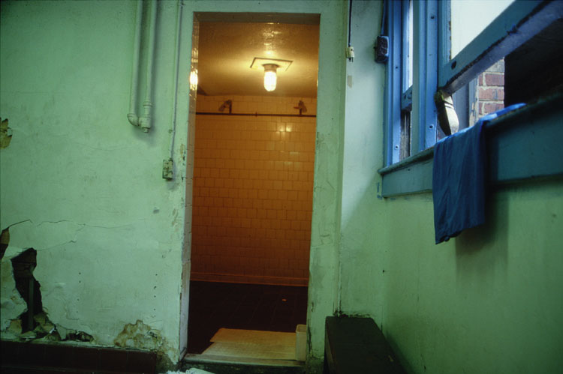
Housing and HIV Risk Behaviors

Slide 25
HIV Risk Behaviors
22 papers examined HIV sex and drug risk behaviors – needle using and sharing, sex exchange, unprotected sex, etc.
22 (100%) found higher rates of risk behavior among those who were homeless or unstably housed
18 (82%) reported statistically significant differences comparing homeless/ unstably housed PLW and those with stable housing
Notes:
e.g., drug risk behaviours: drug equipment sharing, using unsterilized equipment and sexual risk behaviours such as number of partners, condom usage, trading sex for money, drugs or housing).

Slide 26
HIV Risk Behaviors
 |  |  | Sex or Drug Risk Behavior
Study Design |  |  | Negative outcome¹ |  | Stat Signif |  | % Stat Signif
RCT Housing Interventions |  |  | 1/1 |  | 0/1 |  | 0.0%
Longitudinal Studies |  |  | 8/9 |  | 8/9 |  | 85.7%
Cross-sectional Studies |  |  | 12/12 |  | 10/12 |  | 83.3%
Total number of papers |  |  | 22 |  | 18 |  | 81.8%

Slide 27
Housing and the Treatment Cascade
PLWH who are homeless or unstably housed:
More likely to delay entry into care
Experience discontinuous care – lack of retention
Not be receiving medical care that meets minimal clinical practice guidelines
Less likely to be on ARVs or adherent to regimen
Less likely achieve sustained viral suppression

Slide 28
Housing Assistance = Better Outcomes
Homeless/unstably housed PLWHA whose housing status improves over time are:
more likely to report HIV primary care visits, continuous care, care that meets clinical practice standards
more likely to return to care after drop out
more likely to be receiving ARVs
more likely to be virally suppressed
Housing status significant predictor of health care access & outcomes regardless of other barriers to prevention and care

Slide 29
Cost Considerations
Review did not consider cost studies BUT other research:
Two large-scale intervention studies examine the impact of housing on health care utilization & outcomes among homeless/unstably housed persons with HIV & other chronic medical conditions
The Chicago Housing for Health Partnership followed 407 chronically ill homeless persons over 18 months following discharge from hospitals
The Housing and Health (H&H) Study examined the impact of housing on HIV risk behaviors and medical care among 630 homeless/unstably housed HIV+ persons
Findings: Investment in housing is cost effective

Slide 30
H & H Comparative Cost-Effectiveness
Evaluated the “cost-utility” or “cost per quality adjusted life year (QALY) saved” of housing as an HIV health care intervention
“Cost per QALY” is the measure used by health economists to compare the “value for money” of health care interventions
Cost-utility of the H&H housing intervention a function of cost of services provided, transmissions averted, avoidable medical costs saved, and life years saved
Cost per QALY of H&H housing as health care = $62,493
Well within the $100,000 accepted standard for “cost-effective” health care interventions
Holtgrave et al. AIDS Behav 2013;17(5):1626-31

Slide 31
Summary
Findings show homelessness/ unstable/ inadequate housing is consistently associated with worse engagement with HIV health care - poor retention in care, lack of ART uptake, lack of adherence to treatment
Homelessness/unstable/inadequate housing associated with poor HIV clinical outcomes - failure to achieve viral suppression
Homelessness/ unstable housing also associated with increased sex and drug risk behaviors
Better/ Improved housing associated with retention in care, ART uptake, treatment success

Slide 32
Policy Implications
Housing status is strongly association with HIV medical care and outcomes - and medical expenditures
Homelessness/ unstable/ adequate housing contribute to continued HIV transmission
Housing is a promising structural intervention to stop the spread of HIV and improve the health of individuals and communities most affected by the epidemic
Housing can be a cost savings/ cost effective prevention and treatment intervention
Notes:
Improved housing status improves not only access to ART, but adherence as well, and improved
adherence is associated with improved health outcomes, including lowered viral load and reduced
Mortality
Provision of housing is a promising structural intervention to improve access and engagement with medical care and health outcomes for persons living with HIV/AIDS
Current efforts to expand access to health care and to reduce the public and private costs of avoidable crisis care simply will not succeed without stable housing
These data support the assertion that there is a
strong association between housing status and risk
for HIV transmission among people living with HIV
infection. I

Slide 33
Acknowledgements
Review team for Systematic Review:
Angela Aidala, Columbia University Mailman School of Public Health
Anne Bozack, New York Academy of Medicine
Maria Caban, Columbia University Mailman School of Public Health
Lorie Chambers, Ontario HIV Treatment Network
David Gogolishvili, Ontario HIV Treatment Network
Sean Rourke, Ontario HIV Treatment Network
Sergio Rueda, Ontario HIV Treatment Network
Ginny Shubert, Shubert Botein Policy Associates & Housing Works
Michael Wilson, McMaster University; Ontario HIV Treatment Network
Funders:
Review supported by the Ontario HIV Treatment Network (OHTN), the National AIDS Housing Coalition (NAHC) and the U.S. Department of Housing and Urban Development (HUD) Office of HIV/AIDS Housing
Disclosures:
The contents of this presentation are solei the responsibility of the authors and do not necessarily represent the official views of the Ontario HIV Treatment Network or the U.S. Department of Housing and Urban Development
The presenters have no financial interest to disclose regarding this presentation.

