Slide 1
Lean Tools
Nanette Brey Magnani, EdD
Kevin Garrett, MSW
Guest Presenters:
Jennifer Daly, MD, UMass Medical Center
Shawntrell Miles, QI Manager, Jordan Health
Kim Smith, MPA, Supervising Public Health Rep

Slide 2
Ground Rules
Please do not put us on hold.
If you have a question, type it in the chat room.
Participate! Share your examples of how you have used Lean tools.

Slide 3
Learning Objectives
At the end of the presentation you will have learned:
What defines Lean
Why tools are important
Useful Lean tools and how to apply them

Slide 4
What Is Lean?
Lean is a method of quality improvement that wants to maximize customer value and minimize waste
The term described the Toyota Motor Companies business practices during the 1980s
Its goal is to provide the best value to the customer that an organization can deliver

Slide 5
Lean Philosophy and Approach
Create an organizational culture of continuous improvement
Engage in systems thinking and strategic planning
Develop work force to be problem solvers
Create value for the customer or patient
Extend beyond traditional organization boundaries
  How to “pull” together all segments of the value stream
  Need to develop partnerships
  Multi agency problem solvers

Slide 6
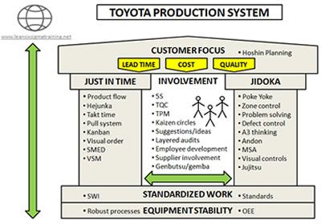
Lean Systems Thinking

Slide 7

Example
“For us to become the best place to give care and the best place to get care, we need an army of problem solvers and innovators.”
Eric W. Dickson, MD, MHCM, FACEP
President & CEO
Center for Innovation and Transformational Change, UMass Memorial Health Care University of Masschusetts Medical School, slides 7-10, 14

Slide 8


What is Lean?
Our Patients
True North
Our People
Our Discoveries
Our Future
Respect for People
&
Continuous Improvement
Continuous
Improvement
Respect for
People
PDSA Learning Cycles
PDSA Learning Cycles
UMASS Memorial
Medical Center
Nursing Program (PDSA)
Notes:
Lean is an organizational philosophy designed to improve processes you and the organization is involved in every day. It is a culture that integrates everyone around, from the frontline staff to senior management, in an effort to continuously improve. You’ve already learned about True North. Lean is a way to achieve and align with our True North goals by utilizing the methods of continuous improvement and the respect for people.

Slide 9
Align Vision and Mission Statements
Vision
UMMS RWP envisions an end to the HIV epidemic in Central New England. We will achieve this by focusing on prevention and treatment, through partnerships. We will decrease HIV transmission in our communities by providing our clients with exceptional, seamless health care delivery, and education from risk reduction to diagnosis to effective treatment.
Mission
UMMS RWP is committed to continuously improve the health of people living with HIV/AIDS throughout the diverse communities of Central New England. We achieve this through culturally sensitive excellence in clinical care, comprehensive medical case management, teaching, and specialty and supportive referrals. We are committed to providing care based on the DHHS clinical service guidelines with protocols updates as new information becomes available to meet patients’ needs and health goals.

Slide 10
Respect for People
Hospital | UMass Medical School RW Program Infectious Disease and Immunology
Seek first to understand | Consistently excel at patient-centered care in an environment free of stigma
Listen to others | Respecting one another—staff, patients, and affected others
Practice and encourage critical thinking | Effecting change through teamwork, continuous quality improvement principles and consumer input
Provide the time to work on process improvement | Acting with personal integrity and accountability
Other ways to show respect for people? | Supporting our diverse communities
 | Creating a supportive environment for both staff and patients
Notes:
Explain the importance of focusing on the process and not the person when a problem arises and that problems give us the opportunity to improve a process.
It’s okay to make mistakes, we can think about why the mistake happened and we learn from them.
Could touch on Sorrel King’s story about her daughter Josie at John Hopkins
http://www.josieking.org/page.cfm?pageID=10

Slide 11
Continuous Improvement
Create a culture where:
  Focus on the problem; not the person
  Problems are recognized as opportunities
  It’s okay to make legitimate mistakes
  Problems are exposed because of increased trust
  People are not problems: They are problem solvers!
  Emphasis is placed on finding solutions instead of assigning blame
  Finding and exposing problems is expected of everyone
Center for Innovation and Transformational Change, UMass Memorial Health Care University of Masschusetts Medical School, slides 7-10, 14
Notes:
Explain the importance of focusing on the process and not the person when a problem arises and that problems give us the opportunity to improve a process.
It’s okay to make mistakes, we can think about why the mistake happened and we learn from them.

Slide 12


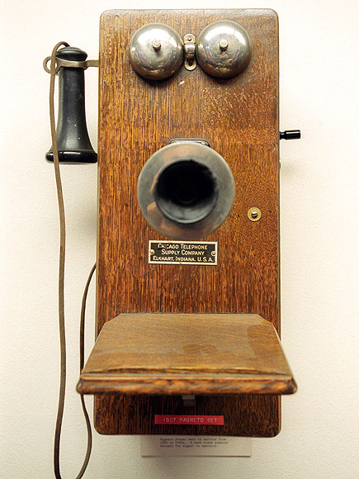

Why Do Tools Matter
Tools help you accomplish your goals
They facilitate our work

Slide 13
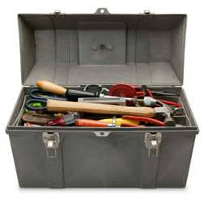
Tools
DMAIC Framework
Value Stream Map
Spaghetti Diagram
5S
Root Cause Analysis

Slide 14
Project Framework: DMAIC
An approach to problem solving that uses a scientific methodology
  Define the scope and purpose of a project
  Measure by collecting data and developing a value stream map
  Analyze the data and determine root causes
  Improve by developing “fixes” for the root cause
  Control by tracking performance indicators

Slide 15
Problem Solving: Enhanced PDSA: “A3”
Enhanced
PDSA
Problem Definition
Countermeasures
PLAN
+
Plan
DO
ACT
Root Cause(s)
STUDY
(or Check)
Results
Enhances “Plan” in PDSA with better understanding of the problem
and causes, to generate better countermeasures
Center for Innovation and Transformational Change, UMass Memorial Health Care University of Masschusetts Medical School, slides 7-10, 14
Notes:
You can think of the A3 as your “standard work” for problem solving, whether it’s removing waste in your department, or working one of the Action Items from a VSM.
At Toyota, managers / approvers don’t say “No”. They either say “Yes”, or they ask more questions – about the problem, root cause, options….

Slide 16
Value Stream Maps
This is a 30,000 foot overview of a process
It maps the inception of the process to its final end point
This is definitely a team exercise
You need data and you need to know the time it takes to complete a process

Slide 17
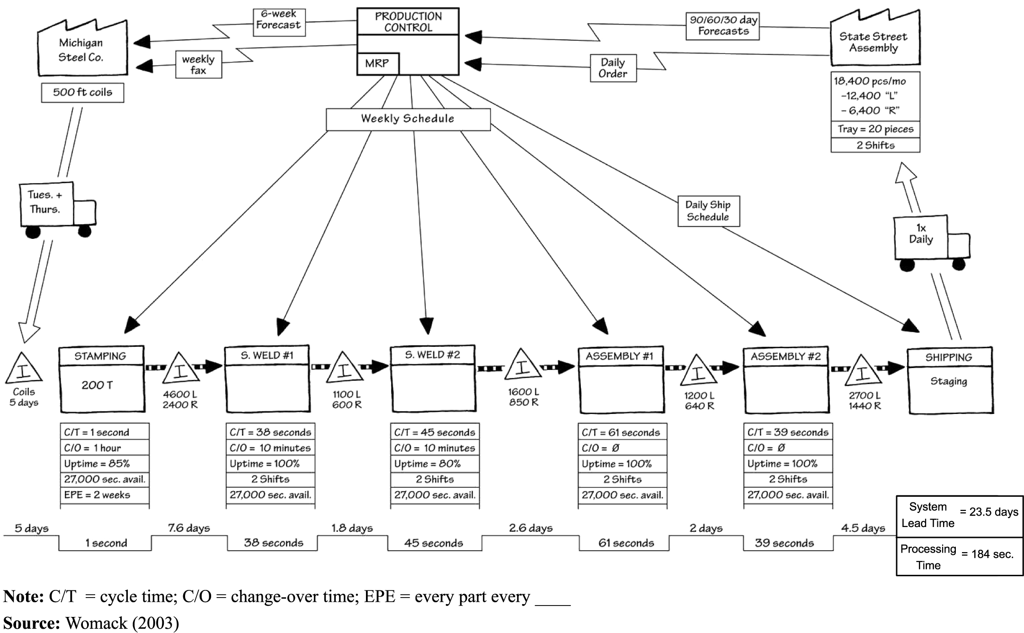
The Value Stream Map

Slide 18
QI Across Agencies To Reduce Time
Same Day Linkage To Care
NY Links: Monroe County DPH, Jordan Health
Causal Analysis
Monroe County DPH | Jordan Health
Client dependent for follow up | No clearly defined and inefficient linkage process
Large case load with patients who are high risk, unknown status and viral load | Cumbersome care coordination intake before patient registration, financial counseling, and lab work
Public health risk | Stigma for care coordinators to work with MCDPH “reporting clients to health department” and “sex police” image
The longer patients are out of care, the more difficult it is to find them

Slide 19
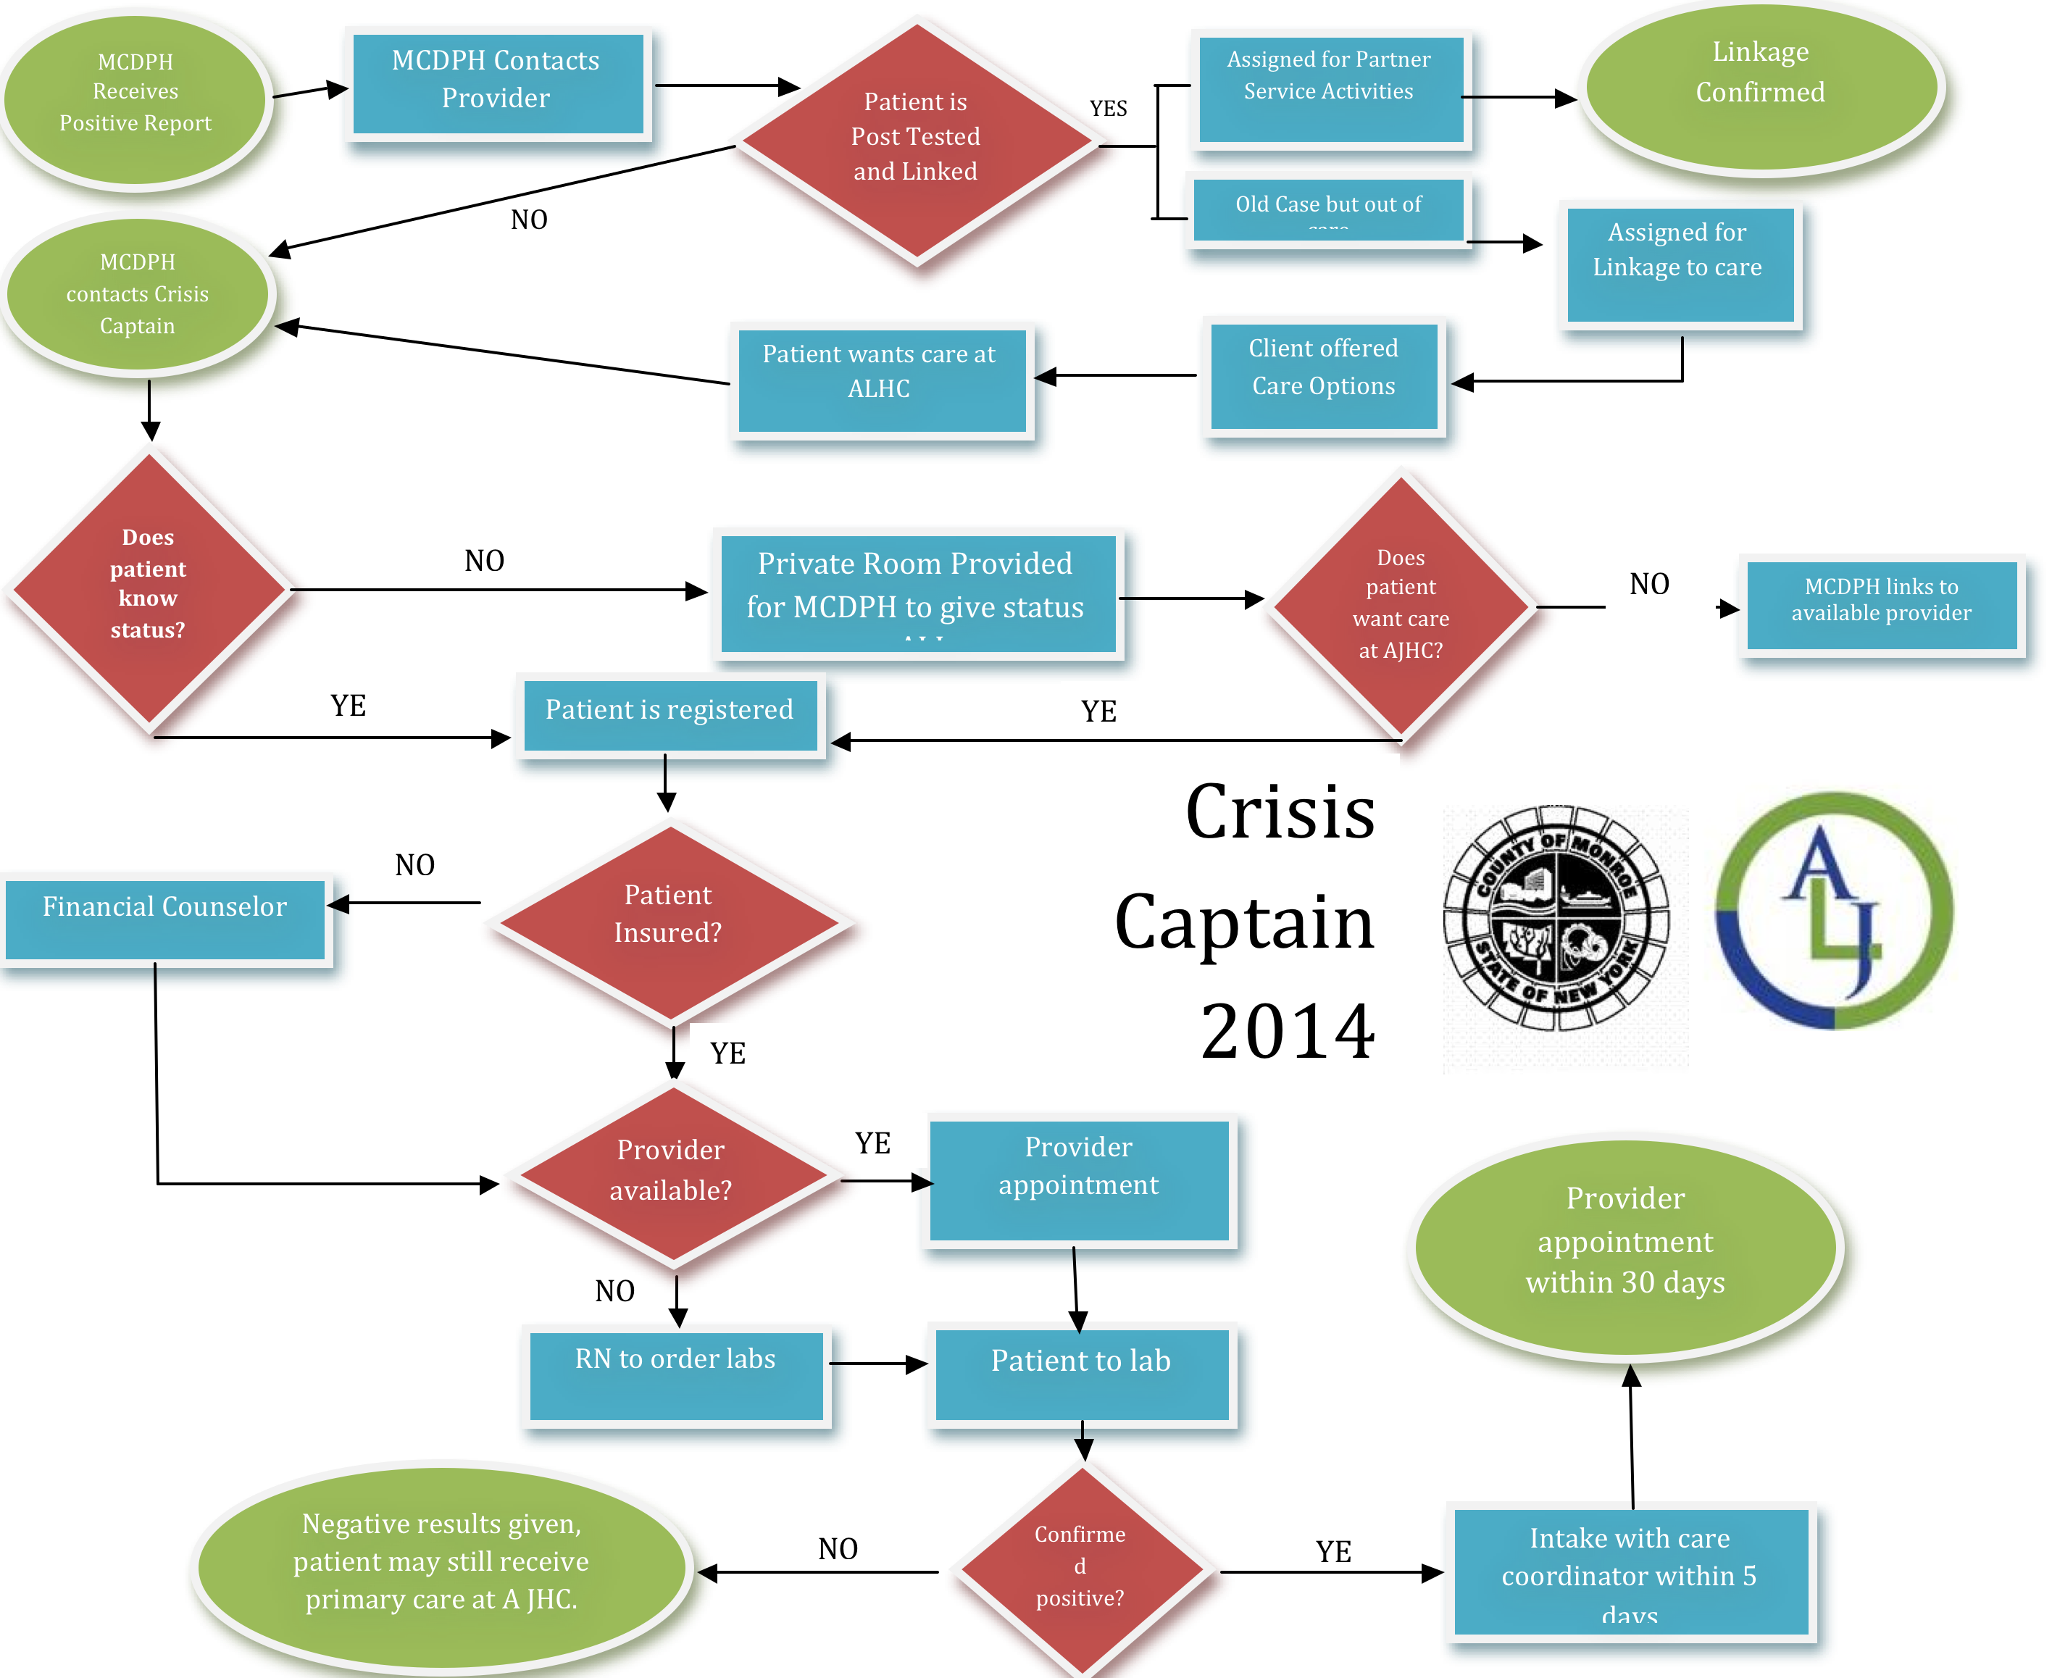
What were your process problems? What value was added from the perspective of the client/patient, staff?

Slide 20
Current Status
Standardized process
  Use of MOUs
  Designated staff assigned crisis captain role
  Private room for MCDPH to counsel client
  Patient registration, insurance, labs, and provider appointments done the same day;
  Crisis Captain serves as a patient navigator
  Buy-in from client, MCDPH, JH
Results
  Same day
  Within 3 days
  Spread to other agencies in Rochester

Slide 21
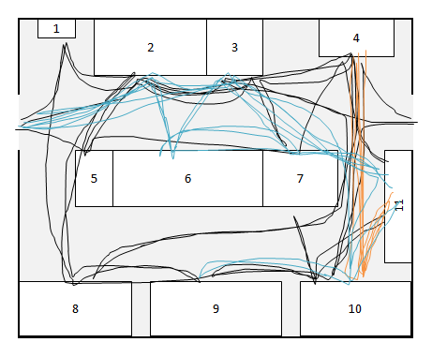
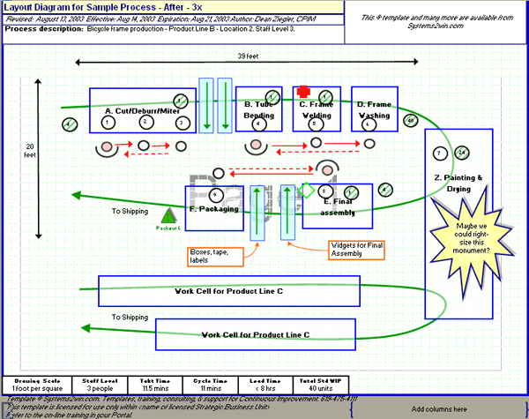
Lean Tools
The Spaghetti Diagram
Which one looks more efficient?

Slide 22
The Spaghetti Diagram
This tool maps out the physical steps someone undertakes to complete a task
It defines efficient and inefficient workflow
It provides an opportunity to eliminate waste

Slide 23
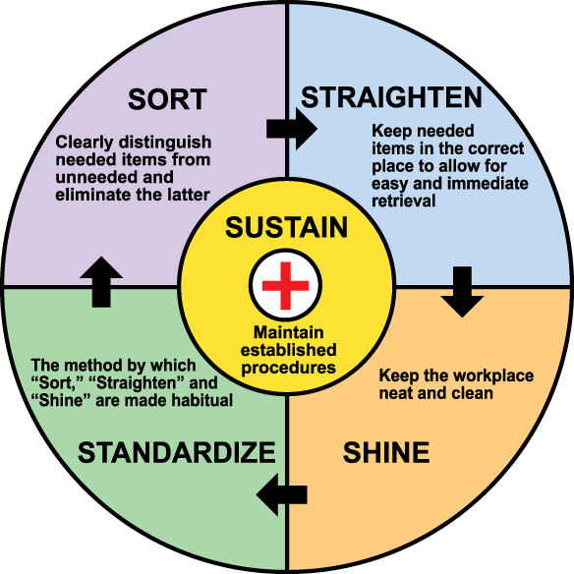
Lean Tools
5S
Seiri (Sort)
Seiton (Straighten)
Seiso (Shine)
Seiketsu (Standardize)
Shitsuke (Sustain)

Slide 24
Why Is This Important?
Think of this applied to a work area like a lab table and reflect on the Spaghetti Diagram
  Is your workstation arranged in such a way that eliminates waste?
  Do you have clutter that you have to navigate around?
  Have you standardized your workflow process
    Patient flow through a clinic
    Organizing lab equipment in sequence to match the sequence of tests to perform
  Will you get to the point of standardizing your procedures?

Slide 25
Root Cause Analysis
Why we use this:
  Identify the underlying problems and solve them
  What underlies the outward?
    toothache? – maybe referred pain?
    Runny nose – maybe allergies?
What it accomplishes
  An open discussion about all the contributing factors that lead to process problems
  Engages all staff in the analysis and in developing solutions

Slide 26

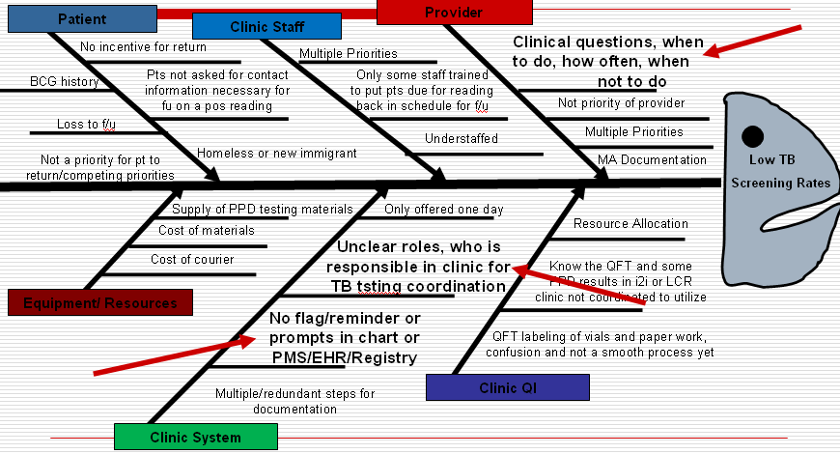

List of Root Causal Analysis Tools
5 Whys
  Ask the question why five times to the stated
  problem
  Ensure action addresses root cause
Fishbone or Cause and Effect or Ishikawa
Other types of mapping with identification of key problem steps and why
  Process mapping – understand a process
  Time value mapping – bottlenecks
Macro and micro mapping

Slide 27
Lean Tools
Current state/ideal state/future state
  Force Field Analysis
  Process mapping
Voice of the Customer
Ohno Circle Ο observe and GEMBA – go and see it!
Idea cards and board

Slide 28

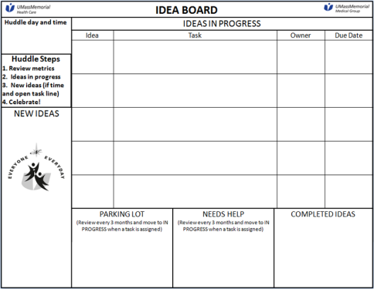
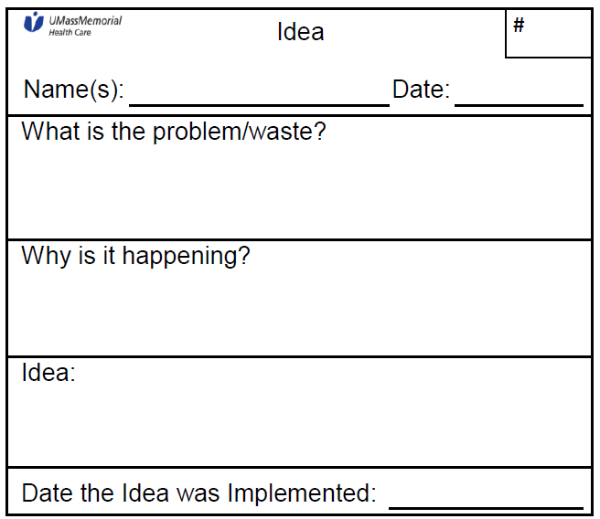


Idea Systems
A process and environment for empowering people, allowing for continuous improvement and aligning with True North
+
+
+
+
Idea Board + Idea Cards + Metrics + Team Huddles + Celebration
Seeing and surfacing problems is a good thing!
Center for Innovation and Transformational Change, UMass Memorial Health Care University of Masschusetts Medical School, slides 7-10, 14

Slide 29
Idea Card
Center for Innovation and Transformational Change, UMass Memorial Health Care University of Masschusetts Medical School, slides 7-10, 14

Slide 30
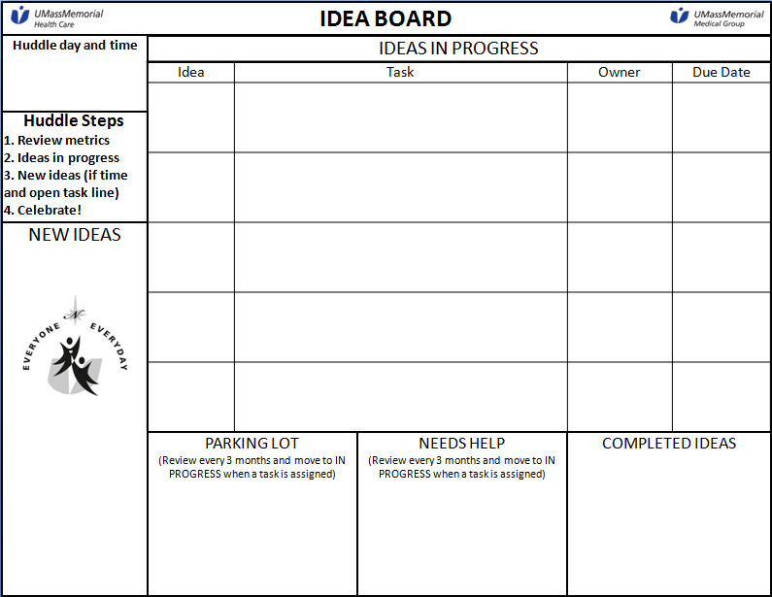
Center for Innovation and Transformational Change, UMass Memorial Health Care University of Masschusetts Medical School, slides 7-10, 14

Slide 31
Thank You!
Nanette Brey-Magnani, NQC Consultant
Jennifer Daly, MD, UMass Medical Center
Shawntrell Miles, QI Manager, Jordan Health
Kim Smith, MPA, Supervising Public Health Rep

Slide 32
To hear the webinar recording:
Go to:
https://meetny.webex.com/meetny/lsr.php?RCID=a922d02775e047d2a3561be96b4fe3cf

