Slide 1
Living with HIV in Rural America – Stigma and Other Barriers to Care
Presenters:
John Nelson, PhD, CPNP
Donna Sweet, MD
Anna Kinder, MS, OTR/L
National Center for Innovation in HIV Care Under HRSA HIV/AIDS Bureau Cooperative Agreement U69HA27176
Notes:
Required slide. Please complete

Slide 2
Objectives
Recognize the differences in HIV Care Continuum outcomes for persons living with HIV (PLWH) in rural and non-rural jurisdictions of the United States and its territories (U.S.).
Identify types of stigma experienced by PLWH in rural jurisdictions of the U.S.
Discuss ways to decrease organizational stigma for PLWH accessing healthcare in rural jurisdictions of the U.S.

Slide 3
Rural Definition
Rural is a geographic area that is populated with <50,000 people with areas of 10,000-49,999 people considered micropolitan or <10,000 people “very rural”.

Slide 4
So what’s happening in rural U.S.?
Rural residents less likely to get HIV tested
Rural residents more likely to internalize HIV-related stigma (S. Kalichman, H. Katner, E. Banas, & M. Kalichman; 2016)
Rural residents are more likely to be tested in non-rural places (S. Kalichman, H. Katner, E. Banas, & M. Kalichman; 2016)
Rural residents more likely to be diagnosed with AIDS at the time of initial HIV diagnosis
Rural residents are less likely to be retained in care (CDC, Rural Health Committee; 2016)
Rural residents are less likely to be virally suppressed (CDC, Rural Health Committee; 2016)

Slide 5
Stigma
Stigma refers to the “disgracing” or “shaming” of people themselves (internalized), by others, and by organizations/institutions (primarily through policies, laws, and behaviors of those within the organization/institution) due to perceived socially unacceptable attributes.^{1,2}
Mahajan AP, Sayles JN, Patel VA, et al. Stigma in the HIV/AIDS epidemic: A review of the literature and recommendations for the way forward. AIDS (London, England). 2008;22(Suppl 2):S67-S79. doi:10.1097/01.aids.0000327438.13291.62.
NAM aidsmap. NAM Publications, 2016. http://www.aidsmap.com/stigma/What-is-stigma/page/1260706/

Slide 6
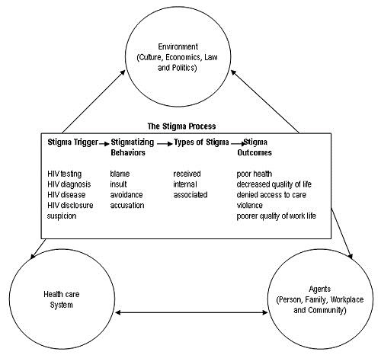
Holzemer, W. L., Uys, L., Makoae, L., Stewart, A., Phetlhu, R., Dlamini, P. S., Greeff, M., Kohi, T. W., Chirwa, M., Cuca, Y. and Naidoo, J. (2007), A conceptual model of HIV/AIDS stigma from five African countries. Journal of Advanced Nursing, 58: 541–551. doi: 10.1111/j.1365-2648.2007.04244.x

Slide 7
What works to decrease stigma and increase engagement in healthcare of PLWH and those at-risk of HIV infection in rural U.S.?

Slide 8
Exemplary Programs
Project ECHO® model (developed by University of New Mexico) now used by Mountain West AETC to provide regular communities of learning among rural primary care providers to provide education, problem solving, and case study discussions related to providing HIV care
University of Kansas School of Medicine – Wichita: takes HIV care team to three different rural sections of Kansas once/6 weeks to provide care

Slide 9
Other “Tools” to Improve Outcomes of PLWH in Rural America?
Use of mobile health van
Use of consultants, including National Clinician Consultation Center
Use of Community Health Workers, Linkage Coordinators, Navigators
Other examples???

Slide 10
Multifaceted Approaches Needed
Decriminalize HIV
Reduce community, healthcare provider, and internalized HIV-related stigma
Reduce other barriers to accessing quality, confidential care in rural U.S.
Increase education of ALL healthcare providers and health profession students to provide HIV related prevention, testing, diagnosis, and treatment in rural communities

Slide 11
AETC Program Rural Health Committee
Harold Katner (GA)
Theresa Bramel (AK)
Anna Kinder (WY)
Joseph Cantil (AK)
Natalia Martinez-Paz (WA)
Laurie Dill (AL)
Jeannette Southerly (WV)
Tracy E Jungwirth (NM)
Dayna Morrison (OR)
Alyssa Guido (AZ)
John Nelson (NJ)
Jason Henry (VIs)
Donna Sweet (KS)
Jennifer Janelle (FL)
Liz Lazo (NJ)

