Slide 1




end+disparities ECHO Collaborative:
Successes of Consumer Engagement
Adam Thompson
Special Guests: Dottie Dowdell, Dawn Trotter & D’Ontace Keys

Slide 2
Learning Objectives
Describe the end+disparities ECHO collaborative
Describe how PWH were involved with the collaborative
Discuss how we are sustaining consumer engagement & involvement
Learn how to connect with us!

Slide 3

HIV-related Health Disparities
end+disparities collaborative video
Notes:
Give feedback regarding disparities and why we did the collaborative in the first place – then move into the collaborative
This is the tool we used to recruit folks but realize that we have a lot of work to do utilizing QI methodologies to reduce HIV-related disparities and impact VS outcomes

Slide 4
Collaborative overview
end+disparities ECHO Collaborative
4

Slide 5
Collaborative Mission
To promote the application of quality improvement interventions to measurably increase viral suppression rates for disproportionately affected subpopulations of people living with HIV among RWHAP-funded providers.
5

Slide 6
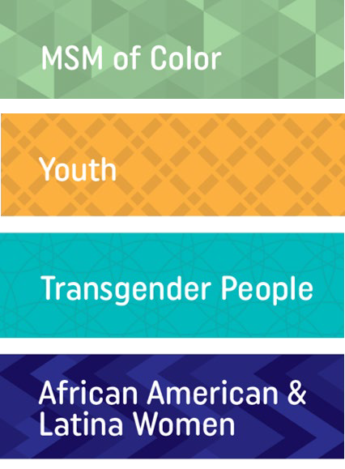
Collaborative Overview
Each Collaborative participant is asked to focus their improvement efforts on one identified subpopulation
Participants join virtual Affinity Groups based on shared interests, such as subpopulations
Recipients and subrecipients partner with other local HIV providers to form regionally-based improvement groups (Regional Group)
Learning sessions with all participants are held every five months, starting June 2018 and transitioning September 2019
6

Slide 7
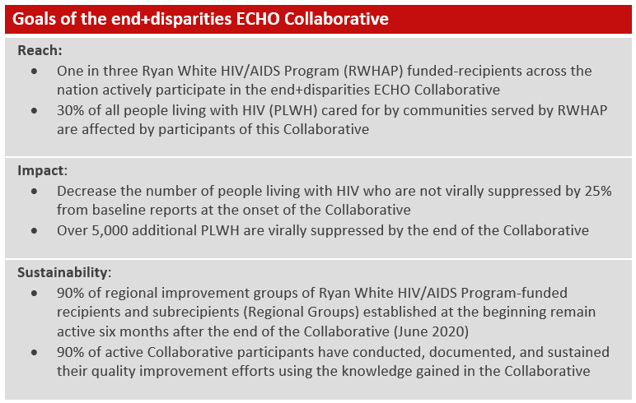
Collaborative Goals
7

Slide 8
Collaborative Reach
HIV providers across 31 States or Territories participated
17 Regional Groups participated (on average 12 recipients per group)
46% of RWHAP Part As (24/52) and 41% of Part Bs (21/51) participated
138,000 people with HIV or 38.4% of all Ryan White patients receiving medical care were reached with this Collaborative; 1 in every 2.6 RWHAP patients (RSR 2018 Data)
11 out of 15 States (including Washington, DC), as well as 6 out of 10 EMAs/TGAs with the lowest viral suppression rates participated (RSR 2018)
Part Funding | # | %
A | 24 | 12%
B | 21 | 10%
C | 108 | 54%
D | 48 | 24%
‘35% (201 out of 567) of all RWHAP Part A, B, C, & D Recipients participated in the end+disparities ECHO Collaborative.’
8
Notes:
Presenter
2020-01-17 17:23:30
--------------------------------------------
Definitions:
RWHAP recipients funded under Part A, Part B, Part C and Part D are included
Participating RWHAP Recipients: #of RWHAP-funded recipients who participated in the Collaborative by meeting any of the following Collaborative activities: Registered/Data Submitted/Affinity Session Participation/Case Presentation/Learning Session Attendance/Tech Survey Completed/Glasscube User/QI Training Participant/Documented QI Activity Active RWHAP Recipients: # of RWHAP-funded recipients who actively participated in the Collaborative by meeting at least one of the core Collaborative activities: Data Submitted/Affinity Session Participation/Case Presentation/Learning Session Attendance//QI Training Participant/Documented QI Activity
359,101 RWHAP clients with HIV hada viral load in 2018 (RSR 2018); 137,826 patients were reported in the initial July 2018 Collaborative data submission cycle Key Messages (as of December 2019):
The Collaborative had a broad reach within the RWHAP community; 35% (201 out of 567) of all RWHAP Part A, Part B, Part C and Part D-funded recipients participated the end+disparities ECHO Collaborative (Part A=24, Part B=21, Part C=108, Part D=48) 46% of RWHAP Part As (24/52) and 41% of Part Bs (21/51) participated
Out of the 201 RWHAP recipients participating in the Collaborative, 185 (92%) RWHAP recipients actively participated in the Collaborative HIV providers across 31 States or Territories were represented in the end+disparities ECHO Collaborative
17 Regional Groups participated with an average of 12 RWHAP recipients per Regional Group
Collaborative reached 138,000 people with HIV or 38.4% of all Ryan White patients receiving medical care; 1 in every 2.6 RWHAP patients (RSR 2018 Data)
11 out of 15 States and Territories with the lowest viral suppression rates were participating, as well as 6 out of 10 EMAs/TGAs with the lowest viral suppression rates (RSR 2018)

Slide 9
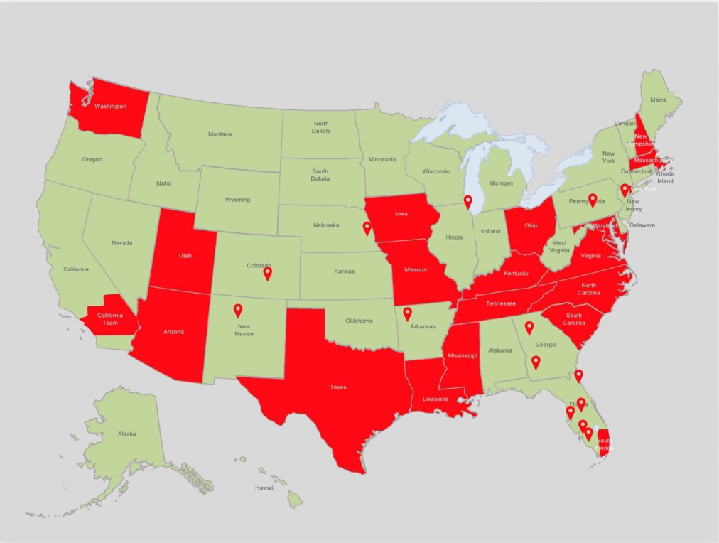
end+disparities ECHO Collaborative Teams
Arizona
California
Mavericks Regional Group
Louisiana
Maryland
Massachusetts
Mississippi
Missouri
New York Regional Group
North Carolina
Ohio
South Carolina
South Florida
Tennessee / Kentucky
Texas
Washington State
Washington, DC / Virginia
end+disparities ECHO Collaborative Enrollment Data: May 25, 2018
9

Slide 10
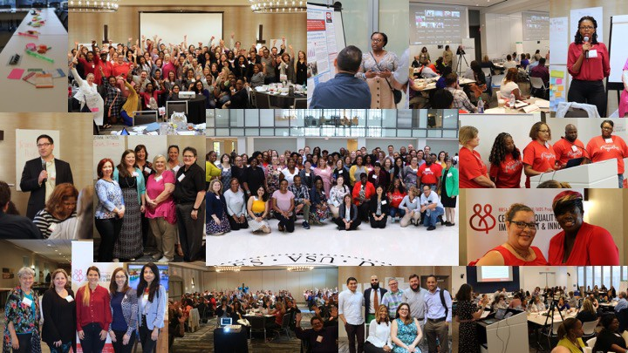
Learning Sessions

Slide 11
Collaborative Firsts…
For the first time, we…
created a collaborative framework combing our past IHI collaborative experiences with the ECHO model
used Zoom to hold virtual collaborative sessions
integrated individuals with lived experiences as equal content experts
utilized existing and new Regional Groups as part of the collaborative
conducted virtual two-day Learning Sessions (5 hours each day) and held virtual breakout sessions using the Zoom functionality
shared real-time participation data throughout the collaborative
conducted an evaluation of participants during collaborative
and many more…
11

Slide 12
Viral Suppression (Jul 2018 – Dec 2019)
Were We Improving? Difference between First and Last Submission for Each HIV Subpopulation (Jan 9, 2020)
Average Differences in Viral
Suppression Rates between First and Last Submission by Participating Agencies
6%
5.3%
5%
4.2%
‘Gains in viral suppression rates were found across all HIV subpopulations (on average 3.9%) when comparing the first and last agency viral suppression data submissions.’
4%
3.3%
3%
2.8%
2%
1%
0%
Black/African American and Latina Women
MSM of Color
Transgender
Youth
# of Sites |  | First Data (%) | First Data (n) | Last Data (%) | Last Data (n)
Black/African American and Latina Women | 39 | 82.9% | 10,402 | 85.7% | 11,400
MSM of Color | 58 | 80.1% | 16,167 | 83.4% | 16,269
Transgender | 21 | 79.8% | 659 | 84.0% | 686
Youth | 45 | 71.3% | 3,256 | 76.6% | 3,135
Total | 163 |  | 30,484 |  | 31,490
Notes:
Presenter
2020-01-17 17:23:35
--------------------------------------------
Methodology:
Inclusion: Collaborative participants that submitted at least two data submissions for the same targeted HIV subpopulation between July 2018 and November 2019 (9 data submission cycles) The average differences were calculated when comparing the first and last agency data submissions for each HIV subpopulation; facility averages were used in the chart
Key Messages (as of December 2019):
Over 160 providers reported over 31,000patients across all HIV subpopulations
An increase of viral suppression rates was found across all HIV subpopulations when comparing the first and last agency subpopulation data submissions
The average viral suppression rate for HIV subpopulations increased by 3.9%; Black/African American and Latina Women 2.8%; MSM of Color 3.3%; Transgender 4.2%; and Youth 5.3% in comparison to 2.0% for the entire caseload

Slide 13
Viral Suppression (Jul 2018 – Dec 2019)
Were We Closing the Gap? Changes in Agency Subpopulation vs Overall Agency VS Rates (Jan 9, 2020)
No Disparity
between
2%
1.0%
‘The gap between HIV subpopulation and overall viral suppression rates was
reduced for all four groups, on average by 3.9%, between July 2018 and November 2019.’
0.4%
0%
Agency Subpopulation and Overall
Agency Averages
-2%
-1.4%
-4%
-3.3%
-4.2%
-6%
-8%
-7.1%
-10%
# of Waves Difference | # of Sites (n=118) | %
9 | 62 | 53%
8 | 29 | 24%
7 | 4 | 3%
6 | 6 | 5%
5 | 4 | 3%
4 | 2 | 2%
3 | 5 | 43%
1 | 7 | 6%
-12%
-11.0%
-14%
-13.3%
-16%
 | Black/African American and Latina Women | MSM of Color | Transgender | Youth
First-Dif to Caseload | 0.4% | -3.3% | -13.3% | -11.0%
Last -Dif to Caseload | 1.0% | -1.4% | -4.2% | -7.1%
Notes:
Presenter
2020-01-17 17:23:35
--------------------------------------------
Methodology:
Inclusion: Collaborative participants that submitted data at least twice for the same HIV subpopulation between July 2018 and November 2019 and corresponding entire caseload viral suppression rates The overall viral suppression rates were calculated by deducting the numerator and denominator of each subpopulation of the entire caseload
The average differences were calculated when comparing the first and last agency data submissions for each HIV subpopulation and the overall agency viral suppression rates during the same reporting cycle Key Messages (as of December 2019):
Over 118 providers reported over 23,000patients across all HIV subpopulations
The viral suppression rates for agency-identified HIV subpopulations improved at a higher rate than the overall viral suppression rates between July 2018 and November 2019
A reduction in the difference between each HIV subpopulation and the overall viral suppression rates between July 2018 and November 2019 was found comparing the first and last viral suppression rates of each agency-identified HIV subpopulation against the overall adjusted agency viral suppression rates during the same time period The average agency viral suppression rates difference between HIV subpopulations and the entire caseload were reduced by 3.9%: Black/African American and Latina Women from 0.4% to 1.0%; MSM of Color from -3.3% to -1.4%; Transgender from -13.3 to -4.2%; Youth from -11.0 to -7.1%
77% (91 out of 118) of agencies submitted viral suppression data in two cross-sectional data points of 8 or 9 data submission cycles apart

Slide 14
PWH engagement
end+disparities ECHO Collaborative

Slide 15
Did you participate in the CQII end+disparities ECHO Collaborative?
In a TCQ+ survey of consumer participants of 53 respondents:
22% responded that they had participated in the Collaborative.
54.55% had participated in Affinity Sessions and 18.18% were faculty/content experts.
Poll! See questions that pop up and answer them!
Notes:
We will do a poll here via zoom for folks that are on to see if they participated in the collaborative!
Did you participate in the end+disparities collaborative? Yes/No
What role did you play? Give multiple choice – provider, consumer, etc (follow survey question)

Slide 16
PWH Involvement & Engagement
Consumer involvement is necessary for effective and appropriate quality improvement
Consumer representation and feedback was integrated in ALL aspects of the Collaborative structure
Opportunities for active and meaningful involvement of patients (those directly impacted by HIV) and their shared experiences was VITAL to the success of the Collaborative
Consumer voices were heard, and the collaborative provided space for their feedback to inform the projects and build their capacity for QI.

Slide 17
Working with Consumers
Support Groups
CABs / QM Teams
Consumer Engagement
Consumer Involvement
Clinical and supportive service interactions
Early phases of activation
In CQII ECHO end+disparities:
  Patient interventions
  Patient journey in system
  Discussion of patients and patient interactions
Consumers providing input and feedback
Later phases of activation
In CQII ECHO end+disparities :
  Experience evaluation
  Participation in QI activities
  Training to assist participation
  Community Partner team representation
Notes:
Here are some of the other ways we can work with consumers in general.

Slide 18
Feedback at the Clinical and Systems Levels
Key Informants or Small Groups to:
  Set targets and weighed in on aim statements
  Provided ongoing insight into QI project progress
Development of Driver Diagrams or Participation in Root Cause Analysis
Patient Journey Mapping to identify meaningful touch points
Tests of change
  Identification and ranking of importance
  Design and Evaluation
Experience evaluation
  Surveys, Focus groups, Key informant interviews

Slide 19
PWH Engagement
CQII Coaches
  Facilitated affinity sessions and were QI experts/coaches
Affinity Faculty
  Content Experts
Consumer Liaisons - Patients and Consumer Representations at Regional Group levels
  Consumer engagement at the Community level
Opportunities to participate in consumer-focused trainings and other CQII capacity building trainings
  Training of Consumer on Quality PLUS (TCQ+)

Slide 20
Affinity Faculty
Served as equal members on the team; considered community experts who provide guidance and recommendations on accessing and engaging patients in clinical quality management activities
Participated in all Affinity ECHO Sessions providing feedback on Case Presentations
Representative of the sub-populations, but they do not speak for all!
Compliments the Clinical Expert by bringing lived experiences to the evidence-base – improving implementation
Dawn and Keyes will share their experiences!

Slide 21
Consumer Liaisons
The power of consumer involvement is to leverage additional skills and critical perspectives to drive QI
Consumer Liaison coordination:
  Assisted in designing assessments, surveys, interview tools
  Ensured that tools were implemented and evaluated
  Own the qualitative data gained from consumer involvement
  Assisted the QI project in working with consumers
  Assisted the Leaders in inviting consumers to key activities, like RCA

Slide 22
Consumer Affinity Group
Expectations
The Consumer Affinity Group is dedicated to consumers to ensure that people living with HIV (PLWH) voices are heard, relevant feedback is incorporated into the Collaborative, and their capacity for QI is strengthened.
Group Function Participants Frequency
Consumer Affinity Group | Support the needs of consumers within the Collaborative Allow consumers to network and share their lived experience Build capacity for consumer involvement in QI | Consumers serving as liaisons on Regional Response Teams Consumers representing Community Partners Consumers participating in the other Affinity Groups CQII Facilitators | Monthly

Slide 23
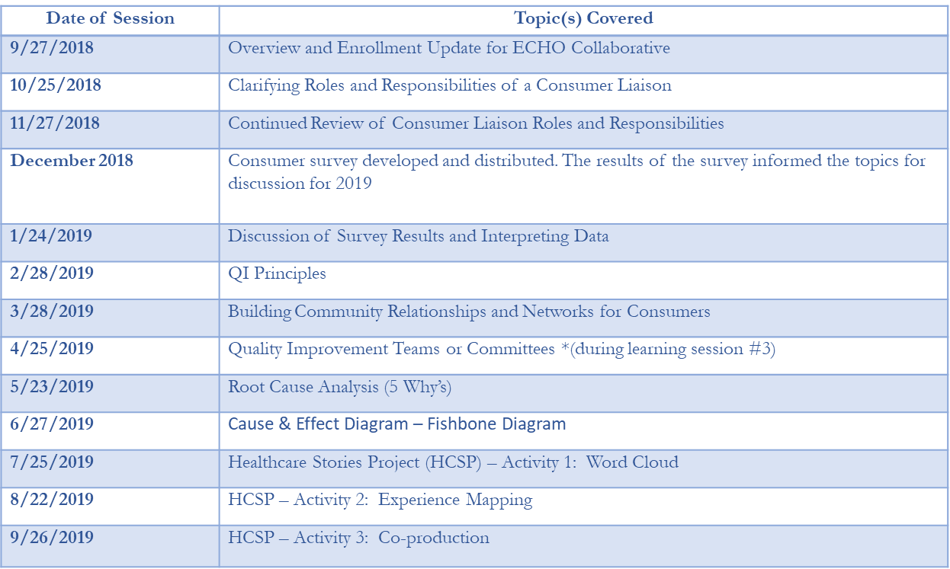
Consumer Affinity Sessions and Topics:

Slide 24
Sustaining engagement
end+disparities ECHO Collaborative

Slide 25
Consumer Affinity Sustainability Schedule
Consumers from the Collaborative will be responsible for sustaining the consumer affinity session until June.
They will set the agenda, co-facilitate the session with the guidance of CQII Coaches.
Please join us on the 3rd Thursday of each month at 3PM EST
  Email Jennifer.Lee@health.ny.gov if you are interested!
If you are interested email: Jennifer.Lee@health.ny.gov
Draft Schedule shown below as an example:
Date | Facilitator | Co-Facilitator | Topic
April 23, 2020 | Dr. Siegler | David & Dawn | HIV & Aging Discussion
May 28, 2020 | Adam & Deloris | Dawn & Keyes | Collaborative Webinar
June 25, 2020 | David Moody | Dawn Trotter | The Impact of COVID

Slide 26

Thank You Community Partners

Slide 27

Thank you CQII Faculty

Slide 28

Notes:
Presenter
2020-01-17 17:23:38
--------------------------------------------
Thank you to
Participants for taking a leap of fa Coaches and Faculty
Individuals with lived experiences CQII staff
HRSA HAB staff for support and encouragement

Slide 29
To listen to the webinar, please go to:
https://youtu.be/J0oZKm1al2g

Slide 30


Thank you!
212-417-4730 (phone)
212-417-4684 (fax)
Info@CQII.org
This project is supported by the Health Resources and Services Administration (HRSA) of the U.S. Department of Health and Human Services (HHS) under grant number U28HA30791 and the HRSA Ryan White HIV/AIDS Program Center for Quality Improvement & Innovation for $1.5 M. This information or content and conclusions are those of the author and should not be construed as the official position or policy of, nor should any endorsements be inferred by HRSA, HHS or the U.S. Government.
45

