Slide 1
Successful Collaborations: CDC and HRSA Capacity Building Initiatives
USCA 2016 - September 16, 2016
Notes:
Care and prevention coordination is more important than ever as agencies seek to engage people in the HIV care continuum, stem new infections, and improve planning to allocate funds to varied HIV services. Join federal and other staff as they cover a series of hot topics (planning, PrEP, data use, HIV testing, stigma). Also, share your insights about capacity building assistance (CBA) collaborative work.

Slide 2
Speakers
Harold J. Phillips, MRP
Director, Office of Domestic & Global HIV Training & Capacity Development Programs
HRSA HIV/AIDS Bureau
A.D. McNaghten, PhD, MHSA
Chief, Capacity Building Branch, Centers for Disease Control and Prevention
Juli Powers, MPH, Senior Consultant, JSI Research & Training Institute, Inc.
Sarah Blust, PhD, Program Director, Primary Care Development Corporation
Helen Burnside, HIV Capacity Building Assistance Manager, Denver Prevention Training Center
Tony Jimenez, MD, Vice President, Cicatelli Associates Inc.
Mazdak Mazarei, Senior Project Manager, Primary Care Development Corporation

Slide 3

Do You Have a Clicker?
Do not press any buttons unless we ask you to!
Before leaving this room…
Leave it on your chair
Leave it with one of us
Place it in a basket by the exit
Notes:
Throughout this session, you will be provided with the opportunity to respond to polling questions, using the clickers on your chairs.

Slide 4
What We Will Cover
2:30-2:45 pm Collaboration: Rationale
Barriers and Challenges
2:45-3:45 pm Collaboration Topics
Integrated Planning (Phillips, Powers)
Capacity Building (McNaghten, Powers)
Data to Care (McNaghten)
HIV Testing (Burnside, Blust/Mazarei, Jimenez)
PrEP and Hepatitis C (Burnside, Blust/Mazarei, Jimenez, Phillips)
3:45-4:00 pm Q/A

Slide 5
What is your favorite part of USCA?
Hearing from the experts
Learning new information about HIV
Getting together with old friends
Having an opportunity to re-energize
The weather is amazing
Meeting new people

Slide 6
What is your primary job focus?
Prevention
Care
Both prevention and care
Research
Other

Slide 7
Rationale: Why Collaborate?

Slide 8
Drivers of Collaboration
Support National HIV/AIDS Strategy (NHAS) Updated to 2020
HRSA and CDC are building federal and jurisdictional capacity to address NHAS
HRSA priorities
HIV care continuum

Slide 9
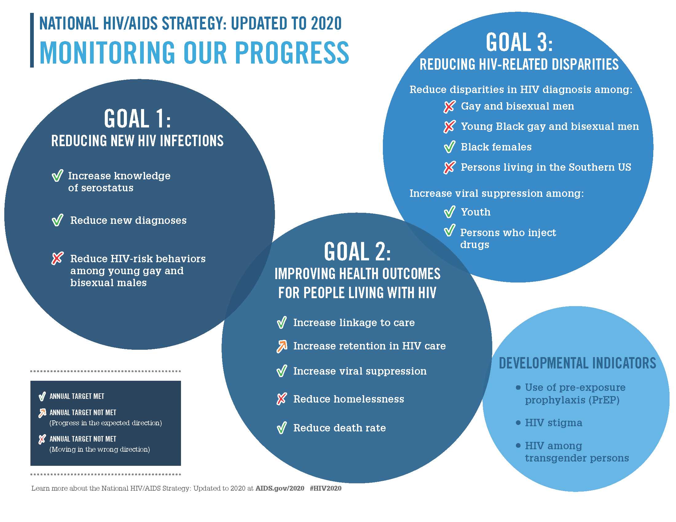

Slide 10
Rationale for Collaboration:
Address HRSA/HAB 2016 Priorities
National HIV/AIDS Strategy (NHAS) 2020/President’s Emergency Plan for AIDS Relief (PEPFAR) 3.0 - Maximize HRSA HAB expertise and resources to operationalize NHAS 2020 and PEPFAR 3.0.
Leadership - Enhance and lead national and international HIV care and treatment through evidence-informed innovations, policy development, health workforce development, and program implementation.
Partnerships - Enhance and develop strategic domestic and international partnerships internally and externally.
Integration - Integrate HIV prevention, care, and treatment in an evolving healthcare environment.
Data utilization - Use data from program reporting systems, surveillance, modeling, and other programs, as well as results from evaluation and special projects efforts to target, prioritize, and improve policies, programs, and service delivery.
Operations - Strengthen HAB administrative and programmatic processes through Bureau-wide knowledge management, innovation, and collaboration.
Notes:
NHAS 2020/PEPFAR 3.0: Maximize HRSA HAB expertise and resources to operationalize NHAS 2020 and PEPFAR 3.0. This includes utilizing our RWHAP and PEPFAR legislations, resources, staff and recipient expertise, national leadership, and partnerships to achieve the goals of NHAS 2020 and PEPAR 3.0.
Examples of focus areas/activities:
• HRSA and HAB level PrEP Workgroups
• RWHAP Part A HIV Continuum of Care Learning Collaborative Initiative
• Global program work in health workforce development and health systems strengthening in the four Fragile States
• Continuous engagement of HAB staff expertise for the development and implementation of NHAS and PEPFAR activities
Leadership: Enhance and lead national and international HIV care and treatment through evidence-informed innovations, policy development, health workforce development, and program implementation.
Examples of focus areas/activities:
• Presenting at the USCA and other high profile meetings to disseminate HRSA policies, HIV care and treatment information and best practices
• Convening the Ryan White HIV/AIDS Program Consultation on Clinical Quality Measurement of Retention in HIV Medical Care
• Staff engagement with opportunities for leadership through workgroups, special projects, Cooperative Agreement and/or contract lead, etc. as well as HRSA leadership training
• Focusing on leadership development by and for people living with HIV
• Development of the National HIV Curriculum with the AETC National Resource and Coordination Center
• Dissemination of best practices through the SPNS Dissemination of Evidence Informed Interventions to Improve Health Outcomes along the HIV Care Continuum Initiative (DEII)
• Developing an HIV health care workforce strategy
• Resilient and Responsive Health Systems in fragile countries
Partnerships: Enhance and develop strategic domestic and international partnerships internally and externally. This includes promoting better collaboration across Divisions, Bureaus/Offices, and HHS OpDivs and other federal agencies in design and implementation of data utilization, programmatic initiatives, communications, and policy development to support service integration and to utilize HRSA, HAB, and partner resources most effectively.
Examples of focus areas/activities:
• Strategic partnerships development work focusing on CDC,SAMSHA, CMS, and HOPWA
• Internal HRSA strategic partnership work with BPHC on service delivery; BHW for workforce development; MCHB for adolescent health and maternal and child health
• Overall Hepatitis C focus and SMAIF Hepatitis C initiative working with BPHC, CDC, and OHAIDP
Integration: Integrate HIV prevention, care, and treatment in an evolving healthcare environment. This includes maximizing opportunities afforded by the healthcare system for preventing infections, increasing access to quality HIV care, and reducing HIV-related health disparities.
Examples of focus areas/activities:
• Quality Management Programs and Quality Measures in the RWHAP and Medicaid
• SPNS Health Information Technology
• Integrated HIV Prevention and Care Plans, including the Statewide Coordinated Statement of Need
• Leveraging opportunities offered by health delivery system reform
Data Utilization: Use data from program reporting systems, surveillance, modeling, and other programs, as well as results from evaluation and special projects efforts to target, prioritize, and improve policies, programs, and service delivery.
Examples of focus areas/activities:
• Continue to document outcomes of the RWHAP and delineate health disparities
• Provide technical assistance to grantees and staff to enhance their capacity
• Focus programmatic, cooperative agreements, and special study investment on specific population focus based on data, e.g. youth, black men who have sex with men, transgender individuals to improve health outcomes
• SPNS Health Information Technology investments
Operations: Strengthen HAB administrative and programmatic processes through Bureau-wide knowledge management, innovation, and collaboration. This includes supporting excellence in HIV care and treatment service delivery and programs by ensuring efficient business and scientific administration, implementing effective communication and policies, and enhancing the skills of current staff.
Examples of focus areas/activities:
• Streamline and improve the site visit, non-site visit, and conference planning processes for travel
• Enhancing communication mechanisms for external and internal stakeholder with an emphasis on staff communications
• Improving SharePoint functionality for workflow processes and information management
• Improving EHB functionality for workflow, dashboard utilization, and reports

Slide 11
Rationale for Collaboration:
Address CDC/DHAP 2016 Priorities
National HIV/AIDS Strategy (NHAS) - Maximize CBB and capacity building assistance providers’ expertise and resources to operationalize NHAS 2020.
Integration - Integrate HIV prevention, care, and treatment in an evolving healthcare environment.
Data utilization - Use data from program reporting systems, surveillance, modeling, and other programs, as well as results from evaluation and special projects to target, prioritize, and improve policies, programs, service delivery and prevention.
High-Impact Prevention - Scientifically proven, cost-effective, and scalable interventions targeted to the right populations to prevent the most HIV and reduce disparities. Focus on prevention along the HIV care continuum.
Efficiency - Sharing resources and expertise to train and provide technical assistance to staff funded by prevention and care, and avoid duplication/overlap of efforts.
Notes:
HIP – activities on the care continuum focusing on viral suppression.

Slide 12
Rationale for Collaboration:
HIV Care Continuum
HIV care continuum is a model to identify issues and opportunities related to improving delivery of services to PLWH

Slide 13
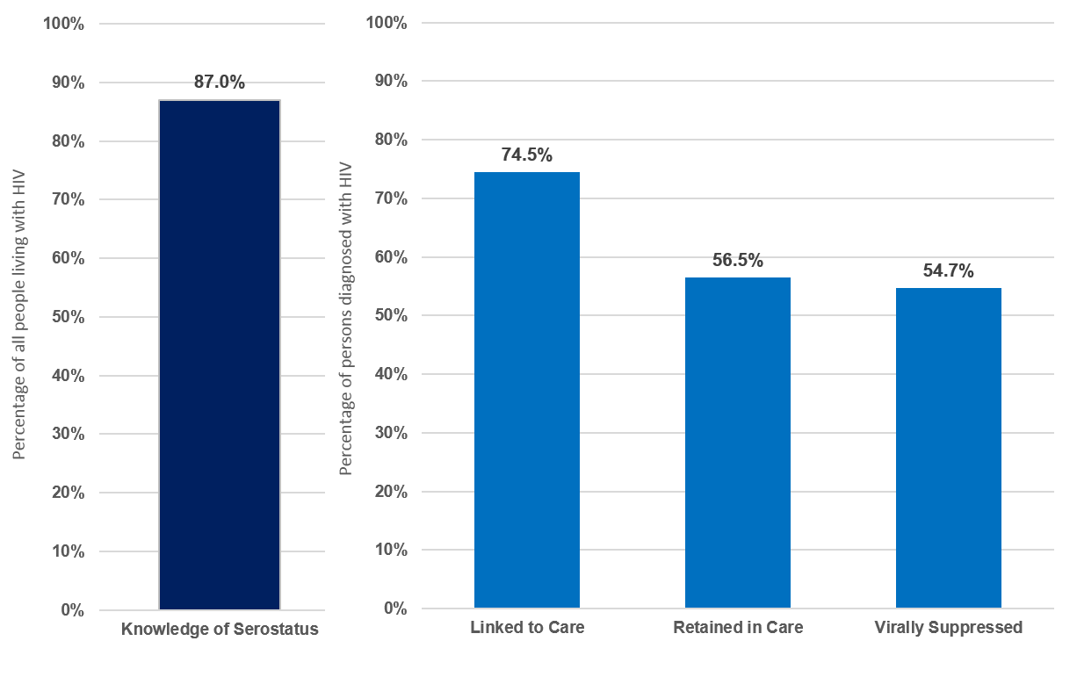
Continuum of Care: NHAS Indicators
ONAP - CDC. HIV Surveillance Supplemental Report 2016;21(No. 4).
13

Slide 14
History of CDC/HRSA Collaboration
Examples
Consultations
HRSA/CDC Advisory Committee (2002-Present)
Consultation Meetings (e.g., Young Men Who Have Sex With Men of Color, Engaging People in Care, Stigma)
Data
Surveillance Reports
Evaluations
Special Project of National Significance (SPNS) Initiatives
Guidelines/Recommendations
HIV Testing
Clinician Training
HIV Testing/Counseling and Consultation Lines
Notes:
We just provided you the rationale for collaboration but want it to be clear that we’ve been at this for many decades across CDC and HRSA.
Here are some examples

Slide 15
More Recent CDC/HRSA Collaboration
Just a Few Examples (Dozens More)
Consultations
HRSA/CDC Advisory Committee (2002-Present)
Consultation Meetings (e.g., Women, Youth, Trauma, PLWH Leadership, HRSA Retention Measure)
Data
Use of surveillance, Ryan White, and other data to determine if patients are out of care
Guidelines/recommendations
PrEP, Integrated HIV Plan
Clinician training
PrEP Consultation for Clinicians
SPNS
Care models (e.g., systems linkages)
Technical assistance and training
Integrated HIV Plan and new integrated planning to enhance collaboration at local level
Notes:
We just provided you the rationale for collaboration but want it to be clear that we’ve been at this for many decades across CDC and HRSA.
Here are some examples

Slide 16
Collaboration: Barriers and Challenges
Challenges to integrating local and state prevention/care
  Planning
  Data
  Service delivery
  Culture/trust/history of collaboration
Ways to remove these barriers
  Identify and disseminate models
  Adjust to new needs (e.g., collaborative panning)
  Adjust to new systems (e.g., Medicaid data sharing)
  Provide capacity building, training, and technical assistance

Slide 17
What has been the greatest barrier to collaboration in your jurisdiction?
Data sharing
Planning
Resource allocation
Trust
Something else

Slide 18
Collaboration Topics
Integrated Planning
Capacity Building
Data to Care
HIV Testing
PrEP and Hepatitis C Co-Infection

Slide 19
How have you been involved in integrated prevention and care planning?
As a planning body member
As a planner/researcher
As a community member observing the process
Not involved at all
Other

Slide 20
Integrated Planning
Notes:
We have been at this for quite a while.

Slide 21
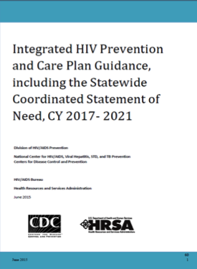
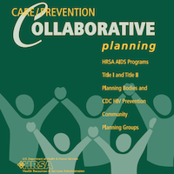

History of Integrated Planning
2003
2000-2014
2014
Notes:
We have been at this for quite a while.

Slide 22
What is Integrated Planning?
Integrated HIV planning is the process by which HIV care and prevention planning groups work together to:
  Review information about the HIV epidemic in the jurisdiction
  Assess needs and service utilization data to inform decisions
  Provide recommendations and allocate resources for HIV prevention and care services to address the HIV epidemic
Notes:
TO ADD MORE TO WHAT IS SAID ON SLIDE
The Integrated HIV Prevention and Care Plan reflects the community’s vision and values regarding how best to deliver HIV prevention and care services
The Integrated HIV Prevention and Care Plan is a living document that serves as a jurisdictional HIV/AIDS strategy, or roadmap, for CDC and HRSA grant recipients

Slide 23
Why Do Integrated Planning?
Streamline communication, coordination, and implementation of needed HIV prevention and care services to improve health outcomes along each stage of the HIV care continuum
Reduce reporting burden for federal recipients
Engage a broader group of stakeholders in jurisdictional HIV prevention and care planning
Maximize federal, state, and local HIV prevention and care investments

Slide 24
National Policy Initiatives Supporting Integrated Planning
CDC/HRSA Advisory Committee on HIV, Viral Hepatitis and STD Prevention and Treatment (2002)
CDC’s Advancing HIV Prevention (AHP) Initiative (2003)
CDC’s High-Impact HIV Prevention Approach (2011)
White House’s National HIV/AIDS Strategy (2015, 2020)
HHS and OMB’s focus on streamlining and reducing reporting burden for federal programs and recipients

Slide 25
Expectations for an Integrated HIV Prevention and Care Plan
CDC and HRSA Guidance on Submission of an Integrated HIV Prevention and Care Plan, including the Statewide Coordinated Statement of Need (SCSN)
ALL CDC (DHAP) and HRSA (HAB) funded jurisdictions are required to:
  Establish a planning process
  Develop a plan that is comprehensive and achievable
  Establish a planning body (i.e., Planning Council, Advisory Group or HIV Planning Group)
Integrated Plan must include all of the components outlined in the guidance

Slide 26
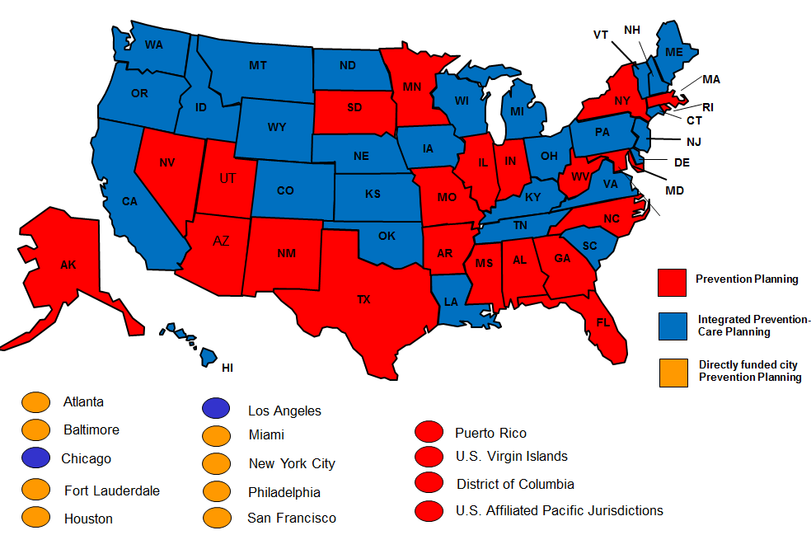
Trends in U.S. HIV Planning Models: July 2014
Source: NASTAD

Slide 27
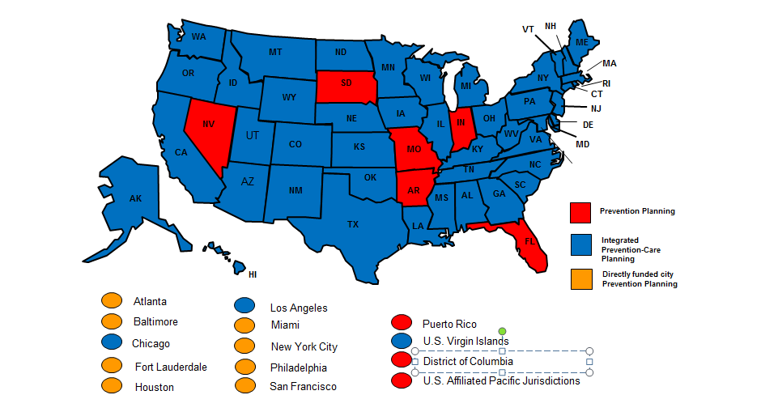
Trends in U.S. HIV Planning Models: Dec 2015
Source: NASTAD

Slide 28
CDC Capacity Building Assistance for Integrated Planning
Facilitation of preliminary discussions on integrating planning bodies and plans
  Understanding requirements, roles, and responsibilities of integrated planning and the planning group
Helping jurisdictions implement an integrated model
Sharing best practices from successful models
Assistance with plan development, implementation, and monitoring

Slide 29



INTEGRATED HIV/AIDS PLANNING
Technical Assistance Center

Slide 30



KEY INFORMATION
3-year
project
Supports
Ryan White
HIV/AIDS
Program
Parts A & B
Will conduct
virtual and in-person technical assistance activities
beginning July 1, 2016
grant recipients and their planning bodies

Slide 31

TA RESPONSE 1.
Develop tools and processes to support the HRSA HAB and CDC DHAP review of Integrated HIV Prevention and Care Plans and provide feedback to jurisdictions.

Slide 32
TA RESPONSE 2.
Deliver targeted TA to select jurisdictions implementing integrated planning activities.

Slide 33
TA RESPONSE 3.
Support peer learning
opportunities across jurisdictions.

Slide 34
TA RESPONSE 4.
Develop and disseminate strategies, tools, and trainings for RWHAP recipients and planning bodies to identify and support activities to integrate planning across prevention and care and treatment service delivery systems
  Identify best and promising practices and existing resources
  Develop new materials to meet additional training and technical assistance needs
  Conduct webinars to address cross-cutting planning and implementation issues

Slide 35
RESOURCE INVENTORY:
Examples
Integrated HIV Prevention and Care Plan Guidance, Including the Statewide Coordinated Statement of Need, 2017-2021
Integrated Guidance for Developing Epidemiologic Profiles
2015 RWHAP Part A and Part B Manuals
Integrated HIV Epidemiologic Profiles for HIV Prevention and Care Planning Training
CDC/HRSA Overview of Integrated HIV Prevention and Care Plan Including the SCSN Guidance Webcast
Integrating HIV/AIDS Community Planning Webinar
Integrated HIV Prevention-Care Planning Activities Examples
Managing Scarcity: Report on a Statewide Initiative to Build Skills and Enhance Collaboration Among Ryan White HIV Planning Councils in California

Slide 36
How confident are you that your jurisdiction’s Integrated Plan will be frequently used and/or updated over the next 5 years?
Extremely confident
Very confident
Somewhat confident
Not at all confident

Slide 37
Capacity Building

Slide 38

CAPACITY BUILDING
An investment in the effectiveness and future sustainability of an organization

Slide 39

INTEGRATED CAPACITY BUILDING STRATEGIES
Supporting NHAS 2020 implementation
Continuous improvement strategy
Organizational development
Systems building
Strengthening human and institutional resources
Focus on quality outcomes
Notes:
Quality outcomes
HIV care continuum
Organizational development
Affordable Care Act (ACA)
Electronic medical records
Patient-centered medical home

Slide 40

INTEGRATED
Capacity Building
Use of technology to extend reach and resources
Cross-site products and activities
Tailored TA and resources
Leverage experience and relationships across funders, partners, content areas, and projects to support NHAS 2020

Slide 41

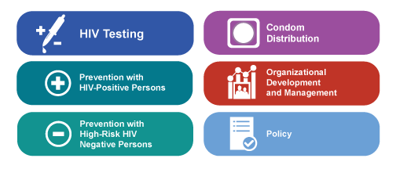
CDC CBA
Training
Technical assistance
Technology transfer
Information dissemination
Community-based organizations
Health departments
Health care organizations

Slide 42

LESSONS LEARNED
To support new integrated initiatives
Create peer-to-peer opportunities to leverage resources and on-the-ground experiences
Partnerships and community engagement are crucial for successful implementation
Must be adaptable and responsive to the changing environment and local context
Distance-based TA/T does not replace in-person interactions and relationship-building
Notes:
Must be adaptable and responsive to the changing environment
Policy
Science
Modalities

Slide 43
Capacity Building Branch (CBB)
Builds the capacity of the HIV prevention workforce
Supports health departments, community-based organizations, and health care organizations to develop and implement effective HIV prevention strategies

Slide 44
Interventions and Prevention Strategies
Biomedical Interventions
  Medical, clinical, and public health approaches designed to prevent HIV infection, reduce susceptibility to HIV, and/or decrease HIV infectiousness (e.g., PrEP or PEP)
Evidence-based behavioral interventions (EBIs)
  Interventions proven effective through research studies that showed positive behavioral (e.g., use of condoms; reduction in number of partners) and/or health outcomes (e.g., reduction in the number of new sexually transmitted infections)
Public Health Strategies
  Time-tested protocols used by public health practitioners in the prevention, screening, diagnostic, or treatment processes for HIV prevention (e.g., HIV rapid testing, partner services)

Slide 45
CBB’s Role in Delivering High-Impact Prevention
Emphasize and prioritize effective interventions
  Scientifically proven
  Supported by CDC’s Division of HIV/AIDS Prevention
Ensure interventions are current
  National HIV/AIDS Strategy
Provide technical and scientific expertise
Oversee a network of Capacity Building Assistance (CBA) providers

Slide 46
CBA for High-Impact Prevention
Program Structure
CDC funds 21 organizations (23 CBA programs) to deliver services to build the capacity of health departments (HDs), community-based organizations (CBOs), and health care organizations (HCOs) to prevent HIV.
  8 CBA Providers for HDs
  11 CBA Providers for CBOs
  3 CBA Providers for HCOs
  1 CBA Provider Network (CPN) Resource Center

Slide 47




















CBA Provider Network

Slide 48
CDC-Funded HIV Prevention Programs
Comprehensive HIV Prevention Programs for Health Departments (PS12-1201)
Comprehensive High-Impact HIV Prevention Projects for Community-Based Organizations (PS15-1502)
Comprehensive High-Impact HIV Prevention Projects for Young Men of Color Who Have Sex with Men and Young Transgender Persons of Color (PS17-1704)

Slide 49

Health Departments
Community Based Organizations
$$$
$$$
HIV Testing
Prevention for Positives
-Linkage to care
-Re-engagement
-Adherence
-Partner services
-Prevention service
referral
-Service integration
-Risk reduction
Condom Distribution
Targeted HIV Testing
Prevention for Positives
-Linkage to care
-Navigation
-Partner services
-Adherence
Prevention for Negatives
-STD/HCV/TB screening
-PrEP, nPEP referrals

Slide 50
Health Departments
Community Based Organizations
$$$
$$$
HIV Testing
Prevention for Positives
-Linkage to care
-Re-engagement
-Adherence
-Partner services
-Prevention service
referral
-Service integration
-Risk reduction
Condom Distribution
Targeted HIV Testing
Prevention for Positives
-Linkage to care
-Navigation
-Partner services
-Adherence
Prevention for Negatives
-STD/HCV/TB screening
-PrEP, nPEP referrals
CBA for
Health Departments
CBA for
Health Care Organizations
CBA for
Community Based Organizations

Slide 51
Data to Care
Notes:
Using HIV Surveillance Data to Find/Link Out of Care
Electronic Medical Records
Accessing Medicaid Data
Examining Testing and ADAP Data

Slide 52
Data to Care
Use of HIV surveillance data to identify HIV-diagnosed individuals not in care, link them to care, and support the HIV care continuum
Focuses on linkage and re-engagement
  Persons never linked to care
  Persons who dropped out of care
The goals of Data to Care are to:
  Increase the number of HIV-diagnosed individuals who are engaged in HIV care
  Increase the number of HIV-diagnosed persons with an undetectable viral load

Slide 53
Health Department Identifies Persons
Not in Care
Laboratory data in health department surveillance system used to determine care status
  CD4 or viral load test result as proxy for care visit
    Persons never linked to care
    Persons who dropped out of care
Health department creates “not in care” list
Query other sources to determine care status
  Medicaid, ADAP, Ryan White Program data
  Health care providers
Update surveillance data and “not in care” list

Slide 54
Follow-up to Link or Re-engage
Health Department Model
  Health department-initiated linkage and re-engagement outreach
Health Care Provider Model
  Health care provider-initiated linkage and re-engagement outreach
Combination Health Department/Health Care Provider Model

Slide 55
What is your greatest challenge using data to engage/re-engage clients who are out of care?
Data quality
Incomplete lab reporting
Data sharing across surveillance and other programs
Data sharing across jurisdictions
Local laws and regulations
Communication with providers
Reaching clients who are out of care

Slide 56
HRSA/HAB TA and Training Activities
(Capacity Building)
HRSA provides TA and training primarily targeting RWHAP grant recipients on:
  ADAP
  Care/prevention capacity building
  Clinician training (AETCs)
  Community health workers and access to care
  Data
  Engaging people in care
  Health coverage enrollment
  Health literacy
  Hepatitis C
  Leadership training for PLWH of color
  Models of care
  Planning
  Quality management
Notes:
This is a new slide to reflect all of the current and new TA/training projects.

Slide 57
AETC Programs: Multi-faceted to meet needs at multiple levels
National Programs
Provides a National Educational platform with standard Curricula, Resources and Evaluation. RIGHT THING
Regional Programs
Locally based, tailored trainings and educational programs to address immediate training needs. RIGHT PLACE
Training Programs
Training NP/PA practitioners in HIV to care for PLWH in the changing healthcare landscape. RIGHT TIME
Notes:
The programs within the AETC Umbrella – the National programs, the regional AETCs and the NP/PA training program- all fit together to provide a comprehensive multi-faceted approach to the education and training needs in the United States.
The National Programs – provide a standard for the country – in terms of resources through the NCRC and a standard National HIV curricula which is scheduled to be released January, 2017. The NCCC provides expert responses to complex clinical questions through the HIV Warmlines. Together, these AETCs provide a national standard of the RIGHT THING.
The regional AETC programs complete a thorough needs assessment of their region to understand the training needs of their area, then provide locally tailored trainings and educational programs. The Regional AETCs have in depth networks and partnerships that make responding to crises like the outbreak in Indiana, possible. They have boots on the ground and are able to respond in the RIGHT TIME.
And the NP/PA training programs are shaping providers for today and for tomorrow as they integrate HIV into the general NP/PA curricula across the country as well as provide specialized training to meet the healthcare needs of PLWH – i.e. putting providers in the RIGHT PLACE.

Slide 58
CBA Providers/AETC Collaborations
CBA providers build the capacity of the HIV prevention workforce
  National approach
AETCs build the capacity of the HIV clinical workforce
  Regional approach
Focus on improving outcomes along the HIV care continuum
  CDC focused on prevention
  HRSA focused on care

Slide 59
CBA Providers/AETC Collaborations
PrEP and PEP
HIV testing
Navigation
Sharing and distributing materials
Coordinated capacity building assistance
  Trainings
  Presentations

Slide 60



CBA for Health Care Organizations
(Category C Grantees) https://www.cbaproviders.org/hcos/
Notes:
Programs must support national delivery of CBA services and be prepared to work with agencies across the entire United States and all of its territories.
Currently, CAI, Denver PTC and PCDC are creating partnerships across the country with other CBA providers, including AETCs, in an effort to reduce duplication of services and improve the delivery of national HIV prevention CBA.

Slide 61
What HCOs are eligible for CPN CBA?
Any healthcare organization that clinically diagnoses and medically treats HIV infections is eligible for CBA. This includes but is not limited to:
Hospitals/Hospital Emergency Departments
Urgent Care
Infectious Disease Clinics
STD Clinics
Health Departments or Community Based Organizations with Clinics
Primary Care clinics
Community Health Centers
Federally Qualified Health Centers
Correctional Health Clinics
Private Clinical Providers
University/College Student Health Services
Occupational Health Services
VA and Military Health Services
Other agencies that may benefit from our services include those that serve the HCOs listed above or that work directly with physicians, nurses and other healthcare providers.
Collaborative Assistance
Continuous Coaching
Tailored Assistance
Ongoing Tech Support

Slide 62



CBA for HCOs: Component Areas
Prevention with
HIV-Positive Persons
Prevention with
HIV-Risk HIV-Negative
Persons
HIV Testing
Through training and TA, Category C CBA providers support HCOs to:
Adopt appropriate CDC supported effective interventions
Provide culturally responsive care and services
Provide patient navigation services
Provide referral and linkage to appropriate HIV care, treatment, prevention, non-HIV medical, and social services
Implement third-party systems for reimbursement of costs associated with eligible HIV testing services (including insurance, navigation, and enrollment)

Slide 63
Areas of Expertise Across CBA for HCOs
High-impact HIV prevention strategies
Services across the HIV care continuum
HIV testing
Linkage/retention in care
Chronic care management
HIV navigation services
Medication adherence
Pre-exposure prophylaxis
Non-occupational post-exposure prophylaxis
Cultural responsiveness
Gay and bisexual men
Men who have sex with men
Women at risk for infection
Transgender individuals
Billing and coding for HIV services
Affordable Care Act implementa­tion
Medicaid expansion
Process and quality improvement
Workflow analysis
Sexual health assessment
Sexually transmitted diseases
Effective Interventions (behavioral and biomedical)
https://effectiveinterventions.cdc.gov

Slide 64



Denver Prevention Training Center (Denver PTC)
605 Bannock Street
Denver, CO 80204
303-602-3616
www.denverptc.org

Slide 65
Denver PTC and AETC Collaborations 2016-2017
National Latino HIV and Hepatitis C Conference: For the second year, collaborating with the South Central AETC in the conference planning and delivery of HIV prevention sessions for this conference in South Padre Island, TX.
MATEC: Discussed plan to assist with training needs based on regional needs assessment needs around PrEP and HIV testing starting in the fall of 2016.
Texas PrEP Summit: Planning a PrEP summit to increase implementation across TX. Will invite and involve TX/OK AETC to participate with target site selection and in summit.
Online Patient Navigator module for the Peripartum Period: Collaboration with NJ AETC, DHAP, and Category C.

Slide 66
Denver PTC and AETC Collaborations 2016-2017
South Carolina: Developed partnerships with the SC primary care association and the Southeast AETC to conduct HIV prevention service/training assessment with all member health centers.
New Jersey: Developed partnerships with NJ primary care association and Northeast/Caribbean AETC to conduct HIV service/training assessment and prioritize 3 areas for NJ health centers to expand the provision of services.
Colorado: CO AETC (Frontier AETC) and Denver PTC developed semi-annual meeting to set priorities with CO primary care association around HIV prevention and care. Presenting PrEP presentation and panel at September medical director meeting.

Slide 67
PCA Process for HIV Prevention Services
Provide consultation for PCA survey on training needs, prevention services, and TA needs
PCA distributes survey and creates report
Denver PTC creates recommended action steps and presents back to health center medical directors for review

Slide 68


Get to Know CBA for HCO Providers
CONTACT US
Primary Care Development Corporation (PCDC)
45 Broadway, Suite 530
New York, NY 10006
(212) 437-3900
http://www.pcdc.org

Slide 69
Primary Care Development Corporation (PCDC)
  California:
    Partnered with Pacific AETC at San Luis Obispo’s 26th Annual AIDS Update Symposium to deliver a comprehensive presentation on PEP and PrEP for non-clinical staff at health centers
    Over the next year, continuing to partner with PAETC to conduct a series of trainings for health care providers and support staff in Central CA. Topics will include:
      How to improve testing in the region
      Increasing knowledge and access to PEP and PrEP
      Improving linkage to care services
      Strategies for addressing HIV co-infection with Hep C/syphilis

Slide 70
Primary Care Development Corporation (PCDC)
  Louisiana: Partnered with the Louisiana AETC (South Central AETC) to support health centers in New Orleans and Baton Rouge to implement routine HIV testing
  Mississippi: Beginning to explore partnerships with the National LGBT Health Education Center, the Mississippi Collaborative for Inclusive Healthcare, Mississippi Primary Care Association and Southeast AETC to provide coordinated CBA services in Mississippi
New Jersey: Partnering with Category C CBA providers and the François-Xavier Bagnoud Center at Rutgers University’s School of Nursing to develop an online PrEP implementation module for Title X audiences

Slide 71


Get to Know CBA for HCO Providers
CONTACT US
Cicatelli Associates Inc. (CAI)
505 Eighth Avenue , Suite 1900
New York, NY 10018
212-594-7741
http://www.hivcbacenter.org

Slide 72
Partnership with
National Alliance for HIV Education and Workforce Development
Completed work with NAHEWD
Webinar to introduce the CBA project to AETC audiences nationwide
Strategized the sharing of HIP materials developed by National AETCs
Distribution of a CBA Center Brochure to AETC Network Partners
Identification of key HIP faculty on targeted locations
Needs assessment data collected by AETCs
Development of infographics/marketing materials
…
Areas identified during Needs Assessments:
HIV Testing
Linkage to Care
Retention in Care
PrEP
…
…
…
AETC Contacts for 12 Cities
Notes:
The National Alliance for HIV Education and Workforce Development (NAHEWD) is a membership organization of 11 regional AIDS Education and Training Centers (AETCs) and 3 national centers that support the AETC mission: the AETC National Resource Center (NRC), the AETC National Evaluation Center (NEC), and the AETC National HIV/AIDS Clinicians’ Consultation Center (NCCC).
National Alliance for HIV Education and Workforce Development
Webinar to introduce the CBA project to AETC audiences nationwide (including the National Resource Center, Mountain Plains AETC, DELTA AETC, NY/NJ AETC, Pacific AETC, New England AETC, Florida/Caribbean AETC, Southeast AETC, Pennsylvania/Mid-Atlantic AETC, Midwest AETC, and the National Clinical Consultations Center)
Regular meetings to coordinate and strategize the sharing of HIP materials developed by National AETCs
Distribution of a CBA Center Brochure to AETC Network Partners via the AETC bi weekly newsletter
Identification of key HIP faculty on targeted locations (Regional AETC Contacts for 12 Cities
1. Atlanta, GA
Southeast AIDS Training and Education Center
2. Baltimore, MD
Pennsylvania/MidAtlantic AIDS Education and Training Center
3. Chicago, IL
Midwest AIDS Training and Education Center
4. Dallas, TX
Texas/Oklahoma AIDS Education and Training Center
5. Houston, TX
Texas/Oklahoma AIDS Education and Training Center
6. Los Angeles, CA
Pacific AIDS Education and Training Center
7. Miami, FL
Florida/Caribbean AIDS Education and Training Center
8. New York, NY
New York/New Jersey AIDS Education and Training Center
9. Philadelphia, PA
Pennsylvania/MidAtlantic AIDS Education and Training Center
10. San Francisco, CA
Pacific AIDS Education and Training Center
11. San Juan, PR (Florida/Caribbean AIDS Education and Training Center
12. Washington, DC.
Pennsylvania/MidAtlantic AIDS Education and Training Center
Sharing of needs assessment data collected by AETCs
Development of infographics/marketing materials and distribution of these materials to AETC Network Partners (http://cba.caiglobal.org/index.php/resources/infographics)

Slide 73
Learning Collaboratives with AETC Partners
Atlanta PrEP Learning Collaborative
Rapid Syphilis Test with HIV Testing Learning Collaborative
Enhance HCO CBO Partnership to Implement HIP Learning Collaborative
  In partnership with Black AIDS Institute (BAI)
  Worked with Partnering with Fulton County Health Department, National AIDS Education & Services for Minorities, Absolute Care, AID Atlanta, and Emory University
  Patients on PrEP:
    Before LC: 37
    After LC: 260
  In partnership with the National Coalition of STD Directors (NCSD)
  Worked with the Rentz Center, the Coordinated Youth & Human Services Clinic, and the Gay Men’s Health Clinic to deliver a CLIA Waived Rapid Syphilis Test
  Tests preformed: 743
    Reactive Tests: 35 (15 newly confirmed)
  In partnership with the Clinical Directors Network (CDN)
  Worked with 9 organizations to deliver a HIP Strategies for Community Health Centers Learning Community
  5 Webcasts
    527 total participants from
    43 States
Notes:
Atlanta PrEP Learning Collaborative, Georgia: Partnering with Fulton County Health Department, National AIDS Education & Services for Minorities, Absolute Care, AID Atlanta, and Emory University to deliver a PrEP Learning Community in collaboration with the Black AIDS Institute
-intent: Worked with organizations to discuss promotion of PrEP, recruitment of patients for PrEP, and providing patients with PrEP
-outcome: Patients on PrEP:
-Before the Learning Collaborative the organizations combined had a total of 37 patients on PrEP
-After the Learning Collaborative the organizations has a combined total of 260 patients on PrEP
Rapid Syphilis Test with HIV testing, Illinois & Pennsylvania:
-intent: to use the RST to find new non-HIV+ syphilis cases and educate about PrEP and to standardize the use of RST in these clinical settings
-Partnering with the Rentz Center, the Coordinated Youth & Human Services Clinic, and the Gay Men’s Health Clinic to deliver a CLIA Waived Rapid Syphilis Test Learning Community in collaboration with the National Coalition of STD Directors
-outcome: Tests preformed: 743, Reactive Tests: 35 (15 newly confirmed), sites now use RST
Enhance HCO CBO Partnership to Implement HIP Learning Collaborative, Connecticut, Idaho, New York, South Carolina, Pennsylvania, California, and New Jersey: Partnering with Sunset Terrace Community Health Center, Cornell Scott-Hill Health Center, Idaho State University Meridian Health Science, Betances Health Center, William F. Ryan Community Health Network, Sandhills Medical Foundation, Inc., Little River Medical Center, Inc, Educating Teens Inc., Roots Community Health Center, and Henry J. Austin Health Center to deliver a HIP Strategies for Community Health Centers Learning Community in collaboration with the Clinical Directors Network
-intent: to provide information and support to healthc enter treams in assessing their demographics and HIV screening, prevention, testing, and management practices, and creating an appropriate action agenda for program implementation
-outcome: 74% of participants in webcasts have implemented HIP Strategies that they learned from the series

Slide 74
Ongoing Activities
  Review of materials directed to
  Dental providers:
Partnering with the Northeast/Caribbean AETC; Columbia University, Department of Psychiatry HIV Center
    Incorporate the subject of cultural competency into the existing PPTs and training curricula
    Development of a stand alone module Cultural Competency in the dental practice
Development of Online
PrEP Module
Partnering with François-Xavier Bagnoud Center School of Nursing Rutgers, The State University of New Jersey; In close coordination with the Office of Population Affairs (OPA)
Training is aimed at Title X grantees
Notes:
Northeast/Caribbean AETC; Columbia University, Department of Psychiatry HIV Center. Review of materials directed to Dental providers in order to incorporate the subject of cultural competency into the existing PPTs and existing training curricula
New Jersey: Partnering with Rutgers to produce an online PrEP module

Slide 75
Future Collaborations
Planning
Implementation of Training and TA
Sharing of lessons learned
Various levels of intensity in the collaboration
Communicate (in person meetings) Joint efforts
              Plans
              Implementing T & TA
Lower
Higher
Notes:
Develop/clarify process for communication between Category C CBA Providers and regional AETCs to explore potential partnerships (CDC & HRSA) and reduce duplication of efforts
Provide overview of Category C CBA services at quarterly AETC directors meeting
Share lessons learned from partnerships already underway

Slide 76
Suggested Activities to Prioritize
Develop/clarify process for communication between CPN and regional AETCs
Determine referral mechanism between CPN and AETCs
  For example: AETC does linkage in care overview with health center but the health center is in need of an evidence based linkage intervention for funding, AETC refers to CPN to assist with training and implementation of ARTAS
Share or combine need assessments process to reduce duplication
Share practice transformation clinics that AETCs are already engaged with

Slide 77
PrEP and HCV Collaboration
PrEP
Curriculum Development
HRSA Policy on PrEP and RWHAP Coverage as Part of Comprehensive Strategy
AETC Training (AETC Training of Clinicians on assessment, risk, payment of PrEP) with focus on integrating primary care and HIV care
Hepatitis C
Support and Development of Surveillance Systems
Screening, Testing and Treatment
Jurisdictional Approach to Curing Hepatitis C in the RWHAP

Slide 78
PrEP
PrEP Federal Guidelines
Evidence of Safety/Efficacy
Indicators (Assessing Risk/Lab Tests)
Providing PrEP
More…
http://www.cdc.gov/hiv/pdf/guidelines/PrEPguidelines2014.pdf

Slide 79
How RWHAP Can Support PrEP
June 23, 2016 Program Letter
Confirms HRSA HIV/AIDS Bureau support of RWHAP recipients’ exploring ways to use expertise and infrastructure to support PrEP
RWHAP cannot be used for PrEP medications or medical services for HIV-negative clients at substantial risk for HIV
Building PrEP services or programs on existing RWHAP systems, services, programs, personnel, and expertise (leveraging what has been built over the past 25 years)
Using components of a few service categories specifically related to: HIV testing and referral; Psychosocial support for affected family members; Risk reduction education for partners of people living with HIV
AETC Trainings
Clinician PrEP Consultation Line
Notes:
AETCs: Training to Primary Care Providers on PrEP
CDC-Funded PrEPline

Slide 80
How CDC Can Support PrEP
Training, technical assistance to build provider capacity to prescribe PrEP and implement PrEP programs
  e-Learnings
  PrEP curriculum
Increase knowledge of PrEP among non-prescribers and potential consumers
  Capacity building assistance
Disseminate information to providers and potential consumers on billing and covering the cost of PrEP

Slide 81
Curing Hepatitis C Virus (HCV) in the
Ryan White HIV/AIDS Program
Over 500,000 PLWH are served by the RWHAP annually.
If 20-25% are coinfected with HCV, then at least 100,000 HIV/HCV coinfected individuals are served by the RWHAP annually.
RWHAP Activities
  AETCs
  SPNS Hepatitis C Treatment Expansion Initiative (2010 – 2014)
  Jurisdictional Approach (Screening, Care, and Treatment)

Slide 82
How would you describe your community’s PrEP activities to educate consumers, providers, and payers?
Very extensive – we have models for others
Moderate – there are some areas we need to enhance
Limited to non-existent

Slide 83
Resources
HRSA Ryan White HIV/AIDS Program TARGET Center http://targethiv.org
Topic Pages: Planning, HIV Care Continuum, Prevention, Testing
Upcoming Resources from Integrated HIV Planning TA Center
Centers for Disease Control and Prevention (CDC)
CDC directly funded organizations
  Consult with your CDC Project Officer
  Submit CBA Request (CRIS) at wwwn.cdc.gov/Cris2009
Organizations not funded directly by CDC
  Contact CDC-funded health department in your jurisdiction to submit a CRIS
  List of CRIS users at CDC-funded health departments www.cdc.gov/hiv/dhap/cbb/crisUsers.html
www.effectiveinterventions.cdc.gov

Slide 85
Contact Information
Harold J. Phillips, MRP
HRSA HIV/AIDS Bureau
HPhillips@hrsa.gov
A.D. McNaghten, PhD, MHSA
Centers for Disease Control and Prevention
aom5@cdc.gov
Juli Powers, MPH, Senior Consultant
JSI Research & Training Institute, Inc.
juli_powers@jsi.com

