Slide 1
Clarifying Ryan White HIV/AIDS Program Clinical Quality Management Program Expectations
Marlene Matosky and Susan Robilotto
HIV/AIDS Bureau (HAB)
Health Resources and Services Administration (HRSA)
Friday, September 8, 2017 9 am - 11am

Slide 2
Meet the HIV/AIDS Bureau Staff
Division of Policy and Data’s Clinical and Quality Branch
Katrina Jackson
Amelia Khalil
Chepkorir Maritim
Marlene Matosky
Chris Redwood
Division of State HIV/AIDS Programs
Susan Robilotto
2

Slide 3
Objectives
Learn the essential components that are required for a clinical quality management (CQM) program
Understand the expectations of how to develop and implement a CQM program
Become familiar with resources available to assist in building a solid CQM program that can positively impact health outcomes

Slide 4
Ryan White HIV/AIDS Program Treatment Modernization Act of 2006
Title XXVI of the Public Health Service (PHS) Act (Public Law 109-415, December 19, 2006)
All Ryan White HIV/AIDS Program recipients are required “to establish clinical quality management programs to:
Measure
Assess the extent to which HIV health services are consistent with the most recent Public Health Service guidelines for the treatment of HIV disease and related opportunistic infections;
Improvement
Develop strategies for ensuring that such services are consistent with the guidelines for improvement in the access to and quality of HIV services”
See §§ 2604(h)(5), 2618(b)(3)(E), 2664(g)(5), and 2671(f)(2) of the PHS Act.

Slide 5
Clinical Quality Management Policy Clarification Notice 15-02
The purpose of this policy clarification notice (PCN) is to clarify the Health Resources and Services Administration (HRSA) Ryan White HIV/AIDS Program (RWHAP) expectations for clinical quality management (CQM) programs.
https://hab.hrsa.gov/program-grants-management/policy-notices-and-program-letters

Slide 6
Policy Clarification Notice 15-02 Scope of Coverage
RWHAP Parts A, B, C, and D
Recipients and Subrecipients

Slide 7
Structure of the Policy Clarification Notice
Scope of Coverage
Purpose of PCN
Background
Components of a CQM Program
Infrastructure
Performance Measurement
Quality Improvement
Related Activities
Quality Assurance
Grant Administration
Applicability to Subrecipients
Resources

Slide 8
Components of a CQM Program
A CQM program is the coordination of activities aimed at improving patient care, health outcomes, and patient satisfaction.
CQM activities should be continuous and fit within and support the framework of grant administration functions.
Components of a CQM program
Infrastructure
Performance measurement
Quality improvement

Slide 9
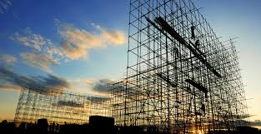
Infrastructure
Leadership
Committee
Dedicated Staffing
Dedicated Resources
Quality Management Plan
Consumer Involvement
Stakeholder Involvement
Evaluation of CQM Program

Slide 10
Infrastructure Components
Leadership:
Leadership to guide, endorse, and champion the CQM program
Internal and external facing
CQM Committee:
Develops the CQM program and corresponding activities
Dedicated Staffing:
Staff who are responsible for CQM duties and resources, as well as any contractors that may be funded to assist with CQM work

Slide 11
Infrastructure Components
Dedicated Resources:
Resources for building capacity in order to carry out CQM activities (e.g., training on collecting performance measurement data)
CQM Plan:
Describes all aspects of the CQM program including infrastructure, priorities, performance measures, quality improvement activities, action plan with a timeline and responsible parties, and evaluation of the CQM program

Slide 12
Infrastructure Components
Consumer Involvement:
PLWH involvement that reflects the population that is being served and ensures that the needs of PLWH are being addressed by CQM activities
Stakeholder Involvement:
Stakeholder involvement (e.g., subrecipient, other recipients in region, planning body and/or its committees, consumers) that provides input on CQM activities to be undertaken

Slide 13
Infrastructure Components
Evaluation of CQM Program:
Evaluation includes assessing whether CQM program activities have been implemented as prescribed by the quality management plan (including the action plan).
Recipients should include regular evaluation of their CQM activities in order to maximize the impact of the program.
Part of the evaluation should include identifying factors (i.e., staff acceptance of change, improved clinical performance, etc.) that affect the quality improvement activities.
Evaluation also identifies effective improvement strategies that can be scaled up or implemented in other facets within a system of care. Additional elements of an evaluation include effectiveness of the team and its ability to meet timelines and deliverables as described in the action plan in order to determine the success of the planned process.

Slide 14
Performance Measurement
Measures should be selected that best assess the services the recipient is funding.
Recipients are strongly encouraged to include HRSA HIV/AIDS Bureau core measures.
How many measures?
Highly utilized and highly prioritized RWHAP-funded service category: Identify two performance measures and collect the corresponding performance measure data.
All other RWHAP-funded service category: at least one performance measure.

Slide 15
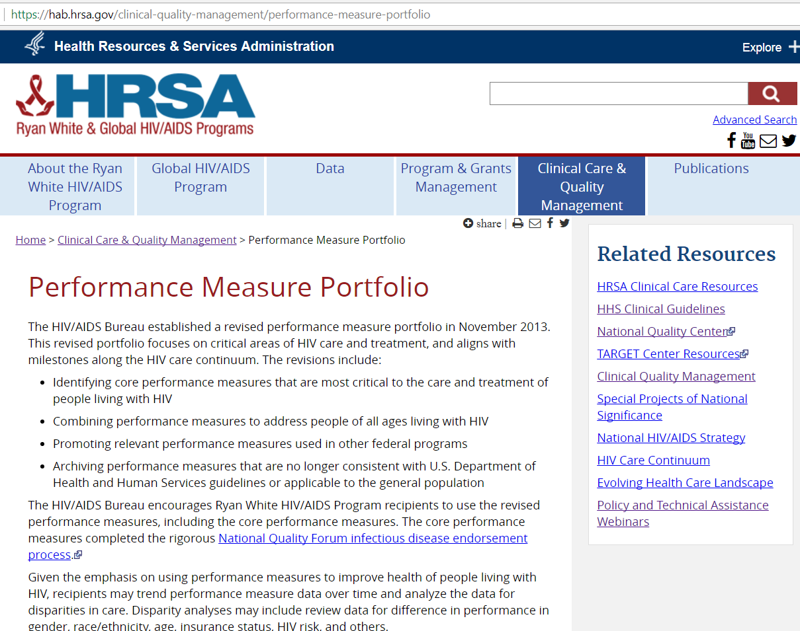
HIV/AIDS Bureau Performance Measures
https://hab.hrsa.gov/clinical-quality-management/performance-measure-portfolio

Slide 16
HIV/AIDS Bureau Performance Measures
https://hab.hrsa.gov/clinical-quality-management/performance-measure-portfolio

Slide 17
Performance Measurement
Frequency: Regularly collect and analyze performance measure data which would occur more frequently than data collection for reporting - quarterly at a minimum.
Analysis: Collect and analyze performance measure data that allows for inspection and improvement of health disparities across different target populations.

Slide 18
Quality Improvement
Quality improvement entails the development and implementation of activities to make changes to the program in response to the performance data results.
Recipients are required to implement quality improvement activities aimed at improving patient care, health outcomes, and patient satisfaction.
Recipients are expected to implement quality improvement activities using a defined approach or methodology.
Recipients should be conducting quality improvement activities for at least one funded service category at any given time.
Quality improvement activities may span multiple service categories.

Slide 19
Applicability to Subrecipients
Recipients are to identify the specific CQM program activities for their service area or network.
CQM activities include performance measure portfolio, frequency of performance measure data collection, and identification of quality improvement activities, among other items.
Recipients need to ensure that their subrecipients that provide services have the:
Capacity to contribute to the recipient’s CQM program
Resources to conduct CQM activities in their organizations
Implement a CQM program in their organizations

Slide 20
Applicability to Subrecipients
Recipients are expected to provide guidance to subrecipients on prioritizing measures and collecting data.
Recipients need to work with subrecipients to identify improvement opportunities and monitor quality improvement activities at the subrecipient locations.
Prioritization of CQM activities should be coordinated across RWHAP recipients within service area and subrecipients funded through the recipient.

Slide 21
Legislative Language for CQM Budgeting
Part | Legislation | Budget Amount
A | Sec. 2604.(h)(5) | Not to exceed the lesser of 5% of amounts received under the grant or $3,000,000
B | Sec. 2618.(b)(3)(E) | Not to exceed the lesser of 5% of amounts received under the grant or $3,000,000
C | Sec. 2664.(g)(5) | Reasonable amount
D | Sec. 2671.(f)(2) | Reasonable amount

Slide 22
Use of CQM and Administrative Funds
Activity | CQM | Administrative
Staffing to implement clinical quality management program activities | ü
Staffing to develop and/or update service standards |  | ü
Staffing to conduct grants monitoring of subrecipients |  | ü
Electronic health record interface with other providers |  | ü
Data extraction for clinical quality management purposes (collect, aggregate, analyze, and report on measurement data) | ü
Monitoring site visits | ü If the purpose of the site visit is to assess or monitor CQM activities | ü

Slide 23
Related Activities: Quality Assurance
Quality assurance:
Refers to a broad spectrum of activities aimed at ensuring compliance with minimum quality standards.
Include the retrospective process of measuring compliance with standards.
Part of the larger administrative function of a recipient’s program or organization and informs the clinical quality management program.

Slide 24
Related Activities: Quality Assurance
Quality assurance activities by themselves do not constitute a CQM program.
Quality assurance is not the same as quality improvement.
Quality Assurance ≠ Quality Improvement

Slide 25
Related Activities: Grant Administration
Grant administration refers to the activities associated with administering a RWHAP grant or cooperative agreement.
The intent of grant administration is not to improve health outcomes. Therefore, they are not CQM activities.
Grant Administration ≠ Clinical Quality Management

Slide 26
Resources
Requesting CQM technical assistance:
Complete a technical assistance request form located at
INSERT WEB PAGE WHEN KNOWN
Submit completed technical assistance request form to:
RWHAPQuality@hrsa.gov
Implementation Center for Quality Improvement:
Cooperative agreement to assist RWHAP recipients and subrecipients with implementing clinical quality improvement methodologies and concepts, as required by the Ryan White HIV/AIDS Treatment Extension Act of 2009, to improve HIV health outcomes for PLWH.
INSERT WEB PAGE WHEN KNOWN

Slide 27
Clinical Quality Management Questions???
RWHAPQuality@hrsa.gov
HIV/AIDS Bureau Performance Measure Questions???
HIVmeasures@hrsa.gov

Slide 28
Contact Information
Amelia Khalil
301-443-0527
akhalil@hrsa.gov
Katrina Jackson
301-443-1831
kjackson2@hrsa.gov
Chep Maritim
301-443-1084
cmaritim@hrsa.gov
Marlene Matosky
mmatosky@hrsa.gov
301-443-0798
Chris Redwood
301-443-2118
rredwood@hrsa.gov
Susan Robilotto
301-443-6554
srobilotto@hrsa.gov

