Slide 1
Who Are Community Health Workers?
Notes:
One main idea of Popular Education is that no matter who we are, we all know a lot as a result of our life experience. Therefore, we should always start with what people already know.
We want to start with what you know about Community Health Workers through a brainstorming activity in pairs.

Slide 2
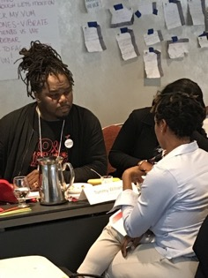
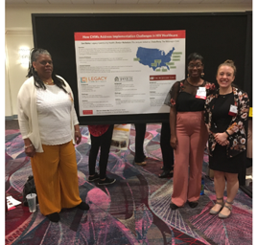
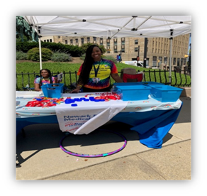
What Do We Already Know or Imagine About Community Health Workers?
Notes:
Ask the question on the slide. Give participants about two minutes to talk in pairs. Bring the large group back together, asking each pair to share one idea. Record answers on a flip chart sheet.

Slide 3
Definition of Community Health Workers from the American Public Health Association:
“A Community Health Worker (CHW) is a frontline public health worker who is a trusted member of and/or has an unusually close understanding of the community served. This trusting relationship enables the CHW to serve as a liaison/link/intermediary between health/social services and the community to facilitate access to services and improve the quality and cultural competence of service delivery. A CHW also builds individual and community capacity by increasing health knowledge and self-sufficiency through a range of activities such as outreach, community education, informal counseling, social support, and advocacy.”
Notes:
Ask for a volunteer to read the slide.
Ask the participants, “What catches your attention about this definition?

Slide 4
CHWs May Work Under Many Job Titles
Community Health Educator
Outreach Educator
Outreach Worker
Enrollment Worker
Health Advocate
Peer Advocate
Peer Leader
Street Worker
Youth Outreach Worker
Family Advocate
Family Planning Counselor
Family Support Worker
Doula
Patient Navigator
Promotor de Salud
Community Health Representative
Notes:
Explain that there are dozens of titles used to refer to CHWs. Ask, “What are some other titles you have used or heard others use when doing this kind of work?”
What titles do they have in their work? Ask them to get back into their pairs and spend 10 minutes sharing with each other the following information:
What title do they have in their work at their agency?
Who do they work with on a daily basis?
What are some of the key tasks in their work?

